Slide 1
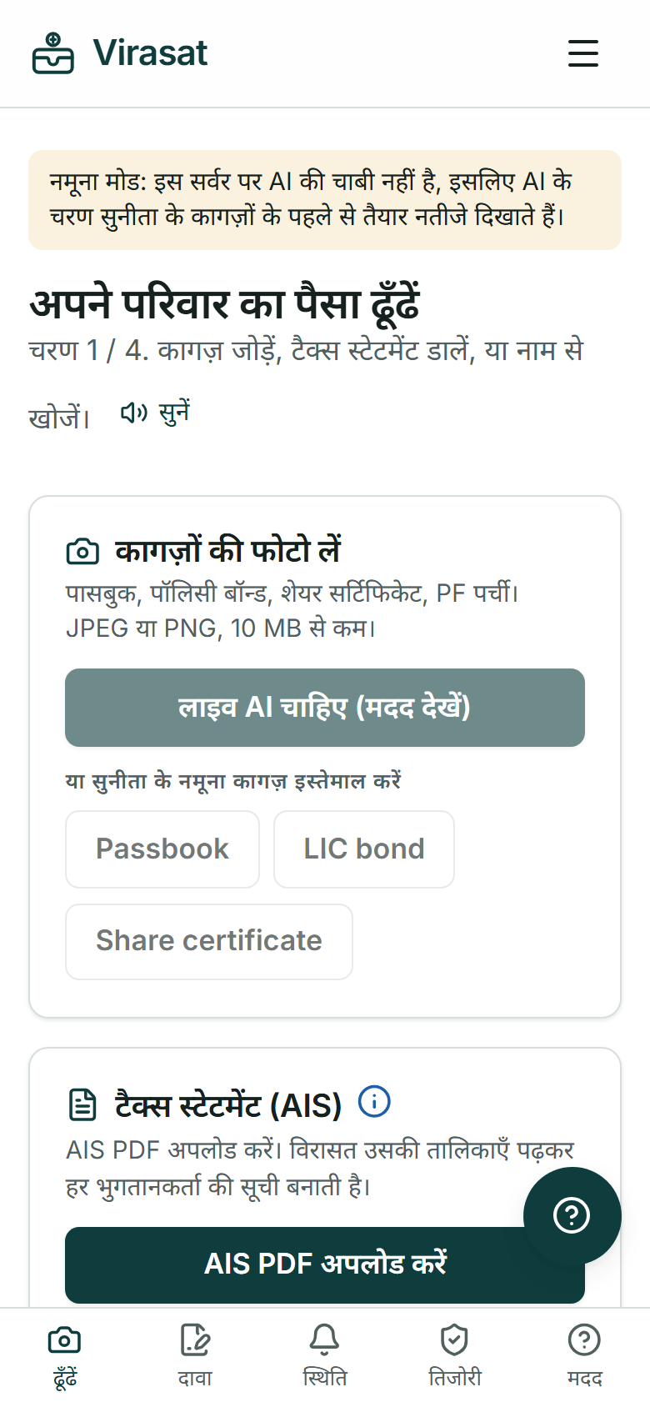
GLOBAL INNOVATION HACKATHON 2026 · PROJECT SUBMISSION
Virasat
Working in Hindi,
on a phone
Find and claim your family's money.
A working product. Photograph old papers, and Virasat finds where the money is, explains what to do in your language, and fills the forms.
Try it now: virasat-indol.vercel.app
Code: github.com/usv240/virasat
Team USV
FinTech · Generative AI · Social Impact · Accessibility

Slide 2

01 · PROBLEM STATEMENT
Lakhs of families have money waiting for them.
They just do not know it.
₹1.84 L cr
₹72,454 cr
20 lakh
₹38,700
unclaimed across banks, insurance, PF and shares
in old bank accounts alone, parked with RBI
people have ever used RBI's search portal, in a country of 140 crore
average returned per family in Gujarat's claim camps
[1]
[2]
[3]
[4]
Why it stays stuck: nobody knew it existed; it is spread across six separate portals, mostly in English; the rules are confusing, so agents take 5 to 15 percent; and accounts without a nominee become new unclaimed money every year.
Sources: [1] Union Finance Minister, Oct 2025 [2] Govt and RBI, Jan 2026 [3] RBI UDGAM, Jul 2025 [4] All India Radio. Full list on the References page of the site.

Slide 3







02 · PROPOSED SOLUTION
Take a photo. Get your family's money back.
1 FIND
2 CLAIM
3 TRACK
4 PREVENT
Photograph old papers, or upload the income tax statement. Virasat lists every place the family may have money, and the exact portal to search.
Three plain questions. A tested rule engine picks the route and generates the filled claim pack as a PDF.
Status, next action, and a pre-written ombudsman complaint after 30 days of silence.
The Parivaar Vault records every account and checks that each has a nominee.
English and Hindi, by voice
Light and dark, phone and laptop
No sign up to try it

Slide 4




03 · INNOVATION
Four things that exist nowhere else
The tax statement becomes an asset map
A legal heir can get the account holder's Annual Information Statement. It lists interest from every bank and dividends from every company. Virasat turns that one PDF into a list of places to claim from, even with no papers at all.
The AI Review
One AI argues for the route, a second hunts for what could go wrong, a third gives the verdict with reasons and risks. The referee can only make advice more careful, never overrule the rules.
Safety by separation
The AI reads, explains and translates. Every legal decision comes from a deterministic, versioned, unit-tested rule engine, so an institution can audit it.
Bring your own data, key and rules
A bank sends its own claim rules as JSON. Virasat applies them and records the rule version on every claim.

Slide 5
03 · INNOVATION: THE AI REVIEW
Virasat challenges its own guidance before a family acts
Supporter
Challenger
The nominee route is correct: the passbook names a nominee and the amount is below the bank's threshold.
The passbook says 'Sunita R Kulkarni'. Her ID may say 'Sunita Ramesh Kulkarni'. Banks reject claims on a spelling mismatch.
Referee
Nominee route. High confidence. Next step: carry an ID that matches the nominee name exactly, or an affidavit for the name variation.
We measured it rather than assuming it. On 3 planted problems the Challenger caught 3 of 3, and so did a single reviewer with no debate: on cases this clear the debate added nothing to accuracy, and we publish that. The case for it is that the family can read the disagreement, and that the Referee is prevented in code from lowering a caution. Reproduce with npm run eval.

Slide 6
04 · TECHNICAL IMPLEMENTATION
What is actually built
READS AND WRITES
DECIDES
SERVES
Claude Opus 5 with JSON schema outputs
AIS PDF tables parsed in code
Claim packs built with pdf-lib
Browser speech in and out
Rule engine, 5 institutions
Versioned and unit-tested
Bring your own rules
Debate can only raise caution
Next.js 16, React 19, TypeScript
Public API with keys and limits
RFC 9457 errors, playground
Data stays in the browser
53
0
99 to 100
about ₹36
automated tests
serious axe violations
Lighthouse, desktop
AI cost per family

Slide 7
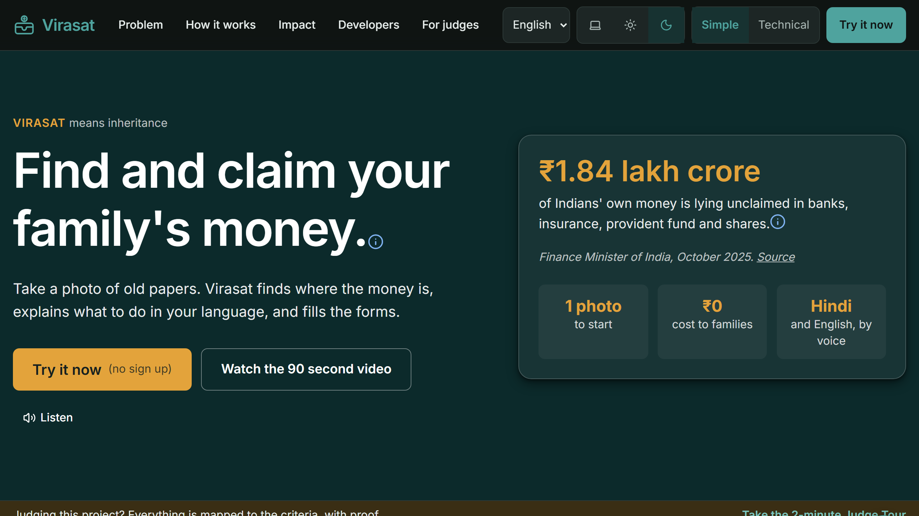
04 · TECHNICAL IMPLEMENTATION: MEASURED, NOT CLAIMED
Built for a cheap phone, in your language
Accessibility (axe, WCAG 2.2 AA)
0 serious or critical across 11 pages, light and dark
Lighthouse, live, 3 runs each
99 to 100 desktop, never below 90 on a throttled phone. 100 accessibility, best practices and SEO on both, and layout shift under a quarter of the 0.1 threshold.
Works with no signal
Installable. A service worker keeps every opened page, the Vault and the glossary working offline, and says which steps are waiting.
Dark mode and Hindi are one tap from any screen.
Languages and reach
English and Hindi on every screen including the rule output and the debate. 320 px, 44 px controls, voice in and out, no sign up.

Slide 8
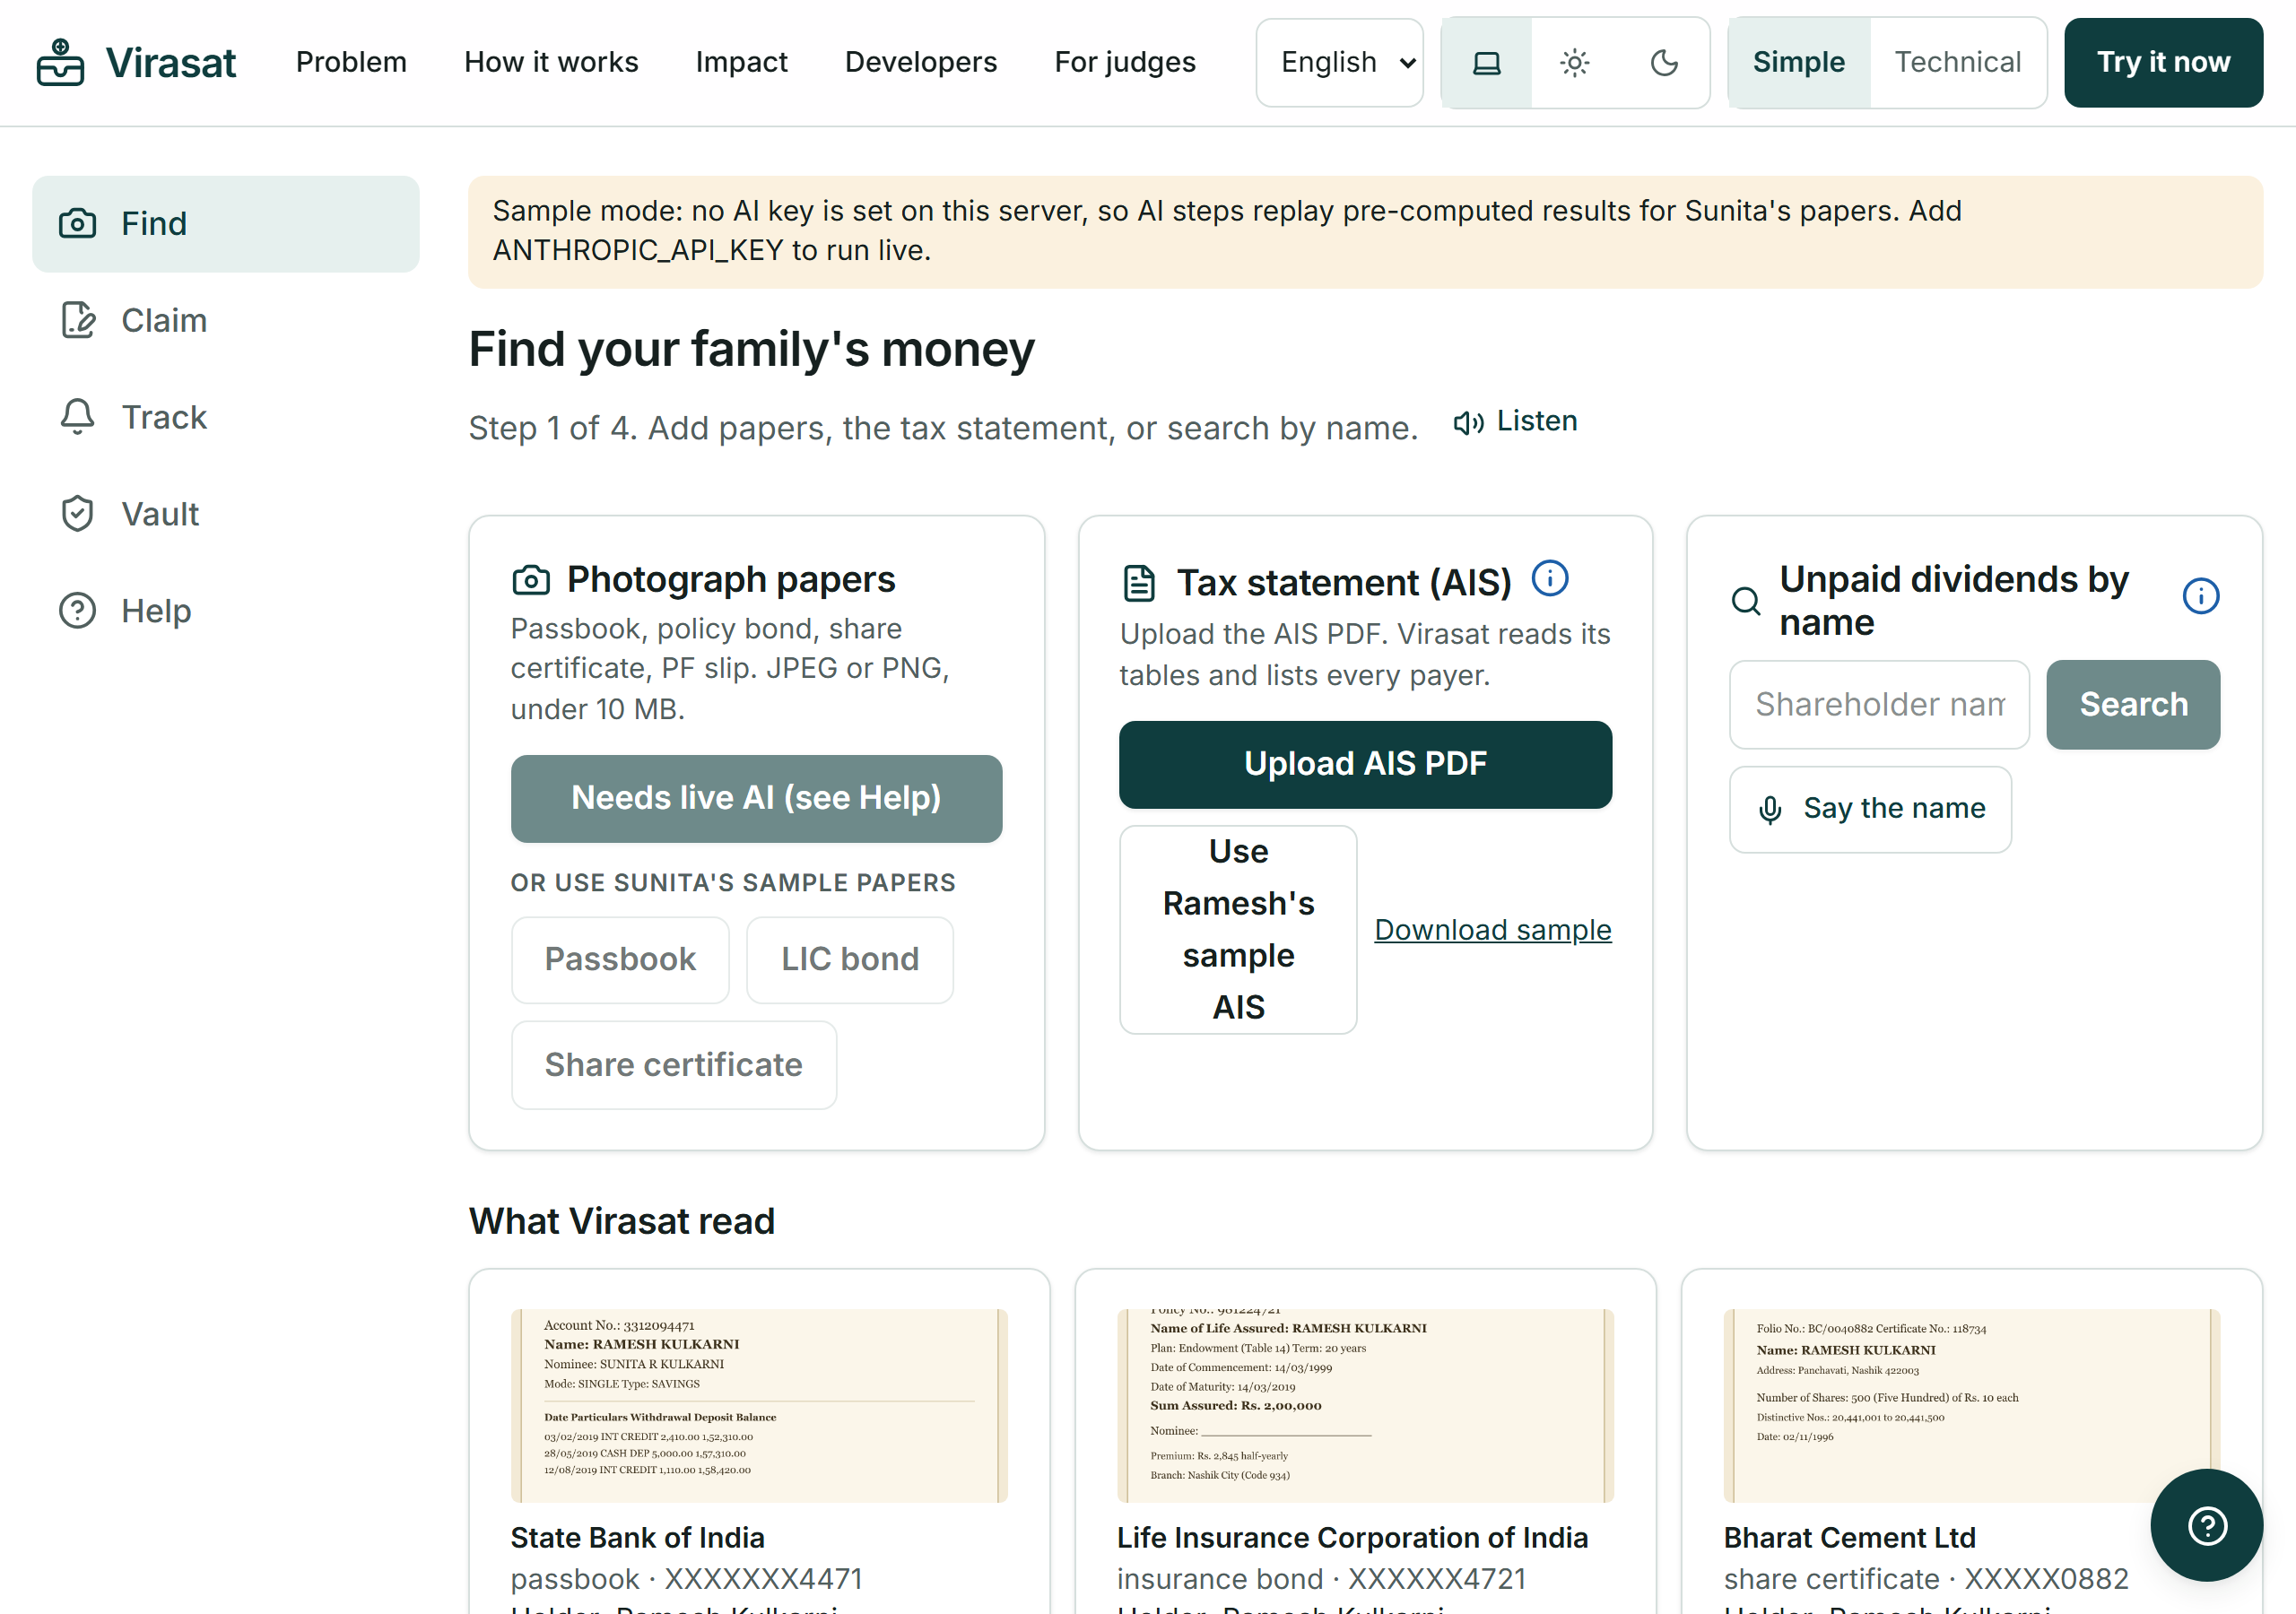
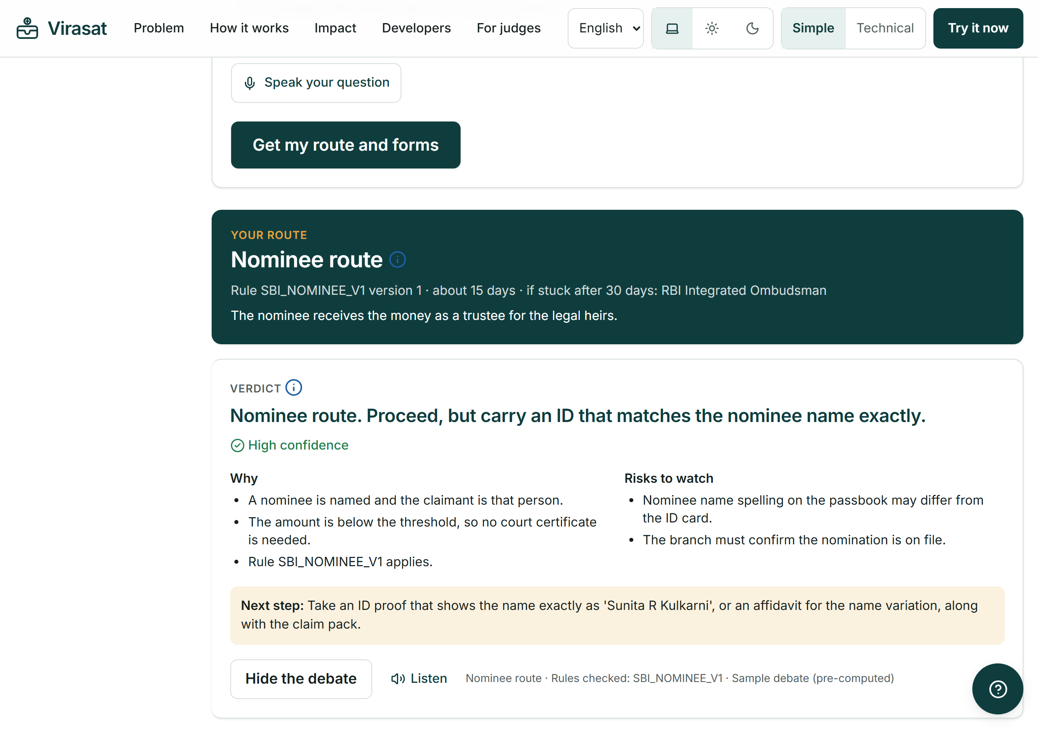
05 · PRODUCT DEMONSTRATION
This is the working product, not a mock-up
Find: three sample papers and the tax statement become a list of ₹4.85 lakh waiting in 5 places, each with its own portal and guided steps.
Claim: the rule engine picks the route, the AI Review checks it, and the filled claim pack downloads as a PDF.

Slide 9
06 · IMPACT
What changes for one family, and for the country
For ₹4.2 lakh owed | Today | With Virasat
Agent's cut (5 to 15%) | ₹21,000 to ₹63,000 | ₹0
Time on paperwork | Months of office visits | Forms ready the same day
Chance of missing money | High: nobody knows what exists | Low: the tax statement shows every bank
₹184 crore
back to families if just 0.1 percent of the pool is claimed
₹38.7 crore
saved in agent fees if we help 1 lakh families
about ₹36
of AI per family, measured from real token counts against the live API, versus ₹38,700 returned on average. Roughly 1,060 rupees recovered per rupee spent.
Agent fees: IEPF recovery consultants publish 5 to 15 percent. ₹38,700 average claim = ₹104 crore over 26,874 claims (All India Radio). AI cost is arithmetic on token counts at published Claude Opus 5 prices, shown in full at /proof and reproducible with npm run measure:cost.

Slide 10
07 · SCALABILITY
Adding a bank is adding one file
How it earns: free for families. Banks and insurers pay, because regulators push them to clear unclaimed balances. Service centres charge a small fixed fee instead of an agent's percentage.
WORLD
INDIA
Beyond India
STATE
22 languages
NRI families, and countries with similar unclaimed money programmes.
START
All institutions
DigiLocker and Account Aggregator. Join the RBI and IRDAI campaigns.
1 district
A rule file per bank, insurer and fund house.
Service centres and one bank. Count the money returned every week.

Slide 11
07 · FEASIBILITY: THE ARITHMETIC, IN PUBLIC
₹36 a family, open rules, and every number checkable
What one family costs
The rules are open
Reading 3 photographed papers
₹5.17
The claim procedure of each institution, as machine readable data. Served with no key, MIT licensed, at /api/v1/rules/corpus. If a bank or a government portal takes it, that is the point. We would rather be the standard than the site.
The AI Review, 3 claim routes
₹14.82
Tax statement, rules, claim packs
free
Every number is checkable
One family, end to end
₹19.99
One command, npm run audit, re-runs accessibility on every page in both themes, Lighthouse three times on two profiles, the tests and the build, then writes the report including whatever failed.
Most of the journey costs nothing per family, because most of it runs in ordinary code. The AI is used only to read a photograph and to argue about a route.
It goes down, not up, with scale: overnight work moves to the Batch API at half price, and a clear printed passbook does not need the largest model. About ₹4 a family at the lowest setting.
Published Anthropic prices, checked 21 Sep 2026, converted at 88 rupees to the dollar. Average of ₹38,700 returned per family: Gujarat camps, All India Radio.

Slide 12
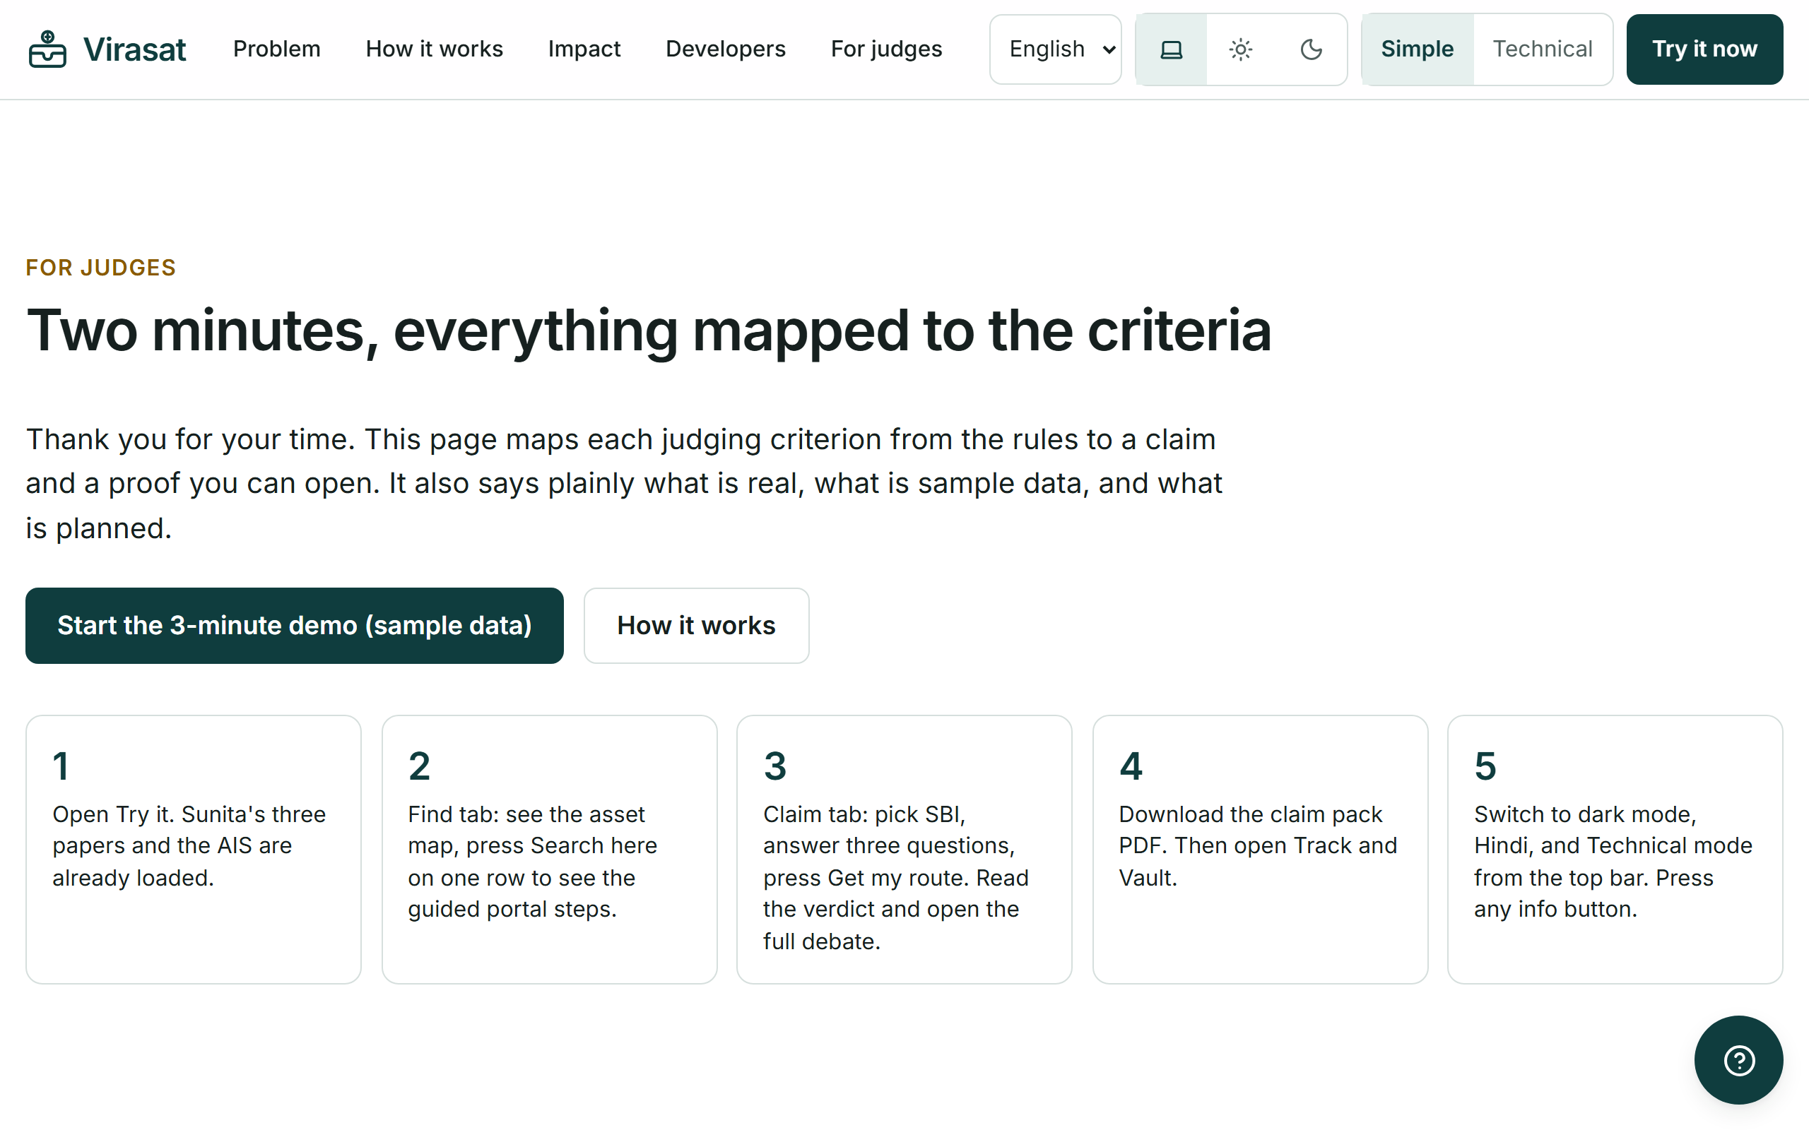
EVALUATION CRITERIA, MAPPED
Every criterion mapped to proof you can open
A 2-minute guided tour of the live product.
A table mapping each criterion and weight to a claim and a link.
An honest list: what is real, what is sample data, what is planned.
Every deliverable Rules.md asks for, with a link.
One click resets the demo for the next judge.
Open /judges on the live site.

Slide 13

08 · FUTURE SCOPE
The next three things we build
WhatsApp and more languages
The same engine behind a WhatsApp number, plus Marathi, Tamil, Telugu and Bengali, so families who never open a website can still use it.
DigiLocker and Account Aggregator
Fetch certificates directly and, with consent, read bank data through India's account aggregator framework, so the search step disappears.
The service centre network
A helper dashboard for the 5 lakh Common Service Centres, so one trained operator can run claims for a whole village.

Slide 14
Aapki Poonji, Aapka Adhikar.
Your money, your right. Virasat is the layer that gets families to it, in their own language.
₹1.84 L cr
1 photo
₹0
53 tests
waiting to be claimed
to get started
cost to families
and zero a11y violations
Team USV · Global Innovation Hackathon 2026 · Live at virasat-indol.vercel.app

