Slide 1

USWDS Monthly Call
August 2022

Slide 2

Hi!
Thanks for being here!

Slide 3
Agenda
Site launches
Product updates
Introducing inclusive patterns
Q&A

Slide 4
Site launches

Slide 5
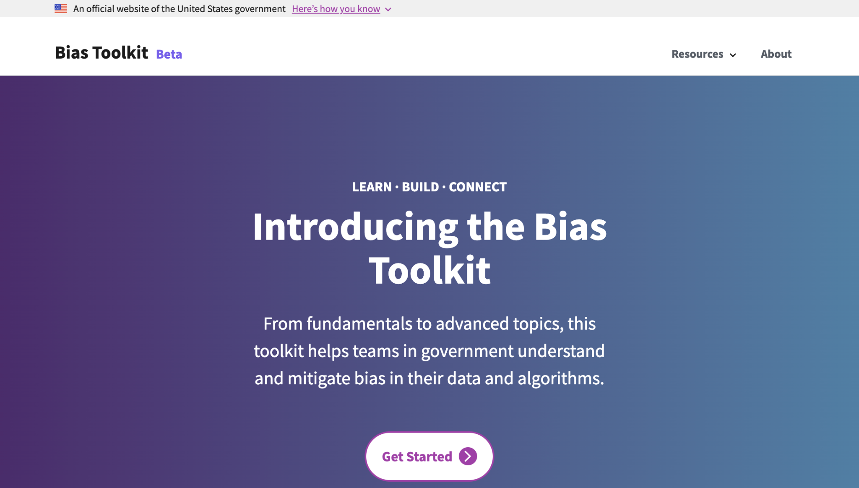
Bias Toolkit from the U.S. Census Bureau
bias.xd.gov

Slide 6
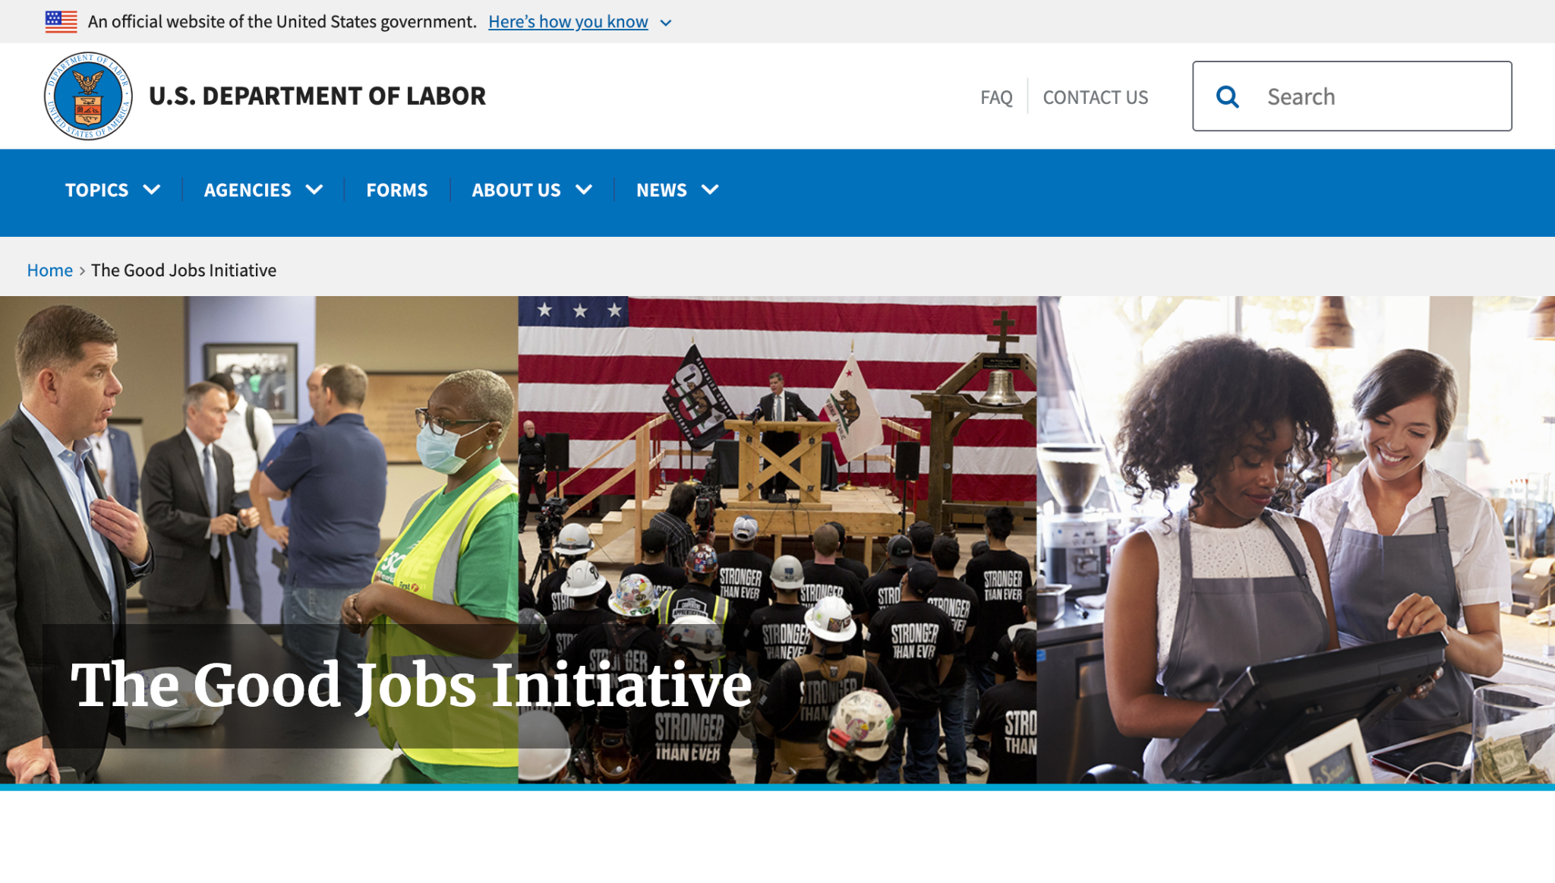
The Good Jobs Initiative from the U.S. Department of Labor
goodjobs.gov

Slide 7
Great work!

Slide 8
Product updates

Slide 9
USWDS 3.1.0

Slide 10
What’s new in USWDS 3.1.0 (1 of 2)
All non-form buttons now include type="button" to prevent unintended and undesired behavior
Elements that use aria-disabled are now styled as disabled
Fixed mobile menu appearance for layouts using flex or CSS grid

Slide 11
What’s new in USWDS 3.1.0 (2 of 2)
Unstyled buttons in a button group now have proper baseline alignment
Added LinkedIn icon
Updated social media icons to remove custom circle outlines
Updated markup in usa-password to use a <button> instead of an <a>

Slide 12
USWDS 3.1.0 Out now

Slide 13
Introducing Inclusive Patterns

Slide 14
Meghan O’Meara
she/her
Content Strategist Inclusive Patterns
Contractor

Slide 15
Mitch Moccia
he/him
Engineer Inclusive Patterns
Contractor

Slide 16
What we’ll discuss today
What are patterns and why are we including them in USWDS
How we developed our pattern guidance
Supporting components
What’s next
Notes:
DW

Slide 17
The building blocks of a site or service
Notes:
DW

Slide 18
The building blocks of
a meal
Notes:
DW

Slide 19
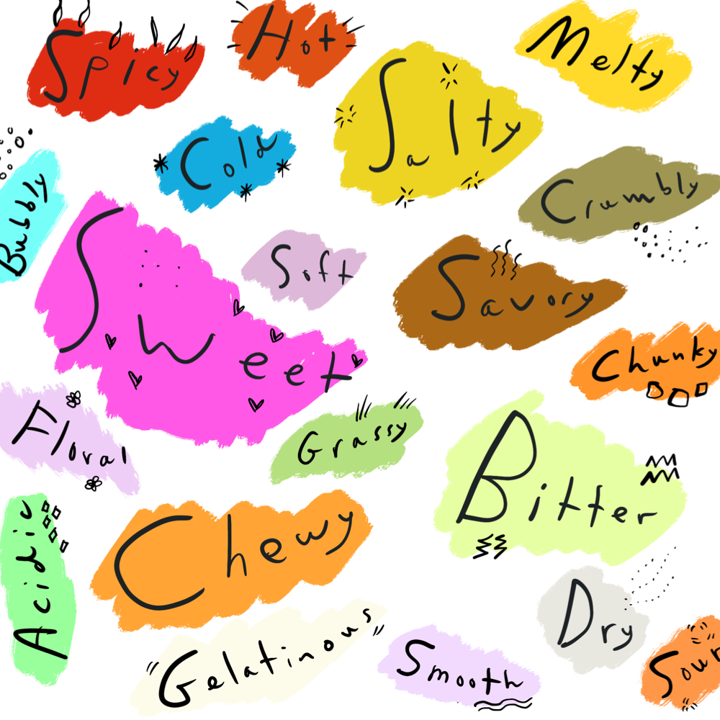
Tokens
Flavors and textures
Notes:
DW

Slide 20
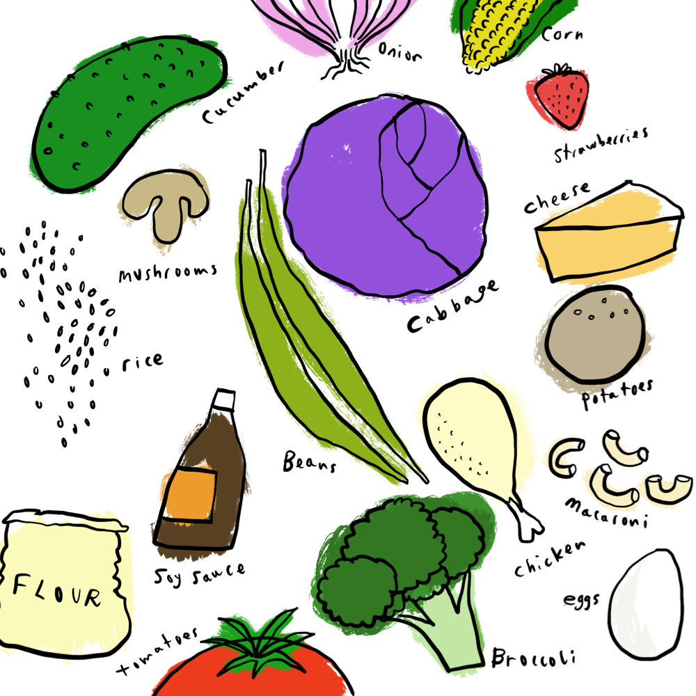
Components
Ingredients
Notes:
DW

Slide 21
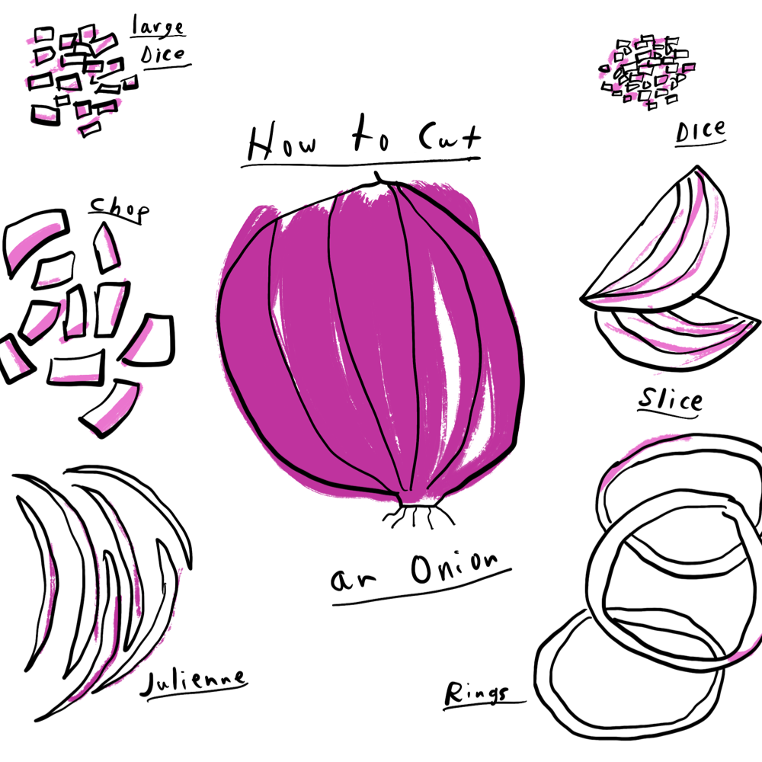
Usability and accessibility guidance
Techniques
Notes:
DW

Slide 22
A design system is more than a store.
It’s the story of how
we do design work.
Notes:
DW

Slide 23
Recipes
Notes:
DW

Slide 24
Patterns
Notes:
DW

Slide 25
Things users do again and again on our sites and services
Notes:
DW

Slide 26
Common interactions
Notes:
DW

Slide 27
“Help a user to blank____.”
Notes:
DW

Slide 28
Help a user to provide their name.
Notes:
DW

Slide 29
Help a user to review a complex form.
Notes:
DW

Slide 30
Help a user to refine search results.
Notes:
DW

Slide 31
Help a user to recover from an error.
Notes:
DW

Slide 32
Help a user to make an appointment.
Notes:
DW

Slide 33
Help a user to upload a document.
Notes:
DW

Slide 34
Help a user to provide their race or ethnicity.
Notes:
DW

Slide 35
Help a user to select their preferred language.
Notes:
DW

Slide 36
Patterns are a missing link between components and services.
Notes:
DW

Slide 37
Tokens build
Components
Notes:
DW

Slide 38
Tokens
Components alone don’t build
Websites and services
Notes:
DW

Slide 39
Tokens
Components & content build
Patterns
Notes:
DW

Slide 40
Tokens
Components & content
Patterns build
Websites and services
Notes:
DW

Slide 41
Where do templates fit in?
Notes:
DW

Slide 42
USWDS vision
Government teams sharing solutions and practicing effective human-centered design
Notes:
DW

Slide 43
Provide fair, equitable, respectful, and inclusive experiences for broad, diverse audiences.
Notes:
DW

Slide 44
Reduce barriers to participation through every interaction
Notes:
DW

Slide 45
Example Including Puerto Ricans by design with Urbanization
Notes:
MO

Slide 46
Executive orders
Notes:
MO

Slide 47
Teams are interested in
sharing what they know
and learning what they
can do better
Notes:
MO

Slide 48
Goals
Notes:
DW

Slide 49
Goals (1 of 6)
To identify common patterns shared by government sites and services
Notes:
DW

Slide 50
Goals (2 of 6)
To identify patterns that government design teams want to better understand
Notes:
DW

Slide 51
Goals (3 of 6)
To identify subject matter experts effectively addressing these patterns
Notes:
DW

Slide 52
Goals (4 of 6)
To identify guidance specific to these patterns
Notes:
DW

Slide 53
Goals (5 of 6)
To ensure that any pattern guidance addresses diversity, equity, inclusion, and accessibility considerations specific to these patterns
Notes:
DW

Slide 54
Goals (6 of 6)
To identify new components and improvements to components that can support these patterns
Notes:
DW

Slide 55
What did we do?
Notes:
DW

Slide 56
Benchmarking and landscape analysis
Notes:
MM

Slide 57
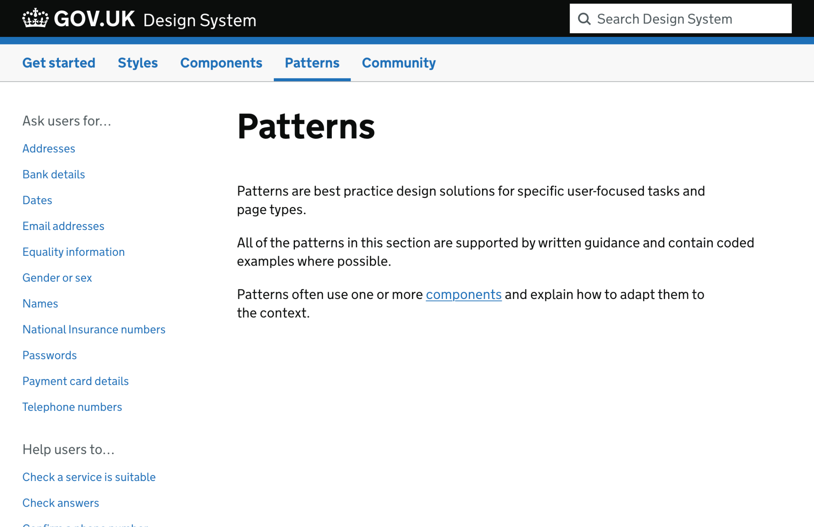
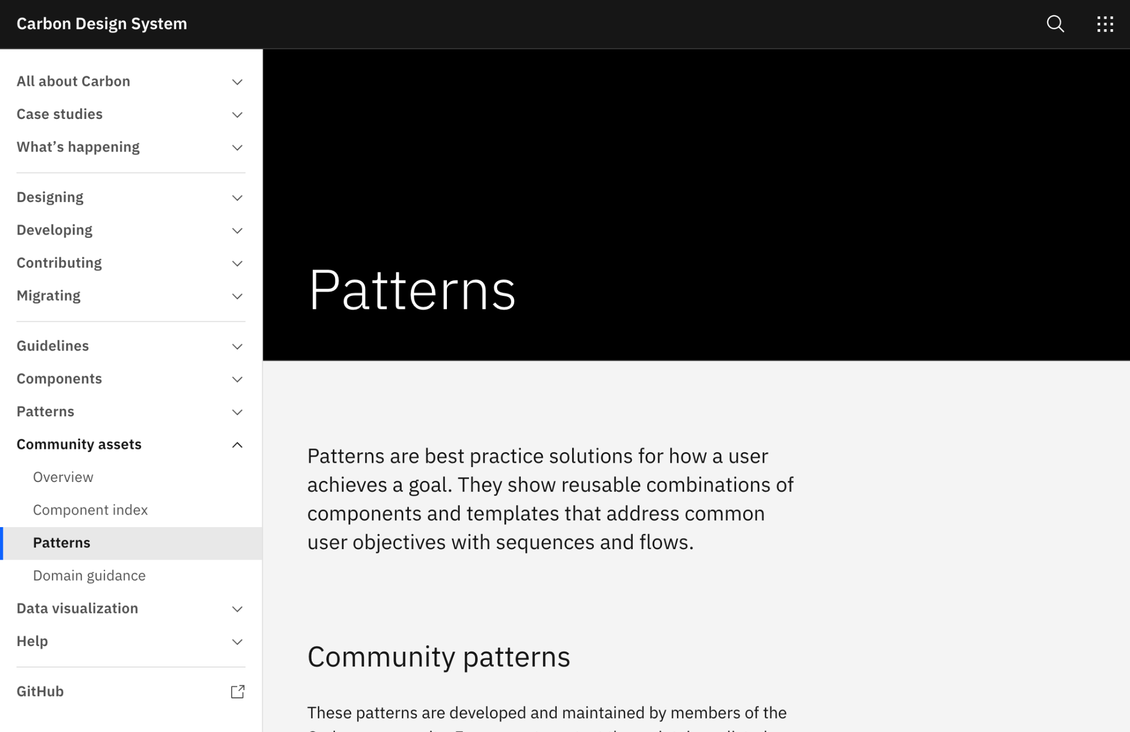
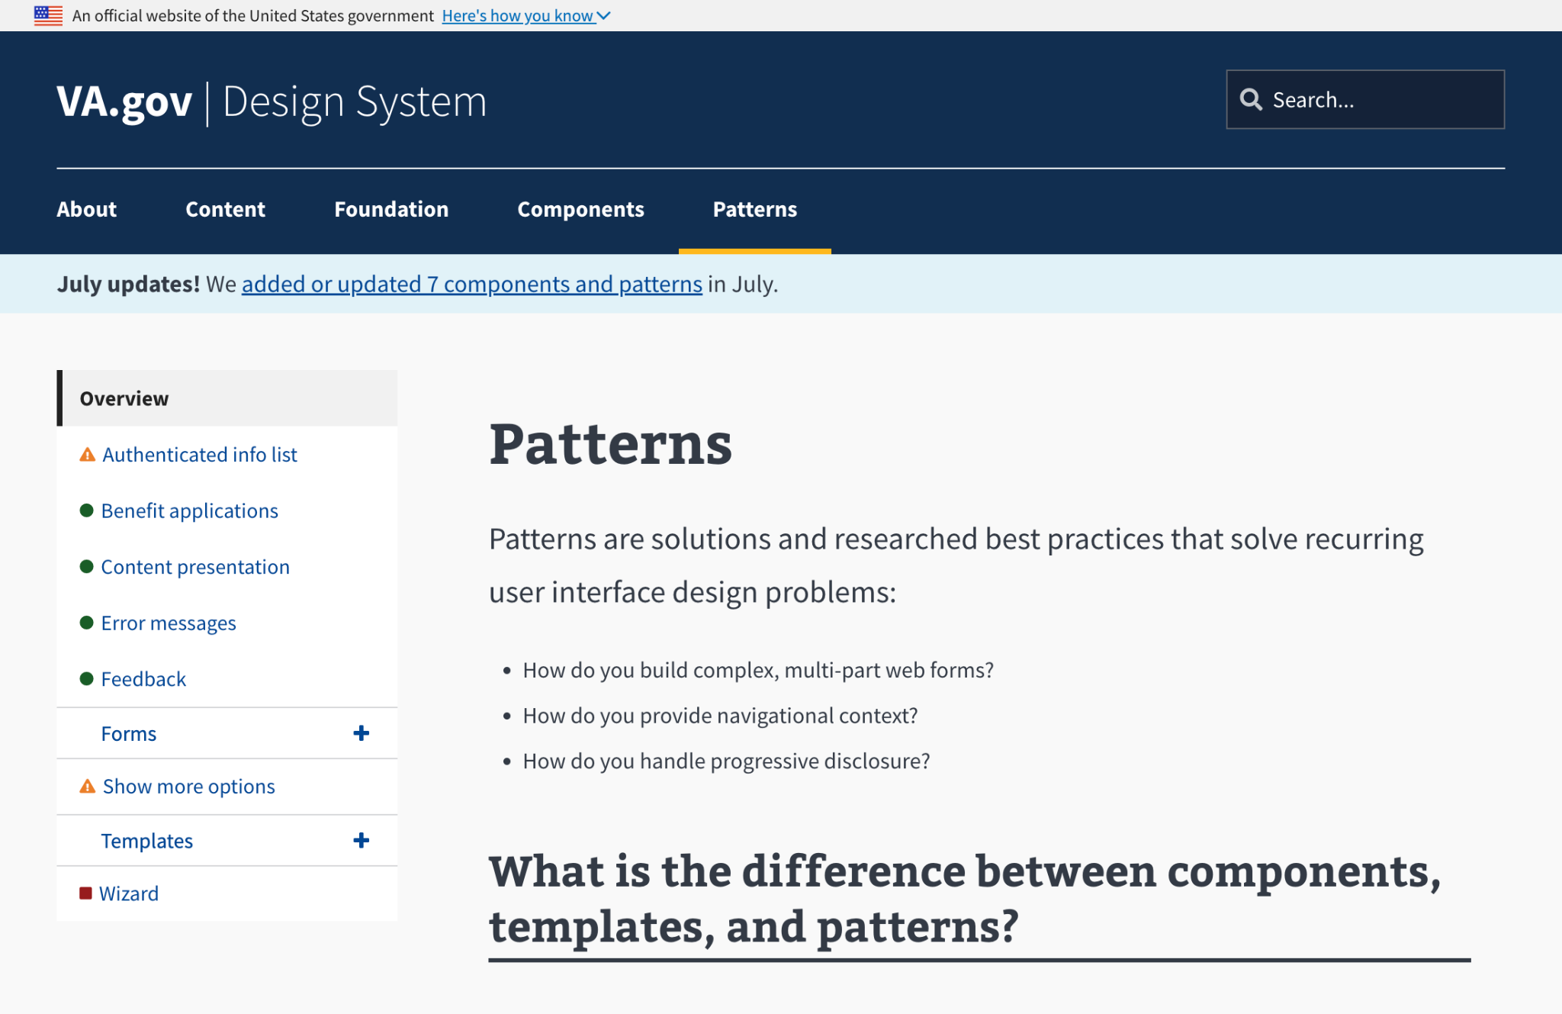
Patterns in other design systems
Gov.uk
Carbon Design System
VA Design System
Notes:
MM

Slide 58
Interviews and research
Notes:
MO

Slide 59
Our interview strategy
Notes:
MO

Slide 60
We talked to over 35 people
from over 20 government agencies and programs
Notes:
MO

Slide 61
16 high impact service providers
Notes:
MO

Slide 62
Veterans Affairs Social Security Administration HHS FEMA Department of the Interior Internal Revenue Service
Notes:
MO

Slide 63
A focus on diversity, equity, inclusion and accessibility
Notes:
MO

Slide 64
Subject matter experts
DEIA Growth for Teams
TTS Diversity Guild
Multilingual CoP
Notes:
MO

Slide 65
What did we hear?
Notes:
DW

Slide 66
Creating more equitable and inclusive experiences is on everyone’s minds.
Notes:
MO

Slide 67
The process of inclusivity is as important as the implementation.
Notes:
MO

Slide 68
Personal information is fundamental to an individual’s sense of self.
Notes:
MO

Slide 69
Complex forms can be challenging, especially during times of stress.
Notes:
MO

Slide 70
“People are reluctant to give information because of the lack of trust and any number of concerns. [We need help] building trust into the design process.”
Design team member
Notes:
MO

Slide 71
Many programs are wrestling with making their content available in multiple languages.
Notes:
MO

Slide 72
“[We’re] struggling with multilingual [content] and accommodating the proper presentation.”
Design team member
Notes:
MO

Slide 73
Synthesis and pattern identification
Notes:
MO

Slide 74
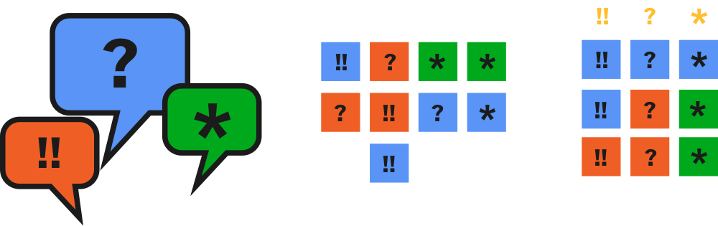
Pattern development process
Notes:
MO

Slide 75
Pattern focus areas
User profiles
Complex forms
Language selection
Notes:
DW

Slide 76
Launching with 15 Patterns
Provide a name
Provide a date of birth
Provide an address
Provide an email address
Provide a phone number
Provide a biological sex or gender
Provide pronouns
Provide their race or ethnicity
Provide a social security number
Provide contact preferences
Understand expectations and build trust in complex forms
Help a user progress smoothly through complex forms
Keep a record of submitted information
Select a language for a site or service
Indicate a preferred spoken and/or written language for a site or service
Notes:
DW

Slide 77
Supporting components
Notes:
MM

Slide 78
In-Page Navigation
Input Masking
Language Selector
Notes:
MM

Slide 79
Pattern driven development
Notes:
DW

Slide 80
Next month’s call:
Inclusive Patterns in depth
Notes:
DW

Slide 81
Thank you to everyone who participated!
Notes:
MO

Slide 82
Q&A
Notes:
DW

Slide 83
Next month
September: Inclusive Patterns in depth
#uswds-public
github.com/uswds
designsystem.digital.gov

