Slide 1


USWDS Monthly Call
October 2022

Slide 2

Hi!
Thanks for being here!

Slide 3
Agenda
Site launches
Community guidelines
Product updates
Contact information patterns
Q&A

Slide 4
Site launches

Slide 5
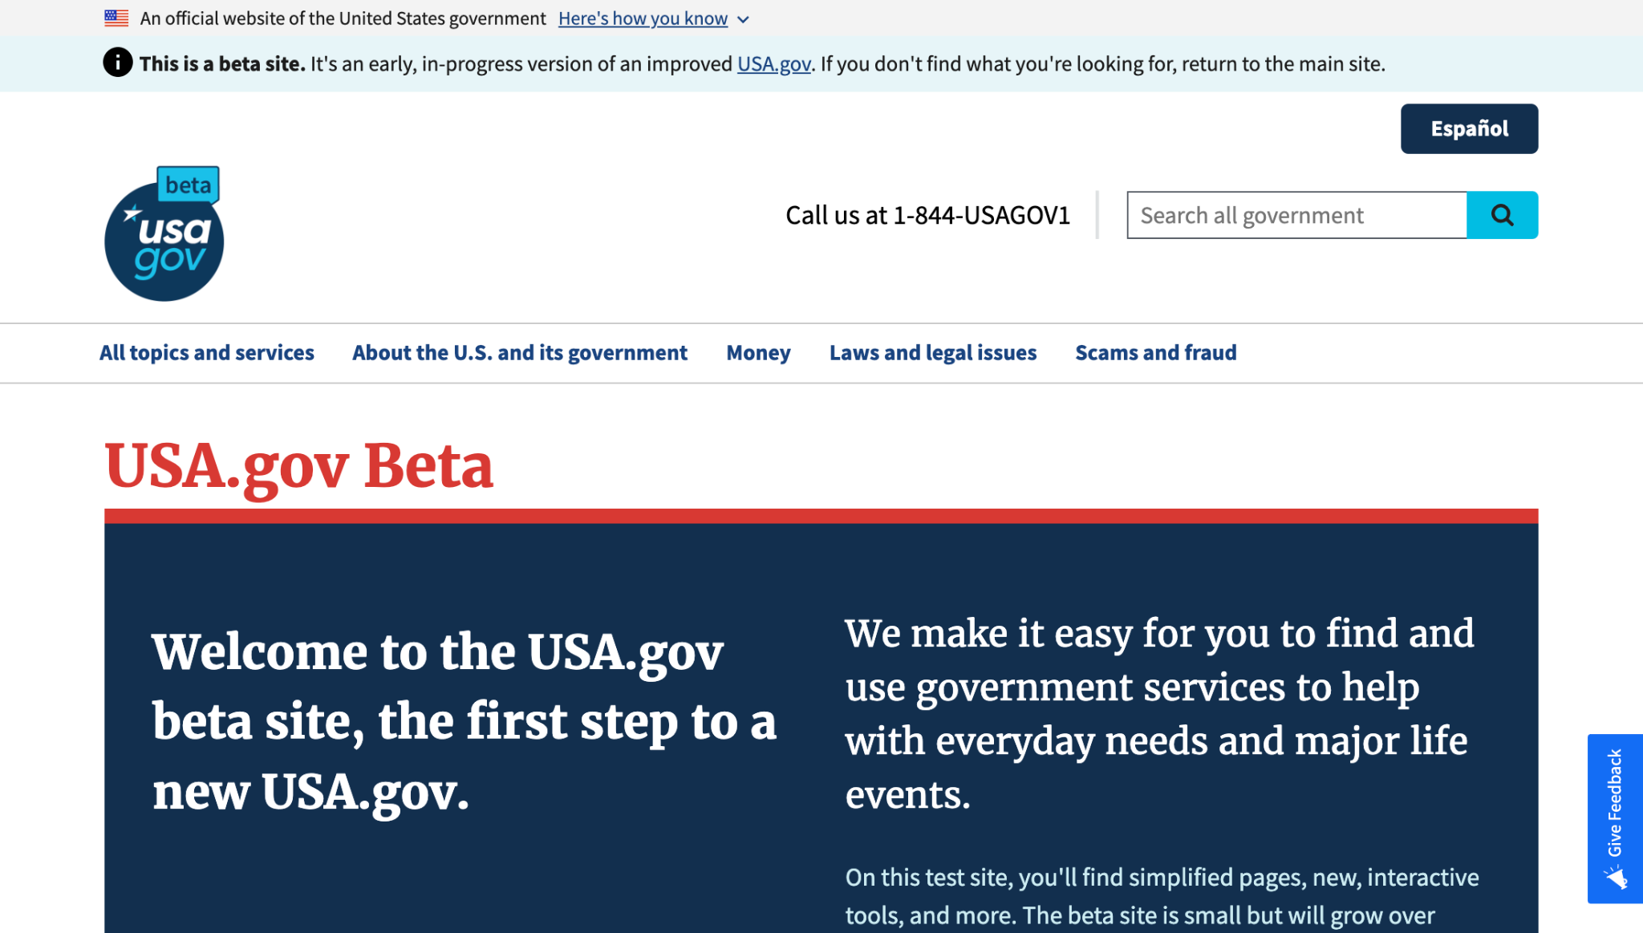
USAGov Beta site
beta.usa.gov
Notes:
TK

Slide 6
Great work!

Slide 7
Spam and community guidelines

Slide 8
USWDS community page
designsystem.digital.gov/about/community

Slide 9
Digital.gov community guidelines
digital.gov/communities/community-guidelines/

Slide 10
Community guideline highlights
Keep the conversation relevant
No commercial communications or endorsements
Use plain language
Practice constructive criticism
Respect your peers
Use your .gov or .mil email if you have one

Slide 11
Thanks for being a good community!

Slide 12
Product updates

Slide 13
USWDS 2.13.4
Taking a second look

Slide 14
USWDS 3.2.0
Accessibility improvements

Slide 15
Banner improvements in 3.2.0
Streamlined and simplified screen reader output
“An official” vs “Unofficial”
Simpler description of lock icon
Skips decorative flag image

Slide 16
Other improvements in 3.2.0
Improved accessibility of usa-validation
Improved screen reader output for character count
Valid ARIA label in Identifier
Fixed potential incompatibility with M1/M2 Macs
Improved alignment of Alert and Site Alert
Allow dynamic initialization of Tooltip

Slide 17
USWDS 3.2.0
Out now

Slide 18
User Profile Patterns Part 1 Contact information patterns

Slide 19
Meghan O’Meara
she/her
Content Strategist Inclusive Patterns
Contractor

Slide 20
Jonathan Bobel
he/him
UX Engineer Inclusive Patterns
Contractor

Slide 21
Patterns: Things users do again and again on our sites and services
Notes:
DW

Slide 22
Help a user to _________.
Notes:
DW

Slide 23
Help a user to
review a complex form.
refine search results.
recover from an error.
make an appointment.
upload a document.
provide their race and ethnicity.
enter their name.
Notes:
DW

Slide 24
Reduce barriers to participation through every interaction
Notes:
DW

Slide 25











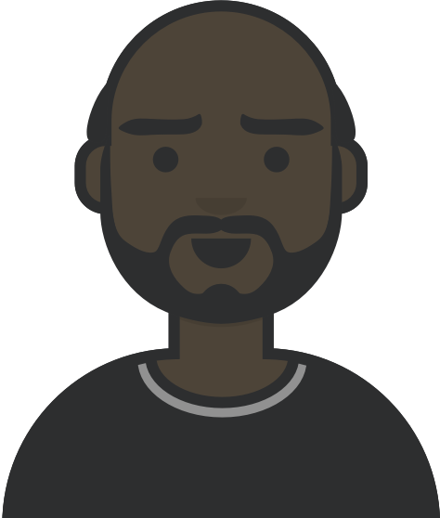







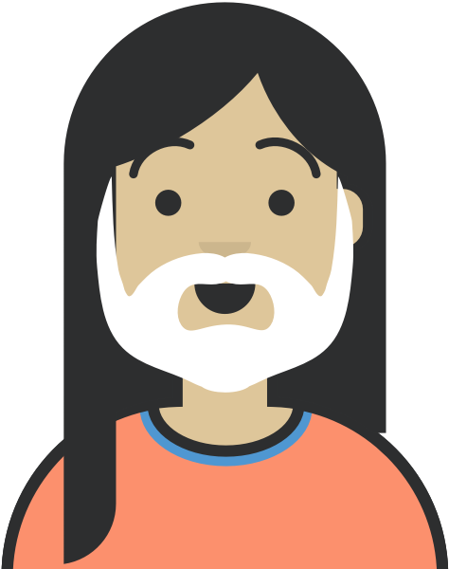


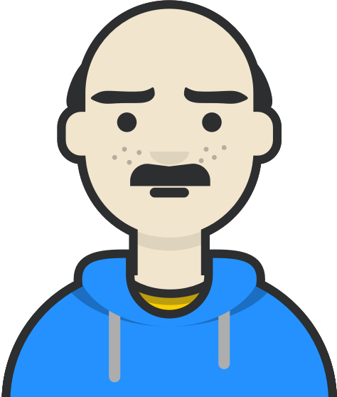







Collecting personal information can be challenging
Notes:
DW

Slide 26
Different cultures, backgrounds, and perspectives
Notes:
DW

Slide 27
USWDS User profile patterns
Provide their name
Enter their address
Provide their email address
Enter their phone number
Indicate their contact preferences
Enter their Social Security Number
Enter their date of birth
Provide their race and ethnicity
Provide their biological sex or gender
Share their pronouns
Notes:
DW

Slide 28
Today we’ll focus on the first four…
Provide their name
Enter their address
Provide their email address
Enter their phone number
Indicate their contact preferences
Enter their Social Security Number
Enter their date of birth
Provide their race and ethnicity
Provide their biological sex or gender
Share their pronouns
Notes:
DW

Slide 29
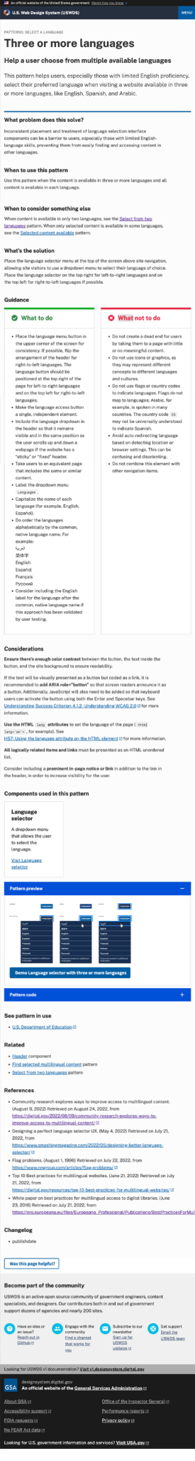
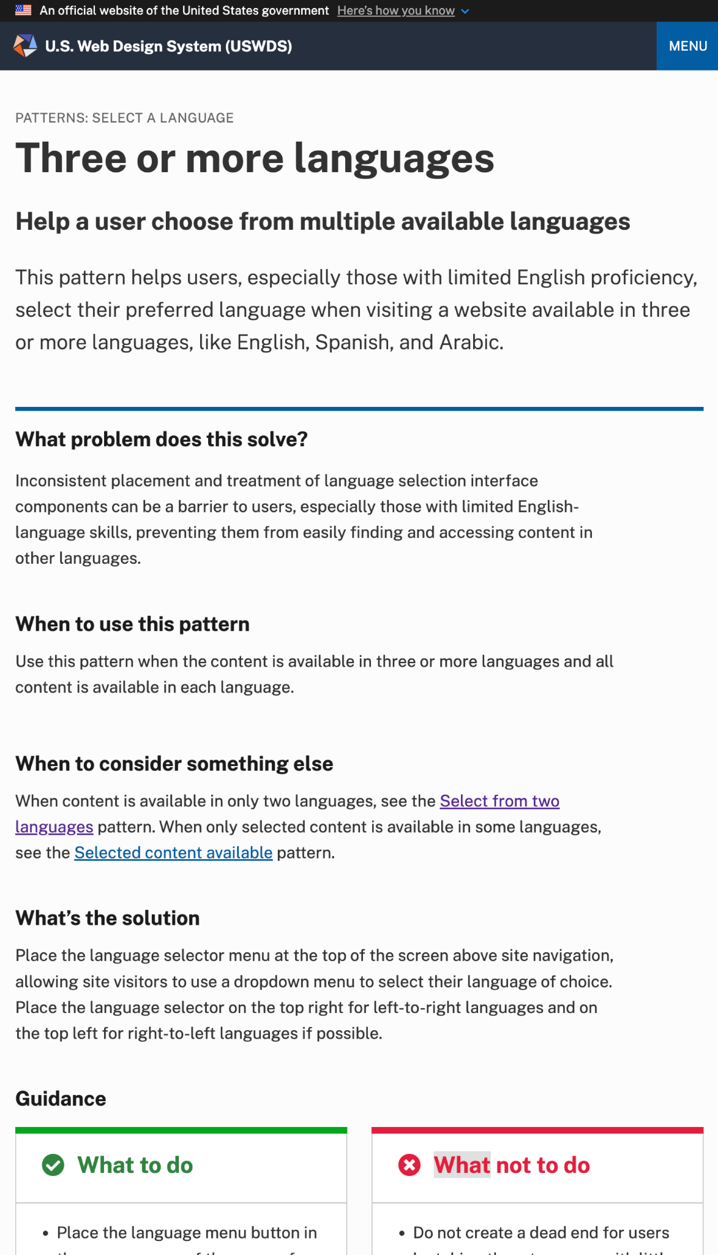
A USWDS pattern page
Patterns have guidance pages just like components

Slide 30
Introducing a pattern
The top of the page describes the pattern

Slide 31
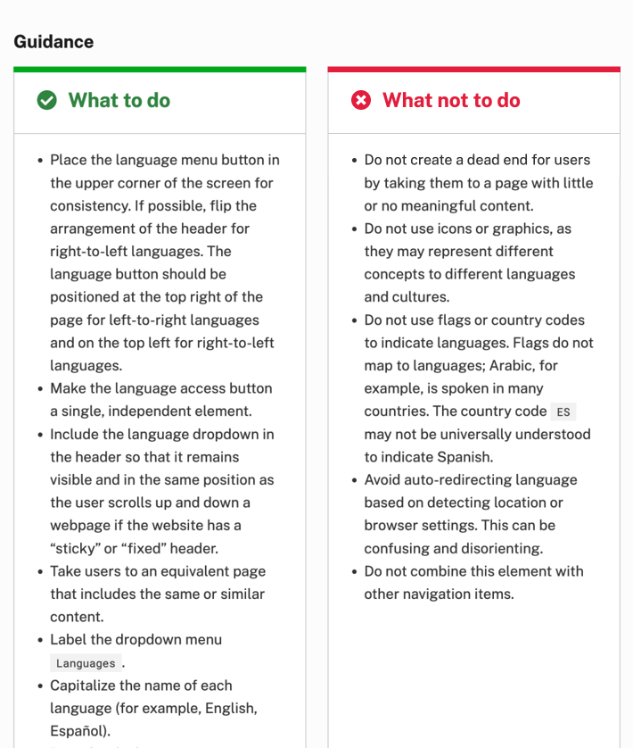
Guidance
What to do and what not to do

Slide 32
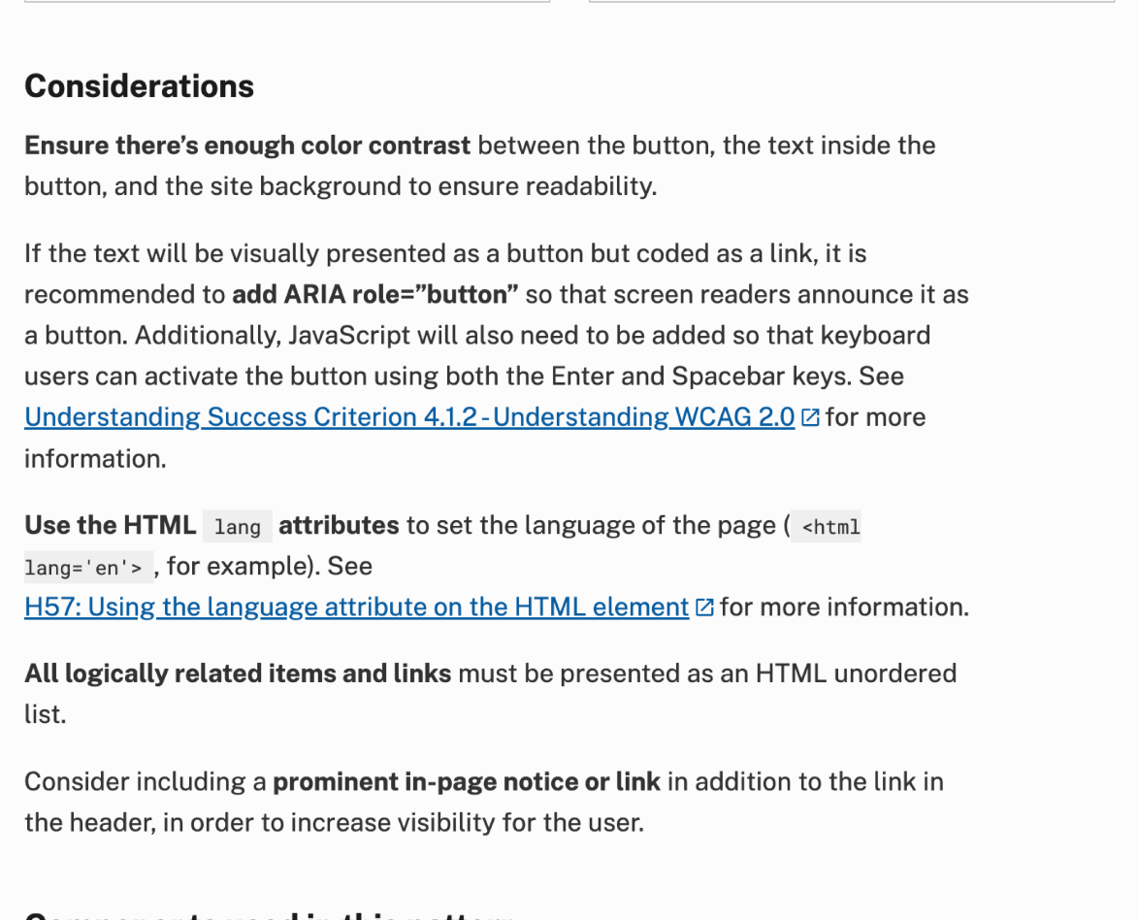
Considerations
Practical implementation details, often related to accessibility

Slide 33
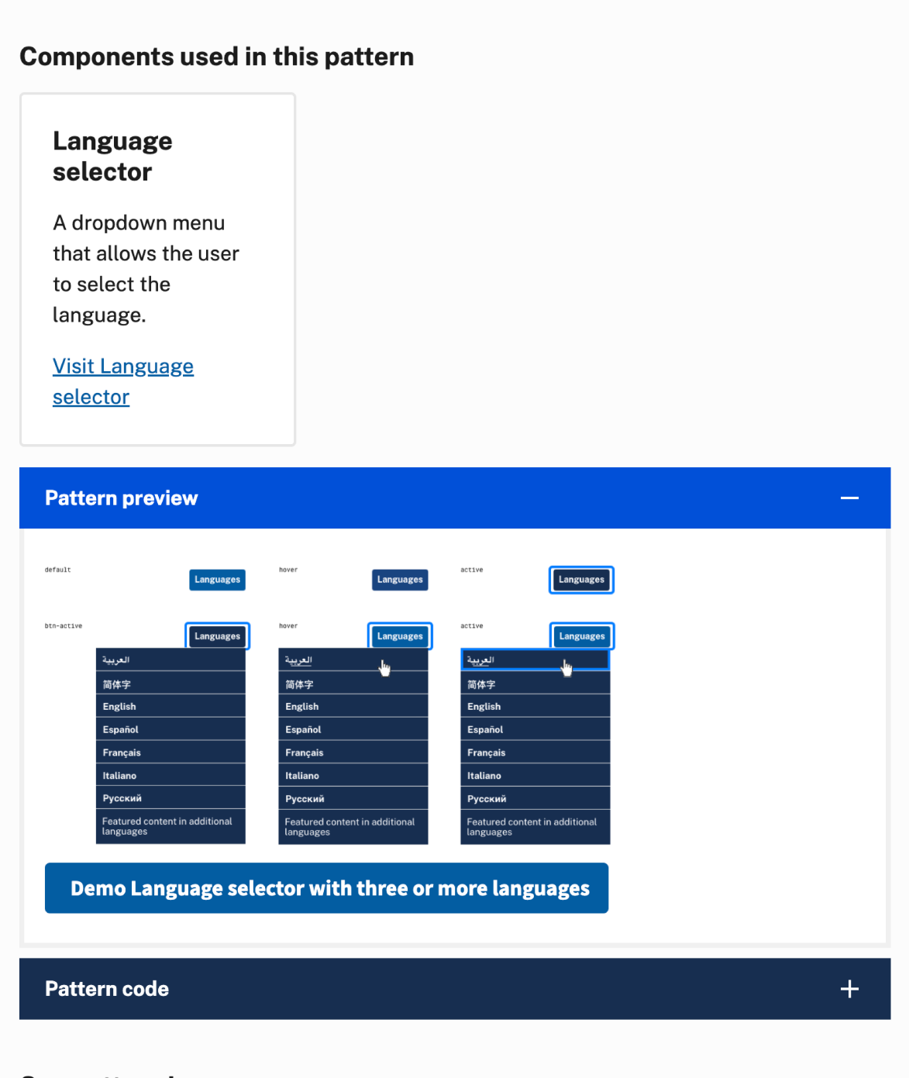
Details
USWDS components used to address the pattern and how to implement our solution in code

Slide 34
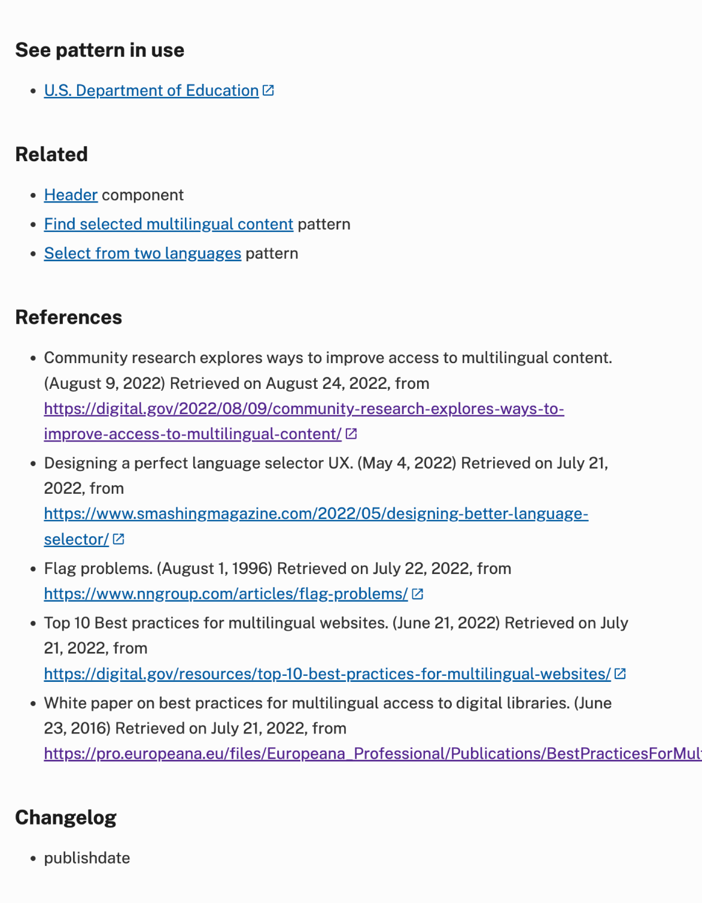
Supporting information
Other examples, related components, sources we used in addition to our direct research, and a list of any changes to the pattern page since publication

Slide 35
Name patterns
Notes:
DW

Slide 36
Only one name
Notes:
DW

Slide 37
Single-letter names
Notes:
DW

Slide 38
Very long names
Notes:
DW

Slide 39
Names with special characters
Notes:
DW

Slide 40
Names with multiple upper- and lowercase letters
Notes:
DW

Slide 41
Two or more last names
Notes:
DW

Slide 42
Anna May Wong
Wong Liu Tsong
Notes:
DW

Slide 43
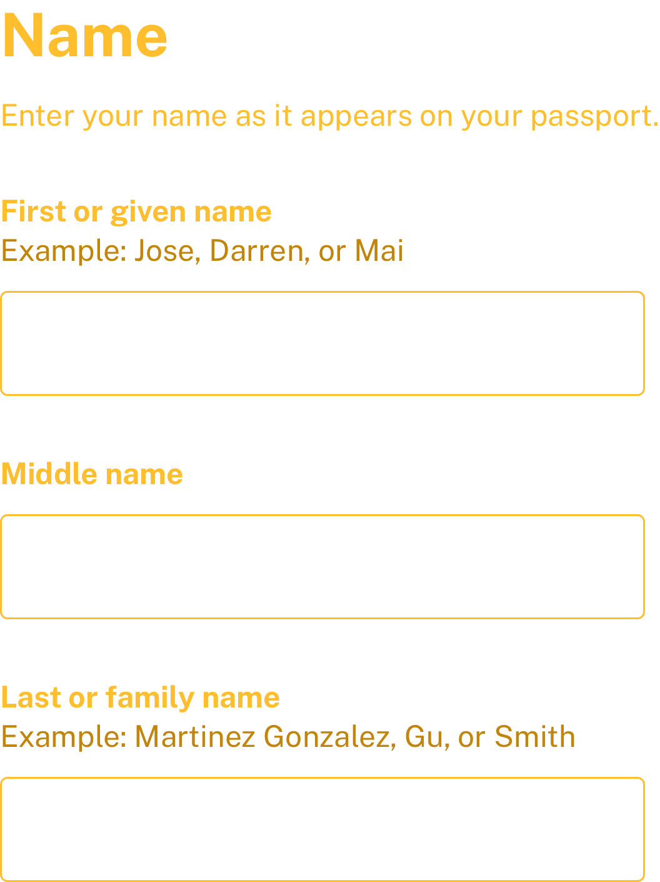
Name Pattern guidance
Support long text fields and short names
Support a rich array of special characters
Allow more than one name in each field
Allow both upper and lowercase letters in each field, along with hyphens, apostrophes and blank spaces
If you need it, ask for previous name not maiden name.
Use descriptive hint text
Notes:
DW

Slide 44
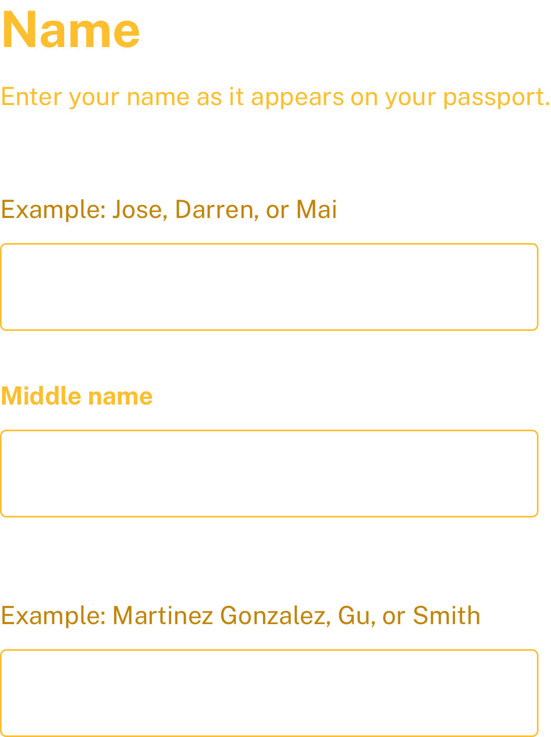
Given and family name
An emerging best practice that addresses some of the challenges with non–Western European names
Notes:
DW

Slide 45
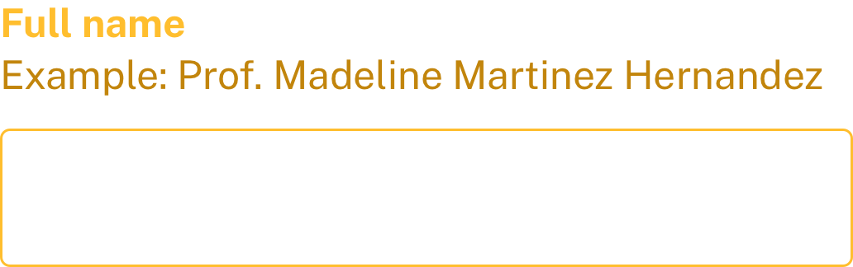
Full name
Use a full name if you don’t need to parse apart the pieces of a name.
Notes:
DW

Slide 46
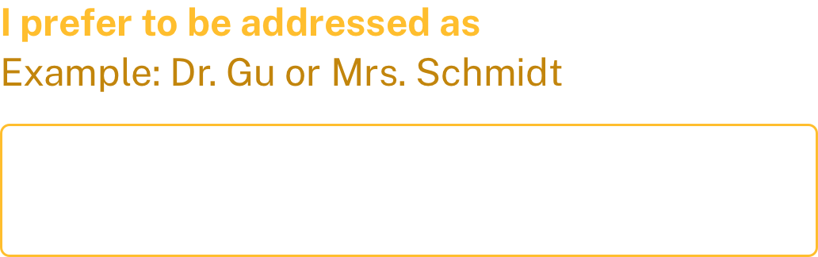
Preferred form of address
If you will be reaching out to speak with someone verbally or expect formal correspondence
Notes:
DW

Slide 47
Address patterns
Notes:
DW

Slide 48
Many Puerto Rican addresses require an Urbanization code or name
Notes:
DW

Slide 49
Many rural areas don’t follow conventions
Notes:
DW

Slide 50
Complexities of context and situation
Notes:
DW

Slide 51
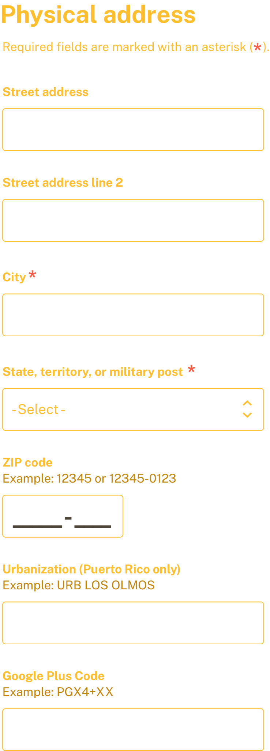
General Address
Fields
Street address
Street address line 2
City
State, territory, or military post
ZIP code
If your audience includes Puerto Rico, include an Urbanization field
If your audience include those in very remote locations, consider a Google Plus Code field
Notes:
DW

Slide 52
General Address
Pattern guidance
Support long text fields.
Support a rich array of diacritics, accents, and alternative characters
Consider using the autocomplete attribute on address input fields
If your program does not serve the armed forces or U.S. territories, you may want to provide links to related resources for these users if such resources exist
Do not assume that people can receive mail at their physical location
Notes:
DW

Slide 53
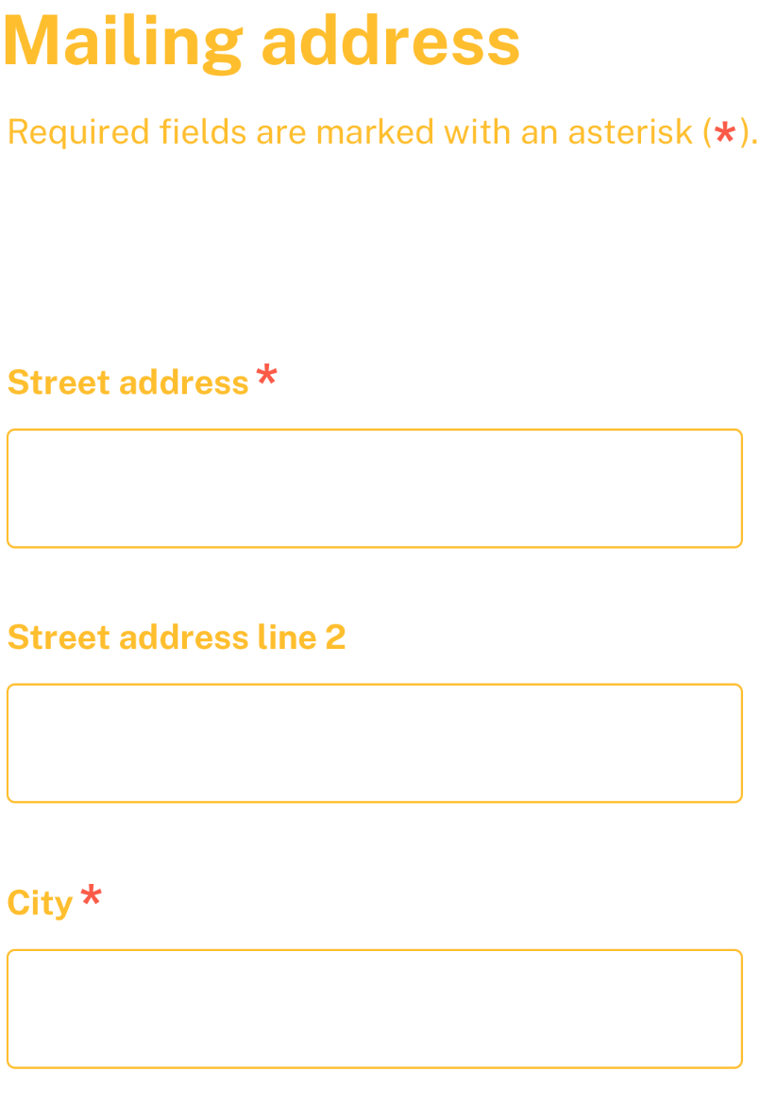
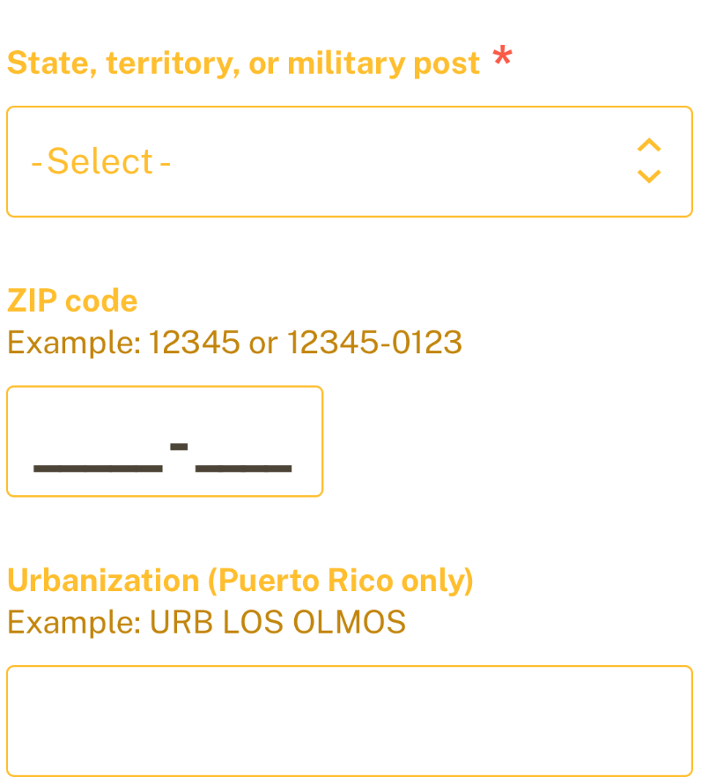
Mailing address
Pattern guidance
If you need both physical address and mailing address, provide a checkbox for “same as physical address” to auto-populate the mailing address if they are the same
The Google Plus Code does not apply to mailing address
A street address is required for a mailing address, but it may not be required for a physical address
Notes:
DW

Slide 54
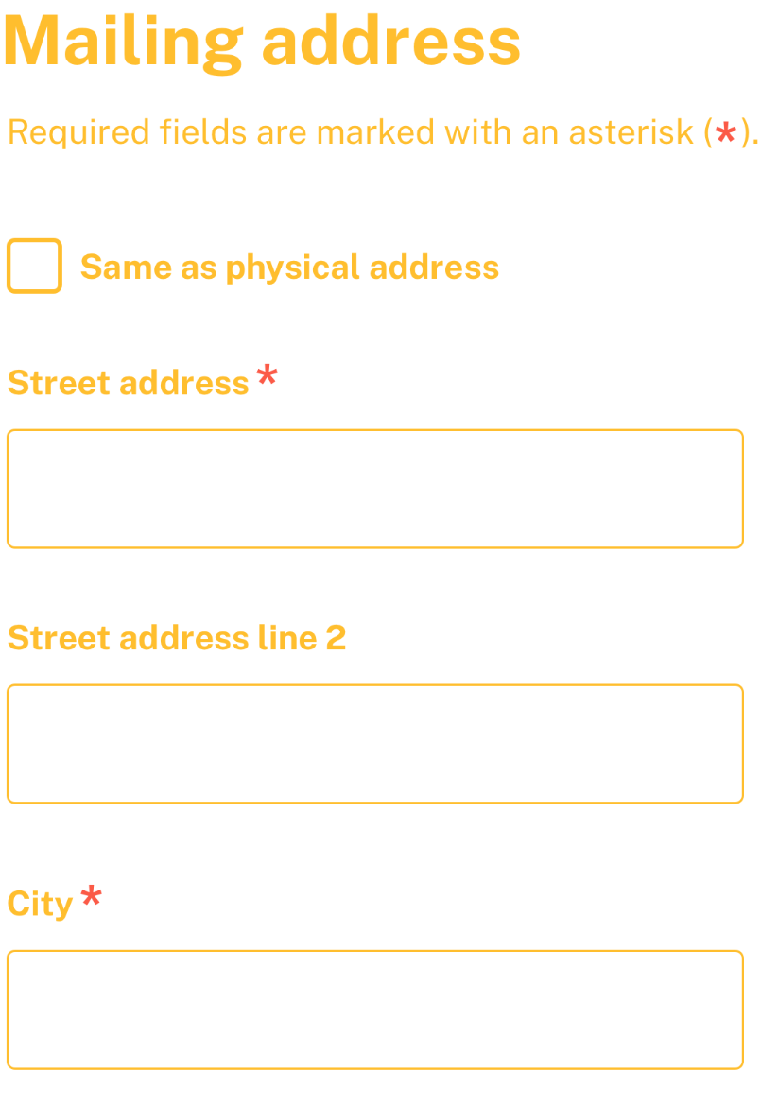
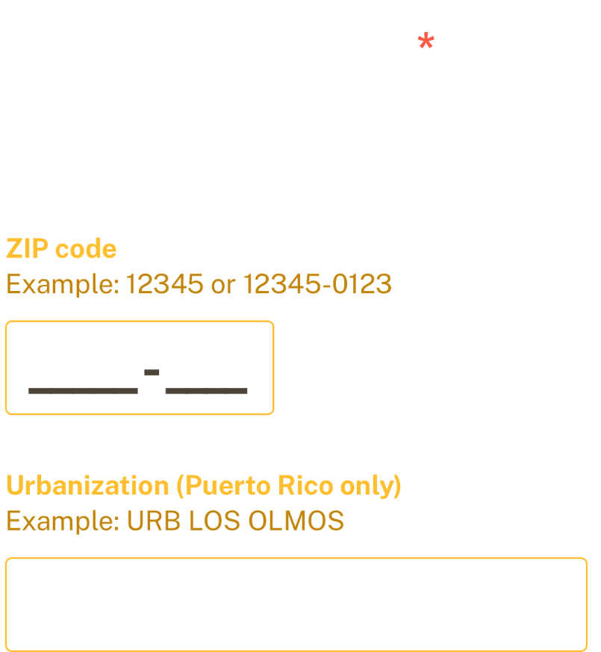
Select instead of Combobox
The Combobox didn't test well with screen reader users, so we’re suggesting a select instead.
Notes:
DW

Slide 55
Email address pattern
Notes:
DW

Slide 56
Clearly state why you need someone’s email address and when you’d email them.
Notes:
DW

Slide 57
Email addresses can be very long.
Notes:
DW

Slide 58
Email address validation can get complicated. Keep it simple.
Notes:
DW

Slide 59
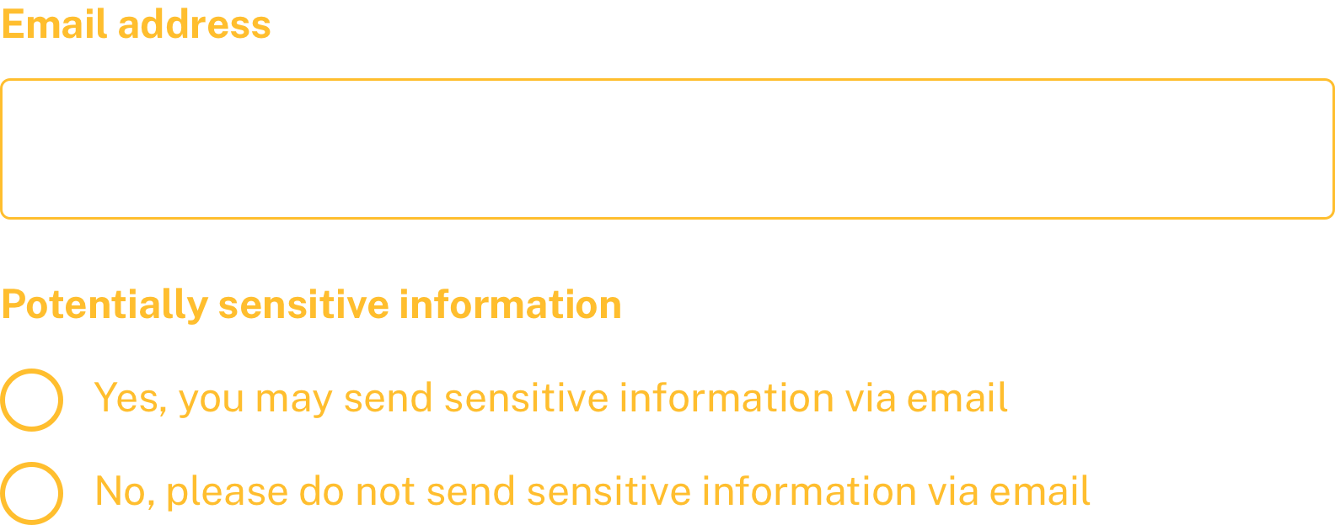
Email address Pattern guidance
Accommodate up to 256 characters
Allow copy/paste
Allow autofill
Consider the safety implications associated with people who share email addresses. You may need to ask for permission to leave potentially sensitive information.
Don't autocorrect
Don’t restrict top-level domains
Notes:
DW

Slide 60
Telephone number pattern
Notes:
DW

Slide 61
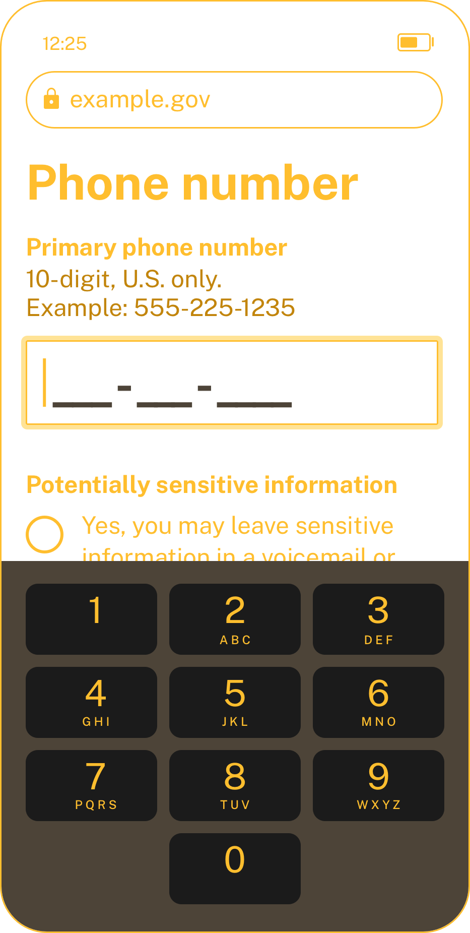
Telephone number Pattern guidance
Use "text" input type instead of "numeric"
Use inputmode="numeric"
If you will be contacting the individual by phone, ask whether you can leave sensitive information in a voicemail or text message
Consider using an input mask to shape the correct format
Notes:
DW

Slide 62
Input mask
Notes:
DW

Slide 63
Demo
Notes:
DW

Slide 64
Personal information and complex forms
Notes:
DW

Slide 65
Feedback
Notes:
DW

Slide 66
Q&A
Notes:
DW

Slide 67
Next month
November: User Profile Patterns Part 2
#uswds-public
github.com/uswds
designsystem.digital.gov

