Slide 1

USWDS Monthly Call
September 2022

Slide 2

Hi!
Thanks for being here!

Slide 3
Agenda
Site launches
Product updates
Language selection patterns
Q&A

Slide 4
Site launches

Slide 5
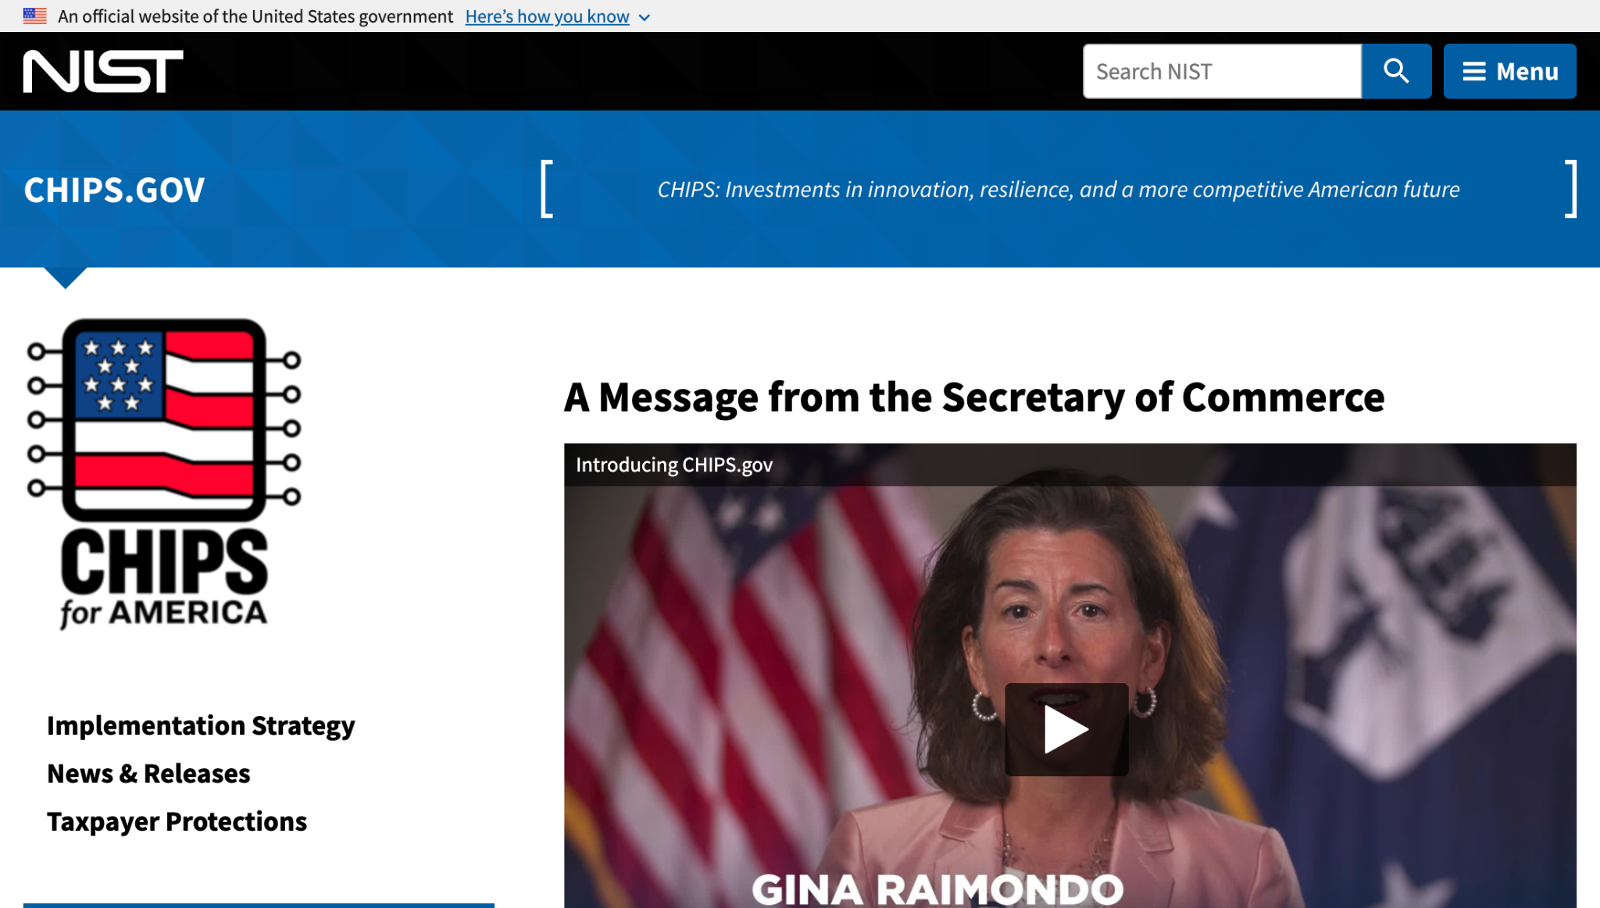
CHIPS and Science Act resource hub
chips.gov

Slide 6
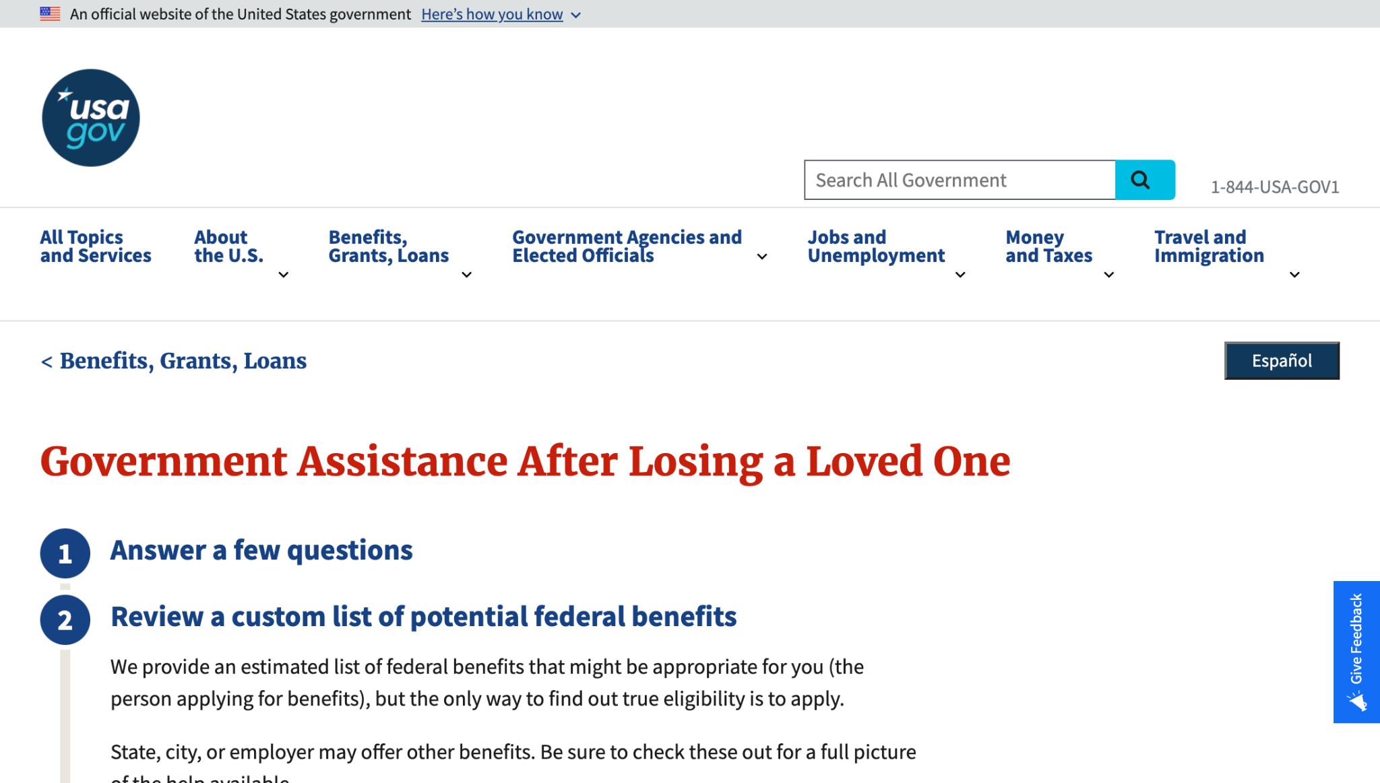
USAGov Benefits Assistance Tool
benefits-tool-beta.usa.gov

Slide 7
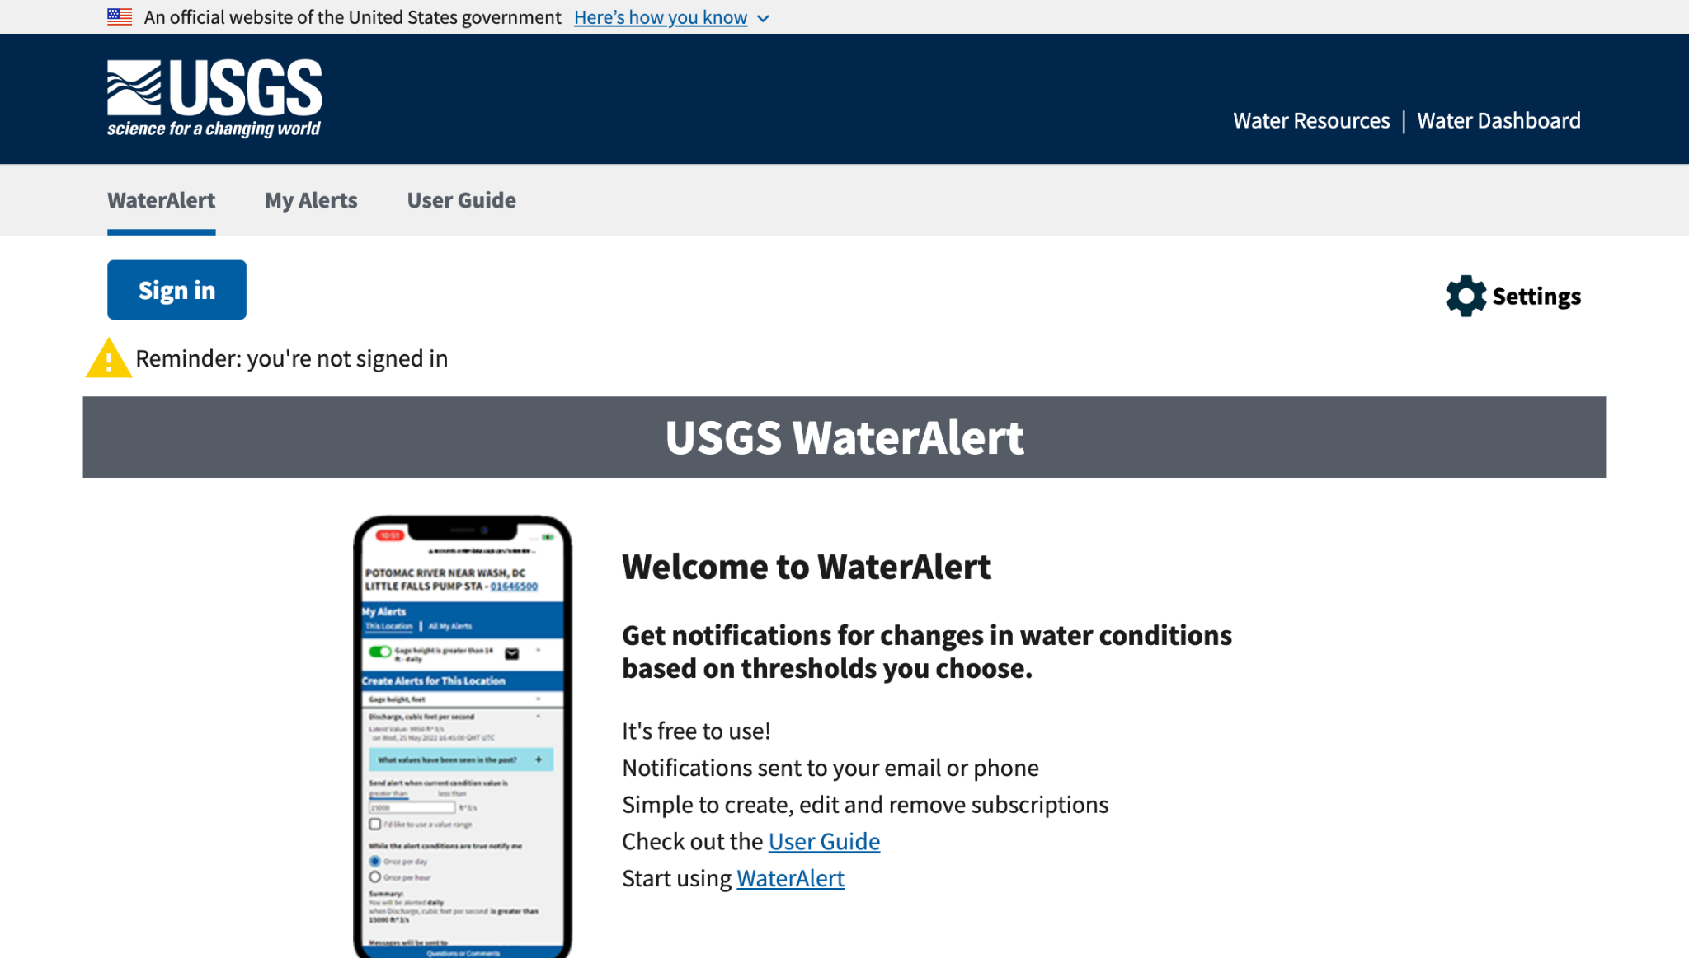
USGS WaterAlert
accounts.waterdata.usgs.gov/wateralert

Slide 8
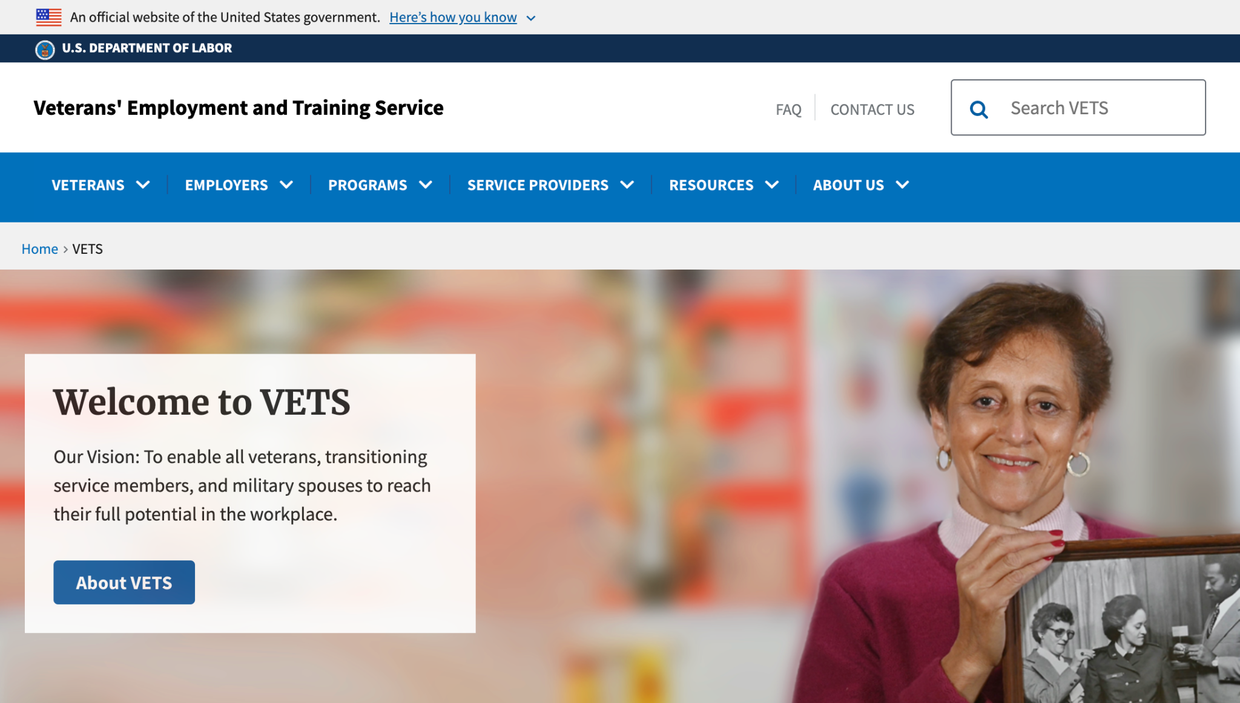
Veterans’ Employment and Training Service
veterans.gov

Slide 9
Great work!

Slide 10
Product updates

Slide 11
USWDS 2.13.4
Security update

Slide 12
USWDS 2.13.4
Out tomorrow

Slide 13
Language Selection Patterns

Slide 14
Meghan O’Meara
she/her
Content Strategist Inclusive Patterns
Contractor

Slide 15
Mitch Moccia
he/him
Engineer Inclusive Patterns
Contractor

Slide 16
Laura Godfrey
she/her
Multilingual CoP
Vote.gov

Slide 17
What we’ll discuss today
Pattern overview
Pattern guidance
Language selector demo
What’s next

Slide 18
The building blocks of a site or service

Slide 19
The building blocks of
a meal

Slide 20
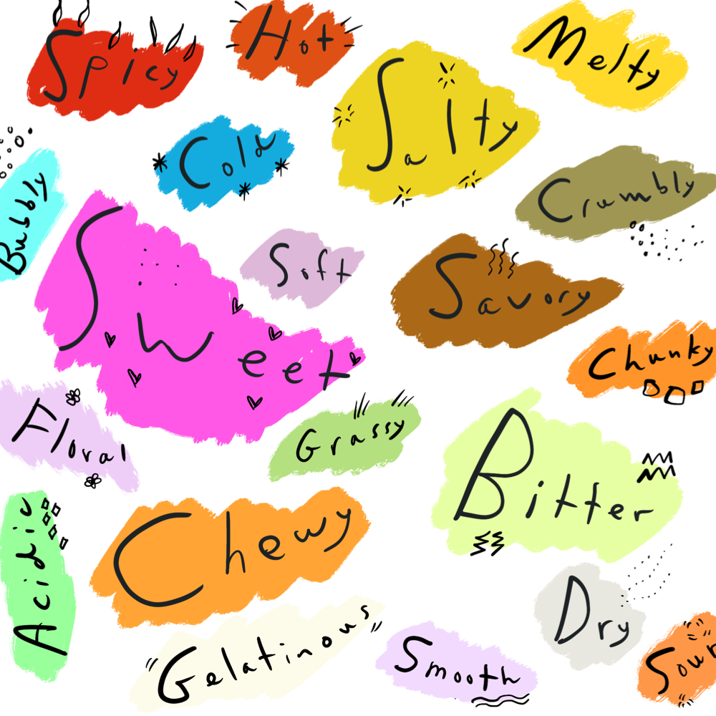
Tokens
Flavors and textures

Slide 21
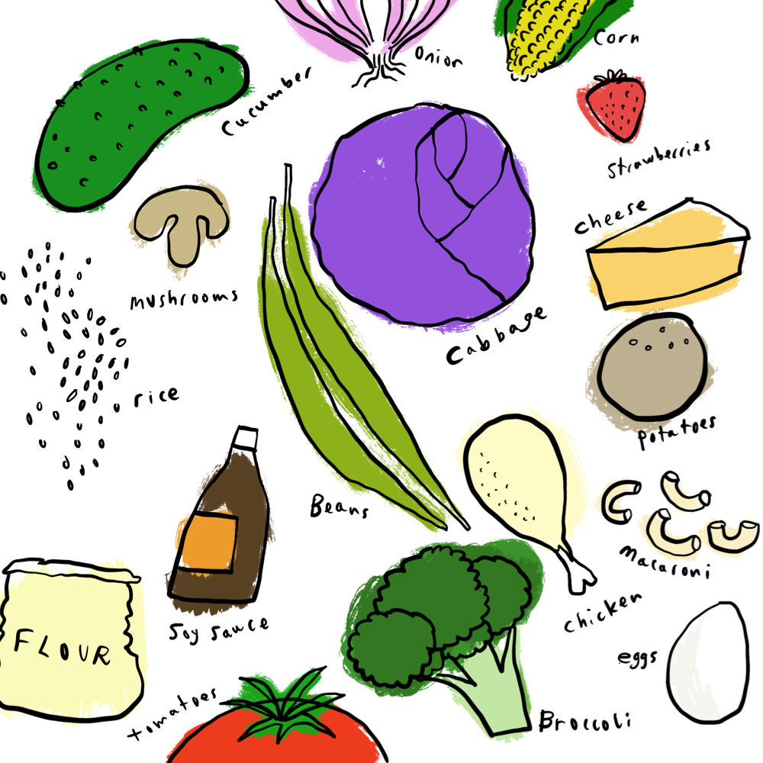
Components
Ingredients

Slide 22
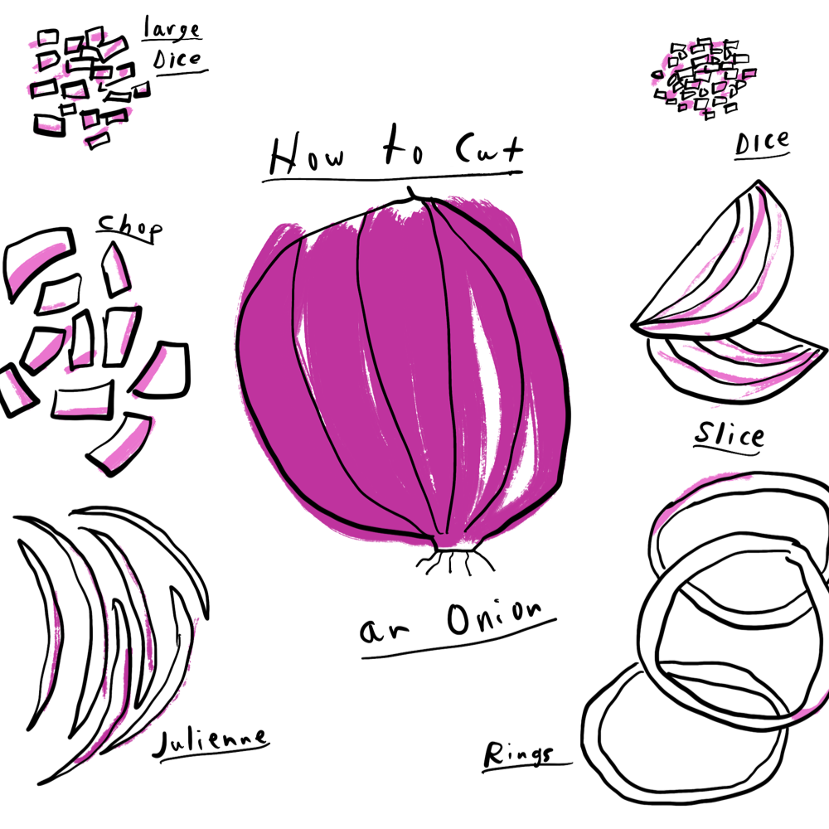
Usability and accessibility guidance
Techniques

Slide 23
Patterns are our Recipes

Slide 24
Patterns: Things users do again and again on our sites and services

Slide 25
Help a user to _________.

Slide 26
Help a user to
enter their name.
review a complex form.
refine search results.
recover from an error.
make an appointment.
upload a document.
provide their race or ethnicity.

Slide 27
USWDS vision
Government teams sharing solutions and practicing effective human-centered design

Slide 28
Provide fair, equitable, respectful, and inclusive experiences for broad, diverse audiences.

Slide 29
Reduce barriers to participation through every interaction

Slide 30
Language selection

Slide 31
Multilingual Community of Practice

Slide 32
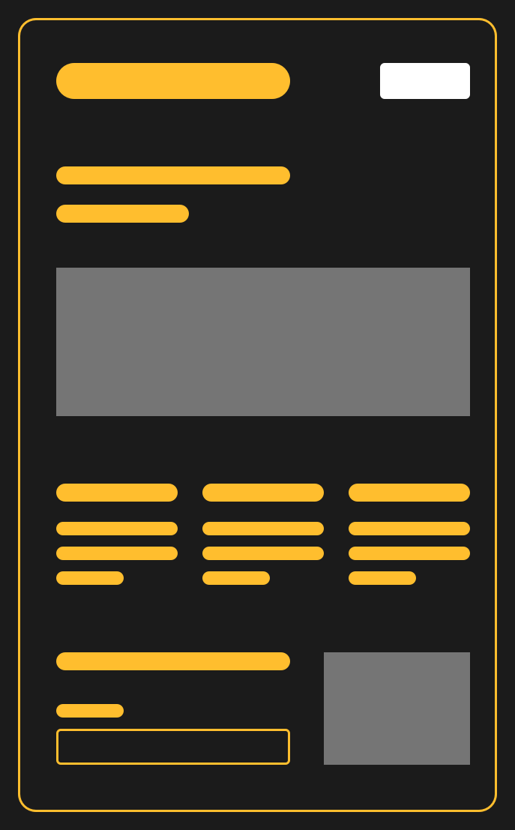
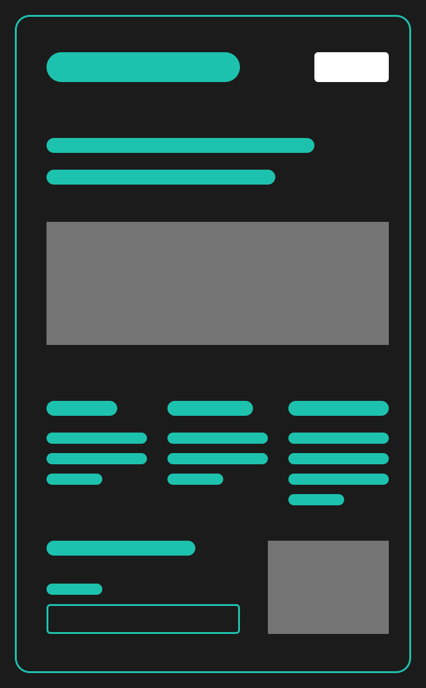
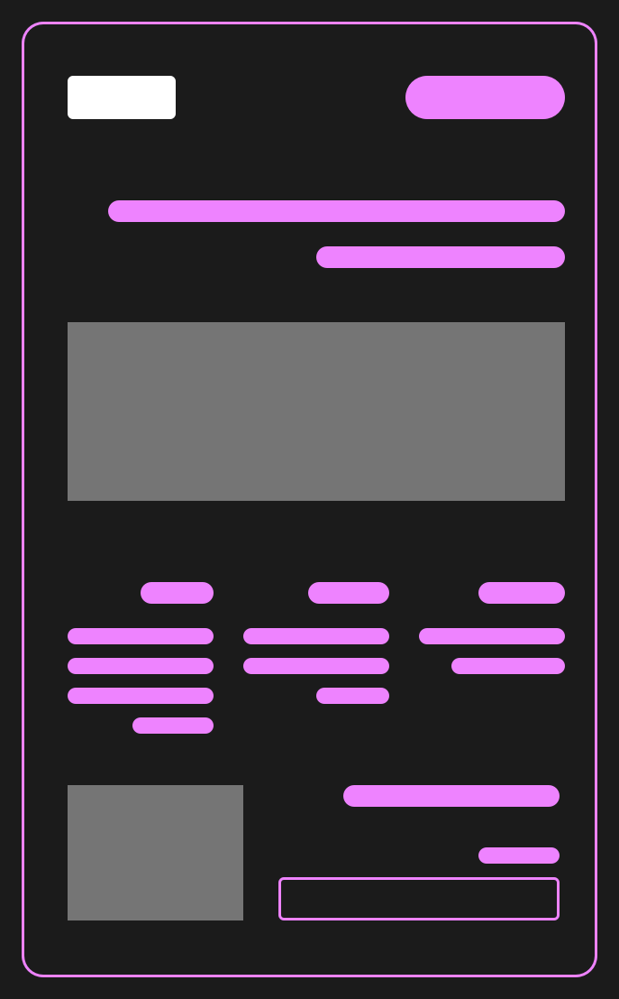
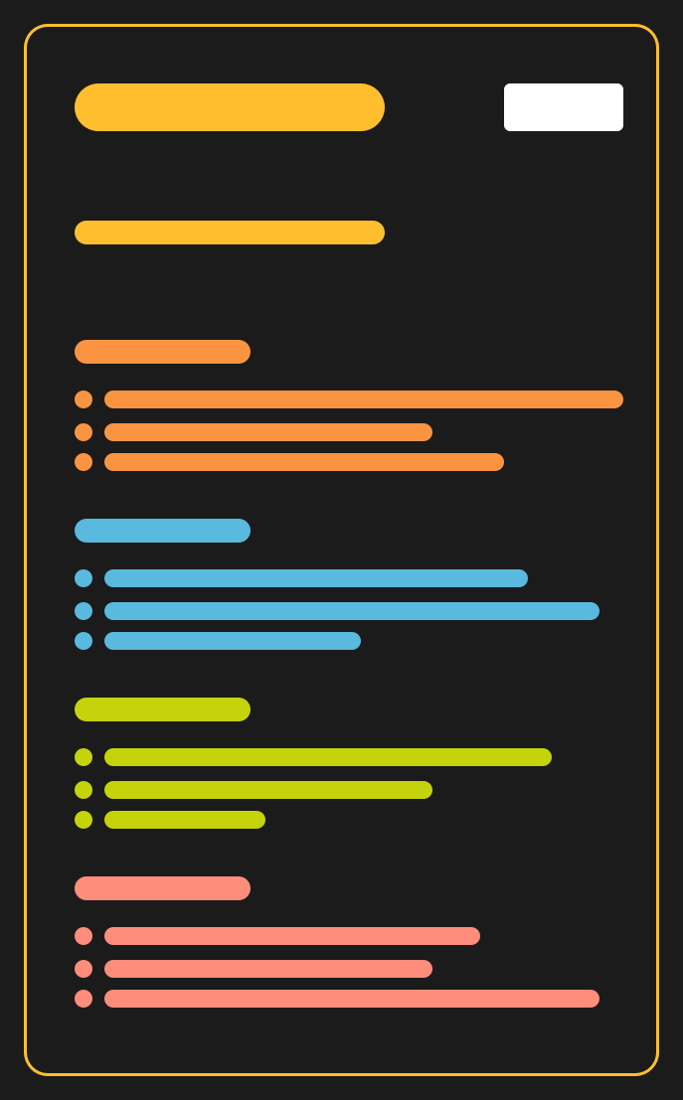



Content in multiple languages
Two languages
Three or more languages
Selected content

Slide 33
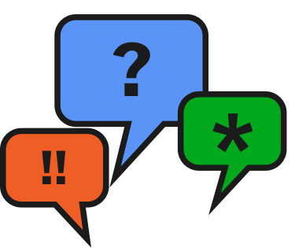
Interviews and feedback

Slide 34



Select a language pattern family
Select between two languages
Select from three or more languages
Find selected multilingual content
Indicate preferred languages

Slide 35
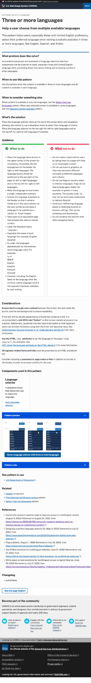
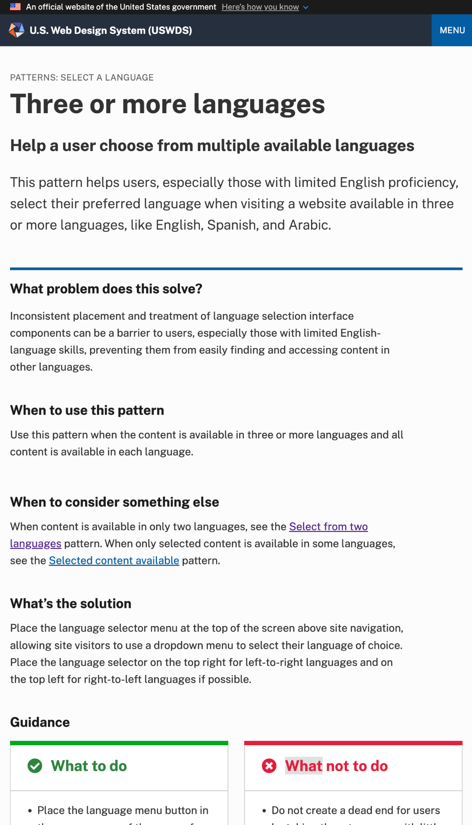
A USWDS pattern page
Patterns have guidance pages just like components

Slide 36
Introducing a pattern
The top of the page describes the pattern

Slide 37
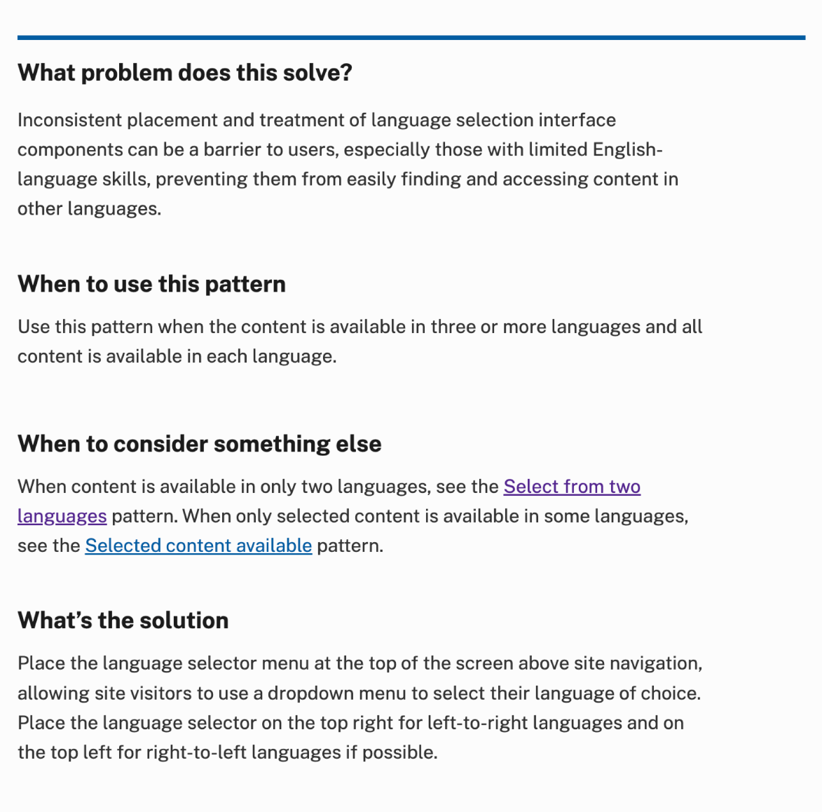
Pattern context
When a pattern applies to your website or service and how to approach its solution

Slide 38
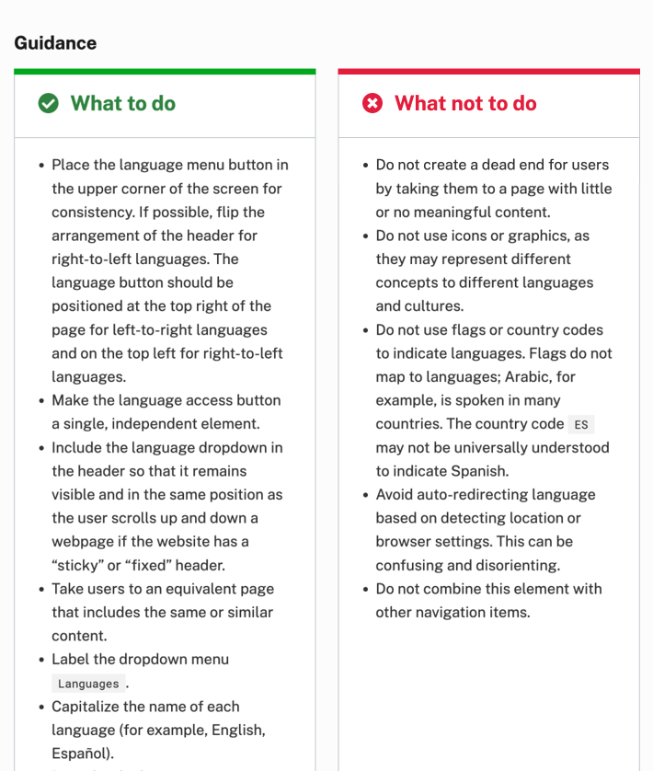
Guidance
What to do and what not to do

Slide 39
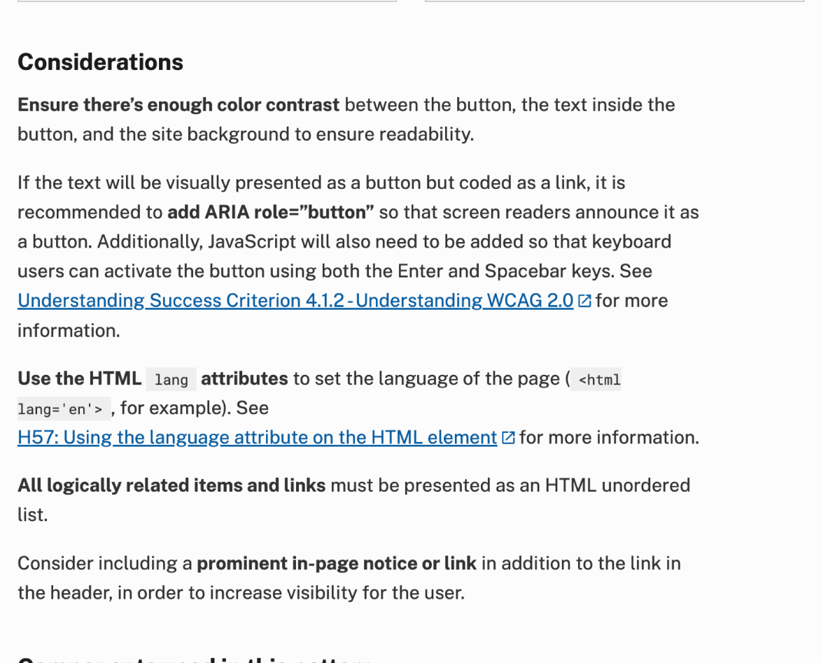
Considerations
Practical implementation details, often related to accessibility

Slide 40
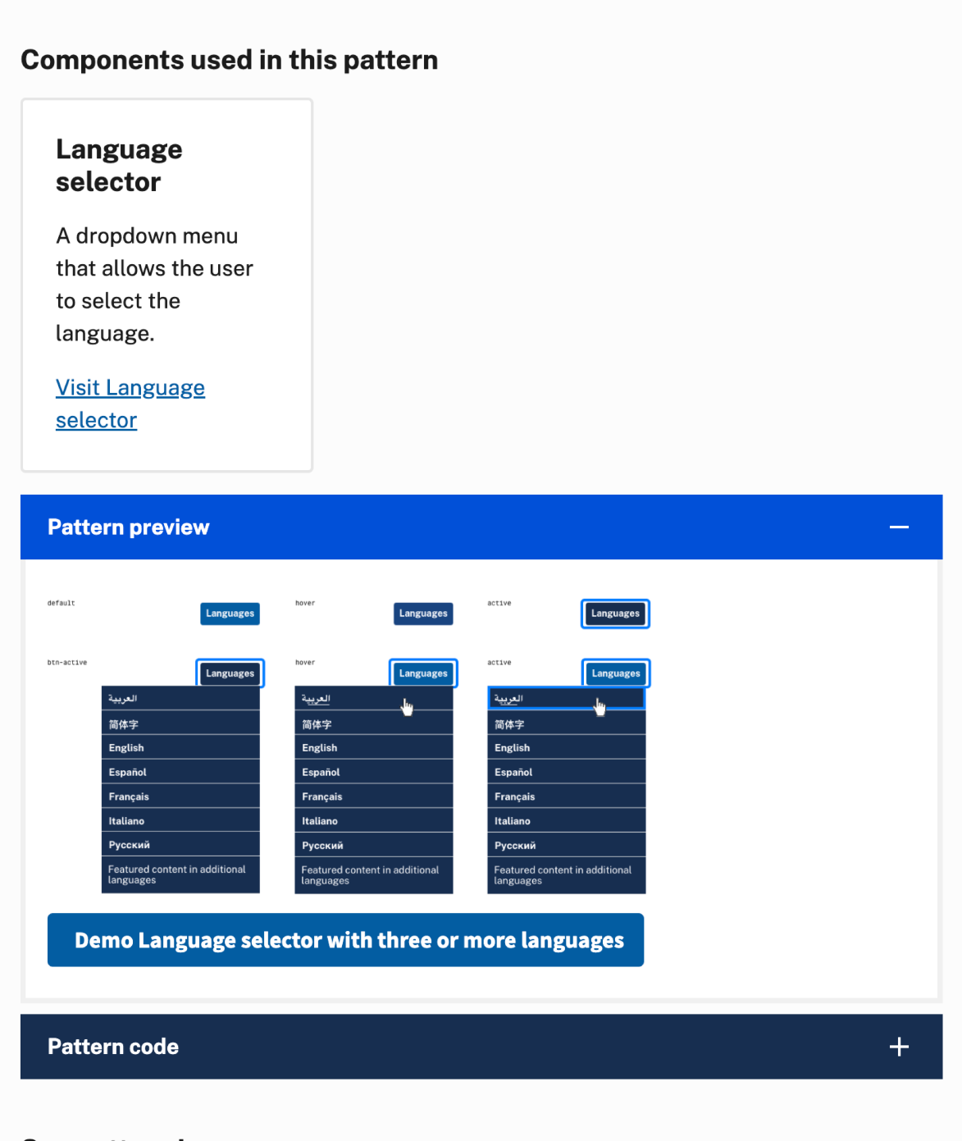
Details
USWDS components used to address the pattern and how to implement our solution in code

Slide 41
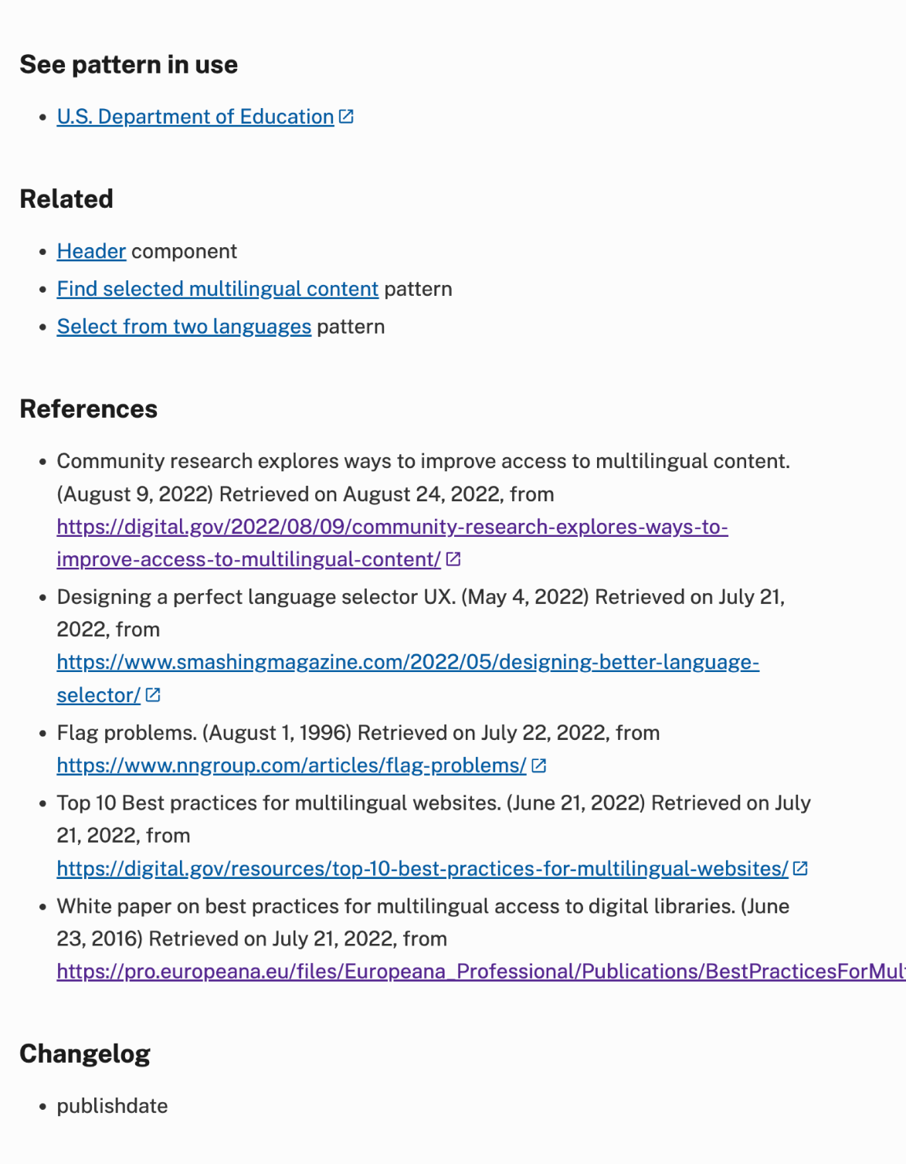
Supporting information
Other examples, related components, sources we used in addition to our direct research, and a list of any changes to the pattern page since publication

Slide 42
Selected multilingual content

Slide 43
Demo

Slide 44
What’s next?

Slide 45
Q&A

Slide 46
Next month
October: User profile patterns
#uswds-public
github.com/uswds
designsystem.digital.gov

