Slide 1
d = Pore Pressure to Slip (Failure)
f = Shear Capacity Utilization
-e = Coulomb Failure Function
e.
Frictional Slip Line
Shear Stress (τ)
f.
d.
Fault
σ₃
σ₂
σ₁
Effective Normal Stress (σ_{n}) = S_{n}-P_{p}

Slide 2
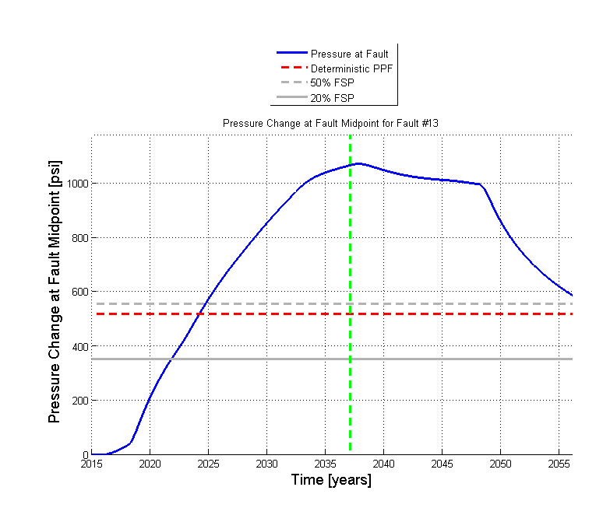
Pressure at fault midpoint curve as a function of time
Red dashed curve: deterministic pore pressure to slip
Gray dashed curve: Pore Pressure change for a 50% potential for the fault to slip
Gray solid curve: Pore Pressure change for a 20% potential for the fault to slip (FSP)

Slide 3
The source code associated with this downloadable file is a derivative work based in part on supplements to, and modifications of, a Matlab-based script originally developed by ExxonMobil Upstream Research Company. To enable broader software distribution ExxonMobil Upstream Research Company provides the opportunity to license under the open-source framework provided by The Apache Software Foundation. As of January 1, 2017, The Apache Software Foundation is a US-based membership corporation and an 501(c)(3) non-profit foundation.
Copyright 2016 ExxonMobil Upstream Research Company
Licensed under the Apache License, Version 2.0 (the "License"); you may not use this file
except in compliance with the License. You may obtain a copy of the License at
http://www.apache.org/licenses/LICENSE-2.0.
Unless required by applicable law or agreed to in writing, software distributed under the
License is distributed on an "AS IS" BASIS, WITHOUT WARRANTIES OR CONDITIONS
OF ANY KIND, either express or implied. See the License for the specific language
governing permissions and limitations under the License.
Copyright (c) 2016, Stanford University,
All rights reserved.
Redistribution and use in binary form, with or without modification, is permitted provided that the following conditions are met:
* Redistributions of code must retain the above copyright notice, this list of conditions and the following disclaimer.
* Redistributions in binary form must reproduce the above copyright notice, this list of conditions and the following disclaimer in the documentation and/or other materials provided with the distribution.
* Neither the name of Stanford University, nor the name of the Stanford Center for Induced and Triggered Seismicity, nor the names of contributors may be used to endorse or promote products derived from this software without specific prior written permission.
* If the software is used to develop scientific or technical material that is published in any peer-reviewed papers, conference abstracts or similar publications, the recipient agrees to acknowledge the Stanford Center for Induced and Triggered Seismicity in a manner consistent with industry practice.
* code is provided without support.
* The author(s) would appreciate being notified of any errors found in the supplied code by emailing: FaultSlipPotential+bugs@gmail.com
THIS SOFTWARE IS PROVIDED BY THE COPYRIGHT HOLDERS AND CONTRIBUTORS "AS IS" AND ANY EXPRESS OR IMPLIED WARRANTIES, INCLUDING, BUT NOT LIMITED TO, THE IMPLIED WARRANTIES OF MERCHANTABILITY AND FITNESS FOR A PARTICULAR PURPOSE ARE DISCLAIMED. IN NO EVENT SHALL THE COPYRIGHT OWNER OR CONTRIBUTORS BE LIABLE FOR ANY DIRECT, INDIRECT, INCIDENTAL, SPECIAL, EXEMPLARY, OR CONSEQUENTIAL DAMAGES (INCLUDING, BUT NOT LIMITED TO, PROCUREMENT OF SUBSTITUTE GOODS OR SERVICES; LOSS OF USE, DATA, OR PROFITS; MISCALCULATION OF FAULT SLIP POTENTIAL; BUSINESS LIABILITY OR BUSINESS INTERRUPTION) HOWEVER CAUSED AND ON ANY THEORY OF LIABILITY, WHETHER IN CONTRACT, STRICT LIABILITY, OR TORT (INCLUDING NEGLIGENCE OR OTHERWISE) ARISING IN ANY WAY OUT OF THE USE OF THIS SOFTWARE, EVEN IF ADVISED OF THE POSSIBILITY OF SUCH DAMAGE.

