Slide 1
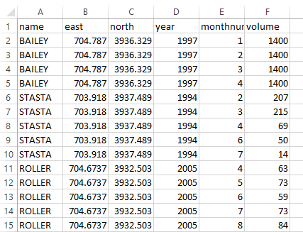
Loading Well Data into FSP
FSP is designed to take a .csv file (such as from MATLAB or excel) with the following data columns: Unique Well ID (can be any unique identifier such as API number or name), X (Easting km), y (Northing km), 4 digit year (eg. 2016), Month number (1-12), Injection Volume (oil barrels/month).
Don’t load any more or less columns than this, and make sure all entries are numbers only, except the first column, which can be any combination of letters and numbers, as long as it uniquely identifies the well.
FSP uses the MATLAB textscan and str2num functions.
FSP will throw an error if too many wells are loaded in.
You can specify the number of header lines.
Here is an example spreadsheet with 1 header line:

Slide 2
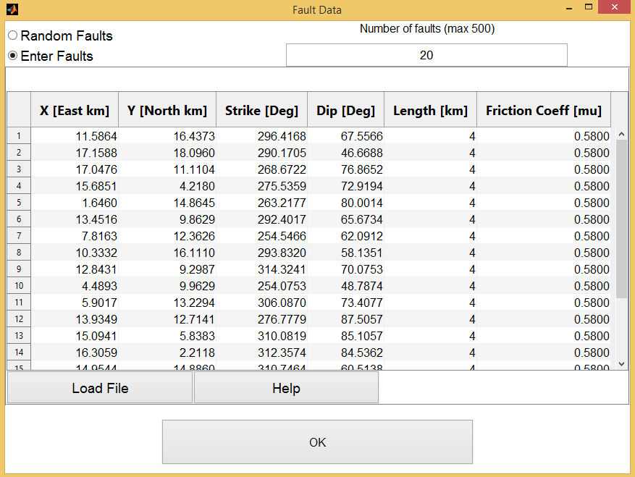
Loading Fault Data into FSP
To load fault data, FSP takes a .csv file with no letters in it, only numbers. (Unlike other tabs)
We generate them in excel or MATLAB.
It prefers you enter data for all 6 columns, if you enter more columns it will throw them out. If you enter at least 3 columns, it will make assumptions to fill in the rest.
The Maximum Fault capacity is listed.
You can also edit the table manually.

Slide 3
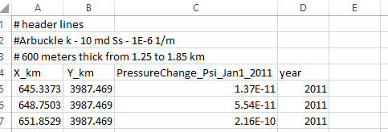
Loading Hydrology Data into FSP
To load hydrology data from an external model, FSP takes a .csv file with 4 columns of numerical data. There is no row limit, but it will be interpolated onto a 50x50 grid in FSP.
We generate .csv’s in excel or MATLAB, after exporting a layer from MODFLOW.
Column headers must be: X (easting in km), Y (Northing in km), Pressure increase from injection (in PSI), and year (4 digit integer).
FSP will assume these pressure changes are at the reference depth specified in Stress Data input.
FSP does not do decimal years, and it will take the data as January 1st, 12:01 AM in the year specified
Specify header lines so it knows where the data starts

