Slide 1


Global and Local Metrics for Network Analyses
Botond Szemes
Univeristy of Tartu, DigiTS
May 2026, Netwrok Analysis Doctoral School

Slide 2
Turn networks into numbers!
So far, networks have primarily been used as visualizations to support the interpretation of relational data.
However, for precise comparison and/or large-scale analysis, networks need to be described mathematically.
Chain of transformations (Bruno Latour): texts → edited texts → digital versions of texts → networks → numbers → etc.

Slide 3
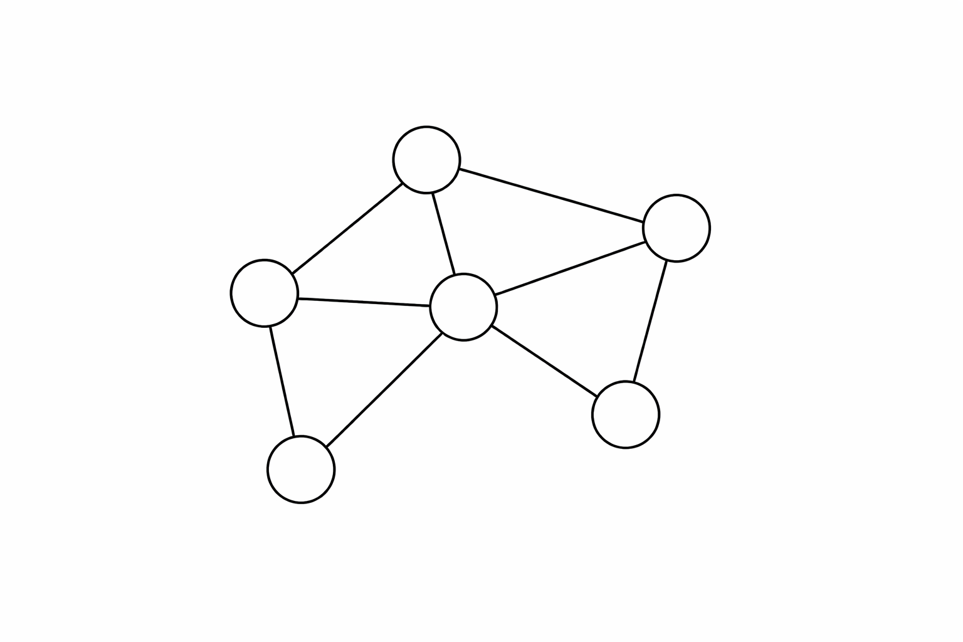
Quick Recap
Directed / undirected
Node
Edge
Path
Size: number of nodes

Slide 4
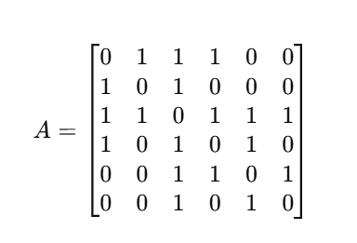
Adjacency matrix
Matrix form of a network
Much harder to read for human eye
Easier to compute
4
5
1
3
6
2

Slide 5
Chapter 1 Node-level metrics

Slide 6
Node-level metrics - Centrality Measures 1.
Degree centrality Number of connections a node has.
→ Measures immediate activity or popularity.
Node strength
Sum of weights of edges connected to the node
Scale-free networks (Barabási 1999):
node degrees follows a power law
there is no typical (average) node degree
„rich gets richer”

Slide 7
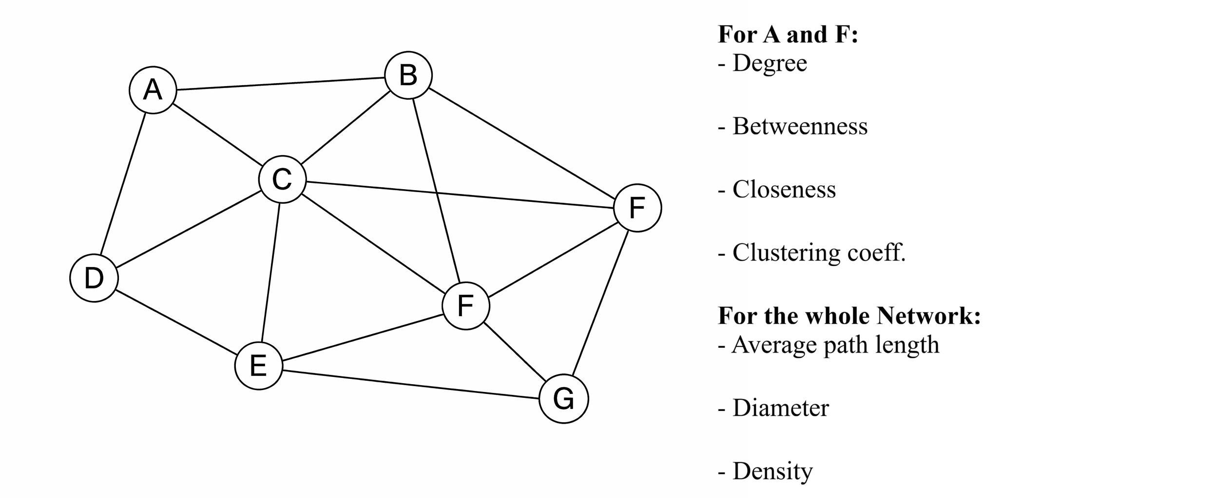

Slide 8
Node-level metrics - Centrality Measures 2.
Betweenness centrality Fraction of shortest paths that pass through a node.
→ Identifies nodes that act as bridges or brokers.
Granovetter: The strenghts of weak ties

Slide 9
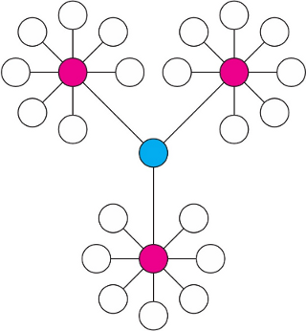
Betweenness Centrality

Slide 10
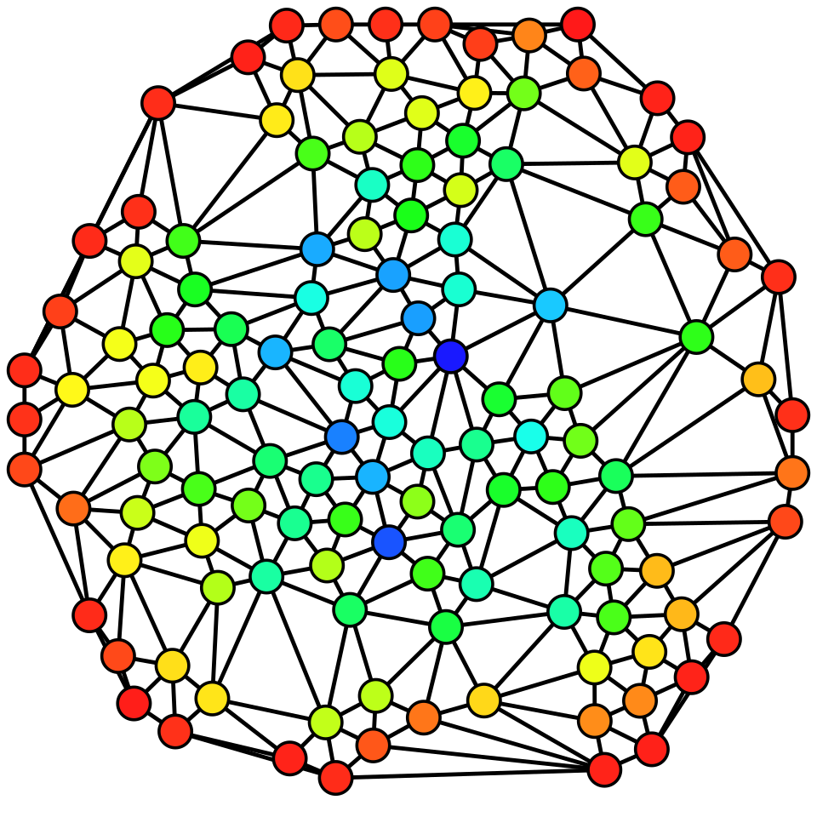

Slide 11
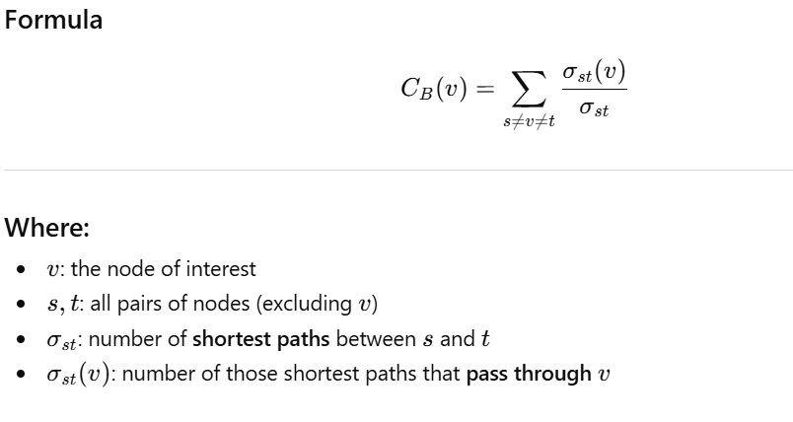

Slide 12
= 1/2

Slide 13
= 4.5

Slide 14
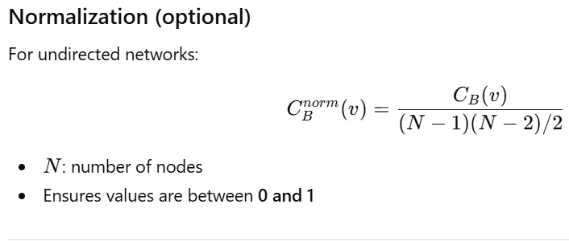

Slide 16
Node-level metrics - Centrality Measures 3.
Closeness centrality measures how close a node is to all other nodes in the network.
A node has high closeness if it can reach other nodes through relatively short paths.
→ It captures accessibility or speed of reach within the network.

Slide 17
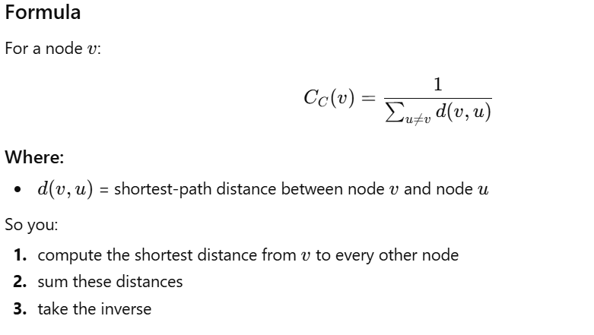

Slide 18
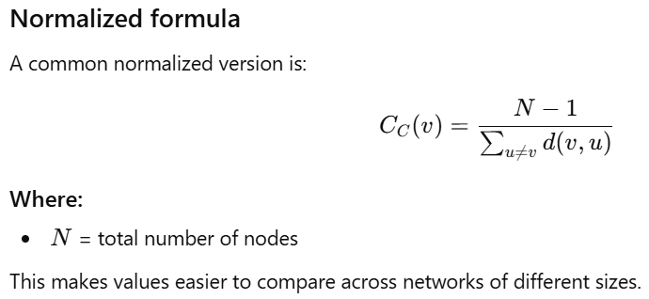

Slide 19
Distances: 1+1+1+2+2 = 7
5/7 = 0.71

Slide 22
Node-level metrics - Centrality Measures 4.
Eigenvector centrality measures how well connected a node’s neighbours
Not all connections are equal — connections to influential nodes matter more.
→ It captures importance (based on the importance of the neighbors) within the network.
Intuitive procedure:
1. Start by giving all nodes equal scores
2. Update each node’s score based on neighbors’ scores
3. Repeat until values stabilize

Slide 23
1
1
1
1
1
1

Slide 24
3
3
3
5
2
2

Slide 25
0.5
0.5
0.5
0.83
0.33
0.33

Slide 26
0.3
0.27
0.27
0.36
0.22
0.22
...
Typically 10-100 iterations

Slide 27
Node-level metrics - Centrality Measures 5.
PageRank centrality
It is a variant of eigenvector centrality, designed especially for directed networks (like the web).
Google invented
Imagine a person randomly browsing a network: PageRank measures the probability of landing on each node
Being linked by important nodes increases your score
Being linked by nodes with many outgoing links gives less value
It captures both: quality and quantity of connections
A node with few but highly ranked incoming links can outrank a node with many weak links

Slide 28
Node-level metrics 6.
Constraint measures how much a node’s connections are redundant. (Ronald Stuart Burt)
→ It captures whether a node is embedded in a tight group (high constraint) or → bridging disconnected others (low constraint)
If your neighbors are also connected to each other, your network is redundant → high constraint
If your neighbors are not connected, you bridge them → low constraint

Slide 29
Node-level metrics 7.
Clustering coefficient measures the extent to which nodes in a network tend to form triangles (closed groups).
→ It captures local cohesion: “If two of my neighbors exist, how likely are they connected?”
Whether a node is in a tight-knit group, and how redundant its connections are
Information circulates locally or between different parts of the network

Slide 30
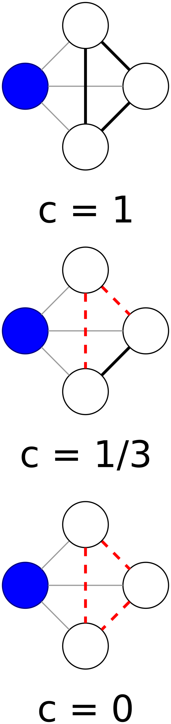

Slide 33
2/3 = 0.66
1/1 = 1
2/3 = 0.66
2/3 = 0.66
1/1 = 1
4/10 = 0.4

Slide 34
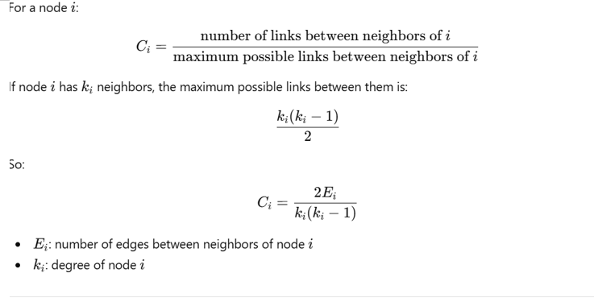

Slide 35

2*2 = 4
4/6 = 2/3
3*2 = 6

Slide 37
Chapter 2 Global metrics

Slide 38
Global metrics 1.
Average clustering coefficient Computes the clustering coefficient for each node (i.e., how interconnected its neighbors are), then takes the average across all nodes. → Reflects the typical local cohesion in the network rather than the global structure.

Slide 39
2/3 = 0.66
1/1 = 1
2/3 = 0.66
4/10 = 0.4
2/3 = 0.66
1/1 = 1
MEAN = 0.73

Slide 40
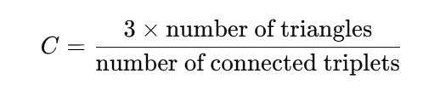
Global metrics 2.
Global clustering coefficient (transitivity) Measures the overall tendency of the network to form closed triangles. It is defined as the ratio of closed triplets (triangles) to all connected triplets in the network. → Captures how likely it is that “a friend of my friend is also my friend” at the global level.
4*3 = 12

Slide 41
All triplets: 12 + 9 = 21
Global clustering coeff:
12/21 = 0.57

Slide 42
Global metrics 3.
Connected components – number of disconnected subgraphs
Giant component size – size of the largest connected component
Number of nodes (N) – total entities in the network (6)
Number of edges (E) – total connections (9)
Diameter – longest shortest path between any two nodes (2)
Average path length (L) – average shortest path between all node pairs (1+1+1+1)+(1+1+1+1+1)+(2+2+2)+(2+2)+2
21/15 = 1.4
Global Efficiency (inverse of L)

Slide 43

Small words
High clustering (nodes form tight local groups)
Short average path lengths (any node can be reached in few steps)
Nodes are locally clustered, but globally close.
Watts–Strogatz (1998): real-world examples

Slide 44
Global metrics 4.
Average degree – average number of connections per node
2+3+3+3+2+5 = 18
18/6 = 3

Slide 46
Global metrics 5.
Density– proportion of actual edges to all possible edges
Always between 0 and 1
1 = total connectedness
E = 9
New = 6, All = 15
D = 9/15 = 0.6

Slide 47
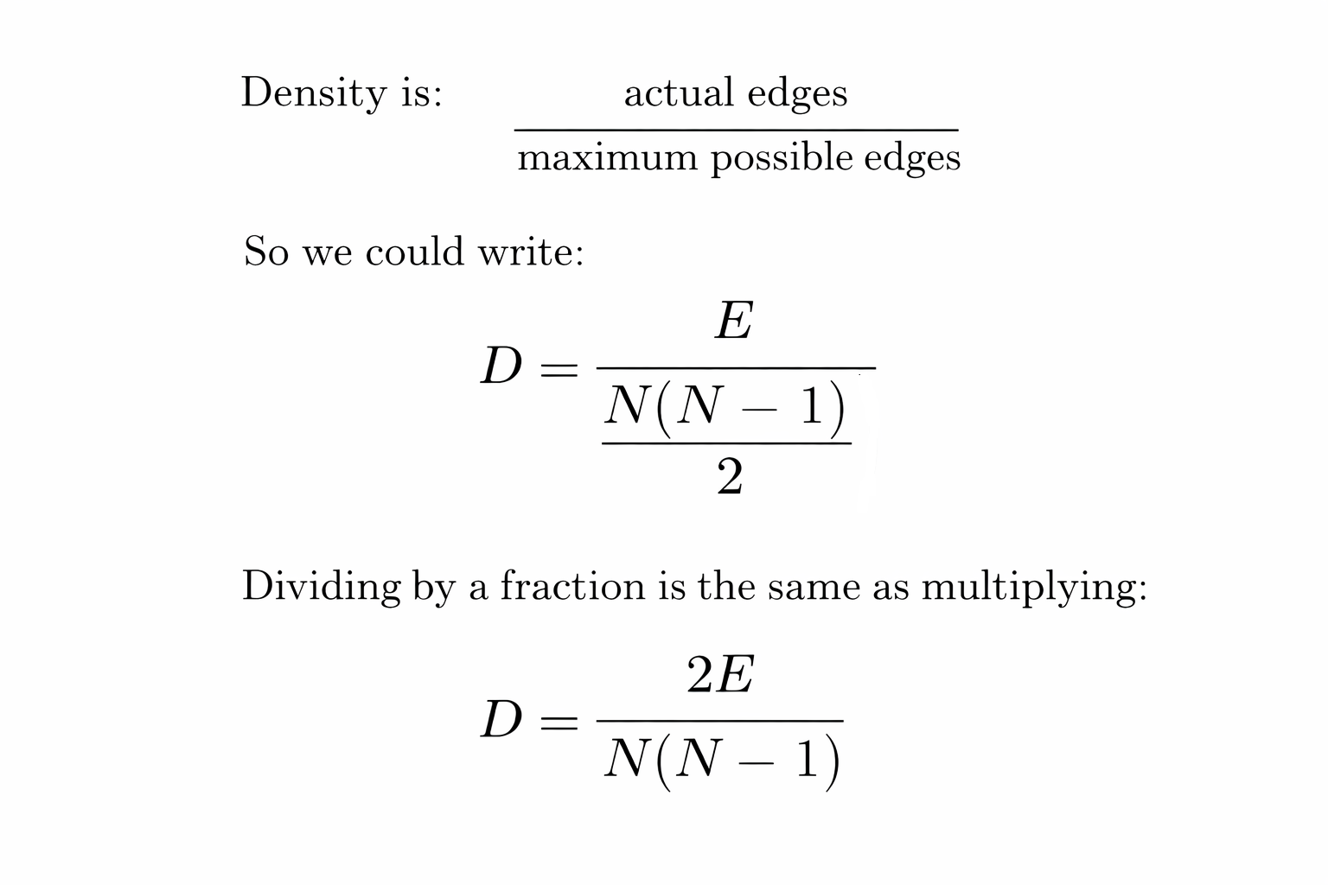
2*9 = 18
6*5 = 30
18/30 = 0.6

Slide 49
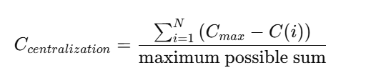
Global metrics 5.
Centralizations
Measures how much a network is dominated by a few highly central nodes, depending on the chosen centrality metric.
How equally the measures distribute

Slide 50
Global metrics 6.
Modularity Measures the strength of division of a network into communities (modules). High modularity means:
many edges within groups
relatively few edges between groups → Indicates a clear community structure or segmentation in the network.

Slide 51
Chapter 3 Let the computer compute!

Slide 52
Materials
https://colab.research.google.com/drive/1SfyNtK0UyRF4FtqwRPMEWGwcLNhQlcHm?usp=sharing
Or see R Rmd file in Github Repo
Find „network_edges.csv” also in Github Repo

