Slide 1

Setting up and operating the EFD source code
Danny Greer
5/19/2021

Slide 2
Workflow
configure.R
Set up simulations
Run simulations
Initial setup
create a simulations_[batch].csv file
only run once
contains inputs for EFD
Run on command line or in RStudio

Slide 3
configure.R
This file takes care of all initial set up steps for operating the EFD. It will only need to run once before the first use of the EFD. The whole process may take some time (~10 minutes)
Run this code file in RStudio
You will be prompted for an email associated with a google account. If you do not have one, you will need to make one before completing this step.
This is how the tool knows where to upload and access the google sheets
A file with the associated names and IDs for the new google sheets will be saved too “/EIoF_gs4_function_data/EIoF_GoogleSheet_NamesAndIDs.Rdata”. This will be need later. Another file containing the email will be saved as ”config.csv” for use later..

Slide 4
Setting up simulations
The EFD is set up to run simulations consecutively in batches from a csv file (see Figure 1).
The file will be indicated with by “simulations_” followed by a batch suffix like (e.g. “simulations_test.csv”).
You will enter the batch suffix as a command line argument when running simulations.
Outputs will be saved with this batch suffix as a distinguisher
There is one column for each input needed by the EFD
Column A specifies the region: 1 = Northwest, 2 = California, 3 = Mountain North, 4 – Southwest, 5 = Central, 6 = Texas, 7 = Midwest, 8 = AL, 9 = Mid-Atlantic, 10 = Southeast, 11 = Florida, 12 = New York, 13 = New England
Columns B-K must sum to 100
A user can specify any number of simulations they would like

Slide 5
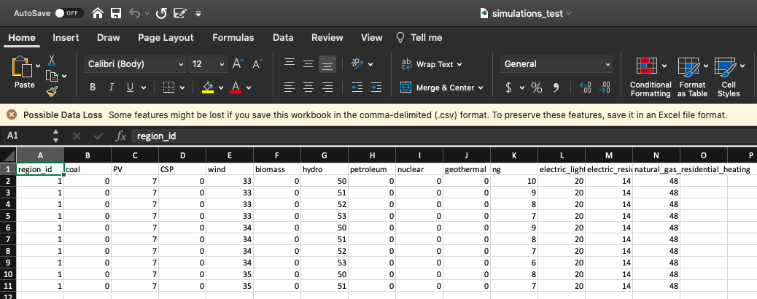
Figure1. Example “simulations_[batch suffix].csv” file

Slide 6
Running Simulations
run_scenarios.R is responsible for running simulations from the indicated simulations_[batch name].csv file
run_scenarios.R is intended to be run from the command line, but can also be run from RStudio
Running from the command line,
Use cd to get to the directory where run_scenarios.R is located
Use the following command to run the file. Commands after “-b” indicate the batch name
rscript run_scenarios.R –b test
Running from Rstudio
Comment out the line that says batch_name = opt$b and uncomment the line immediately after (see Figure 2)
If outputs for a specified simulation already exists, this simulation will be skipped

Slide 7
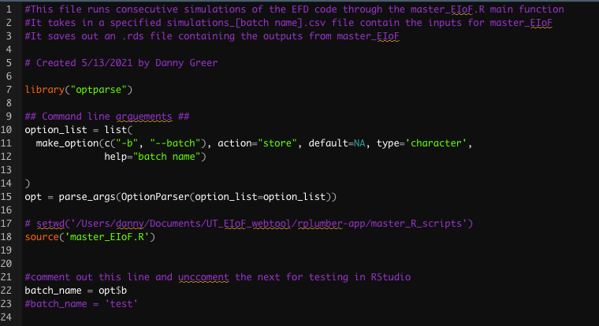

Slide 8
Outputs
Outputs are saved as a Rdata file for each simulation
This will be located in “/simulations/[batch name]”

Slide 9
Tips
You should not run simulations for the same region in parallel. This may cause a google sheet to be overwritten before the results can be pulled.
Because there is a separate google sheet for each region, simulations for different regions can be done in parallel. However, due to the read/write restrictions associated with google accounts, you should not run more than three regions in parallel or risk exceeding read/write limits and simulations not finishing.
A batch will not stop if a simulation fails. There will instead be a command line warning indicating that the simulation failed or the data could not be saved

