Slide 1
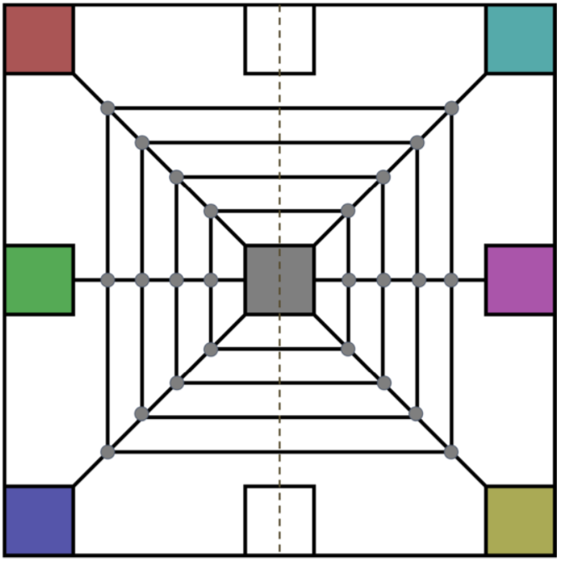
Diagonals and Drop Points

Slide 2
Reversed

Slide 3
Inward Spiral (Edges)

Slide 4
Outward Spiral (Edges)

