Slide 1
Chapter 8
Advanced SQL

Slide 2
Learning Objectives
In this chapter, the student will learn:
  How to use the advanced SQL JOIN operator syntax
  About the different types of subqueries and correlated queries
  How to use SQL functions to manipulate dates, strings, and other data
  About the relational set operators UNION, UNION ALL, INTERSECT, and MINUS

Slide 3
Learning Objectives
In this chapter, the student will learn:
  How to create and use views and updatable views
  How to create and use triggers and stored procedures
  How to create embedded SQL

Slide 4
SQL Join Operators
Relational join operation merges rows from two tables and returns rows with one of the following
  Natural join - Have common values in common columns
  Equality or inequality - Meet a given join condition
  Outer join: Have common values in common columns or have no matching values
Inner join: Only rows that meet a given criterion are selected

Slide 5
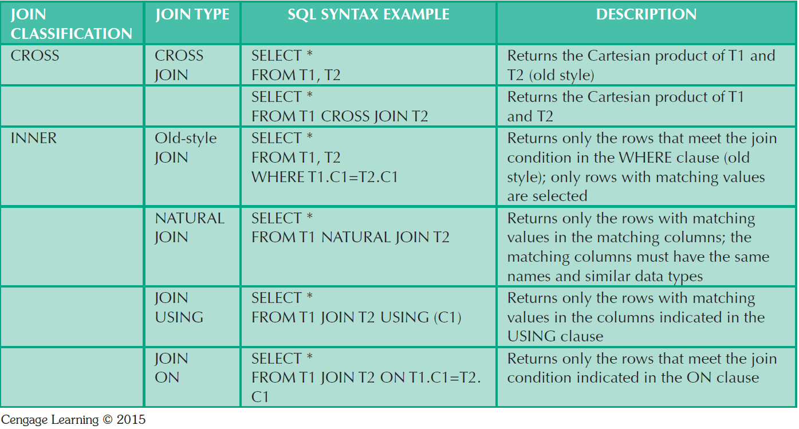
Table 8.1 - SQL Join Expression Styles

Slide 6
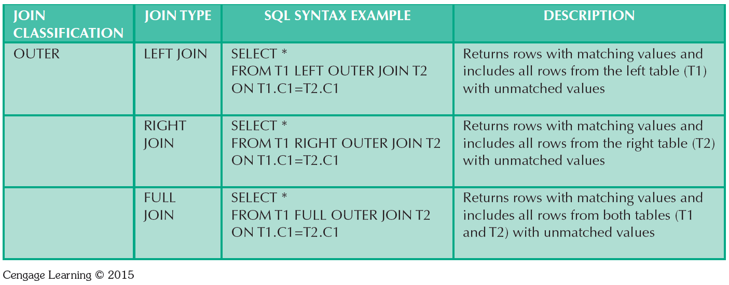
Table 8.1 - SQL Join Expression Styles

Slide 7
Subqueries and Correlated Queries
Subquery is a query inside another query
Subquery can return:
  One single value - One column and one row
  A list of values - One column and multiple rows
  A virtual table - Multicolumn, multirow set of values
  No value - Output of the outer query might result in an error or a null empty set

Slide 8
WHERE Subqueries
Uses inner SELECT subquery on the right side of a WHERE comparison expression
Value generated by the subquery must be of a comparable data type
If the query returns more than a single value, the DBMS will generate an error
Can be used in combination with joins

Slide 9
IN and HAVING Subqueries
IN subqueries
  Used to compare a single attribute to a list of values
HAVING subqueries
  HAVING clause restricts the output of a GROUP BY query by applying conditional criteria to the grouped rows

Slide 10
Multirow Subquery Operators:
ANY and ALL
ALL operator
  Allows comparison of a single value with a list of values returned by the first subquery
    Uses a comparison operator other than equals
ANY operator
  Allows comparison of a single value to a list of values and selects only the rows for which the value is greater than or less than any value in the list

Slide 11
FROM Subqueries
FROM clause:
  Specifies the tables from which the data will be drawn
  Can use SELECT subquery

Slide 12
Attribute List Subqueries
SELECT statement uses attribute list to indicate what columns to project in the resulting set
Inline subquery
  Subquery expression included in the attribute list that must return one value
Column alias cannot be used in attribute list computation if alias is defined in the same attribute list

Slide 13
Correlated Subquery
Executes once for each row in the outer query
Inner query references a column of the outer subquery
Can be used with the EXISTS special operator

Slide 14
SQL Functions
Functions always use a numerical, date, or string value
Value may be part of a command or may be an attribute located in a table
Function may appear anywhere in an SQL statement where a value or an attribute can be used

Slide 15
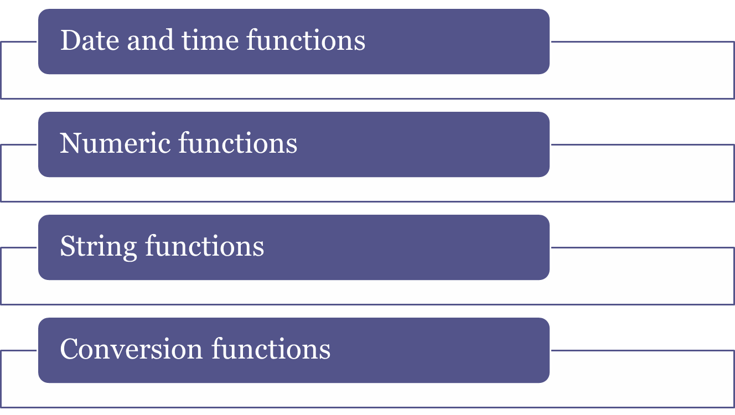
SQL Functions

Slide 16
Relational Set Operators
SQL data manipulation commands are set-oriented
  Set-oriented: Operate over entire sets of rows and columns at once
UNION, INTERSECT, and Except (MINUS) work properly when relations are union-compatible
  Union-compatible: Number of attributes are the same and their corresponding data types are alike
UNION
  Combines rows from two or more queries without including duplicate rows

Slide 17
Relational Set Operators
  Syntax - query UNION query
UNION ALL
  Produces a relation that retains duplicate rows
  Can be used to unite more than two queries
INTERSECT
  Combines rows from two queries, returning only the rows that appear in both sets
  Syntax - query INTERSECT query

Slide 18
Relational Set Operators
EXCEPT (MINUS)
  Combines rows from two queries and returns only the rows that appear in the first set
  Syntax
    query EXCEPT query
    query MINUS query
Syntax alternatives
  IN and NOT IN subqueries can be used in place of INTERSECT

Slide 19
Virtual Tables: Creating a View
View: Virtual table based on a SELECT query
Base tables: Tables on which the view is based
CREATE VIEW statement: Data definition command that stores the subquery specification in the data dictionary
  CREATE VIEW command
    CREATE VIEW viewname AS SELECT query

Slide 20
Updatable Views
Used to update attributes in any base tables used in the view
Batch update routine: Pools multiple transactions into a single batch to update a master table field in a single operation
Updatable view restrictions
  GROUP BY expressions or aggregate functions cannot be used
  Set operators cannot be used
  JOINs or group operators cannot be used

Slide 21
Oracle Sequences
Independent object in the database
Have a name and can be used anywhere a value expected
Not tied to a table or column
Generate a numeric value that can be assigned to any column in any table
Table attribute with an assigned value can be edited and modified
Can be created and deleted any time

Slide 22
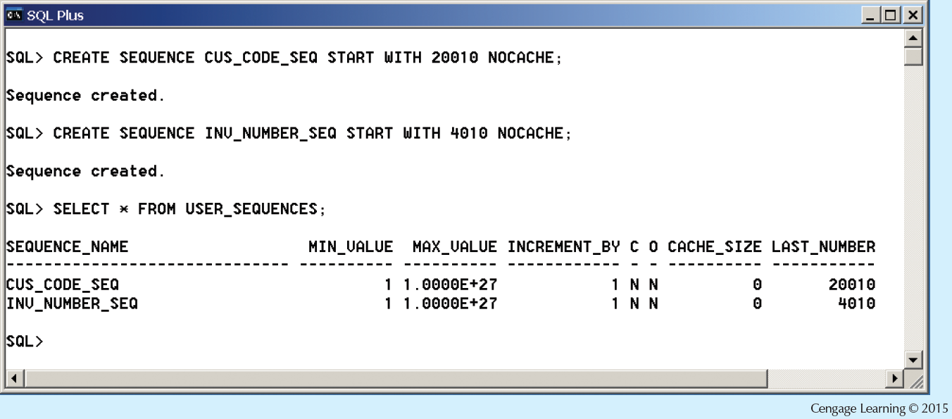
Figure 8.27 - Oracle Sequence

Slide 23
Procedural SQL
Performs a conditional or looping operation by isolating critical code and making all application programs call the shared code
  Yields better maintenance and logic control
Persistent stored module (PSM): Block of code containing:
  Standard SQL statements
  Procedural extensions that is stored and executed at the DBMS server

Slide 24
Procedural SQL
Procedural Language SQL (PL/SQL)
  Use and storage of procedural code and SQL statements within the database
  Merging of SQL and traditional programming constructs
Procedural code is executed as a unit by DBMS when invoked by end user
End users can use PL/SQL to create:
  Anonymous PL/SQL blocks and triggers
  Stored procedures and PL/SQL functions

Slide 25
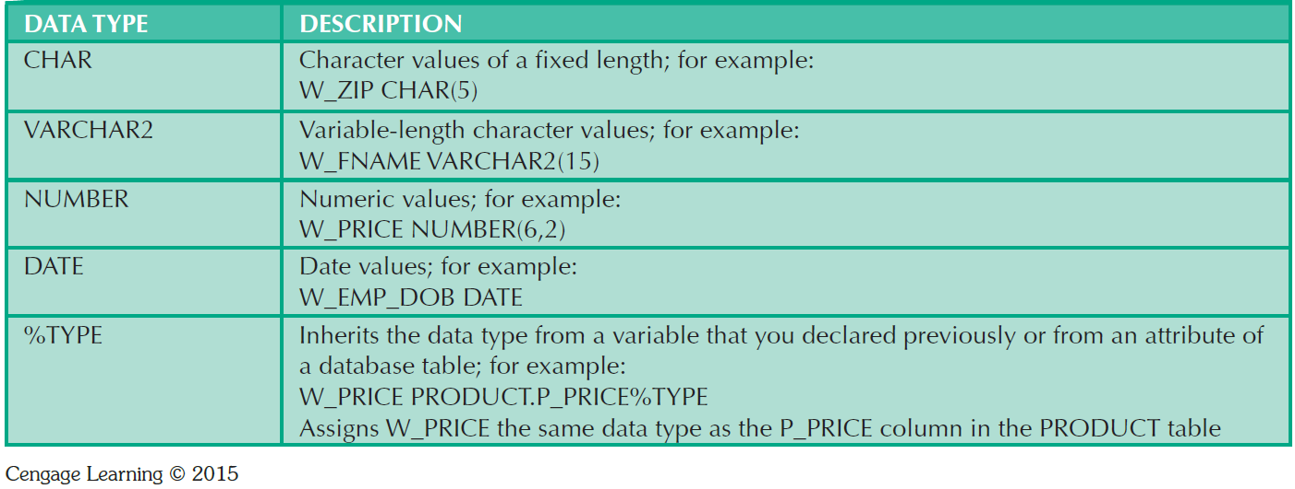
Table 8.9 - PL/SQL Basic Data Types

Slide 26
Triggers
Procedural SQL code automatically invoked by RDBMS when given data manipulation event occurs
Parts of a trigger definition
  Triggering timing - Indicates when trigger’s PL/SQL code executes
  Triggering event - Statement that causes the trigger to execute
  Triggering level - Statement- and row-level
  Triggering action - PL/SQL code enclosed between the BEGIN and END keywords

Slide 27
Triggers
DROP TRIGGER trigger_name command
  Deletes a trigger without deleting the table
Trigger action based on DML predicates
  Actions depend on the type of DML statement that fires the trigger

Slide 28
Stored Procedures
Named collection of procedural and SQL statements
Advantages
  Reduce network traffic and increase performance
  Reduce code duplication by means of code isolation and code sharing

Slide 29
PL/SQL Processing with Cursors
Cursor: Special construct used to hold data rows returned by a SQL query
Implicit cursor: Automatically created when SQL statement returns only one value
Explicit cursor: Holds the output of a SQL statement that may return two or more rows
Cursor-style processing involves retrieving data from the cursor one row at a time
  Current row is copied to PL/SQL variables

Slide 30
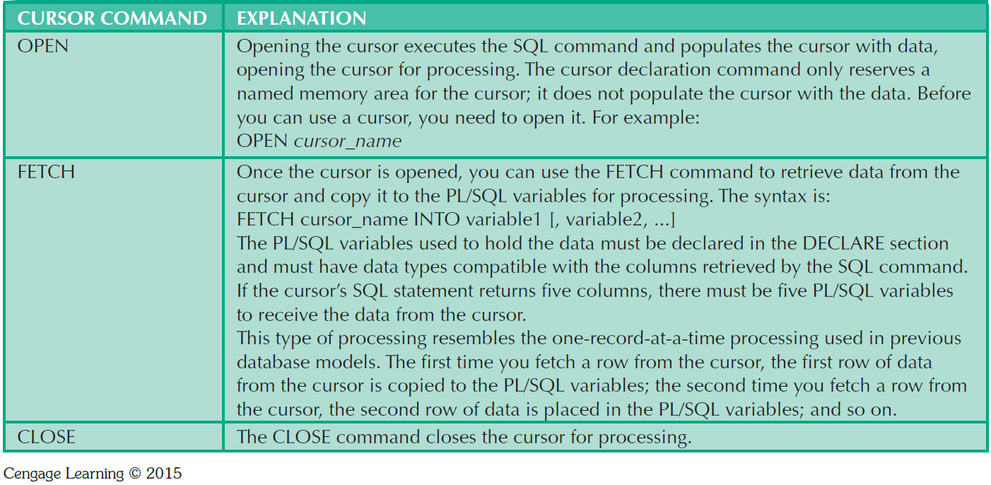
Table 8.10 - Cursor Processing Commands

Slide 31
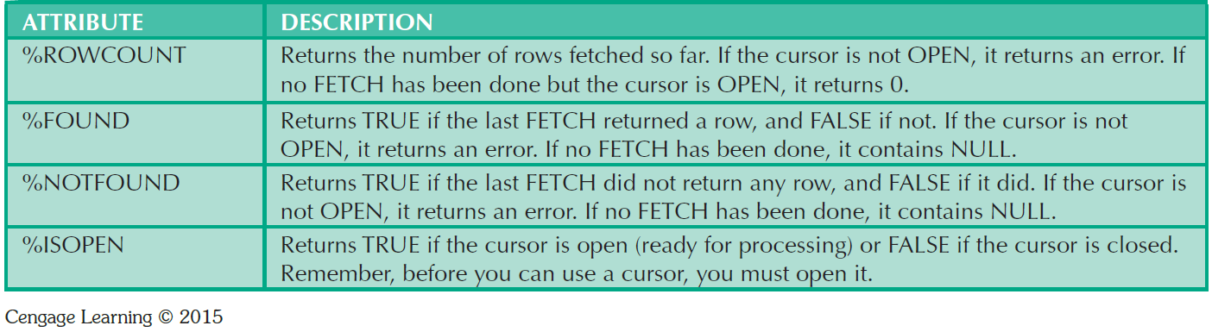
Table 8.11 - Cursor Attributes

Slide 32
PL/SQL Stored Functions
Stored function: Named group of procedural and SQL statements that returns a value
  As indicated by a RETURN statement in its program code
Can be invoked only from within stored procedures or triggers

Slide 33
Embedded SQL
SQL statements contained within an application programming language
Host language: Any language that contains embedded SQL statements
Differences between SQL and procedural languages
  Run-time mismatch
    SQL is executed one instruction at a time
    Host language runs at client side in its own memory space

Slide 34
Embedded SQL
  Processing mismatch
    Conventional programming languages process one data element at a time
    Newer programming environments manipulate data sets in a cohesive manner
  Data type mismatch
    Data types provided by SQL might not match data types used in different host languages

Slide 35
Embedded SQL
Embedded SQL framework defines:
  Standard syntax to identify embedded SQL code within the host language
  Standard syntax to identify host variables
  Communication area used to exchange status and error information between SQL and host language

Slide 36
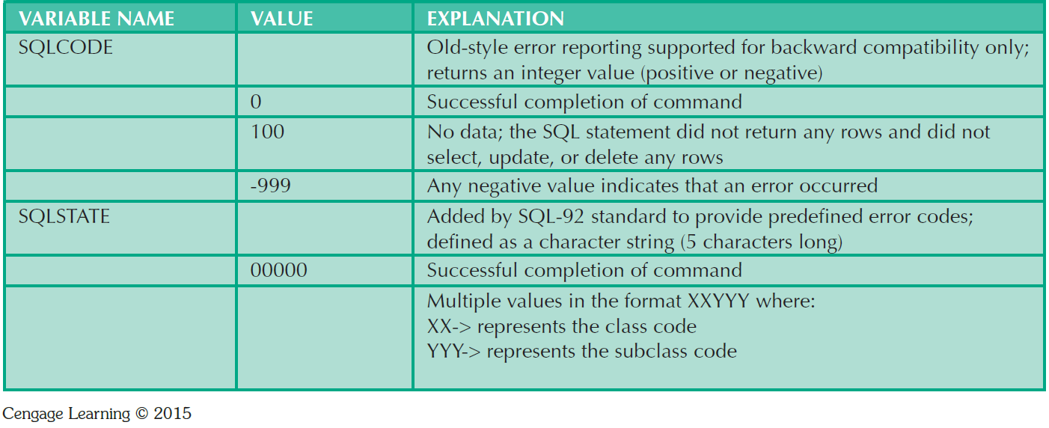
Table 8.12 - SQL Status and Error Reporting Variables

Slide 37
Embedded SQL
Static SQL: Programmer uses predefined SQL statements and parameters
  SQL statements will not change while application is running
Dynamic SQL: SQL statement is generated at run time
  Attribute list and condition are not known until end user specifies them
  Slower than static SQL
  Requires more computer resources

