Slide 1
Chapter 10
Transaction Management and Concurrency Control

Slide 2
Learning Objectives
In this chapter, students will learn:
  About database transactions and their properties
  What concurrency control is and what role it plays in maintaining the database’s integrity
  What locking methods are and how they work

Slide 3
Learning Objectives
In this chapter, students will learn:
  How stamping methods are used for concurrency control
  How optimistic methods are used for concurrency control
  How database recovery management is used to maintain database integrity

Slide 4
Transaction
Logical unit of work that must be entirely completed or aborted
Consists of:
  SELECT statement
  Series of related UPDATE statements
  Series of INSERT statements
  Combination of SELECT, UPDATE, and INSERT statements

Slide 5
Transaction
Consistent database state: All data integrity constraints are satisfied
  Must begin with the database in a known consistent state to ensure consistency
Formed by two or more database requests
  Database requests: Equivalent of a single SQL statement in an application program or transaction
Consists of a single SQL statement or a collection of related SQL statements

Slide 6
Evaluating Transaction Results
Not all transactions update database
  SQL code represents a transaction because it accesses a database
Improper or incomplete transactions can have devastating effect on database integrity
  Users can define enforceable constraints based on business rules
  Other integrity rules are automatically enforced by the DBMS

Slide 7
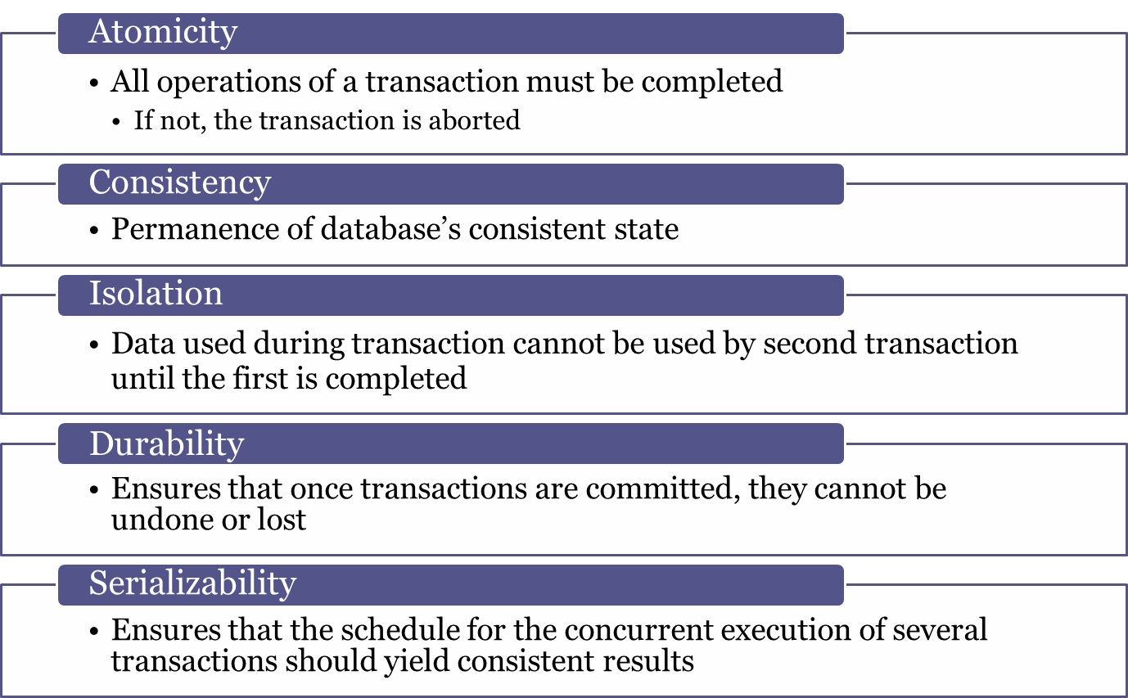
Transaction Properties

Slide 8
Transaction Management with SQL
SQL statements that provide transaction support
  COMMIT
  ROLLBACK
Transaction sequence must continue until:
  COMMIT statement is reached
  ROLLBACK statement is reached
  End of program is reached
  Program is abnormally terminated

Slide 9
Transaction Log
Keeps track of all transactions that update the database
DBMS uses the information stored in a log for:
  Recovery requirement triggered by a ROLLBACK statement
  A program’s abnormal termination
  A system failure

Slide 10
Concurrency Control
Coordination of the simultaneous transactions execution in a multiuser database system
Objective - Ensures serializability of transactions in a multiuser database environment

Slide 11
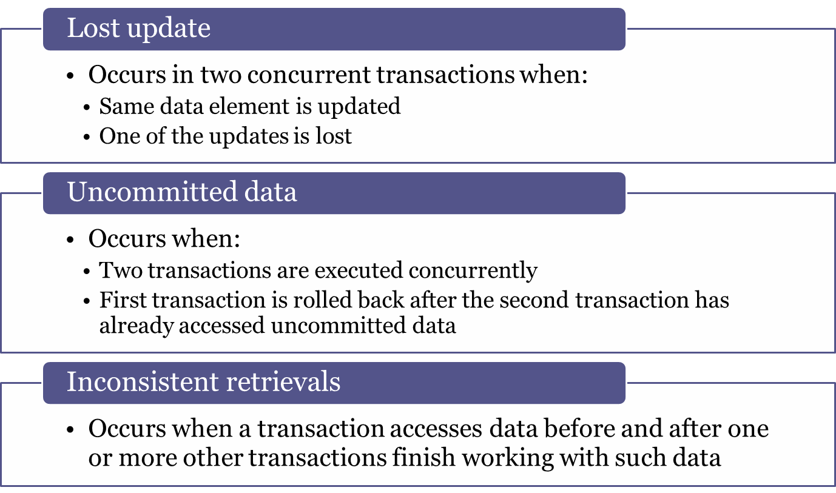
Problems in Concurrency Control

Slide 12
The Scheduler
Establishes the order in which the operations are executed within concurrent transactions
  Interleaves the execution of database operations to ensure serializability and isolation of transactions
Based on concurrent control algorithms to determine the appropriate order
Creates serialization schedule
  Serializable schedule: Interleaved execution of transactions yields the same results as the serial execution of the transactions

Slide 13
Concurrency Control with Locking Methods
Locking methods - Facilitate isolation of data items used in concurrently executing transactions
Lock: Guarantees exclusive use of a data item to a current transaction
Pessimistic locking: Use of locks based on the assumption that conflict between transactions is likely
Lock manager: Responsible for assigning and policing the locks used by the transactions

Slide 14
Lock Granularity
Indicates the level of lock use
Levels of locking
  Database-level lock
  Table-level lock
  Page-level lock
    Page or diskpage: Directly addressable section of a disk
  Row-level lock
  Field-level lock

Slide 15
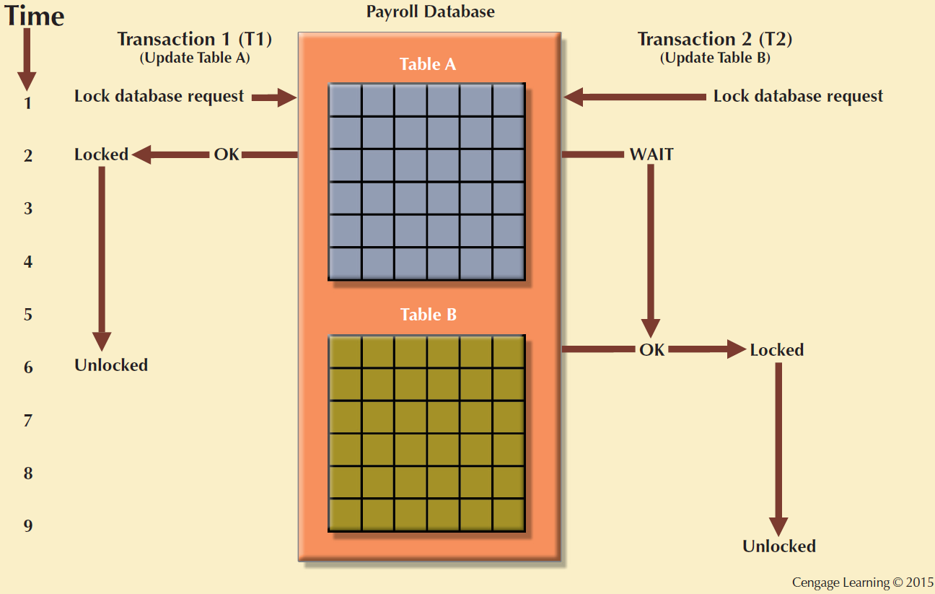
Figure 10.3 - Database-Level Locking Sequence

Slide 16
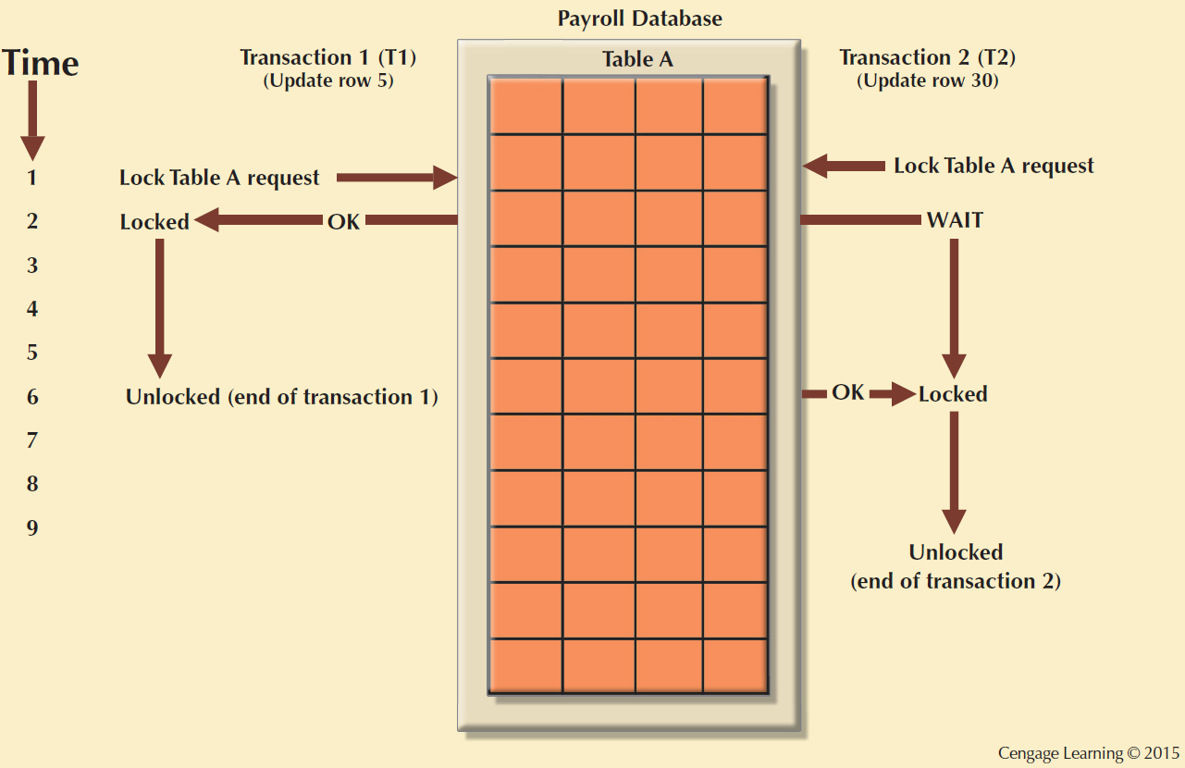
Figure 10.4 - An Example of a Table-Level Lock

Slide 17
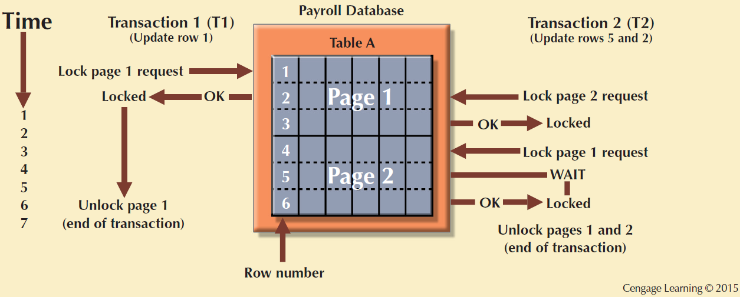
Figure 10.5 - An Example of a Page-Level Lock

Slide 18
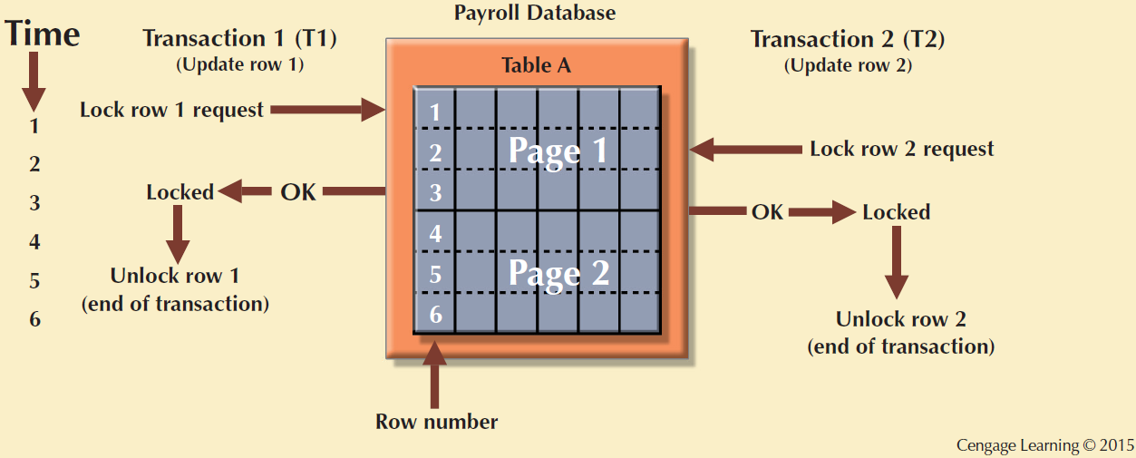
Figure 10.6 - An Example of a Row-Level Lock

Slide 19
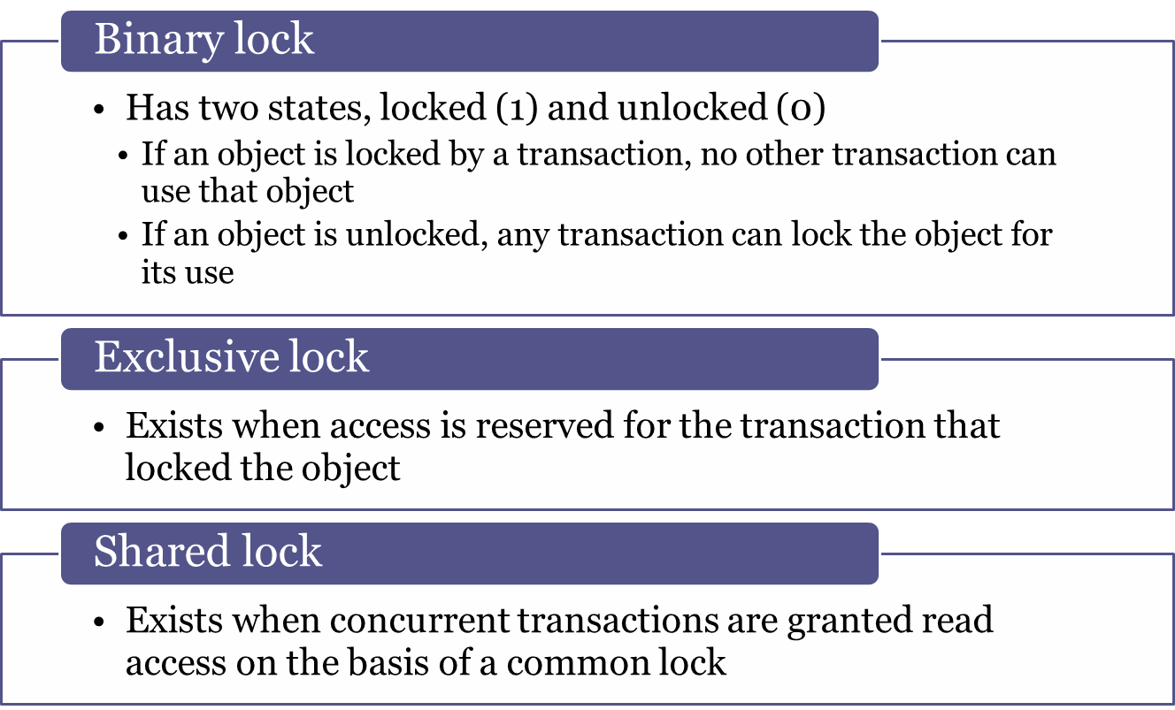
Lock Types

Slide 20
Problems in Using Locks
Resulting transaction schedule might not be serializable
Schedule might create deadlocks

Slide 21
Two-Phase Locking (2PL)
Defines how transactions acquire and relinquish locks
Guarantees serializability but does not prevent deadlocks
Phases
  Growing phase - Transaction acquires all required locks without unlocking any data
  Shrinking phase - Transaction releases all locks and cannot obtain any new lock

Slide 22
Two-Phase Locking (2PL)
Governing rules
  Two transactions cannot have conflicting locks
  No unlock operation can precede a lock operation in the same transaction
  No data are affected until all locks are obtained

Slide 23
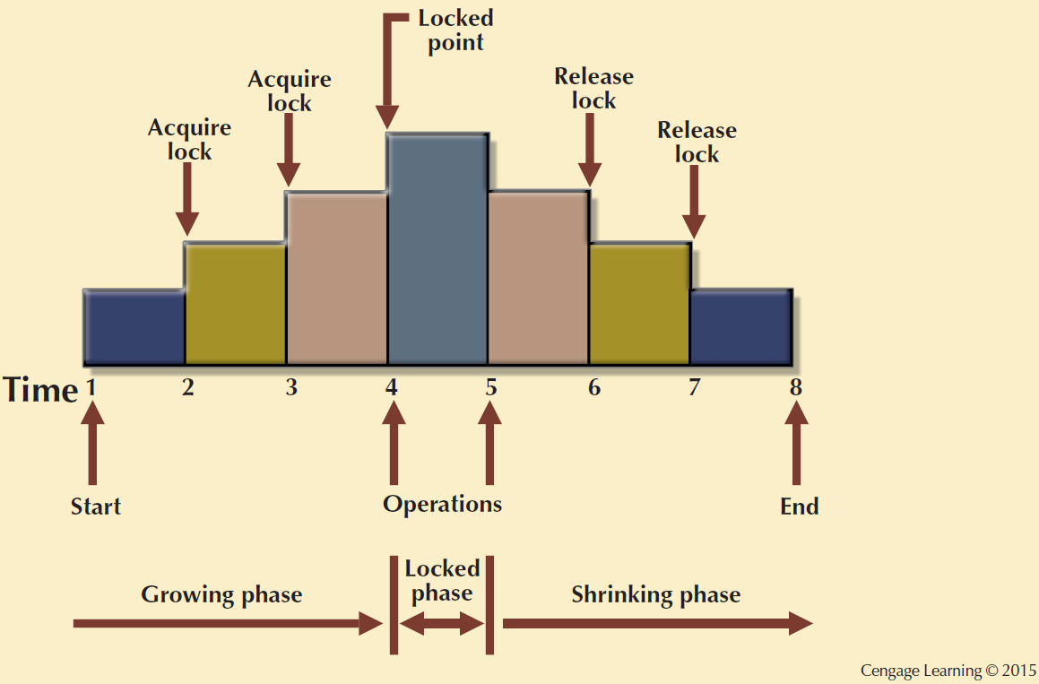
Figure 10.7 - Two-Phase Locking Protocol

Slide 24
Deadlocks
Occurs when two transactions wait indefinitely for each other to unlock data
  Known as deadly embrace
Control techniques
  Deadlock prevention
  Deadlock detection
  Deadlock avoidance
Choice of deadlock control method depends on database environment

Slide 25
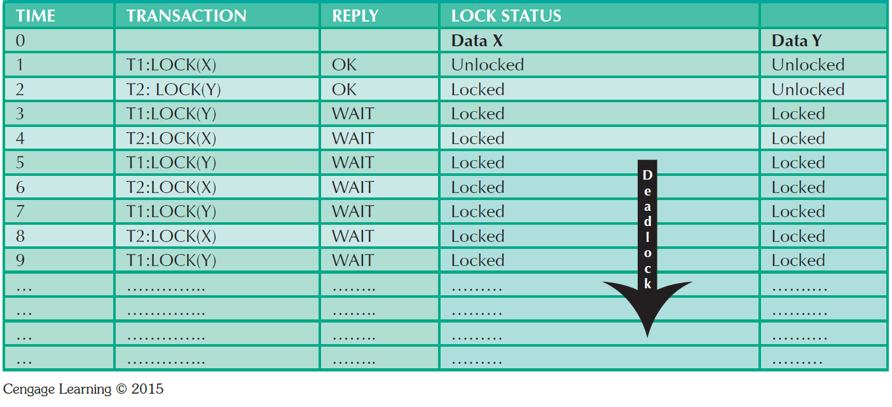
Table 10.13 - How a Deadlock Condition is Created

Slide 26
Time Stamping
Assigns global, unique time stamp to each transaction
  Produces explicit order in which transactions are submitted to DBMS
Properties
  Uniqueness: Ensures no equal time stamp values exist
  Monotonicity: Ensures time stamp values always increases

Slide 27
Time Stamping
Disadvantages
  Each value stored in the database requires two additional stamp fields
  Increases memory needs
  Increases the database’s processing overhead
  Demands a lot of system resources

Slide 28
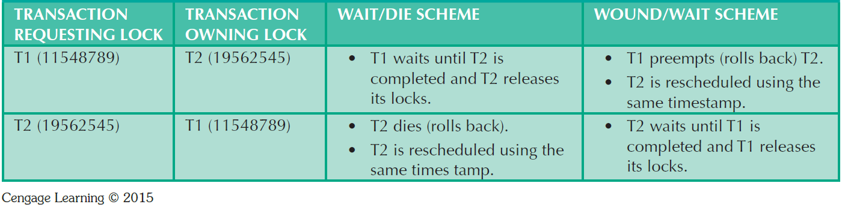
Table 10.14 - Wait/Die and Wound/Wait Concurrency Control Schemes

Slide 29
Concurrency Control with Optimistic Methods
Optimistic approach: Based on the assumption that the majority of database operations do not conflict
  Does not require locking or time stamping techniques
  Transaction is executed without restrictions until it is committed

Slide 30
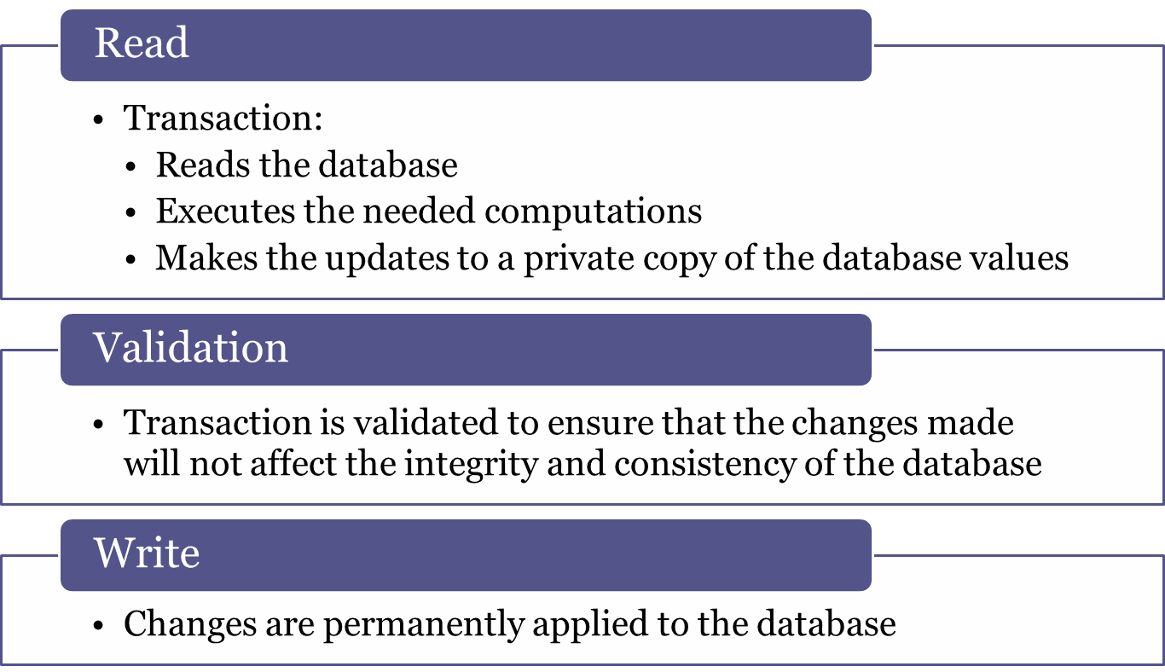
Phases of Optimistic Approach

Slide 31
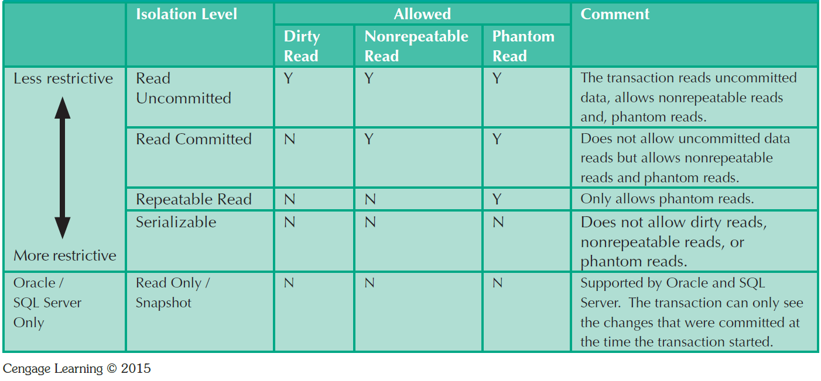
Table 10.15 - Transaction Isolation Levels

Slide 32
Database Recovery Management
Database recovery: Restores database from a given state to a previously consistent state
Recovery transactions are based on the atomic transaction property
  Atomic transaction property: All portions of a transaction must be treated as a single logical unit of work
    If transaction operation cannot be completed:
      Transaction must be aborted
      Changes to database must be rolled back

Slide 33
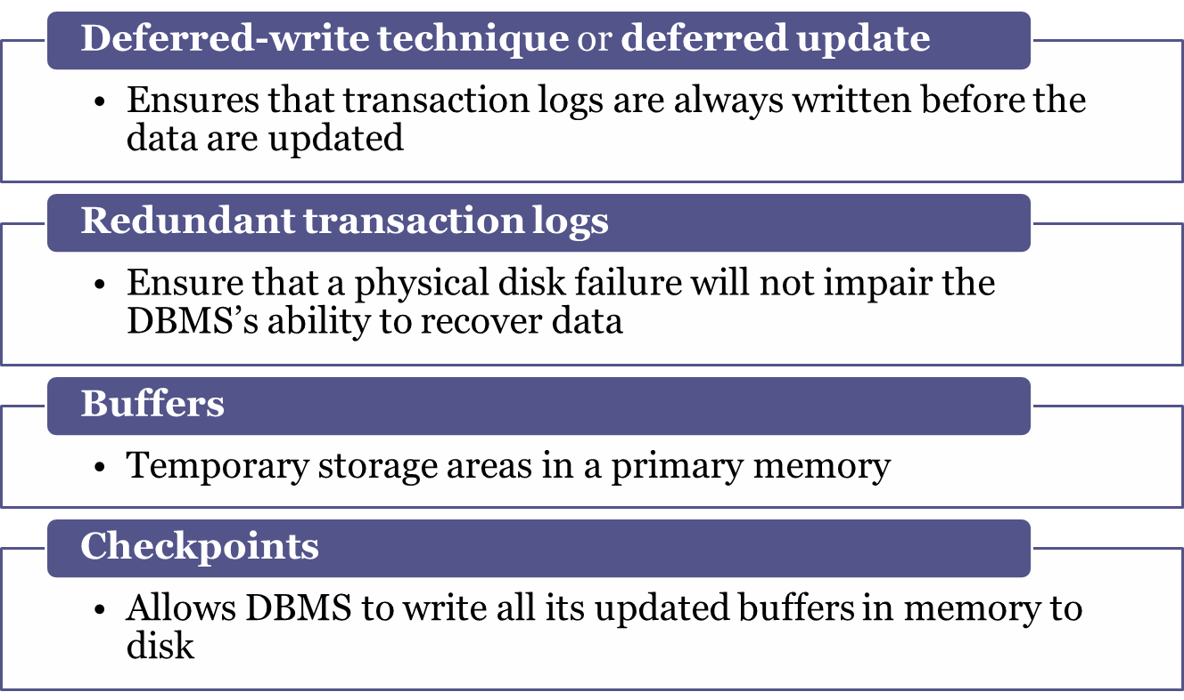
Concepts that Affect Transaction Recovery

Slide 34
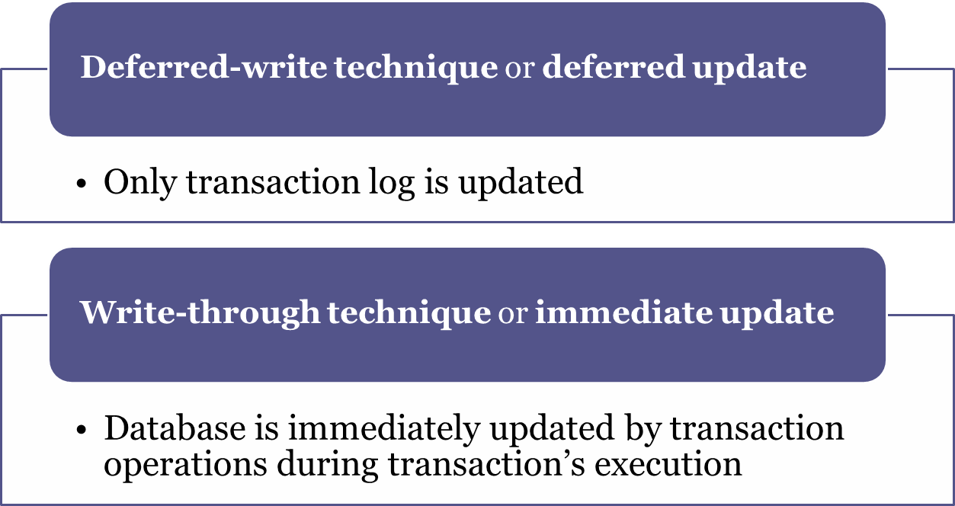
Techniques used in Transaction Recovery Procedures

Slide 35
Recovery Process in Deferred-Write Technique
Identify the last check point in the transaction log
If transaction was committed before the last check point
  Nothing needs to be done
If transaction was committed after the last check point
  Transaction log is used to redo the transaction
If transaction had a ROLLBACK operation after the last check point
  Nothing needs to be done

Slide 36
Recovery Process in Write-Through Technique
Identify the last checkpoint in the transaction log
If transaction was committed before the last check point
  Nothing needs to be done
If transaction was committed after the last checkpoint
  Transaction must be redone
If transaction had a ROLLBACK operation after the last check point
  Transaction log is used to ROLLBACK the operations

