Slide 1
Chapter 12
Distributed Database Management Systems

Slide 2
Learning Objectives
In this chapter, the student will learn:
  About distributed database management systems (DDBMSs) and their components
  How database implementation is affected by different levels of data and process distribution
  How transactions are managed in a distributed database environment

Slide 3
Learning Objectives
In this chapter, the student will learn:
  How distributed database design draws on data partitioning and replication to balance performance, scalability, and availability
  About the trade-offs of implementing a distributed data system

Slide 4
Evolution Database Management Systems
Distributed database management system (DDBMS): Governs storage and processing of logically related data over interconnected computer systems
  Data and processing functions are distributed among several sites
Centralized database management system
  Required that corporate data be stored in a single central site
  Data access provided through dumb terminals

Slide 5
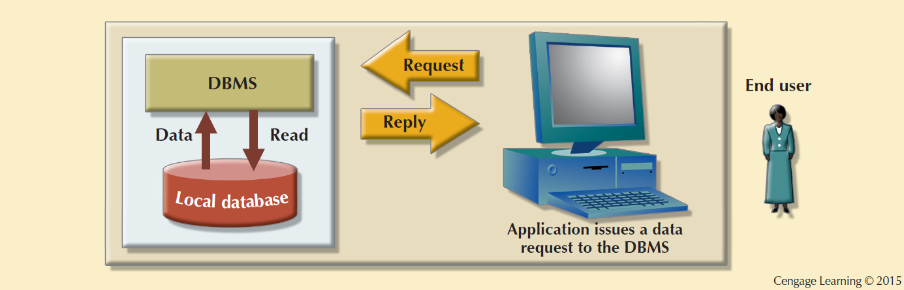
Figure 12.1 - Centralized Database Management System

Slide 6
Factors Affecting the Centralized Database Systems
Globalization of business operation
Advancement of web-based services
Rapid growth of social and network technologies
Digitization resulting in multiple types of data
Innovative business intelligence through analysis of data

Slide 7
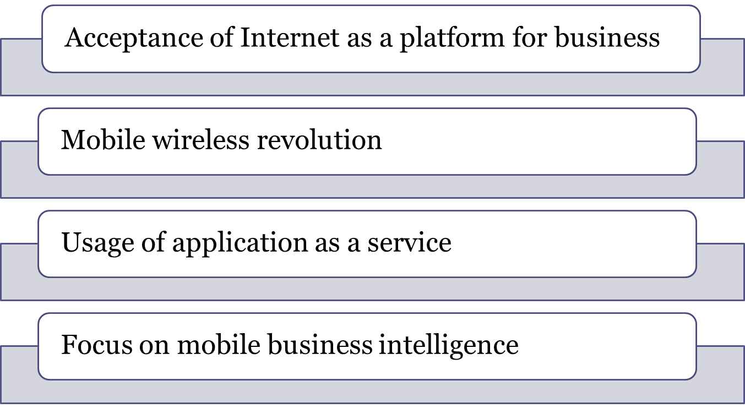
Factors That Aided DDBMS to Cope With Technological Advancement

Slide 8
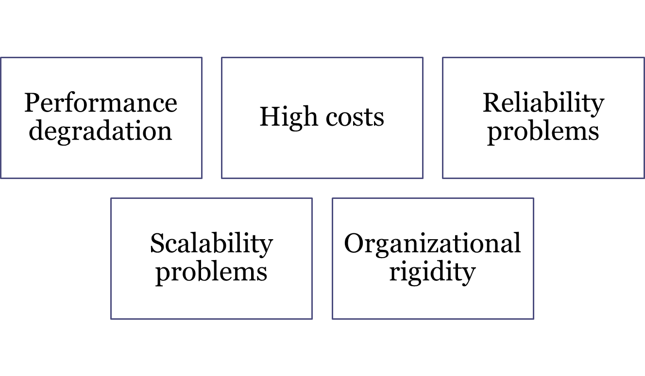
Desirability of Distributed DBMS Over Centralized DBMS

Slide 9
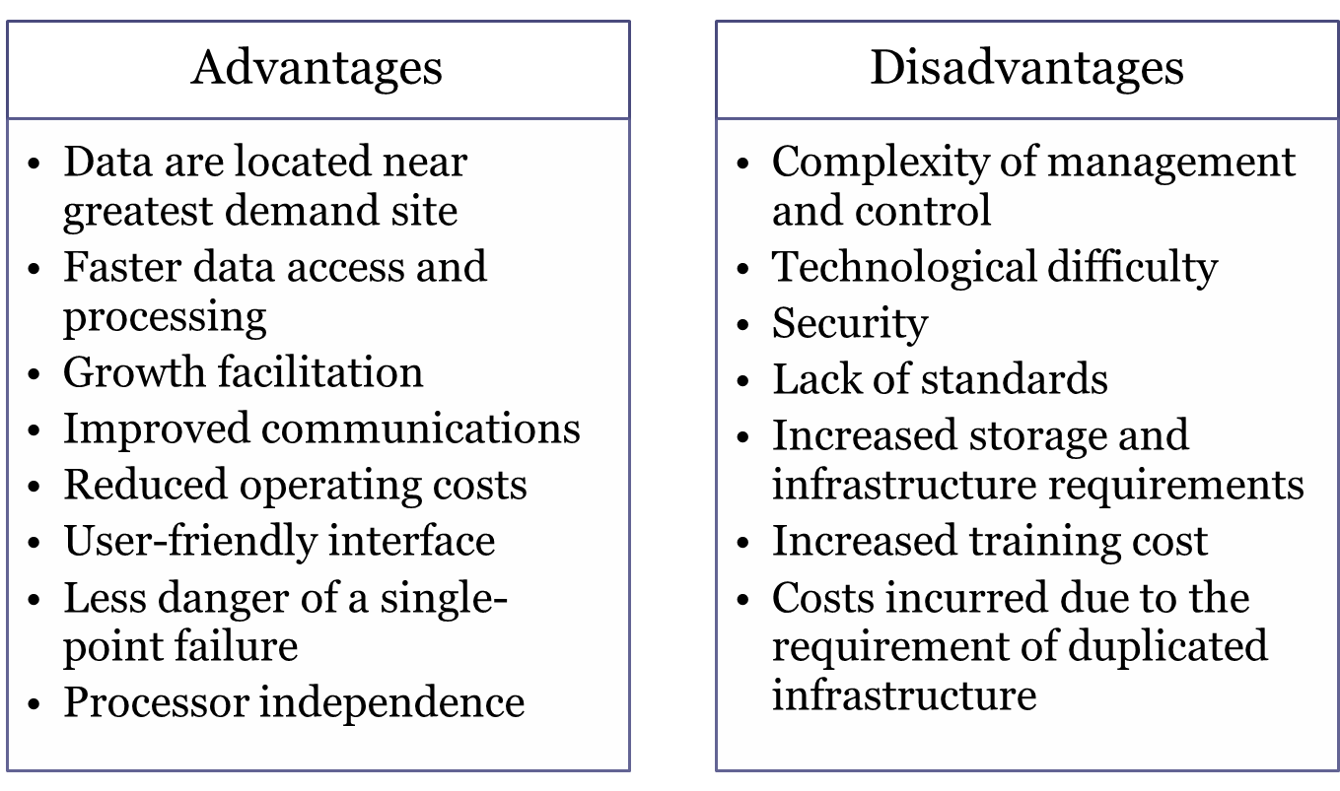
Advantages and Disadvantages of DDBMS

Slide 10
Distributed Processing and Distributed Databases
Distributed processing: Database’s logical processing is shared among two or more physically independent sites via network
  Distributed database: Stores logically related database over two or more physically independent sites via computer network
  Database fragments: Database composed of many parts in distributed database system

Slide 11
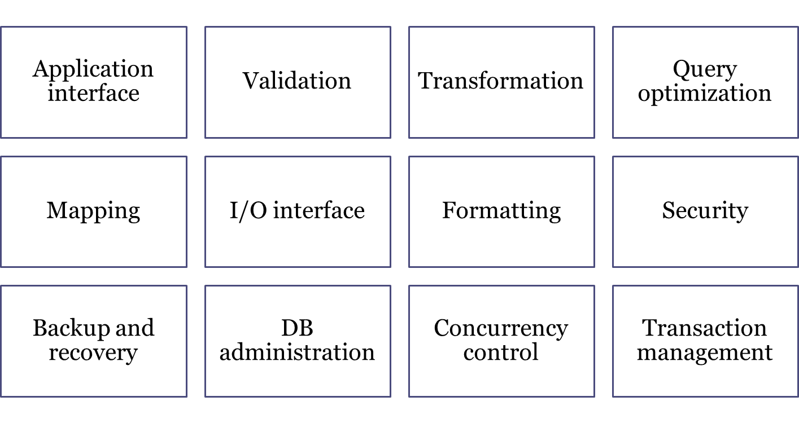
Characteristics of Distributed Management Systems

Slide 12
Functions of Distributed DBMS
Receives the request of an application
Validates analyzes, and decomposes the request
Maps the request
Decomposes request into several I/O operations
Searches and validates data
Ensures consistency, security, and integrity
Validates data for specific conditions
Presents data in required format

Slide 13
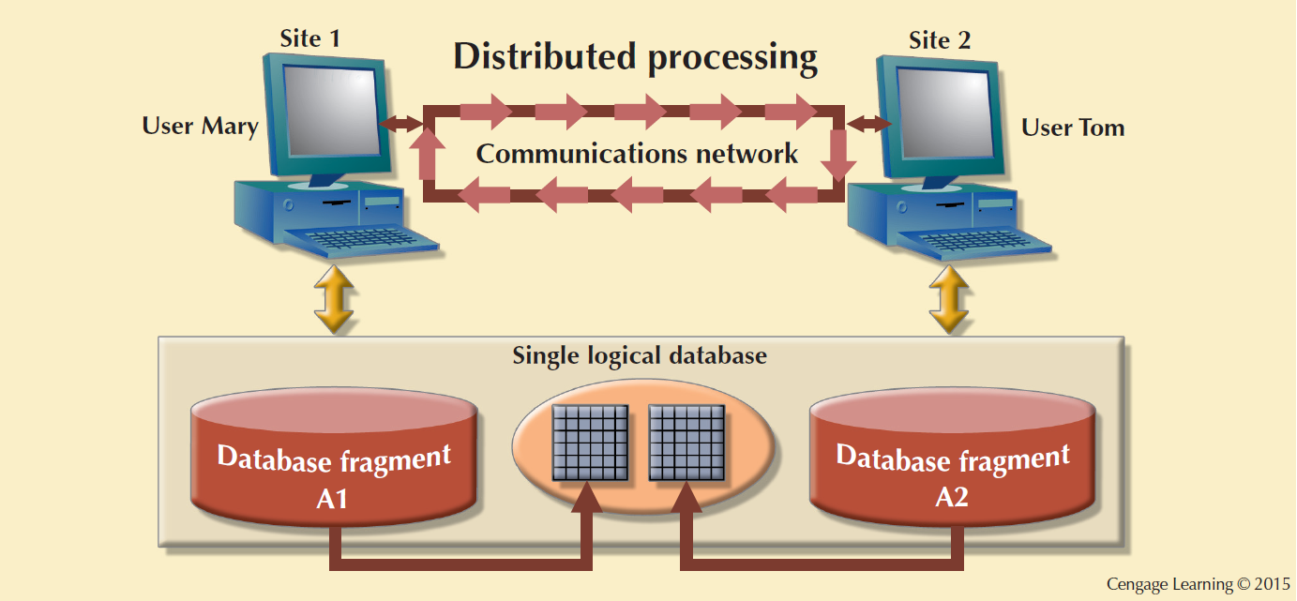
Figure 12.4 - A Fully Distributed Database Management System

Slide 14
DDBMS Components
Computer workstations or remote devices
Network hardware and software components
Communications media
  Transaction processor (TP): Software component of a system that requests data
  Known as transaction manager (TM) or application processor (AP)
Data processor (DP) or data manager (DM)
  Software component on a system that stores and retrieves data from its location

Slide 15
Single-Site Processing, Single-Site Data (SPSD)
Processing is done on a single host computer
Data stored on host computer’s local disk
Processing restricted on end user’s side
DBMS is accessed by dumb terminals

Slide 16
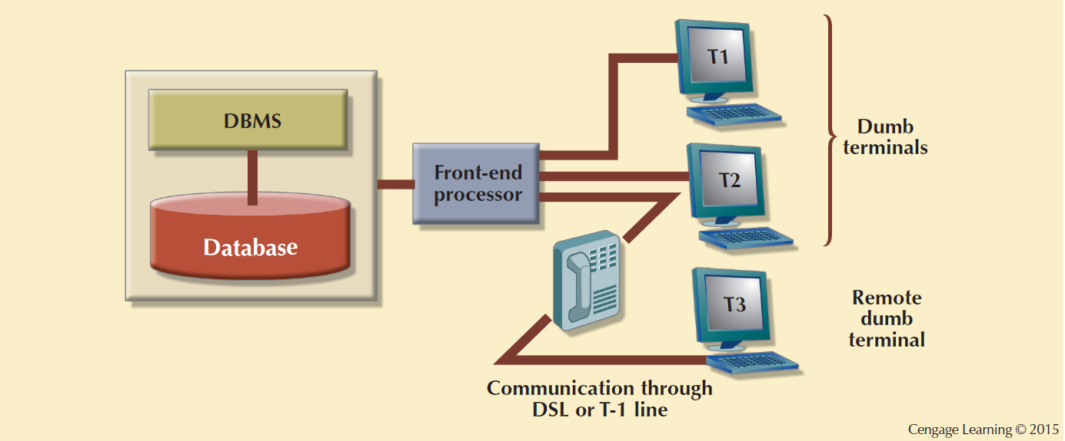
Figure 12.6 - Single-Site Processing, Single-Site Data (Centralized)

Slide 17
Multiple-Site Processing, Single-Site Data (MPSD)
Multiple processes run on different computers sharing a single data repository
Require network file server running conventional applications
  Accessed through LAN
Client/server architecture
  Reduces network traffic
  Processing is distributed
  Supports data at multiple sites

Slide 18
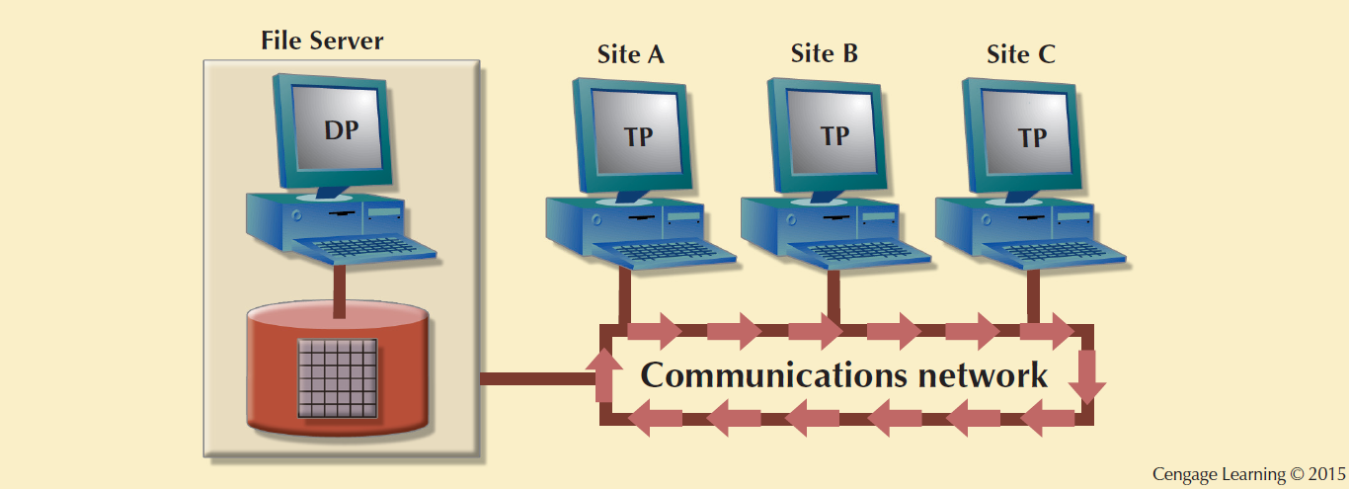
Figure 12.7 - Multiple-Site Processing, Single-Site Data

Slide 19
Multiple-Site Processing, Single-Site Data (MPSD)
Fully distributed database management system
  Support multiple data processors and transaction processors at multiple sites
Classification of DDBMS depending on the level of support for various types of databases
  Homogeneous: Integrate multiple instances of same DBMS over a network
  Heterogeneous: Integrate different types of DBMSs
  Fully heterogeneous: Support different DBMSs, each supporting different data model

Slide 20
Restrictions of DDBMS
Remote access is provided on a read-only basis
Restrictions on the number of remote tables that may be accessed in a single transaction
Restrictions on the number of distinct databases that may be accessed
Restrictions on the database model that may be accessed

Slide 21
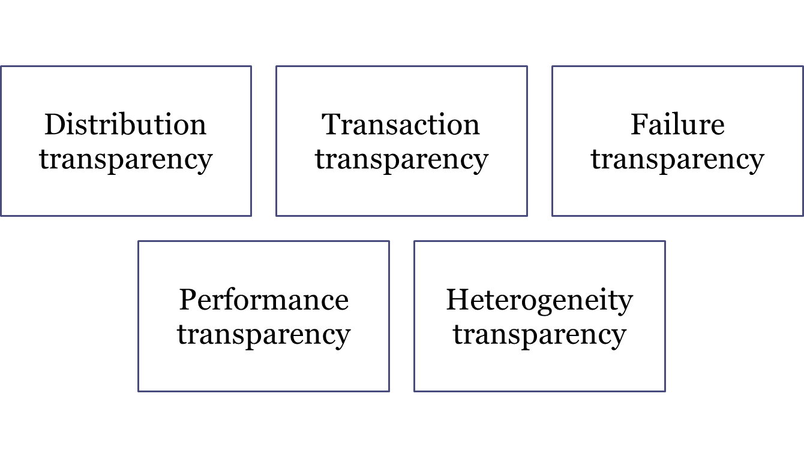
Distributed Database Transparency Features

Slide 22
Distribution Transparency
Allows management of physically dispersed database as if centralized
Levels
  Fragmentation transparency
  Location transparency
  Local mapping transparency

Slide 23
Distribution Transparency
Unique fragment: Each row is unique, regardless of the fragment in which it is located
Supported by distributed data dictionary (DDD) or distributed data catalog (DDC)
  DDC contains the description of the entire database as seen by the database administrator
Distributed global schema: Common database schema to translate user requests into subqueries

Slide 24
Transaction Transparency
Ensures database transactions will maintain distributed database’s integrity and consistency
Ensures transaction completed only when all database sites involved complete their part
Distributed database systems require complex mechanisms to manage transactions

Slide 25
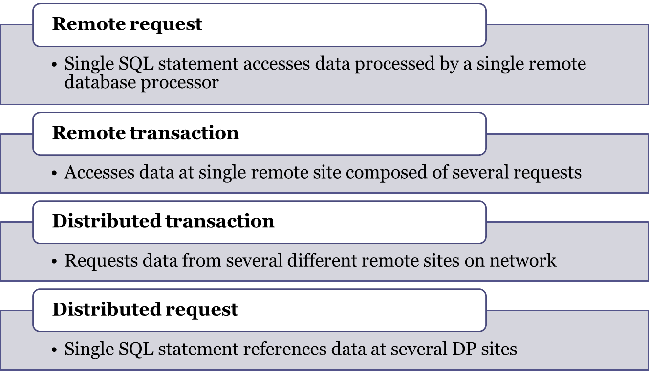
Distributed Requests and Distributed Transactions

Slide 26
Distributed Concurrency Control
Concurrency control is important in distributed databases environment
  Due to multi-site multiple-process operations that create inconsistencies and deadlocked transactions

Slide 27
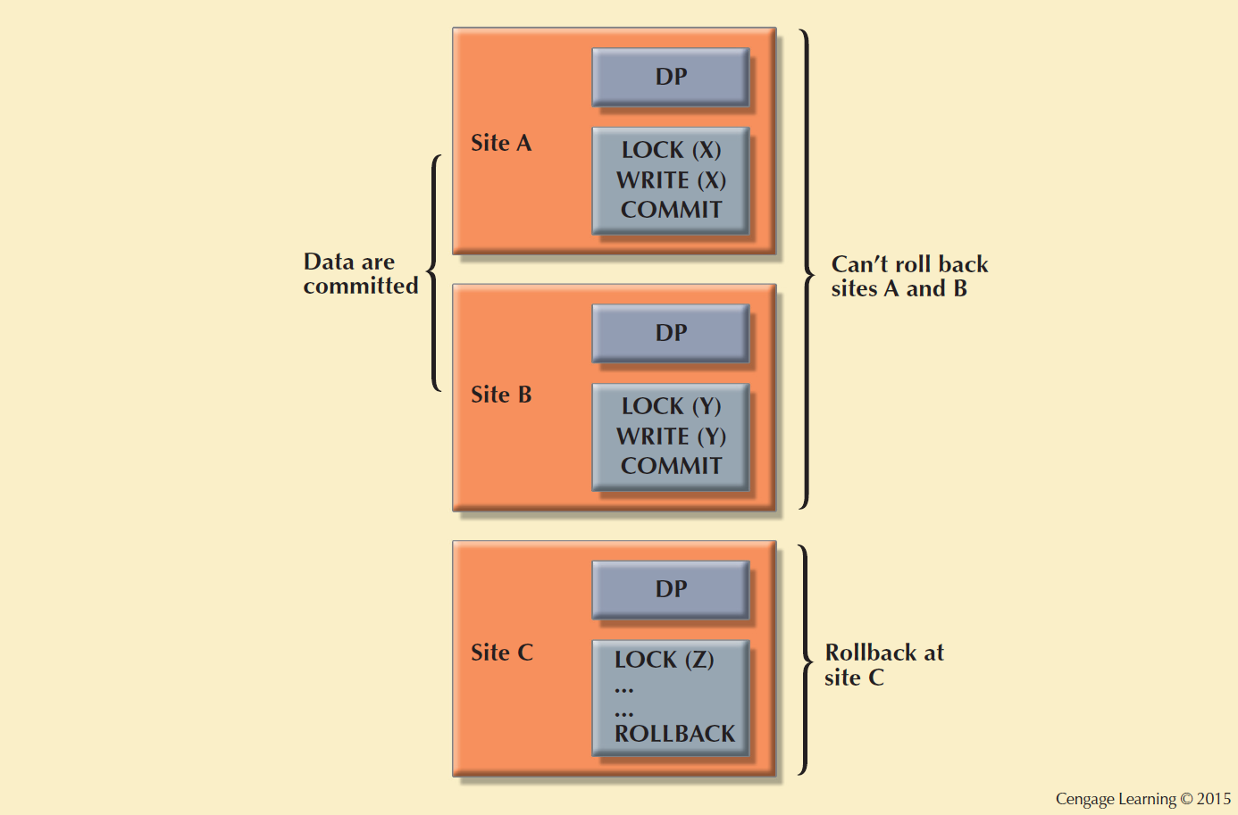
Figure 12.14 - The Effect of Premature COMMIT

Slide 28
Two-Phase Commit Protocol (2PC)
Guarantees if a portion of a transaction operation cannot be committed, all changes made at the other sites will be undone
  To maintain a consistent database state
Requires that each DP’s transaction log entry be written before database fragment is updated
DO-UNDO-REDO protocol: Roll transactions back and forward with the help of the system’s transaction log entries

Slide 29
Two-Phase Commit Protocol (2PC)
Write-ahead protocol: Forces the log entry to be written to permanent storage before actual operation takes place
Defines operations between coordinator and subordinates
Phases of implementation
  Preparation
  The final COMMIT

Slide 30
Performance and Failure Transparency
Performance transparency: Allows a DDBMS to perform as if it were a centralized database
Failure transparency: Ensures the system will operate in case of network failure
Considerations for resolving requests in a distributed data environment
  Data distribution
  Data replication
    Replica transparency: DDBMS’s ability to hide multiple copies of data from the user

Slide 31
Performance and Failure Transparency
  Network and node availability
    Network latency: delay imposed by the amount of time required for a data packet to make a round trip
    Network partitioning: delay imposed when nodes become suddenly unavailable due to a network failure

Slide 32
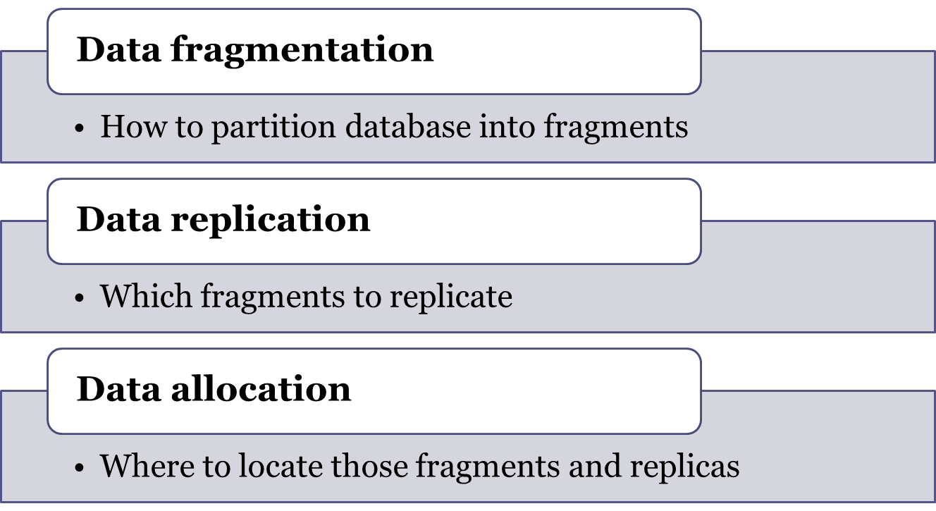
Distributed Database Design

Slide 33
Data Fragmentation
Breaks single object into many segments
  Information is stored in distributed data catalog (DDC)
Strategies
  Horizontal fragmentation: Division of a relation into subsets (fragments) of tuples (rows)
  Vertical fragmentation: Division of a relation into attribute (column) subsets
  Mixed fragmentation: Combination of horizontal and vertical strategies

Slide 34
Data Replication
Data copies stored at multiple sites served by a computer network
Mutual consistency rule: Replicated data fragments should be identical
Styles of replication
  Push replication
  Pull replication
Helps restore lost data

Slide 35
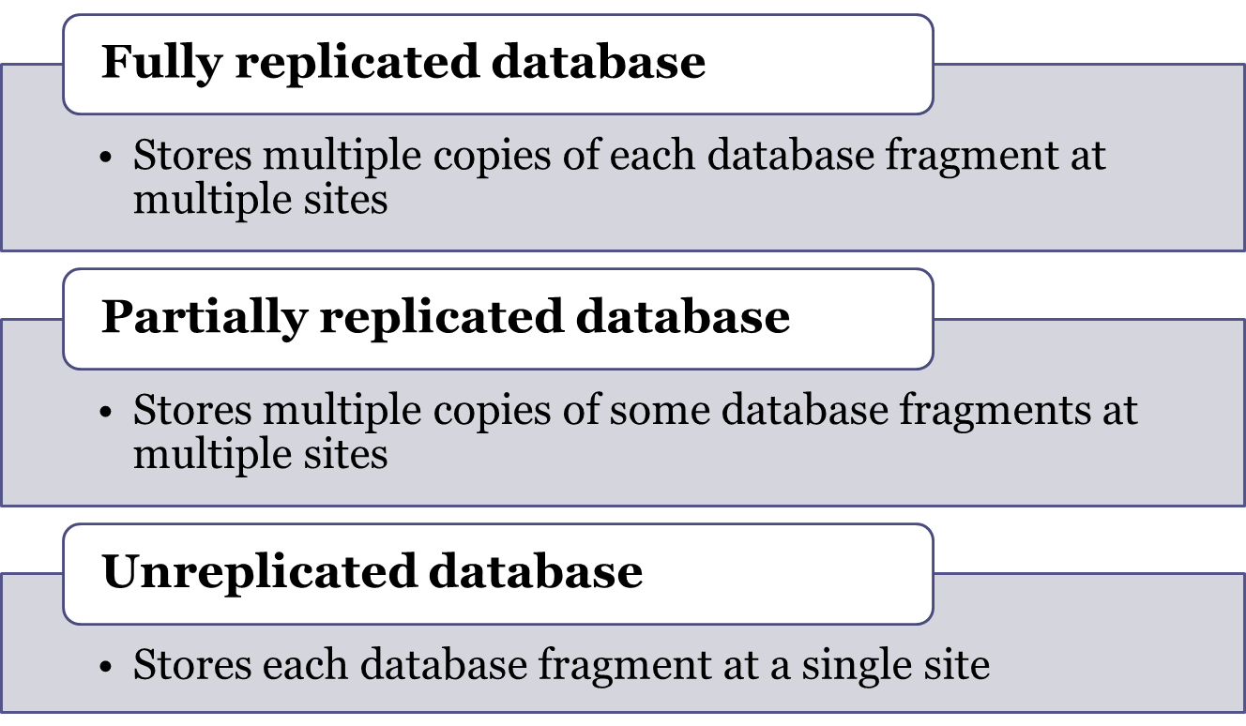
Data Replication Scenarios

Slide 36
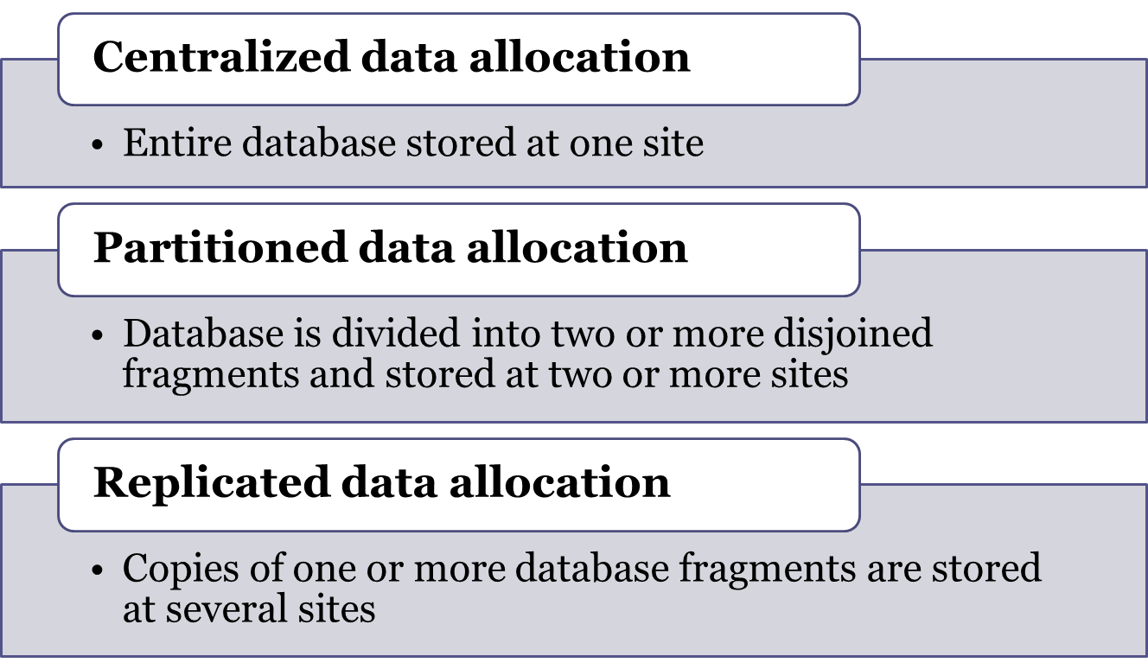
Data Allocation Strategies

Slide 37
The CAP Theorem
CAP stands for:
  Consistency
  Availability
  Partition tolerance
Basically available, soft state, eventually consistent (BASE)
  Data changes are not immediate but propagate slowly through the system until all replicas are consistent

Slide 38
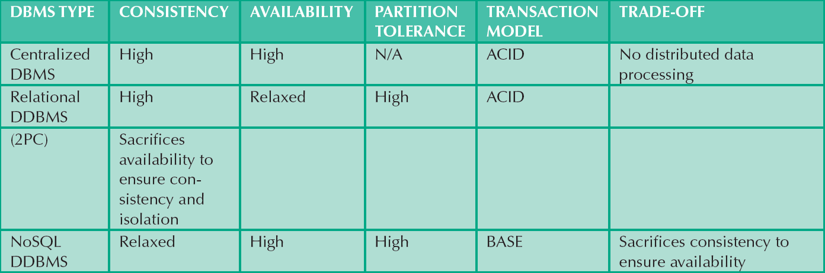
Table 12.8 - Distributed Database Spectrum
Cengage Learning © 2015

Slide 39
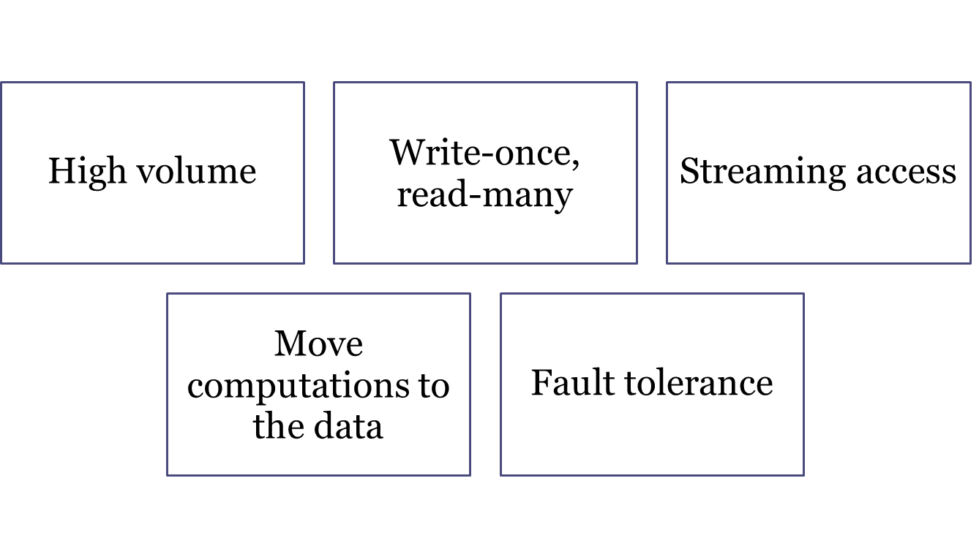
Key Assumptions of Hadoop Distributed File System

Slide 40
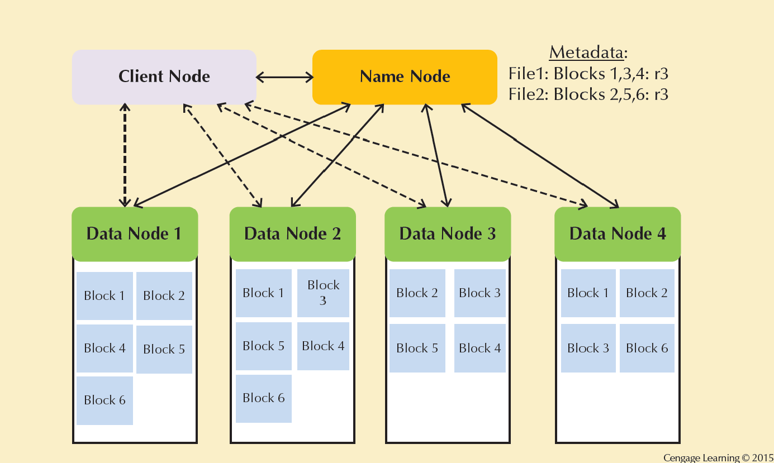
Figure 12.20 - Hadoop Distributed File System (HDFS)

Slide 41
C. J. Date’s Twelve Commandments for Distributed Databases
Local site independence
Central site independence
Failure independence
Location transparency
Fragmentation transparency
Replication transparency

Slide 42
C. J. Date’s Twelve Commandments for Distributed Databases
Distributed query processing
Distributed transaction processing
Hardware independence
Operating system independence
Network independence
Database independence

