Slide 1
Chapter 14
Database Connectivity and Web Technologies

Slide 2
Learning Objectives
In this chapter, students will learn:
  About various database connectivity technologies
  How Web-to-database middleware is used to integrate databases with the Internet
  About Web browser plug-ins and extensions
  What services are provided by Web application servers
  What Extensible Markup Language (XML) is and why it is important for Web database development
  About cloud computing and how it enables the database-as-a-service model

Slide 3
Database Connectivity
Database middleware: Provides an interface between the application program and the database
Data repository - Data management application used to store data generated by an application program
Universal Data Access (UDA): Collection of technologies used to access any type of data source and manage the data through a common interface
  ODBC, OLE-DB, ADO.NET form the backbone of MS UDA architecture

Slide 4
Native SQL Connectivity
Connection interface provided by database vendors, which is unique to each vendor
Interfaces are optimized for particular vendor’s DBMS
  Maintenance is a burden for the programmer

Slide 5
ODBC, DAO, and RDO
Open Database Connectivity (ODBC):Microsoft’s implementation of a superset of SQL Access Group Call Level Interface (CLI) standard for database access
  Widely supported database connectivity interface
  Allows Windows application to access relational data sources by using SQL via standard application programming interface (API)

Slide 6
ODBC, DAO, and RDO
Data Access Objects (DAO): Object-oriented API used to access MS Access, MS FoxPro, and dBase databases from Visual Basic programs
  Provides an optimized interface that expose functionality of Jet data engine to programmers
  DAO interface can be used to access other relational style data sources

Slide 7
ODBC, DAO, and RDO
Remote Data Objects (RDO)
  Higher-level object-oriented application interface used to access remote database servers
Dynamic-link libraries (DLLs)
  Implements ODBC, DAO, and RDO as shared code that is dynamically linked to the Windows operating environment

Slide 8
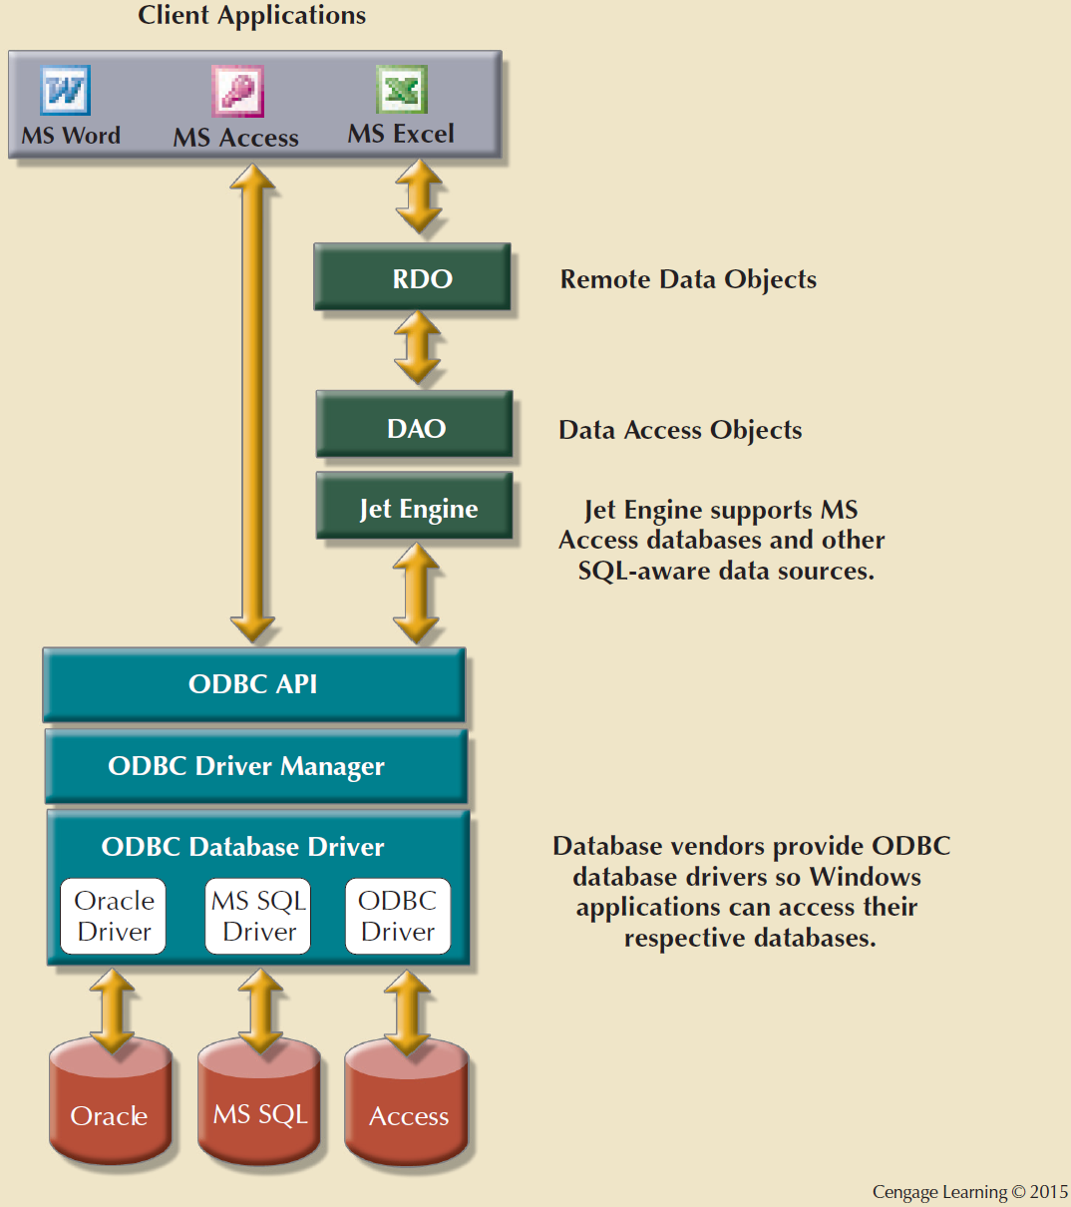
Figure 14.2 - Using ODBC, DAO, and RDO to access databases

Slide 9
Components of ODBC Architecture
High-level ODBC API through which application programs access ODBC functionality
Driver manager that is in charge of managing all database connections
ODBC driver that communicates directly to DBMS

Slide 10
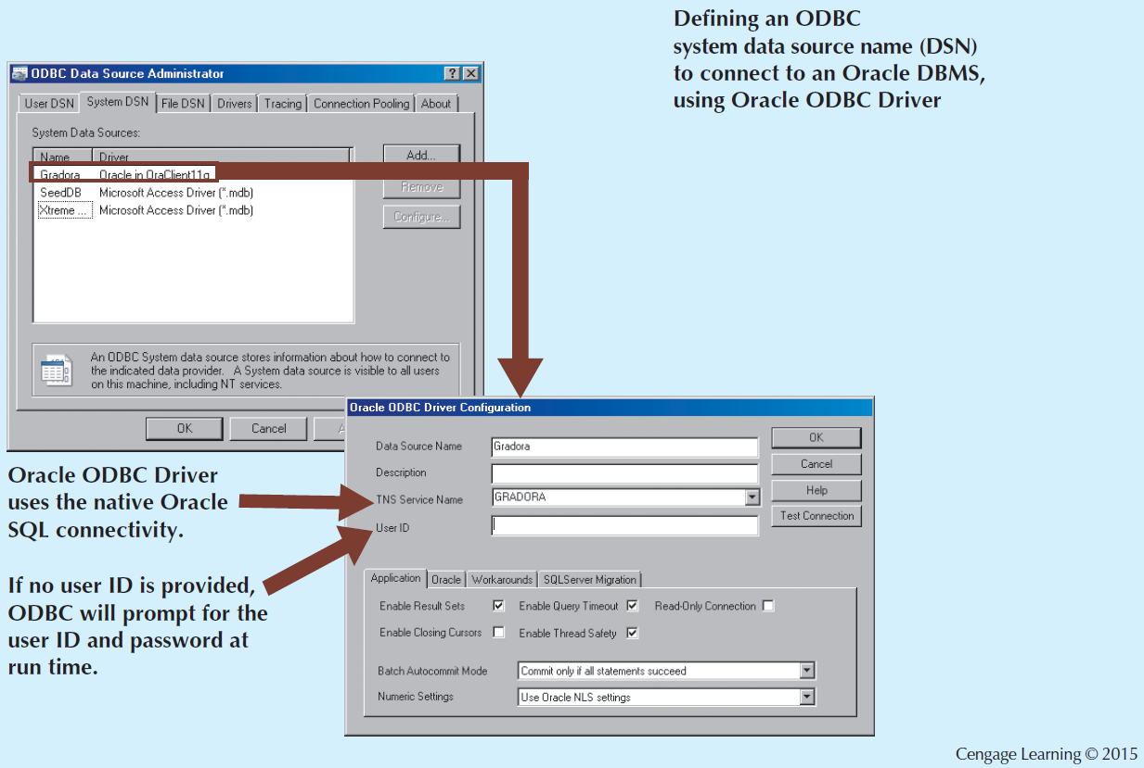
Figure 14.3 - Configuring an Oracle Data Source

Slide 11
Object Linking and Embedding for Database (OLE-DB)
Database middleware that adds object-oriented functionality for access to data
Series of COM objects provides low-level database connectivity for applications
Types of objects based on functionality
  Consumers
  Providers

Slide 12
Object Linking and Embedding for Database (OLE-DB)
Does not provide support for scripting languages
ActiveX Data Objects (ADO): Provides:
  High-level application-oriented interface to interact with OLE-DB, DAO, and RDO
  Unified interface to access data from any programming language that uses the underlying OLE-DB objects

Slide 13
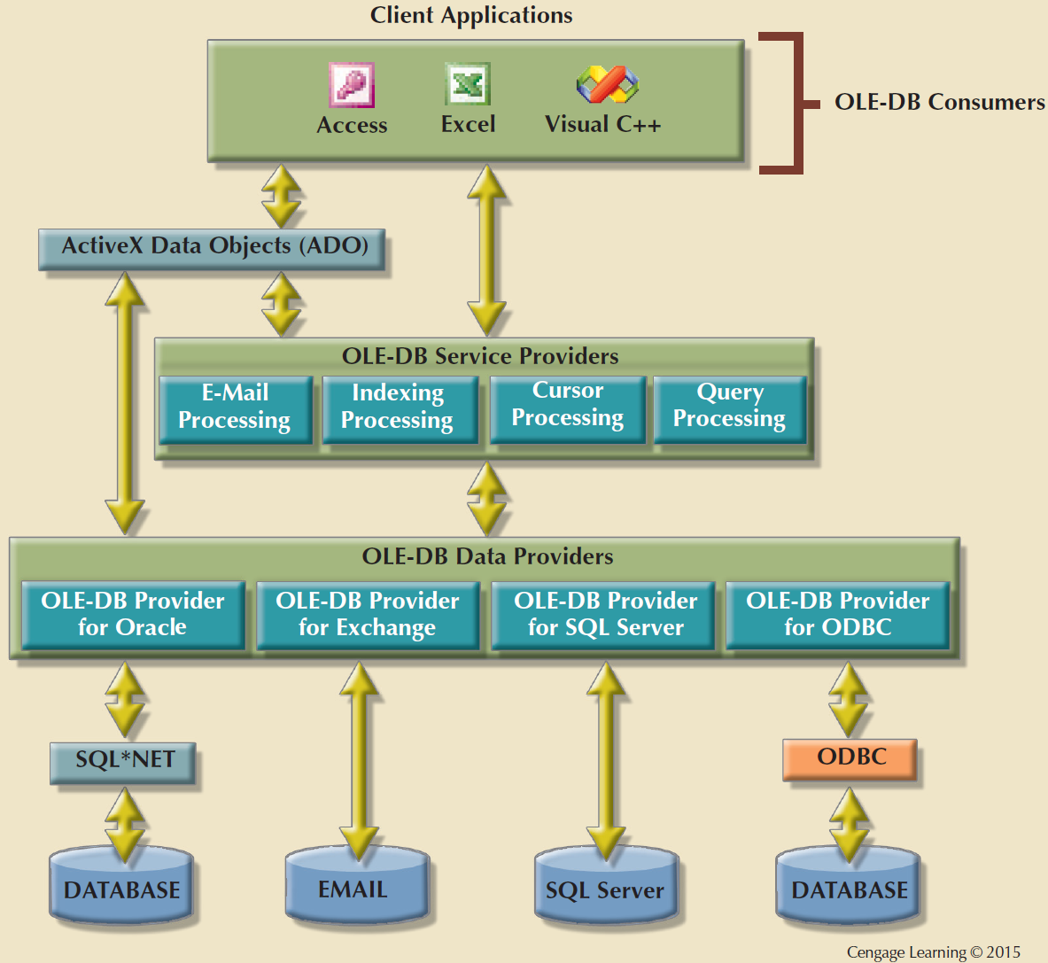
Figure 14.5 - OLE-DB Architecture

Slide 14
ADO.NET
Data access component of Microsoft’s .NET application development framework
Microsoft’s .NET framework
  Component-based platform for developing distributed, heterogeneous, interoperable applications
  Manipulates any type of data using any combination of network, operating system, and programming language

Slide 15
ADO.NET
Features critical for the development of distributed applications
  DataSet: Disconnected memory-resident representation of database
  XML support
    DataSet is internally stored in XML format
    Data in DataSet is made persistent as XML documents
    DataSet is internally stored in XML format
    Data in DataSet made persistent as XML documents

Slide 16
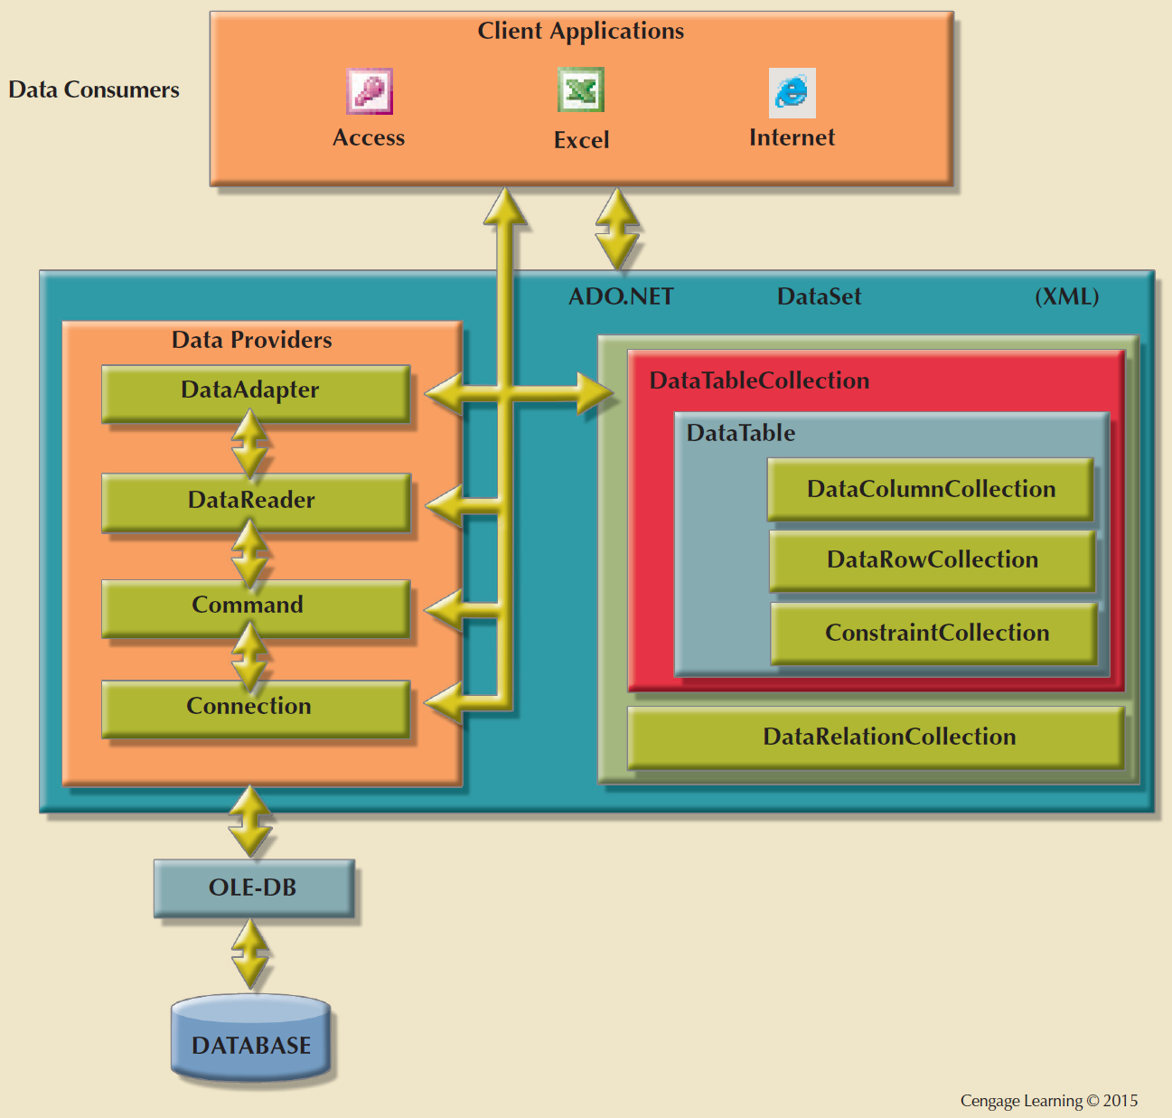
Figure 14.6 - ADO.NET Framework

Slide 17
Java Database Connectivity (JDBC)
Java: Object-oriented programming language that runs on top of web browser software
Application programming interface that allows a Java program to interact with a wide range of data sources

Slide 18
Advantages of JDBC
Company can leverage existing technology and personnel training
Allows direct access to database server or access via database middleware
Allows programmers to use their SQL skills to manipulate the data in the company's databases
Provides a way to connect to databases through an ODBC driver

Slide 19
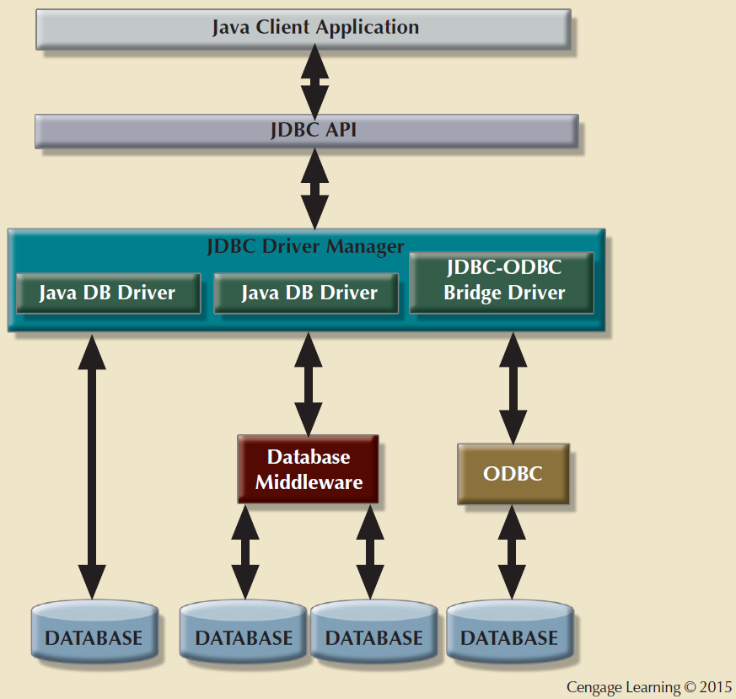
Figure 14.7 - JDBC Architecture

Slide 20
Database Internet Connectivity
Allows new innovative services that:
  Permit rapid response by bringing new services and products to market quickly
  Increase customer satisfaction through creation of web-based support services
  Allow anywhere, anytime data access using mobile smart devices via the Internet
  Yield fast and effective information dissemination through universal access

Slide 21
Characteristics and Benefits of Internet Technologies
Hardware and software independence
  Savings in software equipment and acquisition
  Ability to run on existing equipment
  Platform independence and portability
  No need for multiple platform development
Common and simple user interface
  Reduced training time and cost
  Reduced end-user support cost
  No need for multiple platform development

Slide 22
Characteristics and Benefits of Internet Technologies
Location independence
  Global access and reduced requirements for dedicated connections
Rapid development at manageable costs
  Availability of plug-and-play and interactive development tools
  Reduced costs and development times
  Relatively inexpensive tools
  Free client access tools
  Distributed processing and scalability

Slide 23
Web-to-Database Middleware
Web server is the main hub through which Internet services are accessed
Server-side extension: Program that interacts directly with the web server
  Known as web-to-database middleware
  Provides its services to the web server in a way that is totally transparent to the client browser
Middleware must be well integrated

Slide 24
Web-to-Database Middleware
TCP/IP
NETWORK
WEB
SERVER
CLIENT
COMPUTER
HTML
PAGE
WEB-TO-DATABASE
MIDDLEWARE
RDBMS
SERVER
DATABASE

Slide 25
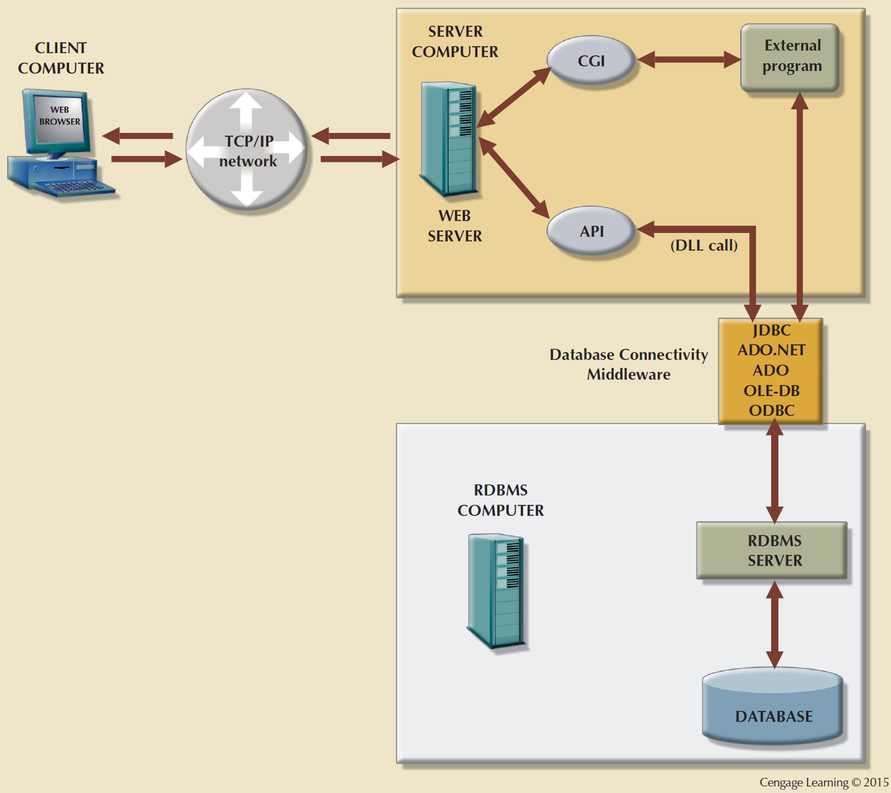
Figure 14.9 - Web Server CGI and API Interfaces

Slide 26
Web Browser
Software that lets users navigate the web from their client computer
Interprets HTML code received from web server
Presents different page components in standard way
Web is a stateless system
  Stateless system: Web server does not know the status of any clients

Slide 27
Client-Side Extensions
Add functionality to Web browser
Types
  Plug-in: External application automatically invoked by the browser when needed
  Java and JavaScript: Embedded in web page
    Downloaded with the Web page and activated by an event
  ActiveX and VBScript: Embedded in web page
    Downloaded with page and activated by event
    Oriented to Windows applications

Slide 28
Web Application Servers
Middleware application that expands the functionality of web servers by linking them to a wide range of services
Uses
  Connect to and query database from web page
  Create dynamic web search pages
  Enforce referential integrity

Slide 29
Features of Web Application Servers
Security and user authentication
Access to multiple services
Integrated development environment
Computational languages
Automation generation of HTML pages
Performance and fault - tolerant features
Database access with transaction management capabilities

Slide 30
Web Database Development
Process of interfacing databases with the web browser
Code examples
  ColdFusion
  PHP

Slide 31
Extensible Markup Language (XML)
Represents and manipulates data elements
Facilitates the exchange of structured documents over the Web
Characteristics
  Allows definition of new tags
  Case sensitive
  Must be well-formed and properly nested
  Comments indicated with <- and ->
  XML and xml prefixes reserved for XML tags only

Slide 32
Document Type Definitions (DTD)
File with .dtd extension that describes elements
Provides composition of database’s logical model
Defines the syntax rules or valid tags for each type of XML document
Companies engaging in e-commerce transaction must develop and share DTDs
DTD referenced from inside XML document

Slide 33
XML Schemas
Advanced data definition language
Describes the structure of XML data documents
Advantage
  More closely maps to database terminology and features
XML schema definition (XSD): File uses syntax similar to XML document

Slide 34
XML Presentation
XML separates data structure from presentation and processing
Extensible Style Language (XSL) displays XML data
  Defines the rules by which XML data are formatted and displayed
  Parts:
    Extensible Style Language Transformations (XSLT)
    XSL style sheets

Slide 35
XML Applications
B2B exchanges
Legacy systems integration
Web page development
Database support
Database meta-dictionaries
XML databases
XML services

Slide 36
Cloud Computing Services
Computing model that enables access to a shared pool of configurable computer resources that can be:
  Rapidly provisioned
  Released with minimal management effort or service provider interaction
Potential to become a game changer
Eliminates financial and technological barriers

Slide 37
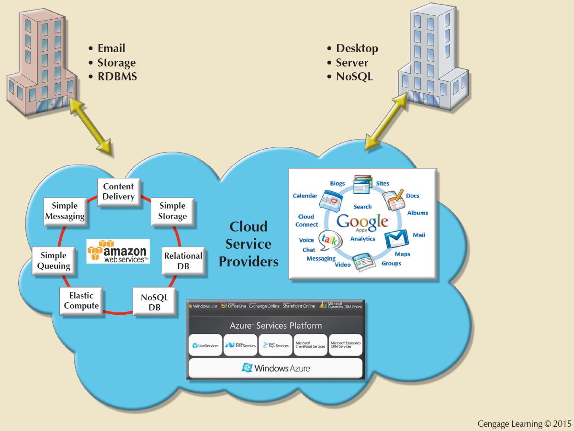
Figure 14.20 - Cloud services

Slide 38
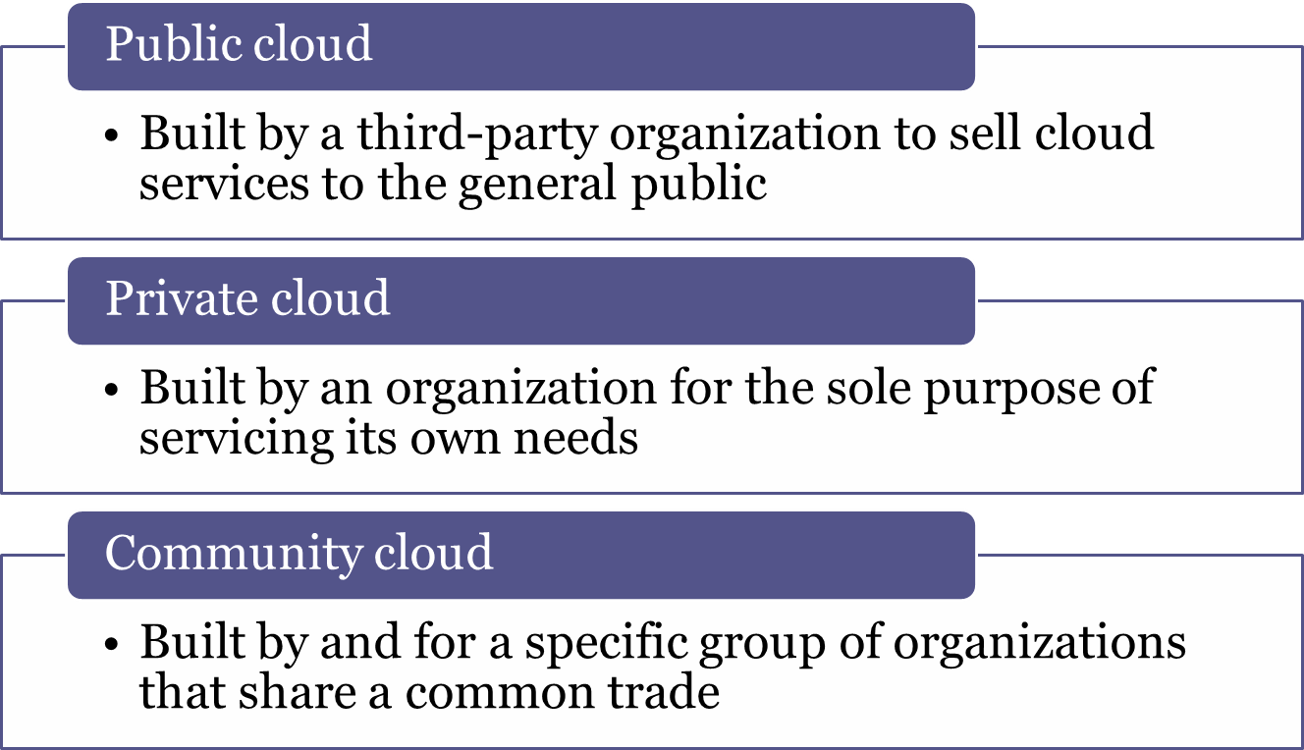
Cloud Implementation Types

Slide 39
Characteristics of Cloud Services
Ubiquitous access via Internet technologies
Shared infrastructure
Lower costs and variable pricing
Flexible and scalable services
Dynamic provisioning
Service orientation
Managed operations

Slide 40
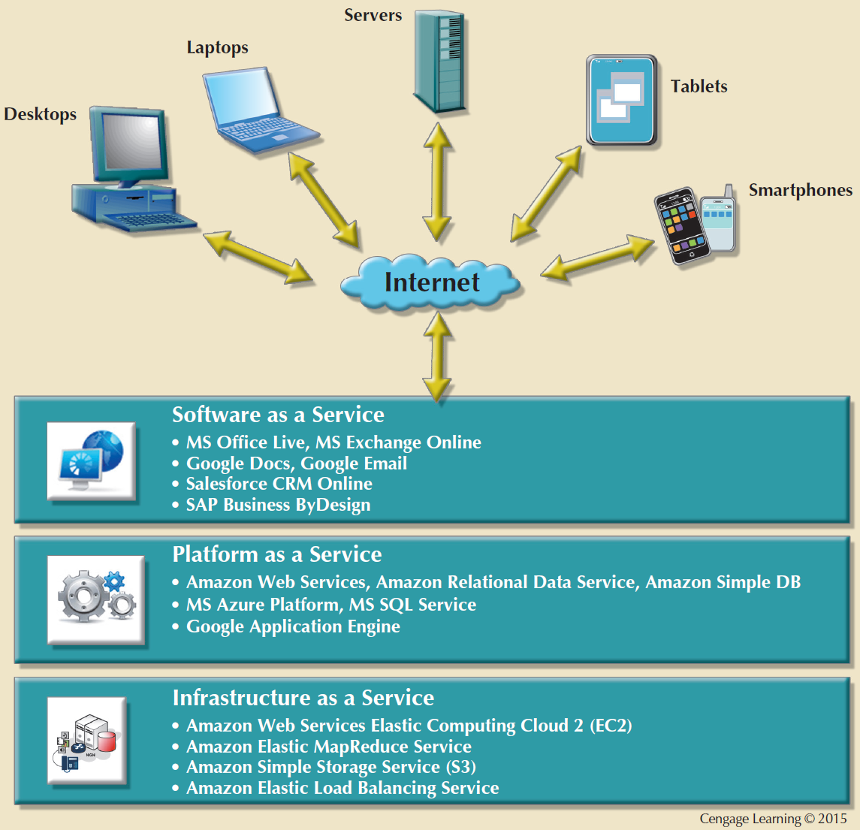
Figure 14.22 - Types of cloud services

Slide 41
Advantages and Disadvantages of Cloud Computing
Advantages
Disadvantages
Low initial cost of entry
Scalability/ Elasticity
Support for mobile computing
Ubiquitous access
High reliability and performance
Fast provisioning
Managed infrastructure
Issues of security, privacy and compliance
Hidden costs of implementation and operation
Data migration
Complex licensing schemes
Loss of ownership and control
Organization culture
Difficult integration with IT system

Slide 42
SQL Data Services
Cloud computing-based data management service
Provide relational data management to companies
Avoid high cost of personnel/maintenance
Leverage Internet to provide:
  Hosted data management
  Standard protocols
  Common programming interface
Assist businesses with limited information technology resources

