Slide 1

Mendix

Slide 2
Contents
What is Rapid Application Development?
What is Mendix?
Why do you need Mendix?
How does it compliment UI5/Fiori?
How does Mendix support Rapid Application Development?
What is the design principle of Mendix?
Design Elements of Atlas UI Framework
What is the development process in Mendix?
App Lifecycle
Requirement
Development
DevOps
What are the components in Mendix?
Domain Model
Workflows
Team Server
What are the uses cases for Mendix?
Extend on-permises – OData/REST/SOAP
Cloud Native – REST/SOAP
Summary
Question and Answer

Slide 3
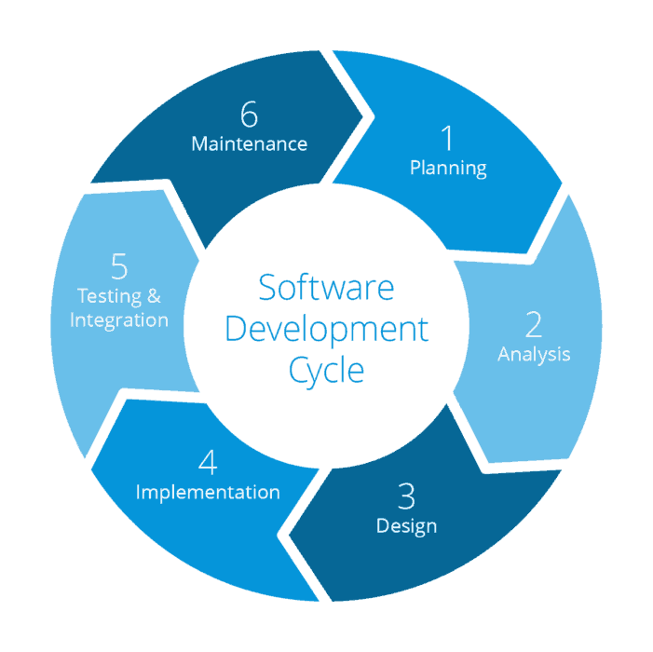
What is Rapid Application Development?
The concept of rapid application development (RAD) emphasizes the fast and iterative release of prototypes and applications. In today’s more competitive market, low-code rapid application development tools allow business and IT teams to effectively collaborate and deliver new applications faster, whether to innovate business practices, differentiate within the market, or streamline costs.
Traditional Model
RAD Model
Advantages
Risk reduction
Increased quality
Faster time to market
Requirements
Design
Implementation
Testing
Deployment
Maintenance

Slide 4
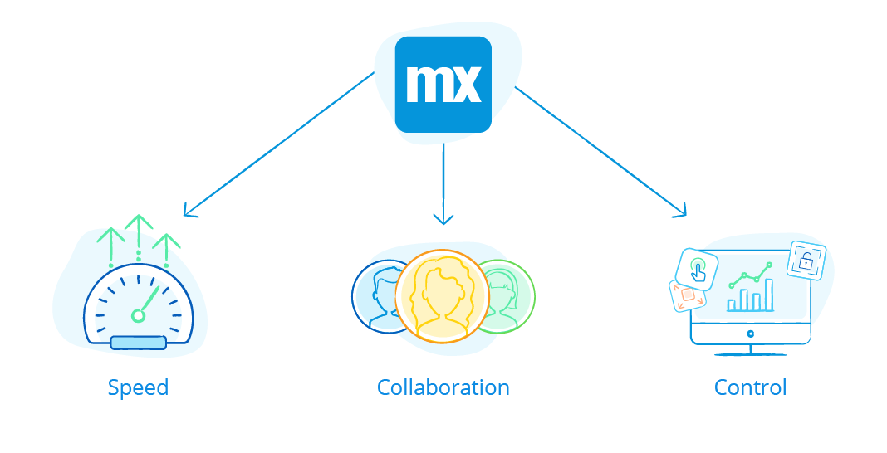
What is Mendix?
Mendix is the only high-productivity application platform (hpa-PaaS) for low-code app development that provides a comprehensive and integrated set of tools and services for managing the entire app lifecycle.
Core Principles
Types of offerings
No code : Mendix provides a web-based visual app-modeling studio that is tailored toward business domain experts
Low code : An extensive and powerful desktop-based visual app-modeling studio is also provided, which is tailored towards professional developers and can be integrated with coding IDEs to extend capabilities

Slide 5
Why do you need Mendix?
Mendix is the leading platform for creating and continuously improving mobile and web applications at unprecedented speed and scale .
Fastest and easiest Low-code platform
Continuous integration and continuous delivery
Collaborative(Multi-User) Development
One-click deployment and out-of-the-box monitoring
Openness & Extensibility
Enterprise grade security
Flexible with Databases
Optimized for performance & designed for scalability
Support of Disaster Recovery
Offers deep and rich integration with SAP products and services
Supports the entire application lifecycle

Slide 6

Mendix helps clients to accelerate digital transformation and S/4 HANA migration
Mendix is an SAP Solution Extension partner and SAP’s low code provider
Mendix provides a comprehensive, integrated set of tools for the entire app lifecycle, from ideation and development through deployment and operation
Solution design
Development can be completed up to 10x faster with fewer resources—increasing margin and competitive differentiation for Firm
Project Timeline
Mendix enables Firm to deliver extended SAP web and mobile apps that are cloud-native, integrate with disparate systems, and maintain a clean core
Clean Core

Slide 7
The software application challenge today
I’m not able to respond fast enough to business app requirements
Our business needs me to stay in control
It is hard to rapidly spin up new apps on top of core systems
And yet there is still a big gap
We need to offer new products and enter new channels
We need digital experiences for our customers & employees
We need to take ideas and initiatives to market faster
1
2
3
4
5
IT Supply
1
1
Outsource development
2
3
2
Hire more developers
Business Demand
3
CI/CD Automation
1
5x increase in market demand for applications
4
PaaS/Cloud
2
Need to offer new products and enter new channels
5
Agile Development
3
Need to take ideas and initiatives to market faster

Slide 8
Mendix Architecture/ System Landscape

Slide 9

Mendix architecture
The Mendix Server architecture consists of multiple components to execute logic, manage data, communicate with the client, and implement security. The diagram below presents an overview of all of the components, which is followed by a short description of their responsibilities:
External System(s)
Modeler, Service Console of Monitoring
Mendix Runtime Engine
HTTP Server
Configuration API
Client API
Services(Rest, WebServices, oData, AppServices)
Custom API
Security Layer
Custom Modules
Custom Java
Project Model
Monitoring API
Microflow Engine
Platform Core
Microflows
Pages
Object Cache
Session Manager
Data Layer
Integration Layer
Security
Domain Model
Runtime Database

Slide 10
How does it compliment UI5/Fiori?
Mendix uses Microflows which allows to easily add complex business logic to the processes in the application without having to write code.
Mendix offers ways to handle more complex validations. The domain model allows you to define event handlers on entity level.
No code need to consume Data, Mendix uses SAP Odata model creator to create domain model via service metadata.
Mendix offers page editor which allows a user to define the end-user interface of application. It provides various layouts including Fiori layout.
Mendix Navigation Layouts controls the navigation of the app, with top-bar or side-bar, main and sub menus.
Mendix offers out-of –the-box theme customizer when compared to FIORI theming.
It offers version control via team servers, this feature is not available in FIORI.
Using Mendix we can create an app with our own data e.g. import a Microsoft Excel spreadsheet and create app.
Mendix offers different collaboration tools like Buzz to track app development, collaborate and share ideas within the team, this feature isn’t available in FIORI.

Slide 11
Comparison Matrix: SAP and UI5 custom apps
<= Least suited
Most suited =>
Category | Mendix |  | Fiori SAP UI5
Development Environment |  | Low code environment: Building blocks and components all pre-developed for you/ Rich responsive control set/ Complex controls |  | High development environment: Development from scratch-multiple XML and JavaScript files involved
Development handoffs |  | No hops between development platform as all functionality built within Designer |  | Too many hops/ hand-offs between development platforms within SAP family of tools
Development Time |  | Development time is highly lower than other platforms Building blocks and components all pre-developed for you/ Rich responsive control set/ Complex controls Bolt-in Agile development concepts |  | Development time is higher than other platform. Develop your own custom control. Developing custom controls in SAPUI5 is really painful and more difficult since there is no support for templates. This means you need to mix the output html with the JavaScript
Resource need |  | Few dev resources needed as tool is easier to use and built-in features intelligently guide developers on the next step of dev |  | High number of resources needed to develop various aspects of development-flow, OData, interfaces etc.
User Experience |  | Users feel at home with native apps, as they have distinct design languages and offer their own user experiences |  | App-centric, device-agnostic user interface
Cost |  | Multiple options available as per customer need |  | None
Performance |  | Better performance |  | Slow performance initial loading and rendering
Native device Features |  | Have access to all device functionalities |  | Mobile Native Development feature not available

Slide 12
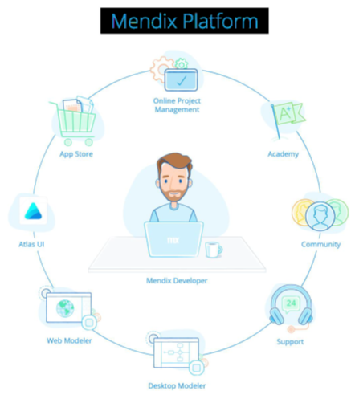
How does Mendix support RAD ?
Mendix provides all the tools and environments that you can use to build and manage the apps.
This includes everything that we need in order to communicate with our team and other Mendix developers, improve and showcase our skills to the world, and find help when we get stuck.

Slide 13
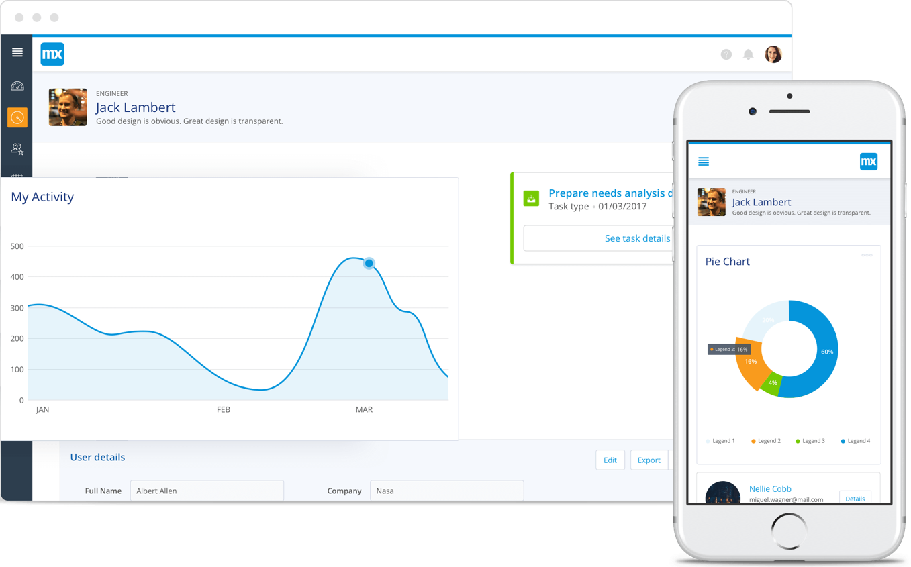
What is the design principle of Mendix?
Mendix is powered by Atlas UI which is a design framework that makes building elegant user experiences a rapid process. It is the design language that brings great user experiences to enterprise apps
Atlas UI is based on three design principles:
Simplicity: Freedom from complexity, helps you focus on what is important
Harmony: Create familiarity and consistency throughout your apps landscape, regardless of the device you use
Flexibility: Design apps that look good and scale in all situations without losing an intuitive and consistent experience

Slide 14
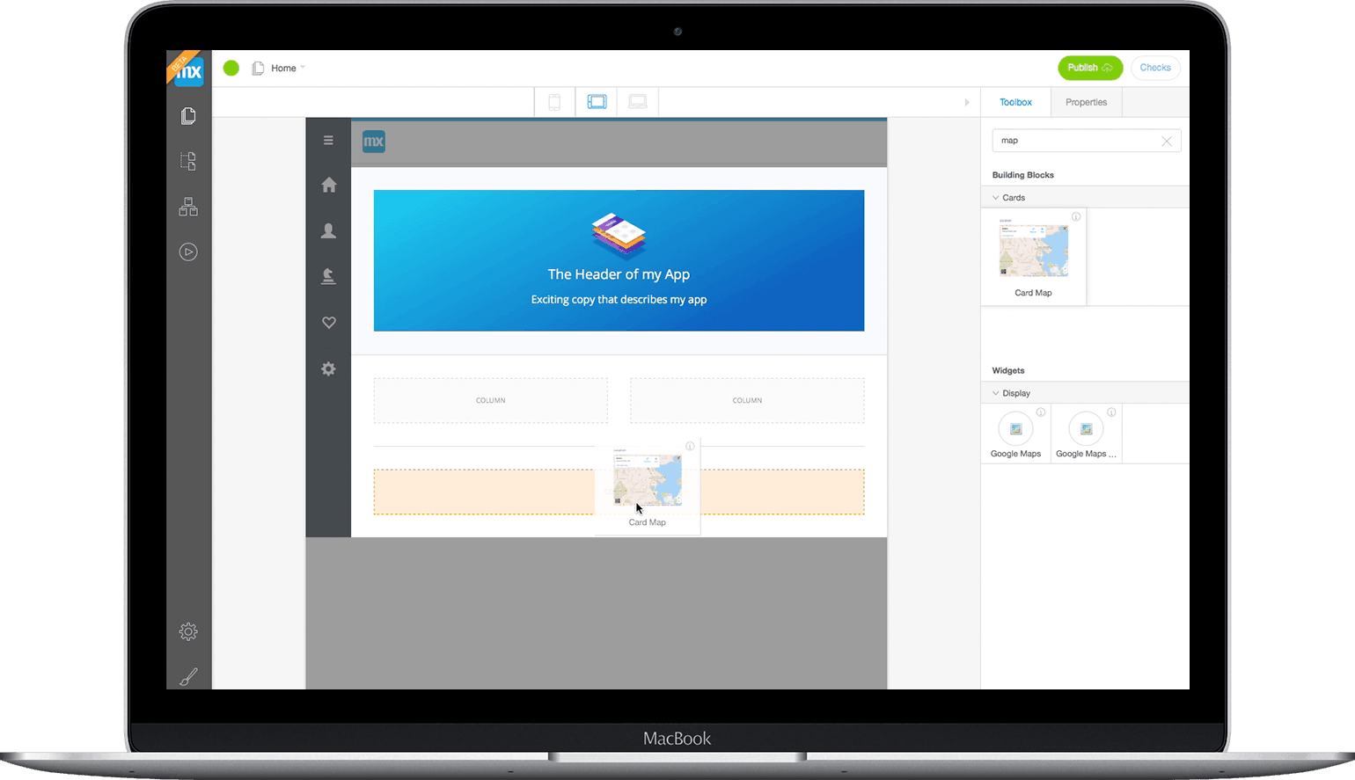
Design Elements of Atlas UI Framework
The Atlas UI Framework consists of five design elements:
Navigation Layouts: These layouts are the frame within which your dynamic pages are housed, and provide consistent structure throughout your app.
Page Templates: Page templates are pre-designed collections of building blocks that can be used as-is, or can be enhanced with custom building blocks and widgets.
Building Blocks: Building blocks are single-purpose user interface elements, comprised of multiple widgets and styling.
Widgets: Widgets are small user interface elements (alerts, buttons, charts, etc.) used to enhance existing building blocks.
Design Properties: You can further customize widgets by changing their design properties. Colors, text, and many other variables can be altered to make the widget what you need it to be.

Slide 15
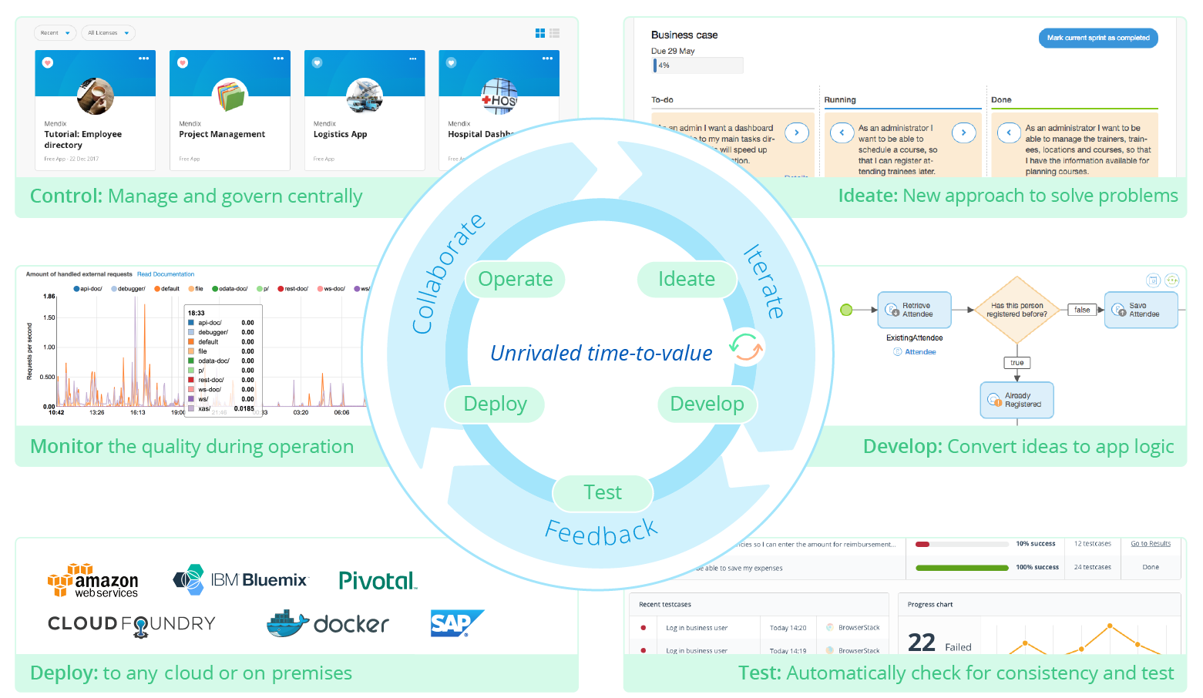
What is the development process in Mendix?
Mendix is the only high-productivity application platform (hpaPaaS) for low-code app development that provides a comprehensive and integrated set of tools and services for managing the entire app lifecycle.
Capture : Requirements
Plan :
Develop :
Deploy :
Review :

Slide 16
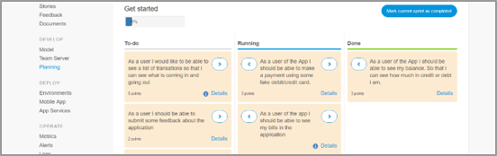
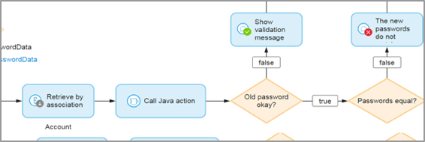
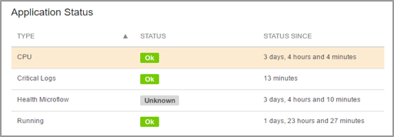
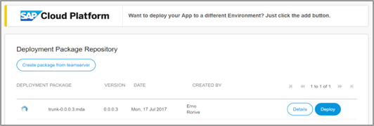
Mendix on SAP Cloud Platform
Accelerate every step of your app journey
Collaborate
1
Design
Build
Design: New Approach to Solve Problems
Iterate
Develop: Convert Ideas to App Logic
Manage
Deploy
Feedback
Manage: Manage and Govern Centrally
Deploy: To SAP Cloud Platform

Slide 17
App Lifecycle
Application lifecycle is an integrated system of people, processes, and tools that guides the journey of an app. There are various frameworks describing that journey, which can differ per company or per app
Capture User stories (requirements)
Develop app
Deploy app
Review and iterate the process

Slide 18
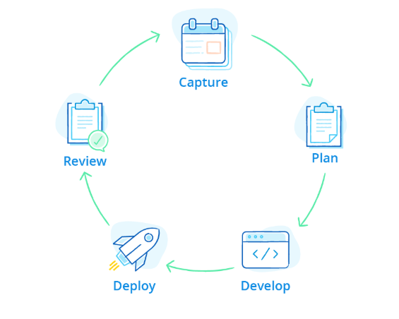
Requirement
Capturing and managing requirements using Agile methodologies is critical to the success of any software development lifecycle (SDLC).
This enables cross-functional teams to close the feedback loop by working collaboratively and iteratively while accelerating the development process towards better and faster business outcomes.

Slide 19
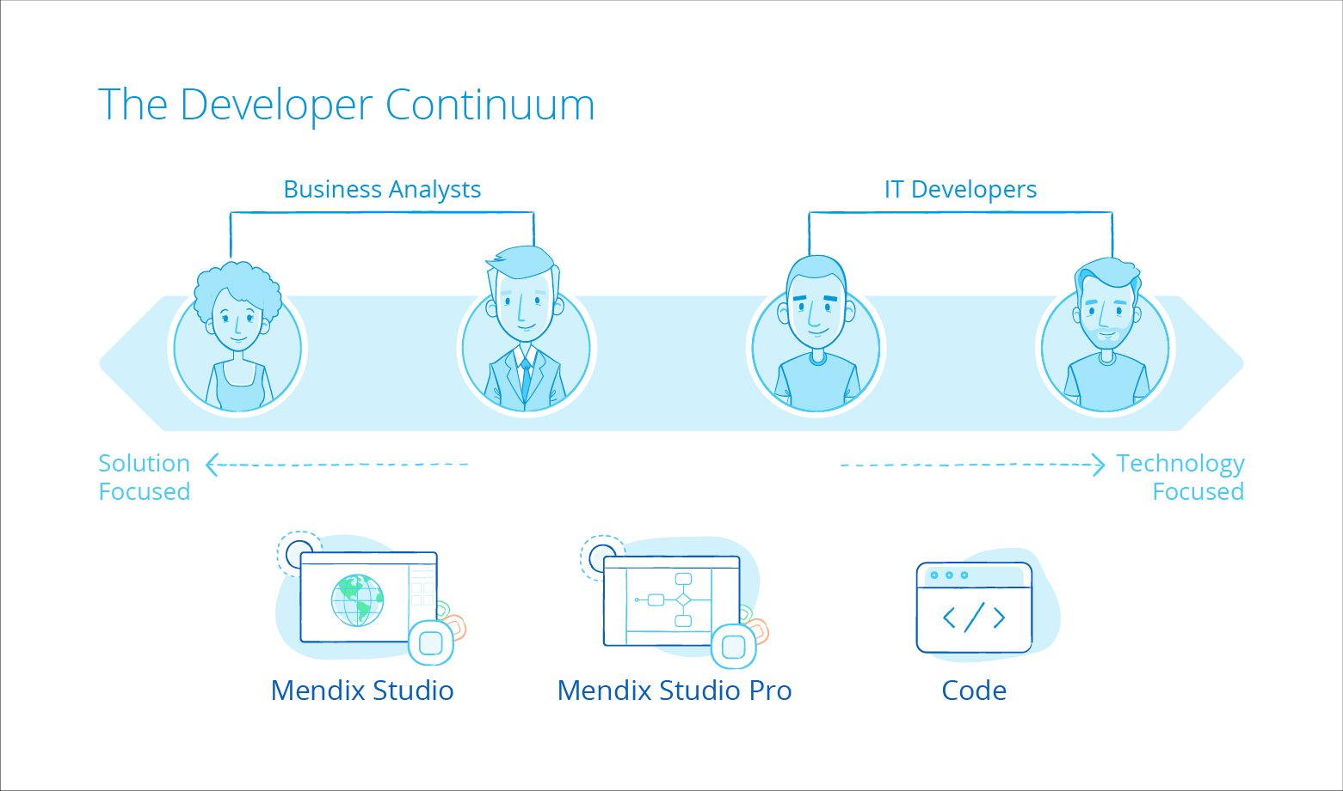
Development
Mendix is a model-driven development environment designed to cater to the needs of today’s enterprise software developers, which includes line-of-business developers, citizen developers, and experienced software engineers.
Using highly extensible visual modeling suite, developers of all skill sets can participate in the designing, building, and deploying of apps using both no-code and low-code development tools.

Slide 20
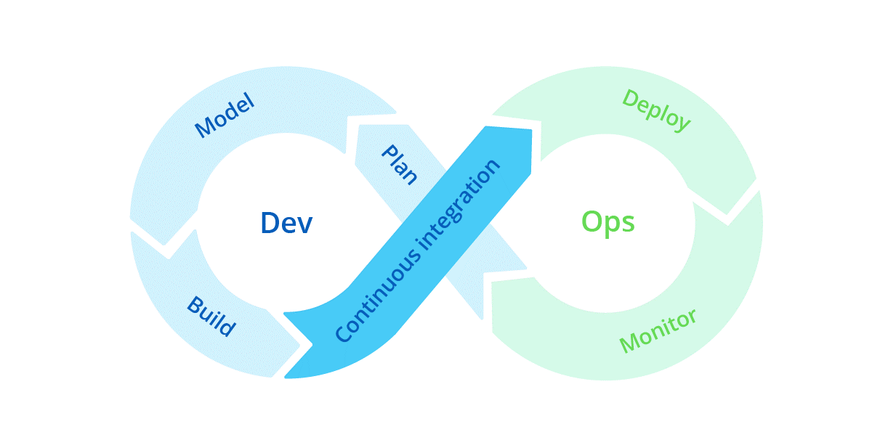
DevOps
Mendix provides DevOps tools out of the box for continuous integration and continuous delivery (CI/CD), test automation, and monitoring (among other services) so that our development team can embrace the DevOps way of working.
Team can rapidly build, test, release, and maintain applications in production environments more autonomously with Mendix while ensuring compliance with your enterprise requirements.
Team can also use the Mendix Platform APIs to support direct integration with your existing CI/CD pipeline.

Slide 21
What are the components in Mendix ?
Domain Model
Workflows
Team Server

Slide 22
Domain Model
Each entity that is present in the domain model will be created in the database as a table.
Each attribute inside that entity will become a column in the database table.
If you want to change your database structure, you need to do that from within the domain model.
The Domain Model – Associations
One-to-Many Association (1–*)
One entity linked with many
One-to-One Association (1–1)
One entity linked with another single entity
Reference Set (*–*)
This is reffered as many to many relationship

Slide 23
Domain Model
Add Associations
The association is created as a one-to-many association by default. To change the association type, just click the association and select a different type in the Properties pane.

Slide 24
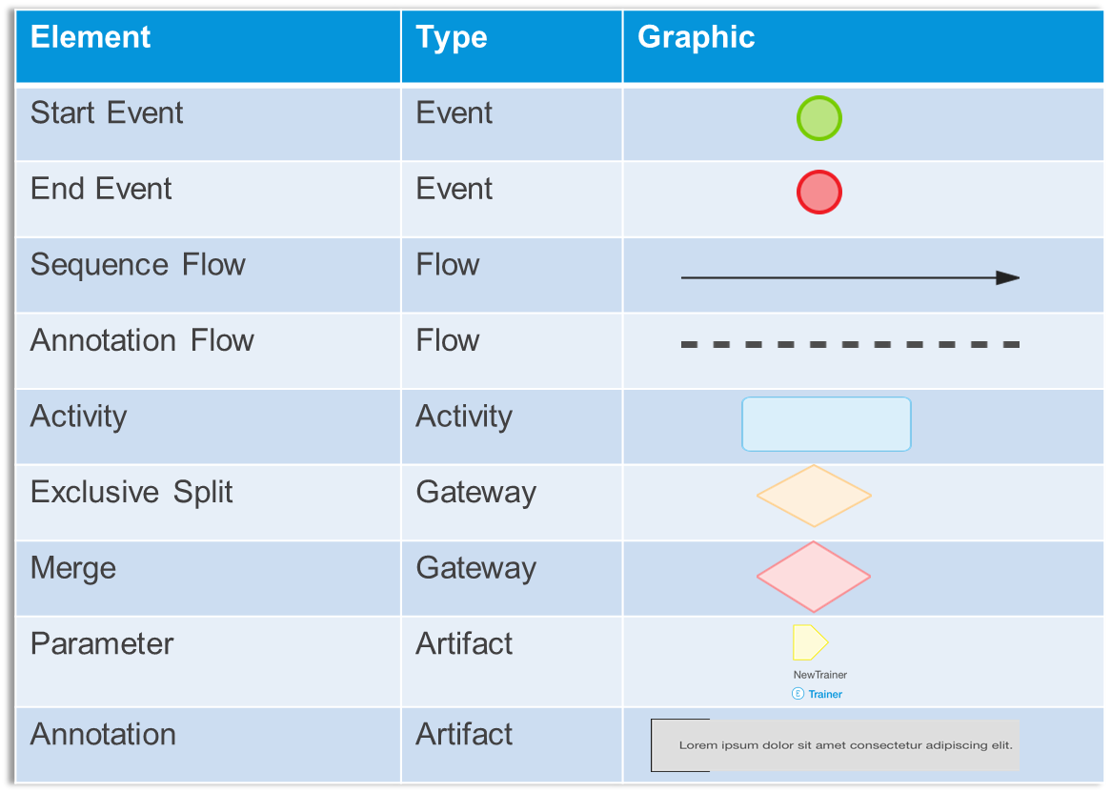
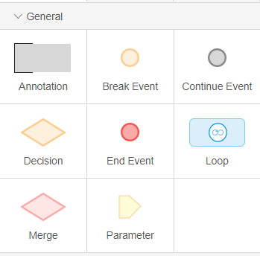
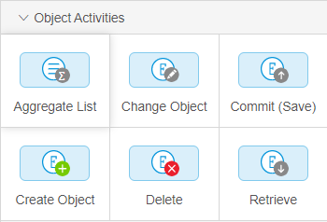
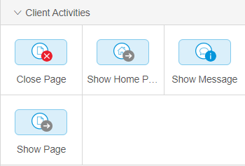
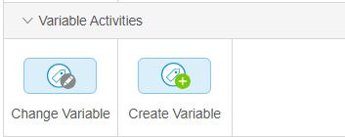
Microflows
Microflow is like a flow chart which add logic to an app and consists of following :
Activities: Blue boxes performing different functions.
Flows: Arrows that connect microflow events and activities
Events: Other things placed in a flow not in a shape of a blue box are events.
Variable: A variable is a temporary storage for data. Variables are used to store information and refer to it when needed.
Microflow logic is modeled using a visual editor for the graphical notation based on the Business Process Modeling Notation. Logic is a sequence of actions and listeners
An action
Executes logic
Exposed by: HTTP, SOAP, API
Base object for standard actions
Listener
Listens to actions
Triggers actions
Catches (before, during, after) events

Slide 25
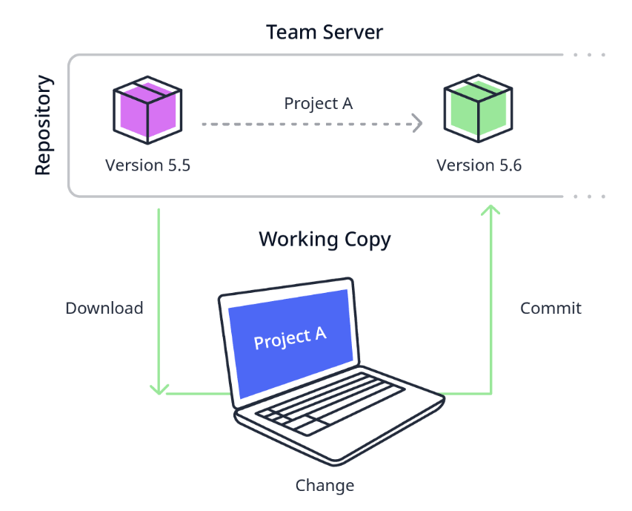
Team Server
The Mendix Team Server is a Mendix-hosted environment that contains all your Team Server apps.
It allows you to collaborate with your team and use versioning.
For every Team Server app, there is an online repository that contains both the model and all the app’s resources.
A working copy is a local copy of the project. Once you are done with the changes, you can commit them, resulting in a new revision in the repository.

