Slide 1
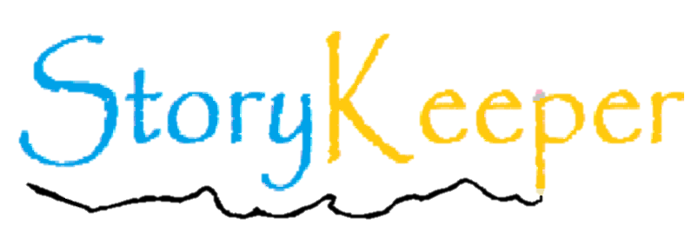
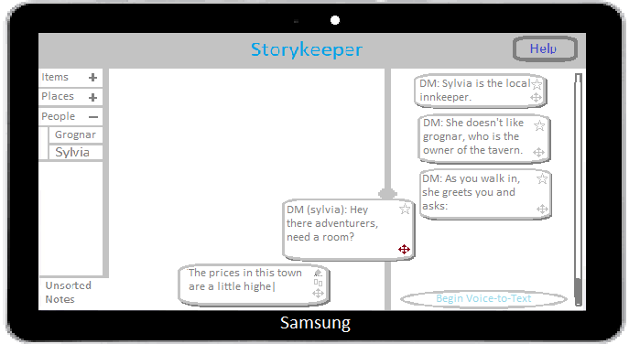
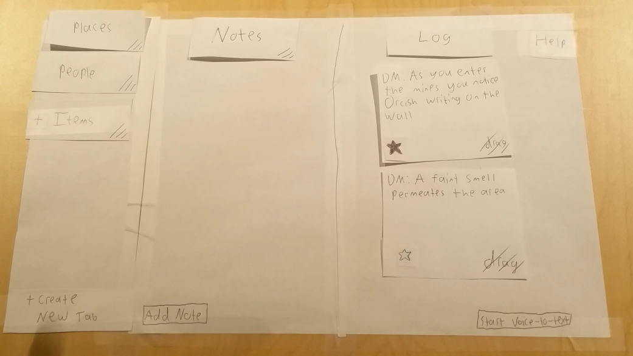
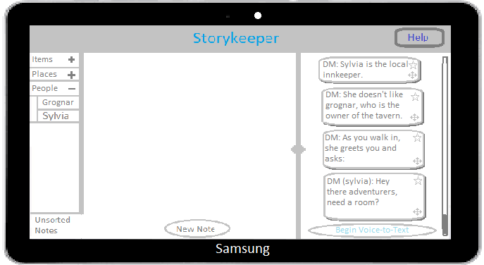
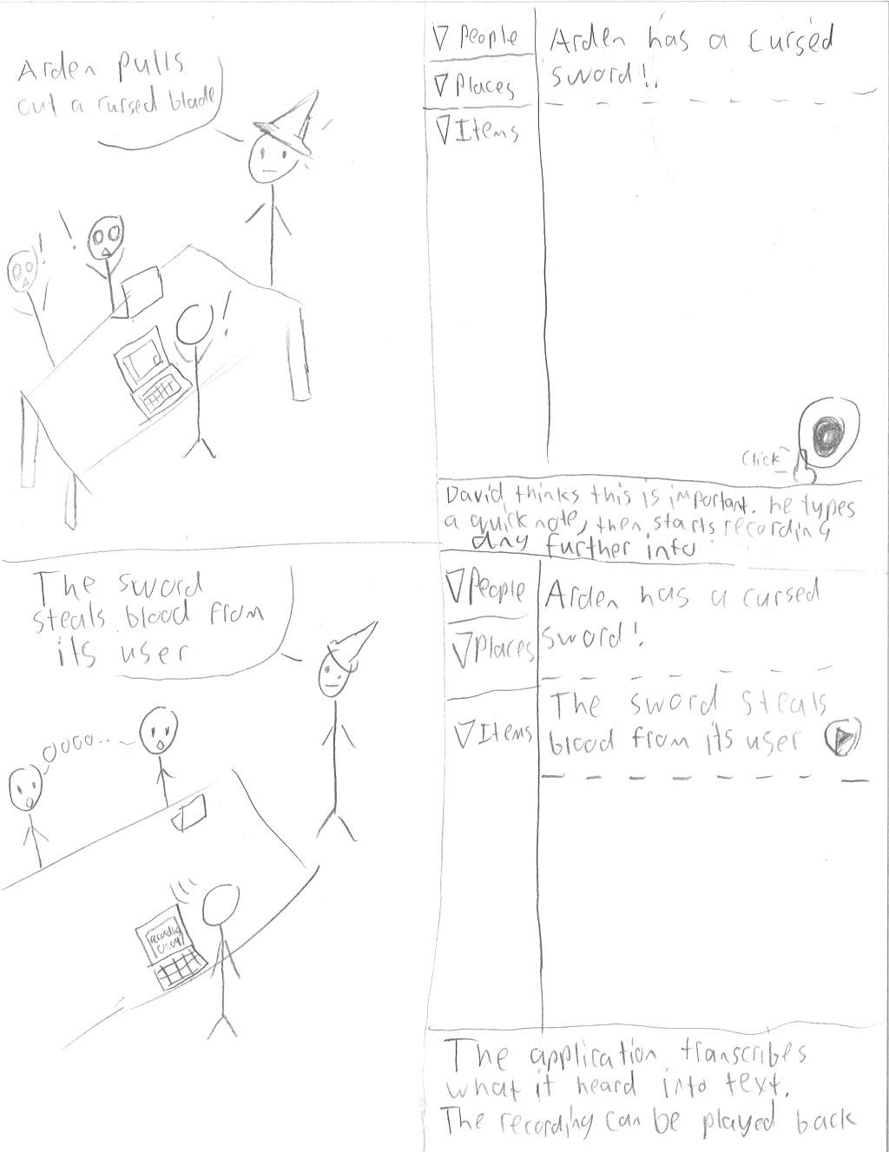
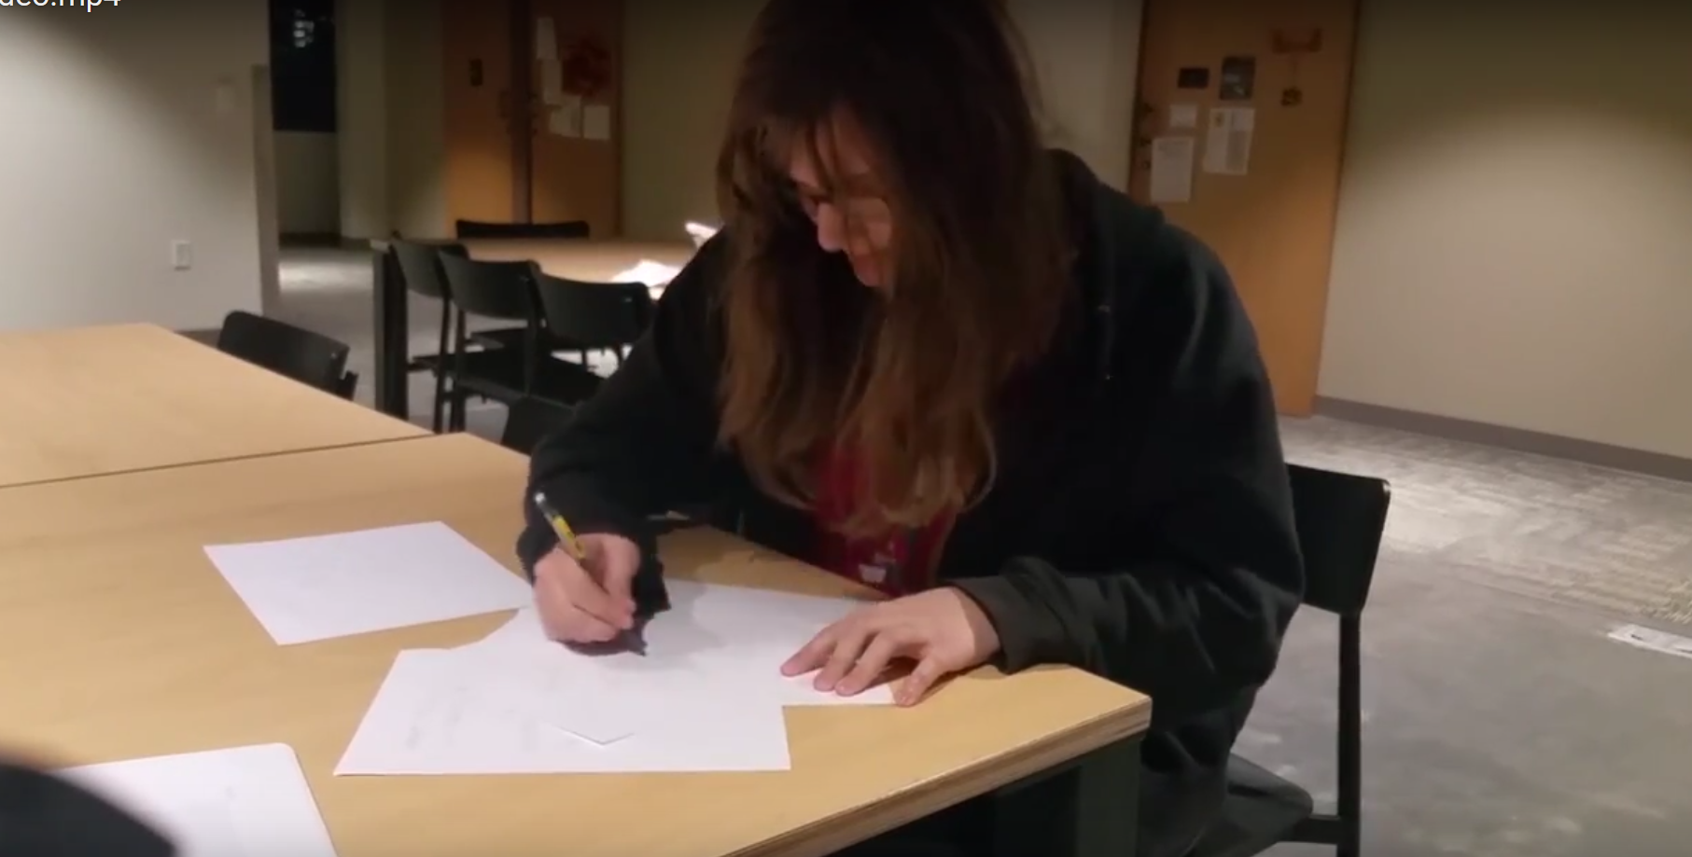
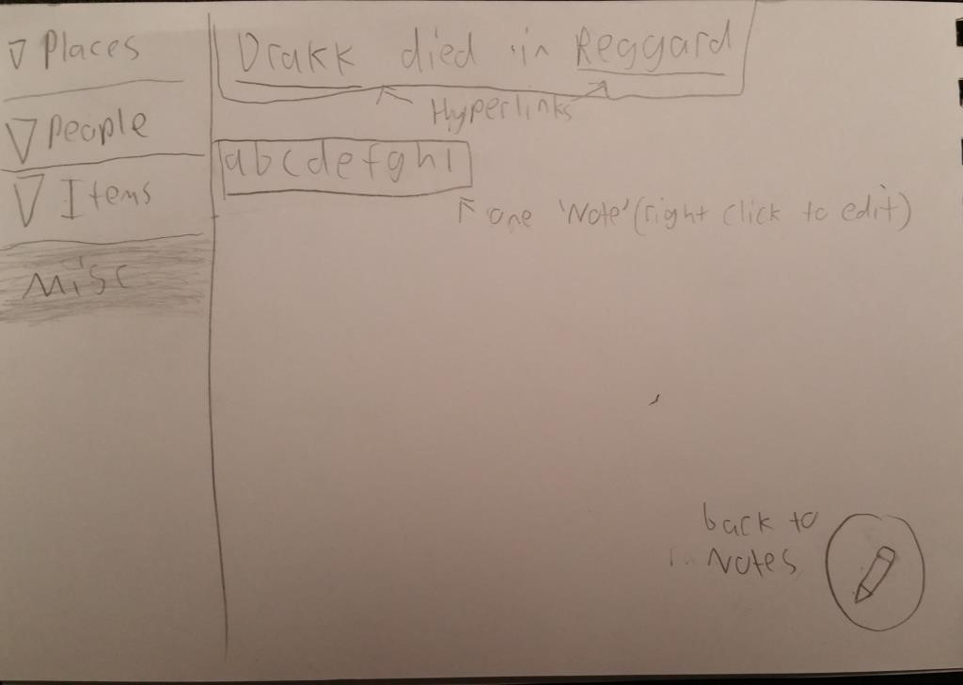
The Journal of Heroes
Take notes faster and organize them easier
Overview
Taking notes during D&D takes too long and finding them can be just as bad. Players and DMs need faster less intrusive methods of keeping track of the information and story.
Our Solution
Voice to text for virtually no downtime to take notes.
Entries can be starred to make finding them easier
Text boxes can be dragged to quickly store information
Tab system that helps you quickly store and find notes.
Design Iteration
Paper Prototype
Digital Mock-up
Design Process
Contextual Inquiry and task analysis
Story Boarding
Video Prototype
Initial Designs
Christian Boyd, Tristan Barajas, Tristian Willis
http://eng.utah.edu/~cs5540/au17/projects/Storykeeper
CS 5540
Spring 2011

