Slide 1
Fundamental Concepts of Security
This lecture slide is mainly based on the power point slides by Professor Lawrie Brown, Dr. Junjie Zhang.

Slide 2
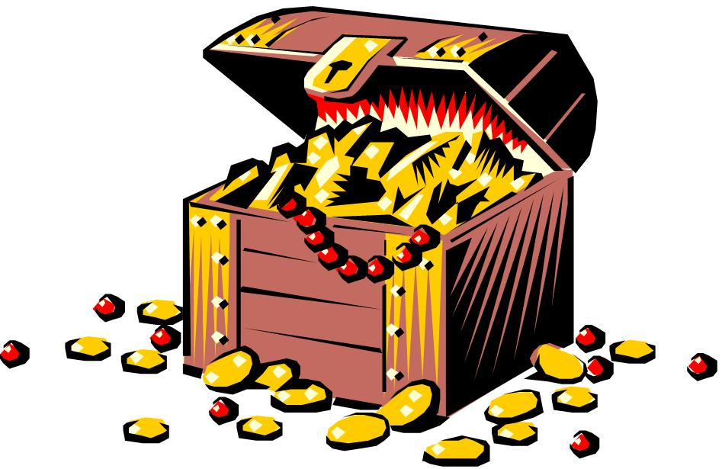
Security Objectives
Security Requirements
Security Objectives
Security Features
Security Services
Digital Assets
Confidentiality
Integrity
Availability
Notes:
When you design a system, there are security requirements, or the security objectives.
After the system is in use, the system has security features, or we can say the system provides security services.

Slide 3



Confidentiality
Assets are accessed only by authorized parties.
Often referred to as privacy or secrecy
Alice
Bob
data
Eavesdrop
Eve

Slide 4
Integrity
Assets can be modified only by authorized parties.
Alice
Bob
$100
$10
Tamper with
Eve

Slide 5
Availability
Assets are accessible to authorized parties at appropriate times.
Alice
Bob
$100
Jam
Eve

Slide 6
Terminology
Vulnerability
A weakness in the security system that might be exploited to cause loss or harm.
Threat
A set of circumstances that has the potential to cause loss or harm.
Attack
The execution of a plan to carry out a threat by exploiting a vulnerability.
Notes:
Threat: a set of circumstances that has the potential to cause loss or harm.

Slide 7
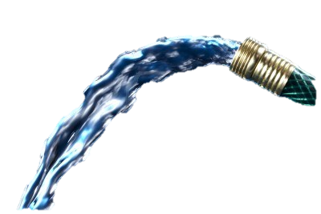


Vulnerability, Threat, and Attack
Attack1
Attack
Vulnerability
Crack
Attack2
Water
Threat
Wall

Slide 8
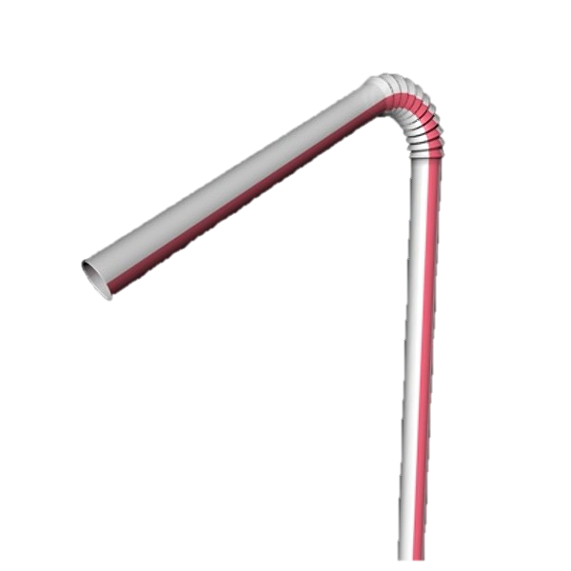
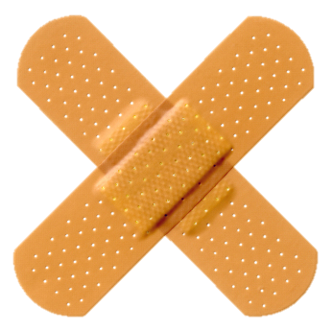
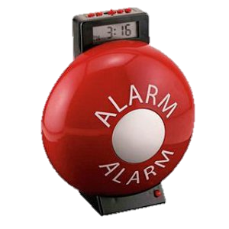

Prevention, Detection, Mitigation
Crack
Water
Wall

Slide 9
Systems with Security Challenges
Software
Hardware
Artificial Intelligence Systems
Cyber-Physical Systems
……

Slide 10
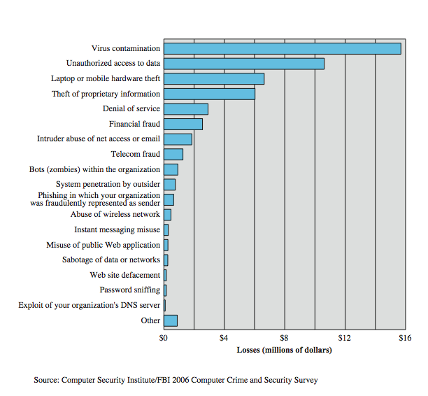
Computer Security Losses
Notes:
Another useful view of trends in computer security is provided by the CSI/FBI Computer Crime and Security Survey for 2006, conducted by the Computer Security Institute, a private organization, and the U.S. Federal Bureau of Investigation (FBI). Figure 1.7 here shows the estimated losses caused by various types of computer security incidents. The top four categories of losses (viruses, unauthorized access, laptop or mobile hardware theft, and theft of proprietary information) accounted for nearly three-quarters of the total loss. Note that these attacks need to be countered by technical measures (in the case of viruses and unauthorized access); physical security measures (laptop or mobile hardware theft); or a combination (theft of proprietary information, which could include electronic as well as paper assets). Other management controls would also come into play.

Slide 11
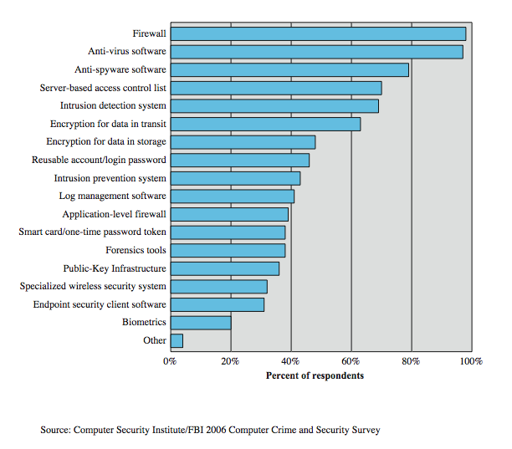
Security Technologies Used
Notes:
Figure 1.8here, also from the CSI/FBI Computer Crime and Security Survey for 2006, indicates the types of security technology used by organizations to counter threats. Both firewalls and anti-virus software are used almost universally. This popularity reflects a number of factors:
• The maturity of these technologies means that security administrators are very familiar with the products and are confident of their effectiveness.
• Because these technologies are mature and there are a number of vendors, costs tend to be quite reasonable and user-friendly interfaces are available
• The threats countered by these technologies are among the most significant facing security administrators.

Slide 12
Policies and Mechanisms
Policy says what is, and is not, allowed
This defines “security” for the site/system/etc.
A Security Policy is a statement of what is, and what is not allowed
A Security mechanism is a method, tool, or procedure for enforcing a security policy.
Composition of policies
If policies conflict, discrepancies may create security vulnerabilities
Notes:
Policy: may be expressed in
natural language, which is usually imprecise but easy to understand;
mathematics, which is usually precise but hard to understand;
policy languages, which look like some form of programming language and try to balance precision with ease of understanding
Mechanisms: may be
technical, in which controls in the computer enforce the policy; for example, the requirement that a user supply a password to authenticate herself before using the computer
procedural, in which controls outside the system enforce the policy; for example, firing someone for ringing in a disk containing a game program obtained from an untrusted source
The composition problem requires checking for inconsistencies among policies. If, for example, one policy allows students and faculty access to all data, and the other allows only faculty access to all the data, then they must be resolved (e.g., partition the data so that students and faculty can access some data, and only faculty access the other data).

Slide 13
Goals of Security
Prevention
Prevent attackers from violating security policy
Detection
Detect attackers’ violation of security policy
Recovery
Stop attack, assess and repair damage
Continue to function correctly even if attack succeeds
Notes:
Prevention is ideal, because then there are no successful attacks.
Detection occurs after someone violates the policy. The mechanism determines that a violation of the policy has occurred (or is underway), and reports it. The system (or system security officer) must then respond appropriately.
Recovery means that the system continues to function correctly, possibly system functions correctly always, but possibly with degraded services, it is said to be intrusion tolerant. This is very difficult to do correctly; usually, recovery means that after a period during which it fails to function correctly. If the attack is stopped, the system fixed (which may involve shutting down the system for some time, or making it unavailable to all users except the system security officers), and then the system resumes correct operations.

Slide 14
Threat consequences
Unauthorized disclosure: threat to confidentiality
Exposure (release data), interception, inference, intrusion
Deception: threat to integrity
Masquerade, falsification (alter data), repudiation
Disruption: threat to integrity and availability
Incapacitation (destruction), corruption (backdoor logic), obstruction (infer with communication, overload a line)
Usurpation: threat to integrity
Misappropriation (theft of service), misuse (hacker gaining unauthorized access)
Notes:
RFC 2828 describes four kinds of threat consequences and kinds of attacks that result:
Unauthorized disclosure is a threat to confidentiality:
Exposure: Sensitive data is directly released to an unauthorized entity.
Interception: An unauthorized entity directly accesses sensitive data in transit.
Inference: an unauthorized entity indirectly accesses sensitive data by reasoning from characteristics or byproducts of communications.
Intrusion: An unauthorized entity circumvents system's security protections.
Deception is a threat to either system integrity or data integrity:
Masquerade: An unauthorized entity poses as an authorized entity.
Falsification: False data deceives an authorized entity.
Repudiation: An entity deceives another by falsely denying responsibility for an act.
Disruption is a threat to availability or system integrity:
Incapacitation: Prevent/interrupt system operation by disabling a system component
Corruption: adversely modifying system functions or data
Obstruction: interrupts delivery of system services by hindering system operation.
Usurpation is a threat to system integrity:
Misappropriation: unauthorized logical or physical control of a system resource.
Misuse: Causes system to perform a function or service detrimental to security.

Slide 15
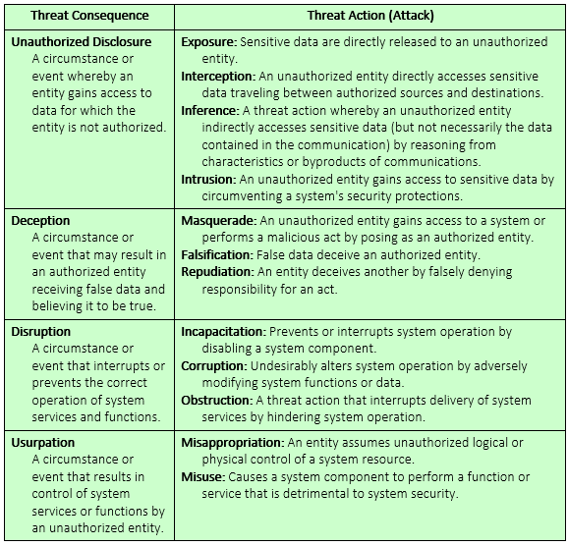
Threat consequences (tabular form)
Notes:
RFC 2828 describes four kinds of threat consequences and kinds of attacks that result:
Unauthorized disclosure is a threat to confidentiality:
Exposure: Sensitive data is directly released to an unauthorized entity.
Interception: An unauthorized entity directly accesses sensitive data in transit.
Inference: an unauthorized entity indirectly accesses sensitive data by reasoning from characteristics or byproducts of communications.
Intrusion: An unauthorized entity circumvents system's security protections.
Deception is a threat to either system integrity or data integrity:
Masquerade: An unauthorized entity poses as an authorized entity.
Falsification: False data deceives an authorized entity.
Repudiation: An entity deceives another by falsely denying responsibility for an act.
Disruption is a threat to availability or system integrity:
Incapacitation: Prevent/interrupt system operation by disabling a system component
Corruption: adversely modifying system functions or data
Obstruction: interrupts delivery of system services by hindering system operation.
Usurpation is a threat to system integrity:
Misappropriation: unauthorized logical or physical control of a system resource.
Misuse: Causes system to perform a function or service detrimental to security.

Slide 16
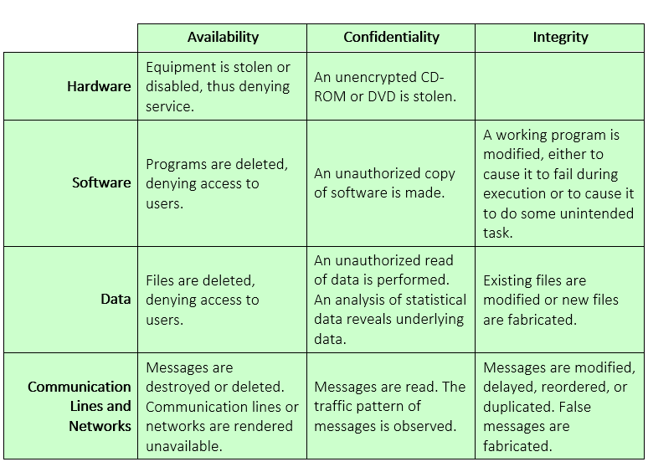
Examples of threats

Slide 17
Categorization of Attacks
Wiretapping: An unauthorized party gains access to an asset. This is an attack on confidentiality.
Modification : An unauthorized party not only gains access to but tampers with an asset. This is an attack on integrity.
Denial of Service : An asset of system is destroyed or becomes unavailable or unusable. This is an attack on availability.
Notes:
Confidentiality: a good example is cryptography, which traditionally is used to protect secret messages. But cryptography is traditionally used to protect data, not resources. Resources are protected by limiting information, for example by using firewalls or address translation mechanisms.
Integrity: a good example here is that of an interrupted database transaction, leaving the database in an inconsistent state (this foreshadows the Clark-Wilson model). Trustworthiness of both data and origin affects integrity, as noted in the book’s example. That integrity is tied to trustworthiness makes it much harder to quantify than confidentiality. Cryptography provides mechanisms for detecting violations of integrity, but not preventing them (e.g., a digital signature can be used to determine if data has changed).
Availability: this is usually defined in terms of “quality of service,” in which authorized users are expected to receive a specific level of service (stated in terms of a metric). Denial of service attacks are attempts to block availability.

Slide 18
Active/Passive Attacks
Passive Attacks :
The goal of the intruder is to obtain information being transmitted.
Ex. Release of message contents, traffic analysis.
Passive attacks are very difficult to detect because they do not involve any alteration of the data.

Slide 19
Active/Passive Attacks
Active Attacks :
Active attacks involve some modification of the data stream or the creation of a false stream.
Ex. Masquerade, replay, modification of the messages, denial of service (DoS).
Active attacks are easier to detect than passive attacks. The goal of security is to detect them and to recover from any disruption or delay caused by them

Slide 20
Attack surfaces
Attack surface: the reachable and exploitable vulnerabilities in a system
Open ports
Services outside a firewall
An employee with access to sensitive info
…
Three categories
Network attack surface (i.e., network vulnerability)
Software attack surface (i.e., software vulnerabilities)
Human attack surface (e.g., social engineering)
Attack analysis: assessing the scale and severity of threats
Notes:
Attack surface is total possible means of entry into a company -Decrease attack surface by having less web servers, reduce entry points to untrusted users.

Slide 21
Attack trees
A branching, hierarchical data structure that represents a set of potential vulnerabilities
Objective: to effectively exploit the info available on attack patterns
published on CERT or similar forums
Security analysts can use the tree to guide design and strengthen coiuntermeasures

Slide 22
Attack Trees—Graph Notation
Goal: Read file from password-protected PC.
Read File
Get Password
Search Desk
Social Engineer
Network Access
Physical Access
Boot with CD
Remove hard disk
Root node represents the goal of attack; Each subnode defines a subgoal of the attack; leaves represent different ways to initialize the attack.
Each node other than the leaf node is either an AND-node, or an OR-node.
Notes:
Graph represents decision-making process of attacker.
Root node represents goal; leaves represent methods of achieving goals.
Leaves become more specific lower in tree.
Most child nodes represent logical ORs, but some represent ANDs (get encrypted key file AND password used to encrypt it.)
Assign values to nodes, representing perceived risk, i.e. how feasible is the attack.

Slide 23
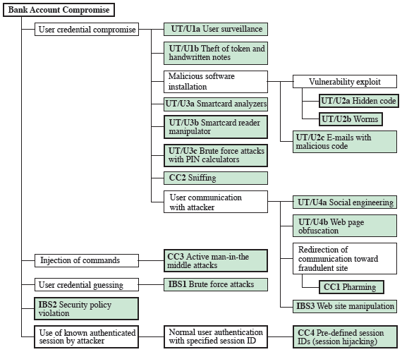
Another attack tree
UT/U: User Terminal and user
CC: Communication Channel
IBS: Internal Banking Service
Notes:
UT/U: User Terminal and user
CC: Communication Channel
IBS: Internal Banking Service

Slide 24
Cybersecurity Safeguards and Countermeasures
Functional Safeguards
Cryptography, Firewalls, Intrusion Detection
2. Procedural Safeguards
Administrative, Configuration, use
3. Policy Safeguards
Rules, Consequences, Regulations, Fines
Notes:
Briefly review some terminology used throughout the course.

Slide 25
Challenge of Security
Security is too often an afterthought to be incorporated into a system after the design is complete rather than being an integral part of the design process.
Despite years of research, it is still difficult to design systems that comprehensively prevent security flaws
But good practices for good design have been documented (analogous to software engineering)

Slide 26
Challenge of Security
Fundamental Security Design Principles
Economy of mechanism
Fail-Safe defaults
Complete mediation
Open Design
Separation of Privilege
Least Common Mechanism
Psychological Acceptability
Isolation,
Encapsulation
Modularity
Layering
Least astonishment

