Slide 1
Cryptography Basic Terms and Concepts
This lecture slide is mainly based on the power point slides by Professor Lawrie Brown, Dr. Junjie Zhang.

Slide 2




Cryptography
Cryptography is the art and science of secret writing
Crypto: hidden, secret
Graph: writing
“…… is about communication in the presence of adversaries” (R. Rivest)
message
Insecure channel
Alice
Bob
Adversaries

Slide 3
What’s the Cryptography
The original intelligible message, referred to as plaintext,
is converted into apparently random nonsense,
referred to as ciphertext. The encryption process consists
of an algorithm and a key.
Cryptography - study of encryption principles/methods
Cryptanalysis (codebreaking) - the study of principles/methods
of deciphering ciphertext without knowing key
Cryptology - the field of both cryptography and cryptanalysis

Slide 4
General Goals
Confidentiality: ensuring that information is accessible to those authorized to have access
Authentication: the process of proving one’s identity
Integrity: assuring the receiver that the received message has not been alerted in any way from the original

Slide 5
Cryptosystem
A cryptosystem is a 5-tuple consisting of
(E, D, M, K, C)
Where,
E is the set of encryption algorithms
D is the set of decryption algorithms
M is the set of plaintexts
K is the set of keys
C is the set of ciphertexts
E: M × K -> C
D: C × K -> M

Slide 6


Cryptosystem
plaintext
Encrypt (Enc)
ciphertext
ciphertext
Decrypt (Dec)
plaintext
Alice
Bob
key
key
Symmetric-key cryptosystem: cryptosystem that uses the same key for encryption and decryption
Asymmetric-key cryptosystem: cryptosystem that uses a public-key/private-key pair for encryption and decryption

Slide 7

Symmetric-Key Cryptosystem
plaintext
Encrypt (E)
ciphertext
ciphertext
Decrypt (D)
plaintext
Alice
Bob
key
key
Enc(key, plaintext) = ciphertext
Dec(key, ciphertext) = plaintext

Slide 8
Asymmetric-Key Cryptosystem Public Key Cryptosystem
plaintext
Encrypt (E)
ciphertext
ciphertext
Decrypt (D)
plaintext
Alice
Bob
S_{Alice}, K_{Alice}
K_{Bob}
S_{Bob}
S_{Bob}, K_{Bob}
Enc(K_{Bob}, plaintext) = ciphertext
Dec(S_{Bob}, ciphertext) = plaintext

Slide 9
Cryptanalysis
Cryptanalysis
How to break a cryptosystem?
How secure is a cryptosystem?
Basic principles to define security properties of cryptosystems
Algorithms are public
Secrets are secret
Adversary is bounded
Computational hardness assumptions

Slide 10
Cryptanalysis
Three types of attacks
Ciphertext only attack
Known plaintext attack
Chosen plaintext attack

Slide 11
Ciphertext Only Attack
Given: the ciphertext
Goal: find its corresponding plaintext or the key
plaintext
Encrypt (E)
ciphertext
Alice
Key
Adversaries

Slide 12
Known Plaintext Attack
Given: the plaintext and its ciphertext
Goal: find the key
plaintext
Encrypt (E)
ciphertext
Alice
Key
Adversaries

Slide 13
Chosen Plaintext Attack
Given: the specific plaintext and its corresponding ciphertext
Goal: find the key
Encrypt (E)
ciphertext
Alice
Key
Plaintext
Adversaries

Slide 14
Types of Cryptanalytic Attacks
Type of Attack | Known to Cryptanalyst
Ciphertext Only | • Encryption algorithm • Ciphertext
Known Plaintext | • Encryption algorithm • Ciphertext • One or more plaintext-ciphertext pairs formed with the secret key
Chosen Plaintext | • Encryption algorithm • Ciphertext • Plaintext message chosen by cryptanalyst, together with its corresponding ciphertext generated with the secret key
Chosen Ciphertext | • Encryption algorithm • Ciphertext • Ciphertext chosen by cryptanalyst, together with its corresponding decrypted plaintext generated with the secret key
Chosen Text | • Encryption algorithm • Ciphertext • Plaintext message chosen by cryptanalyst, together with its corresponding ciphertext generated with the secret key • Ciphertext chosen by cryptanalyst, together with its corresponding decrypted plaintext generated with the secret key

Slide 15
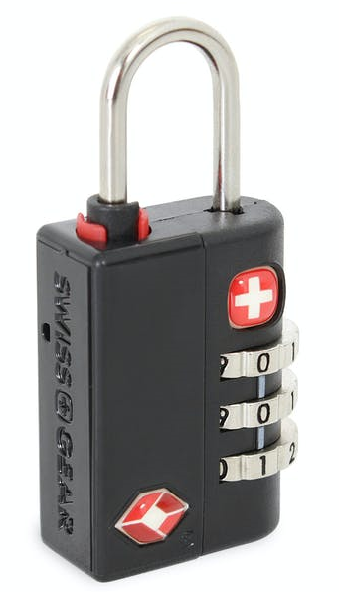
Types of Attacks
Brute-force Attacks:
How many key combinations?
Cryptanalysis Attacks: Linear Cryptanalysis
Differential Cryptanalysis

Slide 16
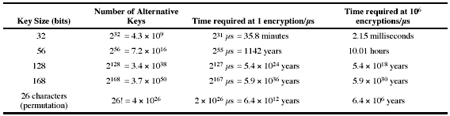
Brute Force Search
Always possible to simply try every key
Most basic attack, proportional to key size
Assume either know / recognize plaintext

