Slide 1
Modes of Operation
This lecture is mainly based on the power point slides by Professor Lawrie Brown.
Notes:
Zili Shao

Slide 2
How to use DES/AES?
Four modes of operations were defined for DES in ANSI standard ANSI X3.106-1983 Modes of Use
subsequently now have 5 for DES and AES
have block and stream modes
http://www.itl.nist.gov/fipspubs/fip81.htm
CEG 260, Meilin Liu
Notes:
Zili Shao
DES (or any block cipher) forms a basic building block, which en/decrypts a fixed sized block of data. However to use these in practise, we usually need to handle arbitrary amounts of data, which may be available in advance (in which case a block mode is appropriate), and may only be available a bit/byte at a time (in which case a stream mode is used).

Slide 3
Handle long messages
Block ciphers encrypt fixed size blocks
eg. DES encrypts 64-bit blocks, with 56-bit key
How to encrypt arbitrary amount of information ?
  Message is broken into blocks of 64 bits
  At end of message, handle possible last short block
    by padding either with known non-data value (eg nulls)
    or pad last block with count of pad size
      eg. [ b1 b2 b3 05 05 05 05 05] <- 3 data bytes, then 5 bytes pad+count
  Then they are encrypted and decrypted in various combinations of keys and texts.
CEG 260, Meilin Liu
Notes:
Zili Shao
DES (or any block cipher) forms a basic building block, which en/decrypts a fixed sized block of data. However to use these in practise, we usually need to handle arbitrary amounts of data, which may be available in advance (in which case a block mode is appropriate), and may only be available a bit/byte at a time (in which case a stream mode is used).

Slide 4
PKCS #7 padding
PKCS#7 padding:
PKCS#7 Padding is in whole bytes. The value of each added byte is the number of bytes that are added, i.e. N bytes, each of value N are added. The number of bytes added will depend on the block boundary to which the message needs to be extended.
Example: [ b1 b2 b3 05 05 05 05 05] <- 3 data bytes, then 5 bytes pad+count
Example: In the following example the block size is 8 bytes and padding is required for 4 bytes
... | DD DD DD DD DD DD DD DD | DD DD DD DD 04 04 04 04 |
If the original data is a multiple of N bytes, then an extra block of bytes with value N is added (if no pad needed, add a dummy block).
... | DD DD DD DD DD DD DD DD | 08 08 08 08 08 08 08 08 |
PKCS#5 padding is identical to PKCS#7 padding, except that it has only been defined for block ciphers that use a 64 bit (8 byte) block size. In practice the two can be used interchangeably.
CEG 260, Meilin Liu
Notes:
Zili Shao
DES (or any block cipher) forms a basic building block, which en/decrypts a fixed sized block of data. However to use these in practise, we usually need to handle arbitrary amounts of data, which may be available in advance (in which case a block mode is appropriate), and may only be available a bit/byte at a time (in which case a stream mode is used).

Slide 5
Electronic Codebook Book (ECB)
Use it as a substitution cipher for letters of 64 bits long.
  message is broken into independent blocks which are encrypted
  each block is a value which is substituted, like a codebook
  each block is encoded independently of the other blocks
  C_{i} = DES(K, P_{i})
CEG 260, Meilin Liu
Notes:
Zili Shao
ECB is the simplest of the modes, where each block is en/decrypted independently of all the other blocks, and is used when only a single block of info needs to be sent (eg. a session key encrypted using a master key).

Slide 6
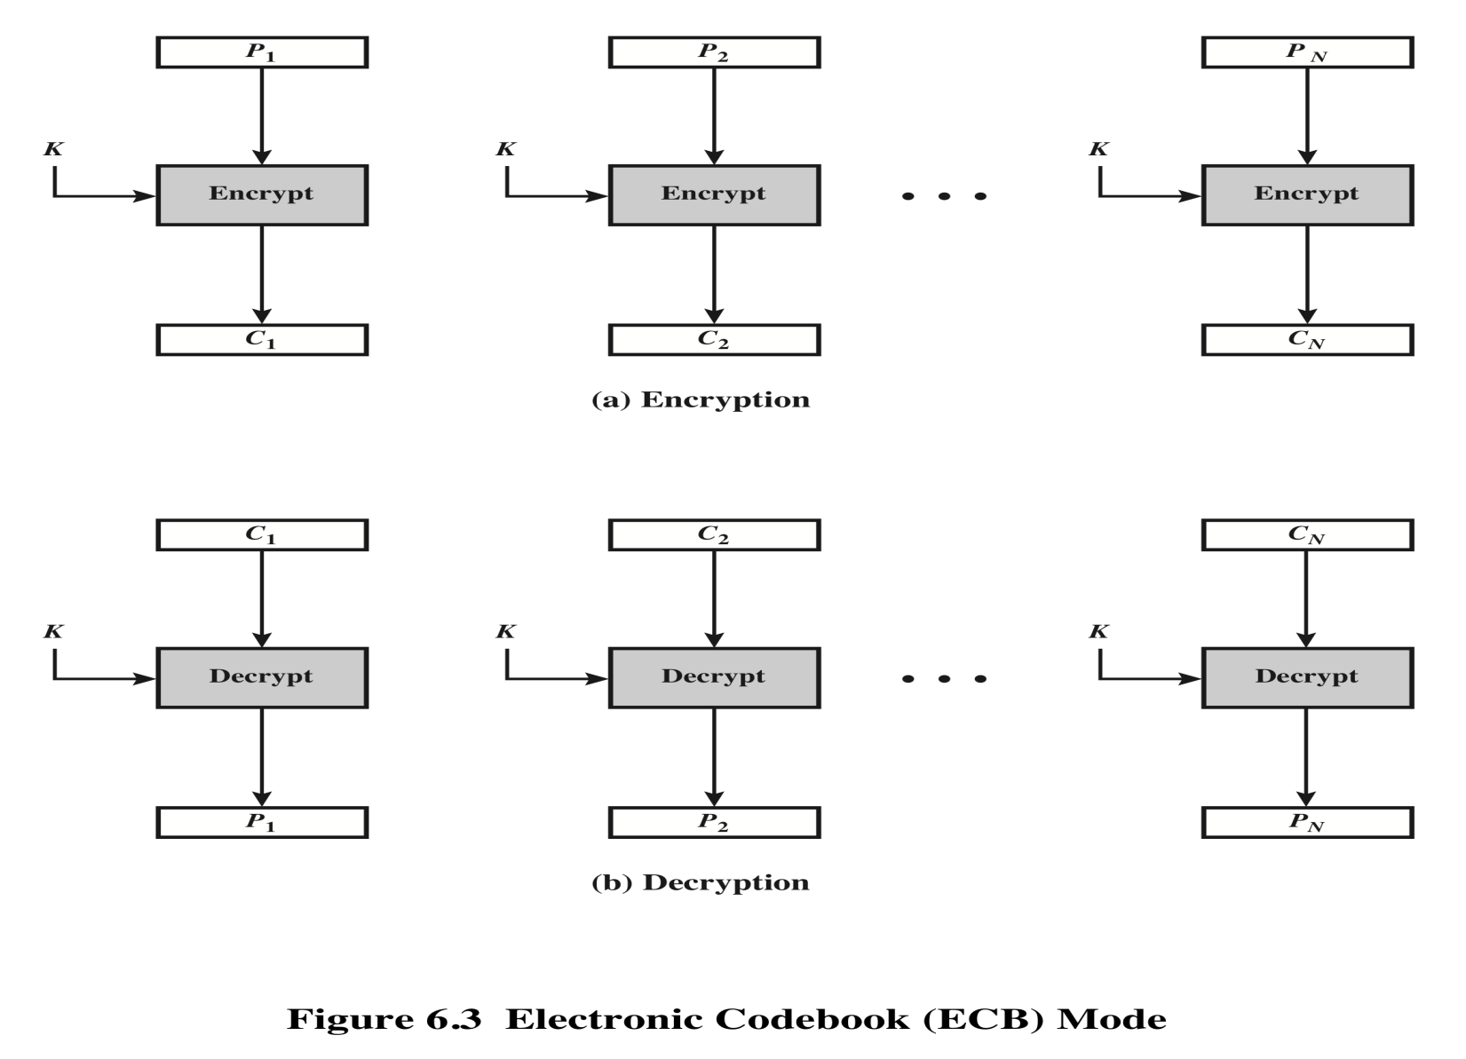
Electronic Codebook Mode (ECB)
Notes:
The simplest mode is the electronic codebook (ECB ) mode, in which plaintext
is handled one block at a time and each block of plaintext is encrypted using the
same key (Figure 6.3). The term codebook is used because, for a given key, there is
a unique ciphertext for every b -bit block of plaintext. Therefore, we can imagine a
gigantic codebook in which there is an entry for every possible b -bit plaintext pattern
showing its corresponding ciphertext.
For a message longer than b bits, the procedure is simply to break the message
into b -bit blocks, padding the last block if necessary. Decryption is performed one
block at a time, always using the same key. In Figure 6.3, the plaintext (padded as
necessary) consists of a sequence of b -bit blocks, P₁ , P₂ , . . . , P_{N} ; the corresponding
sequence of ciphertext blocks is C₁ , C₂ , . . . , C_{N} . We can define ECB mode as
follows.
ECB C_{j} = E(K, Pj) j = 1, . . . , N P_{j} = D(K, Cj₎ j = 1, . . . , N
The ECB method is ideal for a short amount of data, such as an encryption
key. Thus, if you want to transmit a DES or AES key securely, ECB is the appropriate
mode to use.
The most significant characteristic of ECB is that if the same b -bit block of
plaintext appears more than once in the message, it always produces the same
ciphertext.
For lengthy messages, the ECB mode may not be secure. If the message is
highly structured, it may be possible for a cryptanalyst to exploit these regularities.
For example, if it is known that the message always starts out with certain
predefined fields, then the cryptanalyst may have a number of known plaintext–
ciphertext pairs to work with. If the message has repetitive elements with a
period of repetition a multiple of b bits, then these elements can be identified by the
analyst. This may help in the analysis or may provide an opportunity for substituting
or rearranging blocks.

Slide 7

Alice Hates ECB Mode
Alice’s uncompressed image, and ECB encrypted (TEA)
Why does this happen?
Same plaintext yields same ciphertext!
Part 1 ⎯ Cryptography <number>

Slide 8
Advantages and Limitations of ECB
Repetitions in message may show in ciphertext
  if aligned with message block
  particularly with data such as graphics
  or with messages that change very little, which become a code-book analysis problem
Good for a small amount of data
Typical application: secure transmission of a single value such as a session key for transmission.
Weakness: output the same ciphertext for the same block of 64 bits.
CEG 260, Meilin Liu
Notes:
Zili Shao
ECB is not appropriate for any quantity of data, since repetitions can be seen, esp. with graphics, and because the blocks can be shuffled/inserted without affecting the en/decryption of each block.

Slide 9
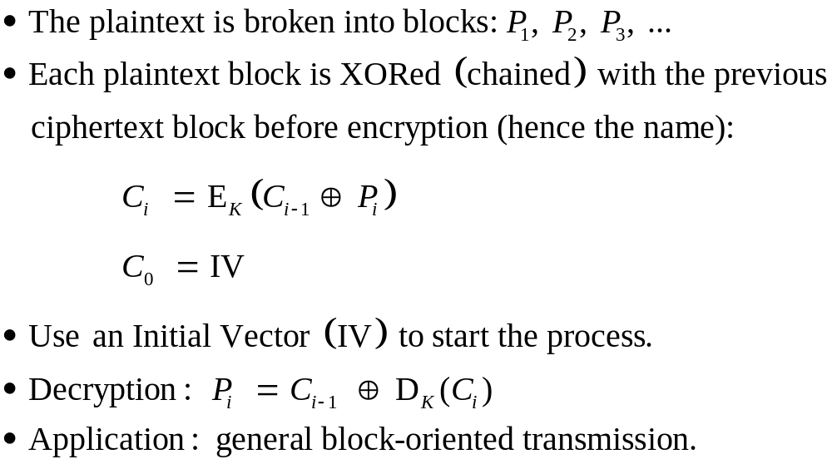
Cipher Block Chaining (CBC)

Slide 10
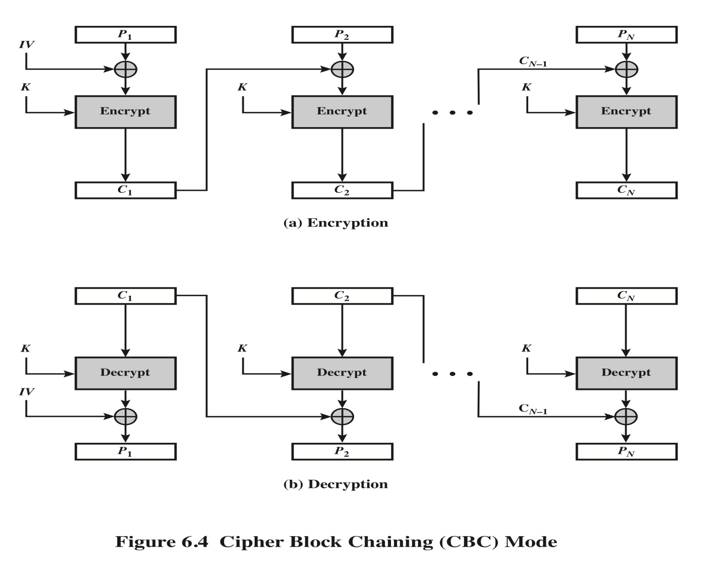
Cipher Block Chaining (CBC)
CEG 260, Meilin Liu
Notes:
Zili Shao
Stallings Fig 3.12

Slide 11
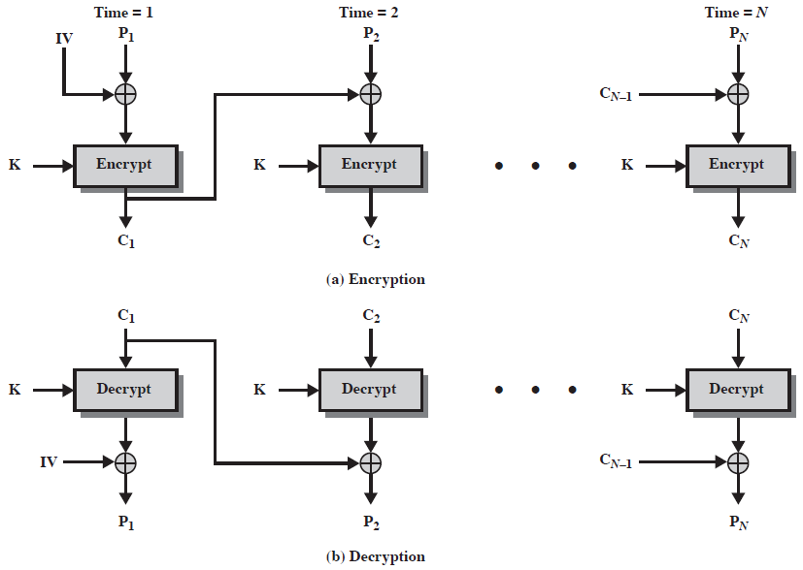
Cipher Block Chaining (CBC)

Slide 12
Advantages and Limitations of CBC
Each ciphertext block depends on all message blocks proceeding it
A change in the message affects all ciphertext blocks after the change as well as the original block
Initial Value (IV) need to be known to sender & receiver
  If IV is sent in the clear, an attacker can change bits of the first block, and change IV to compensate
    Either IV must be a fixed value (as in EFTPOS) or it must be sent encrypted in ECB mode before rest of message
Applications: bulk data encryption, authentication
CEG 260, Meilin Liu
Notes:
Zili Shao
CBC is the generally used block mode. The chaining provides an avalanche effect, which means the encrypted message
cannot be changed or rearranged without totally destroying the subsequent data.
One issue is how to handle the last block, which may well not be complete. In general have to pad this block (typically with 0's), and then must recognise padding at other end - may be obvious (eg in text the 0 value should usually not occur), or otherwise must explicitly have the last byte as a count of how much padding was used (including the count). Note that if this is done, if the last block IS an even multiple of 8 bytes, will have to add an extra block, all padding so as to have a count in the last byte.

Slide 13

Alice Likes CBC Mode
Alice’s uncompressed image, Alice CBC encrypted (TEA)
Why does this happen?
Same plaintext yields different ciphertext!
Part 1 ⎯ Cryptography <number>

Slide 14
Cipher FeedBack (CFB)
Message is treated as a stream of bits
Bitwise-added to the output of the block cipher
Result is feed back for next stage (hence name)
Standard allows any number of bit (1,8 or 64 or whatever) to be feed back
  denoted CFB-1, CFB-8, CFB-64 etc
    C_{i} = P_{i} XOR S_{s}[DES_{K}(R_{i-1})]
    R₀ = IV , R_{i} = LeftShift_{s} (R_{i-1}, C_{i-1})
    Where S_{s}[X] stands for the most significant s bits.
    LeftShift_{s}(X,Y) shifts X to the left by s bits and put Y in place of the rightmost s bits.
Exercise: How to do decryptions? (there is some error in the next page).
CEG 260, Meilin Liu
Notes:
Zili Shao
If the data is only available a bit/byte at a time (eg. terminal session, sensor value etc), then must use some other approach to encrypting it, so as not to delay the info. Idea here is to use the block cipher essentially as a pseudo-random number generator (see stream cipher lecture later) and to combine these "random" bits with the message. Note as mentioned before, XOR is an easily inverted operator (just XOR with same thing again to undo). Again start with an IV to get things going, then use the ciphertext as the next input. As originally defined, idea was to "consume" as much of the "random" output as needed for each message unit (bit/byte) before "bumping" bits out of the buffer and re-encrypting. This is wasteful though, and slows the encryption down as more encryptions are needed. An alternate way to think of it is to generate a block of "random" bits, consume them as message bits/bytes arrive, and when they're used up, only then feed a full block of ciphertext back. This is CFB-64 mode, the most efficient. This is the usual choice for quantities of stream oriented data, and for authentication use.

Slide 15
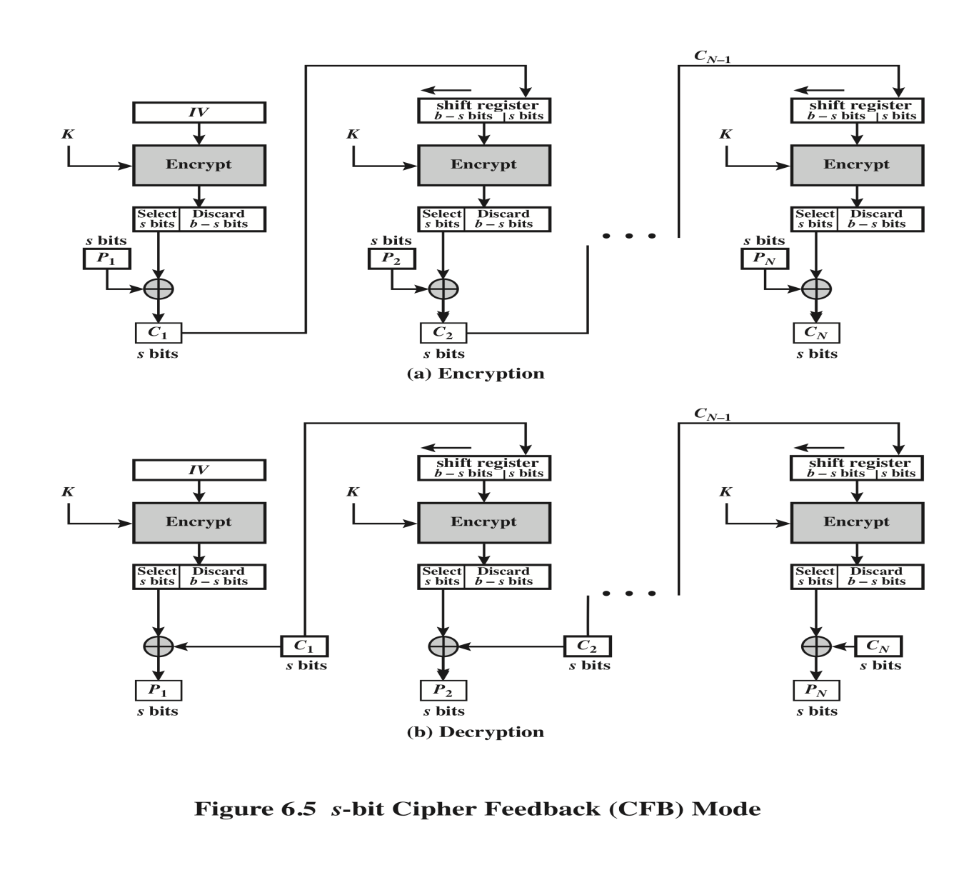
Cipher FeedBack (CFB)
CEG 260, Meilin Liu
Notes:
Zili Shao
Stallings Fig 3.13

Slide 16
Advantages and Limitations of CFB
Appropriate when data arrives in a fixed size
Most commonly used stream mode
Limitation: need to stall while do block encryption after every n-bits
note that the block cipher (DES) is used in encryption mode at both ends (of encryption and decryption)
Applications: stream data encryption, authentication
CEG 260, Meilin Liu
Notes:
Zili Shao
CFB is the usual stream mode. As long as can keep up with the input, doing encryptions every 8 bytes. A possible problem is that if its used over a "noisy" link, then any corrupted bit will destroy values in the current and next blocks (since the current block feeds as input to create the random bits for the next). So either must use over a reliable network transport layer (pretty usual) or use OFB.

Slide 17
Output FeedBack (OFB)
Again, message is treated as a stream of bits
Output of cipher is added to message and used as feedback
  feedback is independent of message
  can be computed in advance
  C_{i} = P_{i} XOR O_{i}
  O_{i} = DES_{K1}(O_{i-1})
  O₀ = IV
Advantage: bit error in transmission does not propagate
CEG 260, Meilin Liu
Notes:
Zili Shao
The alternative to CFB is OFB. Here the generation of the "random" bits is independent of the message being encrypted. The advantage is that firstly, they can be computed in advance, good for bursty traffic, and secondly, any bit error only affects a single bit. Thus this is good for noisy links (eg satellite TV transmissions etc).

Slide 18
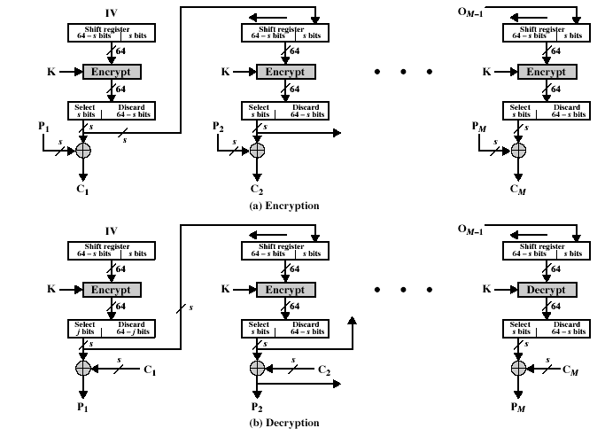
Output FeedBack (OFB)
CEG 260, Meilin Liu
Notes:
Zili Shao
Stallings Fig 3.14

Slide 19
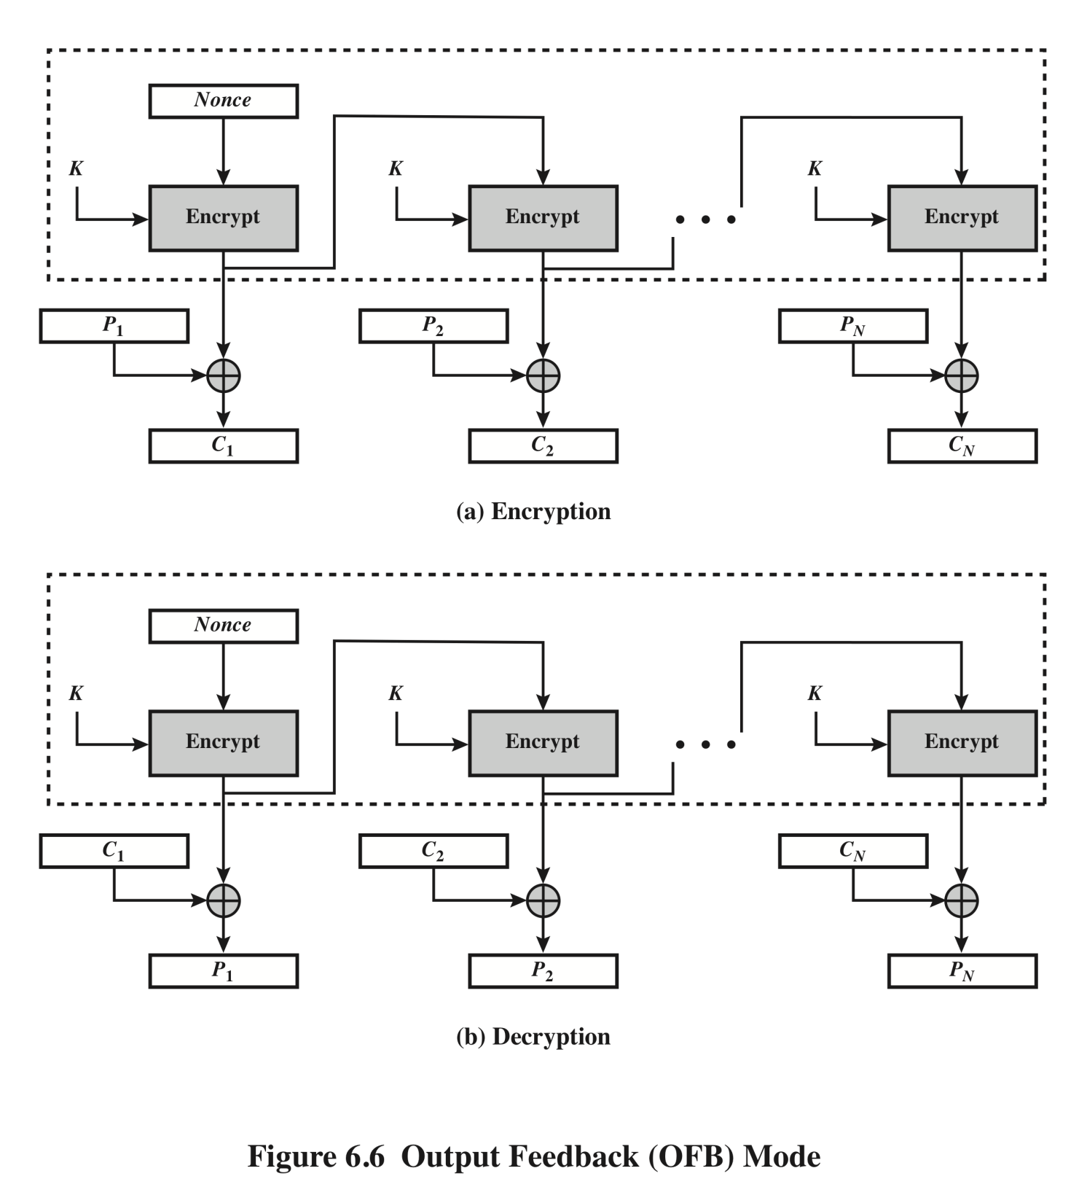
Output Feedback (OFB)
Mode
Notes:
The output feedback (OFB) mode is similar in structure to that of CFB. For OFB,
the output of the encryption function is fed back to become the input for encrypting
the next block of plaintext (Figure 6.6). In CFB, the output of the XOR unit is fed
back to become input for encrypting the next block. The other difference is that the
OFB mode operates on full blocks of plaintext and ciphertext, whereas CFB operates
on an s -bit subset.
As with CBC and CFB, the OFB mode requires an initialization vector. In
the case of OFB, the IV must be a nonce; that is, the IV must be unique to each
execution of the encryption operation. The reason for this is that the sequence of
encryption output blocks, O_{i} , depends only on the key and the IV and does not depend
on the plaintext. Therefore, for a given key and IV, the stream of output bits
used to XOR with the stream of plaintext bits is fixed. If two different messages had
an identical block of plaintext in the identical position, then an attacker would be
able to determine that portion of the O_{i} stream.
One advantage of the OFB method is that bit errors in transmission do not
propagate. For example, if a bit error occurs in C₁ , only the recovered value of P₁ is
affected; subsequent plaintext units are not corrupted. With CFB, C₁ also serves as
input to the shift register and therefore causes additional corruption downstream.
The disadvantage of OFB is that it is more vulnerable to a message stream
modification attack than is CFB. Consider that complementing a bit in the ciphertext
complements the corresponding bit in the recovered plaintext. Thus, controlled
changes to the recovered plaintext can be made. This may make it possible for an
opponent, by making the necessary changes to the checksum portion of the message
as well as to the data portion, to alter the ciphertext in such a way that it is not detected
by an error-correcting code. For a further discussion, see [VOYD83].
OFB has the structure of a typical stream cipher, because the cipher generates
a stream of bits as a function of an initial value and a key, and that stream of
bits is XORed with the plaintext bits (see Figure 3.1). The generated stream that is
XORed with the plaintext is itself independent of the plaintext; this is highlighted
by dashed boxes in Figure 6.6. One distinction from the stream ciphers we discuss
in Chapter 7 is that OFB encrypts plaintext a full block at a time, where typically a
block is 64 or 128 bits. Many stream ciphers encrypt one byte at a time.

Slide 20
Advantages and Limitations of OFB
Used when error feedback is a problem or where need to encryptions before message is available
Superficially similar to CFB
  but feedback is from the output of cipher and is independent of message
a variation of a Vernam cipher
  hence must never reuse the same sequence (key+IV)
Sender and receiver must remain in synchronization, and some recovery method is needed to ensure it
Originally specified with m-bit feedback in the standards
Subsequent research has shown that only OFB-64 should ever be used
Applications: stream encryption over noisy channels
CEG 260, Meilin Liu
Notes:
Zili Shao
Because the "random" bits are independent of the message, they must never ever be used more than once (otherwise the 2 ciphertexts can be combined, cancelling these bits, and leaving a "book" cipher to solve). Also, as noted, should only ever use a full block feedback ie OFB-64 mode.

Slide 21
Counter (CTR)
a “new” mode, though proposed early
similar to OFB but encrypts counter value rather than any feedback value
must have a different key & counter value for every plaintext block (never reused)
  C_{i} = P_{i} XOR O_{i}
  O_{i} = DES_{K}(i)
uses: high-speed network encryptions
CEG 260, Meilin Liu

Slide 22
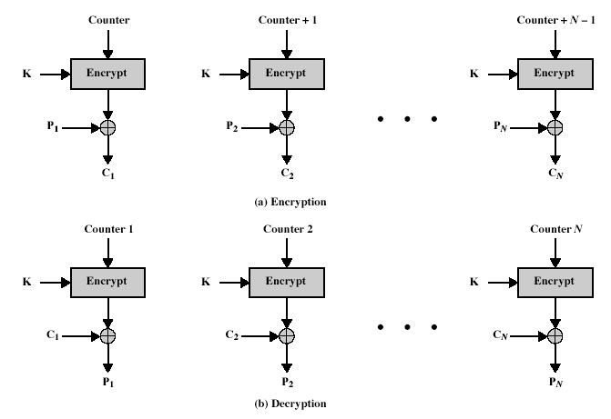
Counter (CTR)
CEG 260, Meilin Liu
Notes:
Zili Shao
Stallings Fig 3.15

Slide 23
Advantages and Limitations of CTR
Hardware efficiency
Software efficiency
Preprocessing
Random access to encrypted data blocks
Provable security: It can be shown that CTR is at least as secure as the other
modes discussed in this section.
  but must ensure never reuse key/counter values, otherwise could break (similar to OFB)
Simplicity
CEG 260, Meilin Liu

Slide 24
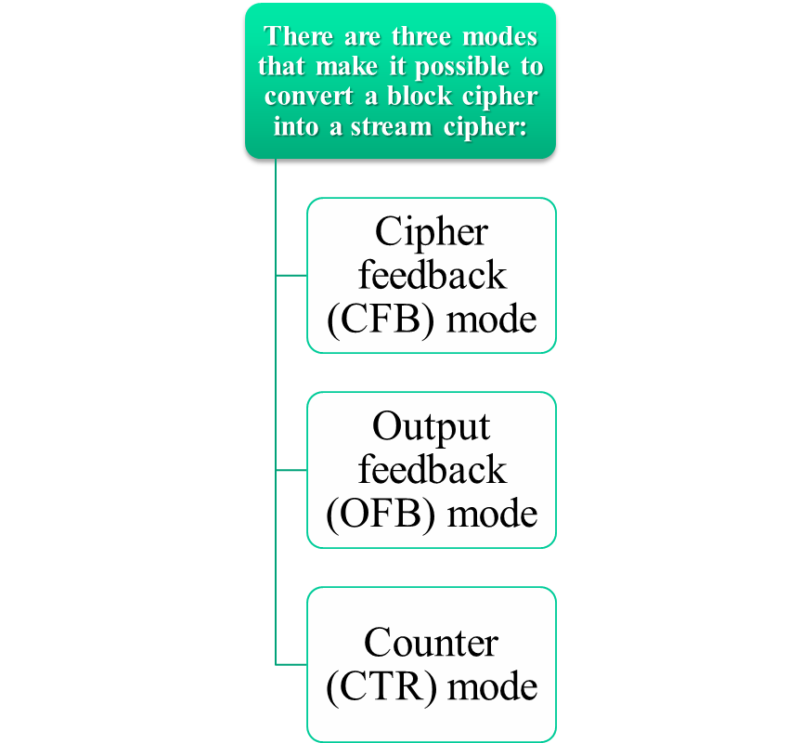
Converting Block Cipher to Stream Cipher
For AES, DES, or any block cipher, encryption is performed on a block of b bits
  In the case of DES b = 64
  In the case of AES b = 128
Notes:
For AES, DES, or any block cipher, encryption is performed on a block of b bits. In
the case of DES, b = 64 and in the case of AES, b = 128. However, it is possible
to convert a block cipher into a stream cipher, using one of the three modes to be
discussed in this and the next two sections: cipher feedback (CFB) mode, output
feedback (OFB) mode, and counter (CTR) mode. A stream cipher eliminates the
need to pad a message to be an integral number of blocks. It also can operate in
real time. Thus, if a character stream is being transmitted, each character can be
encrypted and transmitted immediately using a character-oriented stream cipher.
One desirable property of a stream cipher is that the ciphertext be of the same
length as the plaintext. Thus, if 8-bit characters are being transmitted, each character
should be encrypted to produce a ciphertext output of 8 bits. If more than 8 bits
are produced, transmission capacity is wasted.

Slide 25
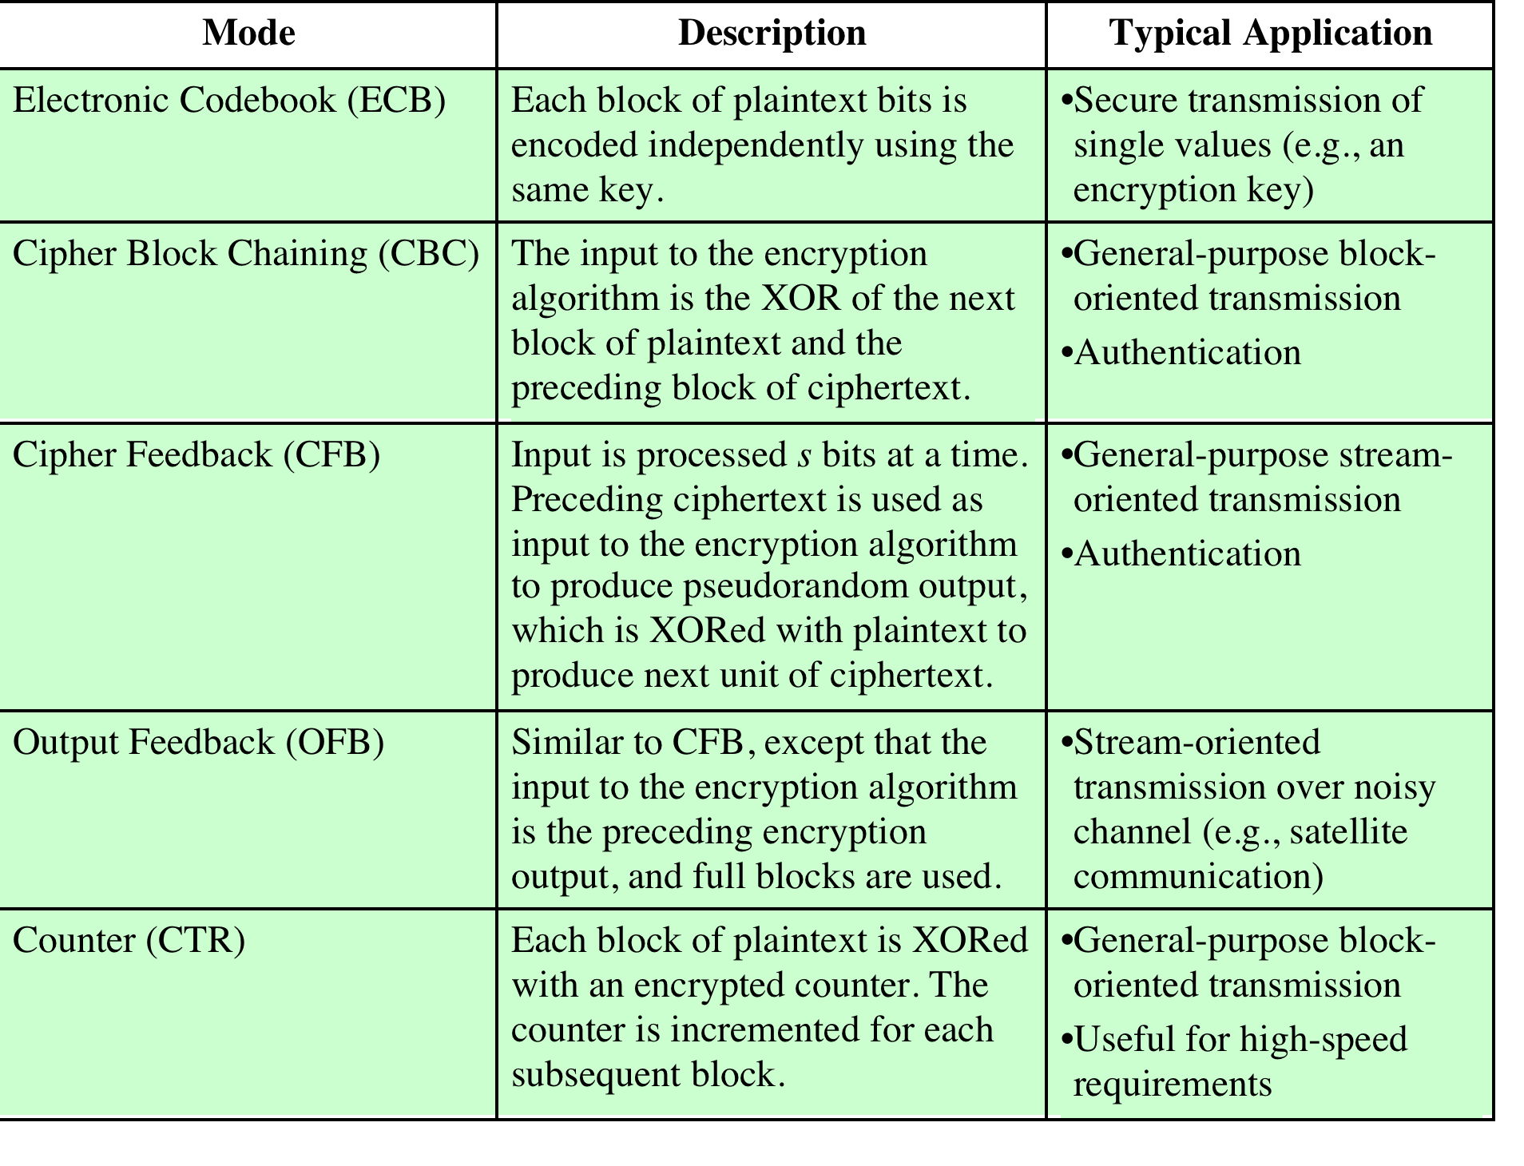
Notes:
The modes are summarized in Table 6.1 and described in this and the following sections.

Slide 26
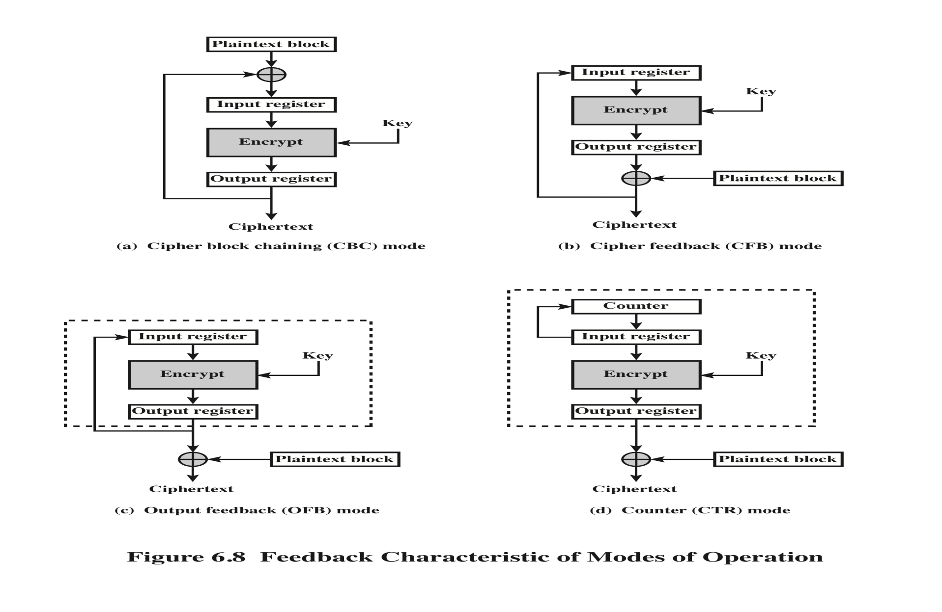
Feedback Characteristics of
Mode of Operation
Notes:
Note that, with the exception of ECB, all of the NIST-approved block
cipher modes of operation involve feedback. This is clearly seen in Figure 6.8. To
highlight the feedback mechanism, it is useful to think of the encryption function
as taking input from a input register whose length equals the encryption block
length and with output stored in an output register. The input register is updated
one block at a time by the feedback mechanism. After each update, the encryption
algorithm is executed, producing a result in the output register. Meanwhile,
a block of plaintext is accessed. Note that both OFB and CTR produce output
that is independent of both the plaintext and the ciphertext. Thus, they are natural
candidates for stream ciphers that encrypt plaintext by XOR one full block
at a time.

Slide 27
XTS-AES Mode for Block-Oriented Storage Devices
Approved as an additional block cipher mode of operation by NIST in 2010
Mode is also an IEEE Standard, IEEE Std 1619-2007
  Standard describes a method of encryption for data stored in sector-based devices where the threat model includes possible access to stored data by the adversary
  Has received widespread industry support
Notes:
In 2010, NIST approved an additional block cipher mode of operation, XTS-AES.
This mode is also an IEEE standard, IEEE Std 1619-2007, which was developed
by the IEEE Security in Storage Working Group (P1619). The standard describes
a method of encryption for data stored in sector-based devices where the threat
model includes possible access to stored data by the adversary. The standard has
received widespread industry support.

Slide 28
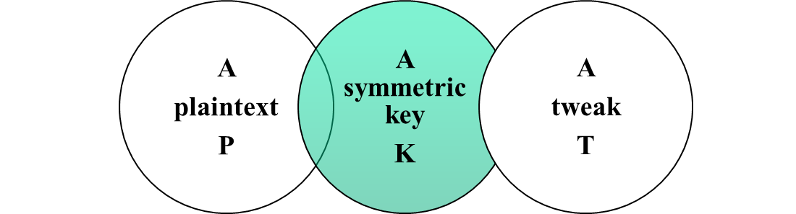
Tweakable Block Ciphers
XTS-AES mode is based on the concept of a tweakable block cipher
General structure:
  Has three inputs:
Tweak need not be kept secret
  Purpose is to provide variability
  Produces
  a ciphertext output
  C
Notes:
The XTS-AES mode is based on the concept of a tweakable block cipher , introduced
in [LISK02]. The form of this concept used in XTS-AES was first described
in [ROGA04].
Before examining XTS-AES, let us consider the general structure of a tweakable
block cipher. A tweakable block cipher is one that has three inputs: a plaintext P ,
a symmetric key K , and a tweak T ; and produces a ciphertext output C . We can
write this as C = E(K , T , P ). The tweak need not be kept secret. Whereas the purpose
of the key is to provide security, the purpose of the tweak is to provide variability.
That is, the use of different tweaks with the same plaintext and same key
produces different outputs.

Slide 29
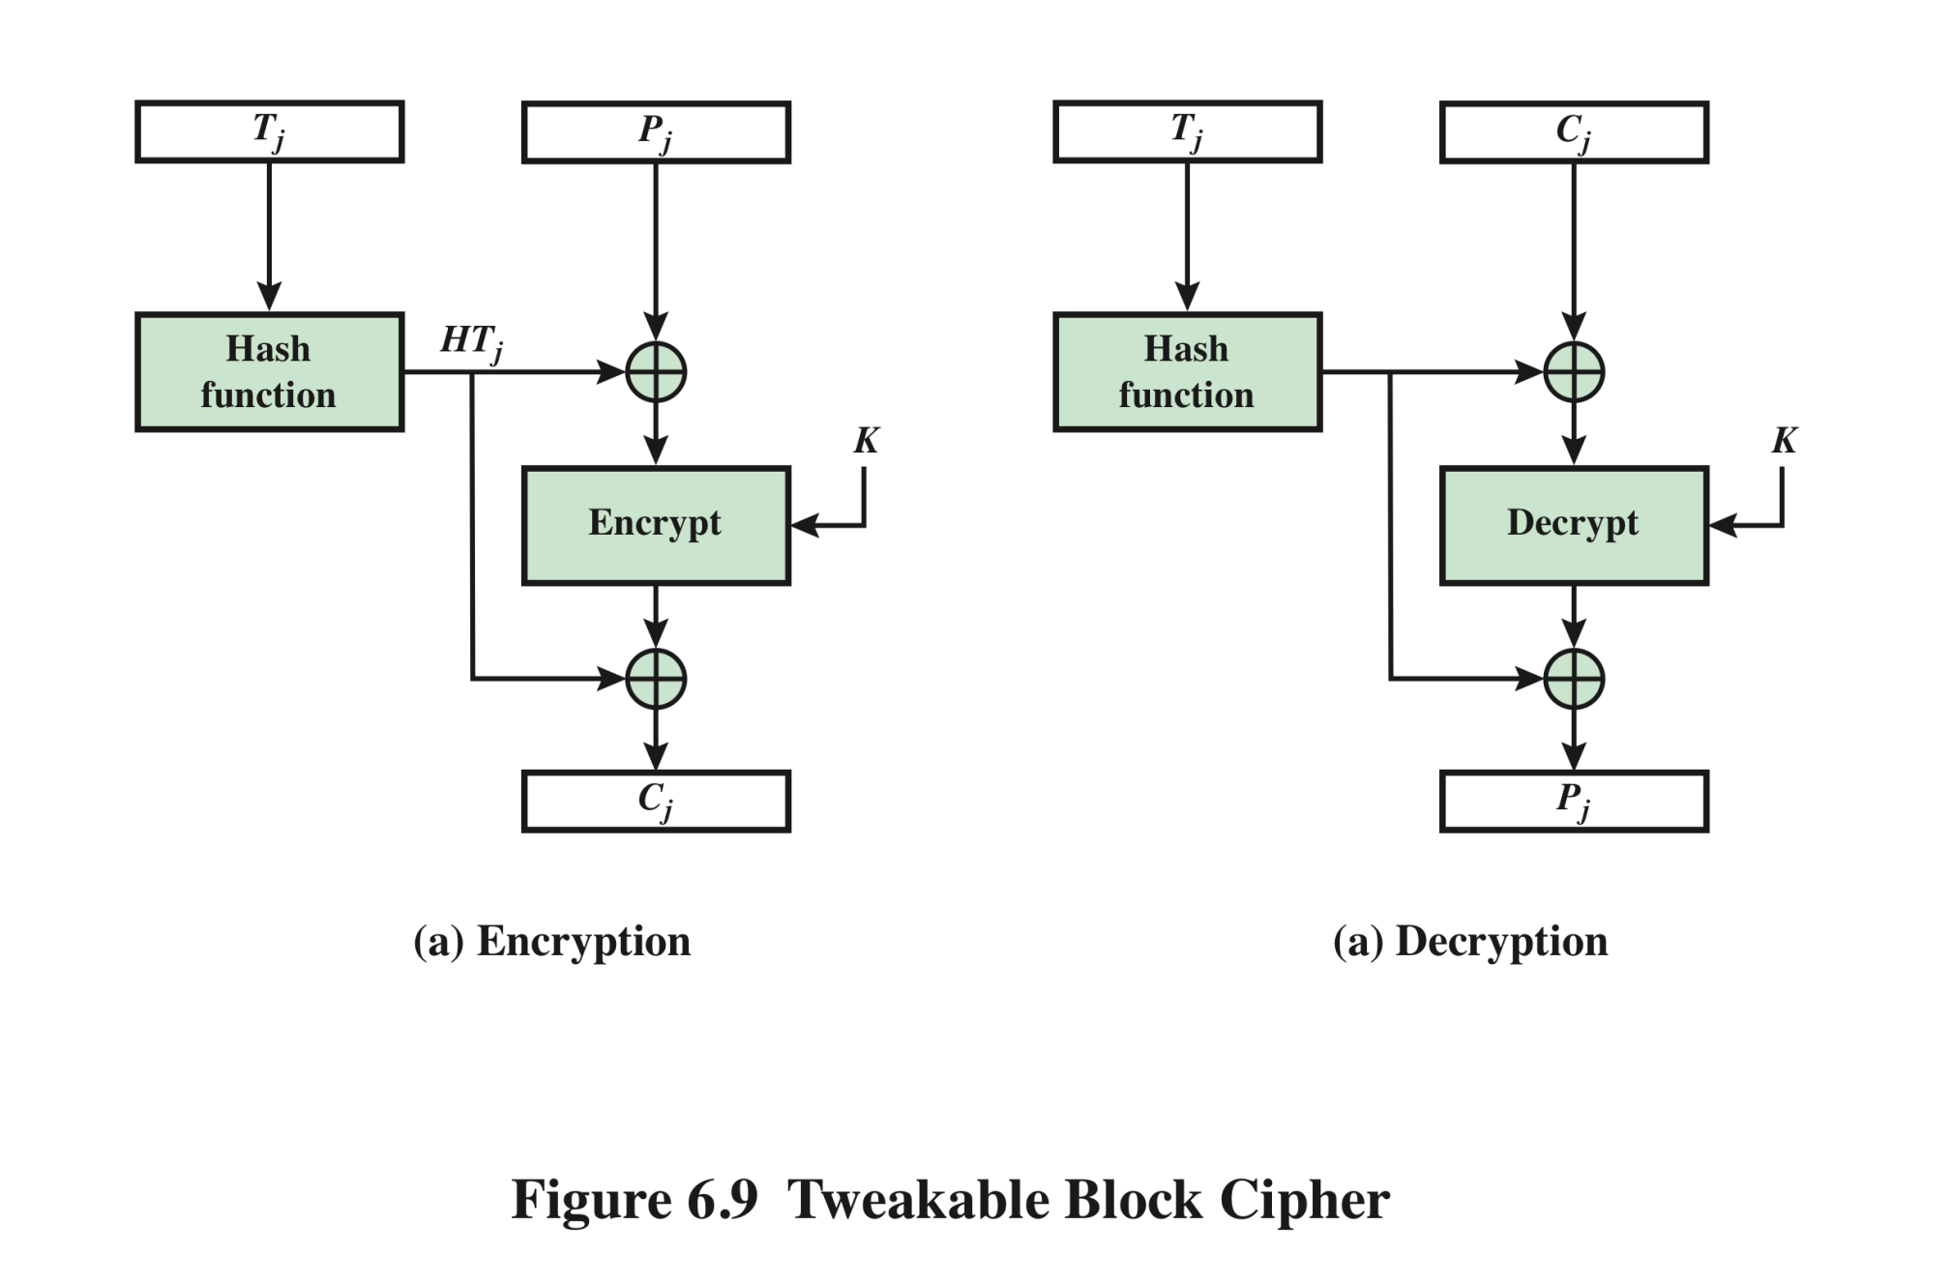
Tweakable Block Cipher
Notes:
The basic structure of several tweakable clock ciphers
that have been implemented is shown in Figure 6.9.

Slide 30
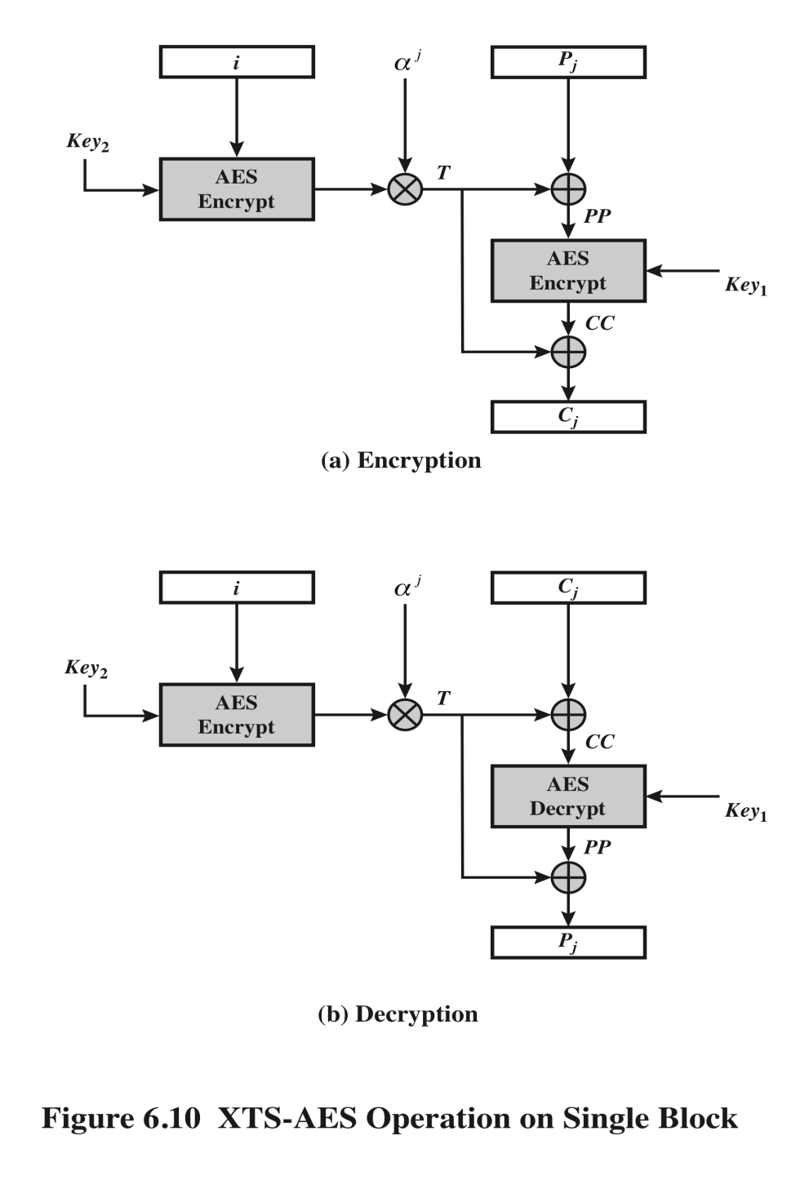
XTS-AES Operation on Single Block
Pj: the jth block of plaintext
Cj: the jth block of plaintext
Ji: 128-bit tweak: non-negative
Alpha: polynomial x 000:00010
Alpha^j: alpha multipied itself
j times in GF(2^128)
Bitwise XOR
Modulo multiplication of
two polynomials in GF (2^128)
with prime polynomial
M(x)=2^128+X^7+X^2+x+1
Notes:
Figure 6.10 shows the encryption and decryption of a single block. The operation involves
two instances of the AES algorithm with two keys.

Slide 31
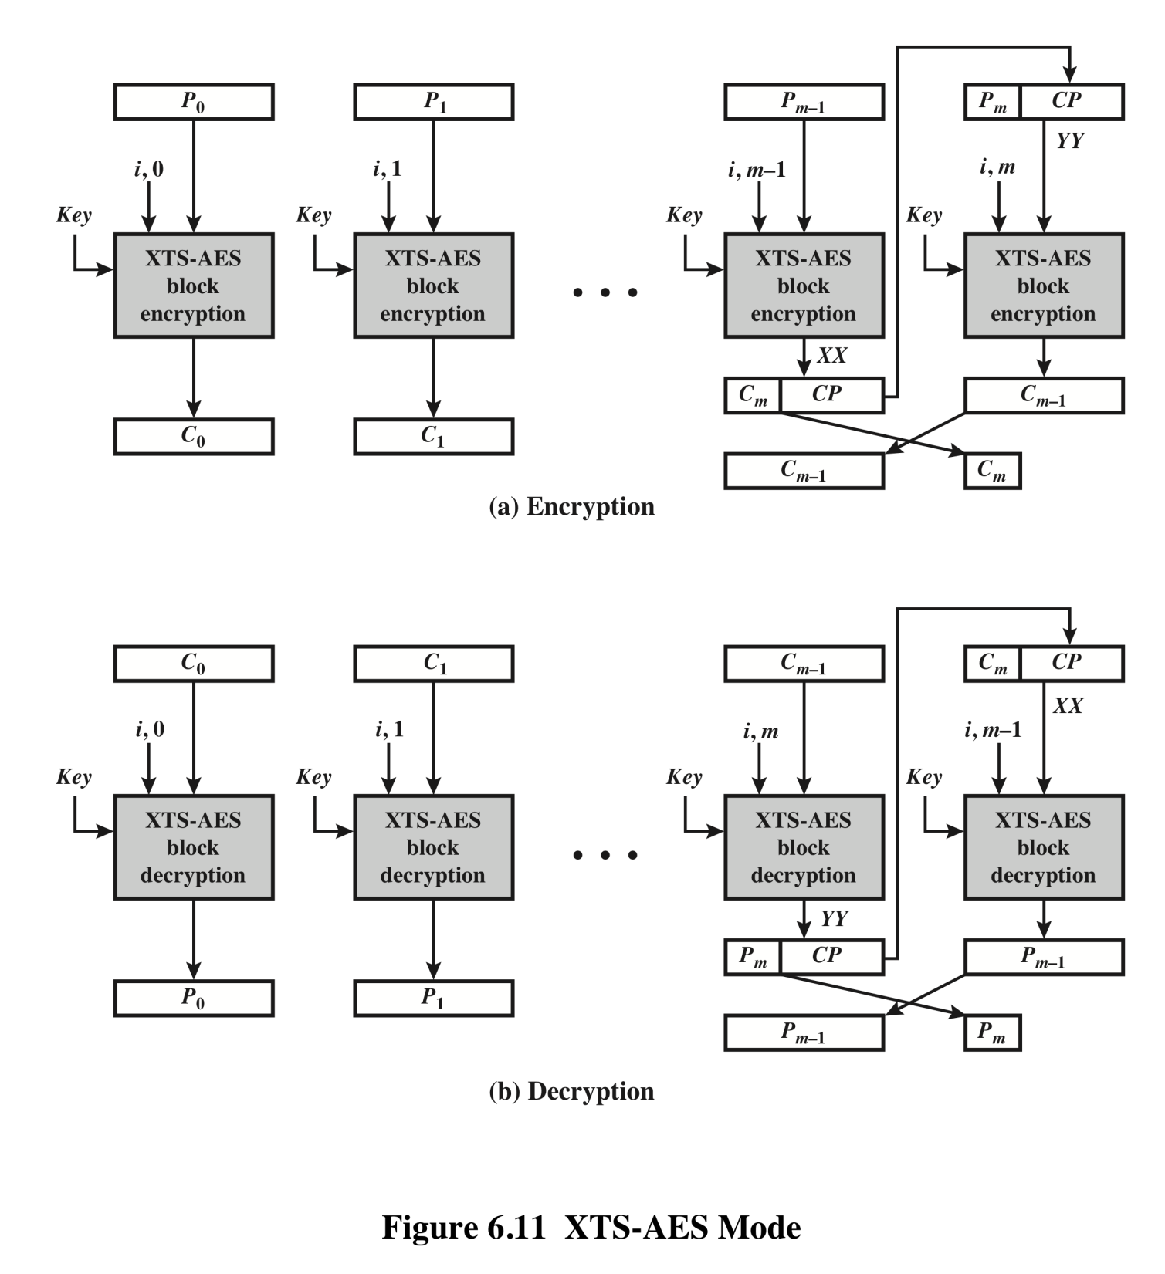
XTS–AES Mode
Notes:
The plaintext of a sector or data unit is organized into blocks of 128 bits. Blocks are
labeled P₀ , P₁ , . . . , P_{m} . The last block my be null or may contain from 1 to 127 bits.
In other words, the input to the XTS-AES algorithm consists of m 128-bit blocks
and possibly a final partial block.
As can be seen, XTS-AES mode, like CTR mode, is suitable for parallel operation.
Because there is no chaining, multiple blocks can be encrypted or decrypted
simultaneously. Unlike CTR mode, XTS-AES mode includes a nonce (the parameter
i ) as well as a counter (parameter j ).
For encryption and decryption, each block is treated independently and
encrypted/decrypted as shown in Figure 6.10. The only exception occurs when
the last block has less than 128 bits. In that case, the last two blocks are encrypted/
decrypted using a ciphertext-stealing technique instead of padding.
Figure 6.11 shows the scheme.

Slide 32
Summary
Electronic code book
Cipher block chaining mode
Cipher feedback mode
Output feedback mode
Counter mode
XTS-AES mode for block-oriented storage devices
  Storage encryption requirements
  Operation on a single block
  Operation on a sector
Notes:
Chapter 6 summary.

