Slide 1
RSA Algorithm
This lecture is mainly based on the power point slides by Professor Lawrie Brown.
Notes:
Zili Shao

Slide 2
Modular Arithmetic
In integer arithmetic, if we divide a by n, we can get quotient q and remainder r. The relationship between these four integers can be shown as
  a= q*n+r
Here, we call a the dividend; n, the divisor; q, the quotient; and r, the remainder.
Modulo operator for a positive integer n
  r = a mod n
equivalent to
  a = r + q*n
In Cryptograph, we need to impose two restrictions. First, we require that the divisor be a positive integer (n>0). Second, we require that the remainder be a nonnegative integer (r>=0).
Example:
  29 mod 13 = 3 13 mod 13 = 0 -1 mod 13 = 12
  29 = 3 + 2*13 13 = 0 + 1*13 12 = -1 + 1*13
CEG 260, Meilin Liu
Notes:
Zili Shao
All security policies and mechanisms rest on assumptions; we’ll examine some in later chapters, most notably Chapter 22, Malicious Logic. Here is a taste of the assumptions.
Policies: as these define security, they have to define security correctly for the particular site. For example, a web site has to be available, but if the security policy does not mention availability, the definition of security is inappropriate for the site. Also, a policy may not specify whether a particular state is “secure” or “non-secure.” This ambiguity causes problems.
Mechanisms: as these enforce policy, they must be appropriate. For example, cryptography does not assure availability, so using cryptography in the above situation won’t work. Further, security mechanisms rely on supporting infrastructure, such as compilers, libraries, the hardware, and networks to work correctly. Ken Thompson’s modified C preprocessor (see the example on p. 615) illustrates this point very well.

Slide 3
Congruent Modulo
Integers: Z ={…,-3,-2,-1,0,1,2,3,…}
Modulo n operation partition the integers into n sets
Z_{n}={0, 1, …, n-1}
Z₃={0, 1, 2} represents 3 sets
0 represent a residue class
Z7 ={0, 1, 2, 3, 4, 5, 6}
Z10 ={0, 1, 2, 3, 4, 5, 6, 7, 8, 9}
CEG 260, Meilin Liu
Notes:
Zili Shao

Slide 4
Facts About Numbers
Prime number p:
  p is an integer
  p >= 2
  The only divisors of p are 1 and p
Examples
  2, 7, 19 are primes
  -3, 1, 6 are not primes
Prime decomposition of a positive integer n:
  n = (p1^e1)*(p2^e2)*...*(pk^ek)
Example:
  200 = (2^3)*(5^2)
Fundamental Theorem of Arithmetic
  The prime decomposition of a positive integer is unique
CEG 260, Meilin Liu
Notes:
Zili Shao
All security policies and mechanisms rest on assumptions; we’ll examine some in later chapters, most notably Chapter 22, Malicious Logic. Here is a taste of the assumptions.
Policies: as these define security, they have to define security correctly for the particular site. For example, a web site has to be available, but if the security policy does not mention availability, the definition of security is inappropriate for the site. Also, a policy may not specify whether a particular state is “secure” or “non-secure.” This ambiguity causes problems.
Mechanisms: as these enforce policy, they must be appropriate. For example, cryptography does not assure availability, so using cryptography in the above situation won’t work. Further, security mechanisms rely on supporting infrastructure, such as compilers, libraries, the hardware, and networks to work correctly. Ken Thompson’s modified C preprocessor (see the example on p. 615) illustrates this point very well.

Slide 5
Greatest Common Divisor
The greatest common divisor (GCD) of two positive integers a and b, denoted gcd(a, b), is the largest positive integer that divides both a and b
The above definition is extended to arbitrary integers
Examples:
  gcd(18, 30) = 6
  gcd(0, 20) = 20
  gcd(-21, 49) = 7
Two integers a and b are said to be relatively prime if
  gcd(a, b) = 1
Example:
  Integers 15 and 28 are relatively prime
CEG 260, Meilin Liu
Notes:
Zili Shao
All security policies and mechanisms rest on assumptions; we’ll examine some in later chapters, most notably Chapter 22, Malicious Logic. Here is a taste of the assumptions.
Policies: as these define security, they have to define security correctly for the particular site. For example, a web site has to be available, but if the security policy does not mention availability, the definition of security is inappropriate for the site. Also, a policy may not specify whether a particular state is “secure” or “non-secure.” This ambiguity causes problems.
Mechanisms: as these enforce policy, they must be appropriate. For example, cryptography does not assure availability, so using cryptography in the above situation won’t work. Further, security mechanisms rely on supporting infrastructure, such as compilers, libraries, the hardware, and networks to work correctly. Ken Thompson’s modified C preprocessor (see the example on p. 615) illustrates this point very well.

Slide 6
Modular Arithmetic and Greatest Common Divisor
Modulo operator for a positive integer n
  r = a mod n
equivalent to
  a = r + kn
Example:
  29 mod 13 = 3 13 mod 13 = 0 -1 mod 13 = 12
  29 = 3 + 2*13 13 = 0 + 1*13 12 = -1 + 1*13
Modulo and GCD:
  gcd(a, b) = gcd(b, a mod b)
Example:
  gcd(21, 12) = 3 gcd(12, 21 mod 12) = gcd(12, 9) = 3
CEG 260, Meilin Liu
Notes:
Zili Shao
All security policies and mechanisms rest on assumptions; we’ll examine some in later chapters, most notably Chapter 22, Malicious Logic. Here is a taste of the assumptions.
Policies: as these define security, they have to define security correctly for the particular site. For example, a web site has to be available, but if the security policy does not mention availability, the definition of security is inappropriate for the site. Also, a policy may not specify whether a particular state is “secure” or “non-secure.” This ambiguity causes problems.
Mechanisms: as these enforce policy, they must be appropriate. For example, cryptography does not assure availability, so using cryptography in the above situation won’t work. Further, security mechanisms rely on supporting infrastructure, such as compilers, libraries, the hardware, and networks to work correctly. Ken Thompson’s modified C preprocessor (see the example on p. 615) illustrates this point very well.

Slide 7
Multiplicative Inverses
The residues modulo a positive integer n are the set
  Zn = {0, 1, 2, …, (n - 1)}, i.e., Zn = {x| 0≤x ≤ n-1, where x is a positive integer}.
Z7 ={0, 1, 2, 3, 4, 5, 6}
Z10 ={0, 1, 2, 3, 4, 5, 6, 7, 8, 9}
Let Zn* = {x| 1≤x ≤ n-1, where GCD(x, n)=1, and x is a positive integer}
Zn* is the subset of elements of Zn relative prime with n or the set of invertible elements in Zn.
Examples: for prime p, Zp* = {1,2,3,...,p-1}
Z7*={1, 2, 3, 4, 5, 6}
Z10*={1, 3, 7, 9}
CEG 260, Meilin Liu
Notes:
Zili Shao
All security policies and mechanisms rest on assumptions; we’ll examine some in later chapters, most notably Chapter 22, Malicious Logic. Here is a taste of the assumptions.
Policies: as these define security, they have to define security correctly for the particular site. For example, a web site has to be available, but if the security policy does not mention availability, the definition of security is inappropriate for the site. Also, a policy may not specify whether a particular state is “secure” or “non-secure.” This ambiguity causes problems.
Mechanisms: as these enforce policy, they must be appropriate. For example, cryptography does not assure availability, so using cryptography in the above situation won’t work. Further, security mechanisms rely on supporting infrastructure, such as compilers, libraries, the hardware, and networks to work correctly. Ken Thompson’s modified C preprocessor (see the example on p. 615) illustrates this point very well.

Slide 8
Multiplicative Inverses
The multiplicative inverse of a modulo m exists iff a and m are coprime (i.e., if gcd(a, m) = 1).
The modular multiplicative inverse of a modulo m, is an integer x belongs to Zm*, such that a*x =1 (mod m).
If the modular multiplicative inverse of a modulo m exists, the operation of division by a modulo m can be defined as multiplying by the inverse, i.e., b/a mod m =b*(a^-1) mod m, Here a^-1 is a’s multiplicative inverse.
CEG 260, Meilin Liu
Notes:
Zili Shao
All security policies and mechanisms rest on assumptions; we’ll examine some in later chapters, most notably Chapter 22, Malicious Logic. Here is a taste of the assumptions.
Policies: as these define security, they have to define security correctly for the particular site. For example, a web site has to be available, but if the security policy does not mention availability, the definition of security is inappropriate for the site. Also, a policy may not specify whether a particular state is “secure” or “non-secure.” This ambiguity causes problems.
Mechanisms: as these enforce policy, they must be appropriate. For example, cryptography does not assure availability, so using cryptography in the above situation won’t work. Further, security mechanisms rely on supporting infrastructure, such as compilers, libraries, the hardware, and networks to work correctly. Ken Thompson’s modified C preprocessor (see the example on p. 615) illustrates this point very well.

Slide 9
Multiplicative Inverses
Theorem: a has a multiplicative inverse modulo m, if and only if a is relative prime to m, i.e., GCD(a,m)=1.
Example: 3*x=1 mod 7, x = 1/3 mod 7
x=5, 3*5 mod 7 = 15 mod 7=1
1/3 mod 7 =5, since 5*3=1 mod 7
CEG 260, Meilin Liu
Notes:
Zili Shao
All security policies and mechanisms rest on assumptions; we’ll examine some in later chapters, most notably Chapter 22, Malicious Logic. Here is a taste of the assumptions.
Policies: as these define security, they have to define security correctly for the particular site. For example, a web site has to be available, but if the security policy does not mention availability, the definition of security is inappropriate for the site. Also, a policy may not specify whether a particular state is “secure” or “non-secure.” This ambiguity causes problems.
Mechanisms: as these enforce policy, they must be appropriate. For example, cryptography does not assure availability, so using cryptography in the above situation won’t work. Further, security mechanisms rely on supporting infrastructure, such as compilers, libraries, the hardware, and networks to work correctly. Ken Thompson’s modified C preprocessor (see the example on p. 615) illustrates this point very well.

Slide 10
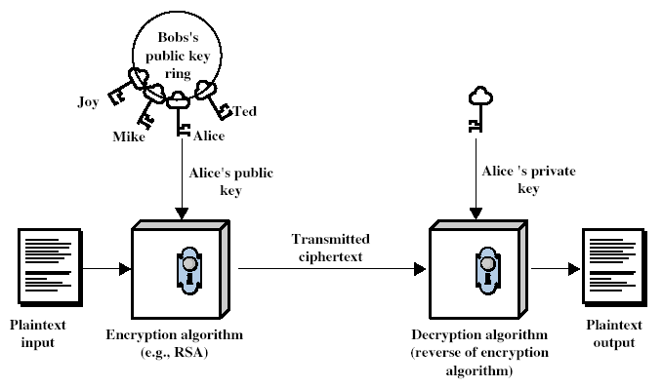
Public-Key Cryptography
CEG 260, Meilin Liu
Notes:
Zili Shao
Stallings Fig 9.1

Slide 11
Public key encryption
Bob: generates (PK, SK) and gives PK to Alice
Alice
Bob
m
E
c
c
D
m
pk
sk
Notes:
Note: asymmetric keys

Slide 12
Public-Key Cryptography
Public-key/two-key/asymmetric cryptography involves in, for each agent u, the use of its associated pair of keys <KU, KR> :
  the public key KU which is published under the user’s name in a ``public directory” accessible for everyone to read,
    can be used to encrypt messages, and verify signatures
  the private-key KR which is known only to the agent u,
    used to decrypt messages, and sign (create) signatures
It is asymmetric because
  Those who encrypt messages or verify signatures may not be able to decrypt messages or create signatures
CEG 260, Meilin Liu
Notes:
Zili Shao

Slide 13
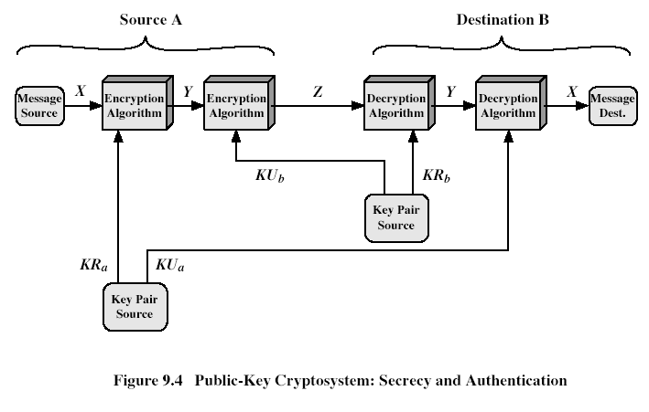
Use of Public-Key Cryptosystems
CEG 260, Meilin Liu
Notes:
Zili Shao
Stallings Fig 9.4
Here see various components of public-key schemes used for both secrecy and authentication. Note that separate key pairs are used for each of these – receiver owns and creates secrecy keys, sender owns and creates authentication keys.

Slide 14
Public-Key Applications
Three major categories:
  encryption/decryption (provide secrecy)
  digital signatures (provide authentication)
  key exchange (of session keys)
Some algorithms are suitable for all uses, others are specific to one
CEG 260, Meilin Liu
Notes:
Zili Shao

Slide 15
RSA
Published as
  Ron Rivest, Adi Shamir, and Leonard Adleman, "On Digital Signatures and Public Key Cryptosystems", Communications of the ACM, vol 21 no 2, pp120-126, Feb 1978

Slide 16
RSA Algorithm
Key Generation
  1. Select 2 large, distinct prime numbers about the same size, namely p and q (e.g., between 512 and 2048 bits)
  2. Compute n = qp and Φ(n)=(q-1)(p-1)
  3. Select e, 1 < e < Φ(n), where gcd(e, Φ(n))=1
  4. Determine d, where ed mod Φ(n) = 1
n is publicly known
e is the public key
d is the private key
Security relies on the difficulty of factoring large composite numbers
Notes:
In mathematics, the greatest common divisor (gcd) of two or more integers, when at least one of them is not zero, is the largest positive integer that divides the numbers without a remainder.

Slide 17
RSA Algorithm
Encryption
  Given a message M
  C = Me mod n (ciphertext)
Decryption
  Given a ciphertext C, use the private key d
  P = C^{d} mod n = (Me mod n)^{d} mod n = M^{ed} mod n = M

Slide 18
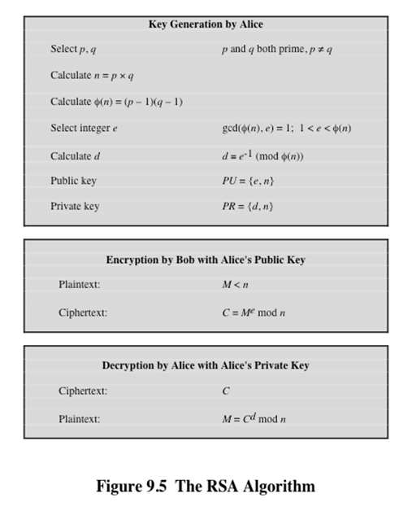
RSA Algorithm
CEG 260, Meilin Liu
Notes:
Zili Shao
So far all the cryptosystems discussed have been private/secret/single key (symmetric) systems. All classical, and modern block and stream ciphers are of this form.

Slide 19
An Example for RSA
p = 11, q = 7, n = 77
Φ(n) = 60
Select e = 37
Generate d = 13 (ed = 481; ed mod 60 = 1)
Let M = 15. Then C = Me mod n
  C = 15³⁷ (mod 77) = 71
M = C^{d} mod n
  M = 71¹³ (mod 77) = 15

Slide 20
RSA Applications
Very widely used:
  SSL/TLS: certificates and key-exchange
  Secure e-mail and file systems
  Many others
CEG 260, Meilin Liu
Notes:
Zili Shao

Slide 21
Key lengths
Security of public key system should be comparable to security of symmetric cipher:
RSA
Symmetric Cipher key-size Modulus size
80 bits 1024 bits
128 bits 3072 bits
256 bits (AES) 15360 bits

Slide 22
RSA Security
three approaches to attacking RSA:
  brute force key search (infeasible given size of numbers)
  mathematical attacks (based on difficulty of computing ø(N), by factoring modulus N)
  timing attacks (on running of decryption)
  Power Attack
  Faults Attack
CEG 260, Meilin Liu
Notes:
Zili Shao

Slide 23
Implementation attacks
Side channel attacks:
  Coming from a completely unexpected direction
  Ciphertext only attack.
Timing attack:
The time it takes to compute c^{d} (mod N) can expose d
Power attack:
The power consumption of a smartcard while it is computing c^{d} (mod N) can expose d.
Faults attack:
A computer error (reducing power) during c^{d} (mod N) can expose d.
A common defense:: check output. 10% slowdown.
Notes:
BB’04: Boneh-Brumley

Slide 24
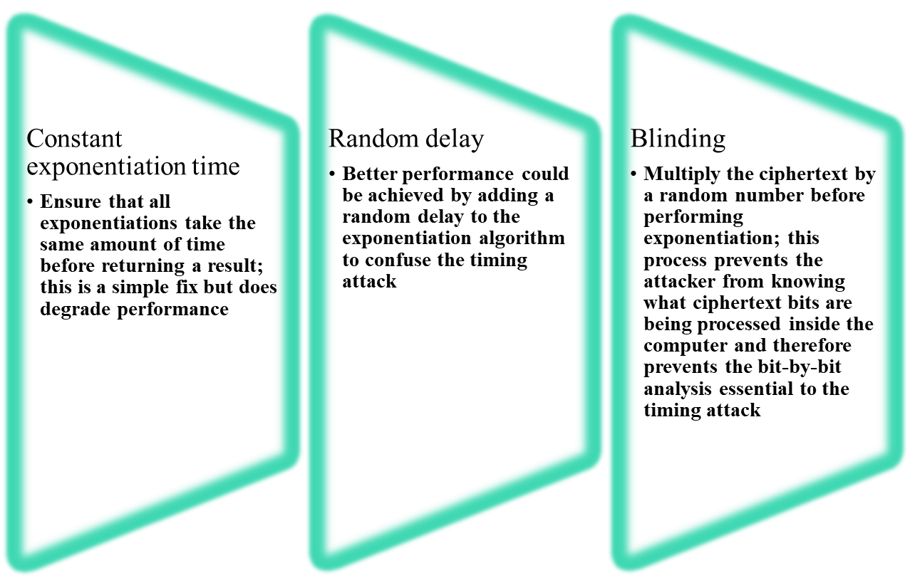
Countermeasures
Notes:
Although the timing attack is a serious threat, there are simple countermeasures
that can be used, including the following.
• Constant exponentiation time: Ensure that all exponentiations take the same
amount of time before returning a result. This is a simple fix but does degrade
performance.
• Random delay: Better performance could be achieved by adding a random
delay to the exponentiation algorithm to confuse the timing attack. Kocher
points out that if defenders don’t add enough noise, attackers could still succeed
by collecting additional measurements to compensate for the random delays.
• Blinding: Multiply the ciphertext by a random number before performing
exponentiation. This process prevents the attacker from knowing what ciphertext
bits are being processed inside the computer and therefore prevents the
bit-by-bit analysis essential to the timing attack.

