Slide 1
One Way Hash Function
This lecture is mainly based on the power point slides by Professor Lawrie Brown.
Notes:
Zili Shao

Slide 2
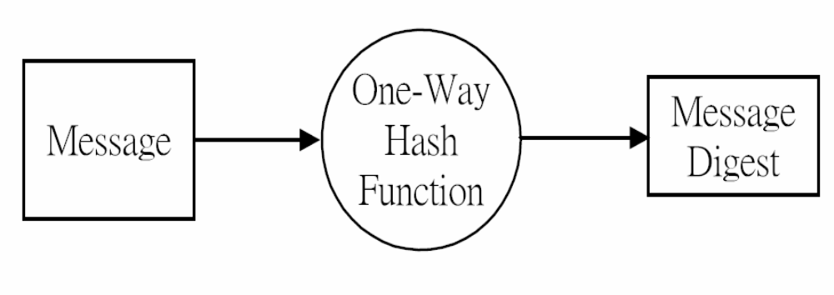
Hash and Message Digest
CEG 260, Meilin Liu
Notes:
Zili Shao
All security policies and mechanisms rest on assumptions; we’ll examine some in later chapters, most notably Chapter 22, Malicious Logic. Here is a taste of the assumptions.
Policies: as these define security, they have to define security correctly for the particular site. For example, a web site has to be available, but if the security policy does not mention availability, the definition of security is inappropriate for the site. Also, a policy may not specify whether a particular state is “secure” or “non-secure.” This ambiguity causes problems.
Mechanisms: as these enforce policy, they must be appropriate. For example, cryptography does not assure availability, so using cryptography in the above situation won’t work. Further, security mechanisms rely on supporting infrastructure, such as compilers, libraries, the hardware, and networks to work correctly. Ken Thompson’s modified C preprocessor (see the example on p. 615) illustrates this point very well.

Slide 3
Hash Functions
condenses arbitrary message to fixed size
  h = H(M)
usually assume that the hash function is public and not keyed
  MAC which is keyed
hash used to detect changes to message
can use in various ways with message
most often to create a digital signature
CEG 260, Meilin Liu
Notes:
Zili Shao
A variation on the message authentication code is the one-way hash function. As with the message authentication code, a hash function accepts a variable-size message M as input and produces a fixed-size output, referred to as a hash code H(M). Unlike a MAC, a hash code does not use a key but is a function only of the input message. The hash code is also referred to as a message digest or hash value.

Slide 4
Requirements for Hash Functions
can be applied to any sized message M
produces fixed-length output h
is easy to compute h=H(M) for any message M
given h is infeasible to find x s.t. H(x)=h
  one-way property
given x is infeasible to find y s.t. H(y)=H(x)
  weak collision resistance
is infeasible to find any x,y s.t. H(y)=H(x)
  strong collision resistance
CEG 260, Meilin Liu
Notes:
Zili Shao
These are the specifications for good hash functions. Essentially it must be extremely difficult to find 2 messages with the same hash, and the hash should not be related to the message in any obvious way (ie it should be a complex non-linear function of the message). There are quite a few similarities in the evolution of hash functions & block ciphers, and in the evolution of the design requirements on both.

Slide 5
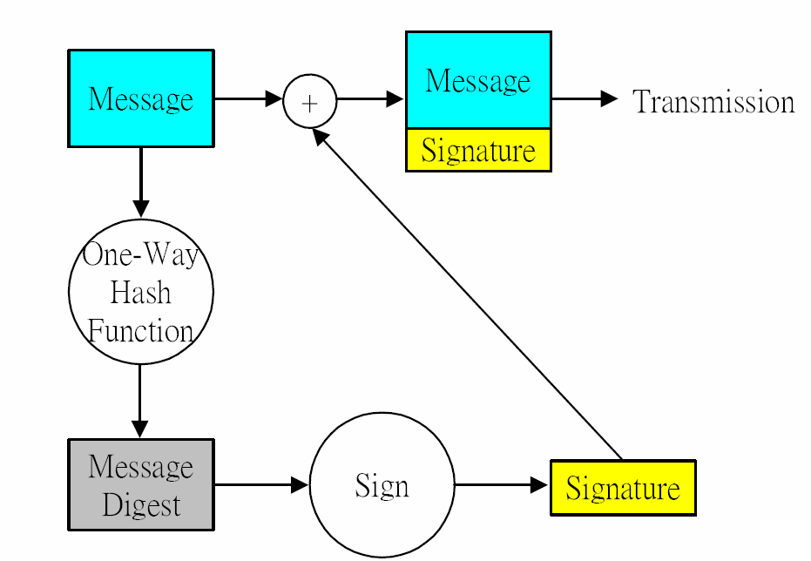
Message Digest and Signature
CEG 260, Meilin Liu
Notes:
Zili Shao
The actual key exchange for either party consists of raising the others "public key' to power of their private key. The resulting number (or as much of as is necessary) is used as the key for a block cipher or other private key scheme. For an attacker to obtain the same value they need at least one of the secret numbers, which means solving a discrete log, which is computationally infeasible given large enough numbers

Slide 6
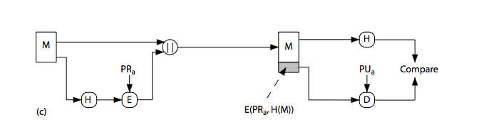
Hash Functions & Digital Signatures
CEG 260, Meilin Liu
Notes:
Zili Shao
Stallings Figure 11.5c “Basic Uses of Hash Functions” shows the hash being “signed” with the senders private key, thus forming a digital signature.

Slide 7
Secure Hash Algorithm
SHA originally designed by NIST & NSA in 1993
was revised in 1995 as SHA-1
US standard for use with DSA signature scheme
  standard is FIPS 180-1 1995, also Internet RFC3174
  nb. the algorithm is SHA, the standard is SHS
based on design of MD4 with key differences
produces 160-bit hash values
recent 2005 results on security of SHA-1 have raised concerns on its use in future applications
CEG 260, Meilin Liu
Notes:
Zili Shao
The Secure Hash Algorithm (SHA) was developed by the National Institute of Standards and Technology (NIST) and published as a federal information processing standard (FIPS 180) in 1993; a revised version was issued as FIPS 180-1 in 1995 and is generally referred to as SHA-1. The actual standards document is entitled Secure Hash Standard. SHA is based on the hash function MD4 and its design closely models MD4. SHA-1 produces a hash value of 160 bits. In 2005, a research team described an attack in which two separate messages could be found that deliver the same SHA-1 hash using 2^69 operations, far fewer than the 2^80 operations previously thought needed to find a collision with an SHA-1 hash [WANG05]. This result should hasten the transition to newer, longer versions of SHA.

Slide 8
Revised Secure Hash Standard
NIST issued revision FIPS 180-2 in 2002
adds 3 additional versions of SHA
  SHA-256, SHA-384, SHA-512
designed for compatibility with increased security provided by the AES cipher
structure & detail is similar to SHA-1
hence analysis should be similar
but security levels are rather higher
CEG 260, Meilin Liu
Notes:
Zili Shao
In 2002, NIST produced a revised version of the standard, FIPS 180-2, that defined three new versions of SHA, with hash value lengths of 256, 384, and 512 bits, known as SHA-256, SHA-384, and SHA-512. These new versions have the same underlying structure and use the same types of modular arithmetic and logical binary operations as SHA-1, hence analyses should be similar. In 2005, NIST announced the intention to phase out approval of SHA-1 and move to a reliance on the other SHA versions by 2010. See Stallings Table12.1 for comparative details of these algorithms.

Slide 9
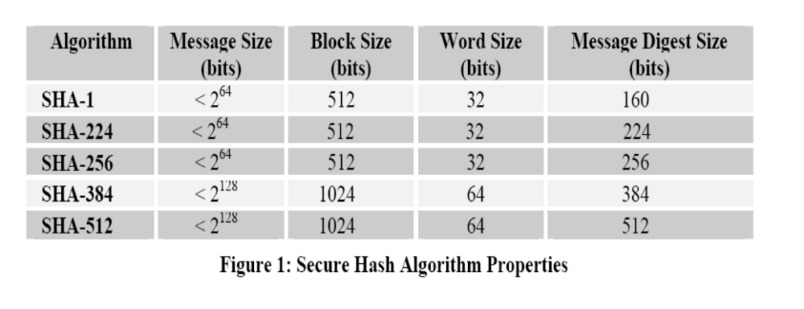
Secure Hash Algorithms
CEG 260, Meilin Liu
Notes:
Zili Shao
All security policies and mechanisms rest on assumptions; we’ll examine some in later chapters, most notably Chapter 22, Malicious Logic. Here is a taste of the assumptions.
Policies: as these define security, they have to define security correctly for the particular site. For example, a web site has to be available, but if the security policy does not mention availability, the definition of security is inappropriate for the site. Also, a policy may not specify whether a particular state is “secure” or “non-secure.” This ambiguity causes problems.
Mechanisms: as these enforce policy, they must be appropriate. For example, cryptography does not assure availability, so using cryptography in the above situation won’t work. Further, security mechanisms rely on supporting infrastructure, such as compilers, libraries, the hardware, and networks to work correctly. Ken Thompson’s modified C preprocessor (see the example on p. 615) illustrates this point very well.

