Slide 1
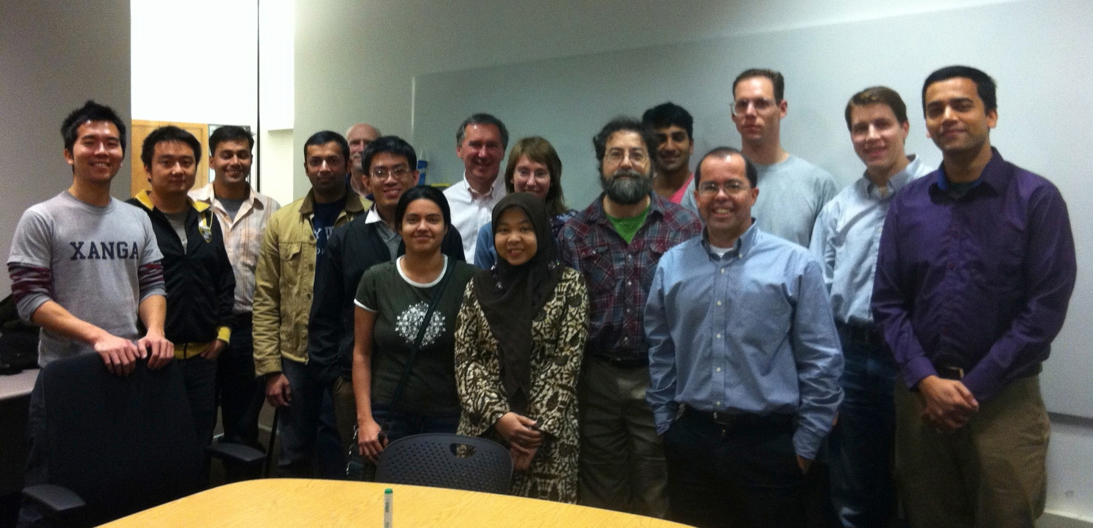
Never Ending Learning
Tom Mitchell Machine Learning Department
Carnegie Mellon University
Presented by:
Uttara Asthana

Slide 2
Tenet 1
We will never really understand learning until we build machines that
learn many different things,
from years of diverse experience,
in a staged, curricular fashion,
and become better learners over time.

Slide 3
Tenet 2:
Natural language understanding requires a belief system
A natural language understanding system should react to text by saying either:
I understand, and already knew that
I understand, and didn’t know, but accept it
I understand, and disagree because …

Slide 4
NELL: Never-Ending Language Learner
Inputs:
initial ontology
dozen examples of each ontology predicate
the web
occasional interaction with human trainers
The task:
run 24x7, forever
each day:
extract more facts from the web to populate the ontology
learn to read (perform #1) better than yesterday

Slide 5
NELL today
Running 24x7, since January, 12, 2010
Result:
KB with > 90 million candidate beliefs, growing daily
learning to read better each day
learning to reason, as well as read
automatically extending its ontology

Slide 6
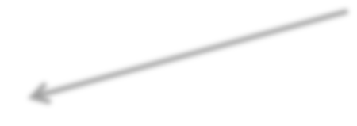

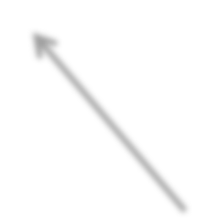


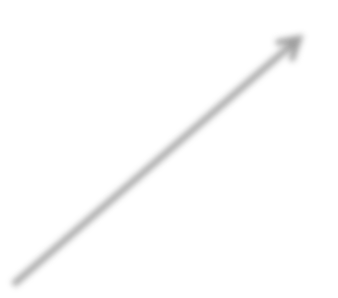
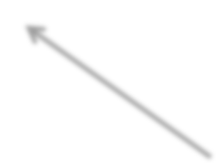

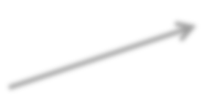
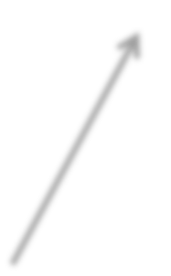




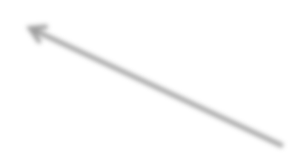
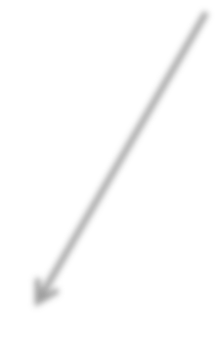
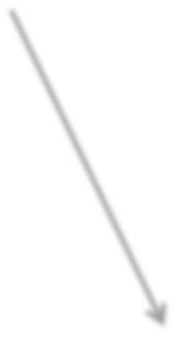
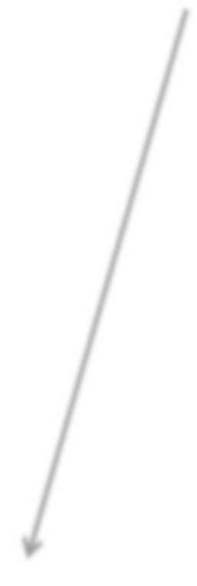



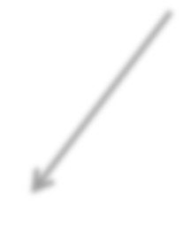
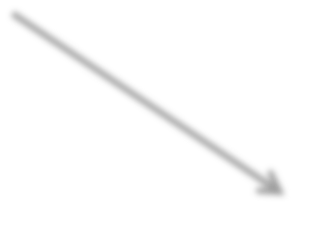
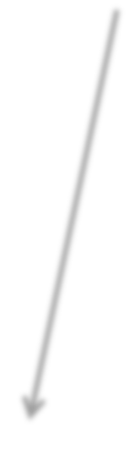


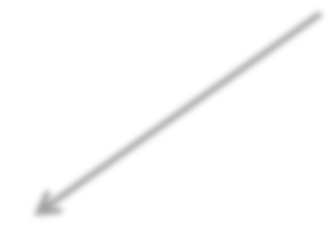


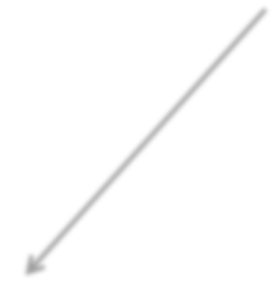
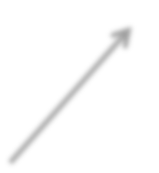
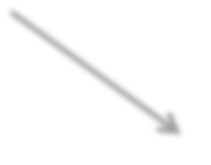
NELL knowledge fragment
football
uses equipment
climbing
skates helmet
Canada
Sunnybrook
Miller
uses equipment
hospital
Wilson
city
country
company
politician
CFRB
hockey
Detroit GM
radio
Pearson
airport
Toronto
play
hometown
hired
competes with
home town
Maple Leafs
Stanley
city company
Cup
Red Wings
city stadium
won
won
Toyota
team stadium
Connaught
city paper
league
league
acquired
city
Air Canada Centre
NHL
stadium
member
Hino
created
plays in
economic sector
Globe and Mail
writer
Sundin Toskala
Prius
Corrola
automobile
Skydome
Milson

Slide 7
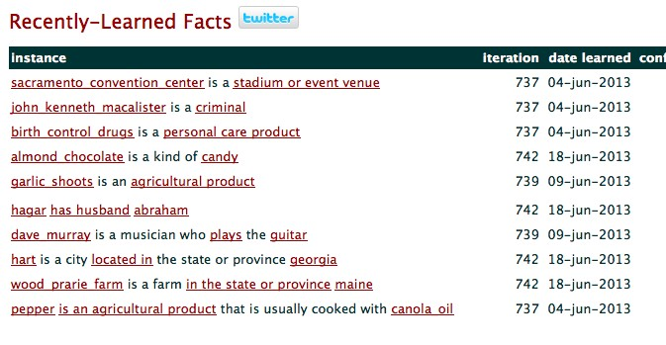
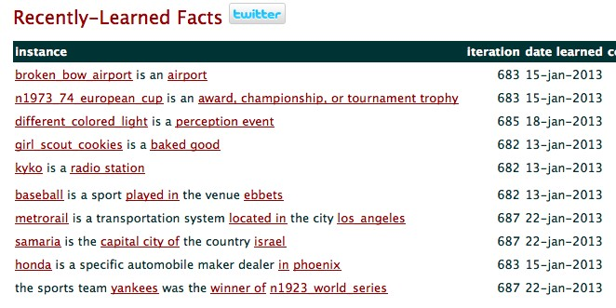
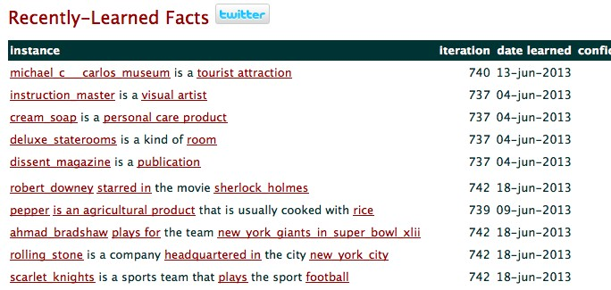
NELL Today
http://rtw.ml.cmu.edu ←← follow NELL here
eg. “diabetes”, “Avandia”, “tea”, “IBM”, “love” “baseball”
NELL on demand
“BacteriaCausesCondition” “kitchenItem” “ClothingGoesWithClothing” …

Slide 8
How does NELL work?

Slide 9
Semi-Supervised Bootstrap Learning
itʼs underconstrained!!
Find cities:
Paris Pittsburgh
Seattle Montpelier
San Francisco Berlin
denial
anxiety selfishness London
mayor of arg1 live in arg1
arg1 is home of traits such as arg1

Slide 10
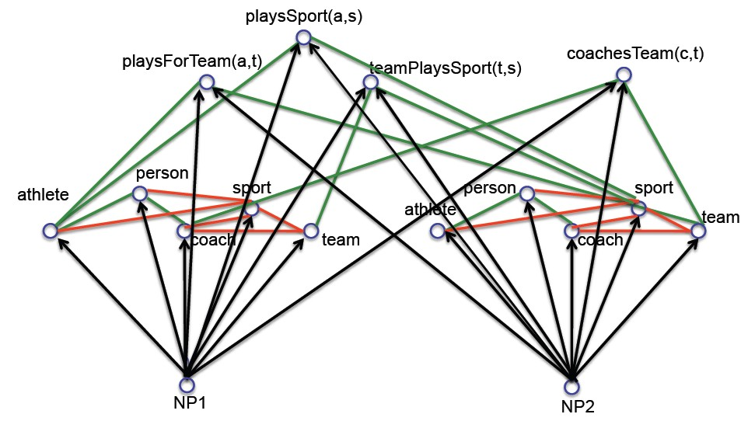




Key Idea 1: Coupled semi-supervised training of many functions
person
noun phrase
hard (underconstrained) semi-supervised learning problem
much easier (more constrained) semi-supervised learning problem

Slide 11
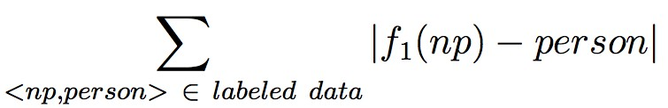

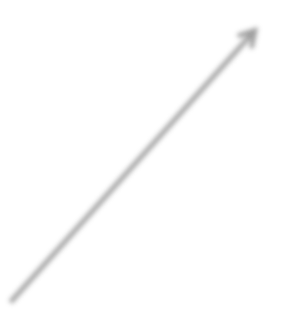

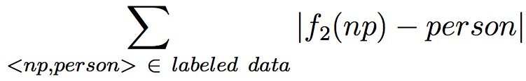

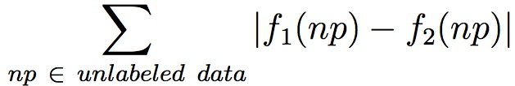











Type 1 Coupling: Co-Training, Multi-View Learning
Coupled training of 2 functions:
person
Minimize:
NP:

Slide 12

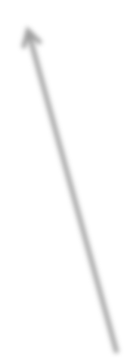




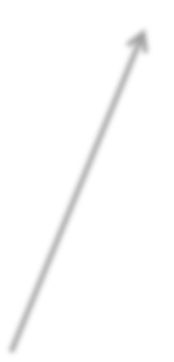



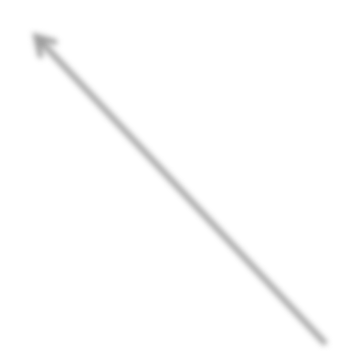
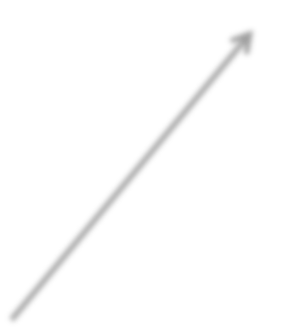

Type 2 Coupling: Multi-task, Structured Outputs
[Daume, 2008]
[Bakhir et al., eds. 2007] [Roth et al., 2008]
person
[Taskar et al., 2009] [Carlson et al., 2009]
athlete
sport
coach
team
athlete(NP) →→ person(NP)
NP
athlete(NP) →→ NOT sport(NP) NOT athlete(NP) ←← sport(NP)

Slide 13
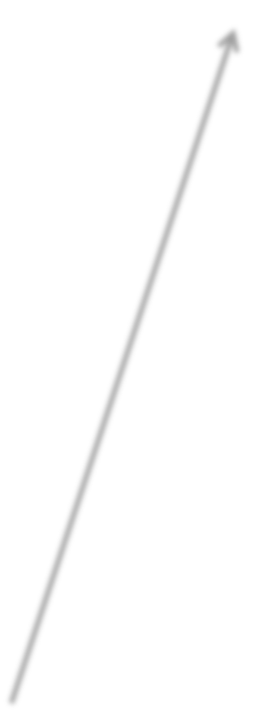
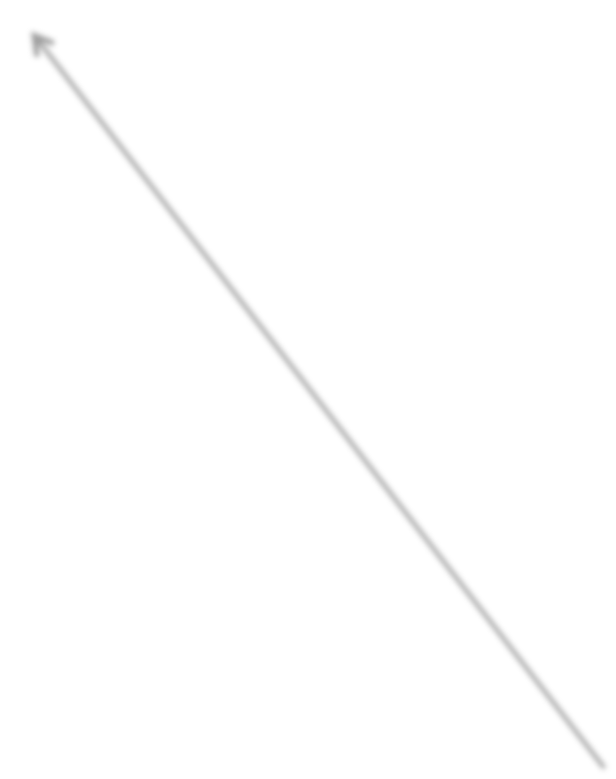
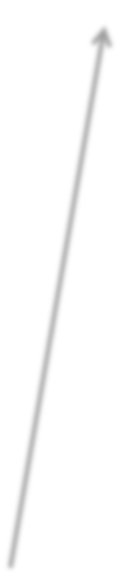
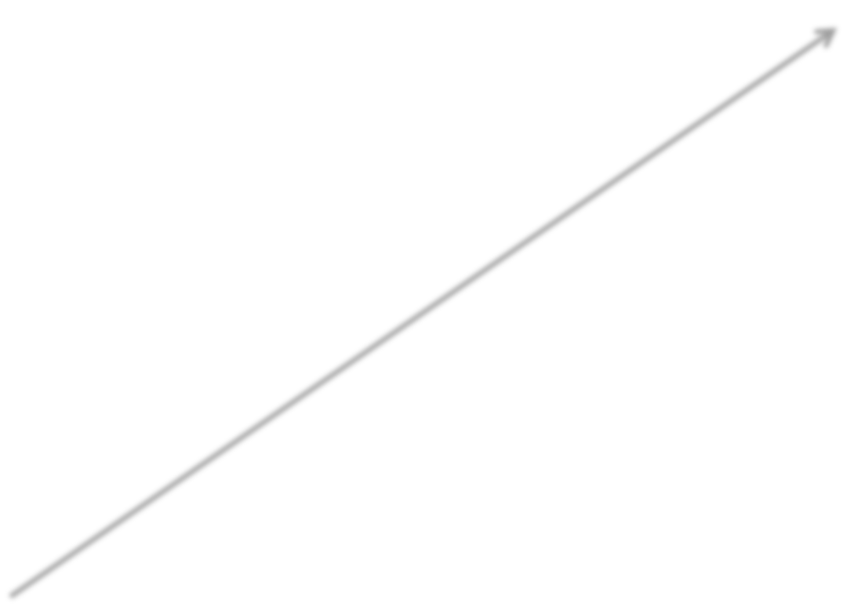

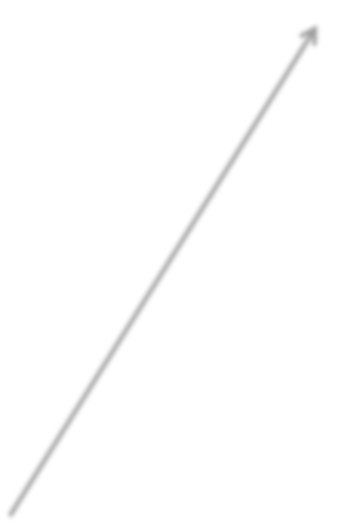
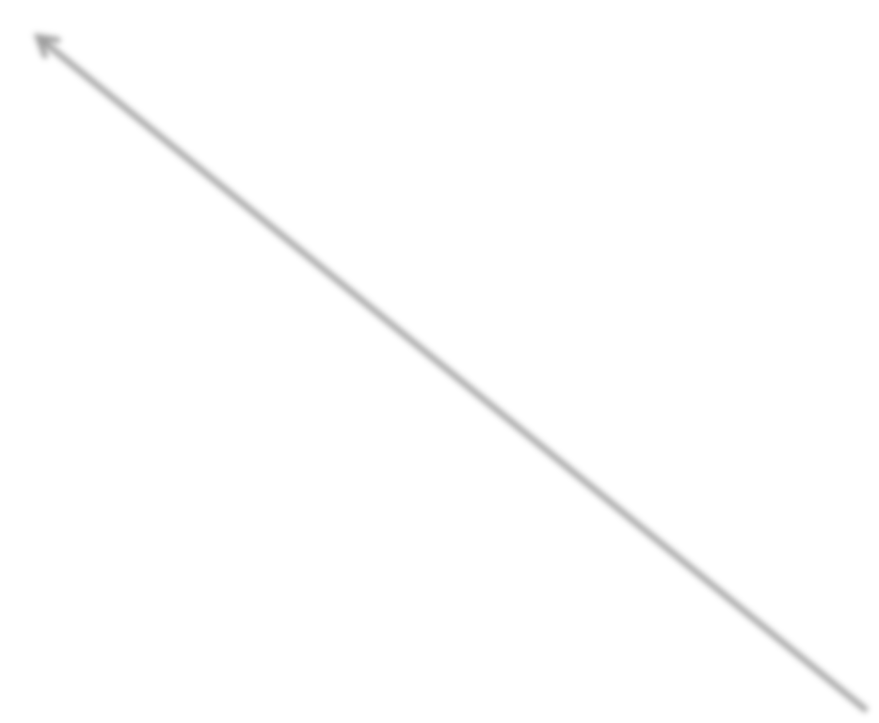

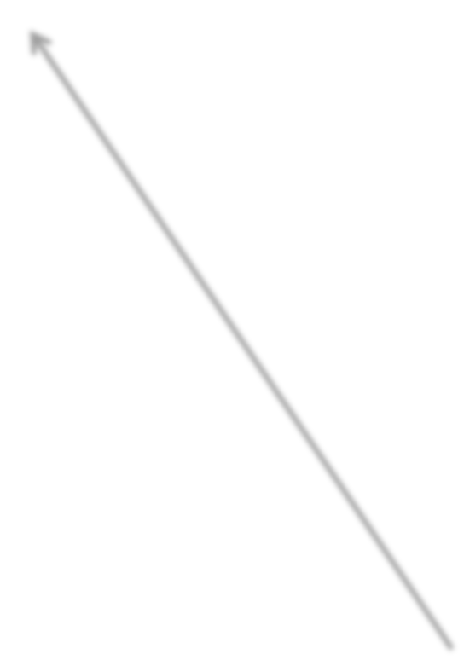


Type 3 Coupling: Learning Relations
playsSport(a,s)
playsForTeam(a,t)
teamPlaysSport(t,s)
coachesTeam(c,t)
NP1
NP2

Slide 14

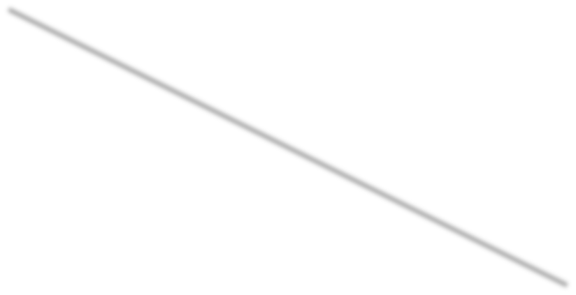
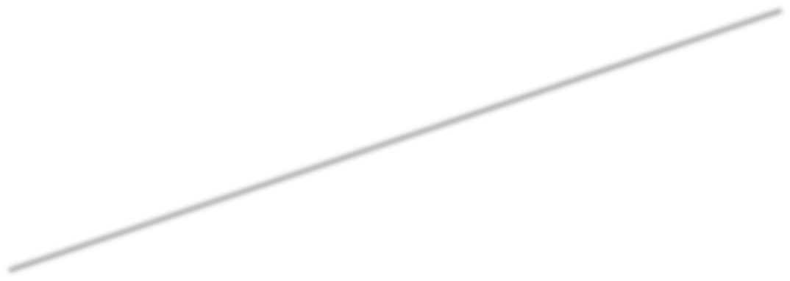


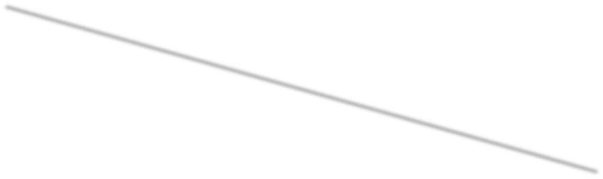

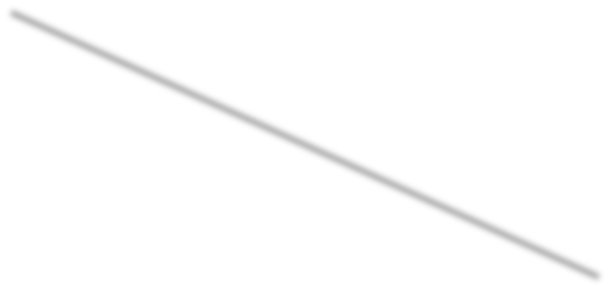



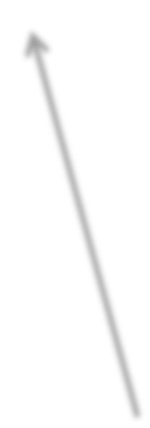

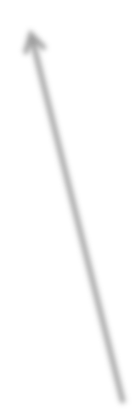




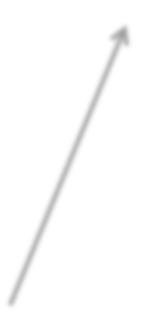

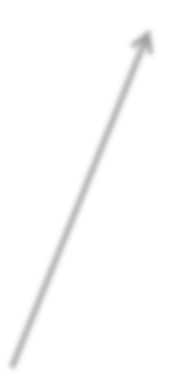


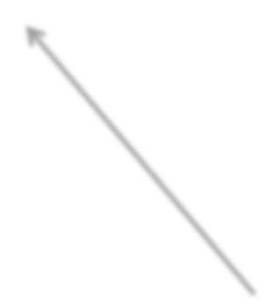


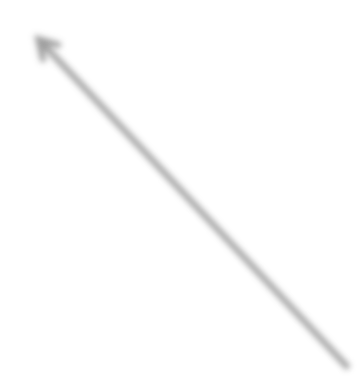
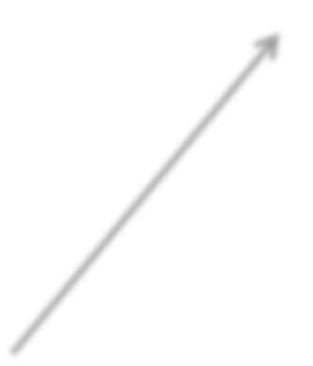
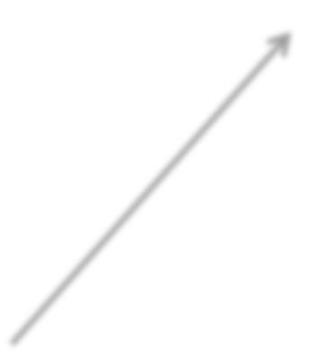

Type 3 Coupling: Argument Types
playsSport(NP1,NP2) →→ athlete(NP1), sport(NP2)
playsSport(a,s)
playsForTeam(a,t)
teamPlaysSport(t,s)
coachesTeam(c,t)
person
sport
person
sport
athlete
athlete
coach
team
coach
team
over 2500 coupled
functions in NELL
NP1
NP2

Slide 15
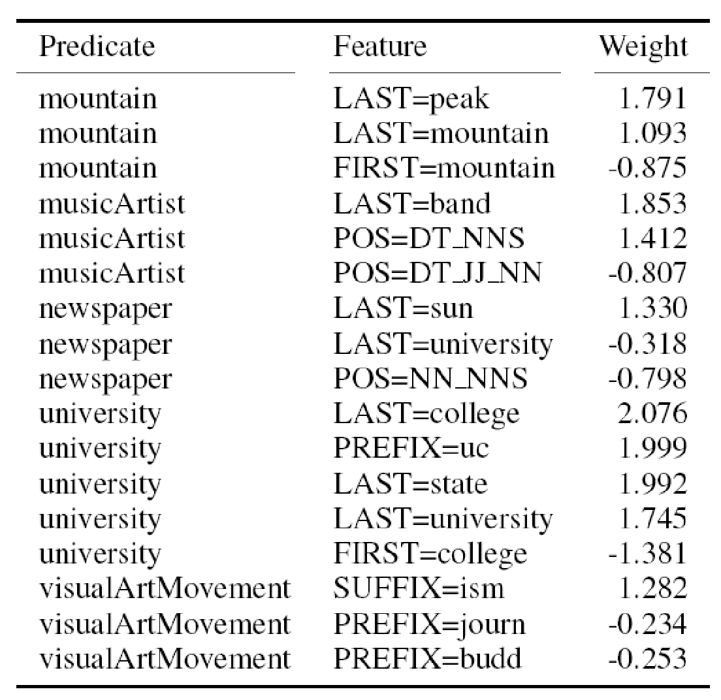


NELL: Learned reading strategies
Plays_Sport(arg1,arg2): arg1_was_playing_arg2
tar_arg1 arg2_icons_arg1 gy_arg1 g2_career_of_arg1
g2 arg2_player_is_arg1
_his_retirement_from_arg2
ayer_like_arg1
ing_arg1 arg2_players_like_arg1 are_steffi_graf_and_arg1 arg2_greats_such_as_arg1 g2_hit_by_arg1 arg2_greats_arg1
arg2_pros_like_arg1
_arg1 arg2_lesson_from_arg1 nd_arg1 arg2_sensation_arg1 nd_arg1 arg2_hall_of_famer_arg1 g1 arg2_legends_such_as_arg1
arg2_player_was_arg1
_was_born_to_play_arg2
_players_are_arg1 arg2_legends_as_arg1 mpion_arg1 …
m
arg2_megas
arg2_player_named_arg1
arg2_prodi
arg1_is_the_tiger_woods_of_arg2 ar arg2_greats_as_arg1 arg1_plays_ar arg2_legends_arg1 arg1_announced
arg2_operations_chief_arg1 arg2_pl arg2_and_golfing_personalities_includ arg2_greats_like_arg1 arg2_players_ arg2_great_arg1 arg2_champ_arg1 arg2_professionals_such_as_arg1 ar arg2_icon_arg1 arg2_stars_like_arg1 arg1_retires_from_arg2 arg2_pheno arg2_architects_robert_trent_jones_a arg2_pros_arg1 arg2_stars_venus_a arg2_superstar_arg1 arg2_legend_ar arg2_players_is_arg1 arg2_pro_arg1 arg2_god_arg1 arg2_idol_arg1 arg1
arg2_star_arg1 arg2_hero_arg1 arg2 arg1_retired_from_professional_arg2 arg2_autographed_by_arg1 arg2_cha

Slide 16







Initial NELL Architecture
Knowledge Base (latent variables)
Beliefs
Evidence Integrator
Candidate Beliefs
Text Context
patterns (CPL)
HTML-URL
context
patterns (SEAL)
Morphology classifier
Human advice
(CML)
Continually Learning Extractors

Slide 17
If coupled learning is the key,
how can we get new coupling constraints?

Slide 18

Key Idea 2:
Discover New Coupling Constraints
first order, probabilistic horn clause constraints:
0.93 athletePlaysSport(?x,?y) ←← athletePlaysForTeam(?x,?z)
teamPlaysSport(?z,?y)
connects previously uncoupled relation predicates
infers new beliefs for KB
restricted rule language: form connected KB subgraphs

Slide 19
Example Learned Horn Clauses
0.95
athletePlaysSport(?x,basketball) ←← athleteInLeague(?x,NBA)
0.93
athletePlaysSport(?x,?y) ←← athletePlaysForTeam(?x,?z)
teamPlaysSport(?z,?y)
0.91
teamPlaysInLeague(?x,NHL) ←← teamWonTrophy(?x,Stanley_Cup)
0.90
athleteInLeague(?x,?y) ←←athletePlaysForTeam(?x,?z),
teamPlaysInLeague(?z,?y)
0.88
cityInState(?x,?y) ←← cityCapitalOfState(?x,?y), cityInCountry(?y,USA)
0.62*
newspaperInCity(?x,New_York) ←← companyEconomicSector(?x,media)
generalizations(?x,blog)

Slide 20
Some rejected learned rules
teamPlaysInLeague{?x nba} ← teamPlaysSport{?x basketball}
0.94 [ 35 0 35 ] [positive negative unlabeled]
cityCapitalOfState{?x ?y} ← cityLocatedInState{?x ?y}, teamPlaysInLeague{?y nba} 0.80 [ 16 2 23 ]
teamplayssport{?x, basketball} ← generalizations{?x, university} 0.61 [ 246 124 3063 ]

Slide 21
Rule Learning Summary
Rule learner run every 10 iterations
Manual filtering of rules
After 120 iterations
565 learned rules
486 (86%) survived manual filter
3948 new beliefs inferred by these rules

Slide 22















































Learned Probabilistic Horn Clause Rules
0.93 playsSport(?x,?y) ←← playsForTeam(?x,?z), teamPlaysSport(?z,?y)
playsSport(a,s)
playsForTeam(a,t)
teamPlaysSport(t,s)
coachesTeam(c,t)
person
sport
person
sport
athlete
athlete
team
coach
team
coach
NP1
NP2

Slide 23
Key Idea 3:
Automatically extend ontology

Slide 24
Ontology Extension (1)
[Mohamed et al., EMNLP 2011]
Goal:
Add new relations to ontology
Approach:
For each pair of categories C1, C2,
co-cluster pairs of known instances, and text contexts that connect them

Slide 25
Example Discovered Relations
[Mohamed et al. EMNLP 2011]
Category Pair | Text contexts | Extracted Instances | Suggested Name
MusicInstrument Musician | ARG1 master ARG2 ARG1 virtuoso ARG2 ARG1 legend ARG2 ARG2 plays ARG1 | sitar , George Harrison tenor sax, Stan Getz trombone, Tommy Dorsey vibes, Lionel Hampton | Master
Disease Disease | ARG1 is due to ARG2 ARG1 is caused by ARG2 | pinched nerve, herniated disk tennis elbow, tendonitis blepharospasm, dystonia | IsDueTo
CellType Chemical | ARG1 that release ARG2 ARG2 releasing ARG1 | epithelial cells, surfactant neurons, serotonin mast cells, histomine | ThatRelease
Mammals Plant | ARG1 eat ARG2 ARG2 eating ARG1 | koala bears, eucalyptus sheep, grasses goats, saplings | Eat
River City | ARG1 in heart of ARG2 ARG1 which flows through ARG2 | Seine, Paris Nile, Cairo Tiber river, Rome | InHeartOf

Slide 26
NELL: sample of self-added relations
athleteWonAward
animalEatsFood
languageTaughtInCity
clothingMadeFromPlant
beverageServedWithFood
fishServedWithFood
athleteBeatAthlete
athleteInjuredBodyPart
arthropodFeedsOnInsect
animalEatsVegetable
plantRepresentsEmotion
foodDecreasesRiskOfDisease
clothingGoesWithClothing
bacteriaCausesPhysCondition
buildingMadeOfMaterial
emotionAssociatedWithDisease
foodCanCauseDisease
agriculturalProductAttractsInsect
arteryArisesFromArtery
countryHasSportsFans
bakedGoodServedWithBeverage
beverageContainsProtein
animalCanDevelopDisease
beverageMadeFromBeverage

Slide 27
NELL: example self-discovered subcategories
Animal: Chemical:
Pets • Fossil fuels
– Hamsters, Ferrets, Birds, Dog, Cats, – Rabbits, Snakes, Parrots, Kittens, …
Carbon, Natural gas, Coal, Diesel, Monoxide, Gases, …
Predator
Gases
– Bears, Foxes, Wolves, Coyotes, Snakes, Racoons, Eagles, Lions, Leopards, Hawks, Humans, …
– Helium, Carbon dioxide, Methane, Oxygen, Propane, Ozone, Radon…
Learned reading patterns:
"arg1 and other medium sized arg2" "arg1 and other jungle arg2” "arg1 and other magnificent arg2" "arg1 and other pesky arg2" "arg1 and other mammals and arg2" "arg1 and other Ice Age arg2" "arg1 or other biting arg2" "arg1 and other marsh arg2" "arg1 and other migrant arg2” "arg1 and other monogastric arg2" "arg1 and other mythical arg2" "arg1 and other nesting
Learned reading patterns:
"arg1 and other hydrocarbon arg2” "arg1 and other aqueous arg2” "arg1 and other hazardous air arg2" "arg1 and oxygen are arg2” "arg1 and such synthetic arg2” "arg1 as a lifting arg2" "arg1 as a tracer arg2" "arg1 as the carrier arg2” "arg1 as the inert arg2" "arg1 as the primary cleaning arg2” "arg1 and other noxious arg2" "arg1 and other trace arg2" "arg1 as the reagent arg2" "arg1 as the tracer

Slide 28
Nell Summary
Learning
-Coupled multi-task, multi-view semi-supervised training.
Inference
- Data mine the KB to learn inference rules
Representation
-Ontology extension:
Cluster pairs of NPs, based on corpus statistics.
-Infer millions of latent concepts from observable text
Curriculum
-Learn easiest things first, build on those to ‘learn to learn’

Slide 29

thank you

