Slide 1
Simplify Patient Notes and Predict Next Encounter using LLM
Code: https://colab.research.google.com/drive/1xcpyzlZ11xCeJ13zBiioDkRBia2irrNl?usp=sharing
ba27444

Slide 2
Use Case
Use Case 1: Simplify Patient Notes
Problem: Patients often struggle to understand clinical terminology.
Goal: Clear, correct, concise explanations suitable for patients.
Prompting Methods: 1. Instructional Prompt 2. Few-shot Learning (for in-context learning)
Use Case 2: Predict Next Medical Encounter
Problem: Can an LLM predict what might happen next in a patient’s care journey?
Goal: Suggest appropriate future encounters (e.g., specialist visit, follow-up test).
Prompting Methods: 1. Chain-of-Thought Reasoning 2. Few-shot Learning

Slide 3
Dataset - Synthea
Synthetic data generator for realistic patient records
Maintains real-world structure:
conditions.csv – diagnosis history
encounters.csv – visit history
patients.csv – patient IDs, demographics
Sample: ~100 patients
Load dataset and save in csv in current directory.
url = "https://synthetichealth.github.io/synthea-sample-data/downloads/latest/synthea_sample_data_csv_latest.zip"

Slide 4
Model
Load the models and use different prompting techniques comparing the two models across different prompts.
Model 1 : PMC_LLaMA 13B
LLM trained on PubMed Central biomedical literature
Hugging Face model: chaoyi-wu/PMC_LLAMA_13B is instruction tuned model
Hosted on colab GPU environment for fast generation
Model 2 : Groq - llama-3.3-70b-versatile
General Purpose LLM by Meta, fine-tuned and hosted by Groq
Meta model: llama-3.3-70b-versatile is instruction tuned model
Hosted on Groq Infrastructure, accessed through API

Slide 5
Sample Prompts
1.1 Simplify Notes:
"""
Simplify and Summarize the following medical note so that a patient without a medical background can understand it:
---
{history_text}
---
"""
1.2 Simplify Notes – Few-Shot:
"""
Simplify and Summarize the following medical note so that a patient without a medical background can understand it:
Note: “Diagnosed with hypertension and prescribed Lisinopril”
Simplified: “You have high blood pressure. Your doctor gave you medicine.”
Now simplify:
---
{history_text}
—
"""

Slide 6
2.1 Predict Next Encounter – Chain-of-Thought:
"""
Simplify and Summarize the following medical note so that a patient without a medical background can understand it
Patient History:
- Type 2 Diabetes
- Foot pain
- Neuropathy
Reason through history and predict the next encounter:
{history_text}
"""
2.2 Predict Next Encounter – Few Shot Chain-of-Thought:
"""
Simplify and Summarize the following medical note so that a patient without a medical background can understand it:
---
Example 1:
History:
- Hypertension
- High cholesterol
- Chest pain
Prediction: The patient may have a cardiology consultation next.
Example 2:
History:
- Asthma
- Shortness of breath
Prediction: The next likely encounter is a pulmonary function test.
Now analyze the following patient:
History:
{history_text}
Prediction:
"""

Slide 7
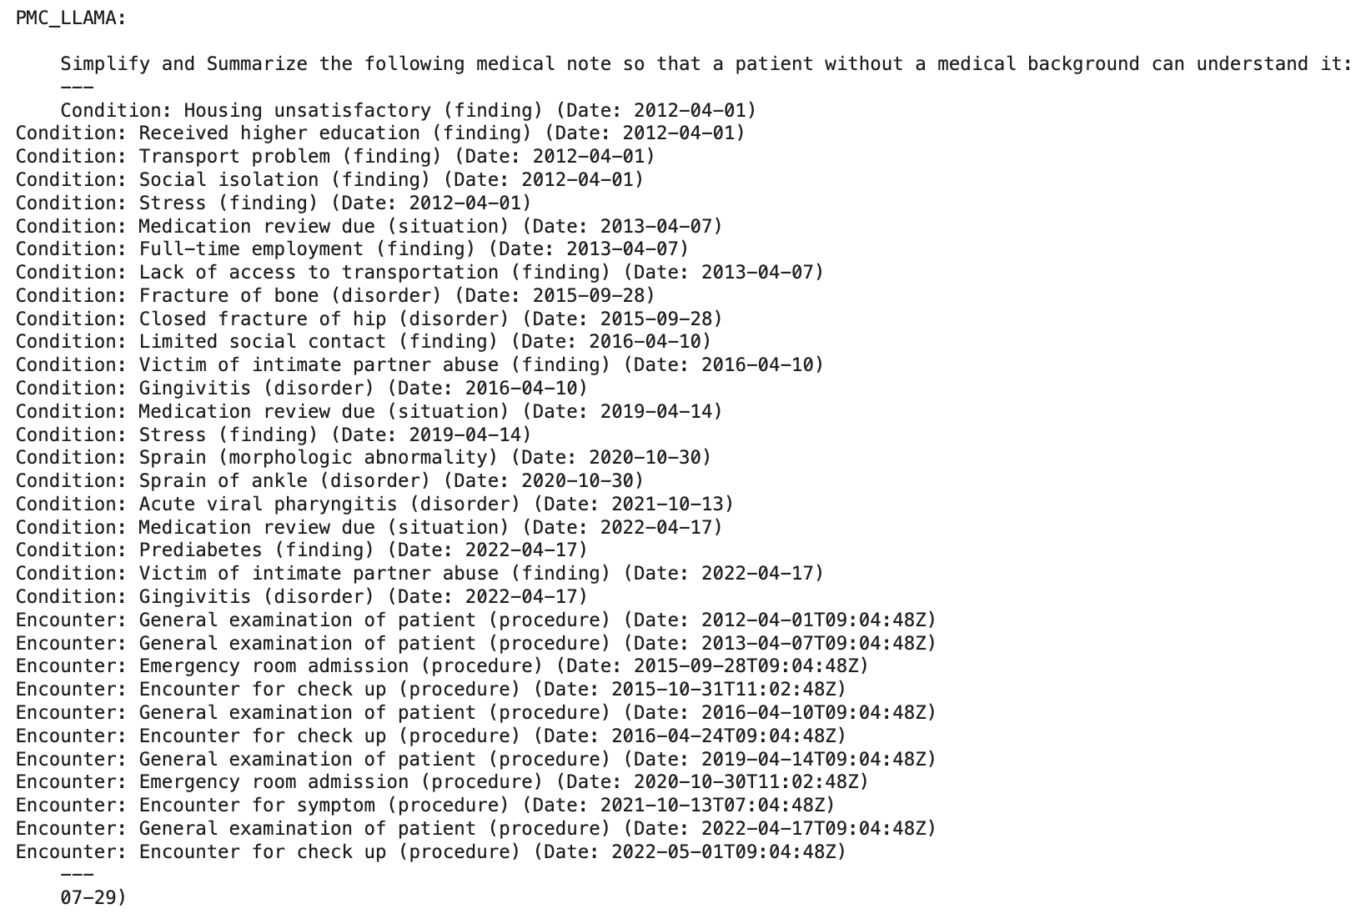
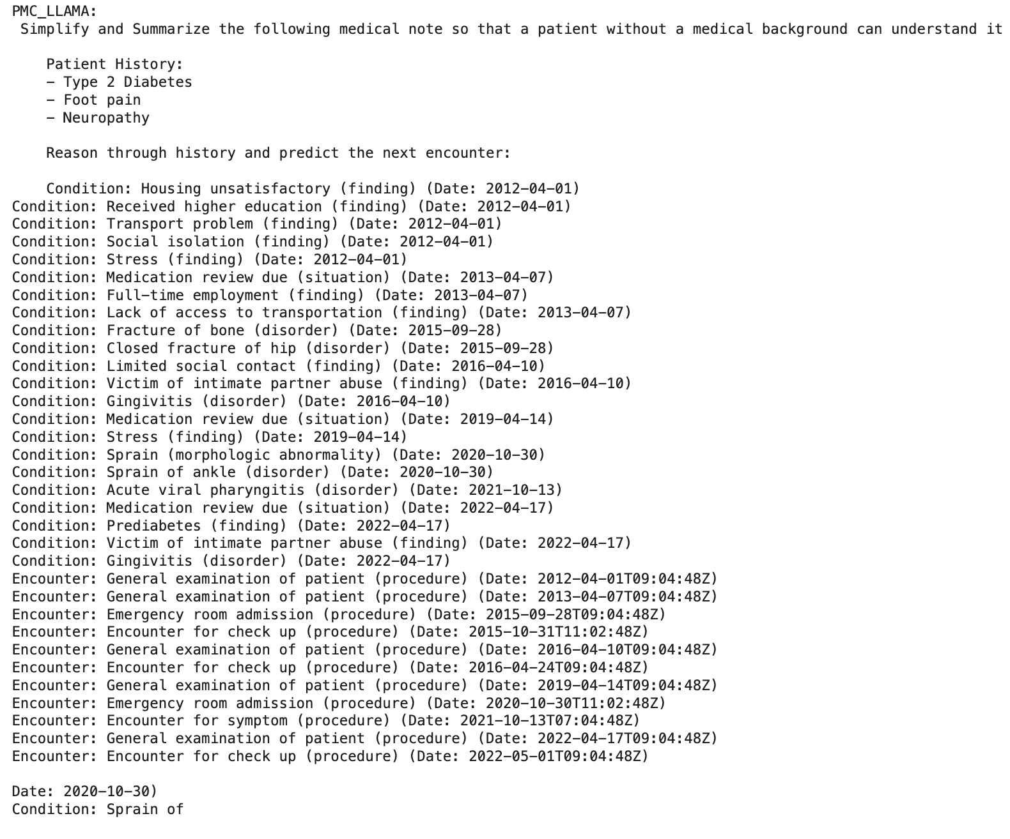
Output - PMC_LLMA
1. Simplification
2. Predict Next Encounter

Slide 8
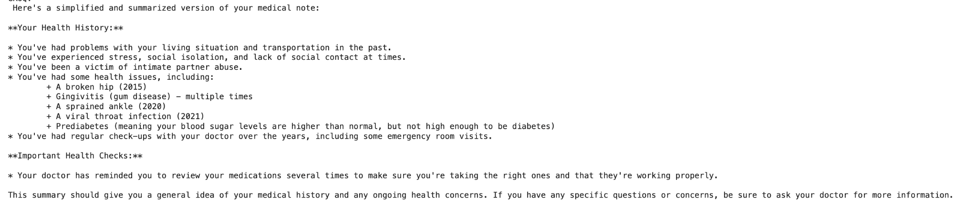
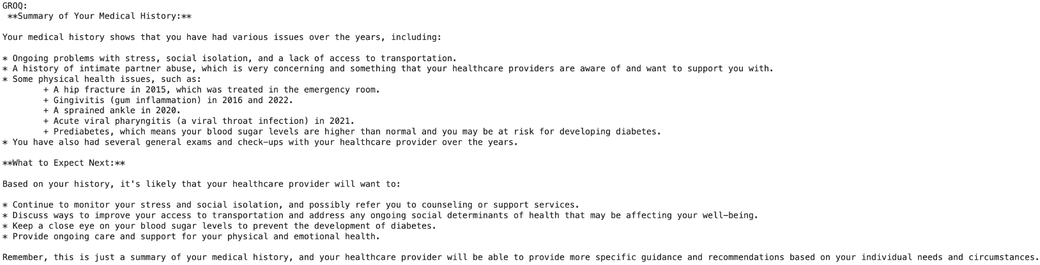
Output - Groq
1. Simplification
2. Predict Next Encounter

Slide 9
Evaluation
Model Generation: Groq - llama-3.3-70b-versatile performs better that PMC_LLaMA 13B at Simplifying the records an Predicting next medical outcome.
Simplification - it selects relevant information
Prediction - it does not directly predicts the outcome but it suggest to take care of medical condition that may predict
Context Length: Groq has bigger context length, hence able to generate longer cohesive text. LLAMA due to limited text truncates longer exact
Inference: Groq has faster inference and generate response much faster than PMC_LLAMA

Slide 10
Future Work
Automate evaluation using LLM scoring or readability metrics
Scale to multiple patients, track aggregate trends
Fine-tune model on task-specific examples for better control

