Slide 1
Contrastive Representation Learning for ICU Patient Trajectory Modeling using MIMIC-III
ba27444

Slide 2
Dataset - MIMIC III
Feature Engineering from LABEVENTS
Load ADMISSIONS.csv, LABEVENTS.csv, and DIAGNOSES_ICD.csv from the MIMIC-III database.
ADMISSIONS.csv: Outcome variables (mortality, discharge location)
LABEVENTS.csv: Time-series structured data (labs, vitals)
DIAGNOSES_ICD.csv: Ground-truth diagnosis codes for patients
Extract the top 20 most common lab tests.
For each patient (SUBJECT_ID), compute the mean value for each test.
Create a fixed-size feature vector (e.g., 20 features per patient).

Slide 3
Contrastive Learning - Patient Features
Embedding Extraction
Use a contrastive learning approach to pre-train a neural encoder that generates embeddings of patient features.
The model learns representations such that similar patients are closer together in embedding space.
Encourages learning clinically meaningful representations.
Helps models generalize better when labeled data is scarce.
Feed each patient’s feature vector into the contrastive-trained encoder.
Extract the 128-dimensional embedding per patient.
They capture high-level patient phenotypes and health states.
Hence, Reusing Embeddings across as inputs to downstream ML models. One shared encoder → Multiple tasks

Slide 4
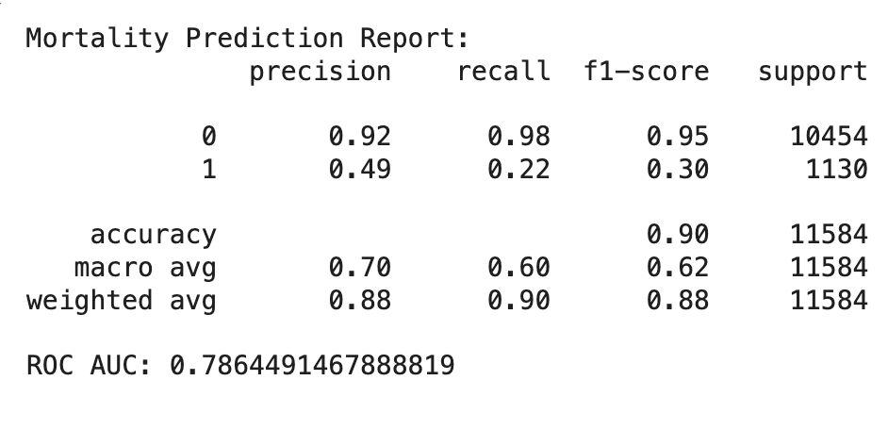
Downstream Task 1: In-Hospital Mortality Prediction
Predict whether a patient will die during the hospital stay (binary classification).
Helps clinicians identify critically ill patients early.
Could be used in an early warning system (EWS).
Supports real-time risk scoring and ICU triage.
Inputs: Embeddings and Labels: HOSPITAL_EXPIRE_FLAG (0 = survived, 1 = died)
Model: Random Forest Classifier (RandomForestClassifier)
Evaluation Metrics: Accuracy, F1-score ROC-AUC Score (area under the curve – shows discrimination ability

Slide 5
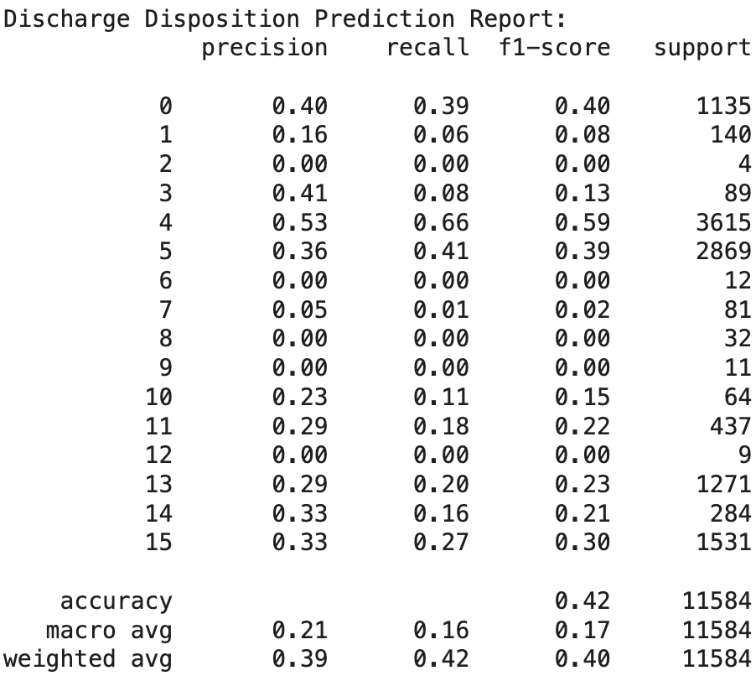
Downstream Task 2: Discharge Disposition Prediction
Predict where the patient will go after discharge from the hospital
Helps case managers and social workers plan for post-hospital care.
Supports resource allocation (e.g., arrange transport to rehab).
Can highlight patients who may be at risk of readmission.
Inputs: Embeddings and Labels: DISCHARGE_LOCATION (categorical, multi-class)
Model: Random Forest Classifier for multi-class classification
Evaluation Metrics: Accuracy + F1-score (macro and weighted)

Slide 6
Evaluation of Prediction
In-Hospital Mortality Prediction
ROC AUC: 0.79 — indicates fair discriminatory ability between patients who lived and died.
Accuracy: 0.90 — seems high, but misleading due to class imbalance (most patients survived).
Precision for Class 1 (Died): 0.49 — about half of the patients predicted as high-risk were truly high-risk.
Recall for Class 1 (Died): 0.22 — the model misses most high-risk patients, which is dangerous in a clinical setting.
Conclusion: The model is good at predicting survival, but needs tuning to better detect high-risk patients (e.g., class weighting, threshold adjustment).
Discharge Disposition Prediction
Accuracy: 0.42 — quite low overall.
Macro F1 Score: 0.17 — shows poor performance across all classes, especially minority ones.
Class-wise Insights:Some classes (e.g., 0, 3, 10, 11) have F1 scores between 0.13 – 0.40.Many classes (e.g., 2, 6, 8, 9, 12) have F1 score = 0.00, meaning they’re never predicted correctly.
Class Imbalance: Dominant classes like 4 and 5 (with higher support) perform better.
Conclusion: The model struggles with this task due to high class imbalance and possibly insufficient feature granularity.

