Slide 1
MIMIC NLP
Dataset used - https://physionet.org/content/mimiciii/1.4/files NOTEEVENTS
Code - https://github.com/utbhanuarya/AIH_UTA/blob/main/MIMIC_NLP_ba27444.ipynb
Bhanu Arya
ba27444

Slide 2
Pipeline Overview (1/2)
Filter Clinical Notes
Extracted relevant patient records from the MIMIC-III dataset that have ICD-9 code 430 (Subarachnoid Hemorrhage).
Used the DIAGNOSES_ICD table to find patients and then filtered their corresponding clinical notes from the NOTEEVENTS table.
Preprocess text
Lowercasing: Converted text to lowercase for uniformity.
Removing Special Characters & Punctuation: Eliminated non-alphanumeric characters to reduce noise.
Create World cloud for the disease
Combined all processed clinical notes related to ICD-9 code 430.
Used WordCloud library to visualize the most frequent words associated with the disease.
Helped identify key medical terms that commonly appear in the notes.
Extract Medical Entities using NLP Models
SpaCy (General NLP Model)
Applied en_core_web_md model, which is trained on general English text.
Extracted disease names, symptoms, and drug names, but with lower accuracy in specialized medical terms.
SciSpaCy (Medical NLP Model)
Applied en_core_sci_md from SciSpaCy, a biomedical NLP model.
Improved recognition of medical terminology, including symptoms, diagnoses, and drugs.
BioBERT (Biomedical Pretrained Model)
Used BioBERT, a Transformer-based model trained on medical literature (PubMed).
Extracted more contextually relevant medical entities compared to previous approaches.

Slide 3
Pipeline Overview (2/2)
Get Top Entities of Each Approach
Counted and ranked the most frequently occurring medical entities extracted from each model.
Compared performance across SpaCy, SciSpaCy, and BioBERT.
Train Word2Vec on Extracted Terms
Trained a Word2Vec model on the extracted medical terms to capture relationships between words.
Apply t-SNE for Dimensionality Reduction
Used t-SNE (t-Distributed Stochastic Neighbor Embedding) to reduce the high-dimensional Word2Vec embeddings to 2D space.
Helped visualize word similarities and clustering of medical terms.
Visualize and Compare - SpaCy, SciSpaCy, and BioBERT
Created comparative bar charts & scatter plots to illustrate the differences between the three NLP models.
Findings:
SpaCy struggled with medical terminology.
SciSpaCy performed better but still had limitations in capturing contextual meaning.
BioBERT provided the most accurate and domain-specific extractions.

Slide 4
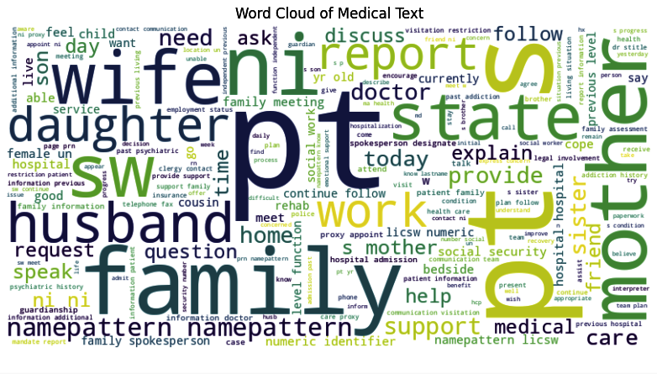
Word Cloud

Slide 5
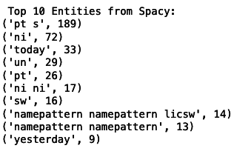
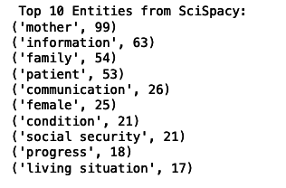
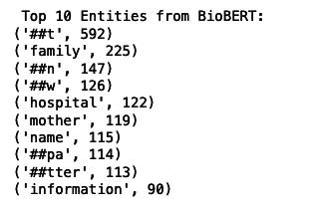
Top Entities
The number of entities in BioBERT is most because of granular tokenization. (Most 592)
Spispacy has more rich and meaningful entities than Spacy

Slide 6
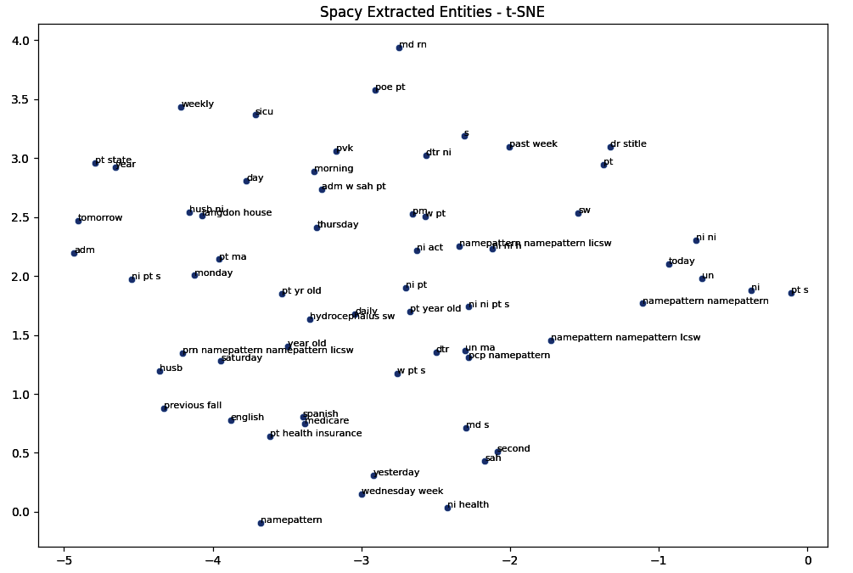
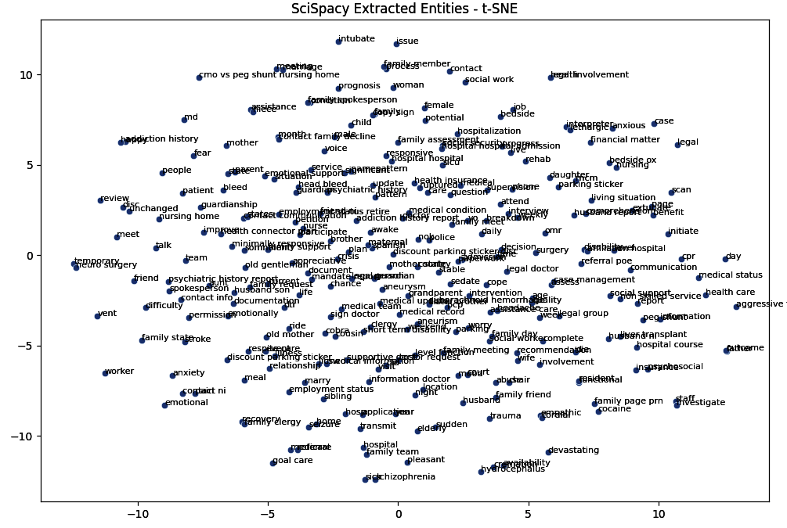
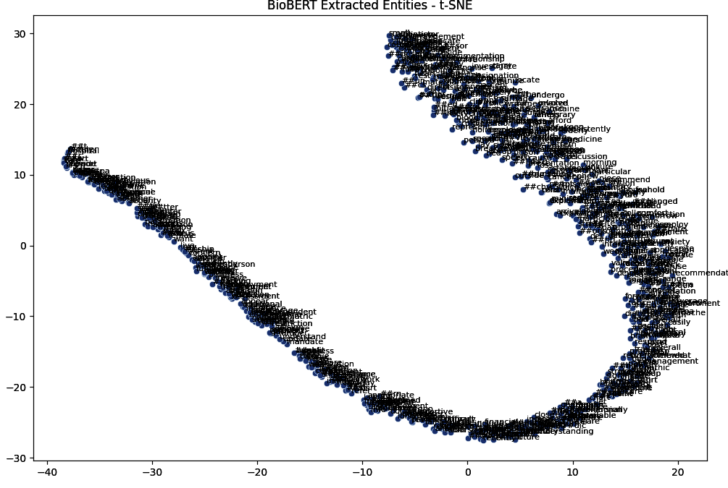
T-SNE + Word Embedding
Spacy embeddings are separated.
SpiSpacy embeddings are denser. Meaning, it is able to extract more meaningful entities from the text.
BioBERT embeddings are dense and in an observable pattern - representing the inherent proximity of vector embedding.

