Slide 1
Digital Accessibility using Local Large Language Models
Bhanu Arya ba27444
Code: https://github.com/utbhanuarya/HighRiskProject

Slide 2


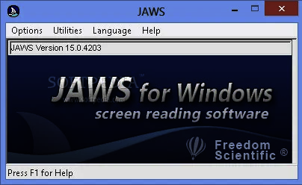
Introduction - What is Digital Accessibility?
Using Assistive technology to enable every access and interact digitally.
Visual disability - unable to see clearly temporary or permanent.
Web Content Accessibility Guidelines
Screen Readers - slow, non-intuitive, limited reach
alt text: Image of a dog.
JAWS : A popular screen reader of Desktop / Laptops

Slide 3
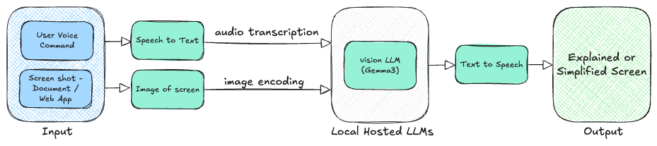
Method
Convert the screen into image, ask vision LLM to explain the image.

Slide 4
Result
Latency - The local hosted vision LLM takes 30 - 40 secs to explain the image in contrast >>> Screen readers take 2-3 minutes
Visual Content Interpretation - The LLM is able to understand the image content and provide a overview >>> does not require alt text
Low cost and Privacy - The local hosted LLM running on CPU does not incur high GPU cost, also the data remains >>> Even supporting offline operation
Multiple Window - When multiple screens on single window, it struggles to accurately explain
Content Heavy - Struggles when there is a lot of text in image

Slide 5
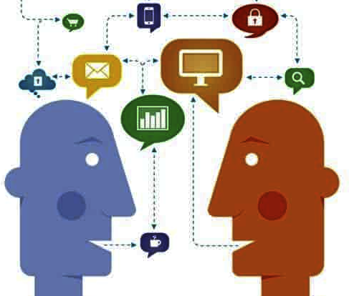
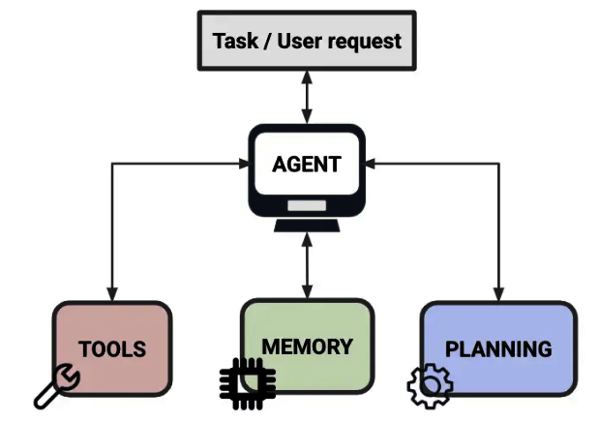
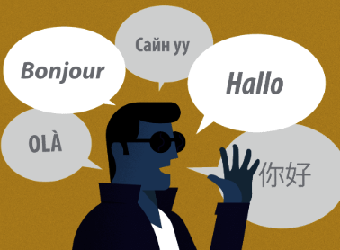
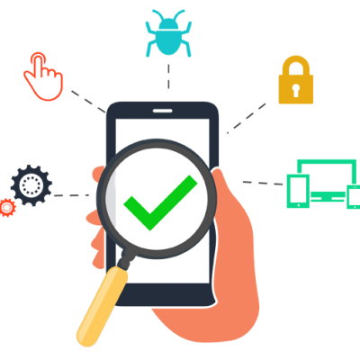

Future Directions
Interactive Dialog Agentic Interaction Multilingual Support
Mobile Deployment Ethical Consideration

Slide 6
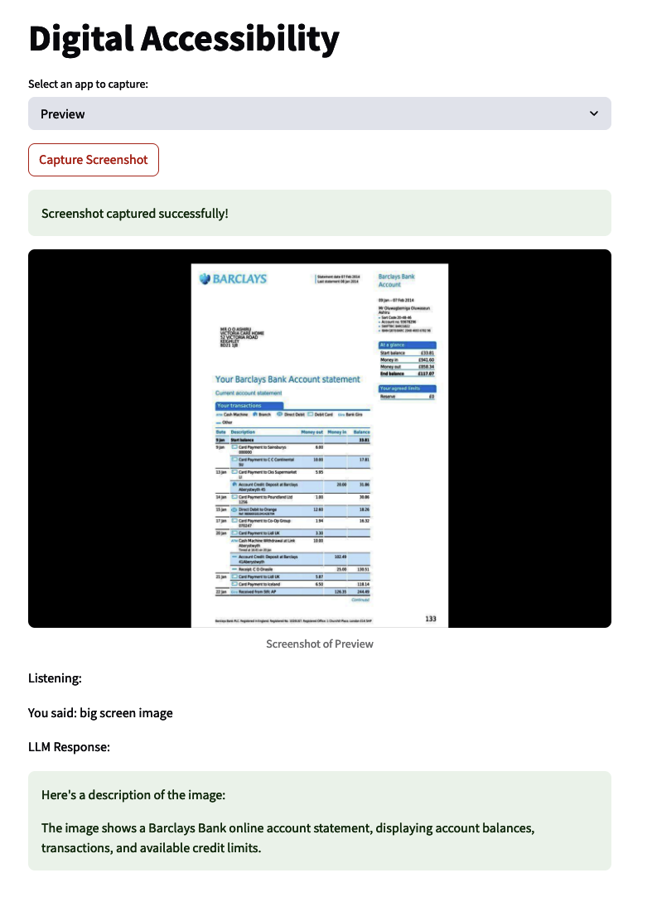
Demo
Streamlit app the captures screenshot and does: 1. Speech to Text
2. Vision Language model Inference
3. Text to Speech

