Slide 1
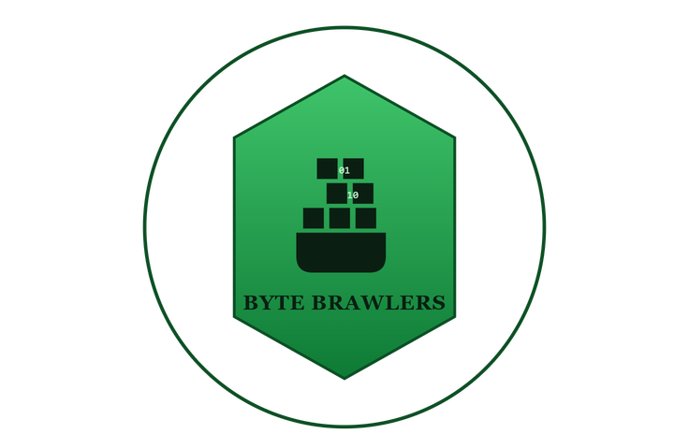



SMART INDIA HACKATHON 2025
Problem Statement ID : SIH26034
Problem Statement Title : Software System to check compliance of Packaged Commodities under Legal Metrology (Packaged Commodities) Rules, 2011 by scanning products, images and labels.
Theme : Agriculture, FoodTech & Rural Development
PS Category: Software
Team ID : SIH-298
Team Name : Byte Brawlers
@Byte-Brawlers
1
Notes:
1

Slide 2
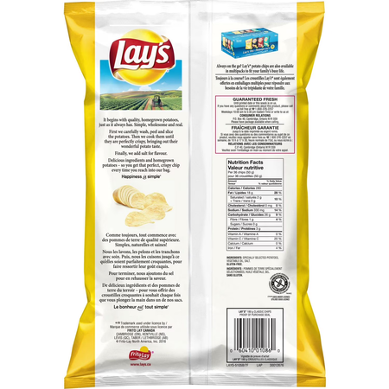
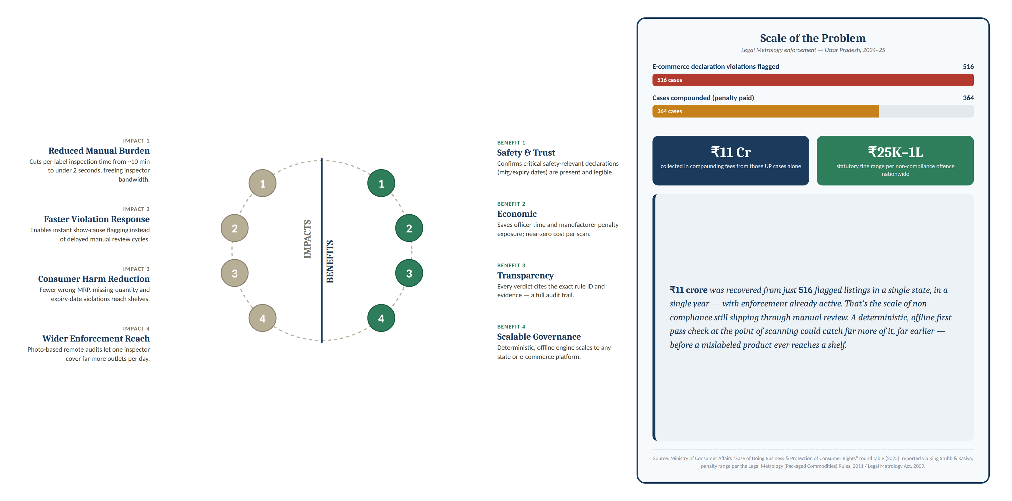
METROCHECK
PACKAGED COMMODITIES COMPLIANCE CHECK
LAY'S CLASSIC SALTED POTATO CHIPS
INGREDIENTS: Potatoes, Edible Vegetable Oil (Palmolein), Iodised Salt.
ALLERGEN INFORMATION: No added gluten.
NET QUANTITY:52 g
DATE OF MANUFACTURE: 08/09/2026
BEST BEFORE: 6 MONTHS FROM DATE OF MANUFACTURE
MAXIMUM RETAIL PRICE: ₹20.00 (INCLUSIVE OF ALL TAXES)
MANUFACTURED BY: Example Foods India Pvt. Ltd.
etc.
PROBLEM EXISTING
Manual Inspection is Slow & Subjective: Manual label checks for 50+ rules, high error rates due to human fatigue
Bribery & Under-Reporting: Inspectors can be bribed to overlook non-compliant labels, letting violators go.
OUR SOLUTION
PROPOSED SOLUTION
Compliance Scanner to scan a label to automatically check key declarations against Legal Metrology requirements.
Deterministic Approach and regex-based rule engine check missing, incorrect, or unclear information, making compliance issues easy to understand.
Offline & Traceable Inspection: Perform checks without external AI/API dependency and generate a digital report for every inspection.
@Byte-Brawlers
2

Slide 3
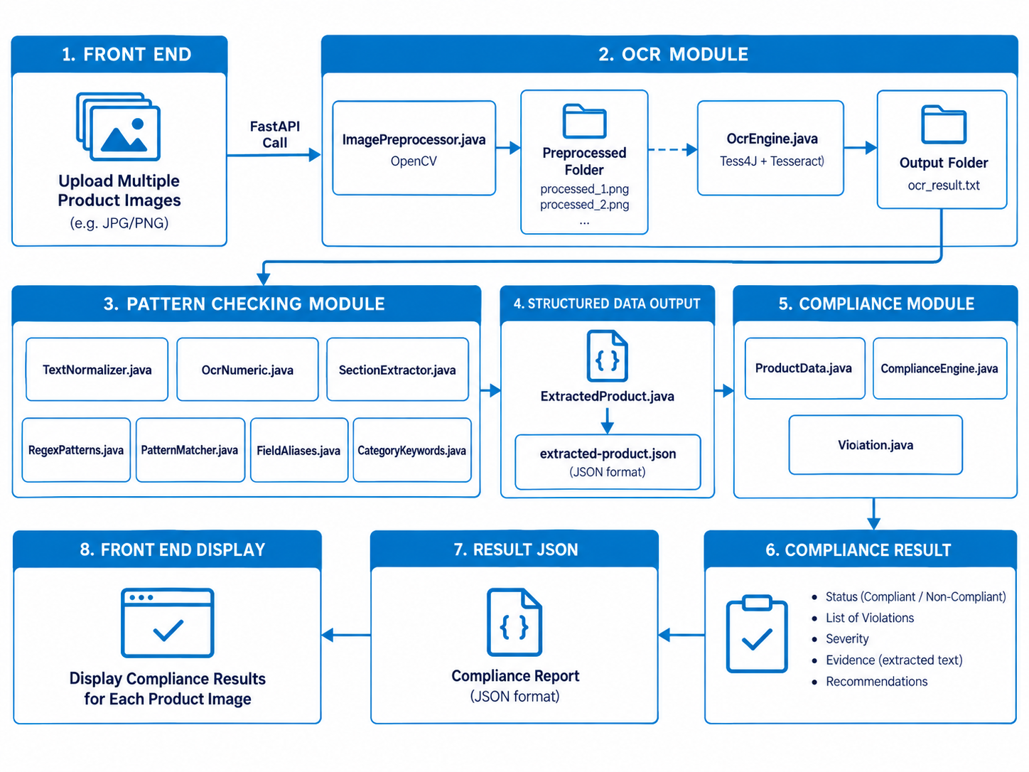
System Architecture and Workflow
Technical Stack
TextNormaliser
.java
OcrNumeric
.java
SectionExtractor
.java
ProductData
.java
Backend:
Java Apache Maven
OpenCV · Tesseract OCR
Tess4J · Jackson
Java Built-In API (Regex API, Image IO, Java Time API)
Frontend: Typescript, React, Python
@Byte-Brawlers

Slide 4
F E A S I B I L I T Y A N D V I A B I L I T Y
FEASIBILITY
VIABILITY
Technical And Operational: lightweight stack — Tesseract OCR + Regex Engine — can run offline from any phone camera.
Market Ready: 10 Core rules cover 95% of common violations ; Real enforcement identified and validated.
Offline, minimal running cost
Regex patterns are deterministic and predictable
Policy & Revenue: Fits Digital India, Ease of Doing Business, revenue from government licensing and enterprise self-compliance SaaS
Regulatory grounding: Rule engine codes Legal Metrology (Packaged Commodities) Rules, 2011 directly — no interpretation gap.
Investment & ROI: Minimal setup cost; cuts per-label inspection time upto 70%.
STRENGHTS
POTENTIAL CHALLENGES
No ML Uncertainty: Regex and compliance rules always produce consistent results
Fast perfomance: <1 second per label vs 10 min manual inspection
Offline capability hence no data send to extrnal services
OCR Accuracy Limitations: Struggle with rotated text, low resolution images.
Regex Pattern Brittleness: Manual pattern writing doesnt capture all label variations
Language Limitations: Currently English only
@Byte-Brawlers
4

Slide 5
IMPACTS & BENEFITS
Overcoming Challenges
Improve OCR Accuracy (75-80% → 90%+ ) :
Multi-angle image capture strategy
Cluster-based approach using OpenCV for label region detection
Deterministic, Auditable Verdicts
Reduced Manual Inspection Time
Enhance Pattern Matching:
Fuzzy matching to handle formatting variations
Build pattern library from real-world label samples
Faster Violation Detection
Offline & Cost-Free Operation
Consumer Harm Reduction
Full Rule-Cited Transparency
Future Scope & Improvements
Enhanced Accuracy:
Implement fuzzy string matching for pattern validation
OpenCV cluster-based approach for OCR post-processing
Wider Enforcement Reach
Scalable Across States & E-Commerce
Language & Scale:
Expand from 10 to 50+ Legal Metrology rules
Hindi + English bilingual support
Premium Option:
Optional Google Vision API integration for critical audits. (We currently avoid it due to cost & latency concerns)
@Byte-Brawlers
5

Slide 6
RESEARCH AND REFERENCES
FOOD SAFETY AND STANDARDS (FSSAI) (LABELLING AND DISPLAY) REGULATIONS, 2020
https://www.fssai.gov.in/upload/uploadfiles/files/Comp_Labelling%20Display_Version%20VII_03042025.pdf?utm
The Legal Metrology (Packaged Commodities) Rules, 2011.
https://wbconsumers.gov.in/writereaddata/ACT%20&%20RULES/Act%20&%20Rules/9%20The%20Legal%20Metrology%20(Package%20Commodities)%20Rules,%202011.pdf
Tesseract OCR Documentation
https://github.com/tesseract-ocr/tessdoc?
https://ksandk.com/legal-metrology/legal-metrology-reforms-boost-consumer-
protection/
Github Repository
https://github.com/utbtt/SIH034_byte_brawlers
10 Rules - Legal Metrology Rules 2011
Rule 6(1)(a) — Commodity name
Rule 6(1)(b) — Manufacturer details
Rule 6(1)(c) — Net quantity
Rule 6(1)(d) — MRP (inclusive of taxes)
Rule 6(1)(g) — Manufacturing date
Rule 6(1)(h) — Best-before date
Rule 3 — Applicability / size limit
Rule 7 — Legibility
Rule 9 — Language
Rule 5 — Standard sizes
Demo Video :
Presentation
@Byte Brawlers
6

Slide 7
