Slide 1




node.js Topics
Hussain Ashruf

Slide 2
- Node.js modules - Explains how to create reusable modules in Node.js, export code, and import modules. This allows organizing code into files and sharing functionality.
- npm packages - Goes over, using npm (Node Package Manager) to install and manage third party packages and dependencies for Node.js projects.
- Node.js web servers – Shows how to build basic web servers in Node.js using modules like http, express, ejs etc. This allows creating and serving web pages dynamically.
- Node.js file system - Explains the fs module for interacting with the filesystem - reading, writing, appending, deleting files and directories.
- Events and event emitters – Teaches you how events work in Node.js, using EventEmitter to create custom events and trigger callbacks.
- Streams - Explains streams for reading/writing data continuously, like reading a file stream or HTTP request stream.
- Databases - Shows you connecting Node.js to databases like MongoDB, MySQL etc. using modules like mongoose.

Slide 3
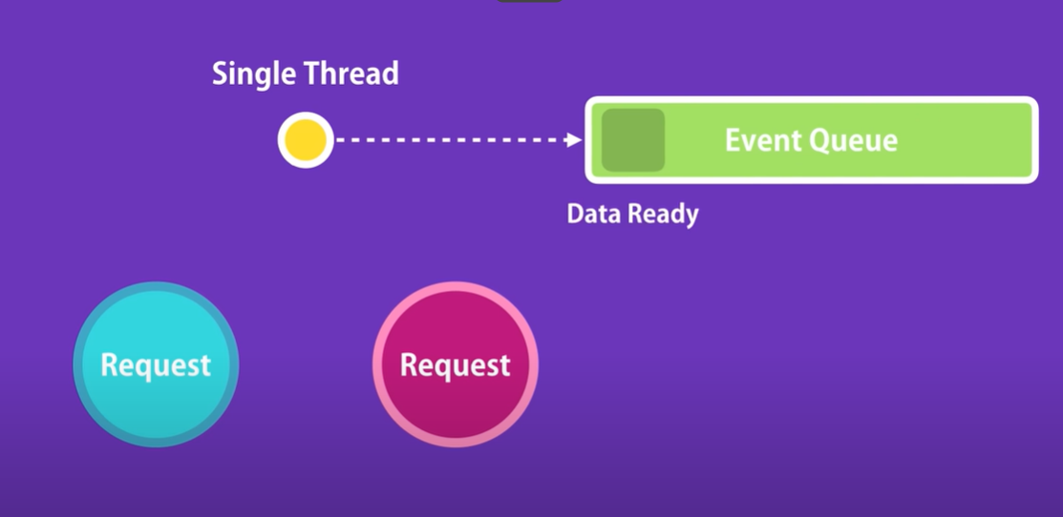
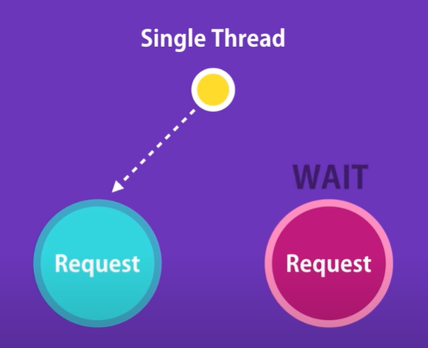
Async nature by Nodejs: Non-blocking by default
Single Threaded:
Good for IO apps (File IO etc): Data intensive
Not good for CPU-Intensive apps (lots of calculations → video encoding, image manipulation services)
Other clients has to WAIT

Slide 4

Node version
$ node –version
Install latest?
https://nodejs.org

Slide 5
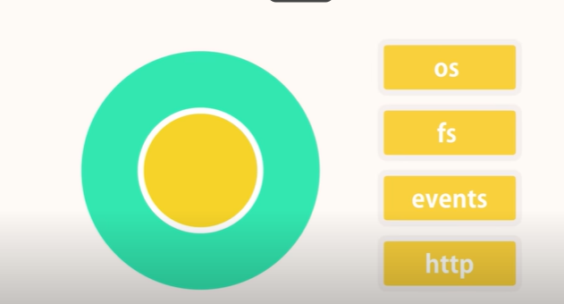
Modules
Core Modules
Every file we write in with .js is a module:
Variables, functions within are private to it.
Else
Declare them with each export so it is visible outside.

Slide 6
export
Export could be a whole Object (from that file)
Export could be just one function (from that file)

Slide 7
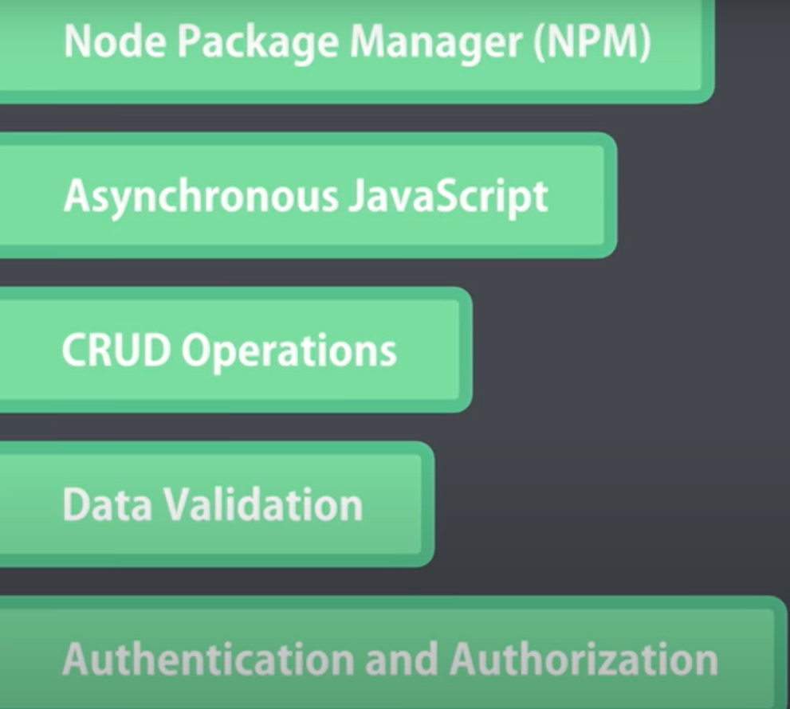
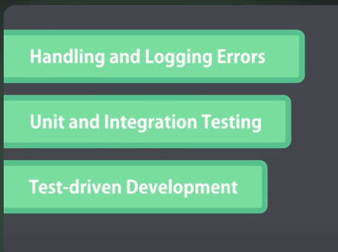
Topics

Slide 8
Nodejs documentation
https://nodejs.org/docs/latest/api/

Slide 9
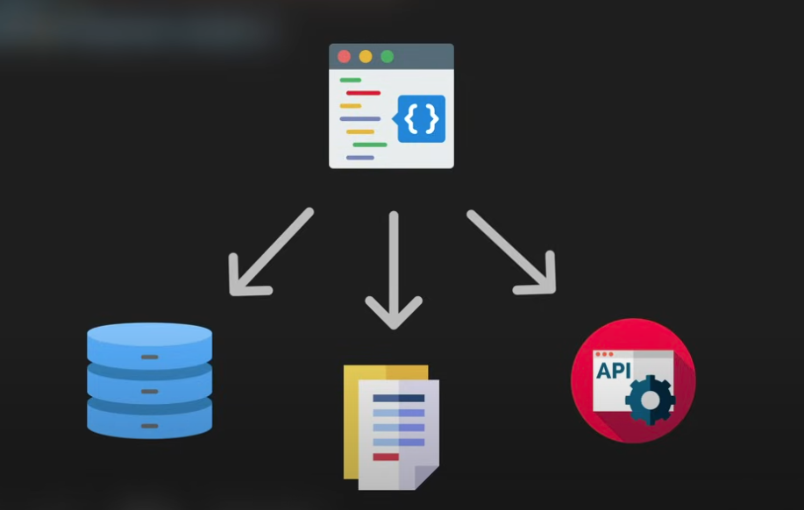
Async await: promise
Real world tasks are async: use cases
The promise Object represents the completion (or failure) of the async operation (with resulting value) that was initiated earlier.
$ npm install axios

Slide 10
Test your code
npm install --save-dev jest

Slide 11
Older projects still use CommonJS (require), for new projects it's recommended to use ES Modules (import/export).

Slide 12
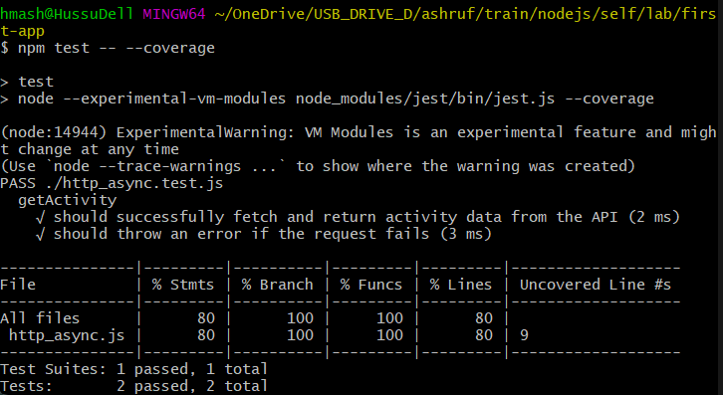
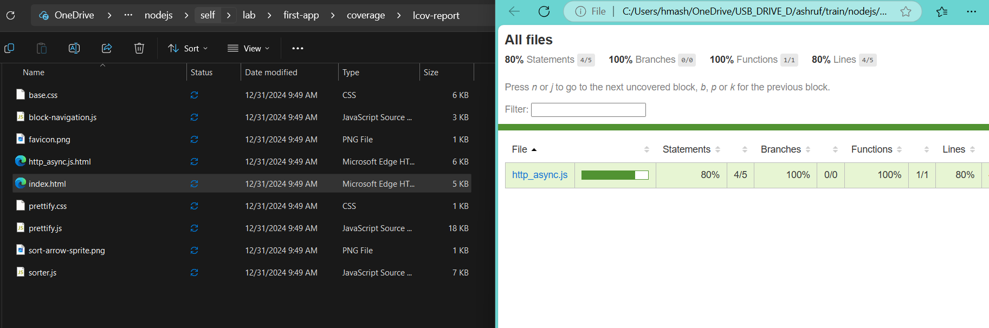
$ npm test -- --coverage

