Slide 1
Q and A session (Transcripts)
Information Session on ICT Systems and Tools for UTokyo Members (Conducted in English)
with all explanators and supporters
The questions and answers posted on slido are also listed on these transcripts.
Ver 3.01 Last updated on 2024/09/14

Slide 2
Session Q&A Transcripts
Do we all have to enable multi-factor authentication for UTokyo Account?
Yes, we ask everyone with a UTokyo Account to do so. Everyone’s cooperation is essential to improving the security of the entire university.
If you encounter any difficulties or have any questions, please do not hesitate to contact utelecon's support desk.
How do we set Microsoft authentication system on the iPhone?
The short answer is you just install it through app store, but there are caveats and pitfalls I mentioned. This page explains everything. https://utelecon.adm.u-tokyo.ac.jp/en/utokyo_account/mfa/initial/
Please read this information carefully and set it up. If it does not work, please let our support office know what is going on.

Slide 3
Session Q&A Transcripts
Should we have to do these steps of setting MFA every semester?
No, you don’t need to repeat the initial setup every semester. Once it’s set up, you’ll just need to use the Authenticator app or phone number for login each time. If you change your device, you may need to set up MFA again. Please refer to the utelecon page about setup of MFA.
Can we still use non-UTokyo Zoom for the class?
You can only use limited functions on a free Zoom account, so it is less convenient than UTokyo Zoom, which has very useful functions. For example, you can ask other UTokyo members to help with your meetings if you use UTokyo Zoom. If you meant to use an organization zoom account other than UTokyo, we don’t prevent you from doing so. At the same time, we don’t recommend you to do so because you can easily switch your Zoom account in the app.

Slide 4
Session Q&A Transcripts
Can anyone (UTokyo Staff, Google, etc) other than the student can see what we store or do (e.g., Google Colab) using ECCS Cloud Email? How secure is it?
Just like with a personal Google account, your privacy is protected. There may be rare exceptions, such as when legal or compliance issues arise, but these are extremely exceptional cases. For more details, please refer to this article (in Japanese). https://www-old.ecc.u-tokyo.ac.jp/system/eccs_cloud_email_policy.html
I use Thunderbird to manage my UTokyo Gmail account (ECCS Cloud Email). Can I use a DeepL-based plugin for translation purposes?
You may use it at your own responsibility.

Slide 5
Session Q&A Transcripts
Does UTOL completely replace UTAS?
The answer is No. There are something you can do with UTAS but you cannot do with UTOL. For example, you need to use UTAS when you do something about syllabus, grades and so on. So please choose which you use by what you want to do.
It is mandatory to use UTAS if you are offering a course. On the other hand, it is not mandatory to use UTOL, and you can also use a different LMS. However, we recommend using UTOL as an LMS.
The information registered in UTAS will be stored semi-permanently. On the other hand, UTOL is a system for conducting classes at the moment, so the data on UTOL should only be stored for a few years.
UTOL allows you to create new seminars and communities for educational purposes that are not registered on UTAS. The courses registered on UTAS are only official courses that grant academic credits.

Slide 6
Session Q&A Transcripts
How to register for certain course in UTAS?
If you are the teaching faculty member in charge of the course, you should be automatically registered. If you are not registered, please contact the faculty's academic affairs office.
If you are a student and the system is not behaving as it should or you do not know what to do, please contact the utelecon technical support desk. https://utelecon.adm.u-tokyo.ac.jp/en/support/

Slide 7
Session Q&A Transcripts
Is there a preference between UTOL and Google Classroom? If Google Classroom essentially provides the same functions as UTOL, is there any plan to move everything to one platform?
UTOL is superior to Google Classroom in terms of its linkage with UTAS. However, if you prefer Google Classroom, you can use that instead.
We recommend the UTOL specification. For students, it is beneficial to have all courses provided on the same platform. We will also continue to work on improving the functionality of UTOL.

Slide 8
Session Q&A Transcripts
On UTOL, can TA (Teaching Assistant) students upload documents and share communications among students and instructors?
Yes, it is possible. On UTOL, TA students can upload documents, view the list of students enrolled in the course, and share communication among students and instructors.
TA students cannot be registered with the course on UTAS, but you should have no problems if you use UTOL.
How can we give TA to upload the document?
Once registered, TA students have the same authority as instructors and can upload documents in the same way as instructors.

Slide 9


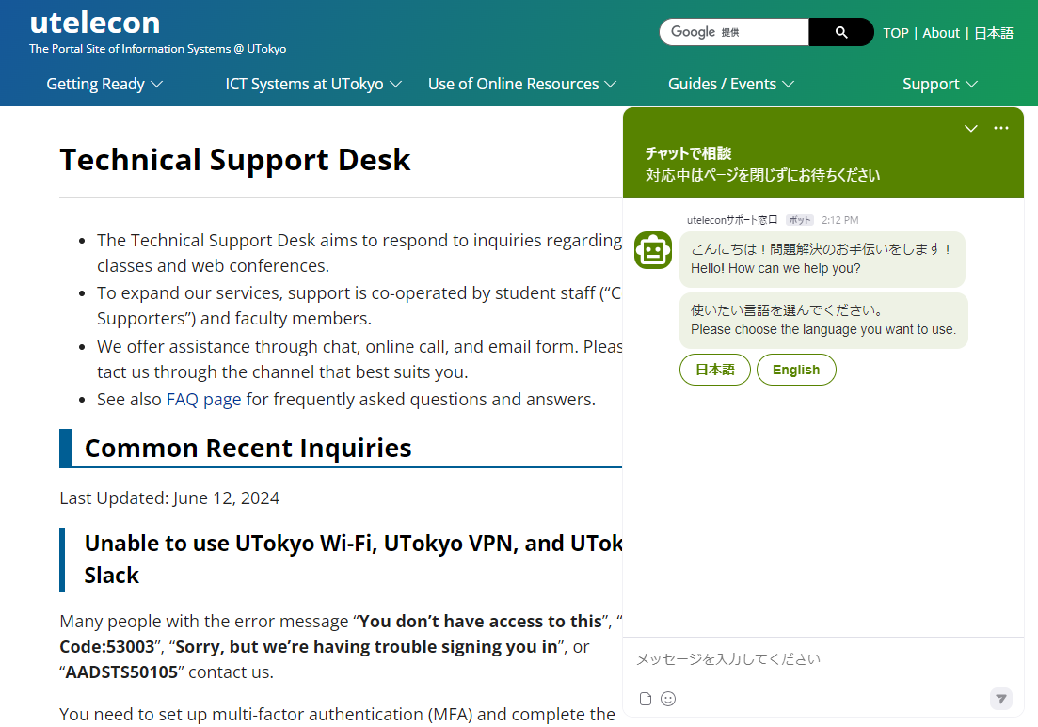
About utelecon
When you have questions, you can use .
Search by Google
In most cases, you can get the information you need by searching with “utelecon.”
Support desk
via Chat
via Online Call
via Email Form
utelecon zoom

Slide 10
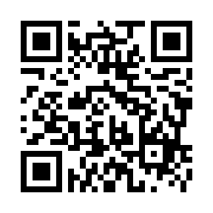
Thank you for your attention.
Information Session on ICT Systems and Tools for UTokyo Members (Conducted in English)
Session materials will be posted on utelecon.
Please cooperate with the post-session questionnaire from this QR code or this URL.
https://forms.office.com/r/uthVkkVf6i

