Slide 1
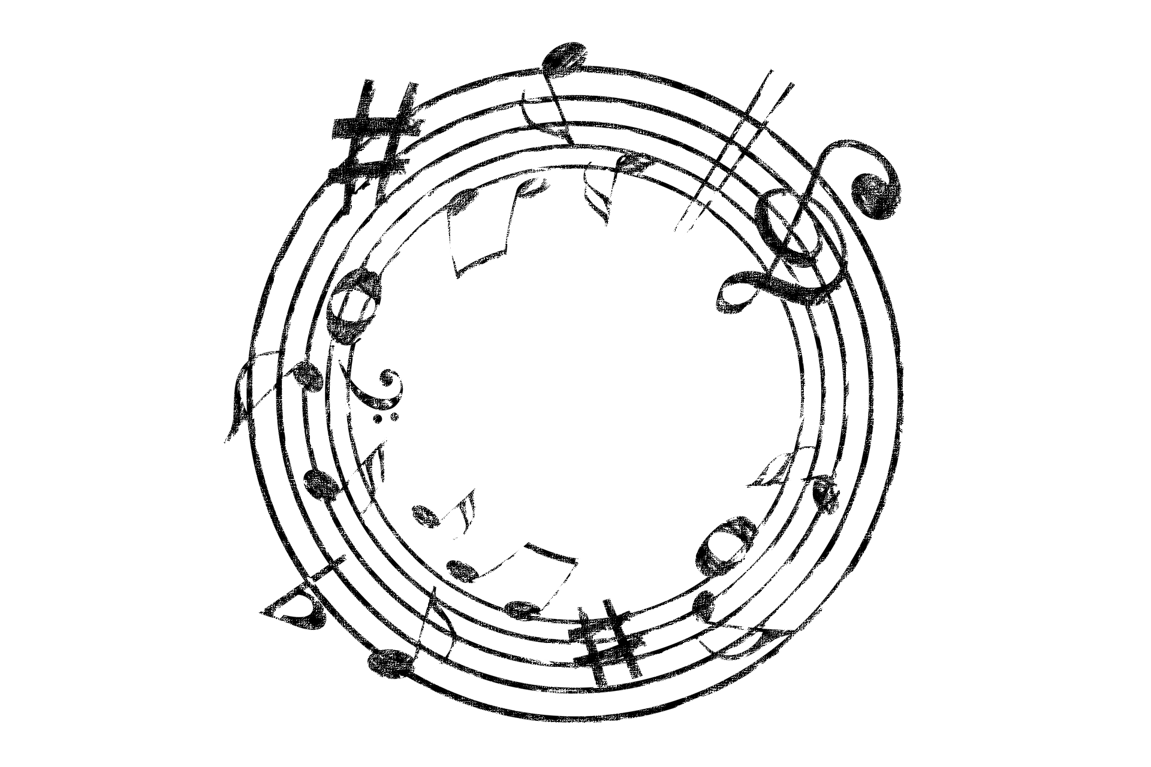
quanternion
move to fill the space with music

Slide 2
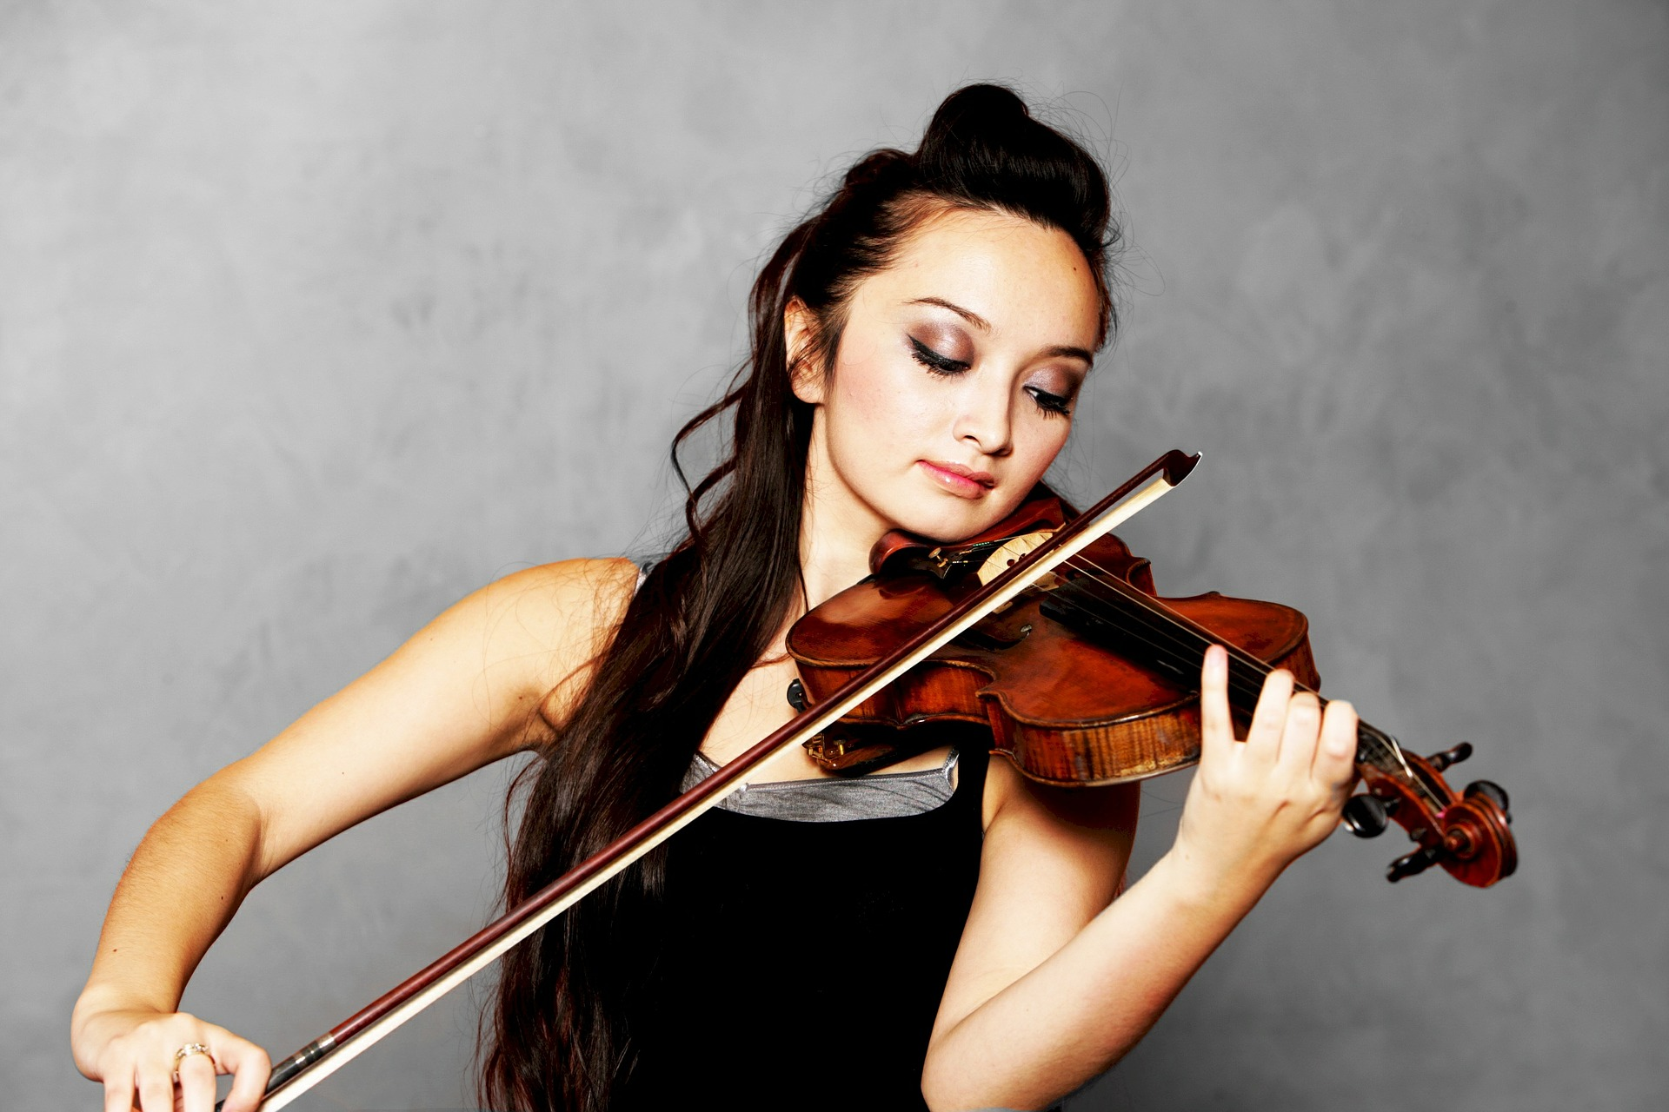
Always keep playing.

Slide 3
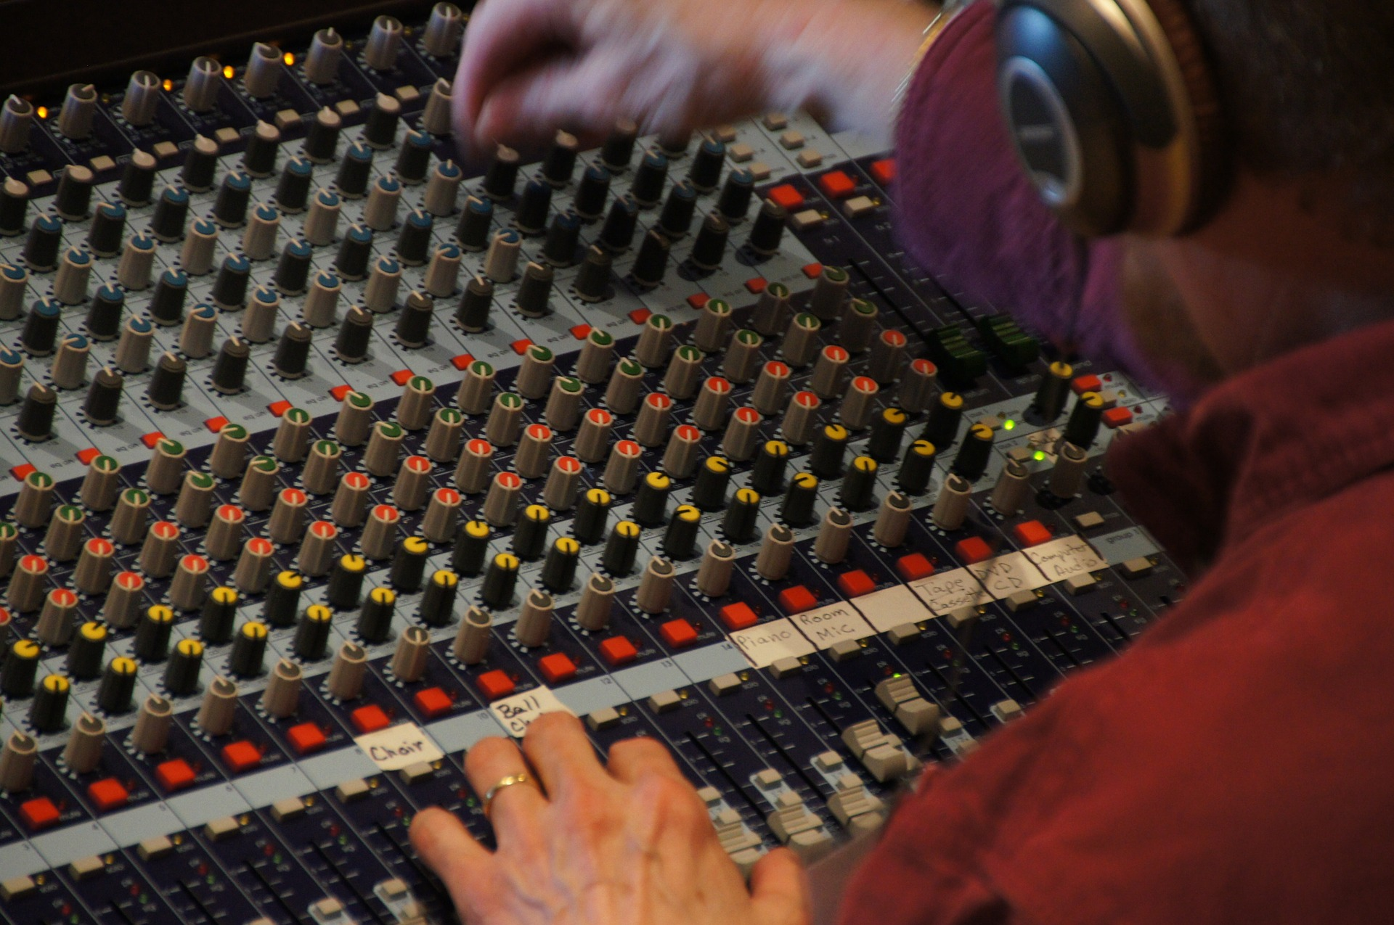
Easily compose your background music

Slide 4



quanternion – your music companion
Have your hands free to play your instrument
Compose background music incrementally
Customize your commands

Slide 5


Architecture
Gesture Recognition
via the Myo Wristband
Instant Feedback
Music Generation

Slide 6





Gestures
Fist Spread Wave In/Out Double Tap Orientation

Slide 7

Demo

Slide 8
quanternion
move to fill the space with music

Slide 9
Outlook
Collaborate with music professionals to improve their practice process
Enhance the music skills of everyday musicians
Adapt this idea to other use cases, like social interaction, polls

Slide 10
Demo Backup

Slide 11
Demo Backup App

