Slide 1
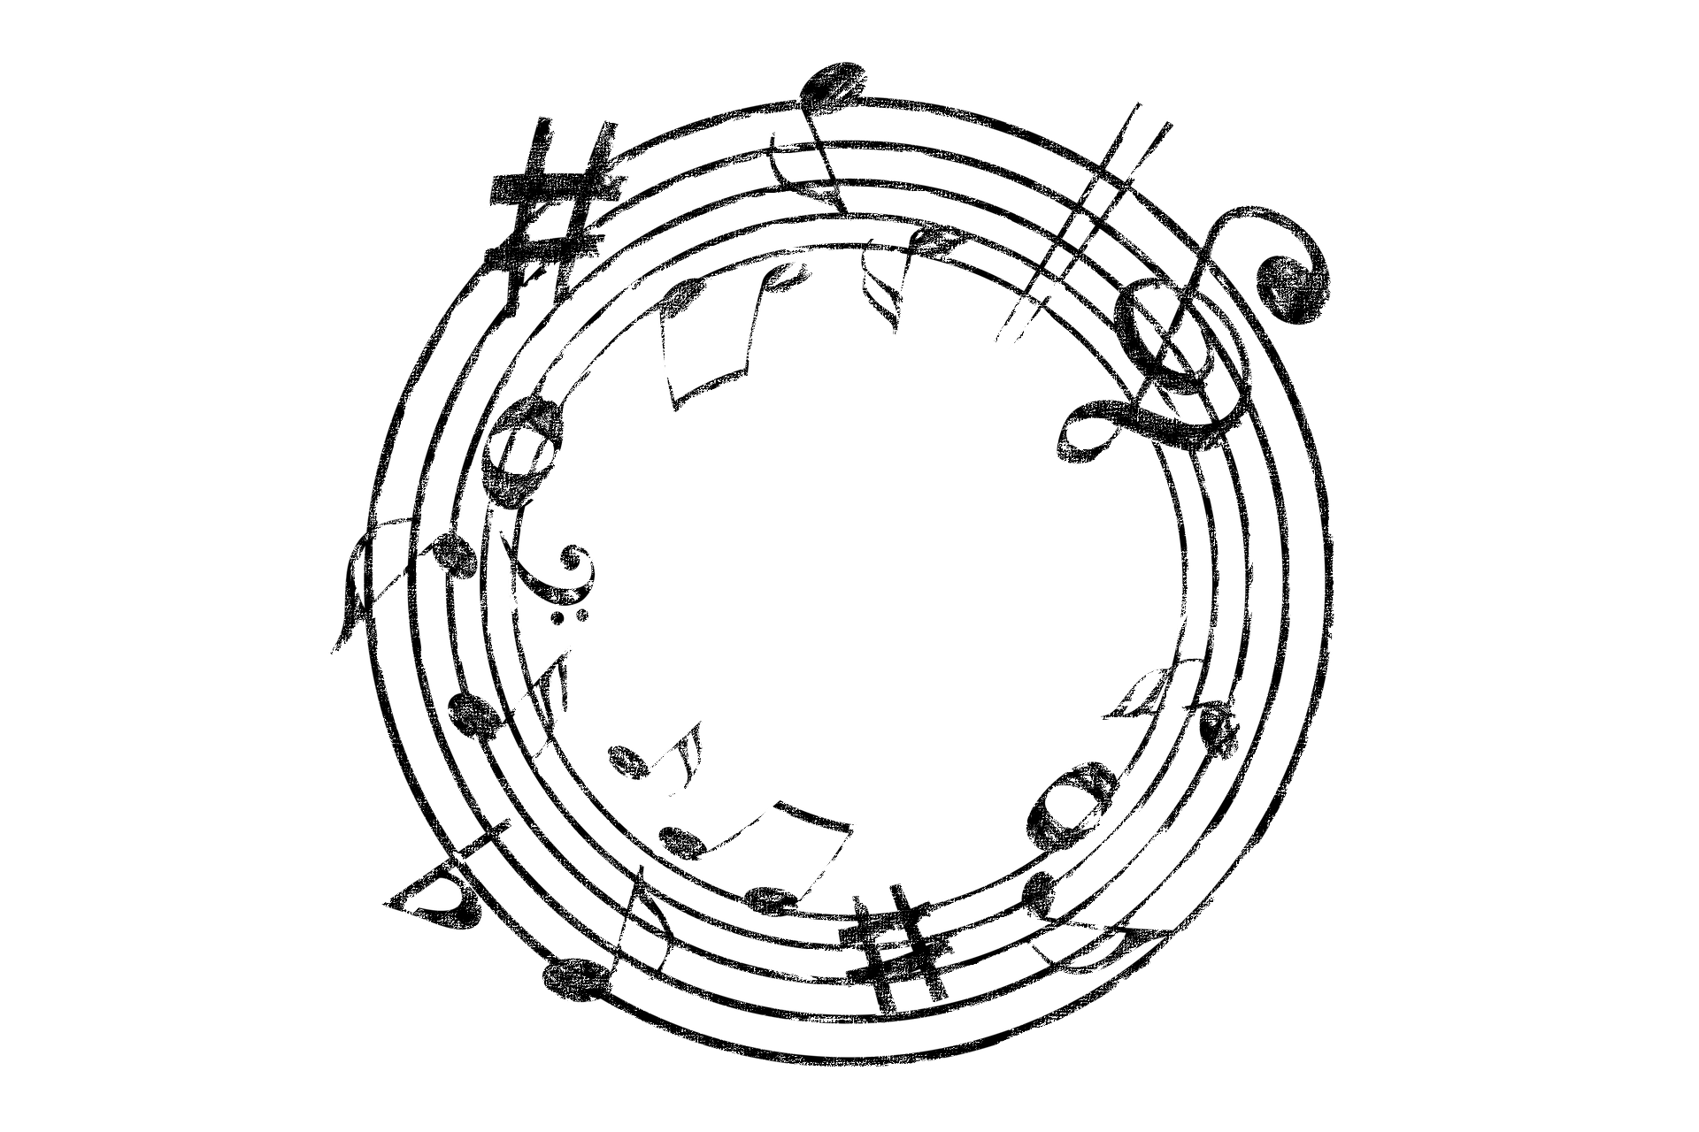
quaternion
move to fill the space with music

Slide 2
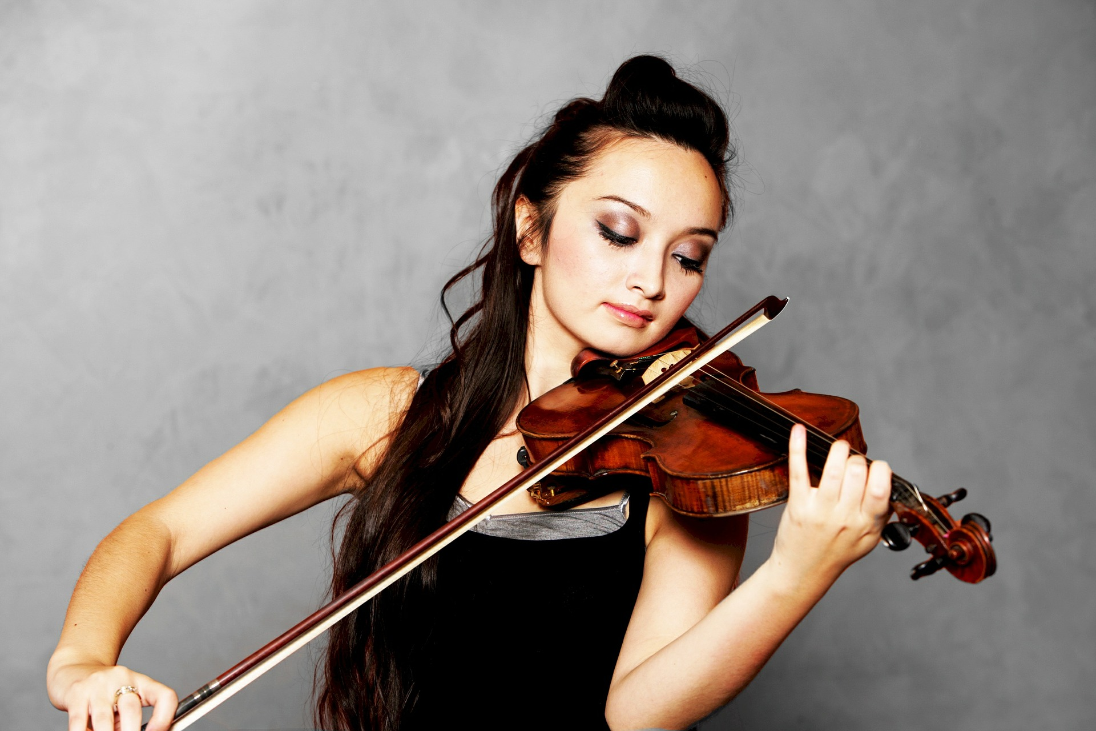
Music is the universal language.

Slide 3
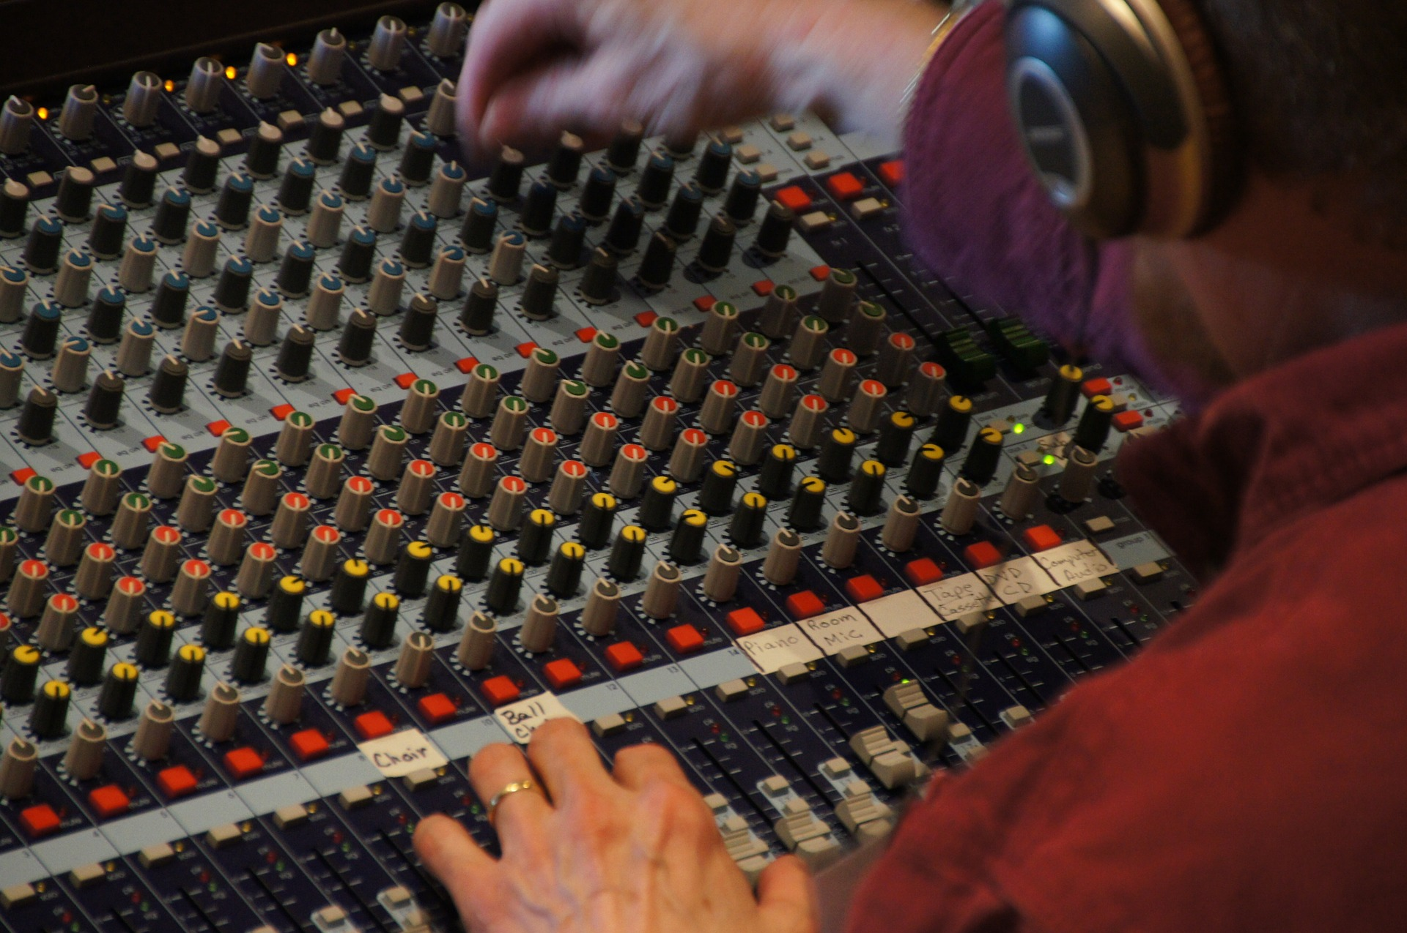
Why don’t we become the composers?

Slide 4



quaternion – your music companion
Intuitive fun experience
Compose your soundtrack incrementally
Involve your people

Slide 5


Architecture
Gesture Recognition
via the Myo Wristband
Instant Feedback
Music Generation

Slide 6





Gestures
Fist Spread Wave In/Out Double Tap Orientation

Slide 7

Demo

Slide 8
quaternion
move to fill the space with music

Slide 9
Outlook
Collaborate with music professionals to improve their practice process
Enhance the music skills of everyday musicians
Adapt this idea to other use cases, like social interaction, polls

Slide 10
Demo Backup

Slide 11
Demo Backup App

