Slide 1

18CSC402 : Deep Learning Case Study - final review
Uthara Koliyot
CB.SC.I5DAS18044
Int.MSc.Data Science, Sem 7

Slide 2
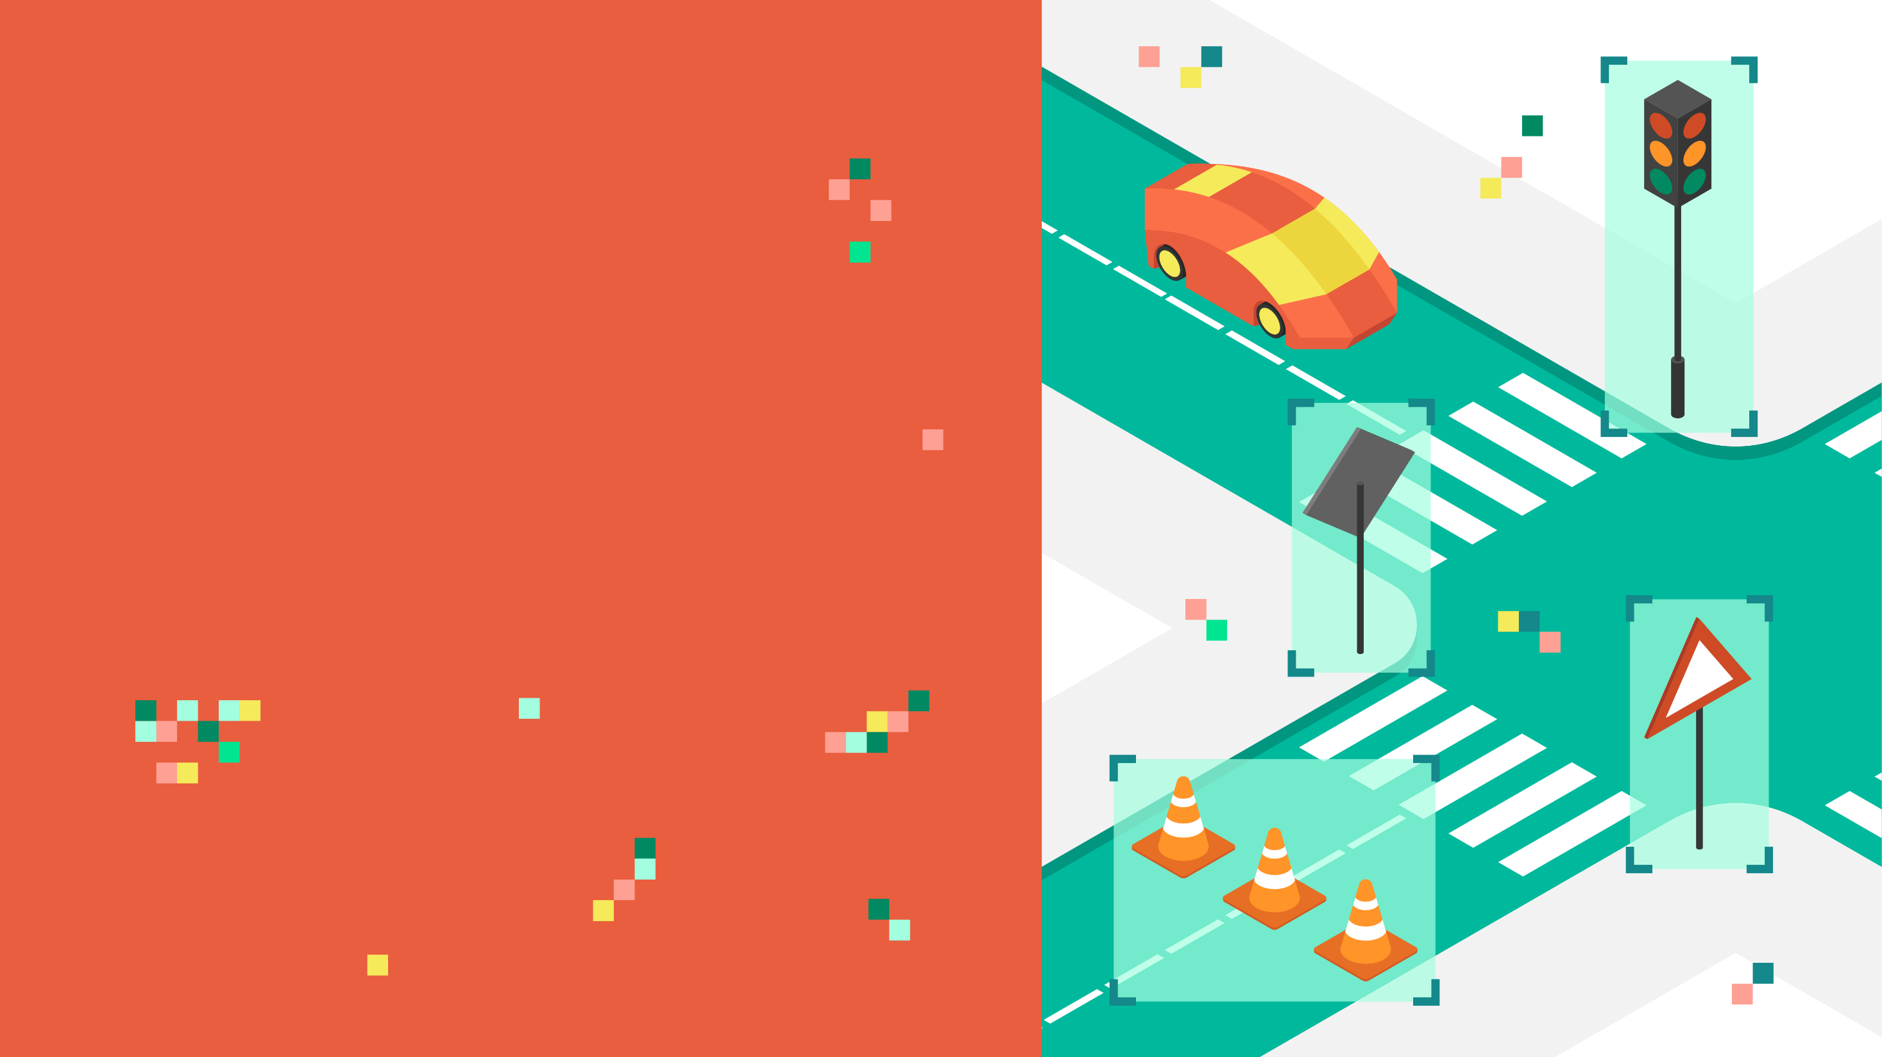
TRAFFIC SIGN
CLASSIFICATION
USING LE-NET DEEP
NETWORK

Slide 3
INTRODUCTION
Traffic sign classification is an important task for self driving cars.
Automatic recognition of traffic signs is required in advanced driver assistance systems and constitutes a challenging real-world computer vision and pattern recognition problem.
This project uses Convolutional Neural Networks to perform classification.
This project has been implemented based on the research paper : A robust system for road sign detection and classification using LeNet architecture based on convolutional neural network by Amal Bouti

Slide 4
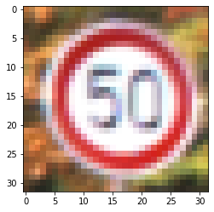
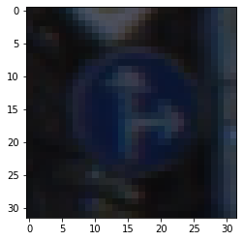
This project uses the “German Traffic Sign Recognition Benchmark” dataset.
This dataset is composed of 39,209 images and 43 classes.
The objective is to classify the images of the German dataset signs into the predefined classes.
Images are 32 x 32 pixels and reflects strong variations in visual appearance of signs due to distance, illumination, weather conditions, partial occlusions, and rotations.

Slide 5
LENET LAYERS
STEP 1: THE FIRST CONVOLUTIONAL LAYER #1
Input = 32x32x1
Output = 28x28x6
Output = (Input-filter+1)/Stride* => (32-5+1)/1=28
Used a 5x5 Filter with input depth of 3 and output depth of 6
Apply a RELU Activation function to the output
pooling for input, Input = 28x28x6 and Output = 14x14x6
STEP 2: THE SECOND CONVOLUTIONAL LAYER #2
Input = 14x14x6
Output = 10x10x16
Layer 2: Convolutional layer with Output = 10x10x16
Output = (Input-filter+1)/strides => 10 = 14-5+1/1
Apply a RELU Activation function to the output
Pooling with Input = 10x10x16 and Output = 5x5x16
STEP 3: FLATTENING THE NETWORK
Flatten the network with Input = 5x5x16 and Output = 400
STEP 4: FULLY CONNECTED LAYER
Layer 3: Fully Connected layer with Input = 400 and Output = 120
Apply a RELU Activation function to the output
STEP 5: ANOTHER FULLY CONNECTED LAYER
Layer 4: Fully Connected Layer with Input = 120 and Output = 84
Apply a RELU Activation function to the output
STEP 6: FULLY CONNECTED LAYER
Layer 5: Fully Connected layer with Input = 84 and Output = 43

Slide 6
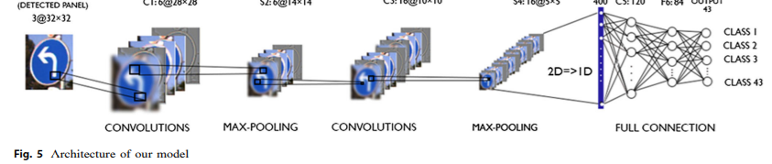
MODEL ARCHITECTURE
In this project I have used LeNet architecture and made some modifications to have the best performance and trained it to recognize signs using the German Traffic Sign Recognition Benchmark (GTSRB) dataset.
It has 7 layers : 3 convolutional layers, 2 layers of subsampling (pooling) and fully connected layers, followed by the output layer.
The convolutional layers use 5 out of 5 convolutions.
The subsampling layers are 2 by 2 average / max clustering layers.
The activation is ReLU except for the output layer that uses Softmax.
4 models were tried showing above 90 percentage accuracy
In the 4th model a dropout layer was introduced to reduce overfitting

Slide 7
OPTIMIZATION OF LENET MODEL PARAMETERS
4 models were tried by modifying some parameters of LeNet Architecture.
The modified parameters are convolution layer filters, fully connected layer neurons, epochs, learning rate and adding a dropout layer.
A convolution layer has a weight, which is its filter, and a bias.
A fully connected layer is just a regular layer of neurons in a neural network. Each neuron receives the inputs of all the neurons of the previous layer, so closely connected.
The epoch can be defined as a forward and a backward pass of all learning data.
The learning rate defines the step size during the gradient descent. This is a parameter chosen by the programmer. • The dropout layer can be considered as a form of regulation to prevent over-fitting. This is a technique of ignoring randomly selected neurons during training.

Slide 8
RESULTS AND OBSERVATIONS
 | Filters in the 1st convolutional layer | Filters in the 2nd convolutional layer | Neurons in the fully connected layer | Pooling Layers | Learning rate | Epochs | Adding a dropout layer | Accuracy |  | Loss
 |  |  |  |  |  |  |  | Training | Testing | Training | Testing
Model 1 | 5 x 5 x 6 | 5 x 5 x 16 | 120 | 2 (Average Pooling) | 1 x 10⁻³ | 50 | X | 0.9950 | 0.8707 | 0.0170 | 1.2412
Model 2 | 5 X 5 X 24 | 5 X 5 X 64 | 480 | 2 (Average Pooling) | 5 x10⁻³ | 100 | X | 0.9969 | 0.9165 | 0.0130 | 1.5926
Model 3 | 5 X 5 X 24 | 5 X 5 X 64 | 480 | 2 (Max Pooling) | 1 x 10⁻³ | 20 | X | 0.9979 | 0.9219 | 0.0089 | 0.6862
Model 4 | 5 X 5 X 24 | 5 X 5 X 64 | 480 | 2 (Max Pooling) | 1 x 10⁻⁴ | 200 | With a dropout layer | 0.9991 | 0.9407 | 0.0037 | 0.4497

Slide 9
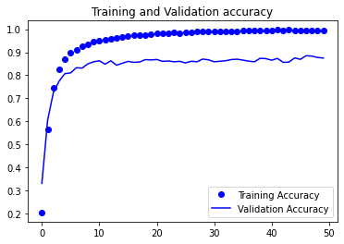
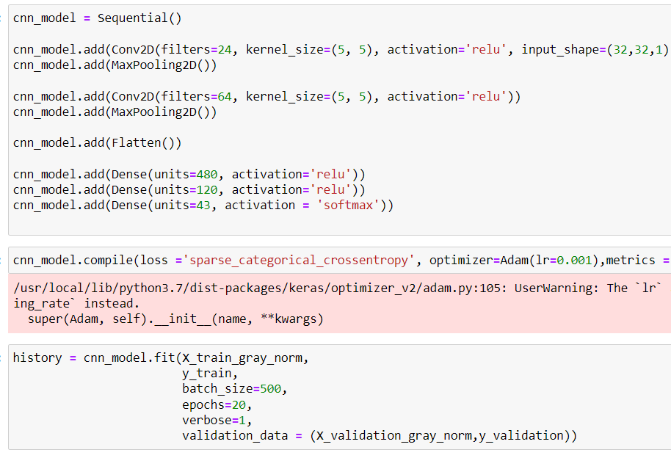
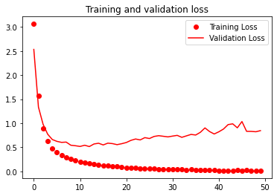
MODEL 1 (good model, loss higher)

Slide 10
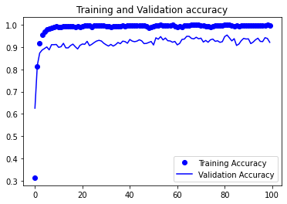
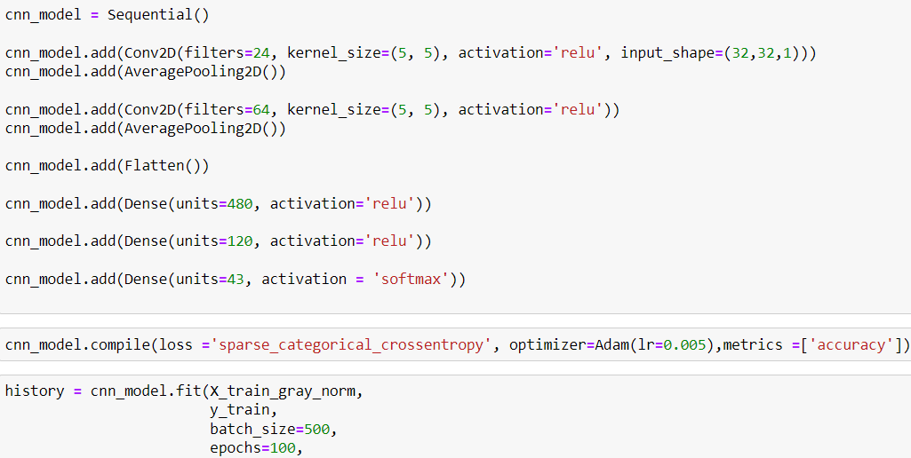
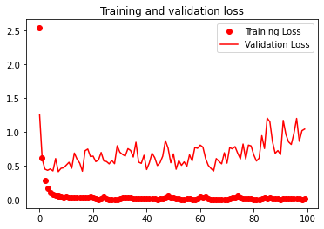
MODEL 2 (Loss was highest)

Slide 11
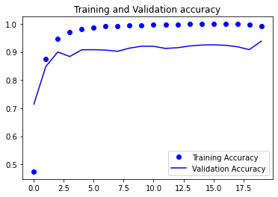
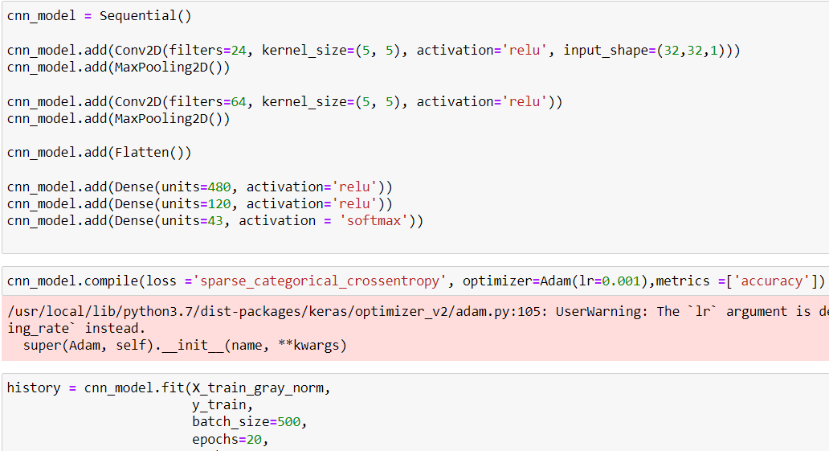
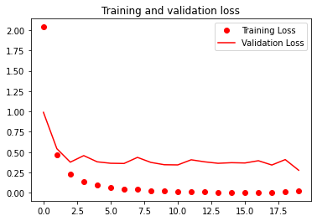
MODEL 3 (Low convergence , Least performance of 4)

Slide 12
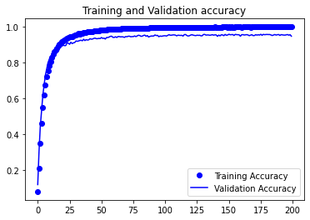
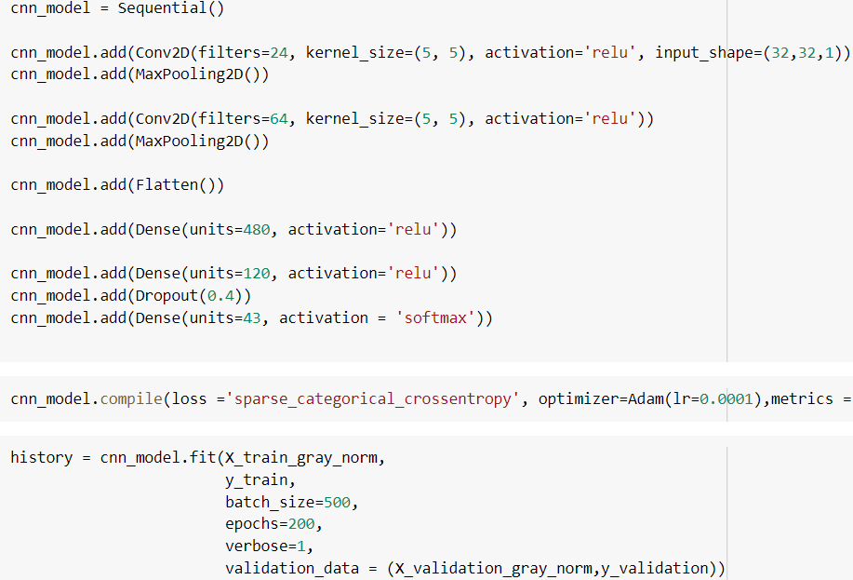
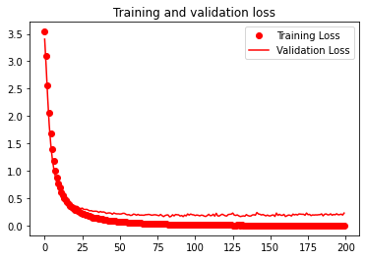
MODEL 4 (best, most convergence)

Slide 13
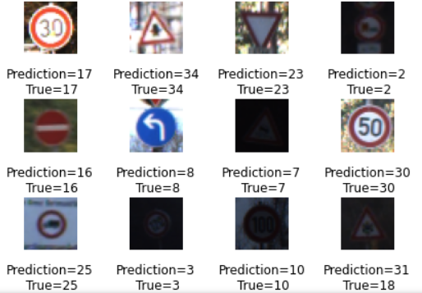
CONCLUSION
Out of the models tried, the 4th model was the most efficient.
The model achieved an overall training accuracy of 99.91% and testing accuracy of 94.07% in the classification.
The research paper model achieved an overall accuracy of 96.23% in the classification part using convolutional neural network model.
After optimizing our CNN model the learning curve and the confusion matrix were plotted and showed decent convergence and classification.
The learning curve is a comparison of the model’s performance based on the number of epochs. I tried the model for up to 200 epochs.
The confusion matrix allows us to measure the quality of the classification system.

Slide 14
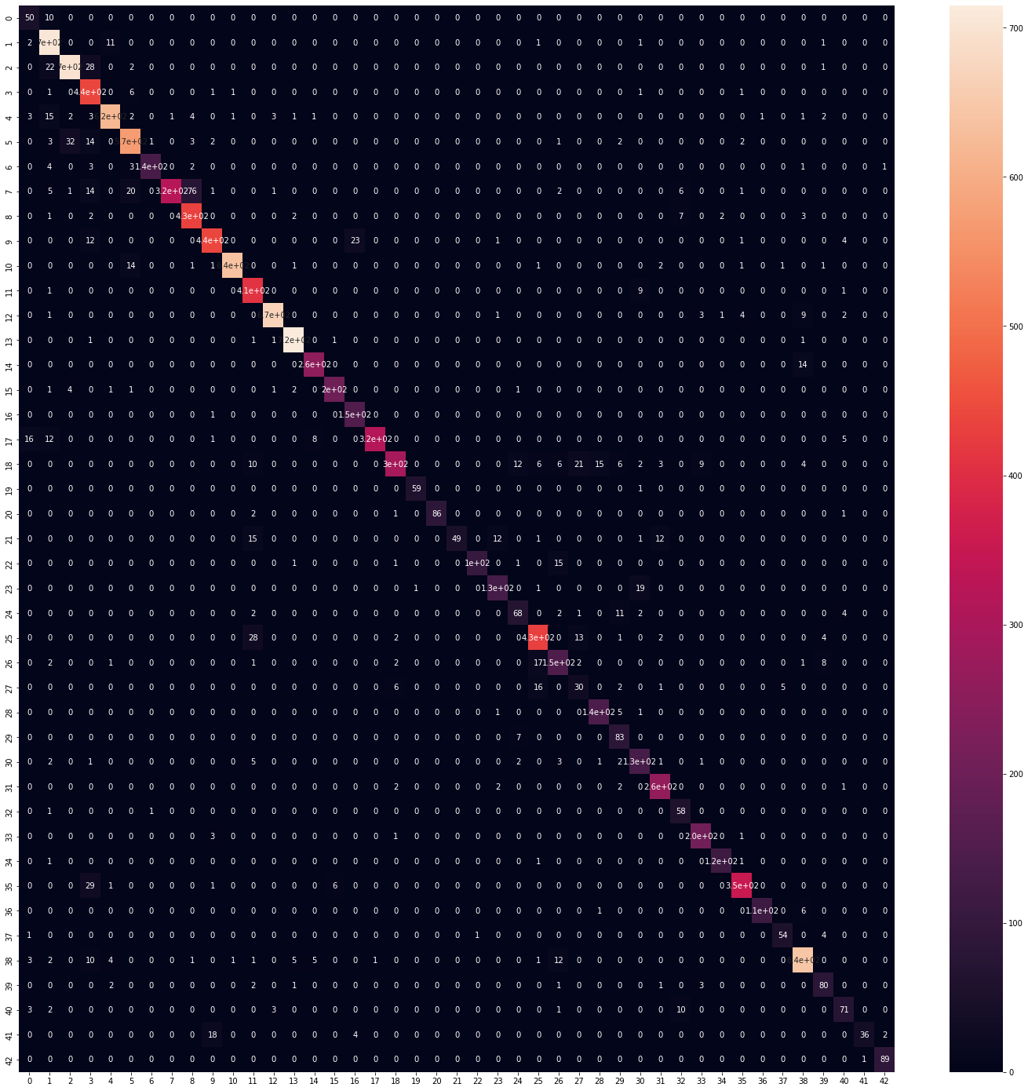
Although the models perform good for the German Dataset, this result may deteriorate in other cases. It means that for each country/region, it would be necessary to train the classifier through a learning base of its road signs.

Slide 15
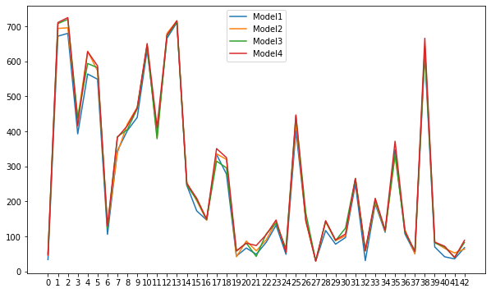

Slide 16

SOFTWARE/TOOLS REQUIREMENTS
The project has been implemented using Python Programming.
The experiments are executed and conducted in Google Colab platform.

Slide 17
REFERENCES :
http://yann.lecun.com/exdb/publis/pdf/lecun-01a.pdf
https://commons.wikimedia.org/wiki/File:Artificial_neural_network.svg
https://paperswithcode.com/dataset/gtsrb
https://towardsdatascience.com/understanding-and-implementing-lenet-5-cnn-architecture-deep-learning-a2d531ebc342

Slide 18
Thank You

