Slide 1

18CSC402 : Deep Learning Case Study - first review
Uthara Koliyot
CB.SC.I5DAS18044
Int.MSc.Data Science, Sem 7

Slide 2
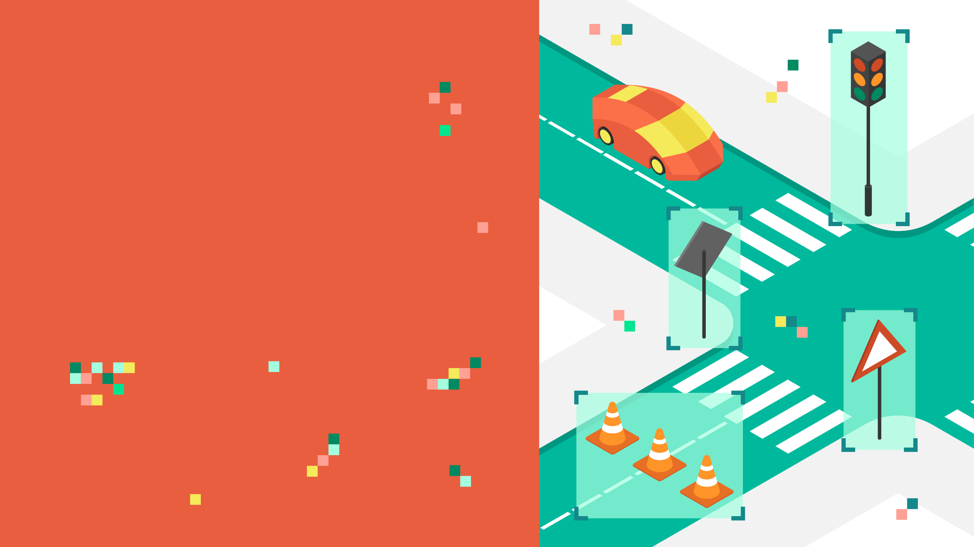
TRAFFIC SIGN
CLASSIFICATION
USING LE-NET DEEP
NETWORK

Slide 3
PROBLEM DEFINITION
With the advancement in autonomous vehicles and self driving cars from big companies like Tesla, Uber, Google, Mercedes-Benz, Toyota, Ford, Audi, etc., it is necessary for these vehicles to understand and follow all traffic rules. So, for achieving accuracy in this technology, the vehicles should be able to interpret traffic signs and make decisions accordingly. This can also assist drivers of manually driven vehicles to identify signals correctly.
MOTIVATION
Traffic sign classification is an important task for self driving cars.
Automatic recognition of traffic signs is required in advanced driver assistance systems and constitutes a challenging real-world computer vision and pattern recognition problem.
This project uses deep learning algorithms to perform classification.

Slide 4
DETAILS OF PAPER
PAPER TITLE :
A robust system for road sign detection and classification using LeNet architecture based on convolutional neural network
This paper reports a system for detection and classification of road signs. This system consists of two parts. The first part detects the road signs in real time. The second part classifies the German traffic signs (GTSRB) dataset and makes the prediction using the road signs detected in the first part to test the effectiveness.
In this project I am focusing on the Traffic Sign classification part.
AUTHORE DETAILS:
Amal Bouti, Faculty of Sciences, Sidi Mohamed Ben Abdellah University, Fez, Morocco
Med Adnane Mahraz1, Faculty of Sciences, Sidi Mohamed Ben Abdellah University, Fez, Morocco
Jamal Riffi1, Sidi Mohamed Ben Abdellah University, Fez,Morocco
Hamid Tairi1, Sidi Mohamed Ben Abdellah University, Fez, Morocco
Published online: 7 September 2019, ©Springer-Verlag GmbH Germany, part of Springer Nature 2019
4

Slide 5
ABOUT THE DATASET
The “German Traffic Sign Recognition Benchmark” is a multi-category classification competition held at IJCNN 2011. A comprehensive, lifelike dataset of more than 50,000 traffic sign images has been collected.
It reflects the strong variations in visual appearance of signs due to distance, illumination, weather conditions, partial occlusions, and rotations.
The images are complemented by several precomputed feature sets to allow for applying machine learning algorithms without background knowledge in image processing.
The dataset consists of 43 different classes.
Images are 32 x 32 pixels
The dataset is divided into three folders : Training set(34799 images) , Validation Set(4410 images) & Test set(12630 images).
Data Source : https://www.kaggle.com/meowmeowmeowmeowmeow/gtsrb-german-traffic-sign

Slide 6
The dataset contains 43 different classes of images with unbalanced class frequencies.
Classes are as listed below:
( 0, b'Speed limit (20km/h)') ( 1, b'Speed limit (30km/h)') ( 2, b'Speed limit (50km/h)') ( 3, b'Speed limit (60km/h)') ( 4, b'Speed limit (70km/h)')
( 5, b'Speed limit (80km/h)') ( 6, b'End of speed limit (80km/h)') ( 7, b'Speed limit (100km/h)') ( 8, b'Speed limit (120km/h)') ( 9, b'No passing')
(10, b'No passing for vehicles over 3.5 metric tons') (11, b'Right-of-way at the next intersection') (12, b'Priority road') (13, b'Yield') (14, b'Stop')
(15, b'No vehicles') (16, b'Vehicles over 3.5 metric tons prohibited') (17, b'No entry')
(18, b'General caution') (19, b'Dangerous curve to the left')
(20, b'Dangerous curve to the right') (21, b'Double curve')
(22, b'Bumpy road') (23, b'Slippery road')
(24, b'Road narrows on the right') (25, b'Road work')
(26, b'Traffic signals') (27, b'Pedestrians') (28, b'Children crossing')
(29, b'Bicycles crossing') (30, b'Beware of ice/snow')
(31, b'Wild animals crossing')
(32, b'End of all speed and passing limits') (33, b'Turn right ahead')
(34, b'Turn left ahead') (35, b'Ahead only') (36, b'Go straight or right')
(37, b'Go straight or left') (38, b'Keep right') (39, b'Keep left')
(40, b'Roundabout mandatory') (41, b'End of no passing')
(42, b'End of no passing by vehicles over 3.5 metric tons')

Slide 7

DEEP LEARNING ARCHITECTURE
INPUT IMAGES
DATA PREPARATION
MODEL TRAINING
MODEL EVALUATION
32
32

Slide 8
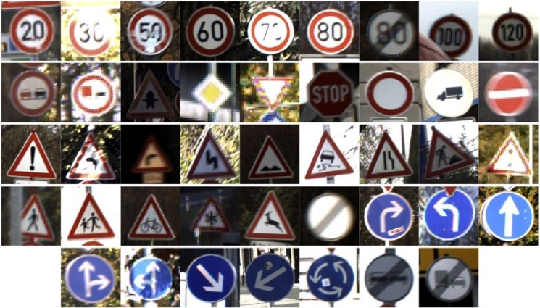
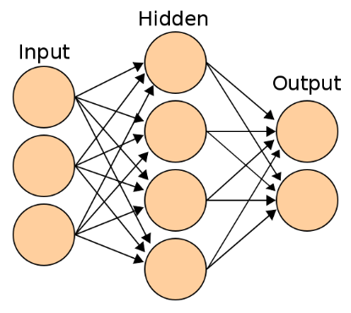
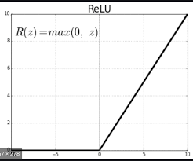
DEEP LEARNING ARCHITECTURE
CONVOLUTION
POOLING
FLATTENING
TARGET CLASSES
Stop
Yield
30 km/h
50 km/h
KERNELS/
FEATURE DETECTORS
POOLING FILTERS
CONVOLUTIONAL LAYER
POOLING LAYER (DOWNSAMPLING)

Slide 9
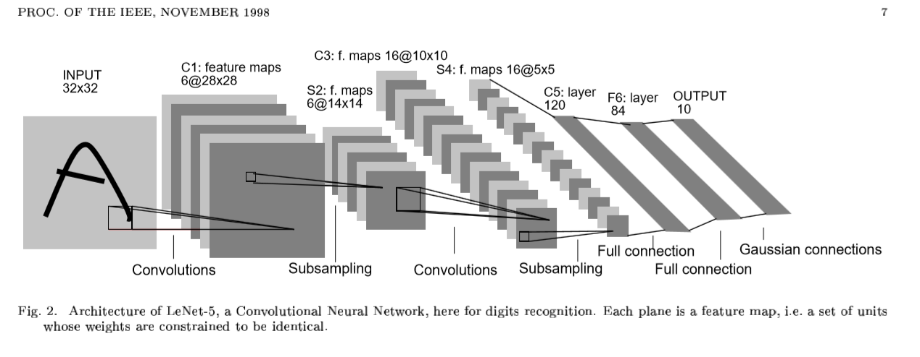
LENET ALRCHITECURE
The network used is called LeNet that was presented by Yann LeCun
C: Convolution layer, S: subsampling layer, F: Fully Connected layer

Slide 10

SOFTWARE/TOOLS REQUIREMENTS
The project has been implemented using Python Programming.
The experiments are executed and conducted in Google Colab platform.

Slide 11
REFERENCES :
http://yann.lecun.com/exdb/publis/pdf/lecun-01a.pdf
https://commons.wikimedia.org/wiki/File:Artificial_neural_network.svg
https://paperswithcode.com/dataset/gtsrb
# https://www.kaggle.com/dataclusterlabs/indian-sign-board-image-dataset

Slide 12
Thank You

