Slide 1
Understanding GIL
Senthil Kumaran

Slide 2
How I use python?
Python coredev - stdlib.
At work – Akamai.
Fun.

Slide 3
Thanks!
David Beazly – Inside the Python GIL talk.

Slide 4
Outline of the talk
Threads.
Python Interpreter.
Python Threading Support.
What is GIL.
GIL Behavior.
Newgil in py3.2
Parallelism – Other ways.
etc

Slide 5
Threads
Parallel units of execution within a process.
All threads share the same memory.
Eat and think around the table, sometimes sharing the fork and knife.
Problems with Threading involve the Shared Resources and Thread Synchronization

Slide 6
Python Programming language
Different Implementations.
  Cpython
  Jython
  IronPython.
We are going to discuss Cpython implementation.
Bytecode based.

Slide 7
Python Interpretor
Interpreter is a single process.
Within that process, only one thread can be interpreting python byte codes at one time.
If that thread is blocked (waiting or I/O), another thread can be run. Some C extensions release GIL so that threads can run concurrently.

Slide 8
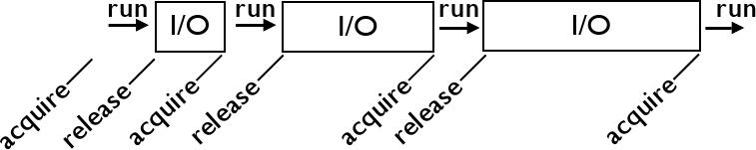
This is how

Slide 9
Python and Threading Support
A standard library module called threading.
But the execution of threaded programs is very basic.
You have to define the synchronization mechanism.

Slide 10
What is Python Thread?
Python threads are real system threads.
  POSIX threads (pthreads)
  Windows threads
Fully managed by the host operating system.
  All the scheduling/threading switching.
Represent threaded execution of the Python inpterpretor process (written in C).

Slide 11
Thread Creation
Python threads simply execute a “callable”
The run() method of Thread
Inside, the Python creates a small data structure containing some interpreter state.
A new thread (pthread) is lauched,
The thread calls PyEval_CallObject. It is just a C function call that runs the Python callable.

Slide 12
Thread Specific State
Each thread has its own interpreter specific data structure (PyThreadState)
  Details of the Thread currently under execution.
The interpreter has a global variable that simply points to the ThreadState strcture of the currently running thread.
/* Python/pystate.c */
Operations in the Interpreter implicitly depend on this variable to know the state.

Slide 13
What is GIL
GIL Serializes the access to most part of the interpreter.
Only one thread is running at a time.
The GIL ensures that each thread gets exclusive access to the Interpreter internals when its running.

Slide 14
GIL Behaviour
Its simple. Threads hold the GIL when running.
However, they release it when blocking for I/O.
It is coperative multi-tasking.

Slide 15
CPU Bound process
To deal with CPU bound threads that never perform any I/O, the interpreter periodically performs a “check”.
By default, every 100 interpreter “ticks”
sys.setcheckinterval
The check interval is independent of thread scheduling.

Slide 16
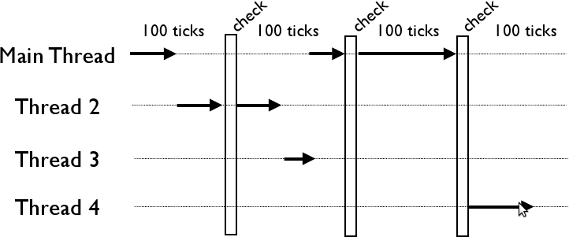
sys.setcheckinterval

Slide 17
The Periodic Check
Release and Reacquire GIL.
Signaling the OS to run other thread.
Other threads get to run.. (somewhat )
All of these is for py < 3.2

Slide 18
Interpreter ticks
They are not time based ( for < py3.2)
Ticks are uninterruptible
Long Operations can block everything.

Slide 19
Thread Scheduling
Interpreter does not do any thread scheduling.
There is no notion of thread priorities, preemption, round-robin scheduling.
All thread scheduling is left to the host operating system.
There comes the problem with signals. Only main thread handles signals and interpretor cannot schedule it execution, but has to wait for OS to schedule it when the any signal arrives.

Slide 20
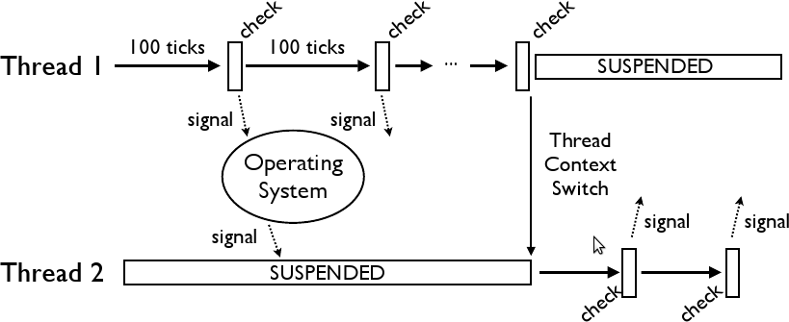
Interpreter does NO thread scheduling

Slide 21
More details on GIL
Its not a simple mutex.
It is some kind of semaphore.
The acquisition and release is based on the signals from the OS.
OS does the scheduling based on priorities like CPU bound task has low priority and IO bound tasks have higher priority.

Slide 22
Multicore GIL contention
CPU bound operations get scheduled simultaneous.
And they have a GIL battle in the Interpeter.

Slide 23
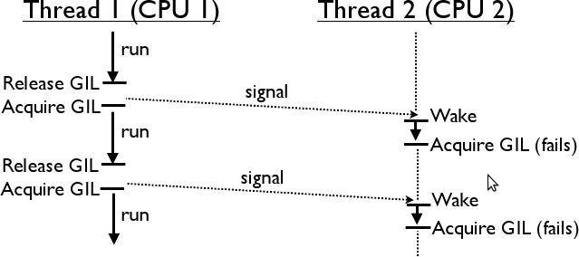
GIL Contention

Slide 24
Newgil implementation
Ditch the switching based on newgil implementation. (No Py_Ticker based count)
Use fixed intervals (5 milliseconds) for the main thread to release the GIL.
This fixed interval switching has significant benefits on thread contentions.
Forced thread switching. Improves the thread switch latency.

Slide 25
ccbench
Pure Python workload (PI Calculation).
C workload which does not release GIL (re.search)
C workload which does release GIL.

Slide 26
Other Concurrency Options
Multi processing.
C extension that can release GIL.
Asynchronous event based – Great for Networking applications.
Coroutines – python 2.5 where you can pass values to generators.
Other Python implementations. Jython, IronPython, Unladen Swallow.

