Slide 1





MENTIS 2026
Problem Statement ID –MENTIS1025
Problem Statement Title -Peer-Led Interventions for Anxiety, Depression, and Digital Addiction in Youth.
Theme-Peer-Led Strategies for Emotional Resilience and Healthy Digital Habits.
PS Category- Software.
Team Name –FOURSOME.

Slide 2

PEER-CARE CONNECT
Proposed Solution:
PEER-CARE Connect is a peer-led mental health and digital wellbeing platform where trained youth peers act as first-line supporters, supported by AI-based monitoring and professional escalation.
Combines peer trust + AI safety.Prevents digital addiction using peer motivation.
Early mental health detection before crisis.
Low-cost and scalable for schools & colleges.

Slide 3

TECHNICAL APPROACH
Technologies to be used are:-
-Frontend: Flutter / React
Backend: Firebase / Node.js
AI Module: Python (pattern detection)
Security: End-to-end encryption

Slide 4
FEASIBILITY AND VIABILITY
Uses existing student communities in schools and colleges.
Potential challenges and risks:
-Peer burnout due to emotional involvement.
-Privacy and data security risks.
-Incorrect advice given by peers.
-Low participation due to stigma.
-Digital misuse of the platform (trolling / fake profiles).Delayed identification of severe mental health cases.
Strategies for overcoming these challenges:
-Mandatory training & certification for peer leaders.Clear do’s and don’ts guidelines. End-to-end encryption & strict data privacy policies.

Slide 5
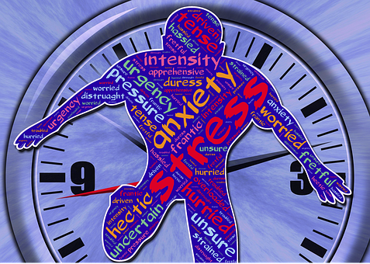
IMPACT AND BENEFITS
Reduced anxiety & depression.
Healthier digital habits.
Increased peer bonding.
Early intervention saves lives.
“Youth helping youth — safely and smartly”.

Slide 6

RESEARCH AND REFERENCES
World Health Organization (WHO) – Adolescent Mental Health & Peer Support Models
UNICEF – Youth Mental Health and Digital Wellbeing Reports.
National Institute of Mental Health and Neurosciences (NIMHANS).
India – Youth Mental Health Initiatives.
Indian Journal of Psychiatry – Effectiveness of Peer-Led Interventions.
American Psychological Association (APA) – Digital Addiction & Anxiety Studies.
Journal of Adolescent Health – Peer Support in Depression Prevention.
~THANK YOU.

