Slide 1

Loan Status Prediction Using Machine Learning
19AIE205
Python For Machine Learning
Submitted by : Team-16
BL.EN.U4AIE20023 – UTHEJ K
BL.EN.U4AIE20030 - KOTHURU GURUNADH
BL.EN.U4AIE20043 – NIKHIL KUMAR MUSUNURU

Slide 2
Loan Status Prediction
Loan Prediction application algorithm is used for approval of loan in banking sector
A Loan Prediction System can easily calculate the weight of each feature that contributes to loan processing
Loan Prediction System allows jumping to specific application so that it can be check on priority basis.

Slide 3
Machine Learning
Machine Learning is a field of computer science.
Machine learning is concerned with identifying patterns and applying computational learning techniques to AI systems.
Machine Learning is used to build programs with its tuning parameters that are adapted
It explores the study and construction of algorithm that can make prediction on data

Slide 4

Algorithms Used
Logistic Regression
Support Vector Machine
Random Forest
Decision Tree

Slide 5
Logistic Regression
Logistic regression comes under the Supervised Learning technique.
It is used for predicting the categorical dependent variable using a given set of independent variables.
Therefore the outcome must be a categorical or discrete value. It can be either Yes or No

Slide 6
Support Vector Machine
Support Vector Machine or SVM is one of the most popular Supervised Learning algorithms.
It is used for Classification as well as Regression problems.
It creates the best line or decision boundary that can segregate n-dimensional .
This best decision boundary is called a hyperplane.

Slide 7
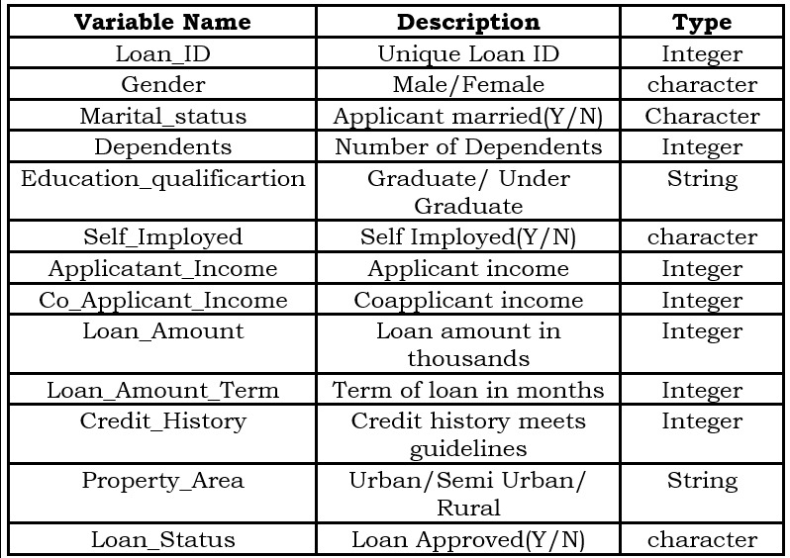

Slide 8
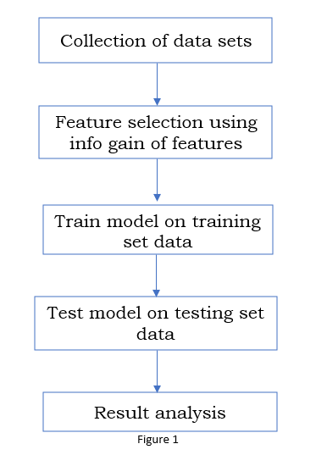
Block Diagram

Slide 9
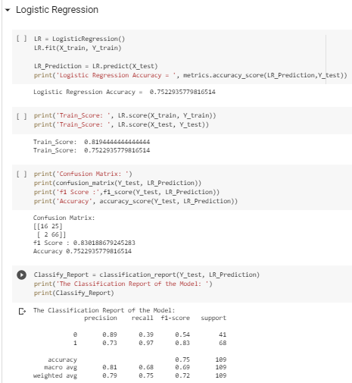
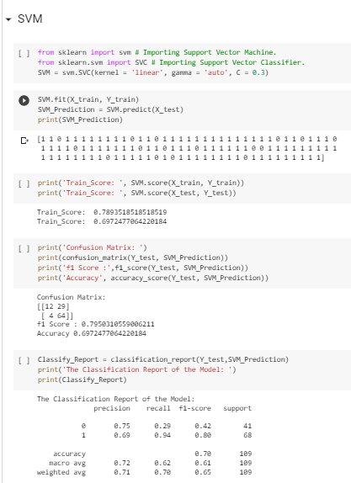
Code & Output

Slide 10
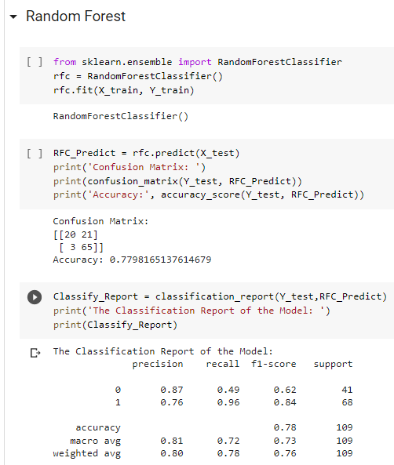
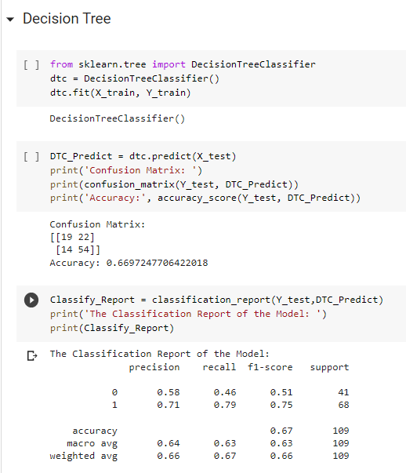

Slide 11

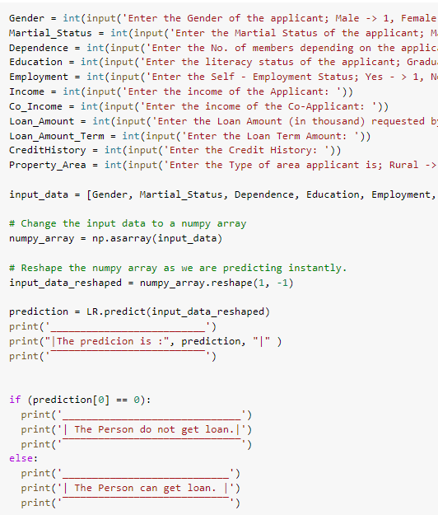
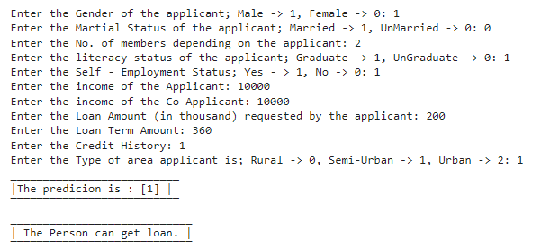
Prediction

Slide 12
Thank You

