Slide 1




The SafeMed Care Transitions Model:
Memphis Experience
James E. Bailey, MD, MPH, FACP Michael Ugwueke, DHA, FACHE Project Director Co-Project Director
Supported by Funding Opportunity Number 1C1CMS331067-01-00
from Centers for Medicare and Medicaid Services,
Center for Medicare and Medicaid Innovation.
Contents of this presentation
are solely the responsibility of the authors
Notes:
Superutilizers of inpatient healthcare
Patients with multiple chronic conditions (MCC) at highest risk for re-hospitalization, ED use, and adverse outcomes
SafeMed Program – ongoing care transitions program with a focus on medication management targeting superutilizing patients with MCC and polypharmacy

Slide 2
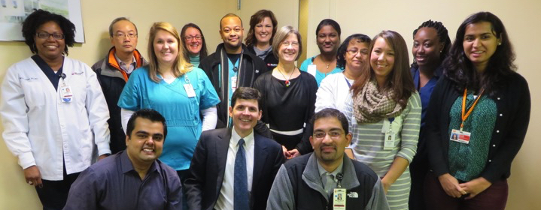

Acknowledgements
The project described was supported by Cooperative Agreement Number 1C1CMS331067-01-00 from the Department of Health and Human Services, Centers for Medicare & Medicaid Services. The contents of this presentation are solely the responsibility of the authors and do not necessarily represent the official views of the U.S. Department of Health and Human Services or any of its agencies.
Notes:
Carrie

Slide 3


The Problem
24.8% of 1.3 million Medicare heart failure hospitalizations readmitted within 30 days
19.9% of 500,000 Medicare MI hospitalizations readmitted within 30 days
Only 1/3 recently hospitalized patients get outpatient follow-up within 60 days of discharge

Slide 4
Root Causes
Medication errors and nonadherence following discharge a significant contributor to readmits
At discharge, 63% of patients unable to state purpose of meds¹
2-40% of discharge summaries lack discharge medications²
Recently hospitalized 40% more likely to experience unintentional discontinuation of meds²
51% fail to take medication (or take correctly) within 2 days of discharge³
¹ Makaryus & Friedman, Mayo Clinic Proceedings, 2005 ² Kripalani et al, JAMA, 2007 ³ Bell, JAMA, 2011

Slide 5
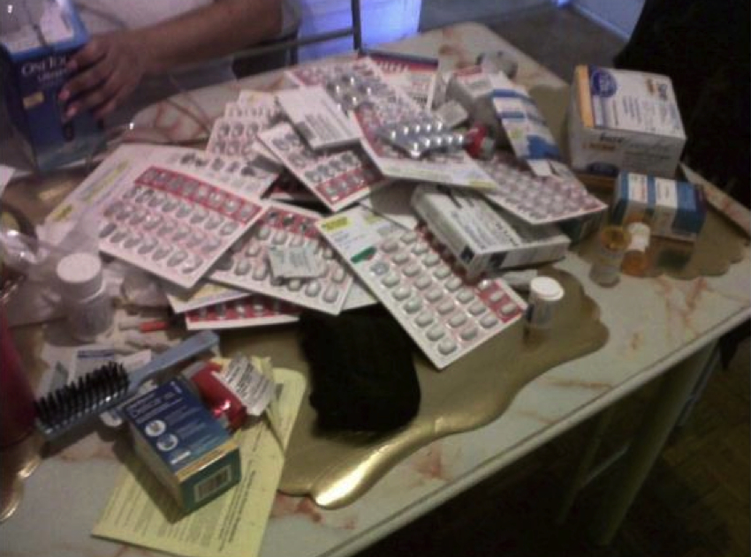

cc
Root Causes

Slide 6
Background
SafeMed –An innovative care transitions program supporting medication management for super-utilizers
Among first programs to employ low-cost certified pharmacy technicians as care transitions–community health workers

Slide 7
Hospital Focused Care Transitions Models
Background
Project Boost¹
Hospital-based standardized processes for: identifying high-risk for readmission, interdisciplinary rounds, patient-family preparation, medication reconciliation, discharge summary communication
The Bridge Program²
Hospital social work-based approach by Bridge Care Coordinators. Pre-discharge ID of older adults, post-discharge needs assessment & phone support
Project RED (Re-engineered Discharge)³
Hospital-based, 11 components: patient ed., follow-up appointments, test result follow-up plan, post-discharge service planning, med reconciliation, discharge plan reconciled with guidelines, plan for problems, expedited DC summary, assess understanding, written patient discharge plan, telephone follow-up
¹ Society of Hospital Medicine ² Illinois Transitional Care Consortium/Rush University Medical Center
³ Boston Medical Center

Slide 8
Super-Utilizer Focused Care Transitions Models
Background
The Camden Coalition of Healthcare Providers
Hot-spotting
Care-transitions support, long-term care management with care coordination, medical and social support
The Care Transitions Program¹
Continuity of care documents/discharge checklists to improve handoffs
Self-management training
Transition coaches
The Transitional Care Model²
3-month APN-directed discharge planning and home follow-up protocol
¹ Coleman EA. Arch Intern Med, 2006;166:1822-1828 & Halasyamani L, J Hosp Med, 2006;1(6):354-60
² Naylor MD, J Am Geriatr Soc. 2004 Jul;52(7):1228

Slide 9
Medication Therapy Management (MTM)
Background
The Asheville Project¹
Community pharmacy-based medication therapy management (MTM) and disease management services improves HbA1c & decreases hospitalization
Various studies
Early identification and resolution of drug therapy problems through MTM may result in: improved clinical outcomes (reduced cardiovascular events, hospital and ED visits, & overall costs
The PILL-CVD (Pharmacist Intervention for Low Literacy in Cardiovascular Disease) study
Hospital-based Med Rec and/or MTM alone is not sufficient to reduce readmissions or clinically important medication errors²
¹ Cranor CW, et al. J Am Pharm Assoc, 2003;43:173‐84 & 2003;43:149‐59
² Kripalani et al, Annals Int Med, 2012

Slide 10
Population Served
Medicare or Medicaid Patients with:
2 + Chronic Conditions
High IP Utilization
Polypharmacy
Hot-spot Communities
Hypertension
Diabetes
Heart Failure
Coronary Artery Disease
Chronic Lung Disease (COPD, Asthma)
In prior 6 months:
3+ inpatient visits, OR
2+ inpatient visits and 2+ ED visits
6 or more medications, OR
Presence of a high-risk (Beers list) medication
Bartlett
Raleigh
Millington
Whitehaven
Frayser
Exclusions: Admissions related to cancer, pregnancy, or surgical procedure, severe mental illness or substance abuse, age <18 years, life expectancy < 6 months, discharge to NH, dementia & no caregiver

Slide 11
cc
Goals & Key Interventions
Aims 1° Drivers 2° Drivers
20% decrease in repeat hospitalizations
$3M cost savings
Within 9 months of program participation:
60% have improved medication adherence
60% have fewer exacerbations of chronic conditions
80% report improved experience of care
Improved Discharge Planning
Redesigned med reconciliation
45-day Care Transitions Support
Home visits within 72 hours & at 2-4 weeks
Targeted Medication Therapy Management
Ongoing Care Coordination
Standardized DC Summary to PCP
Ongoing disease management & medication adherence support
Monthly phone follow-up & Support Sessions
Quarterly Comprehensive Medication Review and Medication Therapy Management
Patient engagement by SafeMed staff
Development of symptom triage plan
Phone triage & stabilization of early exacerbations
Care coordination with PCP
Linkage to community services

Slide 12

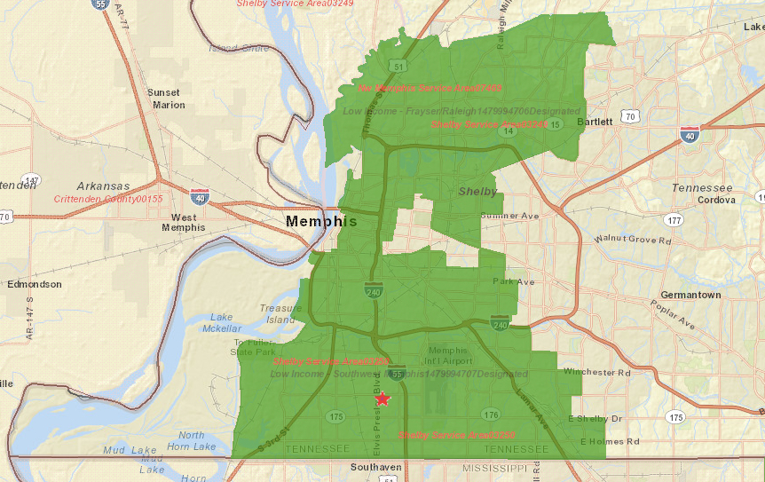
Participating Hospitals:
Serving Readmission Hotspot/Medically Underserved Communities
★
H2
★
H3
H1

Slide 13
Interdisciplinary Team
1 Advanced Practice Nurse & 1 RN
Screening, enrollment, care transition/care coordination
Outpatient urgent care and educational visits
2 Community Health Pharmacists
Hospital-based medication reconciliation
Outpatient comprehensive medication reviews (CMR)
1 Community Social Worker
Screening, enrollment, care transition/care coordination
Participates in home visits, address complex social needs
2 LPN–Community Health Worker (CHW)
Home visit within 72 hours & 2-4 weeks, phone follow-up
2 Pharm Tech–CHW
Home-based symptom and physical assessment
Home visit within 72 hours & 2-4 weeks, phone follow-up
Home-based medication reconciliation

Slide 14
Key Inpatient Interventions
NP/RN –Screening, enrollment, provide disease toolkit and disease state education, enhanced discharge planning
PharmD/CPhT –Enhanced med history (Comprehensive Medication Review) , patient med education, final medication reconciliation, enhanced discharge planning & med recommendations to discharging and outpatient providers
MSW –Assess social needs/underlying causes for readmission (e.g. mental health, substance abuse, housing) & engage hospital case management/SW
LPNs/CPhT Outreach Workers –establish relationship, support education, assist in patient-family preparation
NP/PharmD –Complete SafeMed Discharge Note/Continuity of Care Document and coordinate care between hospital and PCP as a critical bridge
All staff –repeat intensive inpatient intervention upon readmission

Slide 15
Key Outpatient Interventions

Slide 16
Results
Teambuilding: Transition to higher functioning team, skill enhancement seminars, support for innovation, daily huddles
Participation: 386 enrolled in 29 months
Enrollment: 20-25/month, >80% choose to participate
Improved Processes & Outcomes:
PCP follow-up, Phone follow-up, Home visit rates
Readmissions, hospitalizations, ED visits, and overall costs

Slide 21
Main Results
30% in hospitalizations*
44% in readmissions*
52% in ED visits*
* Compared with projected

Slide 22
Process Measures
Results
Pharm Techs (CPhT-CHW) identified potential drug therapy problems at home visits for 84.9% of clients
Pharm Techs coordinated real-time targeted medication therapy management (MTM) by the pharmacist for 34.7% of clients (mean of 1.4 targeted MTM contacts per participant)
Pharm Techs coordinated outpatient comprehensive medication review (CMR) by the Pharmacist for 31.1% of all participants.
Numbers of clients receiving targeted MTM and outpatient CMR have increased since the beginning of the program (slope=0.02, R2=0.63; slope=0.02, R2=0.62, respectively)
Notes:
For DTPs we used SafeMed FileMaker Pro data and used the following two criteria:
1. Post discharge medication match during 1st home visit.
2. If patient experienced any of the symptoms due to starting of any new medication: headache/pain, muscle aches, hives/rash, nausea, problems with sleep, fatigue, stomach or gastrointestinal problem, irregular heartbeat, change in mood, dizziness/balance problems, incontinence/urinating problems, sexual problems, or any other problem related to the medication.
Refers to CMRs completed –many more were scheduled

Slide 23
Key Lessons Learned
Results
Improved med history & reconciliation (PharmD/CPhT)
Need for improved medication histories across system
Enhanced med review and discharge Med Rec with consideration of drug costs)
Improved care coordination and communication during transition from hospital to home (NP/RN/MSW)
Ensure patient has PCP and gets f/u care in appropriate time frame
Ensure transition communication, care coordination, ensuring timely PCP follow-up
Relationships of trust (Multidisciplinary)
Face-to-face contact with patients in the home greatly strengthens likelihood of post discharge outpatient f/u
Notes:
For DTPs we used SafeMed FileMaker Pro data and used the following two criteria:
1. Post discharge medication match during 1st home visit.
2. If patient experienced any of the symptoms due to starting of any new medication: headache/pain, muscle aches, hives/rash, nausea, problems with sleep, fatigue, stomach or gastrointestinal problem, irregular heartbeat, change in mood, dizziness/balance problems, incontinence/urinating problems, sexual problems, or any other problem related to the medication.
Refers to CMRs completed –many more were scheduled

Slide 24
Key Lessons Learned
Results
Physical presence in patient’s home critical (Multidisciplinary)
Better environment for learning & more complete picture of critical health factors
Key is process to communicate findings with providers
Frequent touch points—home visits, phone calls, support sessions— critical for patient success (Multidisciplinary)
Needs to be individualized, and intensive immediately post discharge
Support system augmentation through regular peer and SafeMed Team support
Addressing Psychosocial Needs—Transportation/Housing/Financial Resources/Mental Health—essential for some (MSW)
Most patients leave hospital with unidentified barriers & unmet needs
MSW f/u in the home critical to identify complex social needs & link to critical community based services
Notes:
For DTPs we used SafeMed FileMaker Pro data and used the following two criteria:
1. Post discharge medication match during 1st home visit.
2. If patient experienced any of the symptoms due to starting of any new medication: headache/pain, muscle aches, hives/rash, nausea, problems with sleep, fatigue, stomach or gastrointestinal problem, irregular heartbeat, change in mood, dizziness/balance problems, incontinence/urinating problems, sexual problems, or any other problem related to the medication.
Refers to CMRs completed –many more were scheduled

Slide 25
Return on Investment
Results
2 approaches for comparing costs for SafeMed vs. Controls gave similar results:
Total Projected Annual Savings = $1.2 M or $4,584 to $6,276 per SafeMed enrollee
Yearly Annual Cost for Full Program: $972,496 or $3,242 to $4,052 per SafeMed enrollee
Total Projected Net Cost Savings: $127,664 to $910,304 per year
Notes:
For DTPs we used SafeMed FileMaker Pro data and used the following two criteria:
1. Post discharge medication match during 1st home visit.
2. If patient experienced any of the symptoms due to starting of any new medication: headache/pain, muscle aches, hives/rash, nausea, problems with sleep, fatigue, stomach or gastrointestinal problem, irregular heartbeat, change in mood, dizziness/balance problems, incontinence/urinating problems, sexual problems, or any other problem related to the medication.
Refers to CMRs completed –many more were scheduled

Slide 26
Limitations
Results
Unknown which components of SafeMed most critical for super-utilizers, but early evidence suggests :
Intensive engagement & relationship starting in hospital ideal
Tailored services must extend into the home
Enhanced medication management
Symptom triage & care coordination
Social services critical to address complex social needs (e.g. mental health, substance abuse, housing) & link to critical community based services
Long-term relationship & support necessary for some patients
Notes:
For DTPs we used SafeMed FileMaker Pro data and used the following two criteria:
1. Post discharge medication match during 1st home visit.
2. If patient experienced any of the symptoms due to starting of any new medication: headache/pain, muscle aches, hives/rash, nausea, problems with sleep, fatigue, stomach or gastrointestinal problem, irregular heartbeat, change in mood, dizziness/balance problems, incontinence/urinating problems, sexual problems, or any other problem related to the medication.
Refers to CMRs completed –many more were scheduled

Slide 27
Conclusions
Low cost LPN- and CPhT-CHW are well suited for expanded roles as care transitions–community health workers with a focus on medication management
Effective roles for CPhT-CHW include:
Assistance with identification and reporting of potential drug therapy problems identified during home visit and phone follow-up
Coordination with pharmacists in real time to enable patients to get targeted medication therapy management when and where they need it.
Programs seeking to recruit effective LPN- and CPhT-CHW need to identify candidates with strong patient-centered communication skills
SafeMed model can be successfully scaled to serve super-utilizing patients throughout the country

