Slide 1
notJSON
Jason West
Mikolaj Jakowski
Jackson Mowry

Slide 2


Slide 3
Why not JSON?
JSON is a Text Based data format
JSON does not have types
Parsing JSON is what most web servers spend their time doing

Slide 4
Why notJSON?
notJSON is a binary data format
notJSON is statically typed, supporting both fixed length and variable length data
notJSON requires 0 parsing and unpacking

Slide 5
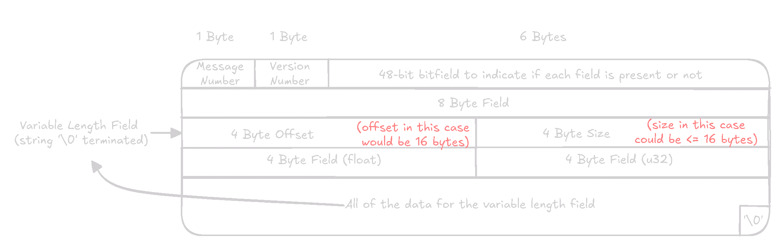

Slide 6
notJSON Generated Code
Code can be generated for both servers and client in any supported language
All generated code contains a packaged library to pack/unpack messages

Slide 7
notJSON Schemafiles
Messages and Procedures are defined within a single file
This file serves as a single source of truth for any generated code

Slide 8
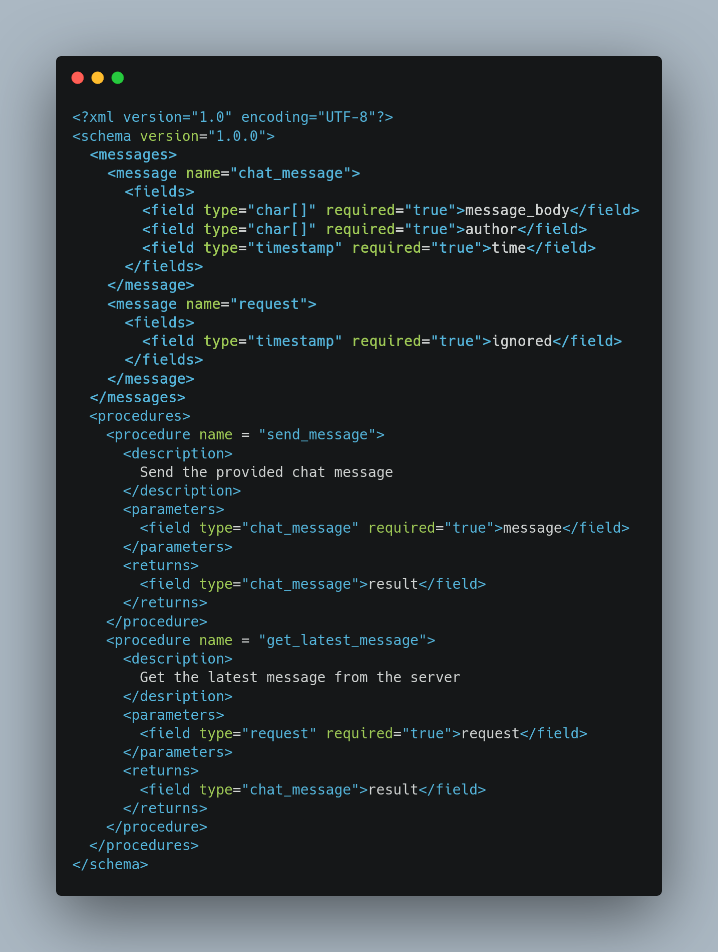

Slide 9
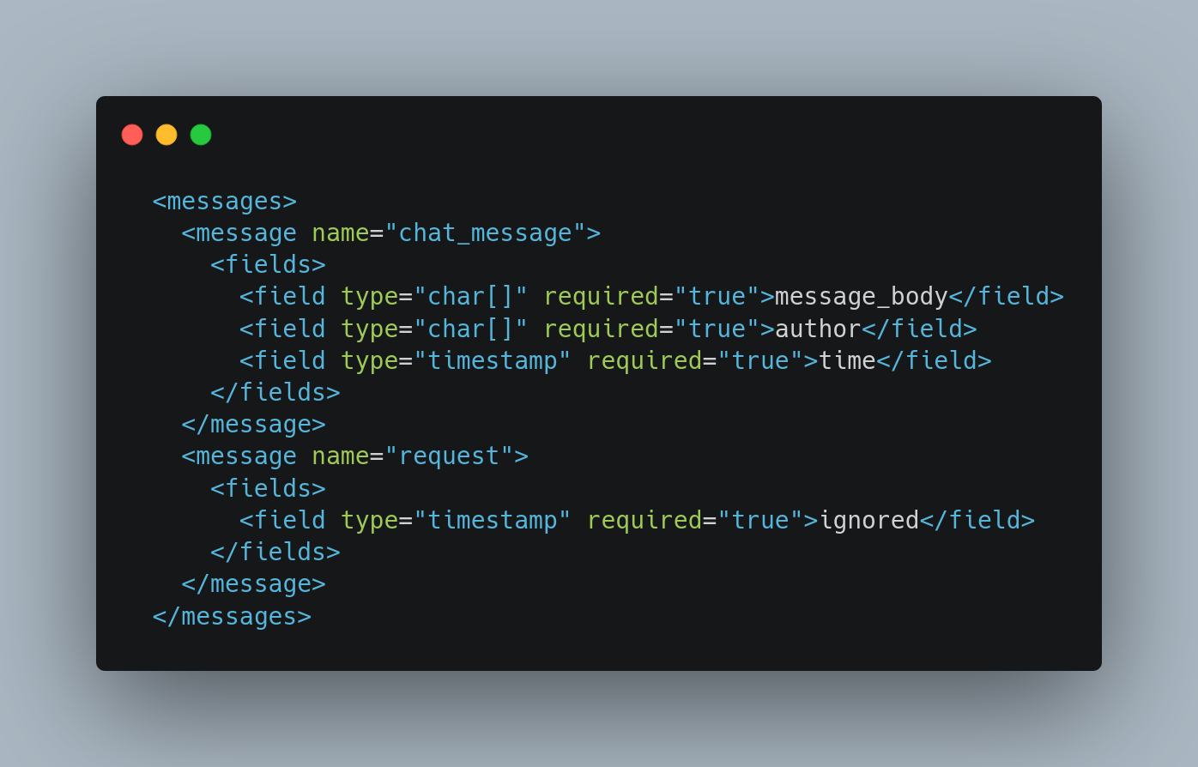

Slide 10
notJSON Message Packing
Differences in packing between JS, C, and Python
Each language required a different byte array primitive

Slide 11
Python
Philosophy of Python has differences between C (i.e. pointers are inherently unsafe)
Presents challenges in implementing C-style concepts
Had to use Struct Python package

Slide 12
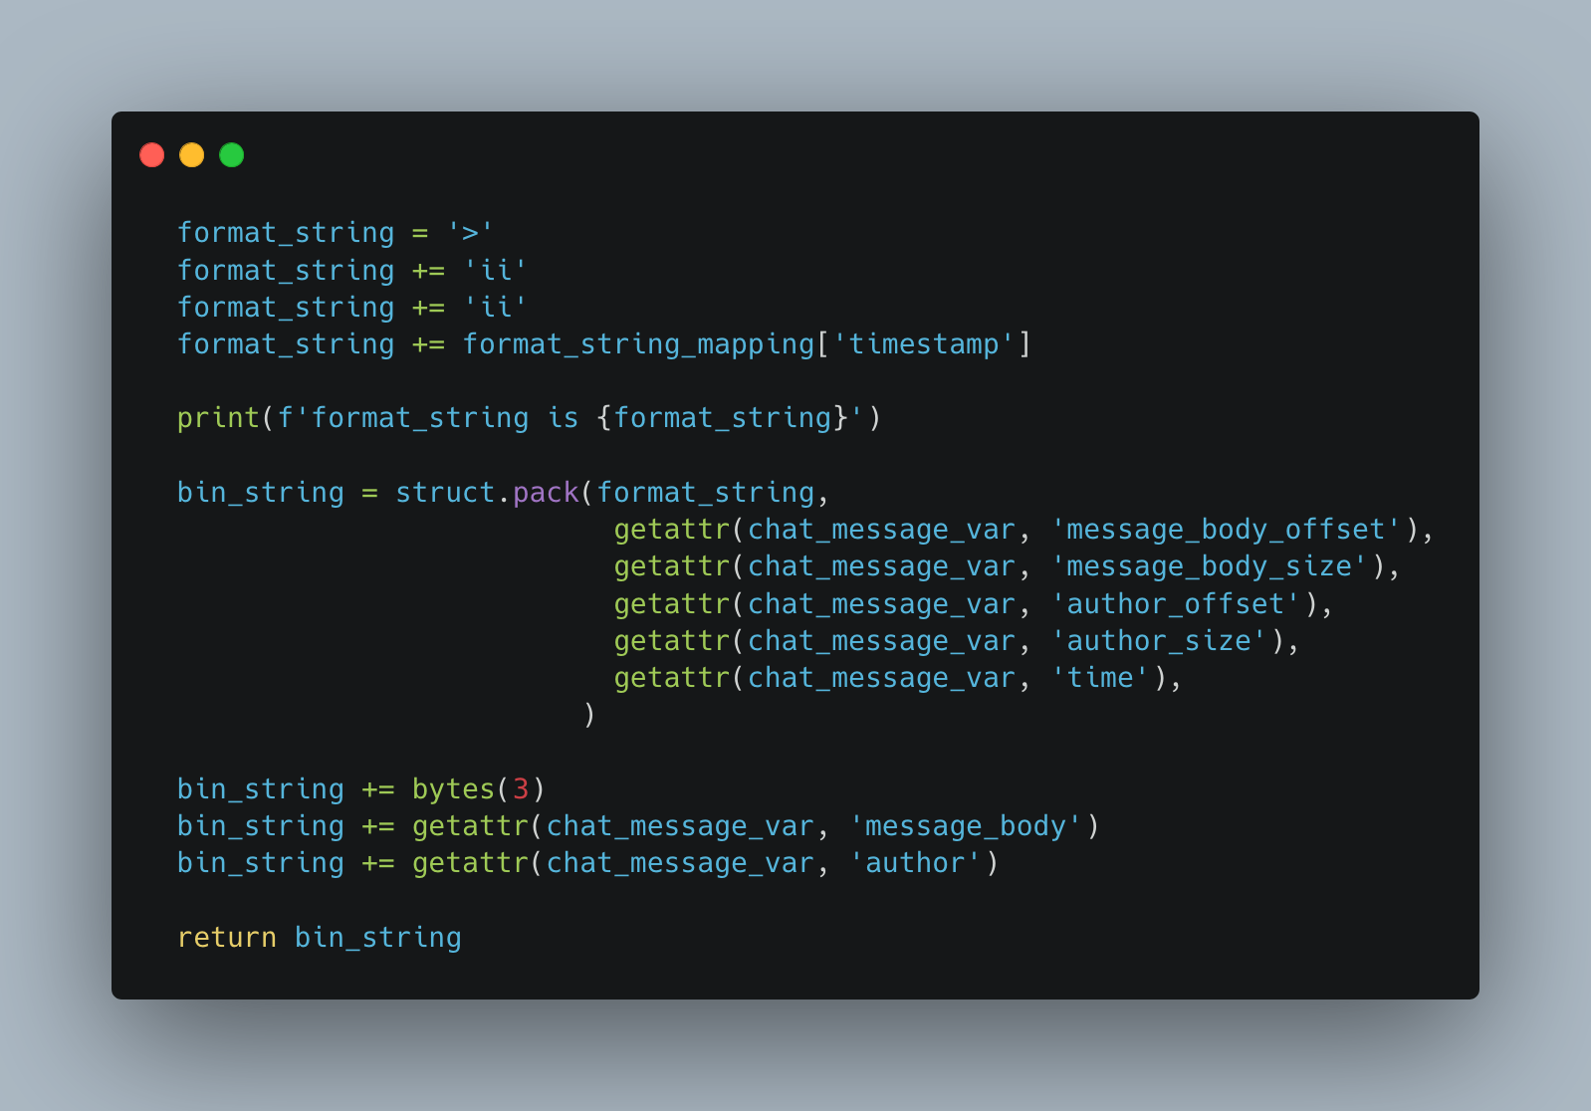

Slide 13
notJSON Procedures
Remote Procedure Calls are supported out of the box
Easily send type safe messages between server/client
Procedure calls look just like regular function calls to the client

Slide 14
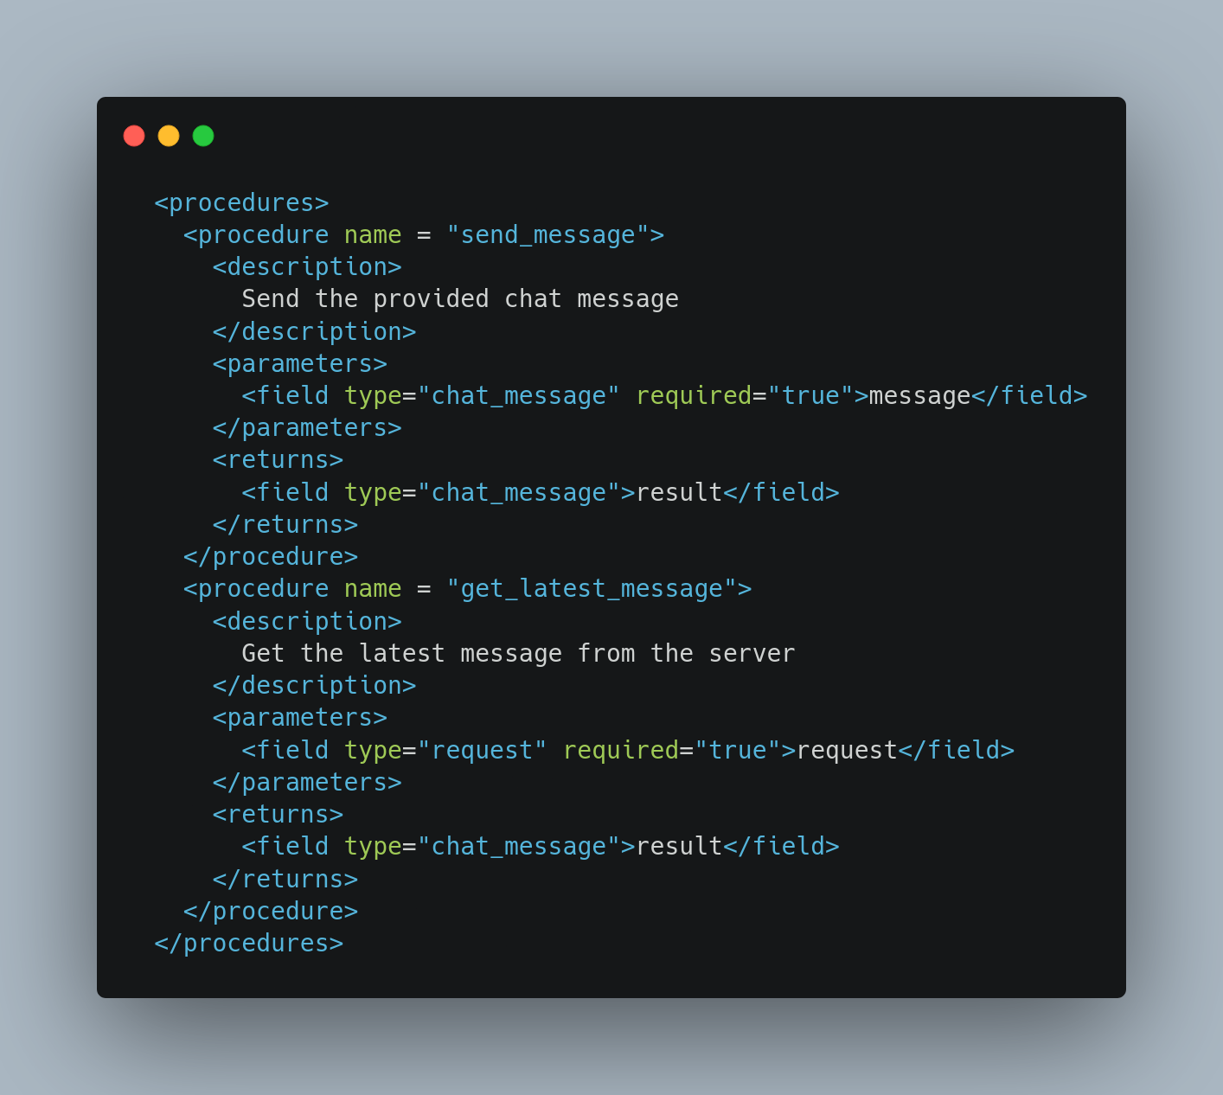

Slide 15
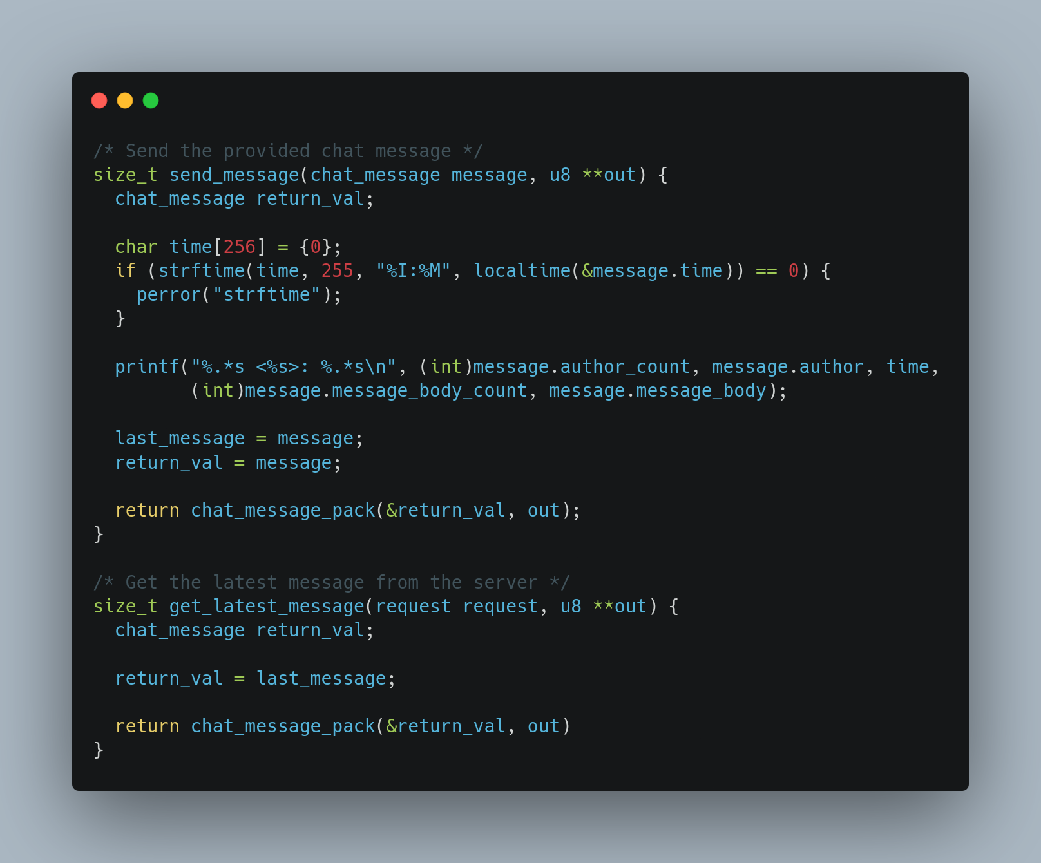

Slide 16
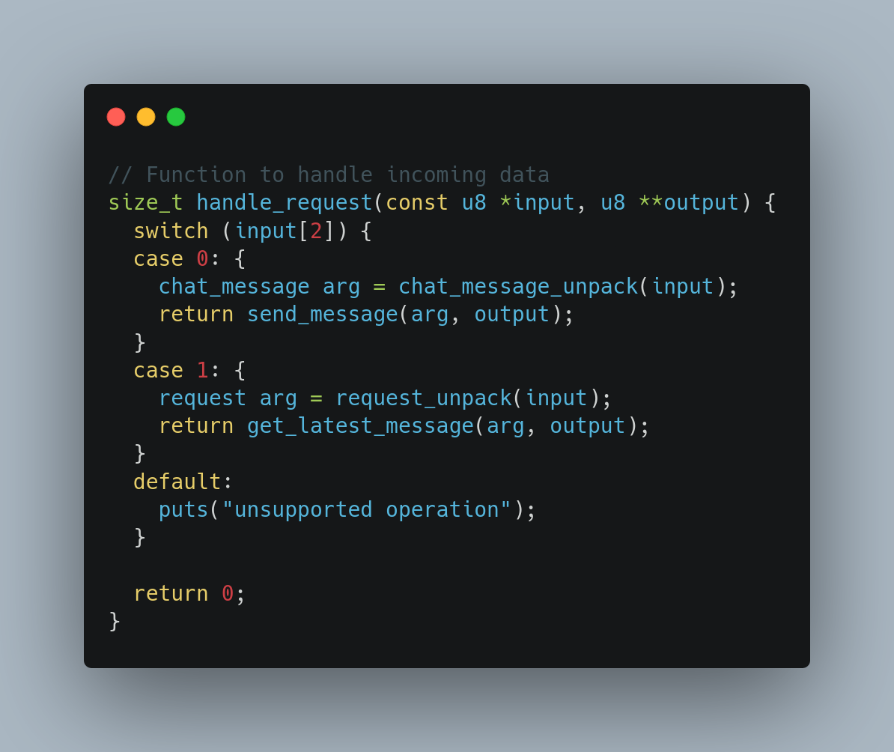

Slide 17
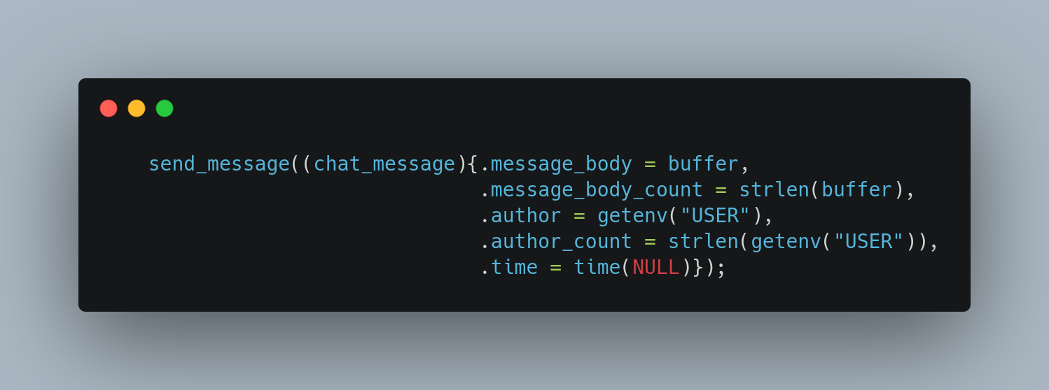

Slide 18
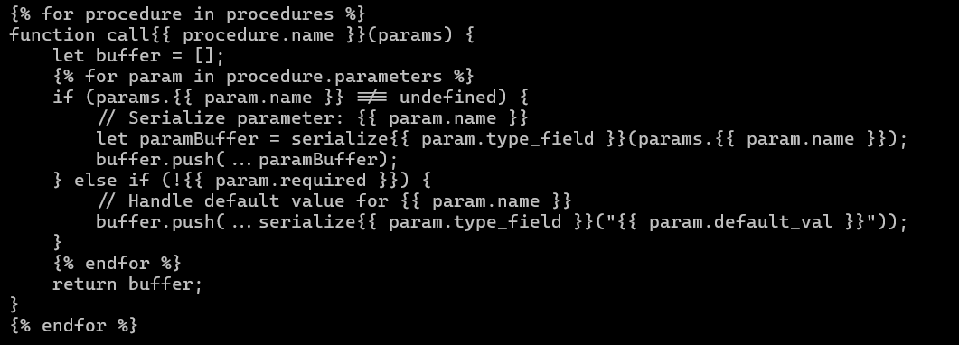
notJSON Templates

Slide 19
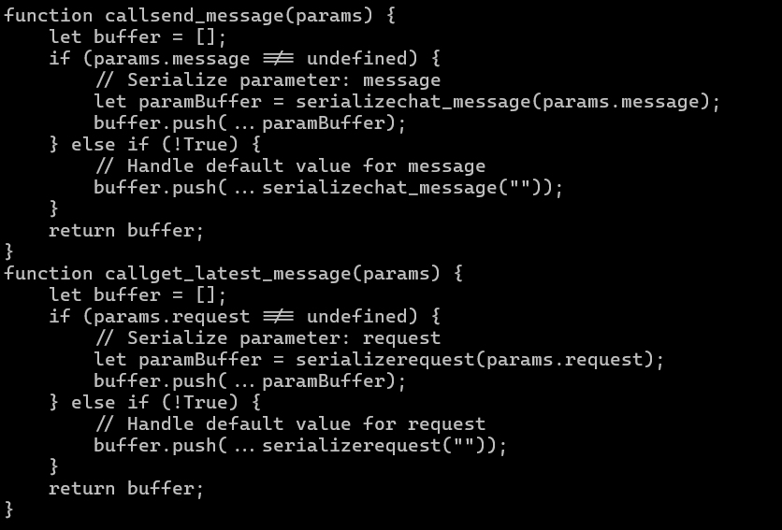
Output

