Slide 1
Homer 445 Presentation

Slide 2
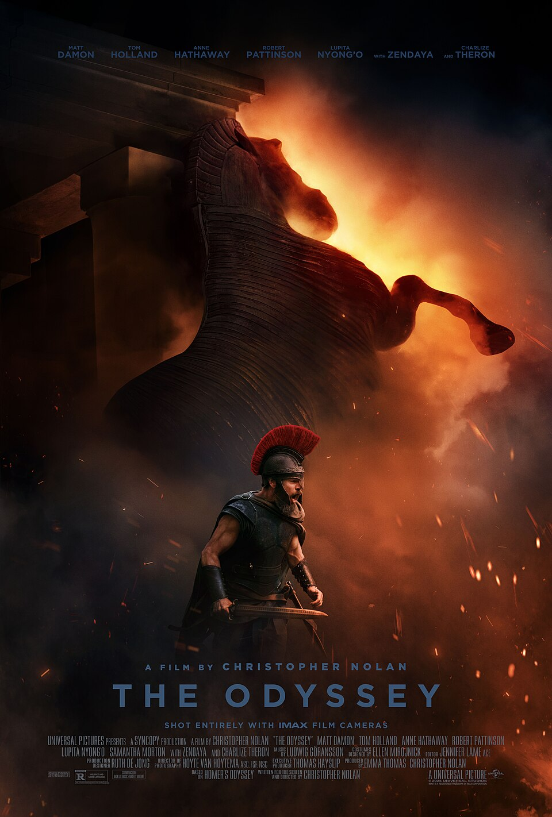
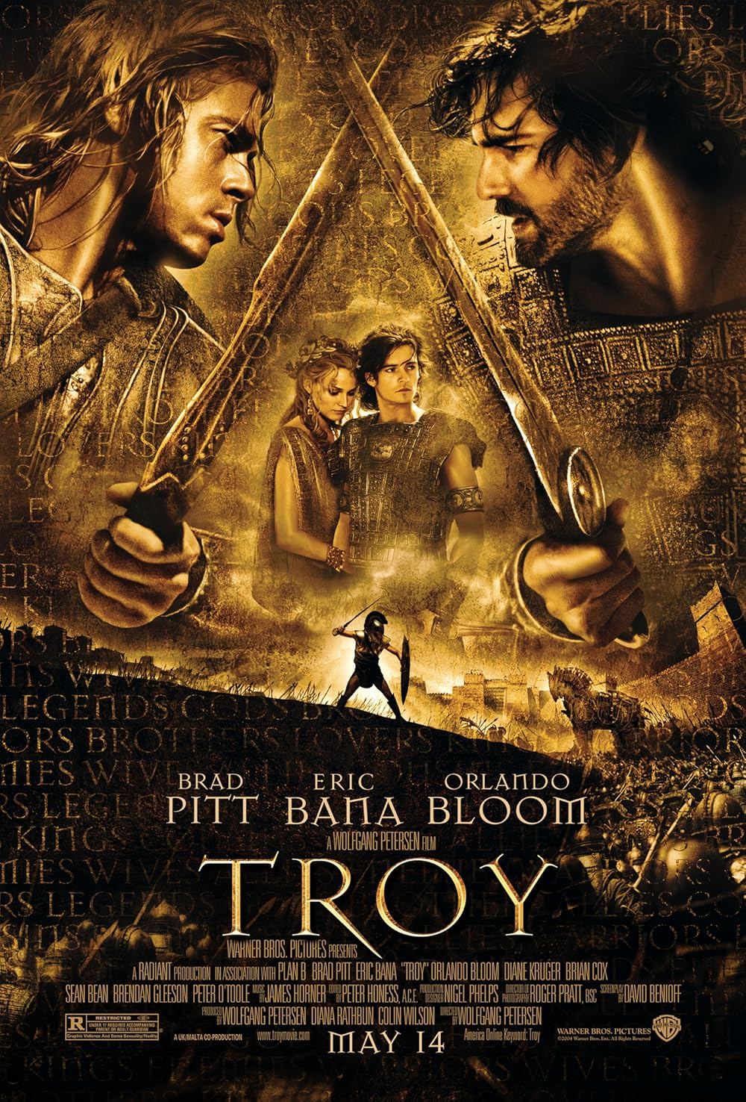
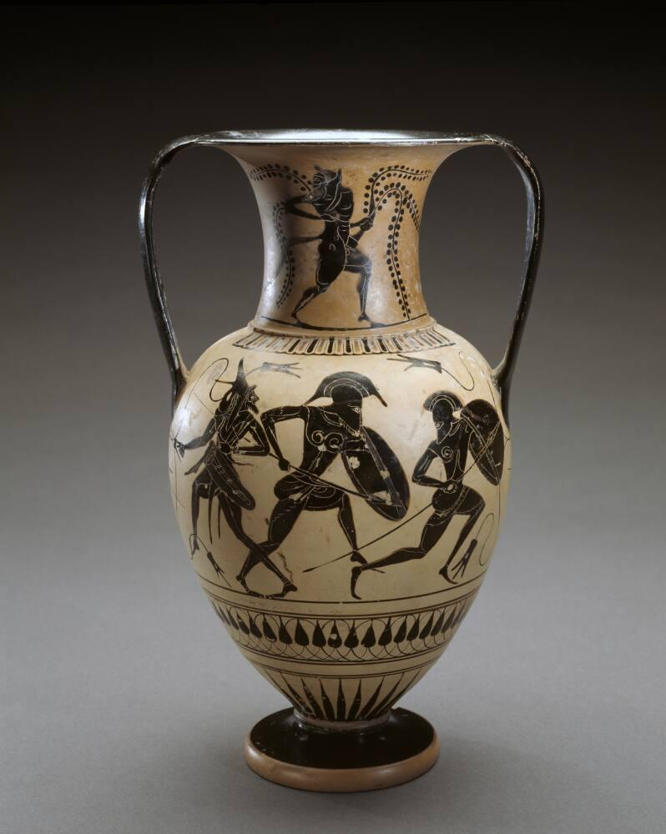

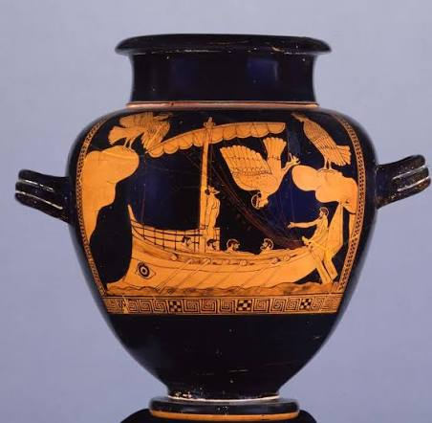
The Greatest Story Ever Told
The Iliad and The Odyssey have been told in some form for almost 3000 years, both being written by the infamous poet, Homer.

Slide 3
The Homeric Question
Was the Odyssey's Homer the same as the Iliad’s

Slide 4
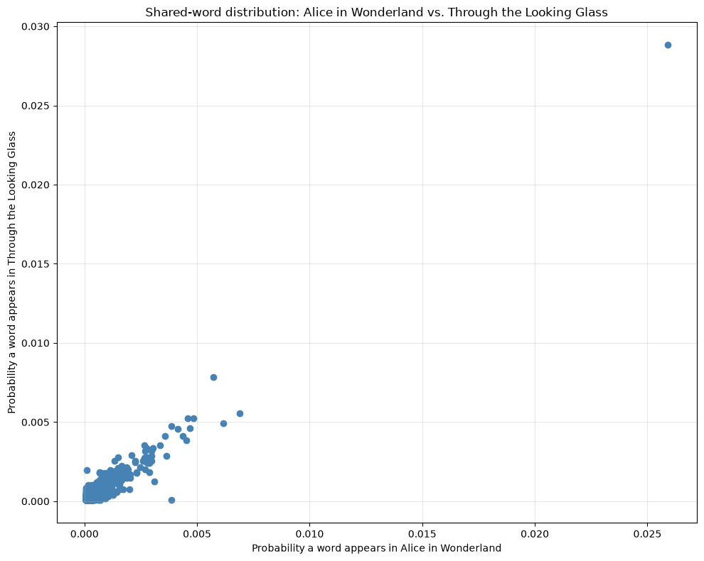
What should we be looking for in the data?
If both books were written by the same author, they should have a similar word frequency.
The word frequency should form something similar to a signature.
Known Author:
  Lewis Caroll
  Alice in Wonderland
  Alice, Through the looking glass.
Filtered for names.

Slide 5
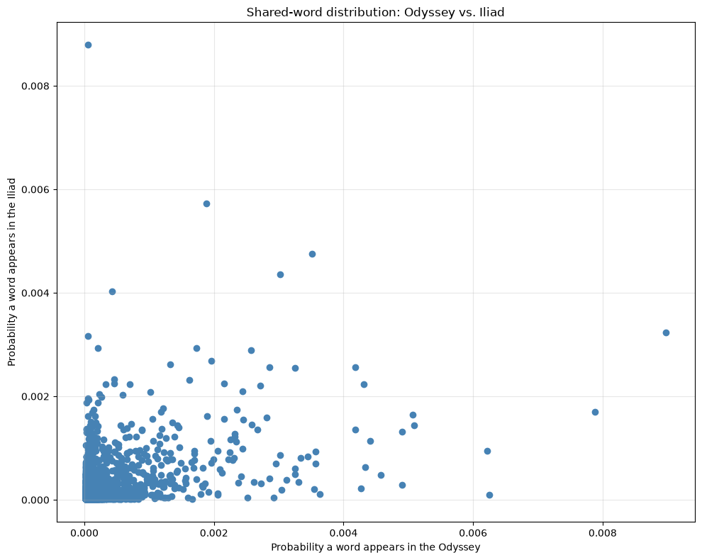
The Odyssey vs The Iliad
Distribution seems random.
Few Words have a similar probability.
Possible issues with this method:
  The books were both translated, and so this may be measuring the translators rather than the authors.
For higher accuracy, use copies in the original Greek.

