Slide 1
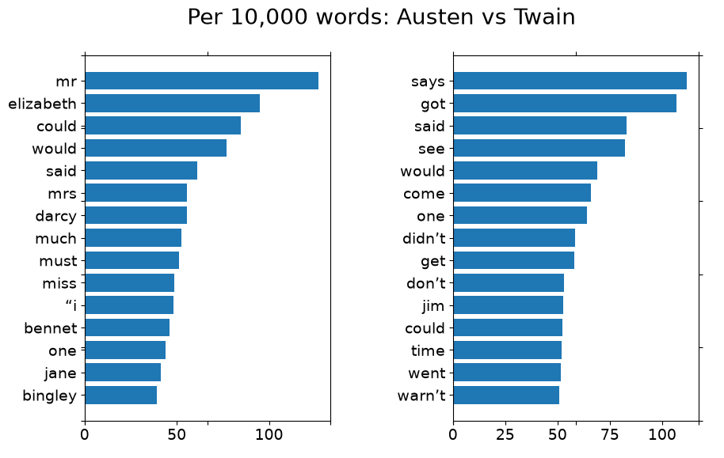
Mini Project 1
Text Analysis
Comparing word frequencies across novels
Jane Austen
Mark Twain
Pride and Prejudice
Emma
Adventures of
Huckleberry Finn
Daeyoung Kim

Slide 2
What is the question?
Can word frequencies show differences in writing style?
Same author
Pride and Prejudice vs. Emma
Different authors
Jane Austen vs. Mark Twain
Preferred words
Which words are used more by one author?
I compared books as text data. The goal was not to interpret the story, but to see whether word usage patterns can reveal differences between books and authors.

Slide 3
What was the approach?
PIPELINE
Download
Clean
Count
Normalize
Compare
Project Gutenberg texts
remove markup, punctuation, stop words
word frequencies
counts per 10,000 words
same author, different authors, selected words
Why normalize?
The books have different lengths, so raw counts are not fair. I used frequencies per 10,000 words so each book could be compared on the same scale.

Slide 4
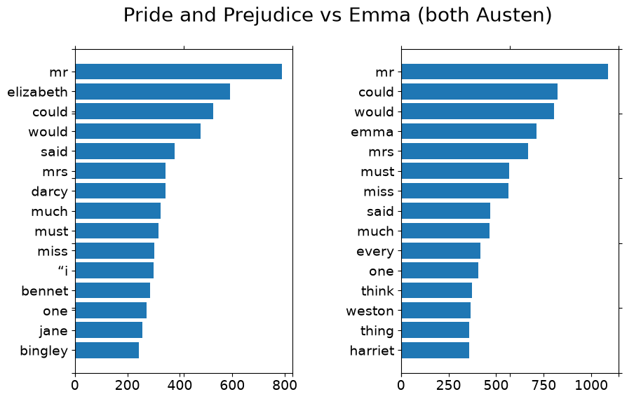
What results did I get? Same author comparison
Pride and Prejudice vs. Emma
Main takeaway
Same author does not mean identical word use.
Some common words and patterns are similar.
Different characters and story topics still affect the counts.
The same-author comparison gives a baseline before looking at Austen vs. Twain.

Slide 5
What results did I get? Different authors
Austen vs. Twain showed stronger differences.
EXAMPLES PER 10,000 WORDS
Word
Austen
Twain
must
51.6
12.1
got
4.0
106.9
said
61.3
83.0
Twain used informal/conversational words much more often, especially “got.” Austen used words like “must” more often.

Slide 6
Problems, statistical check, and new ideas
What problems did I encounter?
Extra-credit check
Book length can distort raw word counts.
Character names can look like style differences.
Setting and time period may explain some differences.
I tested whether selected words appeared at significantly different rates.
said
similar in Austen
different in Twain
must
different
very different
got
similar in Austen
extremely different
What new ideas did this generate?
A future version could remove character names, compare more books by each author, and test whether the patterns hold across a larger collection of novels.
Conclusion: word frequencies can reveal author/style differences, but context matters.

