Slide 1
COMPUTER VISION: LEARNING TO DETECT OBJECTS

Slide 2

What is computer vision?
2

Slide 3
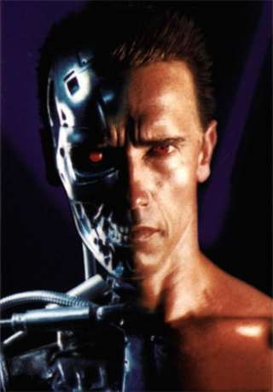
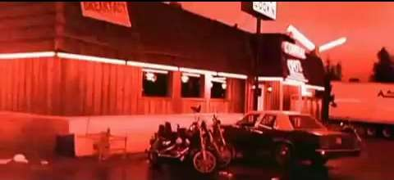
Computer Vision
3
we’re not quite there yet, but….
Terminator 2
terminator 2, enemy of the state (from UCSD “Fact or Fiction” DVD)

Slide 4

Machine Learning: What is it?
Program a computer to learn from experience
Learn from “big data”

Slide 5

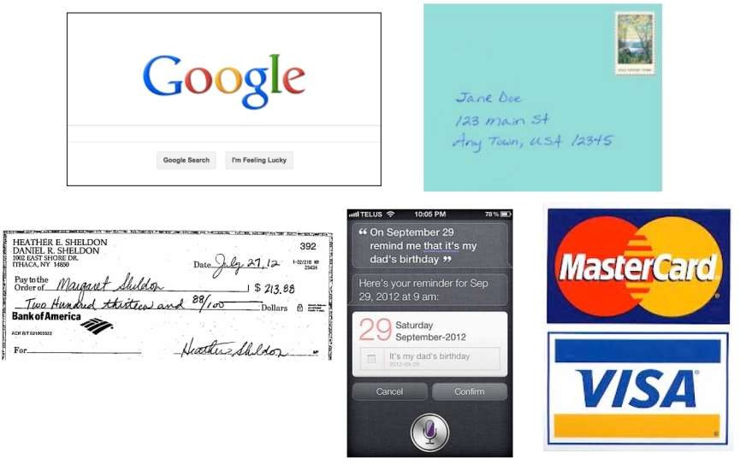
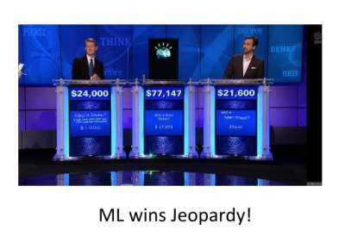
Machine Learning in practice

Slide 6
Machine learning is not perfect
6
https://youtu.be/gXTbQ0Rfjbw?t=72

Slide 7
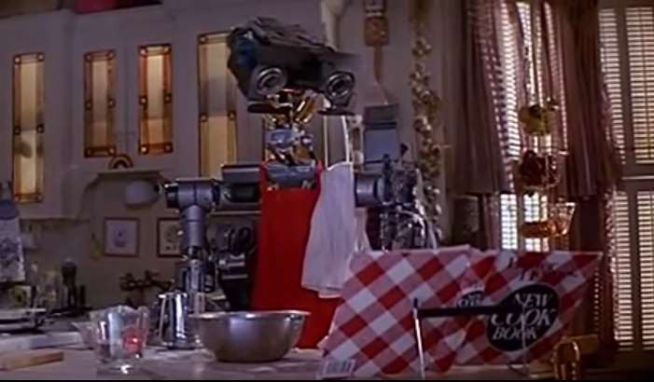
Machine learning is not perfect
7

Slide 8

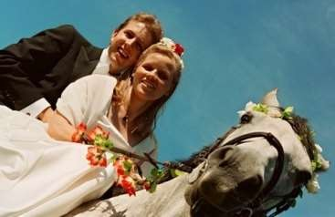
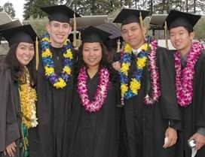

Lots of image data available!
Personal photo albums

Slide 9







Data for computer vision

Slide 10
10
What are applications of computer
vision?

Slide 11
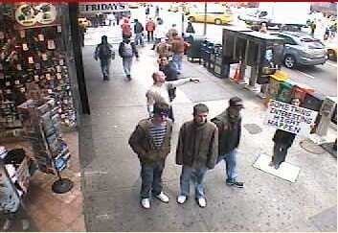
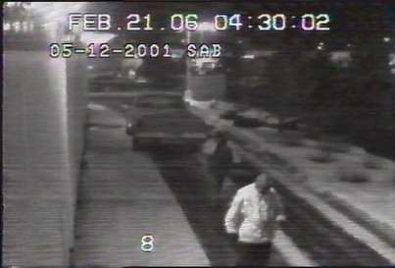
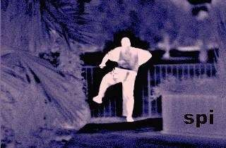
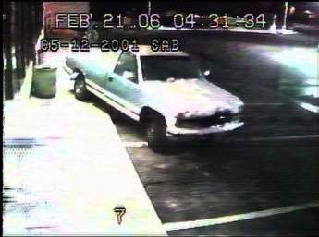
Computer Vision: Surveillance and Security
Surveillance and security

Slide 12
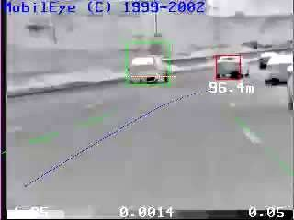
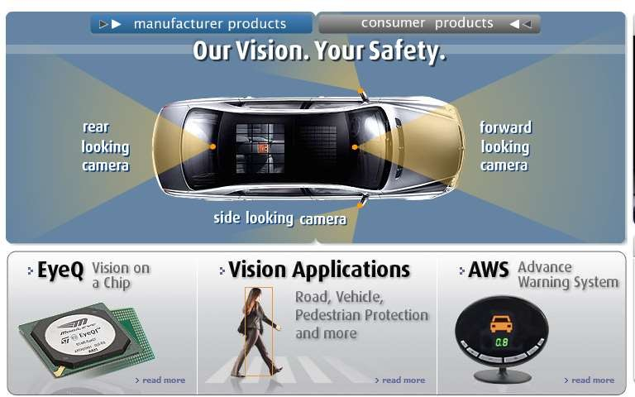
Smart cars
Mobileye
Vision systems currently in high-end BMW, GM, Volvo models, Tesla
By 2020: 70% of car manufacturers
Slide content courtesy of Amnon Shashua

Slide 13
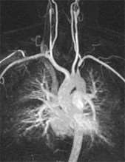
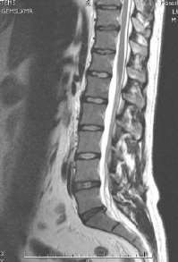
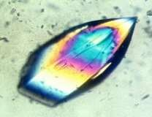
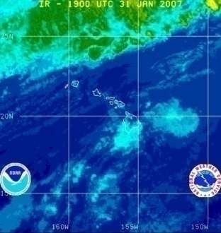

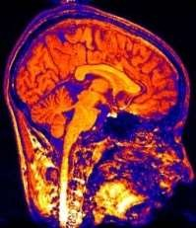
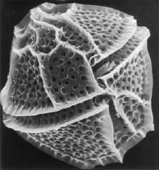
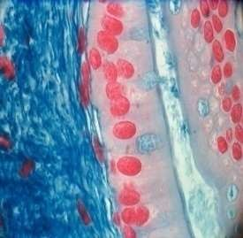
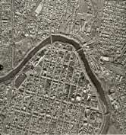
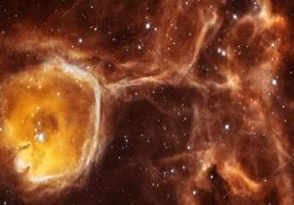
Scientific Images

Slide 14
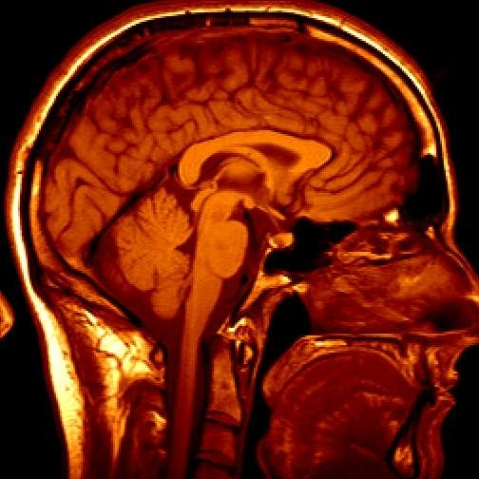
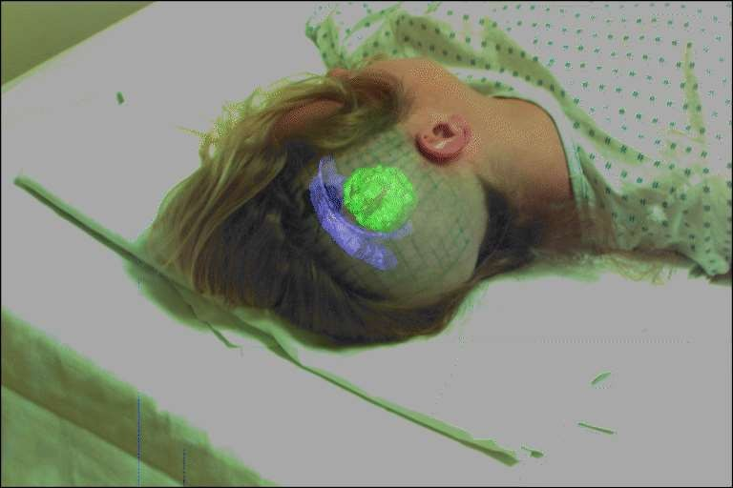
Medical Imaging
3D imaging MRI, CT
Image guided surgery Grimson et al., MIT
slide by S. Seitz

Slide 15
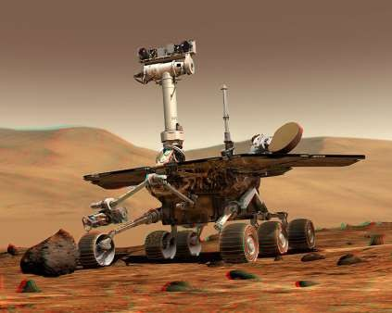
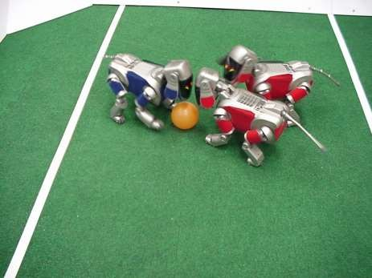
Vision for Robotics
NASA’s Mars Spirit Rover http://en.wikipedia.org/wiki/Spirit_rover
http://www.robocup.org/
slide by S. Seitz

Slide 16
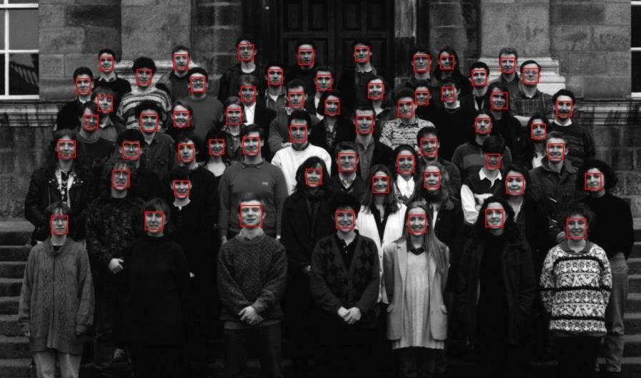
Object Detection: Face Detection
Viola and Jones, Robust object detection using a boosted cascade of simple features, CVPR 2001

Slide 17
What is object detection?
17

Slide 18
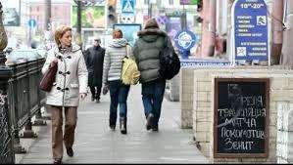



Goal of object detection
18
Detect: PERSON

Slide 19
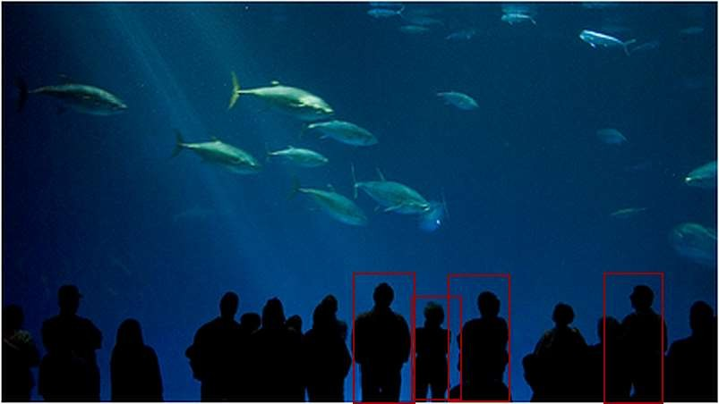
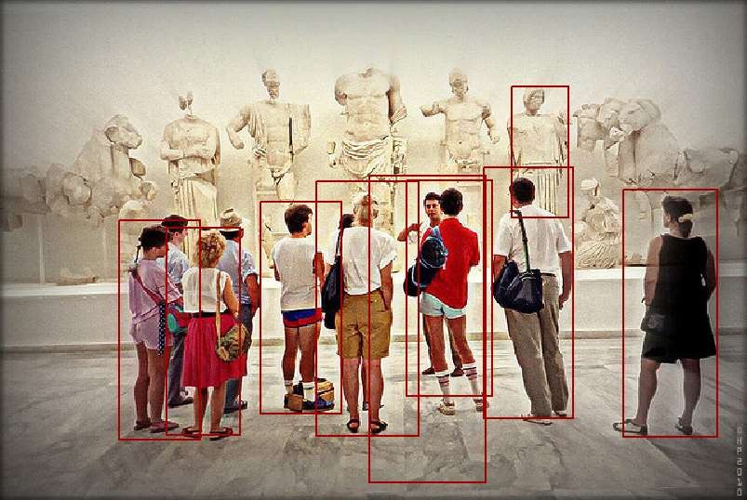
Why is object detection difficult?
19

Slide 20

Why is object detection difficult?
20
Can you detect all objects in this image?

Slide 21
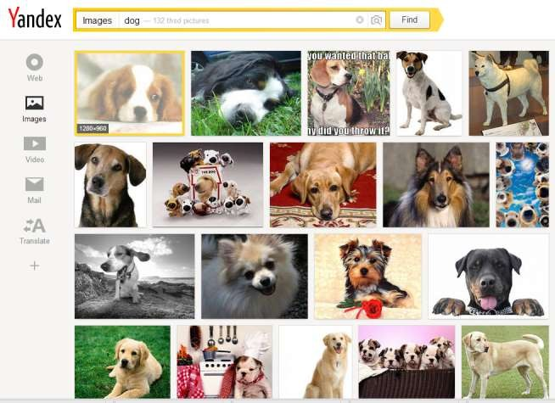
Easy to collect data on the web!
21

Slide 22




Difficult to label image annotations
22
Easy to label from search engine
dog
apple
Much more difficult and costly to label
dog
apple

