Slide 1
BTP Presentation
Topic: Stock Market Prediction using Deep Learning
Utkarsh Gupta : 21UCS222
Utkarsh Singh : 21UCS221
Supervisor : Dr. Navneet Garg Sir

Slide 2

Introduction to Stock Market Prediction using Deep Learning
Harnessing the power of deep learning, we can unlock the complexities of the stock market and make data-driven predictions to guide investment decisions. This presentation explores different kinds of techniques that are revolutionizing the world of finance.

Slide 3
Why Deep Learning ?
Complex Pattern Recognition: In the stock market, where various factors influence prices, deep learning can identify and exploit those patterns which may be difficult for human beings.
Handling Big Data: The data of stock market is very vast and dynamic including various types of data such as price movements, trading volumes. Deep Learning models efficiently processes and analyzes this big data.
Feature Extraction: Deep Learning Models can automatically extract relevant features from raw data, reducing the need for manual feature engineering.

Slide 4
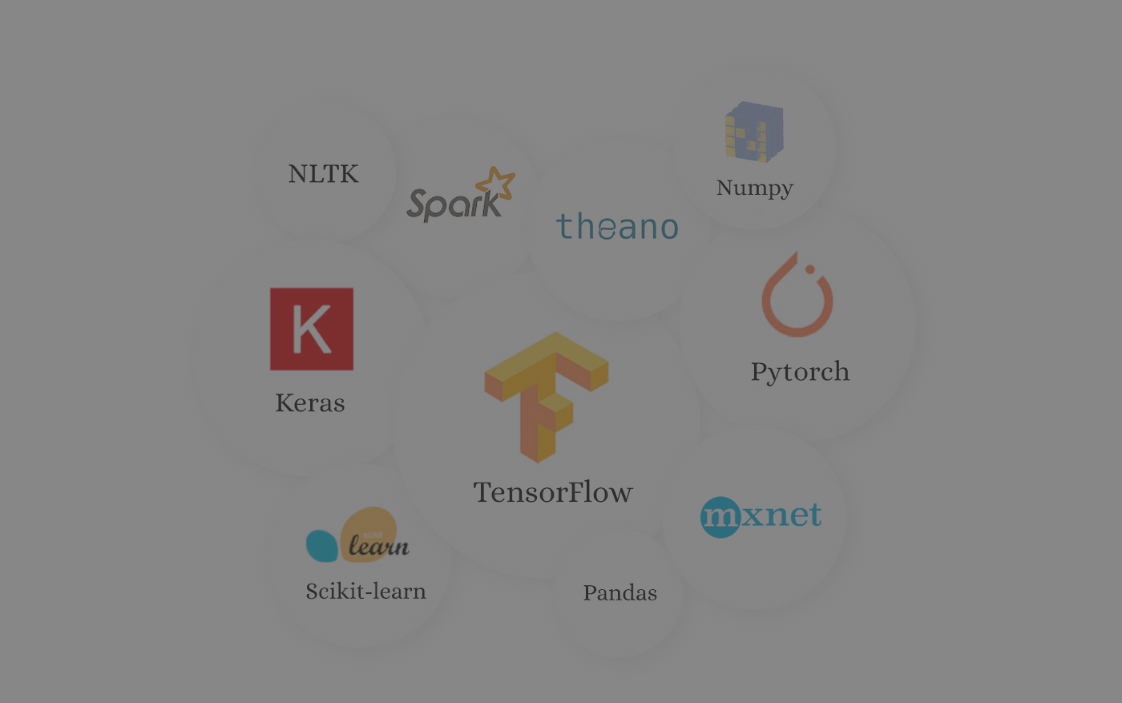
Libraries used:
Pandas
Numpy
yfinance
The dataset which we have used for our project is of the Reliance Industries Limited traded on the National Stock Exchange of India from January 1, 2019 to February 28, 2024 which is approximately 4 years large.
The ‘pd.DataFrame()’ function from the pandas library creates a DataFrame named reliance containing the downloaded data. This DataFrame will be used for storing and manipulating the historical market data of the stock of Reliance Industries Limited for future analysis.

Slide 5
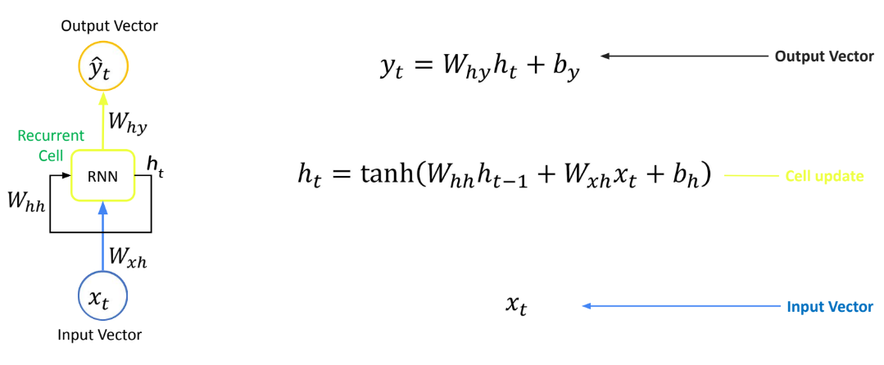
Recurrent Neural Networks (RNNs) for Stock Prediction
It helps in processing sequential data.
Takes sequential input of variable length.
Apply the same weights on each step.
Can produce output of variable length.

Slide 6
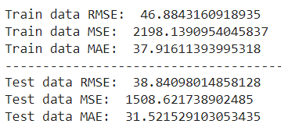

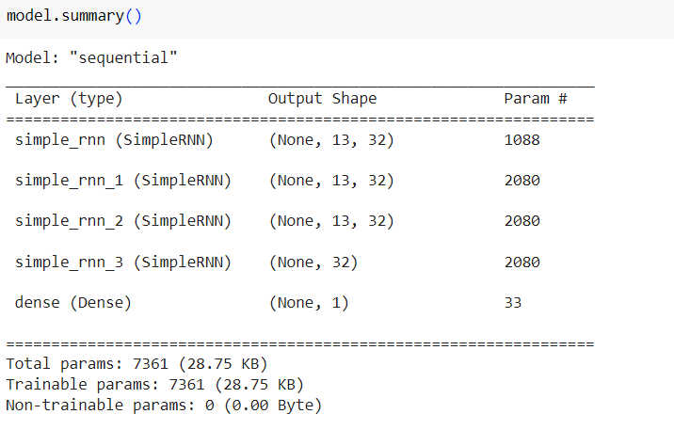
Observations:

Slide 7

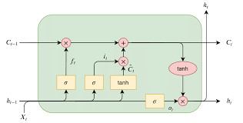
Long Short-Term Memory (LSTM) for Stock Prediction
Sequence Modelling
1
LSTMs excel at capturing long-term dependencies in time series data, crucial for stock price forecasting.
2
Vanishing Gradient Mitigation
LSTMs gating mechanism effectively addresses the vanishing gradient problem, enabling deeper networks.
Multi-Variate Modelling
3
LSTMs can incorporate multiple financial indicators, providing a holistic view of market dynamics.

Slide 8
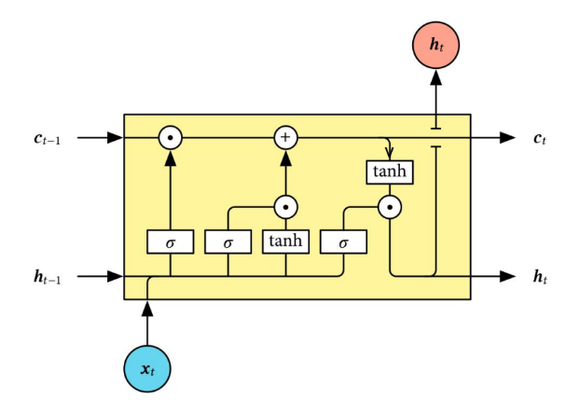
Basic unit of a LSTM is a cell which contains a hidden state and cell state.
Cell State stores information over time.
Hidden State is used to selectively output information from the cell state at each time step.
The hidden state of the neural network can be considered as a short term memory.
It allows the model to selectively forget or remember information over time.
Input Gate decides which information from current input to include in cell state.
Forget Gate decides which information from the previous cell state to forget.
Output Gate decides which information from current cell state to output as hidden state.

Slide 9
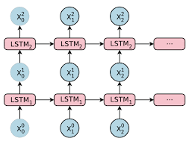
Stacked LSTM for Stock Prediction
Hierarchical Feature Extraction
Stacked LSTM architectures can learn increasingly complex representations of stock market data.
2. Improved Accuracy
Deeper LSTM networks often outperform single-layer models, leading to more reliable predictions.
3. Increased Robustness
Stacked LSTMs are less prone to overfitting, making them more generalizable to new market conditions.

Slide 10
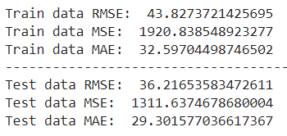

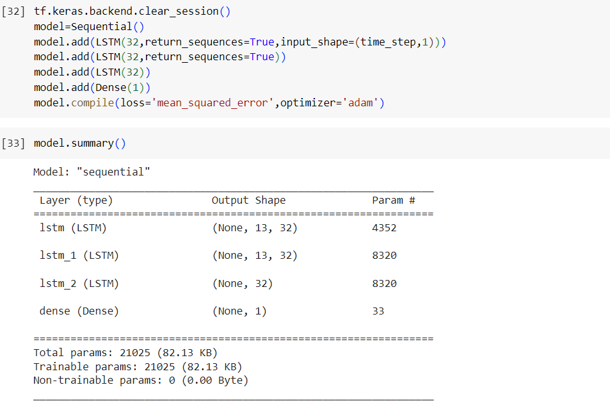
Observations:

Slide 11
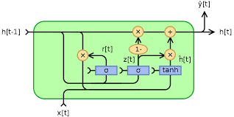
Gated Recurrent Unit (GRU) for Stock Prediction
Simplified Architecture
2. Faster Convergence
GRUs have a simpler architecture than LSTMs, making them more computationally efficient.
GRUs often converge faster during training, leading to quicker model deployment
3. Effective Memory Modelling
GRUs can capture long-term dependencies in stock data with fewer parameters.

Slide 12
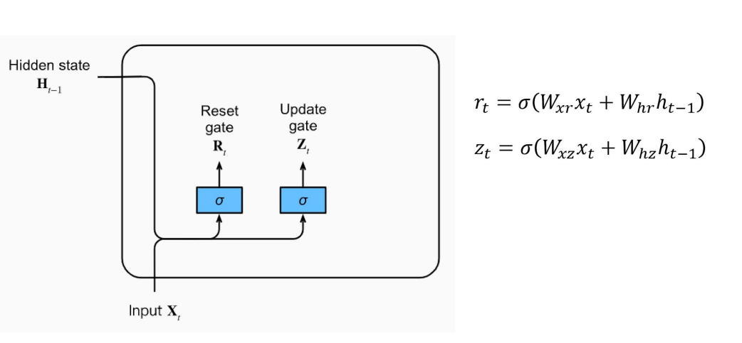
GRU is just like a LSTM but has fewer parameters than LSTM, as it lacks an output gate.
In GRU the LSTM’s three gates are replaced by two:
Reset Gate controls how much of the previous state we might still want to remember.
Update Gate would allow us to control how much of the new state is just a copy of the old state.
Units with short term dependencies will have active reset gates.
Units with long term dependencies have active update gates.

Slide 13
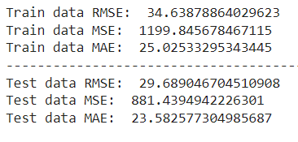

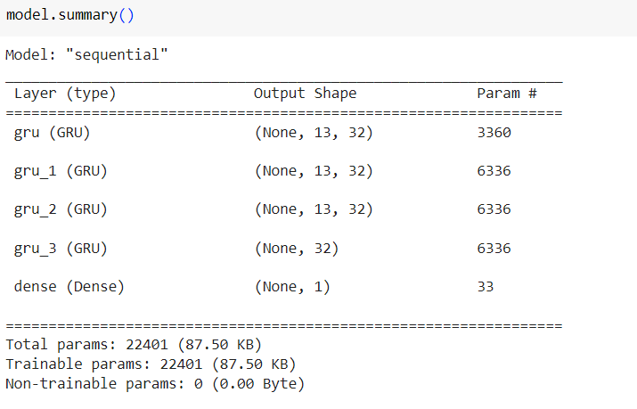
Observations

Slide 14
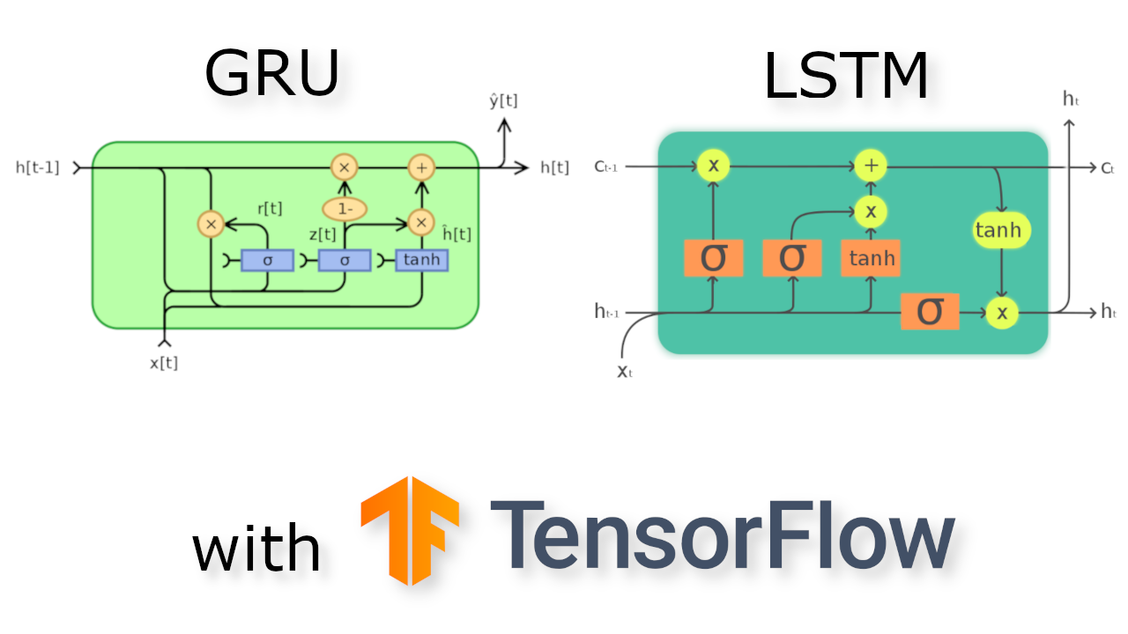
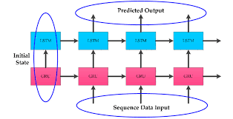
LSTM-GRU
We know that LSTM captures long patterns and GRU is computationally efficient, captures short term patterns. Combined model benefits from both architectures.
The architecture of the combined LSTM-GRU model would involve stacking LSTM and GRU layers, with possibly additionally fully connected layers for further processing of the learned features.
Basically GRU is a variant of the LSTM network that also addresses the vanishing gradient problem. Combining LSTM and GRU in a single model can provide complementary benefits.
The combination of LSTM and GRU can lead to better generalization performance, enabling the model to make accurate predictions on unseen data.

Slide 15
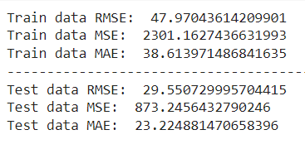

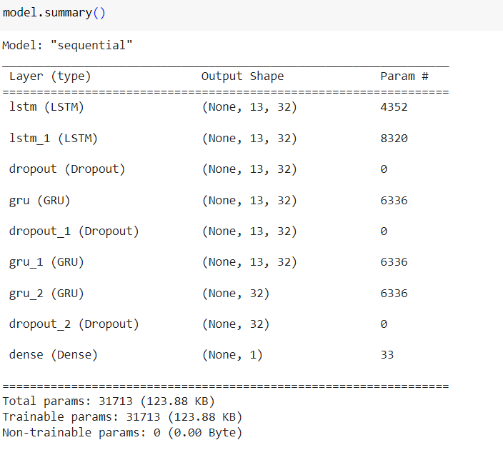
Observations

Slide 16
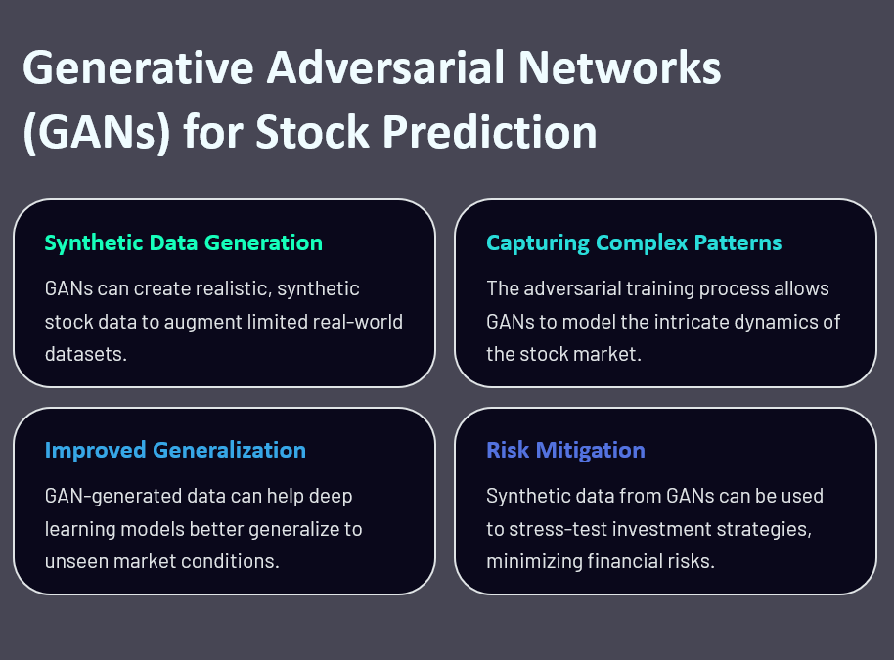

Slide 17
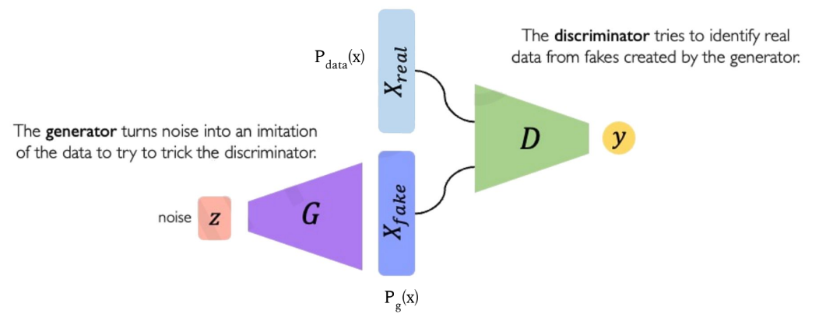
Generative Adversarial Networks (GANs) are a way to make a generative model by having two neural networks compete with each other.
The Discriminator tries to identify real data from fakes created by generator.
The Generator turns noise into an imitation of the data to try to trick the discriminator.

Slide 18
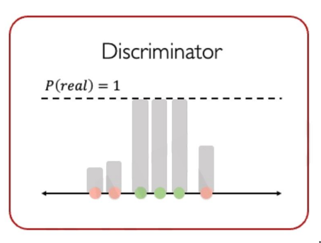
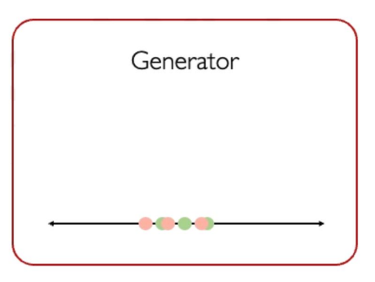
Intuition behind GAN
Generator starts from noise to try to create an imitation of the data.
Discriminator looks at both real data and fake data created by the generator.
Discriminator tries to predict what’s real and what’s fake.
Generator tries to improve its imitation of the data.

Slide 19
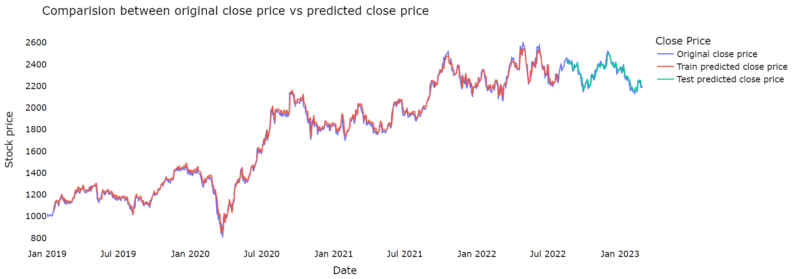
Results:
RNN

Slide 20
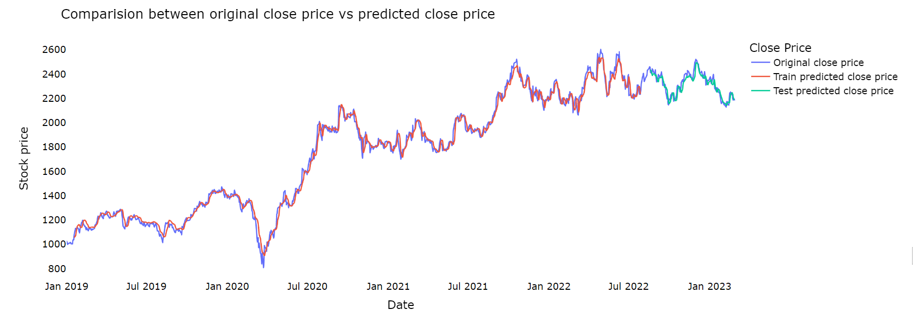
2. Stacked LSTM

Slide 21
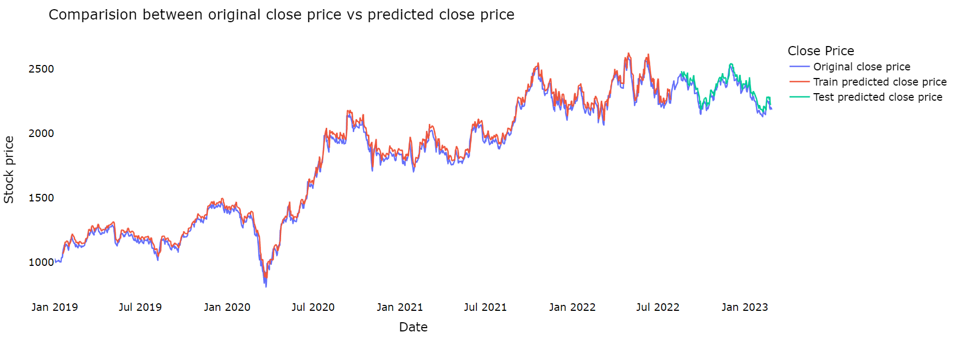
3. GRU

Slide 22

4. LSTM-GRU

Slide 23
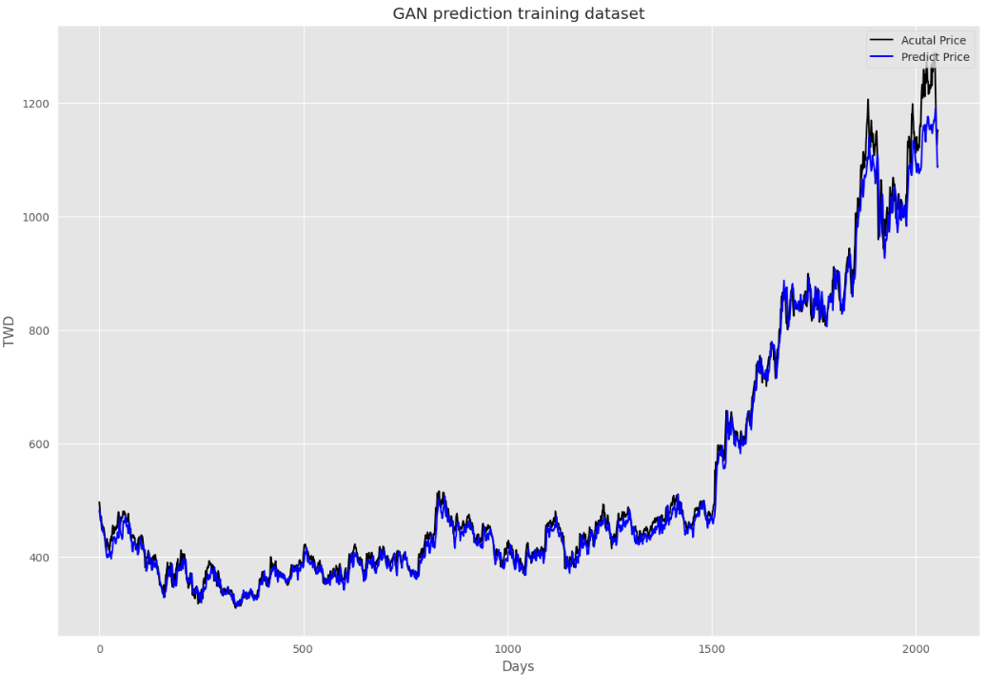
5. GANs

Slide 24
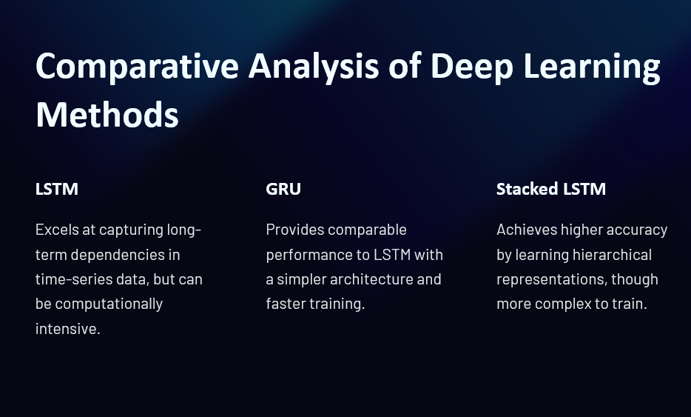

Slide 25
Conclusion
Root Mean Square Error (RMSE) is a common way to measure how well a model predicts quantitative data. The lower the RMSE value the better is the model and its predictions.
According to our observations and results obtained by applying different models on the Reliance dataset we were able to derive the conclusion that LSTM-GRU is the best model among all as it gives us the least RMSE value.

Slide 26
Future Work
Incorporate sentiment analysis of news headlines related to the stock to gauge market sentiment. Evaluate the impact of sentiment-driven features on forecasting accuracy and explore interpretability tools for insights.
A future aspect of this project involves developing a website for stock prediction, aimed at providing users with valuable insights into market trends and potential investment opportunities.

Slide 27
References
Dogu Araci. 2019. Finbert: Financial sentiment analysis with pre-trained language models. arXiv preprint arXiv:1908.10063 (2019).
https://thescipub.com/pdf/jcssp.2021.188.196.pdf
https://link.springer.com/article/10.1007/s12530-022-09481-x
Samit Bhanja and Abhishek Das. 2019. Deep learning-based integrated stacked model for the stock market prediction. Int. J. Eng. Adv. Technol 9, 1 (2019), 5167–5174

Slide 28
THANK YOU

