Slide 1

Automotive Pilot State Recognition
Utkarsh Lal & Ryan Man
E96C Internet of Things Final Presentation

Slide 2
Product Development Mission
The IoT model is designed to train and detect six motions that are essential in a semi-automatic car.
This data can be analyzed to check for safe driving.
The motions are seat belt fastening, accelerating, slowing down, giving signal indication, left steering and right steering.

Slide 3
Design Overview: Technical Challenges
Precisely extracting the motions based on implementation of the accelerometer and gyroscope.
The gyroscope use in both motion states to continuously check for navigation.
Classifying six distinct motions to avoid conflict in detection.
Developing motion testcases that ensure safe driving.

Slide 4
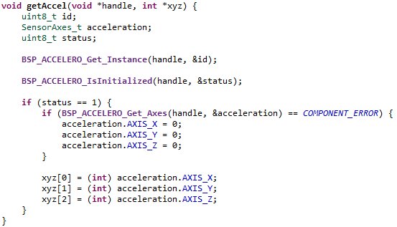
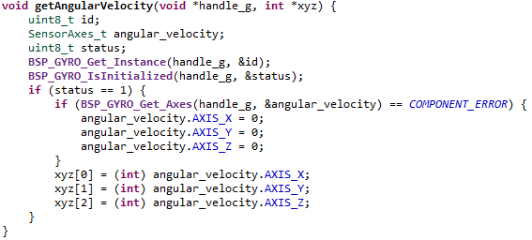
Technical Approach for Sensor Data Acquisition
The feature for this application measures the difference in acceleration between an initial state at a starting orientation, and a final state where the user moves/rotates the SensorTile. This gives accelerometer data.
Gyroscopes measures rotation rate in angle change per unit time. Angular rotation rates are measured across the three axes. This system will measure the difference in SensorTile angular position between an initial position where the user holds the SensorTile in a starting position, and a final state where the user has rotated the SensorTile.
Accelerometer Acquisition
Gyroscope Acquisition

Slide 5
Technical Approach for Feature Extraction
First state uses both sensors while the second state only uses gyroscope to process the feature.
After data acquisition, the accelerometer and gyroscope sensor starts normalizing the feature values
It then executed back propagation, computes the output of trained neural networks and finally checks for classification errors.

Slide 6
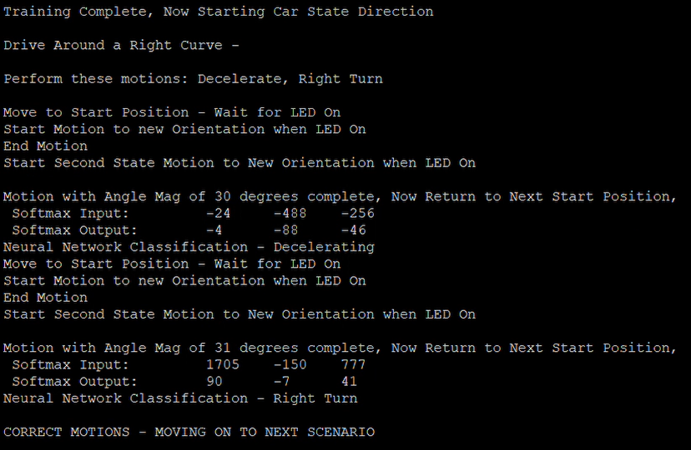
IoT System Implementation
The system sends a random scenario out of the three -
  Starting the car: Fastening seat belt and accelerating
  Making right turn: Signal and right steering
  Driving around left curve: Slow down and left steering
If it detects correct set of inputs, it prints the next scenario and terminates in case of wrong inputs.

Slide 7
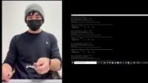
IoT System Demonstration
Demonstration Video Link:
https://www.youtube.com/watch?v=nwlYaALpomg&ab_channel=RyanMan

Slide 8
Future IoT Missions
Improve the event timing feature to detect instant motions.
Implement more motions for training.
Learn Virtual Reality and make a simulation game using this model.
Involve in IoT undergraduate research opportunities.

