Slide 1


Android Recovery:
recovery essentials, firmware investigation and ClockworkMod porting basics.
Drew Suarez (utkanos)

Slide 2
Who am I?
Who am I?
Who am I?
“utkanos” in the Android community
Lead Maintainer of the CyanogenMod wiki, general CM support
Port recovery to new, unloved or problematic devices
Worked on devices from HTC, Samsung, Motorola, ZTE, LG, Amazon, Lenovo and more
https://github.com/utkanos/
+Drew Suarez

Slide 3
Topics
What is recovery?
How do I make a custom recovery?
Testing your new recovery
Questions?

Slide 4
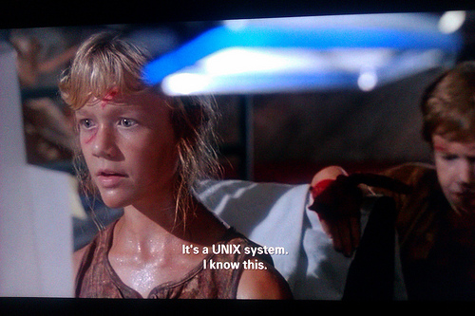

Slide 5
What is recovery?
A mode on Android handsets that boots a minimal Linux environment and provides access to tools to repair/recover an Android install
Provides ADB (Android Debug Bridge) access
Stock recoveries are limited in what they allow the end user to do
Custom recoveries provide root and contain many more useful binaries essential in modifying stock firmware or accessing parts of Android or the device itself. They allow for scriptable installations of files or firmware and provide a means to back up Android and other important bits of data.

Slide 6
What is recovery?
Parts of a standard Android recovery image
  Android boot header
  Kernel (compiled zImage)
  Initial Ramdisk
Parts of an initramfs recovery (ex: Samsung)
  Kernel (compiled zImage) contains initramfs ramdisk
  Recovery ramdisk compiled directly into kernel

Slide 7
What is recovery?
Standard Android Boot Image Header
utkanos@leviathan /amnesiac/android/recovery/dlx $ od -c recovery.img |more
0000000 A N D R O I D ! 310 \t S \0 \0 200 ` 200
0000020 341 P ' \0 \0 200 240 201 \0 \0 \0 \0 \0 \0 P 201
0000040 \0 001 ` 200 \0 \b \0 \0 \0 \0 \0 \0 \0 \0 \0 \0
0000060 \0 \0 \0 \0 \0 \0 \0 \0 \0 \0 \0 \0 \0 \0 \0 \0
0000100 c o n s o l e = t t y H S L 0 ,
0000120 1 1 5 2 0 0 , n 8 a n d r o i
0000140 d b o o t . h a r d w a r e = d
0000160 l x u s e r _ d e b u g = 3 1
0000200 \0 \0 \0 \0 \0 \0 \0 \0 \0 \0 \0 \0 \0 \0 \0 \0

Slide 8
What is recovery?
Initial Ramdisk
  Loads temporary root filesystem into memory as kernel boots
  Contains files needed for recovery specifically
  Contains init and other scripts, images, binaries
  Can be modified and recompiled to include more tools or features, change options, extend functionality, etc

Slide 9
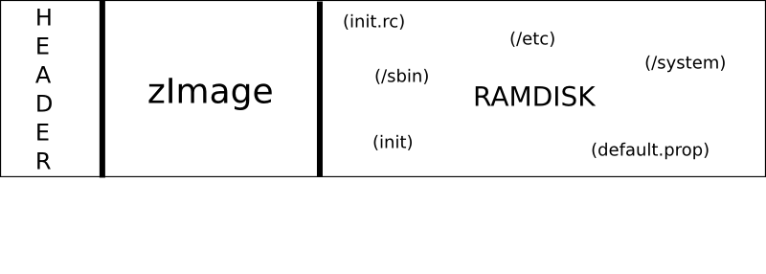
GROSS OVERSIMPLIFICATION :)

Slide 10
What is recovery?
recovery.fstab (CM 10.1 and below (<=4.2.2))
  Filesystem table that contains the block device, mountpoint and filesystem type for each partition
  Located in ramdisk in /etc typically or /res on earlier Samsung devices
fstab.platform (10.2+ (>=4.3))
  Ex: fstab.qcom, fstab.msm7267a
  In ramdisk under rootdir/etc

Slide 11
Basic Architecture
/system: mounted read only, Android system files
/data: user data
/cache: used by dalvik, frequently accessed data, used in recovery
/sdcard: can be external/removable memory or overmounted on /data/media in modern Android handsets
boot: the kernel, variety of configurations
recovery: kernel + ramdisk containing recovery binary and useful exploration tools
misc: ex: used to pass info to bootloader from OS/recovery

Slide 12
How do I make a custom recovery?
Install Linux or OSX to begin building
Obtain the CyanogenMod source (contains ClockworkMod source)
  Full instructions are on the CM wiki :)
  Choose the proper branch of Android
Build the otatools target first
  $> make otatools
  Builds useful tools such as unpackbootimg
Build/install/download other tools
  unpack-initramfs.sh
  binwalk

Slide 13
Information Gathering
Stock firmware (boot or recovery image)
  Variety of sites host stock firmwares
  Pull from rooted device (dd image)
  Useful for troubleshooting / figuring out the device topology
Kernel source
  A must for initramfs style kernels
  Useful for making smaller kernels for recovery on devices with limited storage for recovery
Recovery logs
  Useful for partition layouts information
  Other recovery related quirks

Slide 14
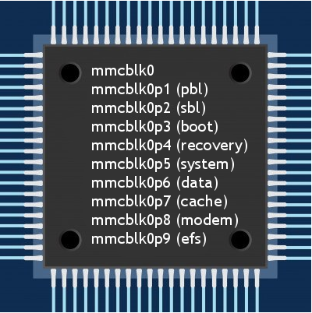
Information Gathering
Partition info
  emmc or mtd (or other)?
  Examine /dev/block/
  /proc/partitions (sizes)
  mount
  sdcard type(s)
  Filesystems

Slide 15
Information Gathering
/system/build.prop
  Contains parameters for setting different options in Android
  Vendor/Device specific codename identification (for build)
/proc/emmc or /proc/mtd
/proc/config.gz / ikconfig

Slide 16
Information Gathering
Now what? Let's look at the stock build:
  unpackbootimg (demo)
    $> unpackbootimg -i file.img -o .
    $> zcat file.gz | cpio -id
  unpack-initramfs.sh (demo)
  binwalk (demo)

Slide 17
Build a Vendor Config
Utilize the handy mkvendor.sh script within the CM source
  build/tools/device/mkvendor.sh
  The script takes oem name, device name and a stock boot or recovery.img
  Ex: $> build/tools/device/mkvendor.sh samsung hltetmo recovery.img (demo)
  Automatically generates folder structure

Slide 18
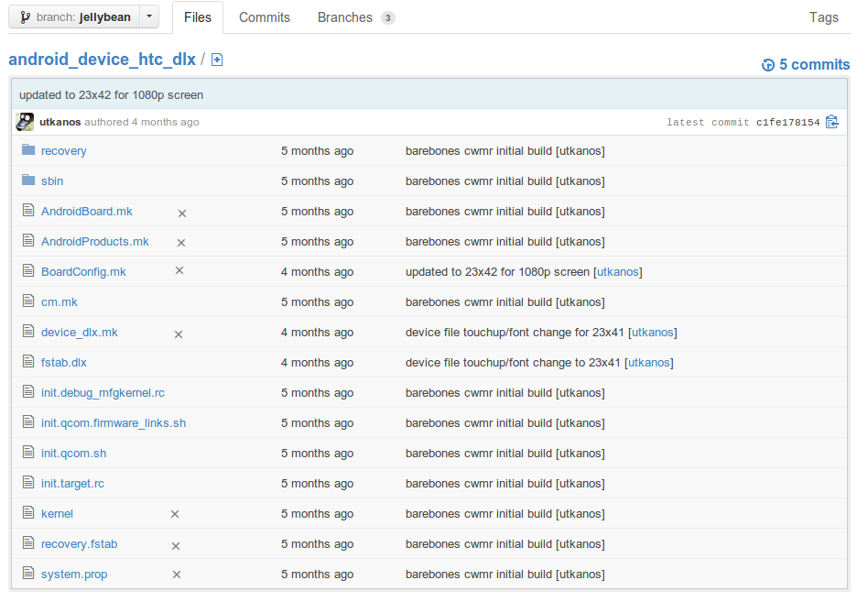
Build a Vendor Config

Slide 19
Build a Vendor Config
Info generated is likely wrong or incomplete, fix it!
  BoardConfig.mk
  recovery.fstab/fstab.platform
  device_codename.mk

Slide 20
BoardConfig.mk
Contains essential information about your device's board, CPU and other hardware
Requires the most modification and is continually evolving the further the Android bring up process progresses
For the scope of this talk, only the barebones basics required to bring up a recovery will be covered

Slide 21
BoardConfig.mk
TARGET_ARCH: set to arm for almost all current Android devices.
TARGET_ARCH_VARIANT: set this parameter to the proper variant
BOARD_KERNEL_CMDLINE: not all devices pass boot parameters however if your device does this must be filled out properly in order to boot successfully.
BOARD_KERNEL_PAGESIZE: the pagesize of the stock boot.img and must be set properly in order to boot. Typical values for this are 2048 and 4096 and this information can be extracted from the stock kernel.
BOARD_BOOTIMAGE_PARTITION_SIZE: the number of bytes allocated to the kernel image partition.
BOARD_RECOVERYIMAGE_PARTITION_SIZE: the number of bytes allocated to the recovery image partition.
BOARD_SYSTEMIMAGE_PARTITION_SIZE: the number of bytes allocated to the Android system filesystem partition.
BOARD_USERDATAIMAGE_PARTITION_SIZE: the number of bytes allocated to the Android data filesystem partition.
Multiply values from /proc/partitions by 1024 blocksize for above sizes
BOARD_HAS_NO_SELECT_BUTTON: (optional), use this if your device needs to use its Power button to confirm selections in recovery.
BOARD_FORCE_RAMDISK_ADDRESS / BOARD_MKBOOTIMG_ARGS: (optional), use these to force a specific address for the ramdisk. This is usually needed on larger partitions in order for the ramdisk to be loaded properly where it's expected to exist. This value can be obtained from the stock kernel. The former is deprecated as of Android 4.2.x and the latter will now be used in 4.2.x and beyond.

Slide 22
Sample fstab
mountpoint
fstype
block device
/recovery emmc /dev/block/mmcblk0p22
/boot emmc /dev/block/mmcblk0p21
/cache ext4 /dev/block/mmcblk0p34
/data ext4 /dev/block/mmcblk0p35
/external_sd vfat /dev/block/mmcblk1p1
/system ext4 /dev/block/mmcblk0p33
/misc emmc /dev/block/mmcblk0p23
/sdcard datamedia /dev/null

Slide 23
device_codename.mk
Contains instructions about what packages to build and where to copy specific files or properties during your build
Use this file to insert necessary or additional files into your ramdisk during compile time
Essential for including OEM specific binaries or scripts needed for recovery
  watchdogs
  rmt_storage

Slide 24
Ex: device_codename.mk
PRODUCT_COPY_FILES += \
$(LOCAL_KERNEL):kernel \
$(LOCAL_PATH)/sbin/choice_fn:recovery/root/sbin/choice_fn \
$(LOCAL_PATH)/sbin/offmode_charging:recovery/root/sbin/offmode_charging \
$(LOCAL_PATH)/sbin/detect_key:recovery/root/sbin/detect_key \
$(call inherit-product, build/target/product/full.mk)
PRODUCT_BUILD_PROP_OVERRIDES += BUILD_UTC_DATE=0
PRODUCT_NAME := full_dlx
PRODUCT_DEVICE := dlx

Slide 25
Build Your Recovery
Use lunch to load in your device configuration, then make:
  $> source build/envsetup.sh
  $> lunch cm_codename-eng
  $> make recoveryimage (or recoveryzip, etc)

Slide 26
So.... now what?
Verify file built successfully
Test your recovery!
  dd
  flash_image
  ODIN/Heimdall
  fastboot
  Other?

Slide 27
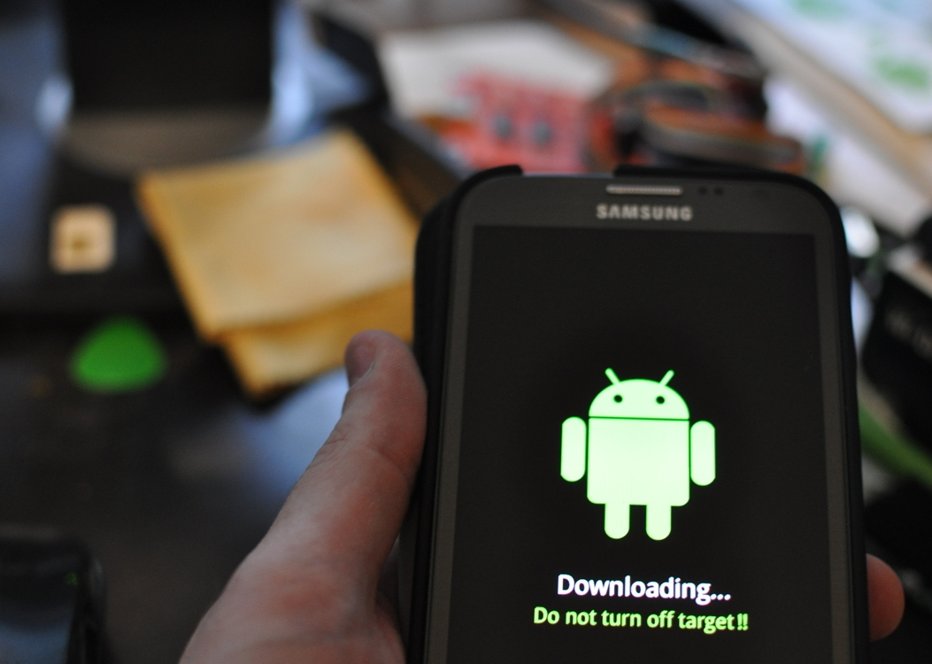

Slide 28
ODIN/Heimdall
Interface with Download Mode on Samsung devices
ODIN is closed source Windows only binary and accepts ustar formatted tar archive files:
  $> tar -H ustar -c recovery.img > recovery.tar
  $> md5sum -t recovery.tar >> recovery.tar
  $> mv recovery.tar recovery.tar.md5
Heimdall is open source, cross platform version capable of writing raw images
Must usually be named accordingly
PIT files

Slide 29
ODIN/Heimdall
heimdall print-pit –no-reboot
  Prints the PIT of the device
  Useful for identifying partition names/numbers
  Proves communication with device
Heimdall can pass multiple image/file arguments at once
Finicky!

Slide 30
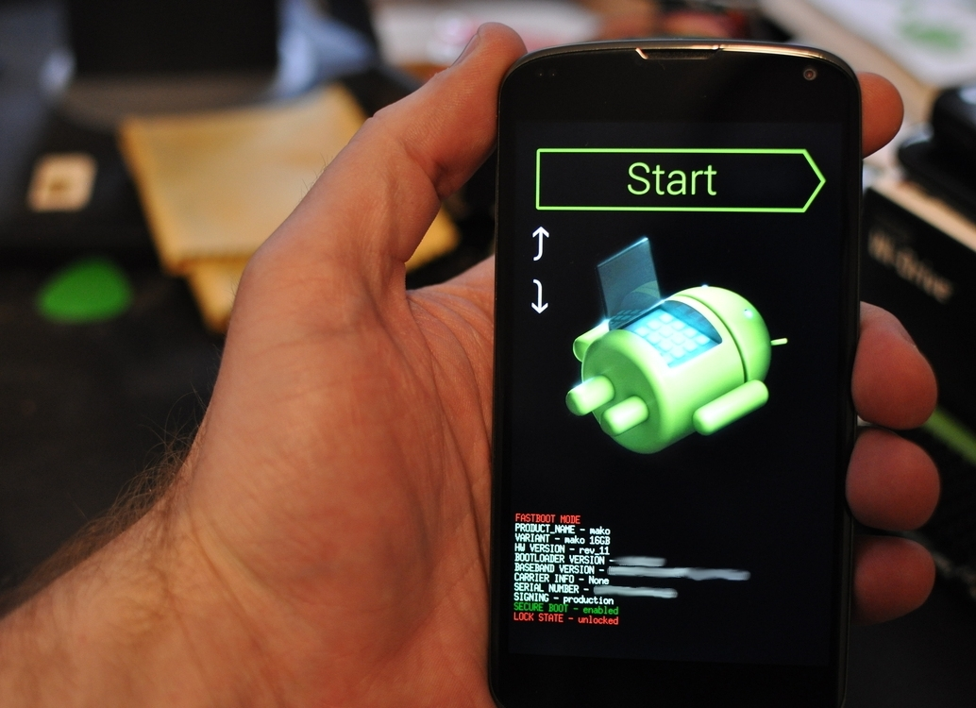

Slide 31
fastboot
Found on Nexus, HTC devices among many others
Great for testing an image without writing it to memory (fastboot boot recovery.img)
Easy to write your new recovery (fastboot flash recovery recovery.img)
Typically unlocking (if locked) triggers a /data wipe

Slide 32
Boot status?
It booted up and ran the first time!
It booted up but something is horrifically (or not so) wrong.
It didn't boot at all!
  Make sure. Try talking to the device with adb. Video issues are very common.
  It's totally dead or endlessly reboots itself

Slide 33
Common Issues
No video or distorted and otherwise jacked up display
  Try specifying a pixel format
  May require a custom graphics.c
  Github for common devices
Filesystem issues
  Check /tmp/recovery.log for specific failures
  Use recovery root shell to sort out these issues

Slide 34
Common Issues
Recovery boots, but reboots itself after X interval
  More than likely a watchdog or binary like rmt_storage
  Copy over binaries into the ramdisk and configure init scripts properly
Boots to black screen
  If recovery partition is large, ensure you are specifying a ramdisk offset in your boardconfig
  Verify page sizes

Slide 35
Common Issues
Buttons/layout derpage
  May require a custom keys file
  If select button doesnt work, set proper boardconfig option for select button status.
Size (too big) – rebuild kernel or chop up ramdisk (ugly).
Other?
  There's no shortage of interesting problems to figure out.

Slide 36
Keep It Clean
$> make clobber
  Is your friend.
  Cleans all of out/ directory
  Run if you make any changes to makefiles to ensure everything is rebuilt from scratch
Track test criteria (changes) properly
  ie don't change a ton at once
  Document progress

Slide 37
update.zip
Packages of software or firmware flashed by the update-binary packaged within the archive.
Controlled by the edify script in the updater-script
  META-INF/com/google/google/android/
Custom ones can be made and flashed by custom recoveries but typically not by stock recoveries
Always read the edify!
Be wary of carrier OTAs!
Asserts

Slide 38
Taking It Further
Backup capability
Further exploration
Device bringup
Test platform
Specific custom support

Slide 39
Resources
ClockworkMod Builder
  builder.clockworkmod.com
Github
https://github.com/utkanos/bootable_recovery_howto

Slide 40
Questions?
utkanos on freenode / #cyanogenmod / #koush
https://www.github.com/utkanos
utkanos at gmail dot com
stop and say hi (bbq)

