Slide 1


SMART INDIA HACKATHON 2025
TITLE PAGE
Problem Statement ID – SIH25023
Problem Statement Title- AyurSutra- Panchakarma Patient Management and therapy scheduling Software
Theme- MedTech/BioTech/ HealthTech
PS Category- Software

Slide 2
IDEA TITLE
Your Team Name
Proposed Solution:
AYURSUTRA – a web-based software designed to digitize Panchakarma therapy management.
Provides Patient Dashboards, Doctor & Therapist Panels, and Admin Control.
Simplifies therapy scheduling, patient tracking, and progress monitoring.

Slide 3

Your Team Name
Detailed Explanation of the Proposed Solution:
Patient Dashboard-
Register/Login → Submit Health Form → View Prescribed Therapies → Track Progress → Get Reminders.
Provide feedback on therapy sessions & overall experience.
Doctor Panel-
View patient history & reports.
Prescribe Panchakarma therapies (Abhyanga, Vamana, Basti, etc.).
Assign therapists & monitor outcomes digitally.
Therapist Panel-
Receive assigned therapies.
Manage schedules via weekly calendar.
Conduct sessions & update records.
Admin Panel-
Manages users, resources, and therapy schedules.
Generates analytics & reports.
@SIH Idea submission- Template

Slide 4
Your Team Name
How it Addresses the Problem-
Patient Side-
Digital health forms & records → removes manual paperwork.
Slot booking in movie-ticket style calendar → avoids confusion.
Track therapy progress & give feedback easily.
Doctor Side-
Quick access to patient history, reports & requests.
Digital therapy assignment with duration & frequency.
Real-time communication with patients.
Therapist Side-
Auto-generated weekly calendars reduce scheduling conflicts.
Add daily available slots & update session records in real time.
Admin Side-
Centralized management of users, appointments & resources.
Generates reports & analytics for better efficiency.
@SIH Idea submission- Template

Slide 5
Your Team Name
Innovation & Uniqueness-
Domain-Specific: First solution focusing on Panchakarma therapy management.
Smart Scheduling: Unique slot-booking system (like online movie tickets).
Digital Integration: Built using React.js + Spring Boot + MySQL.
Feedback-Driven Care: Patient feedback loop improves therapy quality.
Scalable: Can extend to other Ayurveda treatments & multi-clinic support.
User-Friendly UI: Simple dashboards + multilingual support for all users
@SIH Idea submission- Template

Slide 6
TECHNICAL APPROACH
Your Team Name
Technologies to be Used-
Frontend: HTML, CSS, JavaScript, React.js
Backend: Spring Boot
Database: MySQL
UX Design: Figma
Hardware: Any standard PC/Laptop (≥4GB RAM, browser-based access).
Methodology and process for implementation-
Step 1: Requirement Analysis-
Collect needs from patients, doctors, therapists, and admin users.
Identify problems: manual paperwork, scheduling conflicts, limited tracking.
Step 2: System Design-
Create wireframes in Figma.
Define workflow diagrams:
    Patient → Doctor → Therapist → Admin flow.

Slide 7
Your Team Name
Step 3: Frontend Development (React.js)-
Patient Dashboard: Register, fill health form, view therapies, give feedback.
Doctor Panel: View history, assign therapies, monitor outcomes.
Therapist Panel: Manage schedules, add slots, conduct therapy sessions.
Admin Panel: Manage users, resources, and reports.
Step 4: Backend & Database Integration (Spring Boot + MySQL)-
Build REST APIs for patient records, prescriptions, therapy schedules.
Store patient data, therapy history, and session records securely.
Step 5: Testing & Deployment-
Test scheduling logic (avoid conflicts).
Secure login & role-based access for all users.
Deploy frontend (Netlify/GitHub Pages) + backend (Spring Boot server).
@SIH Idea submission- Template

Slide 8
Your Team Name
Flowchart (Working Prototype Flow)-
Patient-
Registers/Login → Submits Symptoms Form → Selects Doctor → Views Therapy Schedule → Books Slot → Tracks Progress → Gives Feedback
⬇
Doctor-
Views Consultation Request → Reviews Records → Prescribes Therapy (type, duration, frequency) → Assigns Therapist → Monitors Reports
⬇
Therapist-
Gets Notification of Assigned Patient → Opens Weekly Calendar → Adds Available Slots → Conducts Sessions → Updates Records
⬇
Admin-
Oversees Patients, Doctors, Therapists → Manages Appointments & Resources → Generates Reports & Analytics
@SIH Idea submission- Template

Slide 9
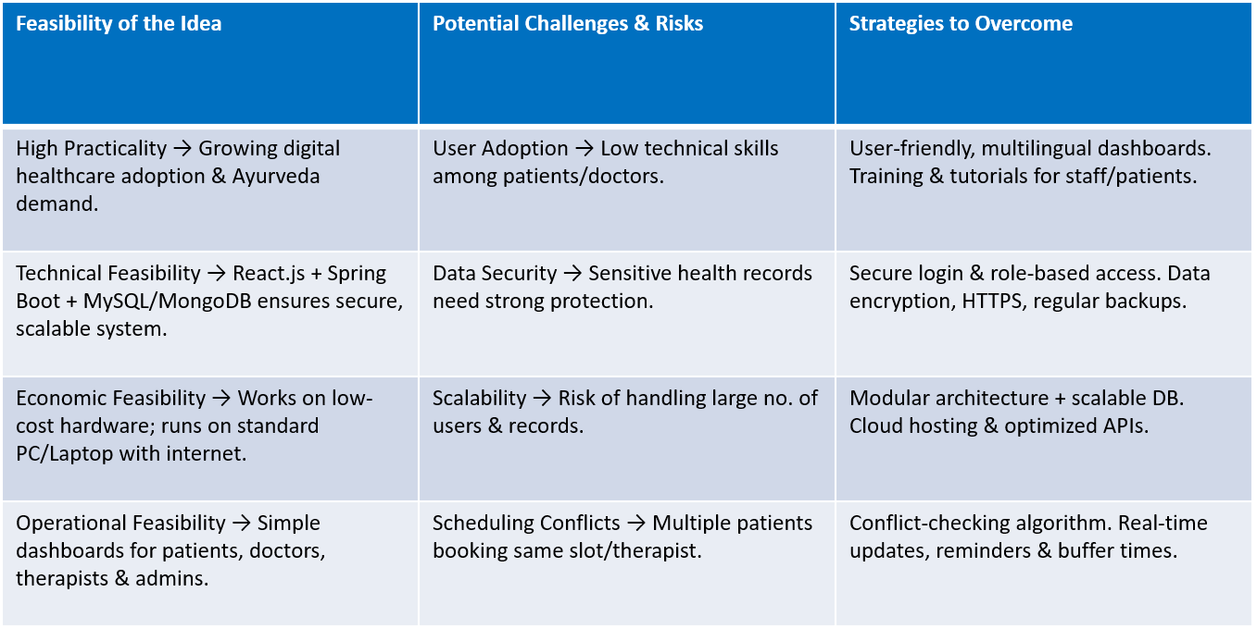
FEASIBILITY AND VIABILITY
Your Team Name
Feasibility, Challenges & Solutions-

Slide 10
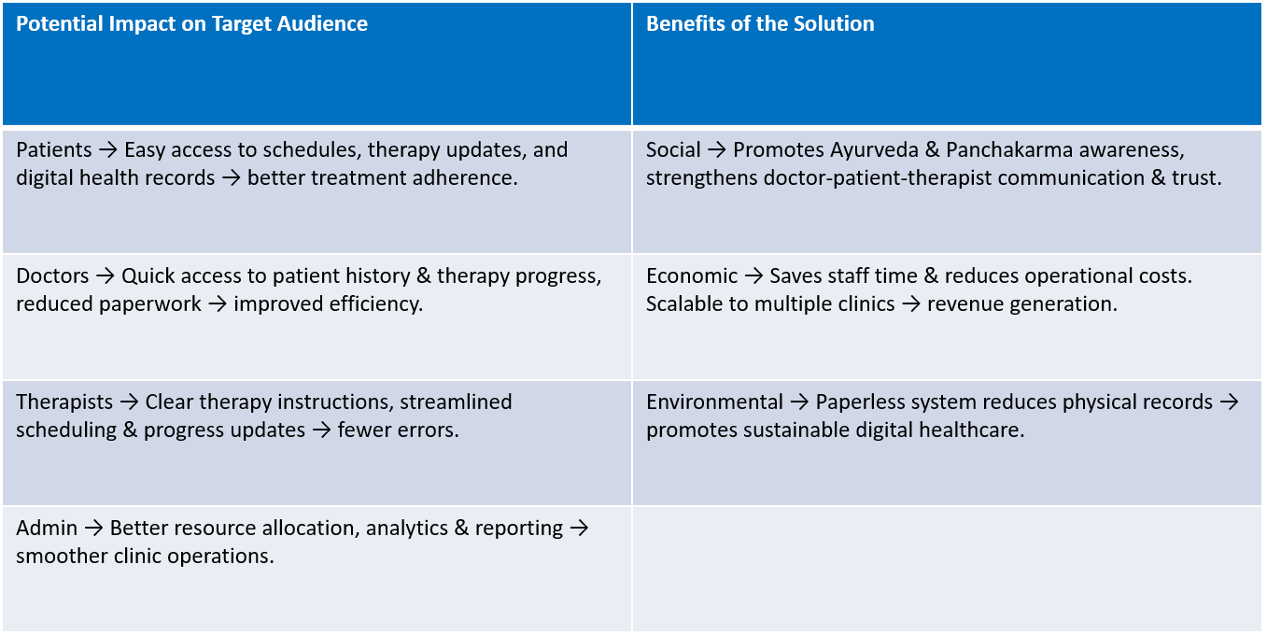
IMPACT AND BENEFITS
Your Team Name

Slide 11
Your Team Name
Thank You!
@SIH Idea submission- Template

