Slide 1
MAKEATHON PROJECT
By – THOSE I T GUYS

Slide 2

Problem Statement
BEML Earth Moving equipment is deployed in remote mining areas and hence cannot transfer vital data to central systems due to lack of network coverage. Develop a solution to optimally send the data to a server.

Slide 3
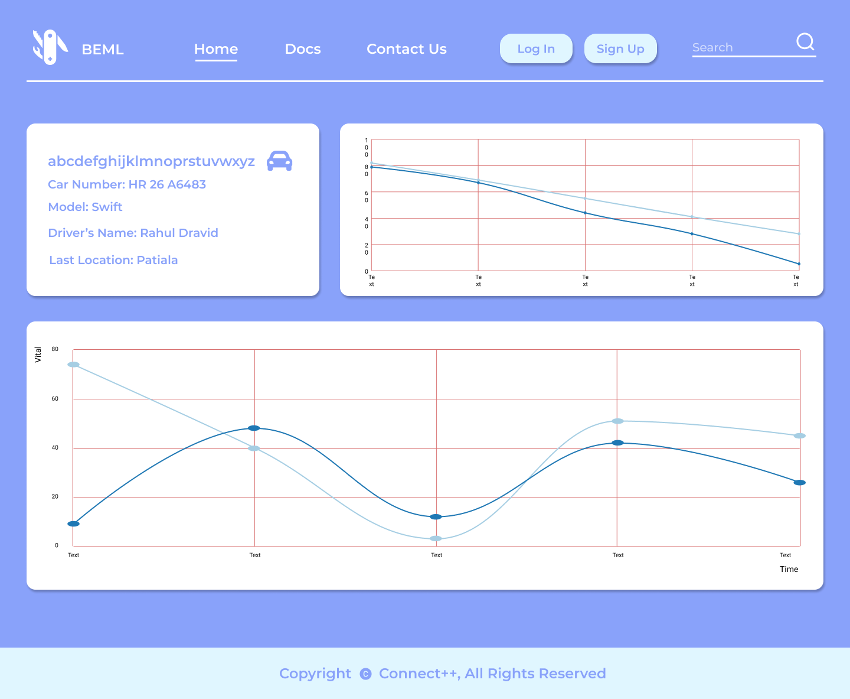
Features of our solution
Removes the data upload problem by introducing a mobile device as a middle man.
Solves security issues by end to end encryption.
Provides a one stop solution to manage the fleet on ground.
Stores the data in a secure cloud which can be accessed anytime.
Efficient sending of data to server with minimal data packet loss.

Slide 4

Solution
Fetching and encryption of data in on-board systems
Transfer of data from onboard system to mobile
Detection of availability of network by mobile
Transfer of data from mobile to cloud and decryption
Data packet loss will be minimal

Slide 5
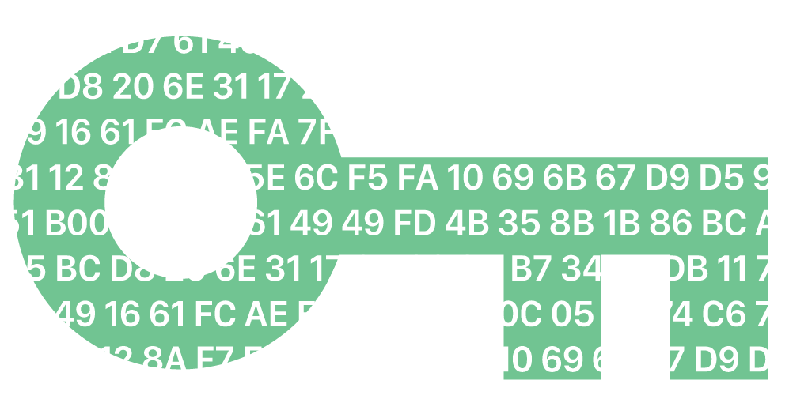
Fetching and encryption of data on on-board systems
Easy-to-use CLI and GUI.
The encrypted data is fetched from the machine to prevent any tampering from the middle man.
This data is encrypted with a public key

Slide 6
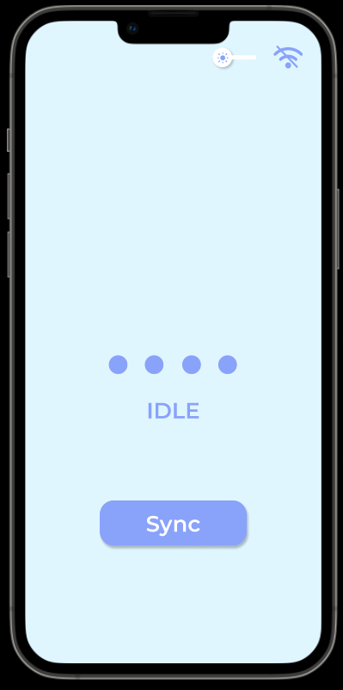
Transfer of data from onboard system to mobile
When the user presses the sync button, the encrypted data is received by the app.
It is then stored locally on the mobile in a secure manner so no one can tamper with it.
The mobile app is connected with the on board device via a pseudo network achieved using the inbuilt hotspot technology in mobile devices.

Slide 7
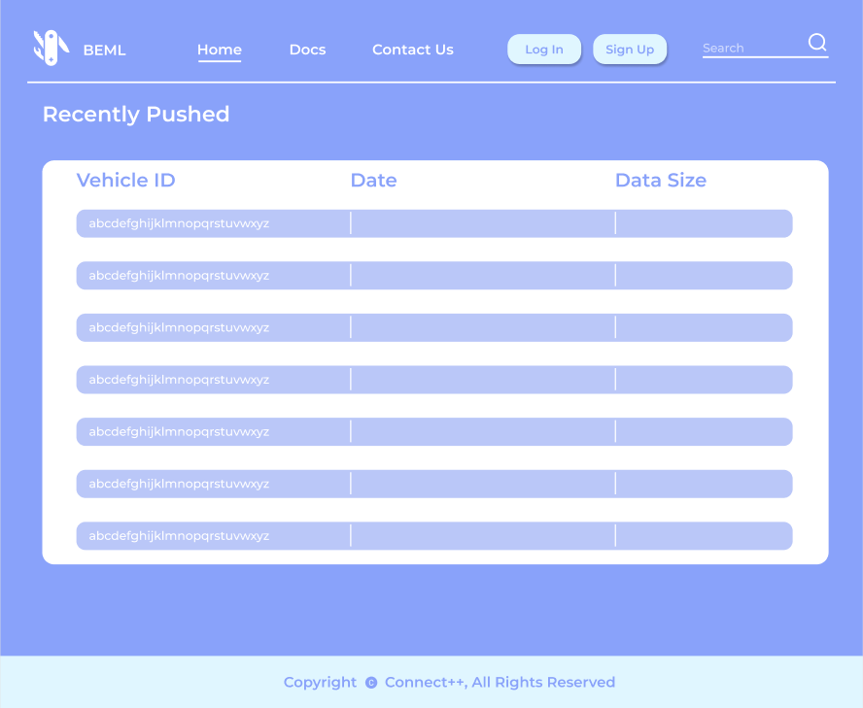
Transfer of data from mobile to cloud and decryption
As soon as the device gets connected to a stable internet connection, the data would be pushed to the cloud and decrypted.
The user would also be informed of the same via a prompt.
We have also made a fleet management system to track the vitals of all machines on site.

Slide 8
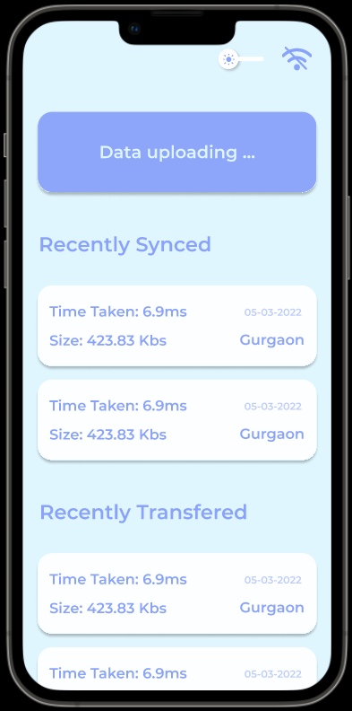
Making data packet loss minimal
The data packet is send optimally to prevent data loss due to network.
The network connectivity is checked before sending the data.

Slide 9
Tech stack used
Node JS: Would be used to create a backend for the entire application, providing the basic apis.
Node-Crypto: Provides cryptographic functionality, specifically methods to implement public/private cryptographic in our case.
Azure Cloud Services: Cloud service to be used to implement a central system for data collection. (To host our database and fleet management dashboard)
React-Native: To create the mobile application for data collection and data transfer to the cloud.
Mongo DB: To create a database to store vehicle information.
Basic web Development tools (HTML, CSS, JS) : to be used to develop the Fleet management and analysis dashboard.
Figma: To design the UI/UX for the mobile application and the Fleet Management Dashboard.
Electron JS: Used to make the GUI to transfer data from machine to app.

