Slide 1

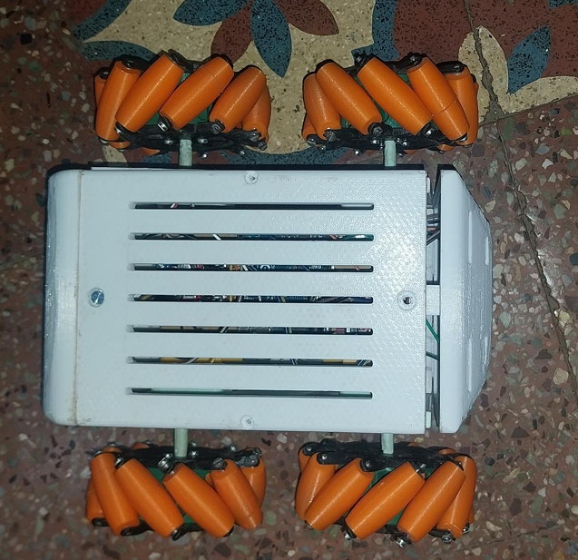
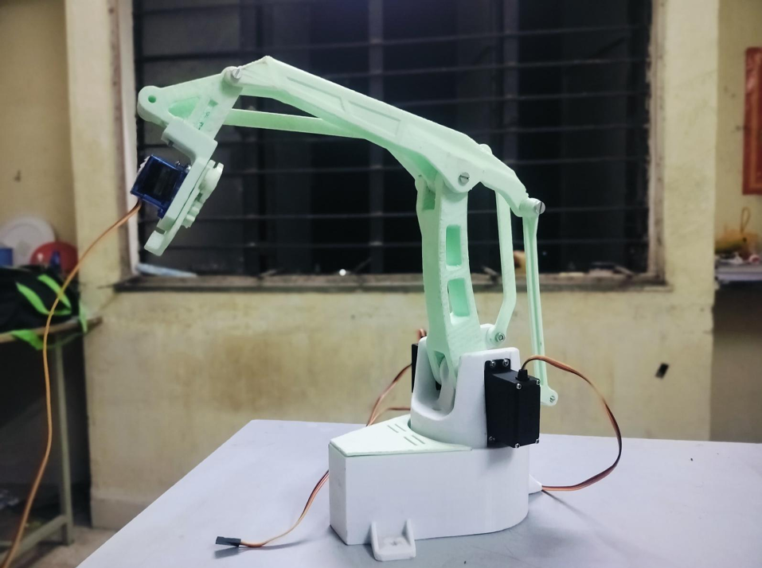
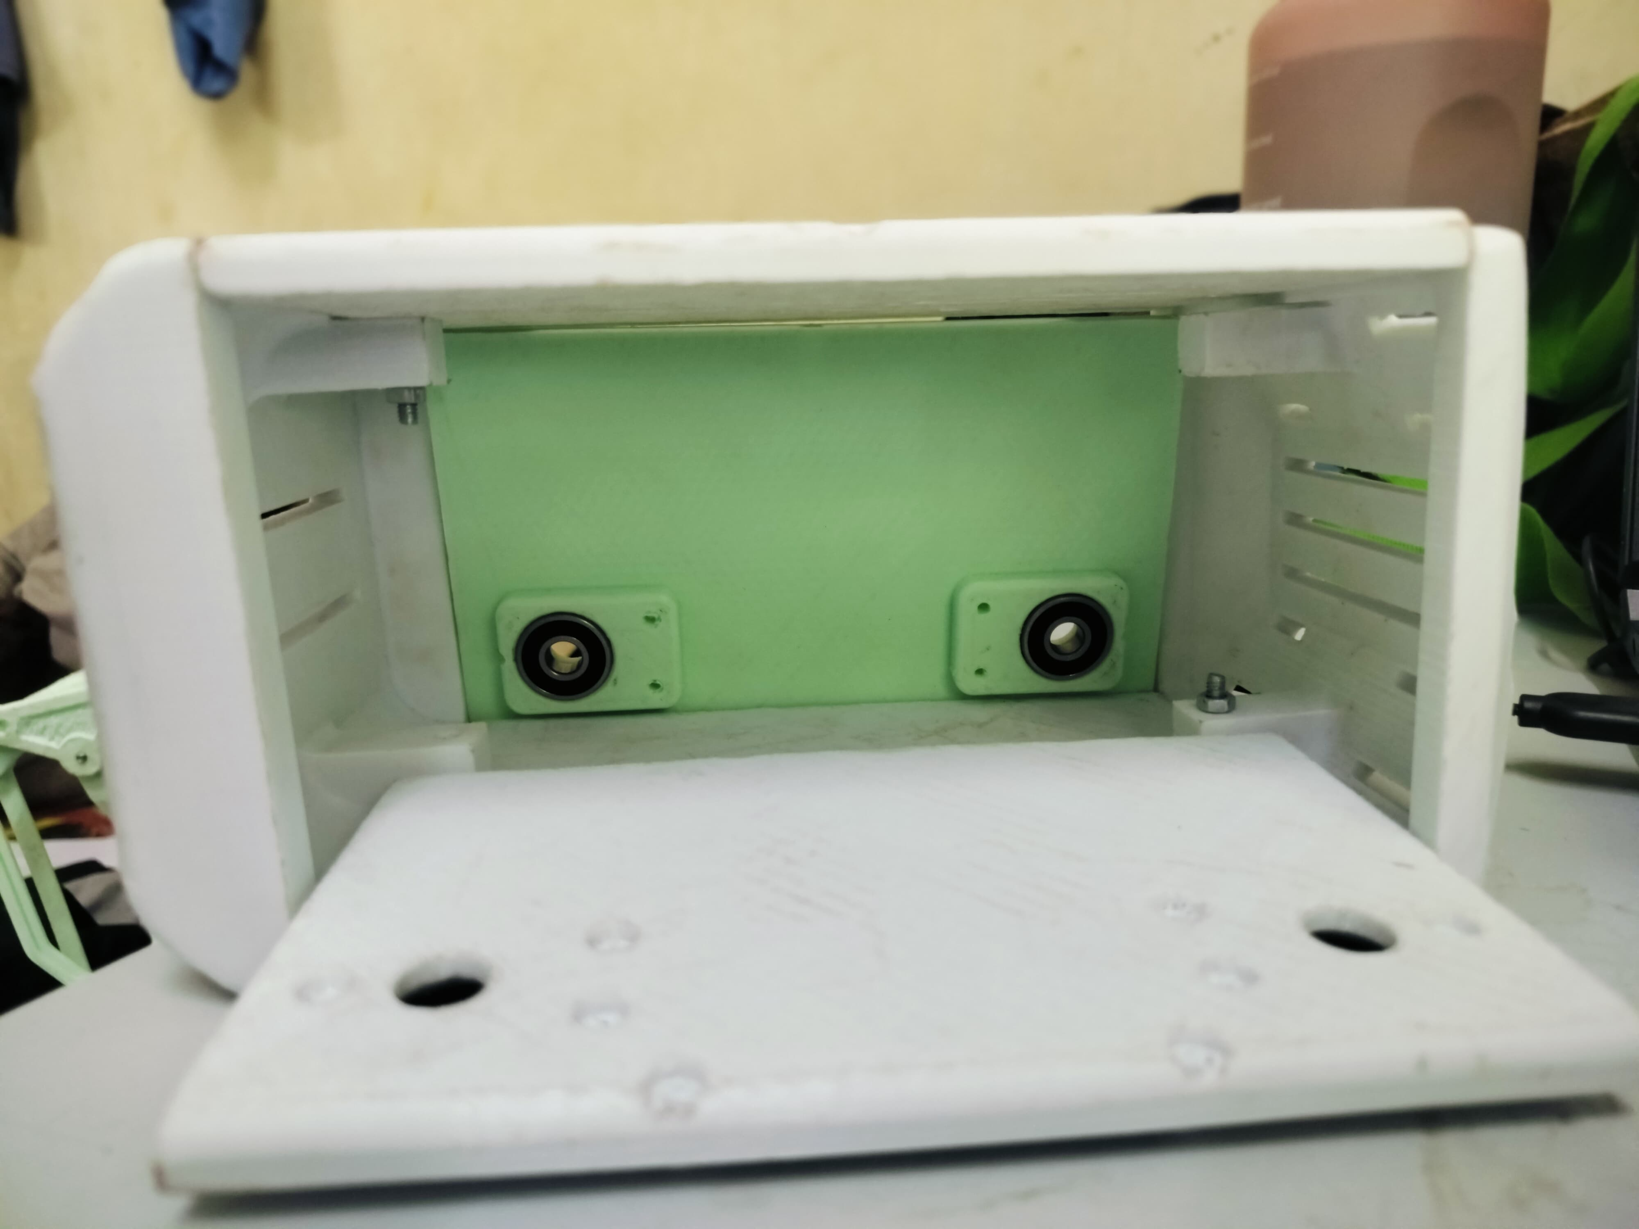
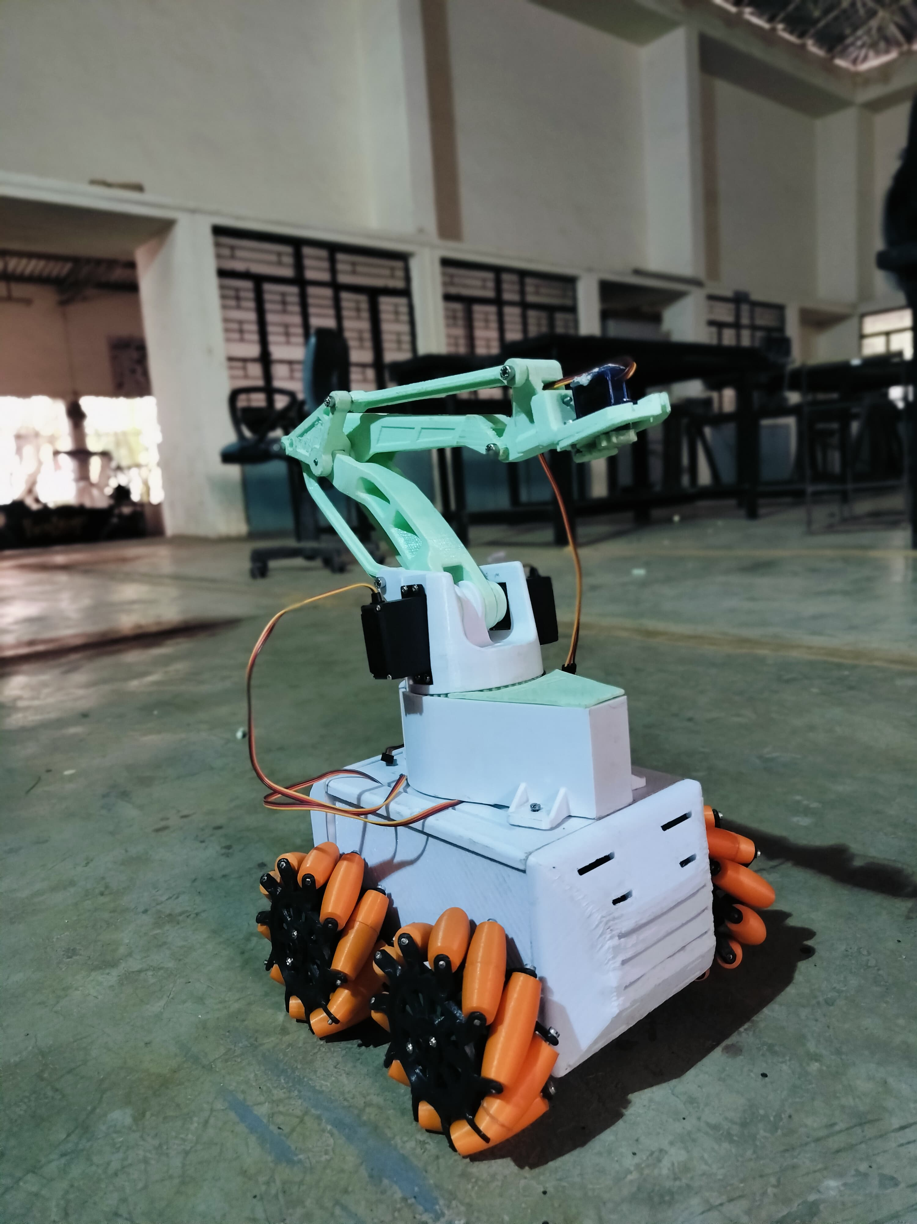
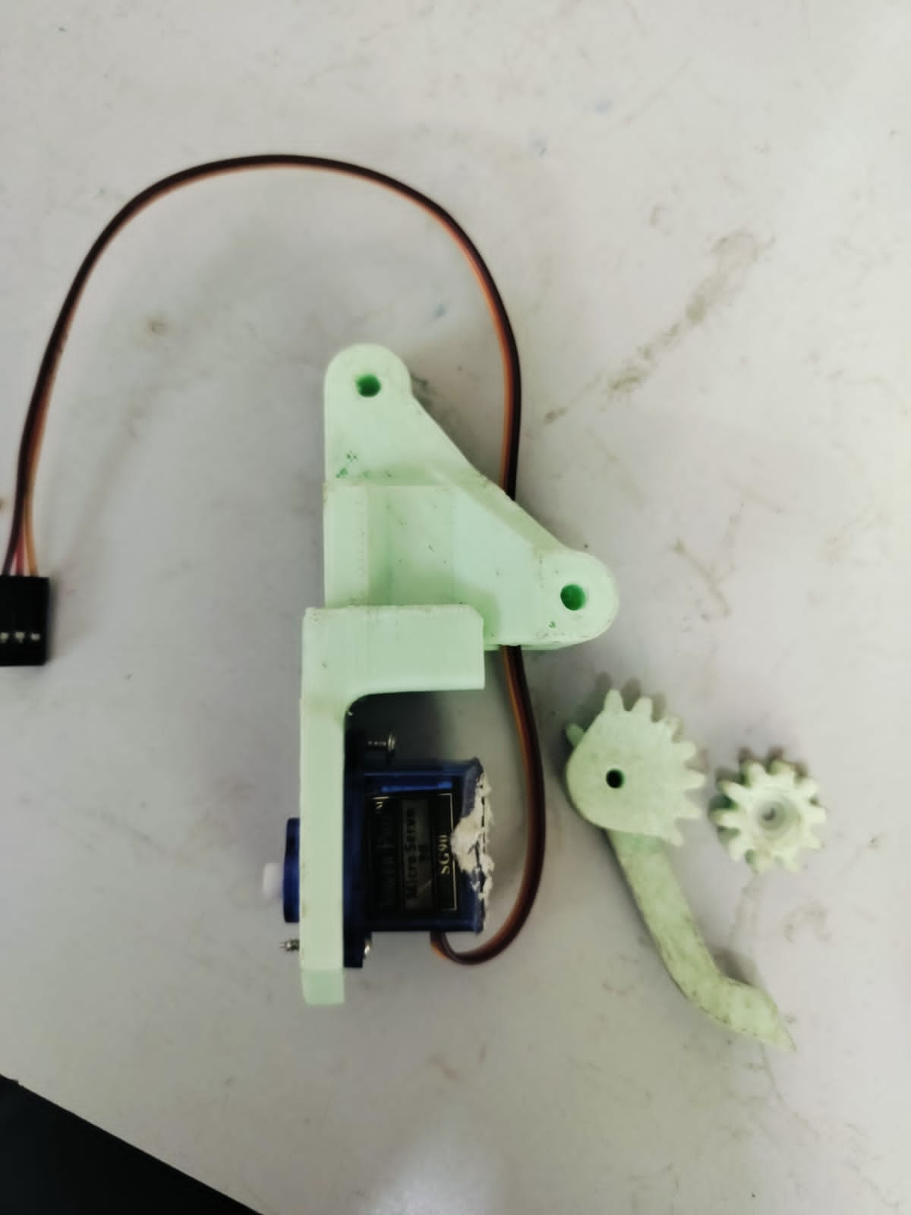
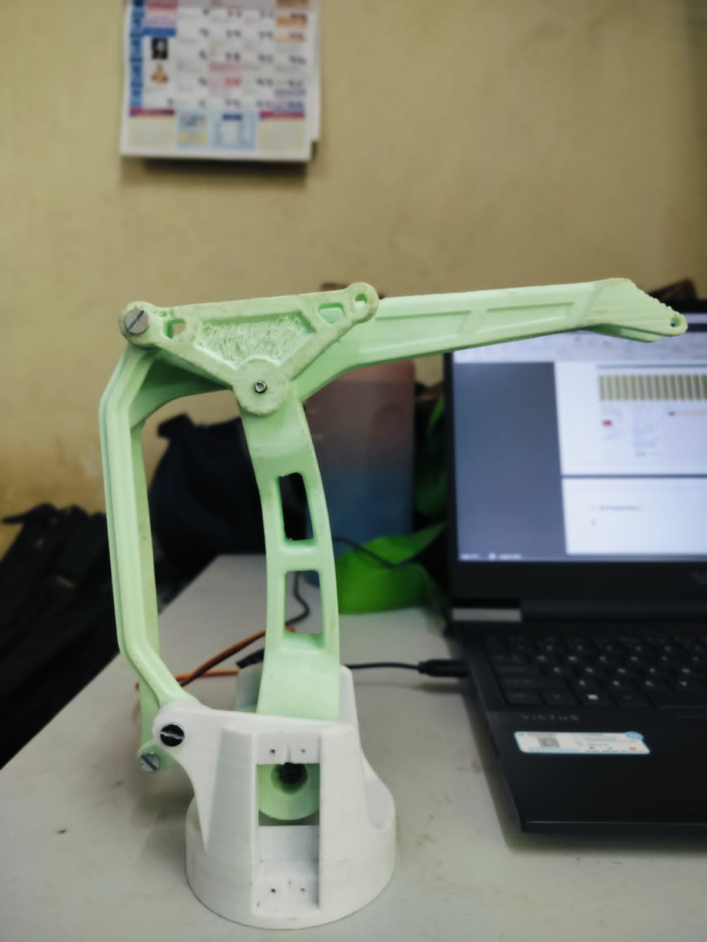
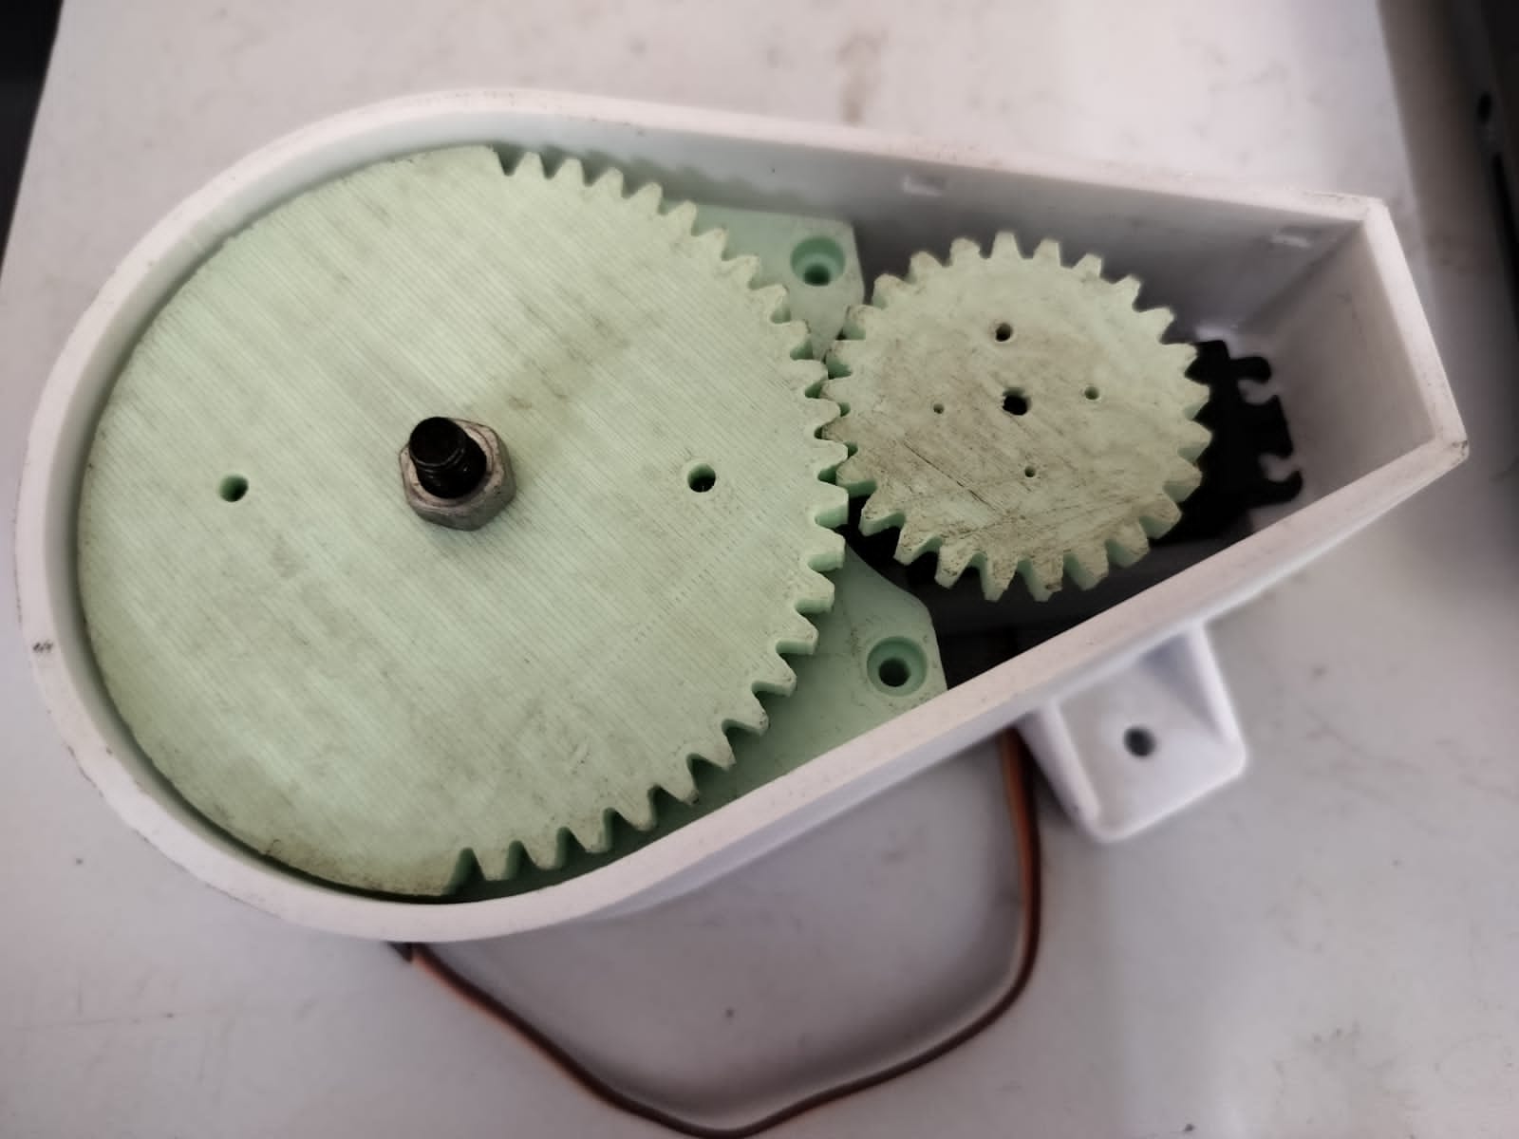
“Development of Automated Mobile Robotic Arm for Cold Storage Operations”
Subodh Bhosale (244418 ) Girish Patil (244425) Utkarsh Jadhav (244426)
Omkar Pore (244460) Sunil Dhargude (244464 )
Under Guidance of :- Prof. S. H. Kumbhar
Academic Year 2024-25
Department of Mechanical Engineering, VPKBIET Baramati
Abstract
Objectives
Results
The development of an automatic mobile robotic arm for cold storage operations is aimed at enhancing efficiency, accuracy and security in the environment, where temperature-sensitive items are handled. This robotic system is designed to autonomally navigate cold storage features, pick, sort and store items and operate tasks such as storing and operating in tight temperature conditions. This innovation is particularly important for industries such as food and pharmaceuticals, where it is important to maintain the integrity of temperature
sensitive products. Robotic arm dynamics allow it to make it favourable to various cold storage configurations, while its exact control mechanisms ensure safe handling of delicate objects. The system not only strengthens operations, but also improves security by reducing human risk for extremely cold environment, which leads to better overall productivity and cost savings.
Robotic Arm Design & Development
Cold-Resistant Materials & Components
Enhanced Speed & Precision
Worker Safety & Injury Prevention
System Testing & Optimization
AI & Automation Integration
For the development of an automated mobile robotic arm in cold storage operations:
• The payload capacity should be designed for at least 0.26 kg with an overload protection factor.
• The joint torque requirement is 10.00 kg.cm (98.1 N.cm) for smooth operation.
• The motor power requirement is 2.05 W, ensuring energy-efficient operation.
These calculations provide a fundamental basis for selecting appropriate actuators, ensuring reliability in cold storage environments. Further refinements should consider frictional losses, joint dynamics, and environmental
adaptations.
Methodology
Design of Robotic Arm
Motor and Servo Selection for Cold Storage
Battery and Power Management System
Mobility and Navigation System
Control System and Software Integration
Testing and Evaluation Protocol
Introduction
Cold storage facilities play a crucial role in industries like food processing, pharmaceuticals, and biotechnology, where temperature-sensitive goods need to be stored and transported under controlled conditions. However, the extreme low temperatures in these environments create significant challenges for traditional manual handling and existing automation systems. Workers face health risks, and productivity is often slow and labor-intensive.
To address these challenges, automation in cold storage is increasingly becoming a necessity. Automated systems, such as robotic arms and mobile platforms, can enhance efficiency, reduce human exposure to cold, and improve safety. However,
most existing systems are not designed for the harsh conditions of cold storage, limiting their effectiveness.
This project focuses on the development of an “Automated Mobile Robotic Arm (AMRA)” for cold storage environments. The goal is to design a robotic arm capable of autonomously retrieving, placing, and transporting items with high precision in sub-zero temperatures. The robotic arm will be mounted on a mobile platform, allowing it to navigate aisles, avoid obstacles, and adapt to different layouts within the cold storage facility.
The aim is to improve operational efficiency, reduce labor costs, and enhance worker safety by minimizing human intervention. This system will also ensure the
careful handling of temperature-sensitive goods, thus improving the overall productivity and safety of cold storage operations. The following sections will detail
the design, development, and testing of the AMRA, focusing on its hardware, software, and integration into a cold storage environment..
Fig.1 Automated Robotic Car Assembly Part
Conclusion
Integrating the EEZYBotArm MK2 with an omnidirectional mobile platform enhances efficiency in industrial settings like cold storage. This setup enables precise manipulation, flexible mobility, and seamless navigation. Future advancements may include AI automation, advanced sensors, and IoT connectivity for real-time optimization, boosting productivity and safety.
Fig.2 Robotic Aram Assembly Part
References
1.Smith, J. A., & Doe, R. (2022). Robotic Arms in Industrial Automation. Journal of Robotics, 15(4), 123-134.
2. Lee, C., & Wang, H. (2021). Advancements in Cold Storage Automation. International Conference on Robotics and Automation, 98-106.
3. Brown, T., & Green, R. (2020). Impact of Low Temperatures on Robotic Systems. Journal of Mechanical Design, 142(6), 654-670.
4. CESAREO CONTRERAS Autonomous Mobile Robot Makers Answer the Call During Holiday Rush.
5. Namita Sharma, Sadaf Anjum, Amrah Maryam, Savita Gautam (2024), Robotic Arm Car: A Mobile Solution For Automated Pick And Place Operations.

