Slide 1


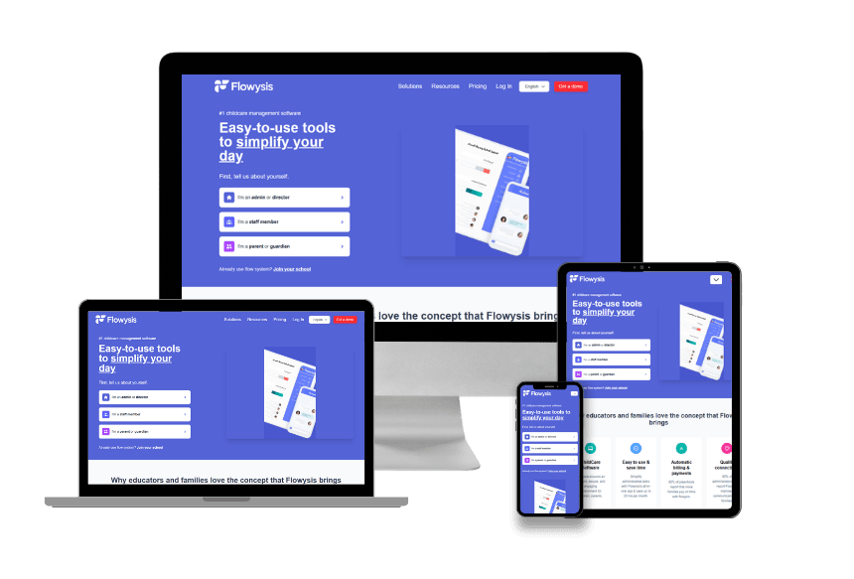
MOBRILZ PRIVATE LIMITED
Building Digital Solutions
Enabling Business Growth
Mobrilz is your technology and digital transformation partner helping businesses build, scale, and thrive through software engineering, intuitive product design, cloud operations, and performance digital marketing.
WEB & E-COMMERCE • MOBILE APPS • CUSTOM SOFTWARE • UI/UX DESIGN • CLOUD & DEVOPS • DIGITAL MARKETING • AI AUTOMATIONS

Slide 2

COMPANY PROFILE
Your Partner in Digital Transformation
Mobrilz turns ideas and operational bottlenecks into market ready digital products. By uniting software engineering, product design, cloud operations, and marketing, we support organizations across their complete digital journey.
01 · ESTABLISH
Digital Presence & Brand
• Architect high converting corporate websites and e-commerce platforms.
• Establish unified brand visual language and frictionless UI/UX touchpoints.
• Equip internal marketing teams with modern headless and CMS capabilities.
02 · DEVELOP
Custom Software & Mobile
• Engineer bespoke cloud applications and native iOS/Android mobile solutions.
• Automate core business processes and eliminate manual operational drag.
• Modernize legacy software systems with resilient backend microservices.
03 · SCALE
Cloud, Marketing & AI
• Deploy secure cloud infrastructure with automated CI/CD and DevOps pipelines.
• Drive qualified customer acquisition via technical SEO and Google Ads.
• Integrate intelligent AI workflows and automations for exponential efficiency.
02 / 24

Slide 3

PROVEN SCALE
Our Journey in Numbers
2018
ESTABLISHED
Pioneering transformative digital solutions, agile engineering, and scalable tech execution.
250+
PROJECTS DELIVERED
Proven track record across consumer mobile apps, enterprise web portals, and SaaS platforms.
200+
GLOBAL CLIENTS
Long term client partnerships spanning startups, scaleups, and established enterprises.
25+
COUNTRIES SERVED
International presence spanning India, UAE (Dubai), Kenya, France, and West Africa.
03 / 24

Slide 4

CORE PURPOSE
Our Mission, Vision and Values
OUR MISSION
Solve Meaningful Challenges Through Tech
To help businesses solve real world operational and commercial challenges through reliable digital solutions, thoughtful user experience design, and modern engineering practices.
Client Partnership
We treat your objectives as our own, fostering radical transparency, direct collaboration, and long term shared success.
Quality & Reliability
Zero compromise on code integrity, security standards, usability, and rigorous end to end quality assurance.
OUR VISION
The Trusted Global Technology Partner
To be the most reliable, adaptive technology partner for organizations worldwide, enabling them to continuously innovate, outpace competitors, and lead in a digital first economy.
Continuous Innovation
Rapidly evaluating and integrating modern technologies, from cross platform frameworks to generative AI automations.
Accountability & Ownership
Clear ownership over delivery timelines, transparent sprints, proactive communication, and measured outcomes.
04 / 24

Slide 5
THE PROBLEM & OPPORTUNITY
Technology Should Solve Real Business Problems
Organizations hit critical growth plateaus when their digital infrastructure fails to keep up. Mobrilz directly resolves the four major friction points holding modern companies back:
01 · OUTDATED DIGITAL EXPERIENCES
The Conversion Barrier
Slow, clunky, non-responsive websites and apps erode customer trust, drive bounce rates up, and hand market share to tech-savvy competitors. We rebuild digital touchpoints with modern UI/UX and lightning fast performance.
02 · INEFFICIENT MANUAL PROCESSES
The Capacity Bottleneck
Teams bogged down by repetitive manual data entry, disconnected spreadsheets, and fragmented tools waste costly hours. We engineer custom automation workflows and business systems that save hundreds of labor hours.
03 · DISCONNECTED SYSTEMS & SILOS
The Data Blindspot
When CRM, inventory, ERP, and payment systems cannot communicate, operations stall and decisions are made blind. We build resilient API integrations and centralized dashboards that provide unified real time visibility.
04 · LIMITED DIGITAL REACH & TRAFFIC
The Growth Ceiling
Building a great product means nothing if qualified prospects never discover it. We deploy high intent SEO, targeted paid acquisition (Google Ads/Social), and digital PR to build an ongoing inbound customer pipeline.
05 / 24

Slide 6
OUR CAPABILITIES
One Partner. Multiple Digital Capabilities.
Web & E-Commerce
High performance corporate websites, global e-commerce stores, custom web apps, and modern CMS architectures built for conversion.
Next.js · React · Node · Laravel
Mobile Applications
Native iOS & Android, plus high velocity cross platform Flutter and React Native apps with real time sync and offline support.
iOS (Swift) · Android · Flutter
Custom Software & UX
Tailored ERP/CRM business systems, SaaS platforms, intuitive UI/UX design systems, interactive prototypes, and usability audits.
Figma · Design Systems · SaaS
Cloud & Technical Ops
Scalable cloud infrastructure, DevOps pipelines (CI/CD), API integrations, 24/7 proactive maintenance, and security hardening.
AWS · Azure · Docker · CI/CD
Digital Marketing
Technical and e-commerce SEO, high ROI Google & Meta ad campaigns, social media management, brand positioning, and content.
SEO · PPC · Social · Branding
AI & Intelligent Automation
Generative AI, machine learning, automated customer SDR agents, voice bots, and intelligent workflow automation tools.
LLMs · NLP · Custom AI Agents
06 / 24

Slide 7
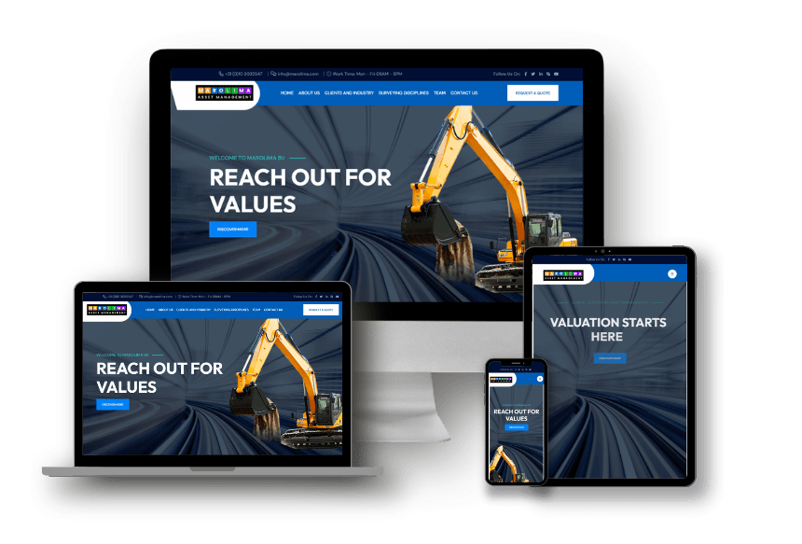
CORE SERVICE · 01
Digital Experiences Built for Business: Web & E-Commerce
THE MOBRILZ WEB ADVANTAGE
Engineered for Conversion & Speed
A modern website must do far more than look impressive, acting as an automated engine for qualified leads, smooth checkout journeys, and operational efficiency.
From high traffic corporate portals to headless e-commerce architectures, we engineer websites built for blazing speed (95+ Core Web Vitals), ironclad security, and maximum ROI.
• Corporate Portals & Enterprise Sites
• High Conversion E-Commerce Engines
• Dynamic Custom Web Applications & SaaS
• Headless CMS Architectures (Strapi, WP)
• Progressive Web Apps (PWA) with Offline Sync
FEATURED CASE STUDY: MAROLIMA ASSET MANAGEMENT
Institutional corporate web platform engineered for security, high-net-worth investor engagement, and compliance.
07 / 24

Slide 8
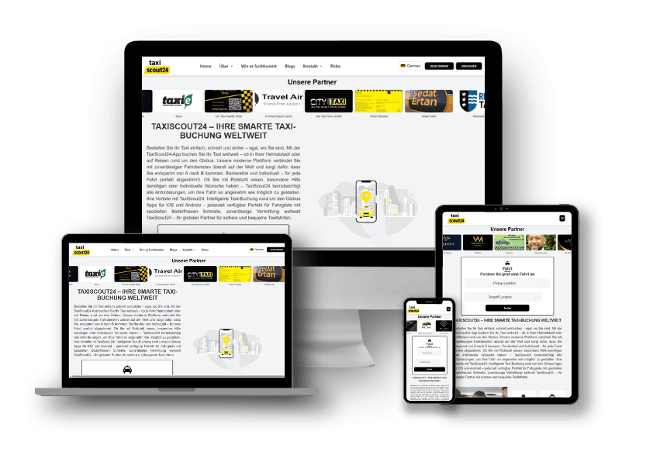
CORE SERVICE · 02
Bringing Digital Products to Mobile: iOS & Android
MOBILE EXCELLENCE
Native Speed, Unified Multi Platform
Mobile apps give businesses a direct line to customers' pockets. We architect iOS and Android apps with striking UI, resilient backends, real time sync, and fluid 60fps animations.
Whether developing native Swift/Kotlin or high velocity Flutter/React Native solutions, we ensure maximum performance and five-star user ratings.
• Customer-Facing eCommerce & Account Apps
• On Demand Booking & Dispatch with GPS Tracking
• Enterprise Mobility & Field Staff Tools
• Real Time Chat, Push Alerts & Streaming
• End to End Store Publishing (App Store & Play Store)
08 / 24

Slide 9
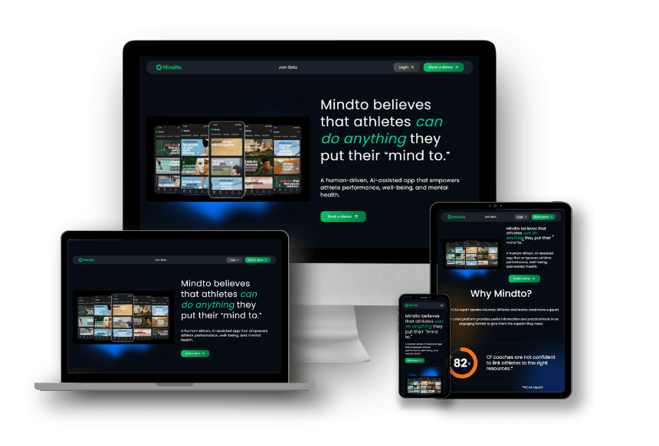
CORE SERVICE · 03
Software Designed Around Your Business: Tailored Systems
BESPOKE ENGINEERING
Own Your Tech. Eliminate Bottlenecks.
Standard software forces your business into someone else's rigid mold, creating expensive per seat fees, disjointed spreadsheets, and manual workarounds.
Mobrilz architects bespoke software applications built 100% around your proprietary rules, team workflows, and competitive edge. You own the IP, eliminate recurring SaaS seat tax, and scale infinitely.
• Business Process Management & Workflow Automation
• Custom Multi Tenant SaaS Platforms from MVP to Scale
• Centralized Enterprise ERP/CRM Platforms
• Legacy Code Refactoring & Microservice Modernization
• Secure Enterprise API Integrations & Webhooks
FEATURED CASE STUDY: MINDTO
Tailored digital platform built with modern full-stack architecture, dynamic role-based access, and automated workflow logic.
09 / 24

Slide 10
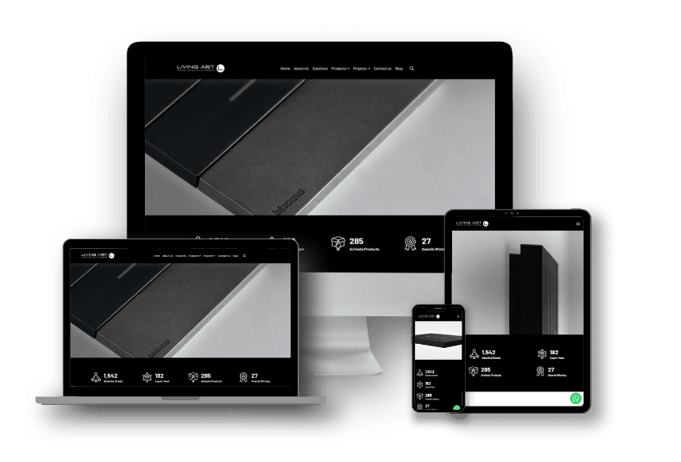
CORE SERVICE · 04
Thoughtful Design. Better Digital Experiences: UI/UX
01 · DISCOVER
UX Research & Strategy
User interviews, persona definition, competitor benchmarking, and behavioral analytics mapping.
02 · STRUCTURE
Information Architecture
Sitemaps, navigation hierarchies, user flows, and core customer journey optimization.
03 · PROTOTYPE
Interactive Figma Models
Rapid clickable prototypes to test usability, validate hypotheses, and align stakeholders before coding.
04 · POLISH
UI Design & Design Systems
High-fidelity visual design, WCAG accessibility, cohesive component libraries, and design tokens.
THE CRO FIRST DESIGN PHILOSOPHY
We don't design just for surface-level aesthetics; every interface, form, button, and checkout funnel is engineered to reduce cognitive friction, accelerate user engagement, and lift conversion rates.
From interactive wireframing to comprehensive component libraries, our design systems ensure that your brand looks cohesive and authoritative across mobile, tablet, and desktop viewports.
10 / 24

Slide 11
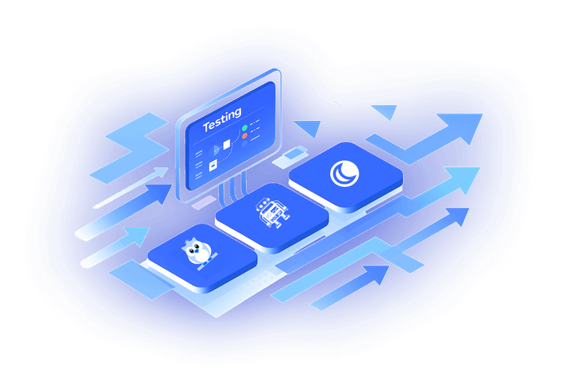
CORE SERVICE · 05
Keeping Digital Products Resilient: Cloud & DevOps
INFRASTRUCTURE & RELIABILITY
Zero Downtime and Elastic Scalability
Great software requires bulletproof hosting infrastructure. Mobrilz architects elastic cloud environments, automates CI/CD deployment pipelines, and manages 24/7 security hardening.
Our DevOps practices eliminate deployment bottlenecks, maintain 99.9% uptime SLAs, and ensure your system handles viral traffic surges with ease.
• Cloud Infrastructure on AWS, Microsoft Azure & GCP
• Automated CI/CD Deployment Pipelines (Docker, Jenkins)
• Microservices & Decoupled REST/GraphQL Architectures
• 24/7 Server Monitoring, Security Patches & Backups
• Database Sharding, Caching (Redis) & Load Balancing
CONTINUOUS AUTOMATION TESTING & DEVOPS
Automated test suites, load testing, containerization, and automated rollback safeguarding your mission-critical applications.
11 / 24

Slide 12
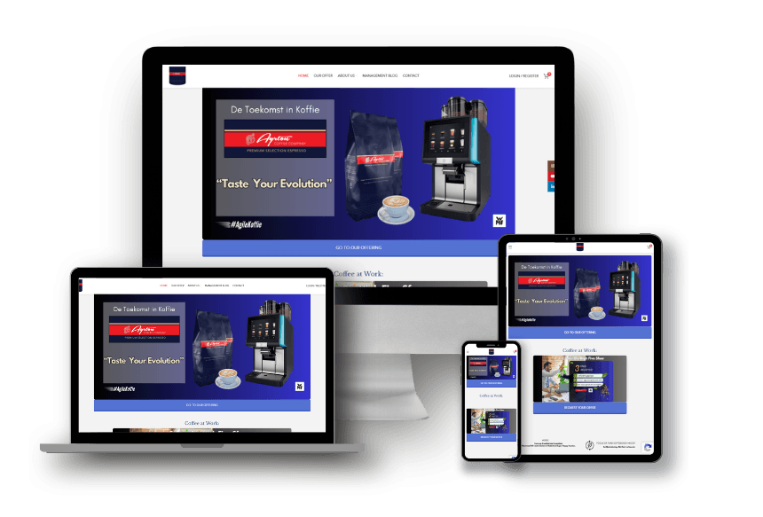
CORE SERVICE · 06
Helping Businesses Reach the Right Audience: Digital Growth
PERFORMANCE MARKETING
Sustainable Organic Rank. High ROAS Ads.
Building a stunning digital platform is only half the battle. We drive qualified buyer traffic through rigorous technical SEO, data driven Google Ads (PPC), social advertising, and brand campaigns.
Every marketing dollar is tracked against concrete commercial KPIs, measuring Cost Per Lead (CPL), Customer Acquisition Cost (CAC), and Return on Ad Spend (ROAS).
• Technical, On-Page & Local SEO with Core Web Vitals Focus
• High Intent Google Ads, Search, Shopping & Performance Max
• Paid Social Media Campaigns on Meta, LinkedIn & TikTok
• Landing Page Conversion Rate Optimization (A/B Testing)
• Brand Strategy, Digital PR & High-Authority Link Building
FEATURED CASE STUDY: AYRTON COFFEE COMPANY
Full digital branding, e-commerce storefront, and ongoing organic search visibility lifting direct-to-consumer sales.
12 / 24

Slide 13
CORE SERVICE · 07
Exploring New Possibilities: AI & Intelligent Automation
Generative AI & LLMs
Integrate state-of-the-art language models for smart enterprise search, dynamic document summarization, and automated content generation.
CAPABILITY: CUSTOM LLM & RAG PIPELINES
AI SDRs & Chat Agents
Deploy 24/7 intelligent sales and customer support agents that qualify incoming leads, answer technical queries, and book appointments automatically.
CAPABILITY: VOICE & CHAT LEAD CAPTURE
Intelligent Process Automation
Automate complex decision trees, invoice data extraction, document classification, and multi-system syncing without manual touch.
CAPABILITY: ZERO-MANUAL DATA HANDLING
Predictive Analytics & ML
Harness customer behavioral data and past sales metrics to forecast demand, reduce churn, and personalize product recommendations.
CAPABILITY: DATA-DRIVEN FORECASTING
13 / 24

Slide 14
DOMAIN EXPERTISE
Digital Solutions Across Key Industries
Finance & Fintech
Secure investment portals, wealth management dashboards, AML/KYC compliant workflows, and transaction systems.
Healthcare & Fitness
HIPAA conscious patient scheduling portals, wellness mobile apps, telehealth consultations, and clinic management.
E-Commerce & Retail
Omnichannel retail engines, B2B wholesale portals, multi vendor marketplaces, and integrated payment gateways.
Logistics & Supply Chain
Fleet tracking apps, dispatch dispatchers, automated shipment tracking, and warehouse inventory control systems.
Manufacturing & Industrial
Custom ERP suites, equipment maintenance logging, supply procurement automation, and production monitoring.
Education & E-Learning
Interactive learning management systems (LMS), student progress analytics, course delivery, and live video sessions.
Professional Consulting
Lead capture engines, client onboarding portals, automated contract signing, and digital brand platforms.
Hospitality & Services
Direct booking engines, dynamic pricing integrations, reservation management, and interactive guest apps.
14 / 24

Slide 15
HOW WE WORK
From Business Challenge to Digital Solution: 5 Step Lifecycle
01 · DISCOVER
Scope & Alignment
Deep stakeholder interviews, technical discovery, KPI definition, and requirements documentation.
02 · DEFINE
Architecture & Plan
Sprint roadmap, cloud tech stack selection, data modeling, and security framework specification.
03 · DESIGN
Prototypes & Flows
Interactive Figma wireframes, UI design systems, and rapid user testing before a line of code is written.
04 · DEVELOP
Agile Sprints & QA
Bi weekly sprint demos, automated unit/integration testing, security audits, and continuous peer reviews.
05 · DEPLOY
Launch & Evolution
Production rollout, CDN configuration, real time telemetry, team training, and continuous sprint iteration.
15 / 24

Slide 16
COMMERCIAL MODELS
Flexible Ways to Work With Mobrilz
PATH 01 · PROJECT-BASED
Fixed Scope Delivery
• Ideal for clearly defined websites, mobile apps, MVPs, and software builds.
• Guaranteed delivery milestones, fixed pricing, and predetermined launch dates.
• Dedicated Project Manager leading complete end to end execution.
VALUE: FIXED TIMELINE & BUDGET
PATH 02 · DEDICATED TALENT
Staff Augmentation
• Embed dedicated senior developers, designers, or SEO specialists into your team.
• Full time commitment (160 hrs/mo) working directly under your workflows.
• 70% cost reduction vs. local onshore hires with zero HR/payroll management.
VALUE: PLUGGED STRAIGHT INTO YOUR TEAM
PATH 03 · MANAGED SERVICES
Ongoing Support & Growth
• Continuous technical maintenance, security updates, and infrastructure monitoring.
• Ongoing monthly SEO, Google Ads management, and conversion rate optimization.
• Guaranteed response SLAs with dedicated communication via Slack & Asana.
VALUE: CONTINUOUS LONG-TERM EVOLUTION
16 / 24

Slide 17
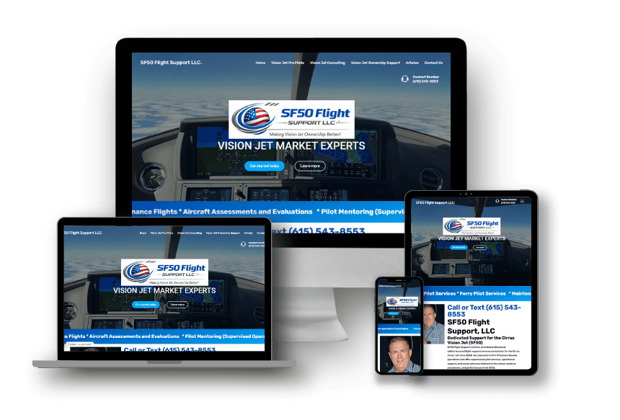
PROVEN CASE STUDIES
Turning Ideas Into Digital Experiences: Selected Client Work
MAROLIMA ASSET MANAGEMENT
Corporate Fintech Web Portal
Custom-engineered by Mobrilz delivering enterprise security, high velocity UX, and scalable cloud performance.
TAXISCOUT24
On Demand Ride Hailing App
Custom-engineered by Mobrilz delivering enterprise security, high velocity UX, and scalable cloud performance.
AYRTON COFFEE COMPANY
Direct-to-Consumer E-Commerce
Custom-engineered by Mobrilz delivering enterprise security, high velocity UX, and scalable cloud performance.
SF50 FLIGHT SUPPORT
Aviation Services & Corporate Web
Custom-engineered by Mobrilz delivering enterprise security, high velocity UX, and scalable cloud performance.
17 / 24

Slide 18
GLOBAL CLIENTELE
Trusted by Fast Growing Businesses & Enterprises
AI & SAAS
Mindto
mindto.io
AI productivity & knowledge management SaaS
ENTERPRISE SAAS
Flowysis
flowysis.com
Automated workflow & business analytics platform
COMMUNITY
Tula Family
tula-family.com
Digital community & modern family portal
SWISS MOBILITY
LocaFri
locafri.ch
Swiss vehicle rental & fleet management software
MATCHMAKING
Niyyah Marriage
niyyah-marriage.com
Verified matchmaking & privacy-first social web app
DISPLAY & EVENTS
Team1 Display
team1displayservices.com
Exhibition booth & event operations portal
REAL ESTATE
El Manantial
elmanantial.eu
Official residential community management in Marbella
HEALTHCARE APP
KoreMe Longevity
koremeantiaging.com
Patient wellness tracking & mobile app (iOS & Android)
FEATURED TRAVEL APP: CHALO REISEN (iOS & ANDROID)
End to end travel companion published across Apple App Store and Google Play Store with real time booking and interactive travel guides.
18 / 24

Slide 19
TECHNICAL CAPABILITIES
The Right Technologies for the Right Requirements
Frontend Development
React.js · Next.js · Vue.js · TypeScript · Tailwind CSS · Vite
High speed, responsive, SEO-ready user interfaces.
Backend Engineering
Node.js · Python (FastAPI, Django) · PHP (Laravel) · Express
Scalable, secure, high-throughput microservice backends.
Mobile Engineering
Flutter · React Native · iOS (Swift) · Android (Kotlin)
Fluid native animations and multi-platform velocity.
Databases & Storage
PostgreSQL · MongoDB · MySQL · Redis · Cloud Firestore
ACID-compliant relational systems and distributed document stores.
Cloud & DevOps
Amazon Web Services (AWS) · Google Cloud · Microsoft Azure · Docker
Elastic cloud scaling, CI/CD pipelines, and zero-downtime deploys.
CMS & Headless
WordPress · Strapi · Shopify · WooCommerce · Headless CMS
Flexible content management tailored for marketing independence.
19 / 24

Slide 20
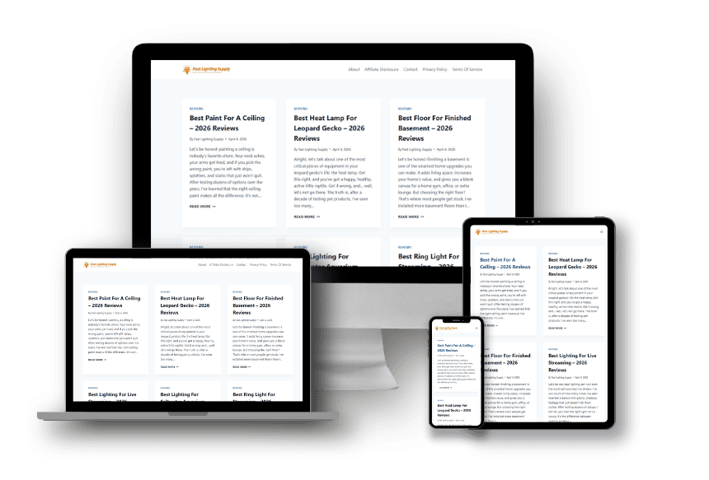
OUR VALUE PROPOSITION
A Technology Partner for the Entire Digital Journey
THE MOBRILZ ADVANTAGE
01 · Integrated Capabilities
No need to juggle separate agencies for mobile, web, design, and SEO. Mobrilz handles your full stack under one synchronized team.
02 · Commercial Orientation
We don't build software for technology's sake. Every line of code and user journey is engineered directly around your revenue and operational KPIs.
03 · Maximum Flexibility
From fixed scope turnkey project delivery to dedicated full time talent embedding, our engagement models adapt to your exact stage of growth.
04 · Lifecycle Commitment
We don't disappear after launch. We provide ongoing security patches, performance scaling, technical maintenance, and growth marketing.
REAL RESULTS: FAST LIGHTING SUPPLY
Engineered custom B2B e-commerce platform with automated catalog indexing, high-volume order processing, and wholesale tier pricing.
20 / 24

Slide 21
OUR LEADERSHIP
Driven by People and United by Technology
EXECUTIVE LEADERSHIP
Chief Executive Officer
Sets corporate vision, global expansion strategy, and high level client relationship standards.
ENGINEERING LEADERSHIP
Chief Technology Officer
Directs software architecture, engineering standards, cloud security, and R&D adoption.
PRODUCT & UX
Head of Product Design
Ensures world class user experience, visual elegance, accessibility standards, and CRO principles.
DELIVERY & OPERATIONS
Director of Project Delivery
Guarantees on time agile delivery, sprint velocity, transparent communication, and QA governance.
21 / 24

Slide 22
ENGINEERING GOVERNANCE
Built Around Clarity, Collaboration & Quality
01 · CLEAR SCOPE & EXPECTATIONS
No Ambiguity
Detailed specifications, wireframes, and agreed acceptance criteria up front to ensure everyone is completely aligned before development begins.
02 · COLLABORATIVE DECISION-MAKING
Partners, Not Vendors
Regular sprint check ins, transparent backlog reviews, and collaborative problem solving to adapt dynamically as requirements evolve.
03 · RIGOROUS QUALITY ASSURANCE
Zero Tolerance for Flaws
Automated regression testing, peer code reviews, vulnerability scanning, and manual device testing across iOS, Android, and web.
04 · TRANSPARENT SPRINT COMMUNICATION
You're Never Out of the Loop
Real time updates via dedicated Slack/Teams channels, weekly video check-in calls, and fully documented tasks in Asana/Jira.
21 / 24

Slide 23
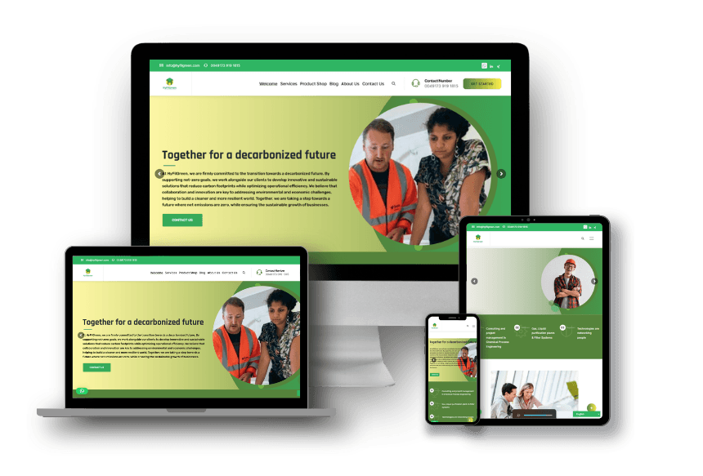
CLIENT SATISFACTION
Building Relationships Beyond Delivery
98%
CLIENT RETENTION
Our clients stay because we deliver consistently, communicate proactively, and constantly hunt for optimizations.
250+
DEPLOYMENTS
Battle-tested experience across complex multi-stakeholder deployments, high-load e-commerce, and SaaS apps.
25+
GLOBAL MARKETS
Cross-cultural expertise serving businesses in the US, Europe, Middle East, Africa, and Asia-Pacific.
24/7
SUPPORT AVAILABILITY
Dedicated engineering and maintenance teams available to resolve critical issues and maintain seamless uptime.
LONG TERM COLLABORATION & SHARED OUTCOMES
"Mobrilz took complete ownership of our product architecture from the initial sprint through national deployment. Their engineers are transparent, proactive, and exceptionally skilled."
We measure our success purely by the business impact delivered to our partners, measured in uptime, customer acquisition, and technical resilience.
22 / 24

Slide 24
LOOKING FORWARD
Ready for What Is Next: The Transformation Roadmap
01 · DISCOVER
Map Your Goals
A focused strategy session to evaluate your current technology bottlenecks, product roadmap, and business targets.
02 · ARCHITECT
Tailored Proposal
A transparent delivery roadmap with clear architecture specs, milestone timelines, and resource packaging.
03 · EXECUTE
Agile Deployment
Seamless onboarding, dedicated Slack integration, and sprint based execution with working software in weeks.
24 / 24

Slide 25
START A CONVERSATION
Let's Build Something Meaningful Together.
MOBRILZ PRIVATE LIMITED
Have a Project in Mind?
Let's Discuss Your Vision.
Whether you are looking to build a new mobile app, revamp an enterprise web portal, augment your engineering capacity, or accelerate customer acquisition, we are ready to partner with you.
Schedule a consultation with our technology strategists and receive a tailored implementation plan.
GET IN TOUCH
OFFICIAL WEBSITE
https://www.mobrilz.com/
SALES & INQUIRIES
sales@mobrilz.com
DIRECT LINE
+91 8010355718
GLOBAL FOOTPRINT
Head Office: India
Regional Offices: Dubai (UAE) · Kenya · France · Sénégal
PREFERRED CONSULTATION
Video Call · Phone Call · On-Site Meeting
25 / 24

