Slide 1
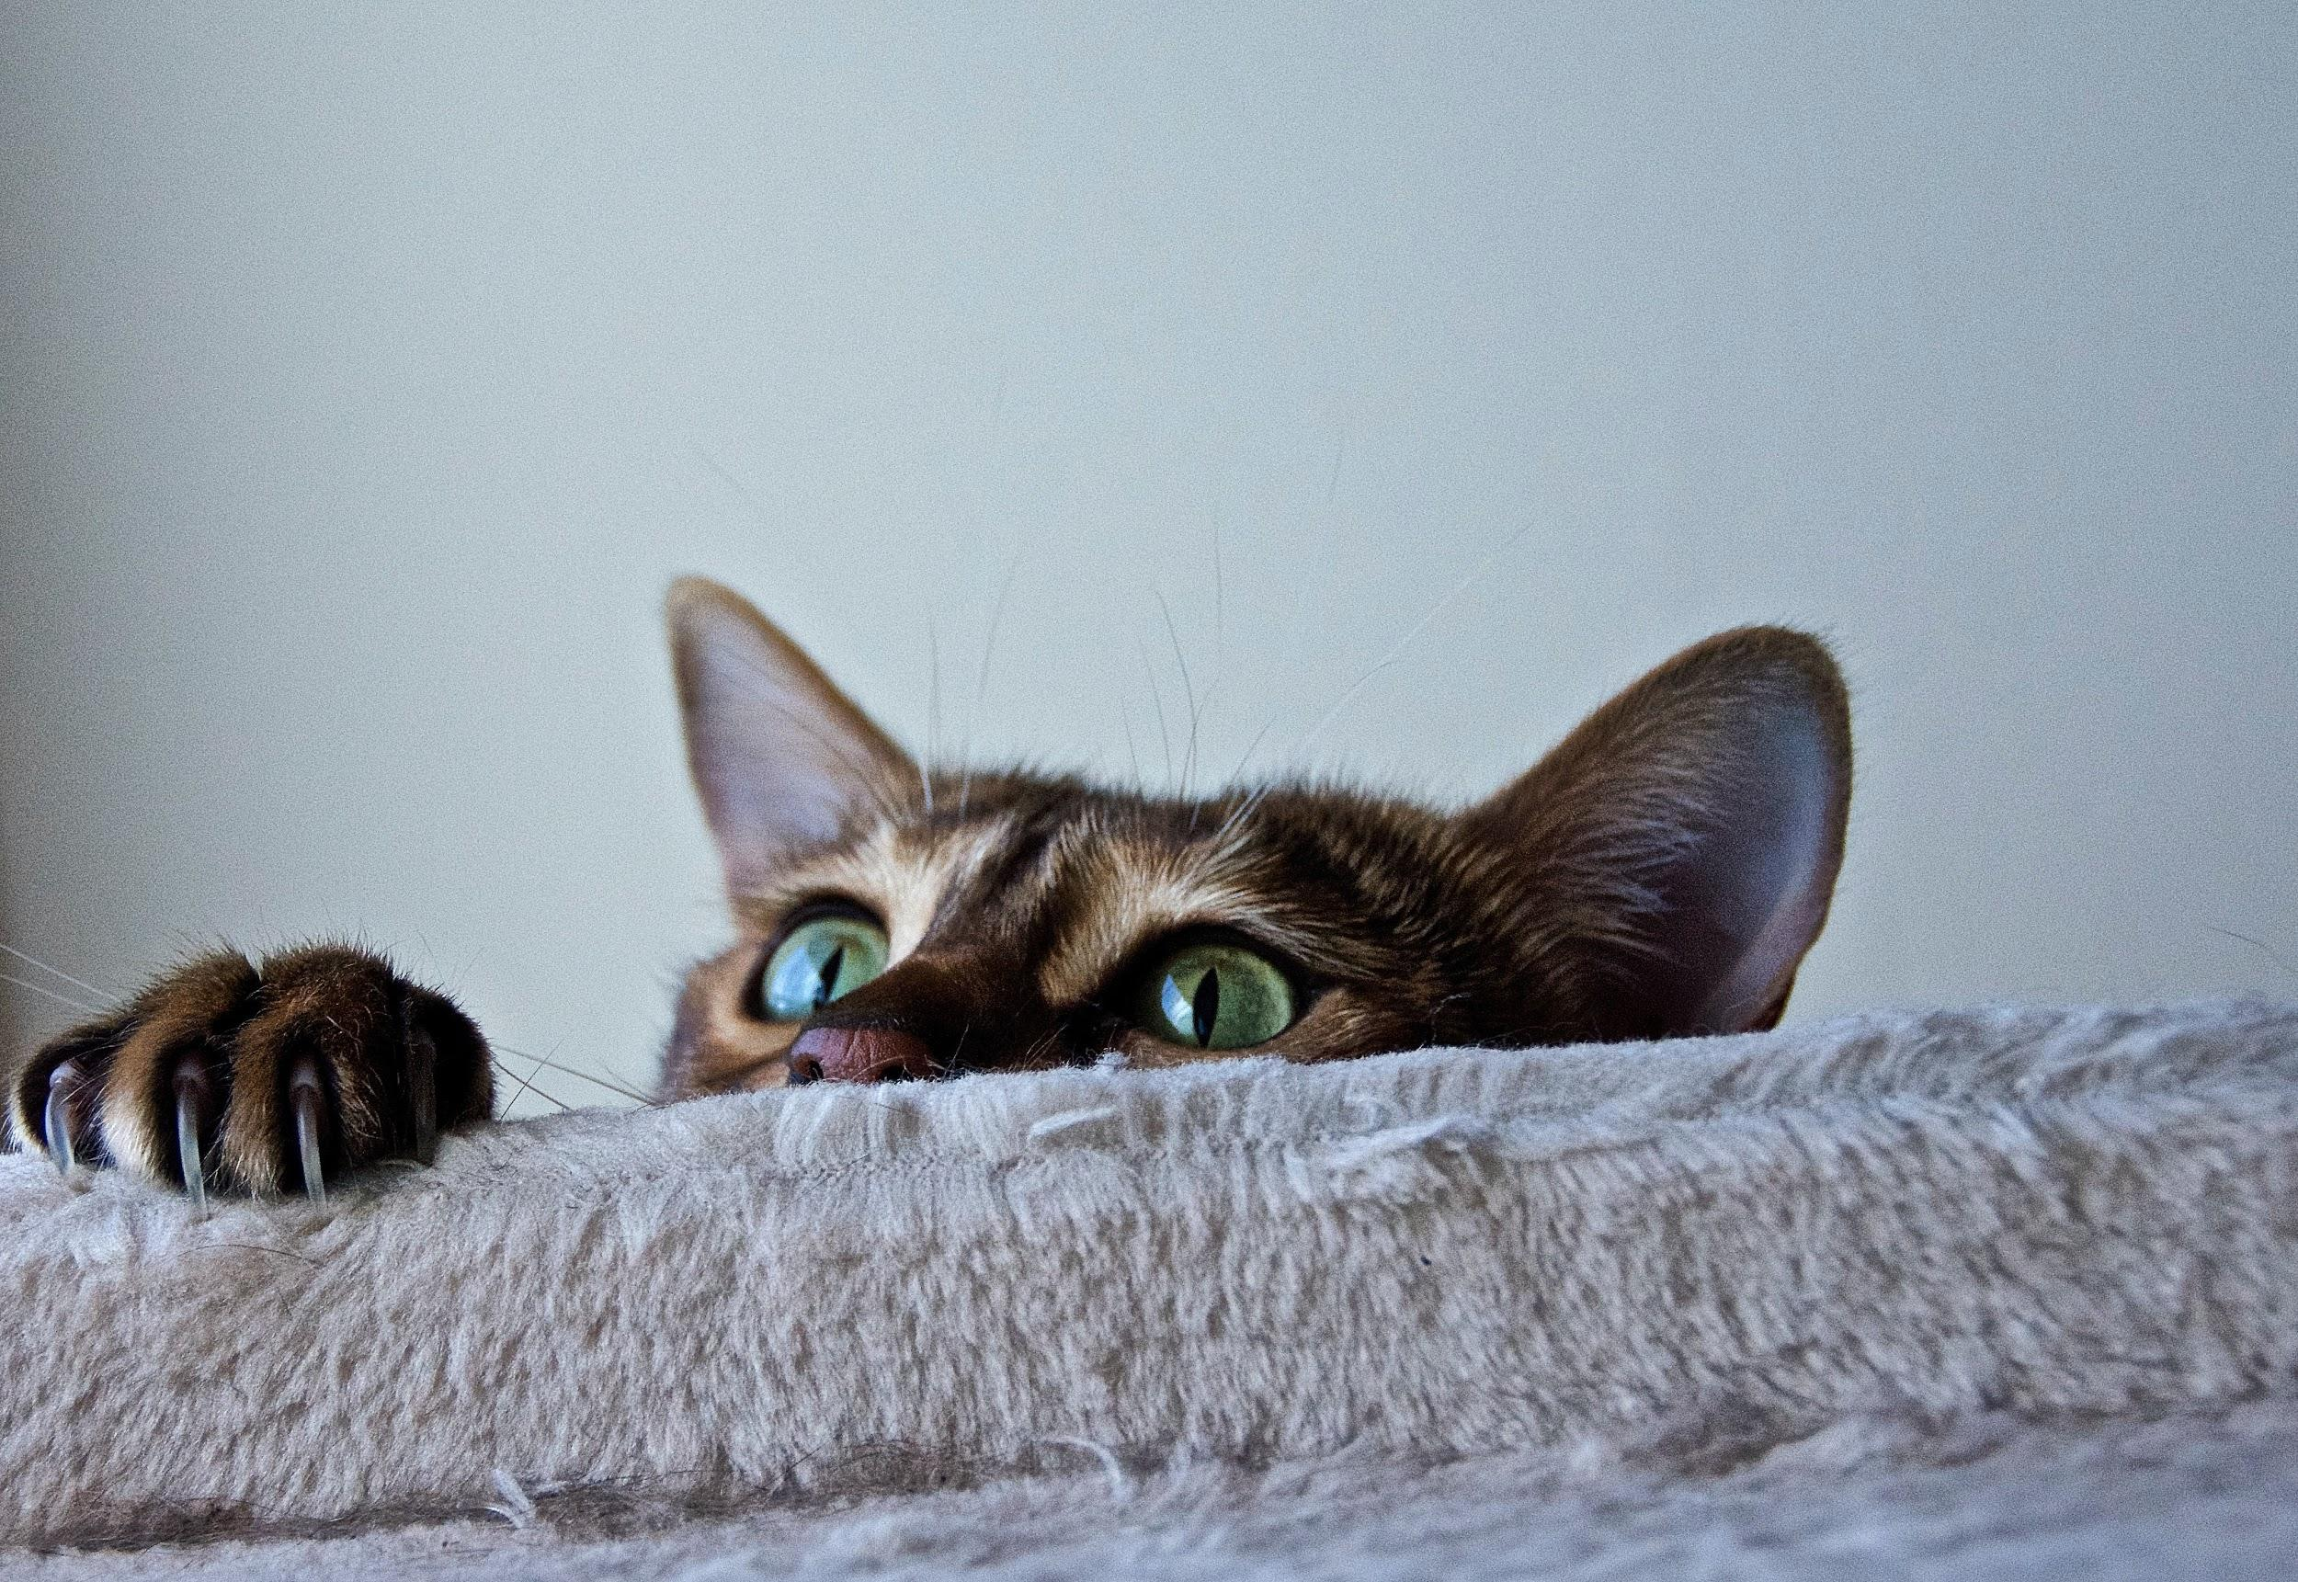
Data Augmentation Using GAN to Improve Training of CNN Models
Presented by Dinesh Kumar P. and Utkarsh N.

Slide 2
Problem Statement
Is it better to down/upsample, or do nothing at all when working with an image dataset?

Slide 3
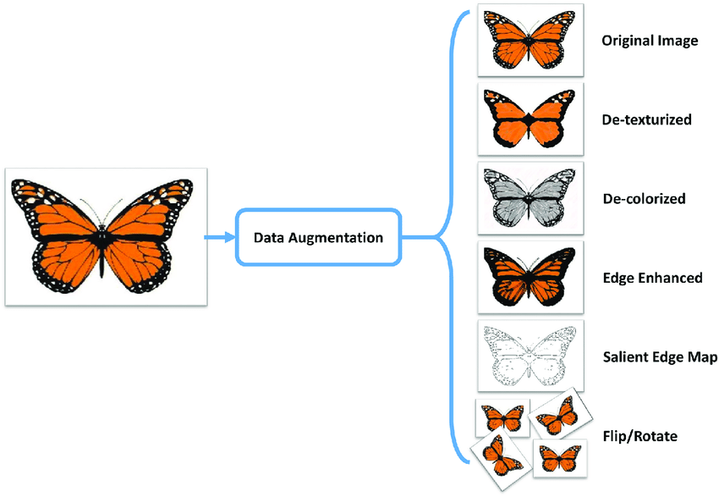
Background
Data Augmentation is a ingenious and prominent solution to address an unbalanced image dataset
Reduces overfitting and improve the model by increasing training dataset diversity
Source: https://medium.com/secure-and-private-ai-writing-challenge/data-augmentation-increases-accuracy-of-your-model-but-how-aa1913468722

Slide 4
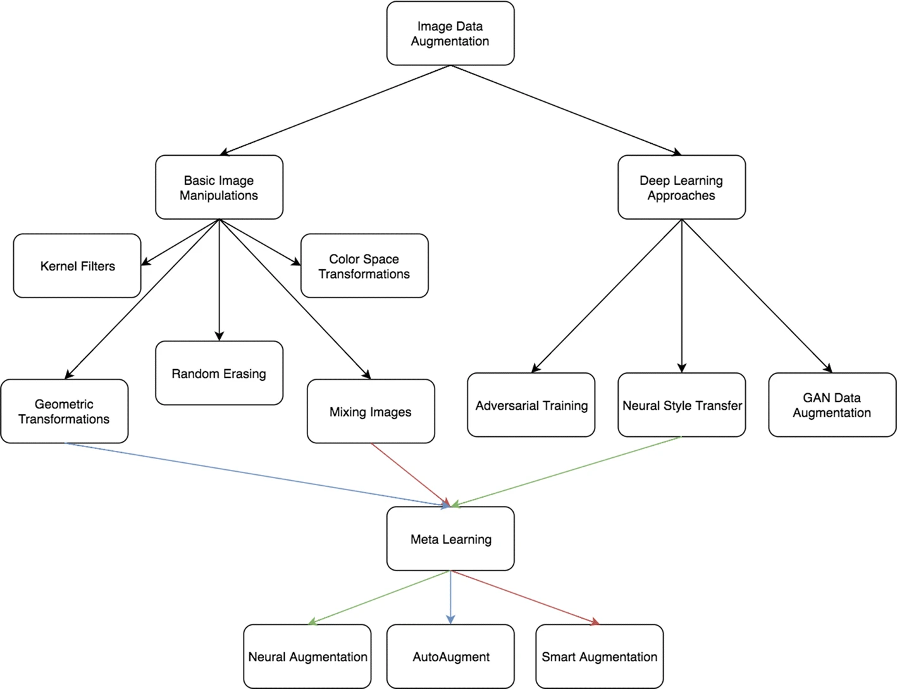
Data Augmentation
Deep neural networks memorize datasets causing overfitting
Neural Networks benefit from a large and assorted dataset
Data augmen. generates new images from the existing dataset
retains semantic content from original observations preventing the introduction of new data
Source: https://link.springer.com/article/10.1186/s40537-019-0197-0
Notes:
Why is Data Augmentation Effective?

Slide 5
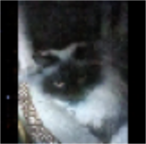
Standard Data Augmentation
Vary depending on the input images.
Example: MNIST
Medical images which adhere to strict formats.
Challenge of limited data.
Notes:
Dinesh Starts

Slide 6
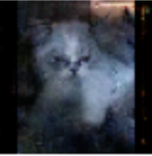
Generative Adversarial Network (GAN)
Generative models can create new patterns in data
learn the distribution of the data and not the boundary between them
Generative Adversarial Networks (GAN) are industry and research standard.
Notes:
Dinesh Starts

Slide 7
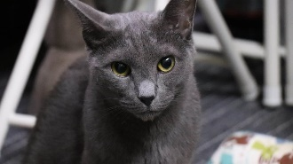
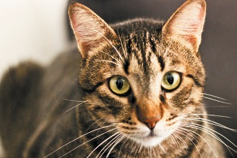
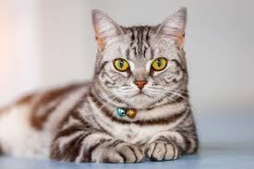
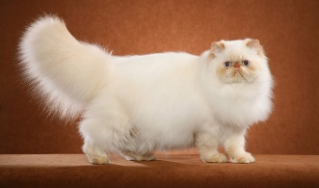
CATS Breed Dataset
Data sourced from Kaggle
67,145 Images observations from 37 breeds of cats (classes)
Limited scope of this project to "American Shorthair", "Tabby", "Russian Blue", and "Himalayan"
Notes:
Dinesh Starts

Slide 8
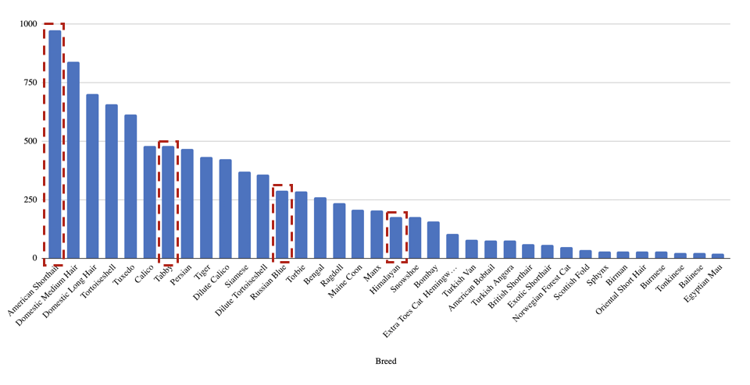
Limit 4!
American Shorthair
Tabby
Russian Blue
Himalayan
Notes:
Dinesh Starts

Slide 9
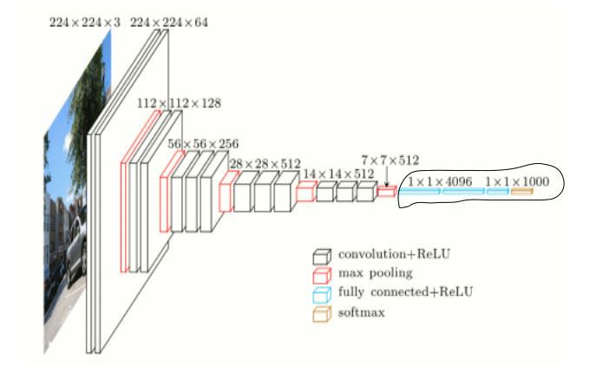
CNN Architectures
AlexNet
ResNext
DenseNet
VGG19

Slide 10
Project Workflow
1
2
3
4
Data Pre-processing
No Augmentation
GAN
Conventional Augmentation
Notes:
Data, preprocessing, no augumentaiton, conventional aug, GAM

Slide 11
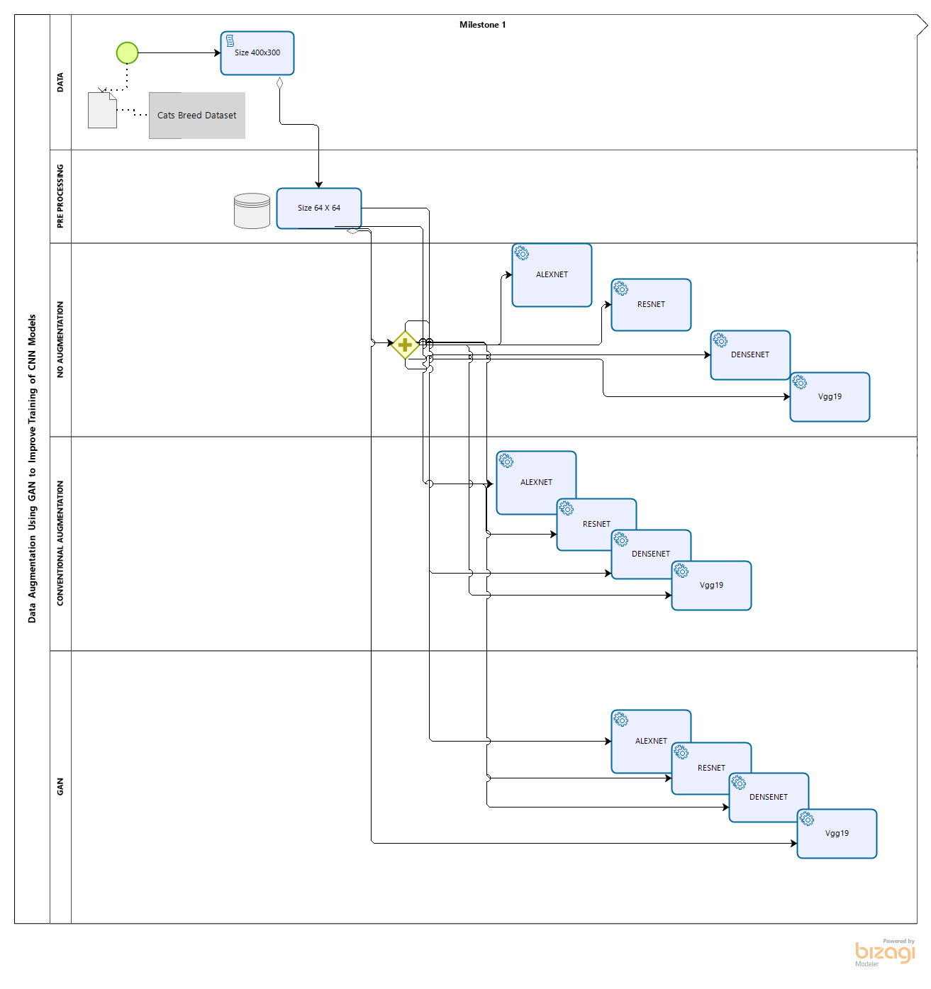
Notes:
Data, preprocessing, no augumentaiton, conventional aug, GAM

Slide 12
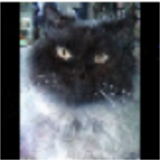
Challenges
GANs requires extensive computation capacity, time, and resources
Scope Reduction: two breed classification
Goal: exhibit that is it the best method for this process rather our ability
American short hair (most observations) and Himalayan (least observations)
Notes:
doing for 3 breeds was hard for the time frame

Slide 13
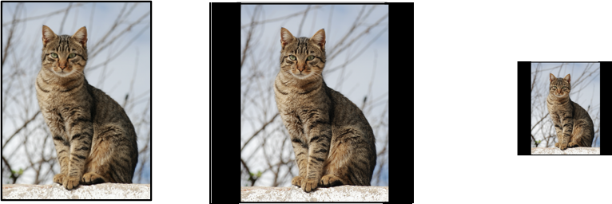
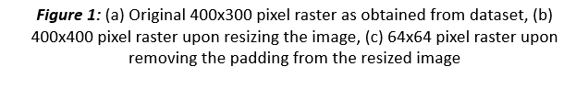
Preprocessing
Notes:
Dinesh Starts

Slide 14
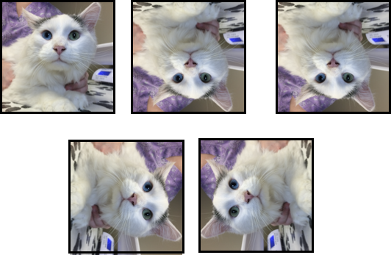

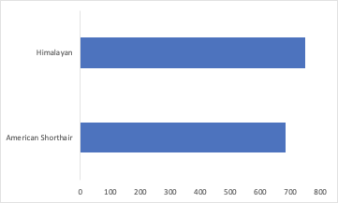
Conventional Augmentation

Slide 15
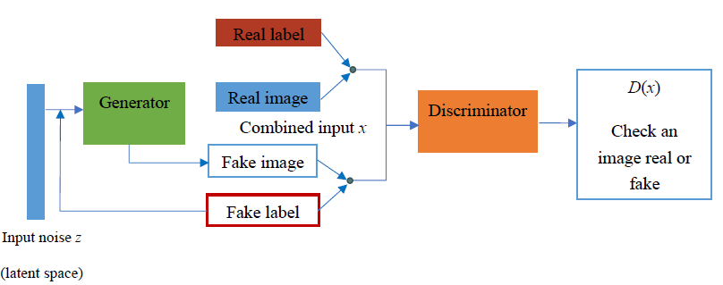
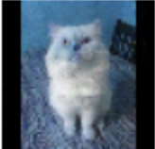
GAN Augmentation

Slide 16
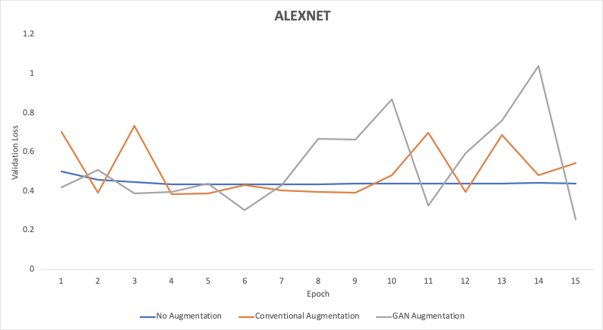
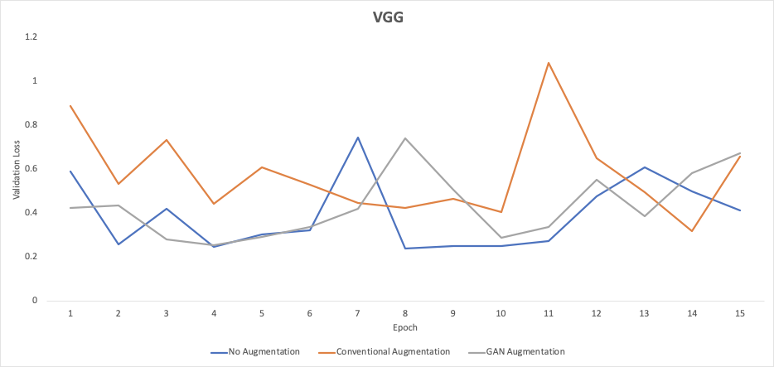
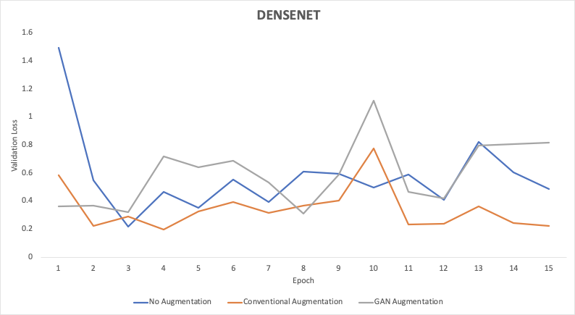
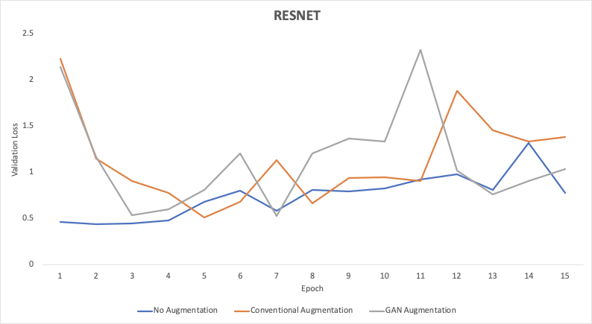
Validation loss v/s EPOCHs Run Time
RESNEXT

Slide 17
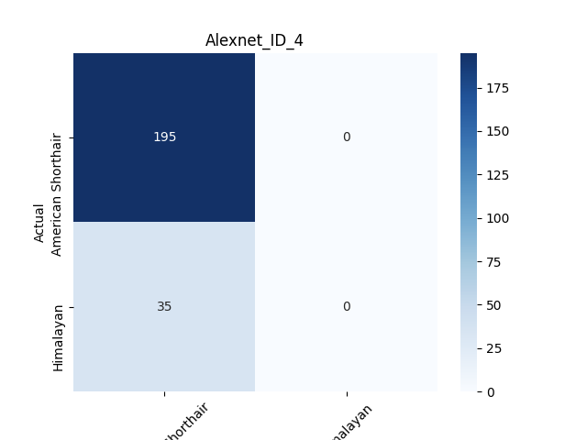
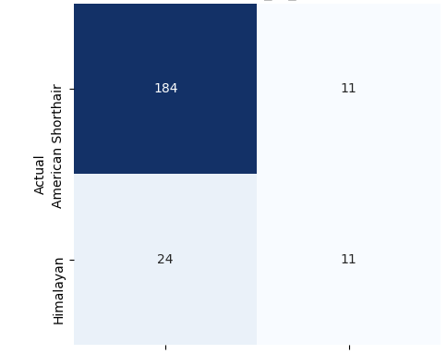
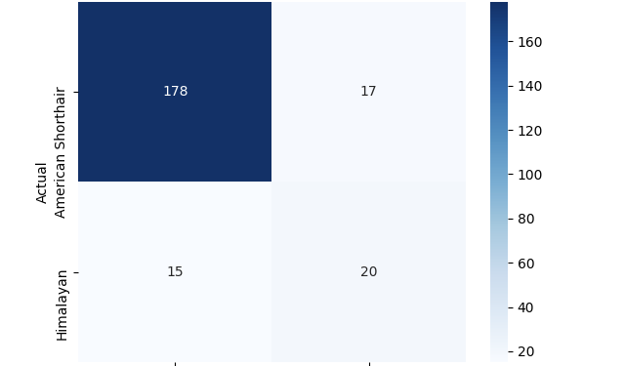
Confusion Matrix
No Augmentation
Conventional Augmentation
CGAN Augmentation

Slide 18
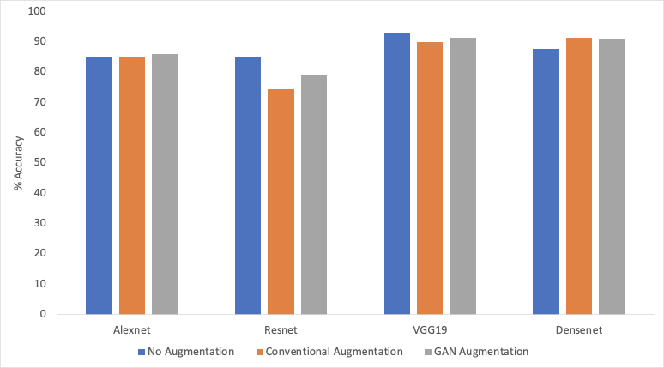
Accuracy Report
ResNext

Slide 19
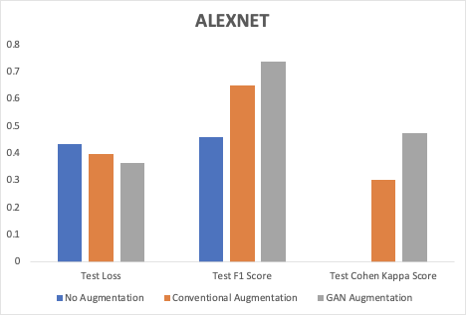
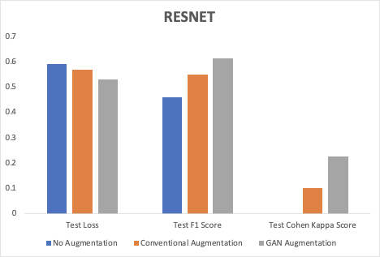
Performance
RESNEXT

Slide 20
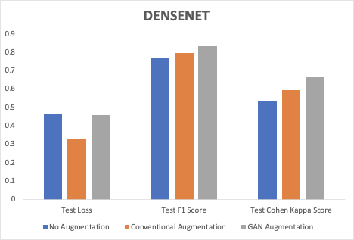
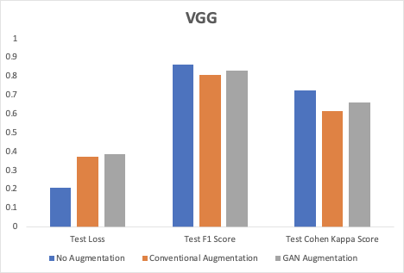
Performance

Slide 21
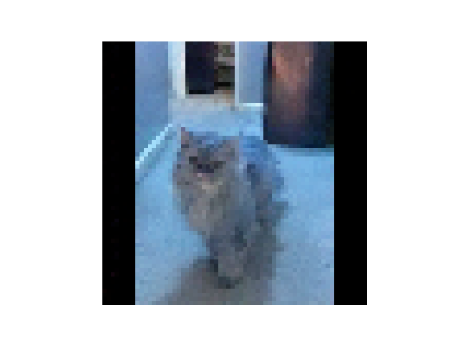
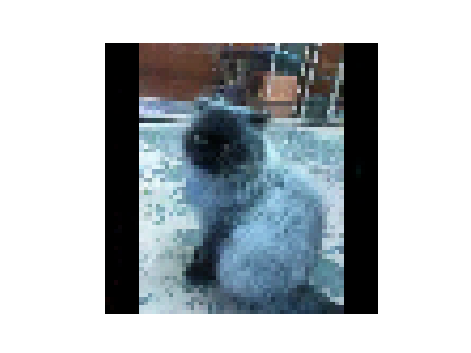
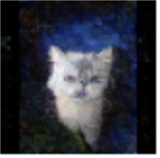
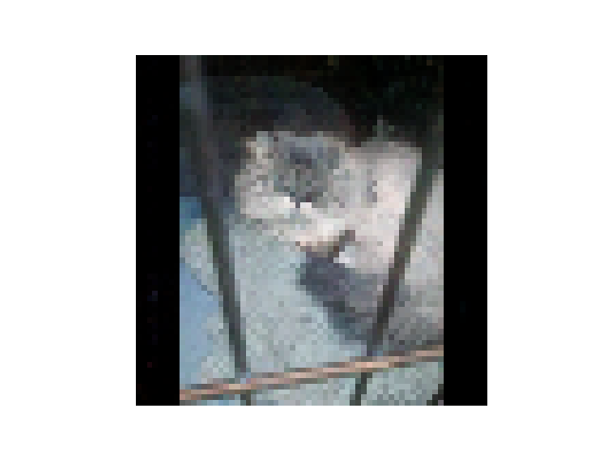
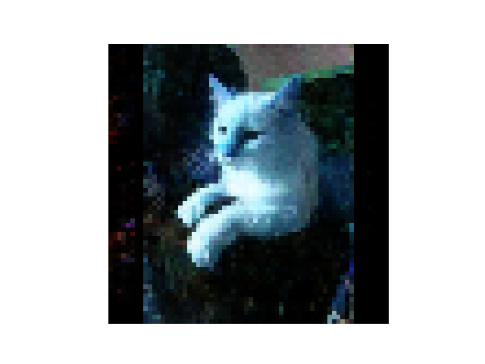
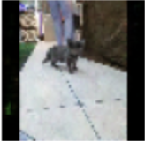
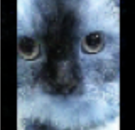
Questions?

