Slide 1
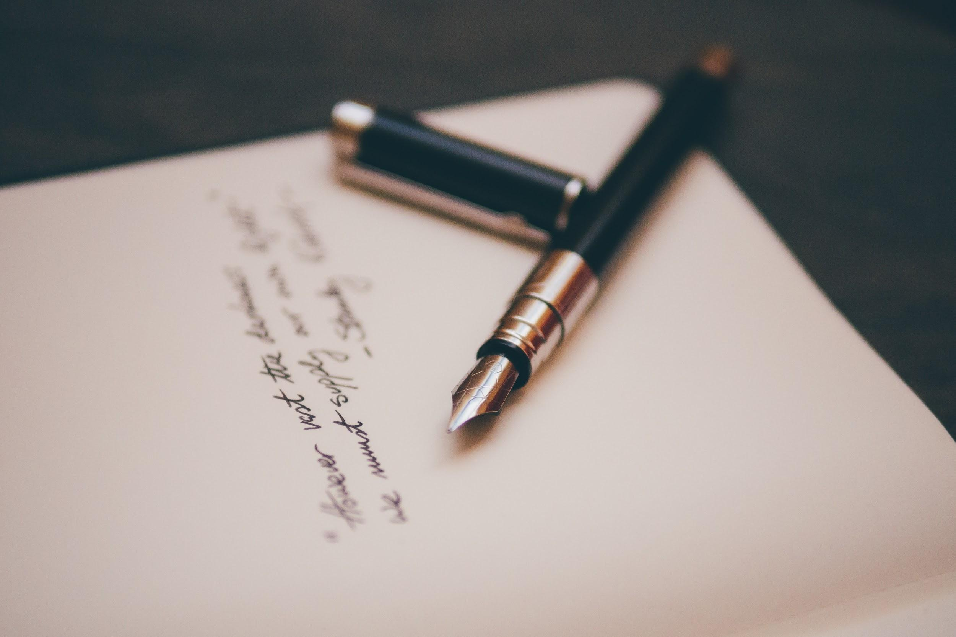
Machine Learning-Based Handwriting Recognition
Presented by Reema D., DineshKumar P., and Utkarsh N.

Slide 2
Problem Statement
Create a ML-driven handwriting recognition application that continuously works to convert the handwriting into a computerized legible script.

Slide 3
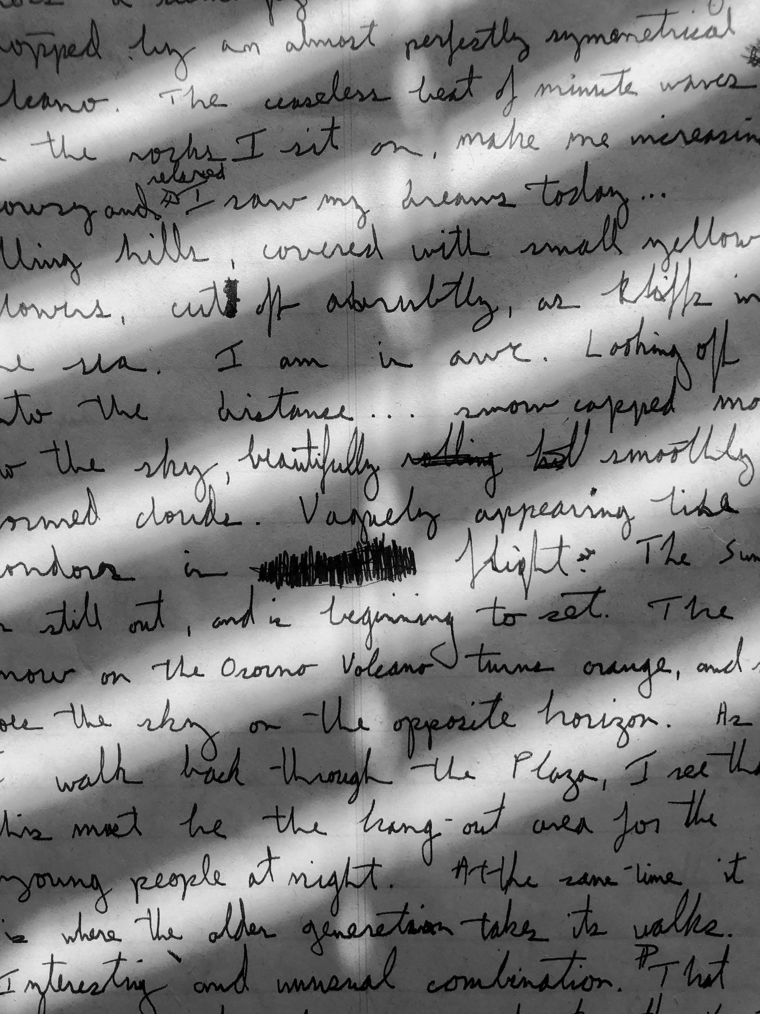
Background
Historically, the notes that doctors scribbled into a patient's medical record file were generally only seen by doctors
Now, doctors are just one component of a multidisciplinary healthcare network
61% of medication errors in hospitals are a result of illegible handwriting and transcription errors
7,000 patient deaths a year with a root cause being illegible handwriting

Slide 4
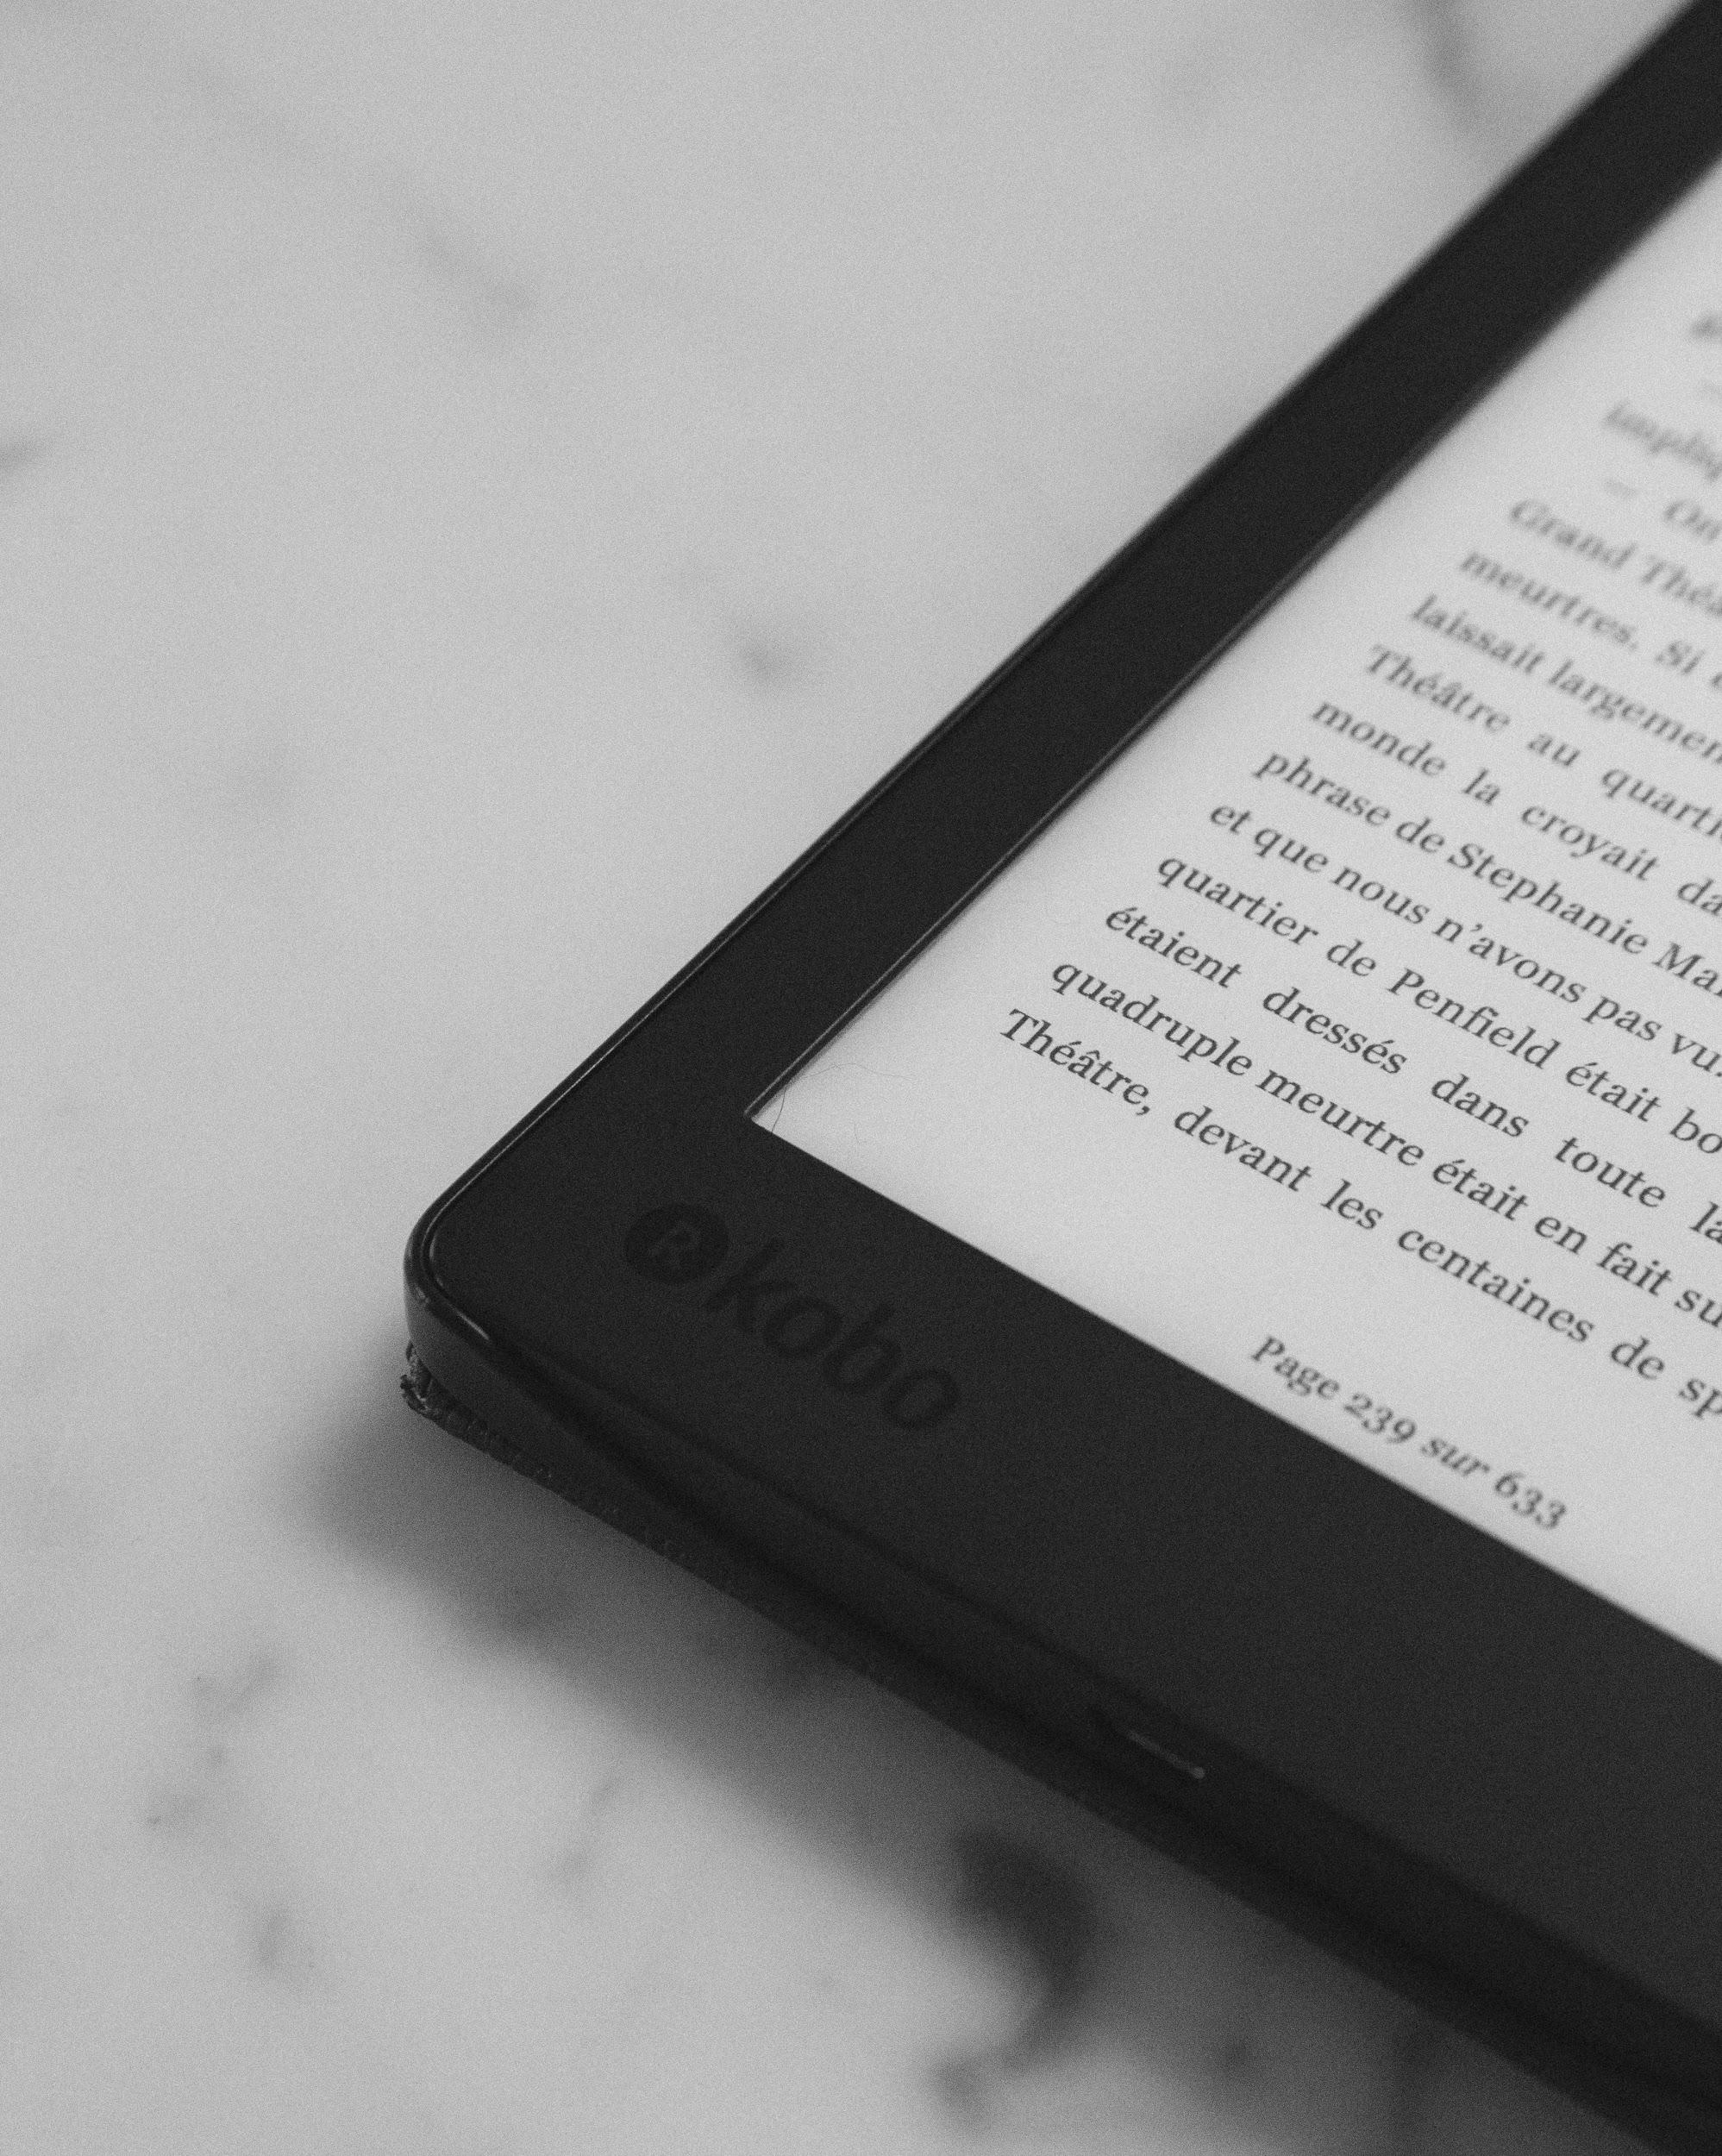
Advantages
Leaving no room for misinterpretation, despite changing multiple hands
Improving patient safety by minimize time spent and stress of deciphering illegible handwriting
Creating less work for the health professionals = decreasing stress on the healthcare worker = more productive on their jobs by attending more patients or requests.

Slide 5
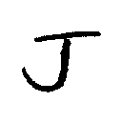
Data: NIST Dataset
Data published in the National Institute of Standards and Technology (NIST) Special Database 19
Roughly 0.7 million handwriting sample png images serving as observations
The characters in the original database occupy 128x128 pixels but were reduced to 28x28 pixels by removing the padding
Each character is labeled sequentially from “A”- “Z
Notes:
Dinesh Starts

Slide 6
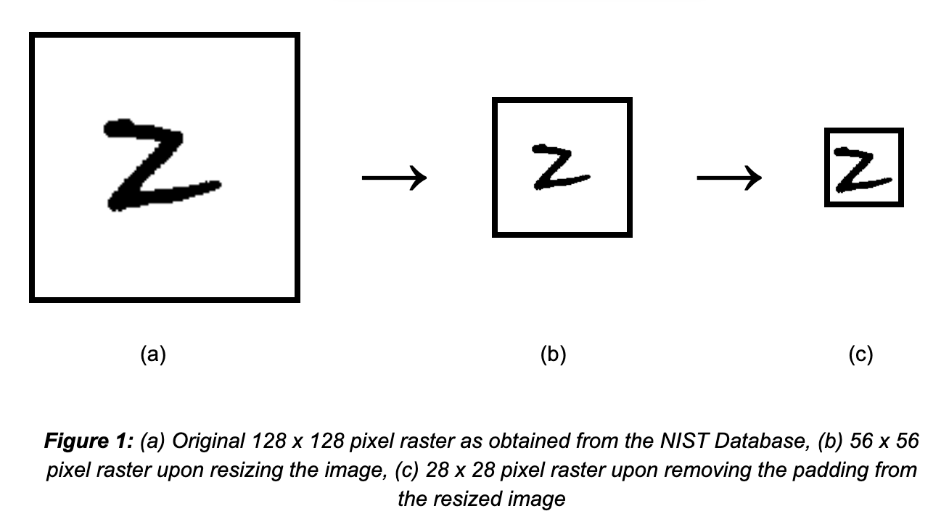
Data: Preprocessing
Notes:
Dinesh Starts

Slide 7
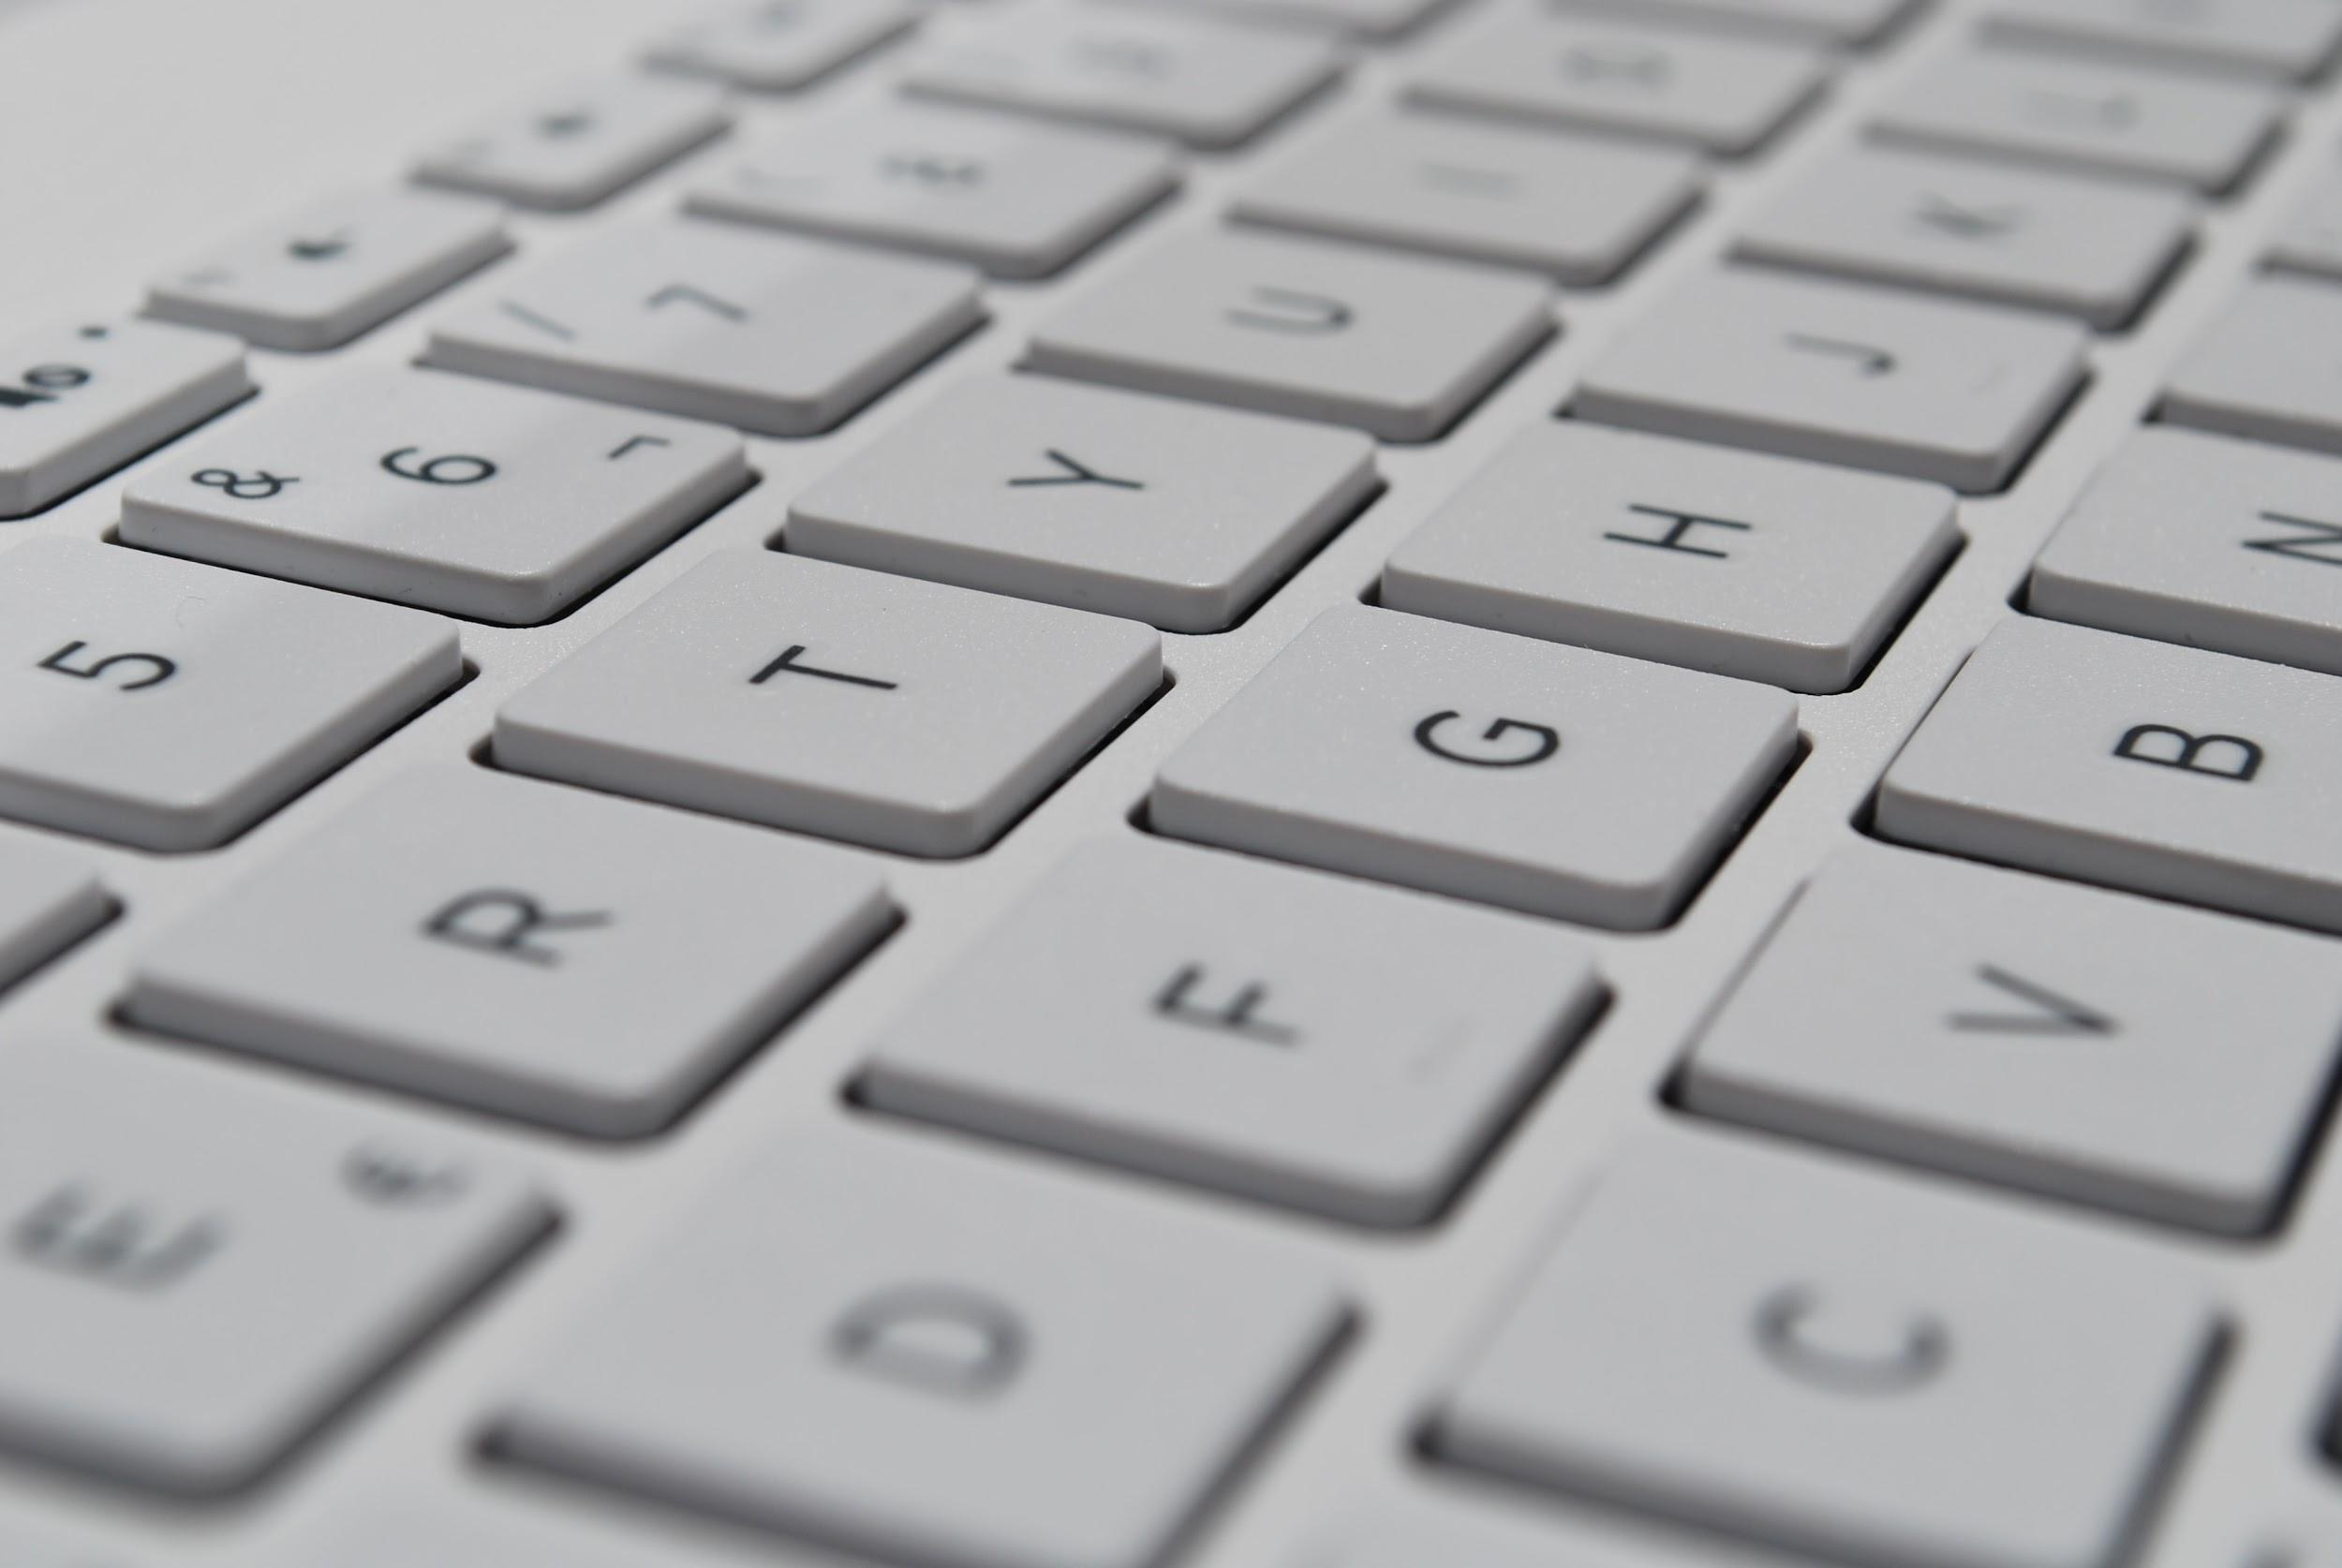
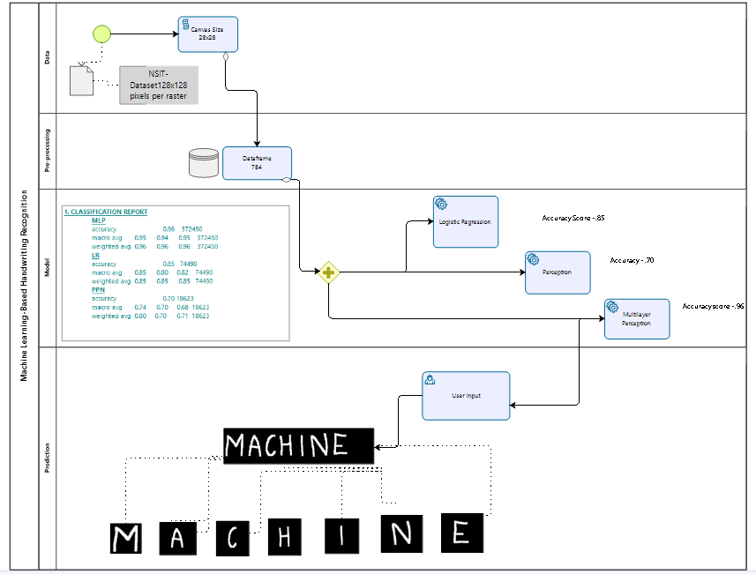
Project Workflow

Slide 8
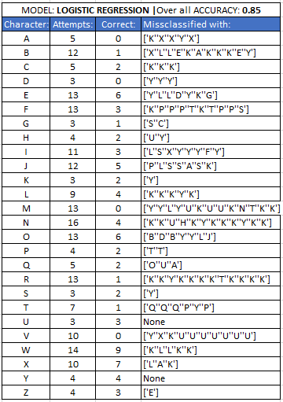
Misclassification Analysis
All Logistic Regression, Perceptron and Multilayer Perceptron were evaluated on the basis of misclassification of characters.

Slide 9
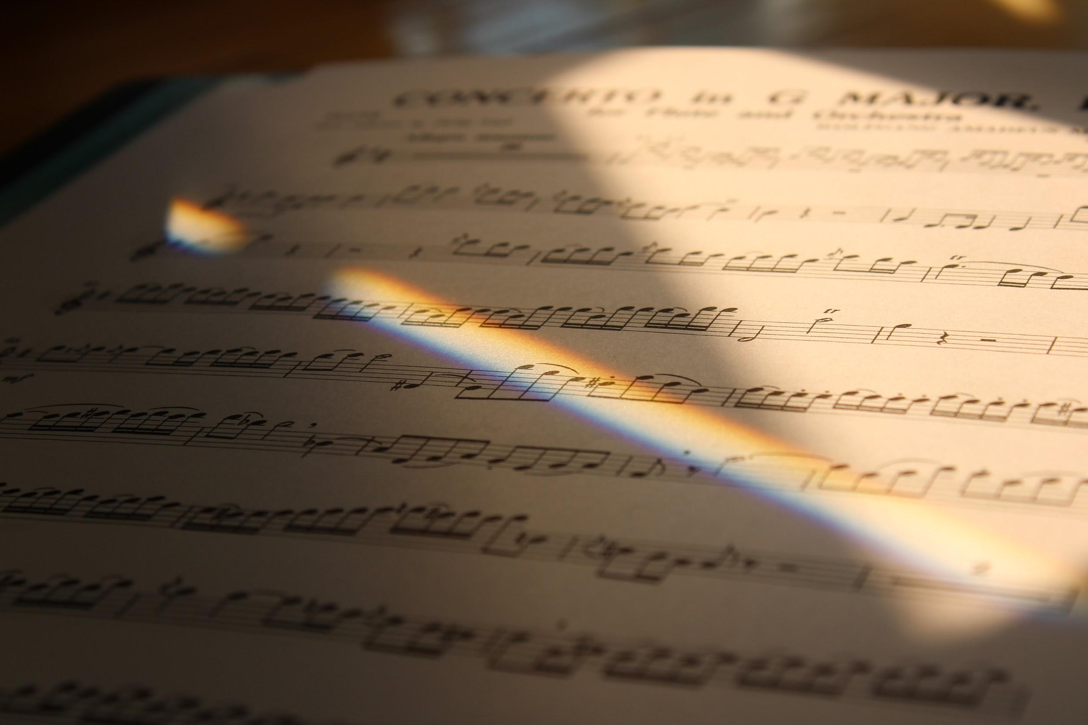
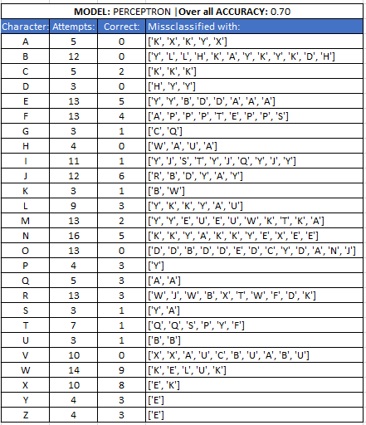
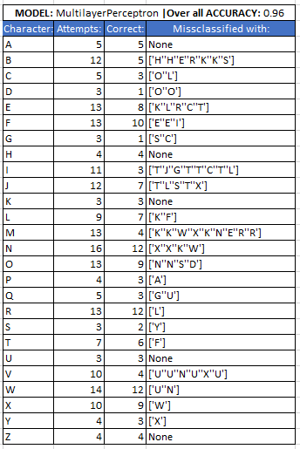

Slide 10
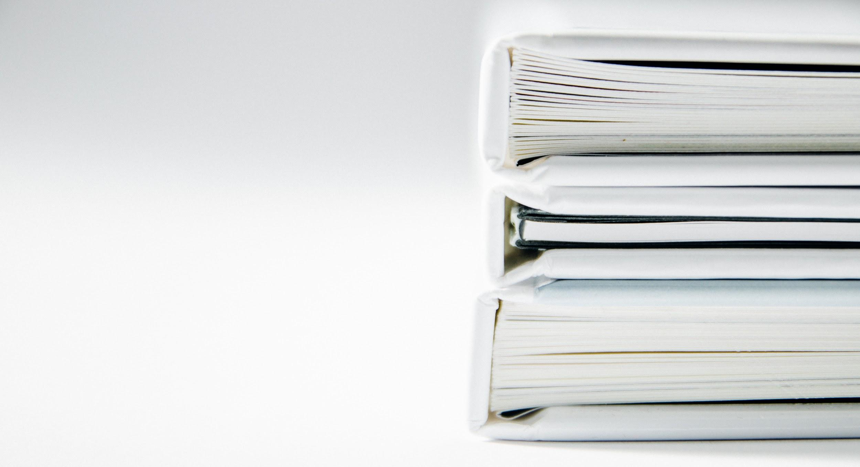
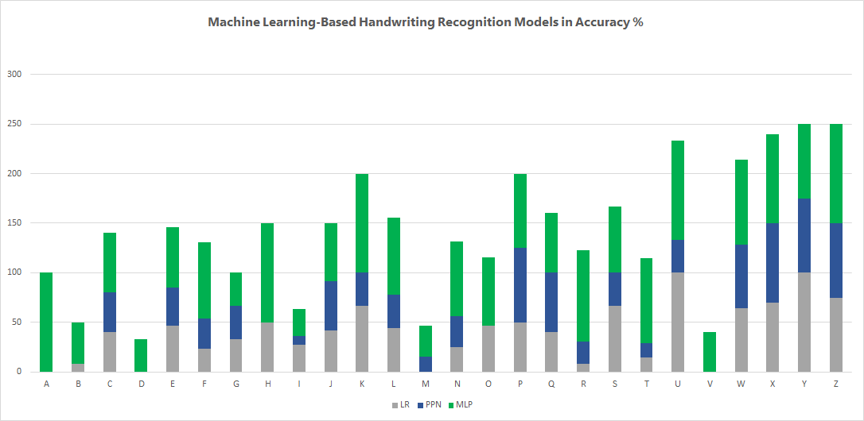
Results

Slide 11
Challenges
Hyper tuning is difficult due to the large nature of the dataset
Imbalance count of observations among the characters in the dataset, resulted in complications between testing and training phase (i.e. 10k and 2.5k images for J and K respectively)
Similar looking letters confused the model (B - P - R)

Slide 12
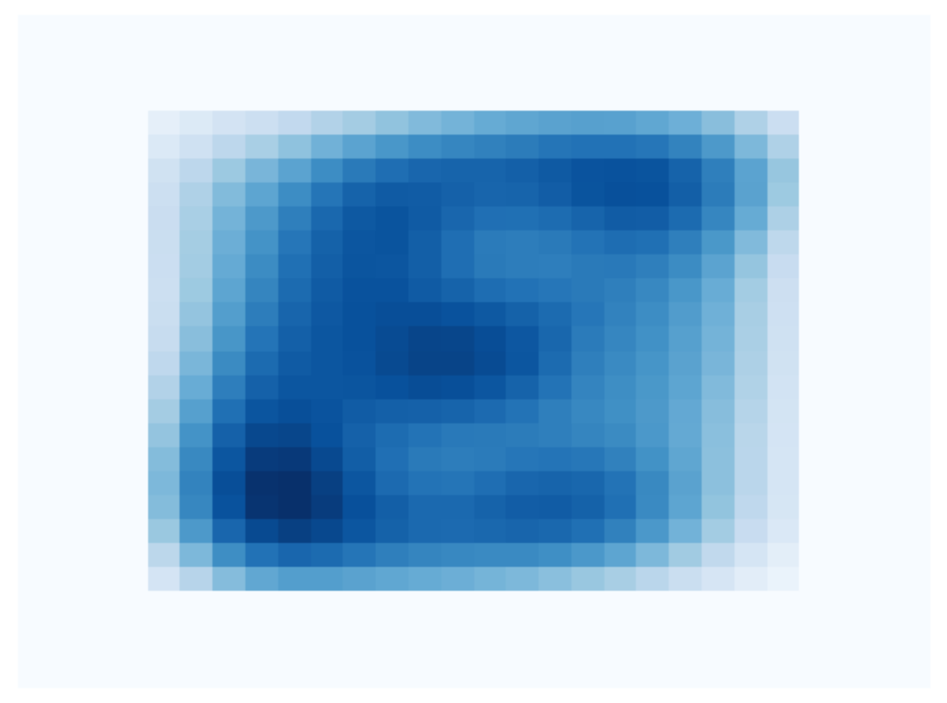
Pixel Density
28 pixels
28 pixels

Slide 13
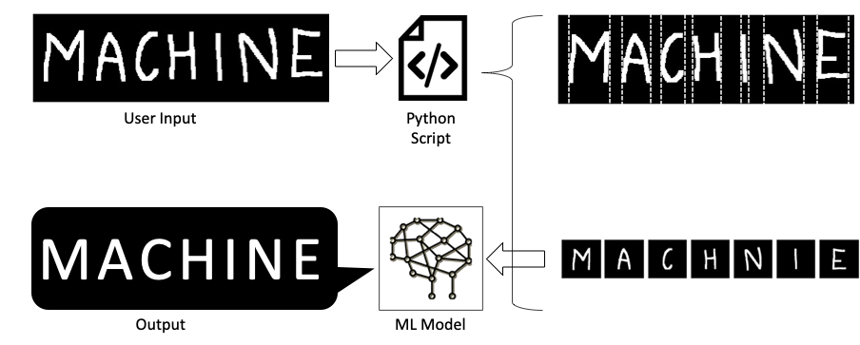

User Input: Interpretation

Slide 14
DEMO

