Slide 1
Computational Fluid Dynamics (L31+L32) Utkarsh Rawat(16BME1251)
Bifurcating Artery

Slide 2
Table Of Content
Sr. No | Topic
1 2 3 4 5 6 | Problem Specification Geometry Mesh Physical Setup Result Outcome

Slide 3
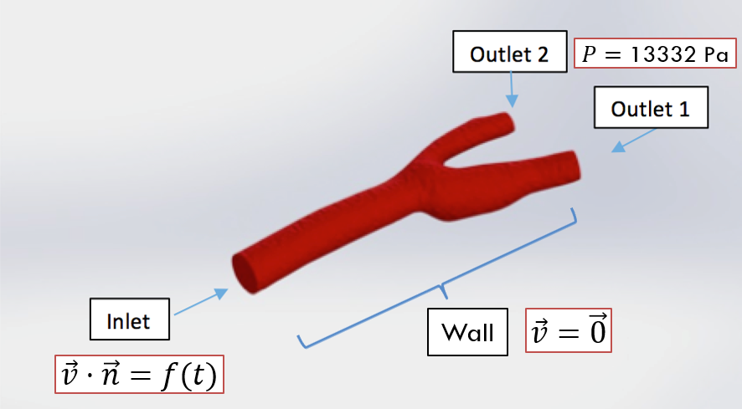
Problem Specification

Slide 4
Problem Specification
Blood flows through the bifurcating artery from the inlet (to the left in the graph above) and exits from the two outlets (to the right). The diameter of the artery at the inlet is around 6.3mm. The diameter of outlet 1 is around 4.5mm and the diameter of outlet 2 is around 3.0mm. The density of blood is 1060 kg/m^3 .
As blood is a non-newtonian fluid, the coefficient of viscosity of blood is not a constant, but rather, it is a function of velocity gradients.
Here we use the Carreau-model to model blood’s viscosity. Since blood flow is pulsatile and cyclic, the velocity profile at the inlet is a function of time. The pressure at the outlet is defined to be constant (100 mmHg).

Slide 5
Problem Specification (Boundary Conditions)
Wall : From a physical viewpoint, the “wall” condition dictates that the velocity at the wall is zero.
Inlet: The pulsatile profile within each period is considered to be a combination of two phases. During the systolic phase, the velocity at the inlet varies in a sinusoidal pattern. The sine wave during the systolic phase has a peak velocity of 0.5m/s and a minimum velocity of 0.1m/s. Assuming a heartbeat rate of 120 per minute, the duration of each period is 0.5s.
Outlets:Taking the average pressure of the two phases, we use 100 mmHg (around 13332 Pascal) as the static gauge pressure at the outlets.

Slide 6
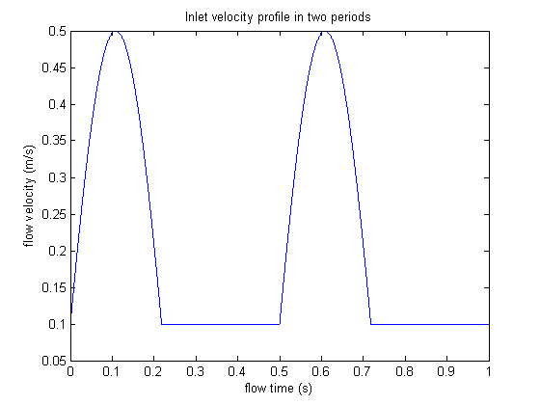
Problem Specification (Boundary Conditions)
Inlet Velocity Assumed Function

Slide 7
Geometry
Open Workbench
Give name to fluent-analysis(Bifurcating_artery)
Predesigned geometry is imported to design moduler)
Save the project

Slide 8
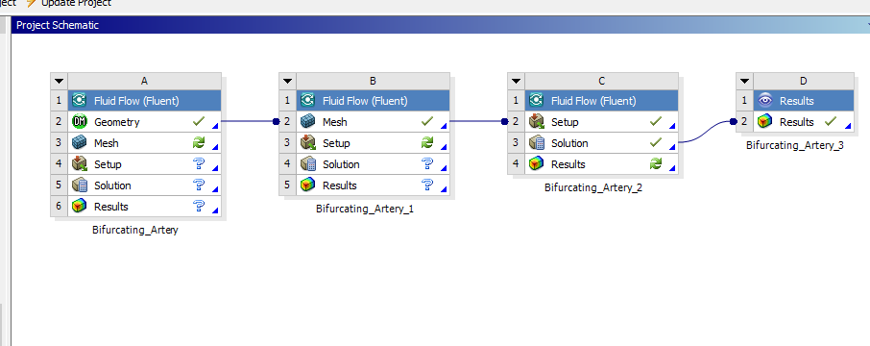
Geometry
Open Workbench
Give name to fluent-analysis(Bifurcating_artery)

Slide 9
Geometry
Predesigned geometry is imported to design moduler)
File > Open>select All files format>bif_artery.STEP o Alternatively, Right click Geometry>Import Geometry>Browse

Slide 10
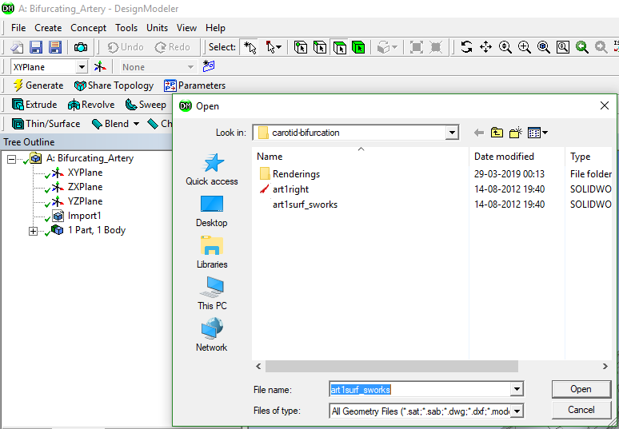
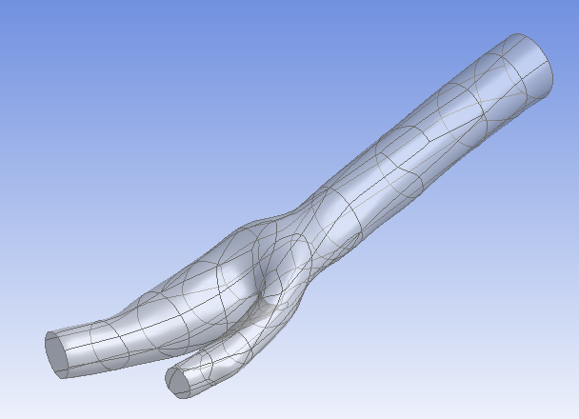

Slide 11
Mesh
Add new fluent mesh file and name it as Bifurcating_artery_1
Double click mesh/ Right click>Edit
Right click Model in tree>Insert>Virtual Topology
Hold down left mouse button and sweep through the surfaces
Hold down center mouse button to rotate model
Hold down control button and sweep through remaining surfaces using left mouse button
Right click on highlighted regions>Insert>Virtual Cell
Highlight remaining regions as shown and repeat the above step
Select Face select Option
Left click on Inlet in model>Right click>Create Named Selection>Type inlet1
Repeat for outlet1 and outlet2
Left click anywhere on artery wall>Extend to limits

Slide 12
Mesh
Right click>Create Named Selection>Type wall_artery
Select Body option>Select body>right click>Named Selection>Type fluid_zone
Mesh>Insert>Sizing o Geometry>Select Body
Element size = 1e-3m ▪ If units are not in m, Units>Metric(m,kg,N,s,V,A)
Mesh>Insert>Inflation o Geometry>Select Body
Boundary Scoping Method>Named Selections
Boundary>wall_artery>Hit Enter
Inflation Option>Total Thickness
Maximum Thickness>6e-4
Mesh>Sizing>Min Size>5e-4
Generate Mesh

Slide 13
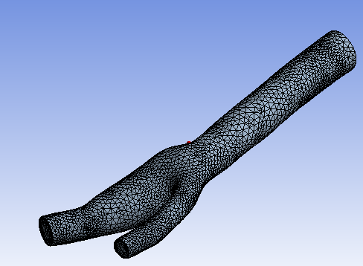
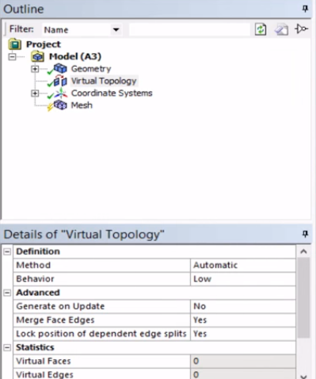
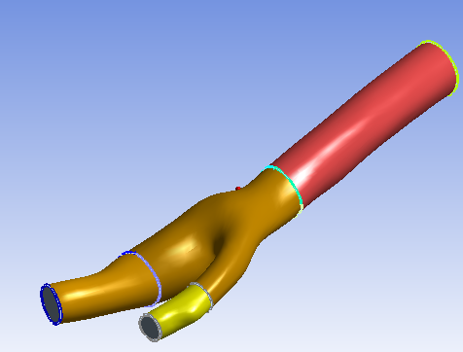
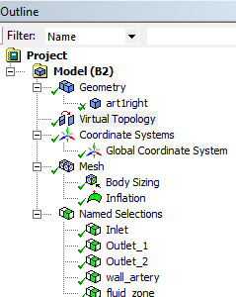

Slide 14
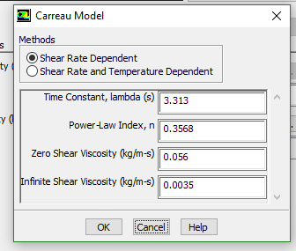
Physical Setup
Add new fluent tab name it as Bifurcating_artery_2
Start FLUENT o Double precision
General>Time>Transient
Materials>Fluid o Change name from air to blood
Set Density to 1060 kg/m3
Viscosity>Carreau

Slide 15
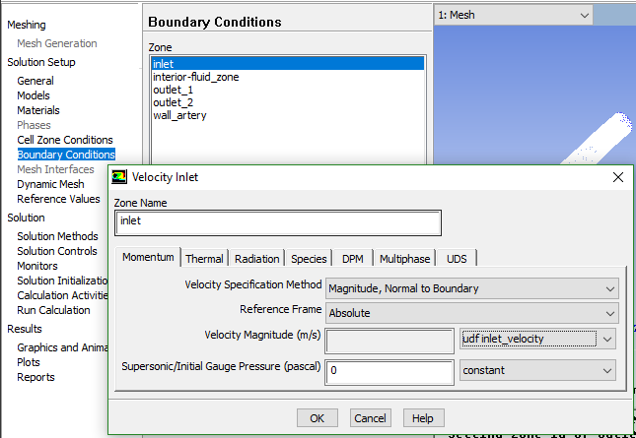
Physical Setup
User Defined>Functions>Compiled o Add UDF file vinlet_udf.c>Build>Read
Boundary Conditions>Inlet>Velocity Inlet> Edit>Velocity Magnitude>Change "Constant" to "udf inlet_velocity".
Outlet1>Pressure Outlet>Edit>Gauge Pressure 13332
Outlet2 same as outlet1

Slide 16
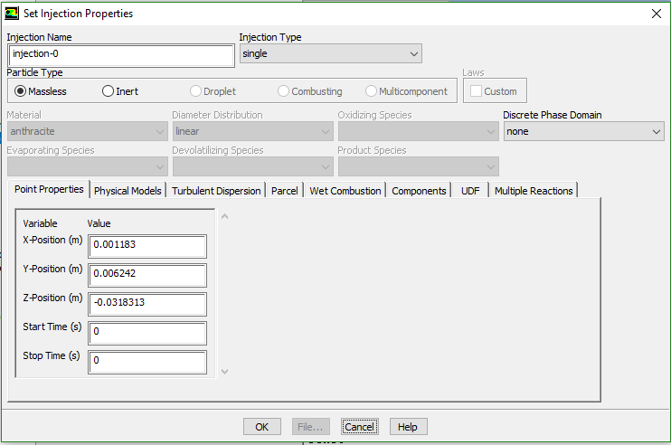
Physical Setup
Setting Up Physics>Model Specific>Discrete Phase Models>Injections Injections>Create>Change "Particle Type" to Massless>Input the coordinates
Repeat the steps above to inject another particle

Slide 17
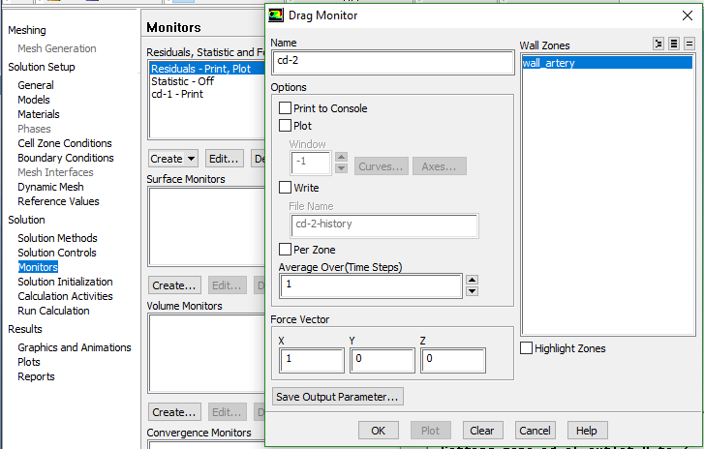
Physical Setup
Open Spaceclaim>Measure>Mass Properties
Note down Total Surface Area
Go back to Setup>Reference values o Type in the values given below
Report Monitors>New>Force Report>Drag Select wall_artery

Slide 18
Physical Setup
Solution Initialization>Hybrid Initialization>Initialize
Calculation Activities>Create>Solution Data Export
Change file type to “CDAT for CFD Post and Ensight”
Select the following ▪ Static Pressure
Total Pressure
Velocity Magnitude
X Velocity
Y Velocity
Z Velocity

Slide 19
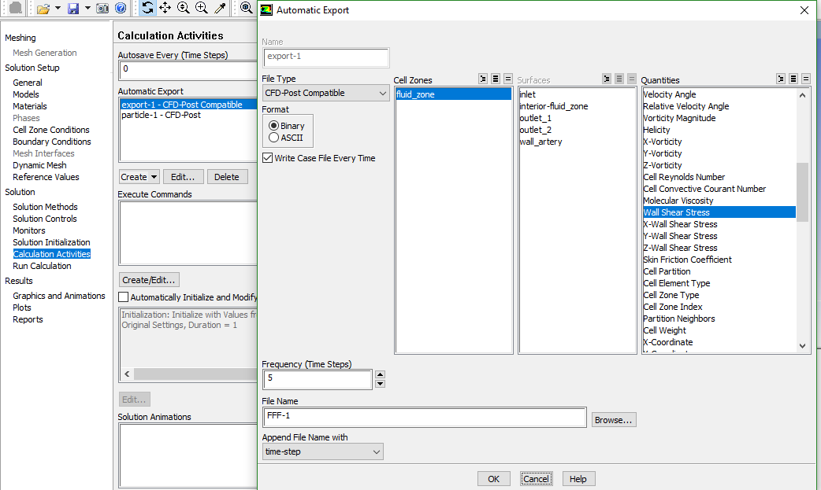

Slide 20
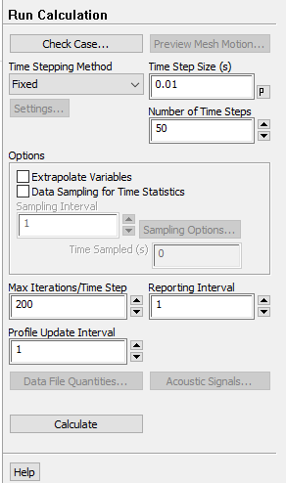
Physical Setup
Wall Shear Stress
Change Frequency (Time Steps) to 5
Select both injections
Set Time Step Size(s) to 0.01
Set Number of Time Steps to 50
Set Maximum Iterations/Time Step to 200
Calculate
Calculation Activities>Create>Particle Data History Export
Run Calculation

Slide 21
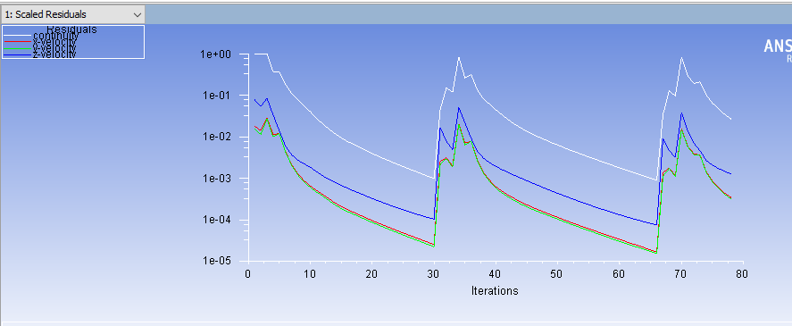
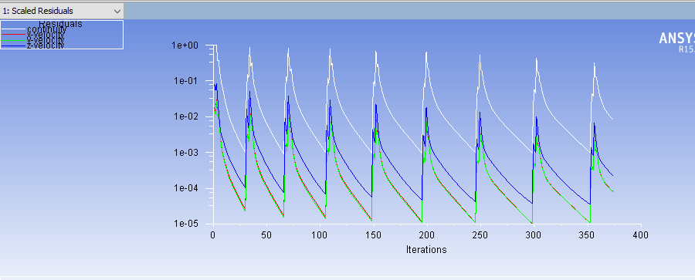

Slide 22
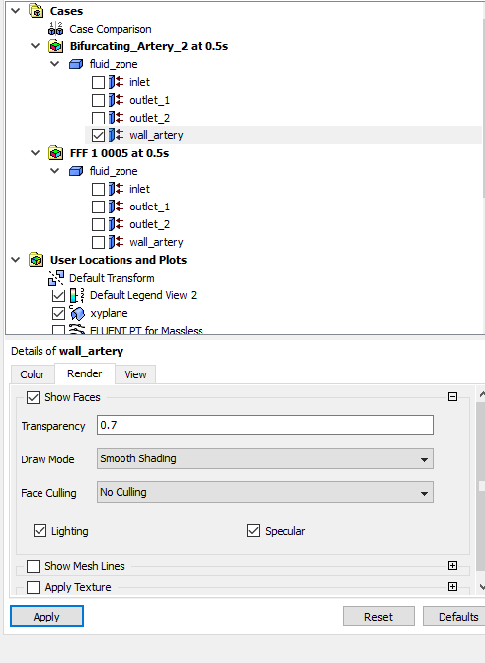
Result
Add another fluid component and link it to result of previous
Name it as Bifurcating_artery_3
Right click wall_artery>Edit>Render o Set Transparency to 0.7
Creating Velocity Vectors
Toolbar>Create Vector
Locations>fluid_zone

Slide 23
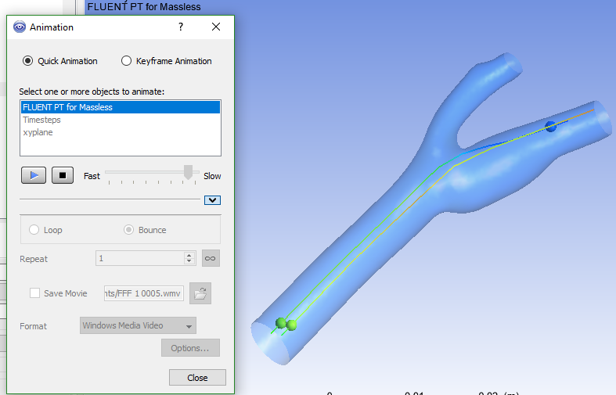
Result
Adding and Animating Particle Path Lines
File>Import>Fluent Particle Track File
Fluent PT for Massless>Color>Mode>Variable Variable>Velocity
Symbols>Show symbols>Current Time o Set scale to 0.5
In Toolbar>Animation o Select Fluent PT for massless
Hit Play
To Save video, select save video option
Change speed by moving the slider accordingly

Slide 24
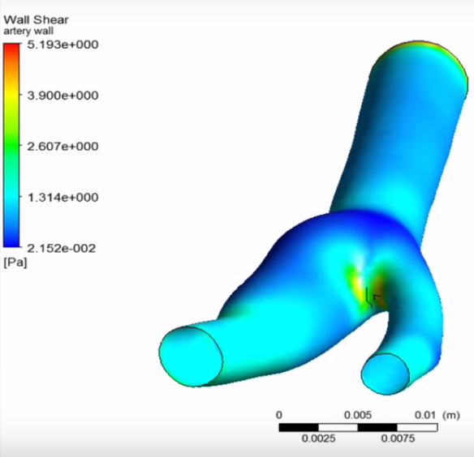
Result
Plotting and Animating Wall Shear on Artery Wall
Turn off FLUENT PT for Massless
Click on Location > select Surface Group o Name it Artery Wall
Geometry>Location>wall_artery
Color>Mode>Variable ▪ Variable>Wall shear

Slide 25
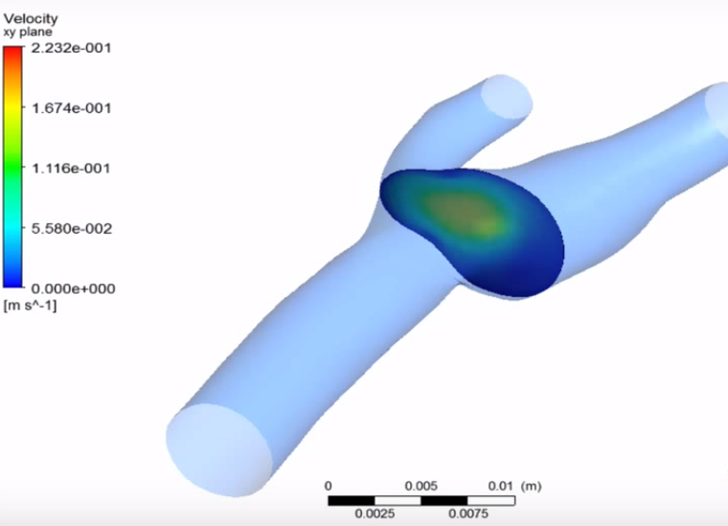
Result
Creating a Sweep for Velocity Profiles at different sections
Turn off artery_wall
Location>Isosurface o Geometry>Variable>Z
Value> drag the slider to the most left for smallest value
Color>Mode>Variable o Variable>Velocity
Click on Animation Icon
Click on XY Plane for animation
Repeat process from previous tutorial videos

Slide 26
Outcomes
Create a mesh for a three dimensional internal flow,
Apply Non-Newtonian fluid properties using the Carreau model.
Apply time-varying boundary conditions using User Defined Functions (UDF).

